Slide 1
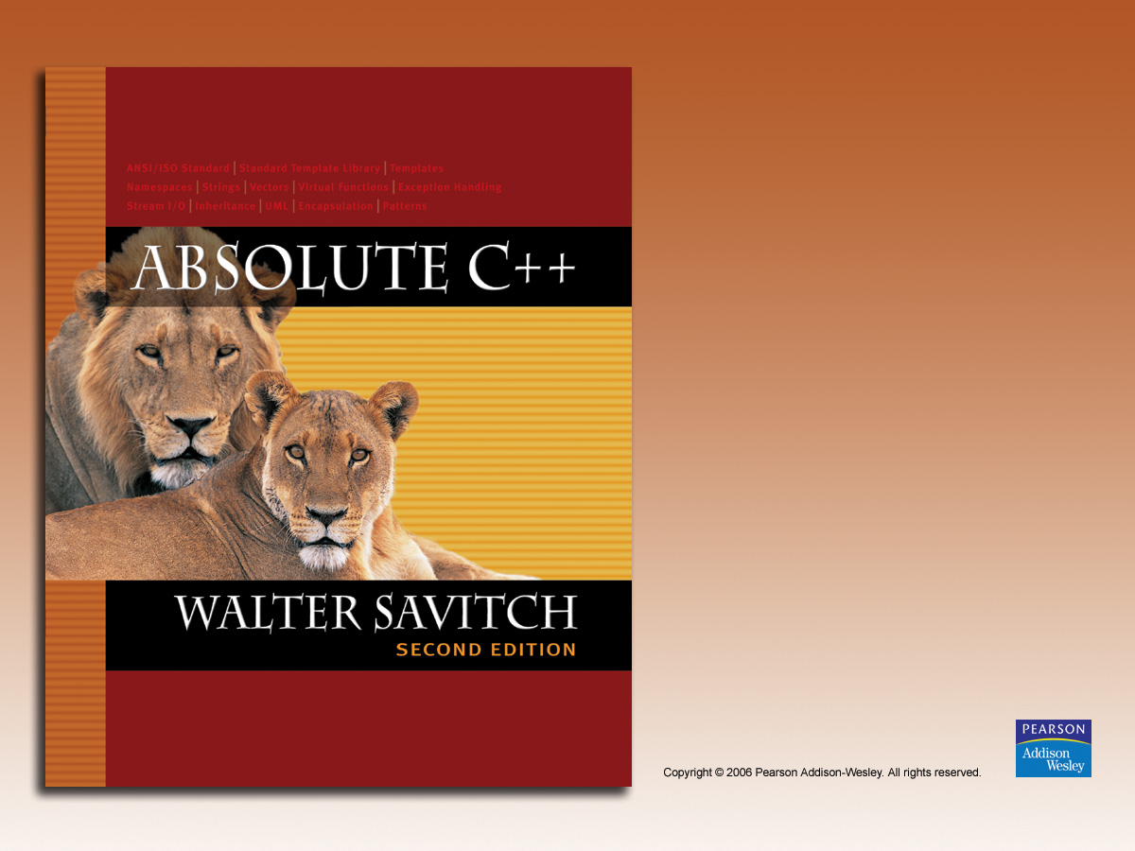
Chapter 20
Patterns
and UML

Slide 2
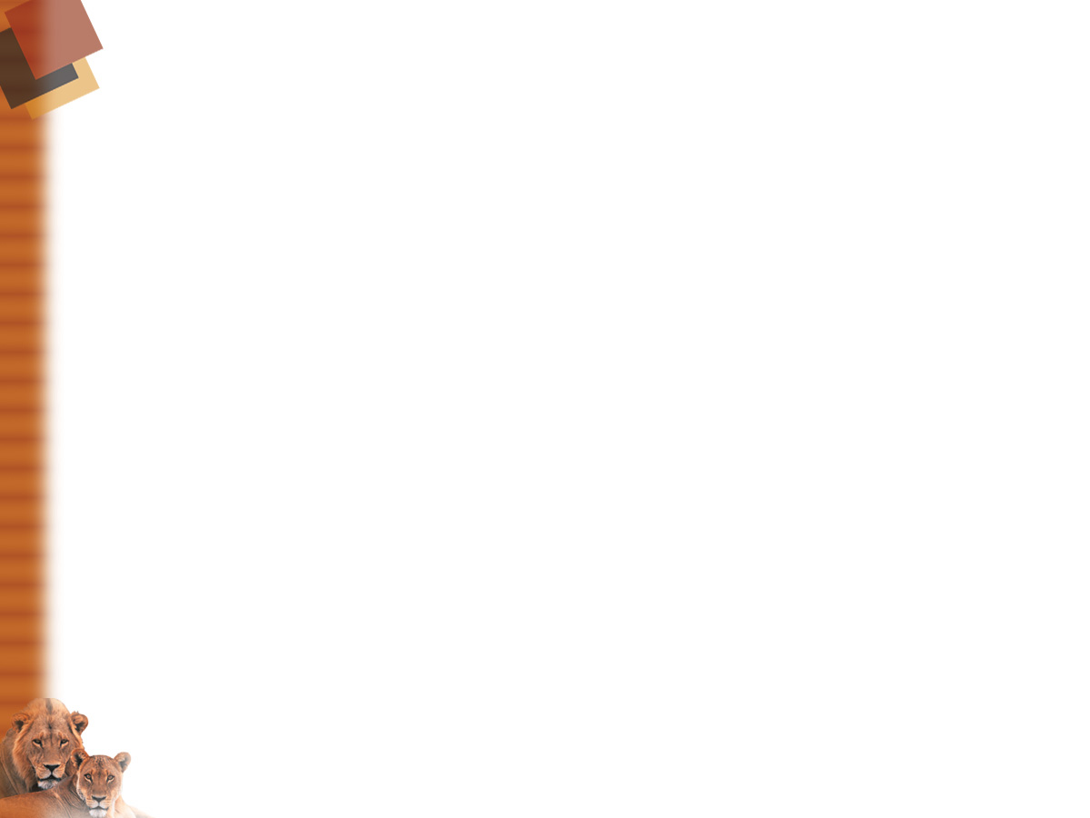
Learning Objectives
Patterns
  Adapter pattern
  Model-View-Controller pattern
  Sorting pattern and it’s efficiency
  Pattern formalism
UML
  History of UML
  UML class diagrams
  Class interactions

Slide 3
Introduction
Patterns and UML
  Software design tools
  Programming-language independent
    Assuming object-oriented-capable
Pattern
  Like "ordinary" pattern in other contexts
    An "outline" of software task
  Can result in different code in different but
  similar tasks
UML
  Graphical language for OOP design

Slide 4
Patterns
Patterns are design principles
  Apply across variety of software applications
  Must also apply across variety of situations
  Must make assumptions about
  application domain
Example:
Iterator pattern applies to containers of
almost any kind

Slide 5
Pattern Example: Iterators
Recall iterators
Iterator pattern applies to containers of
almost any kind
1st described as "abstract"
  As ways of cycling thru any data in any container
Then gave specific applications
  Such as list iterator, constant list iterator,
  reverse list iterator, etc.

Slide 6
Consider No Patterns
Iterators
  Imagine huge amount of detail if all container
  iterators presented separately!
  If each had different names for begin(), end()
  To make "sense" of it, learners might make
  pattern themselves!
Until pattern developed, all were different
  "Seemed" similar, but not organized
Consider containers as well
  Same issues!

Slide 7
Adapter Pattern
Transforms one class into different class
  With no changes to underlying class
  Only "adding" to interface
Recall stack and queue template classes
  Both can choose underlying class used to
  store data:
  stack<vector<int>> -- int stack under vector
  stack<list<int>> -- int stack underlying list
  All cases underlying class not changed
    Only interface is added

Slide 8
Adapter Pattern Interface
How to add interface?
  Implementation detail
  Not part of pattern
But… two ways:
  Example: for stack adapter:
    Underlying container class could be member
    variable of stack class
    Or stack class could be derived class of
    underlying container class

Slide 9
Model-View-Controller Pattern
Way of dividing I/O task out
  Model part: heart of application
  View part: output
    Displays picture of model’s state
  Controller part: input
    Relays commands from user to model
A divide and conquer strategy
  One big task → three smaller tasks
    Each with well-defined responsibilities

Slide 10
Model-View-Controller Pattern
Any application can fit
But particularly suited to GUI
design projects
  Where view can actually be visualization of
  state of model

Slide 11
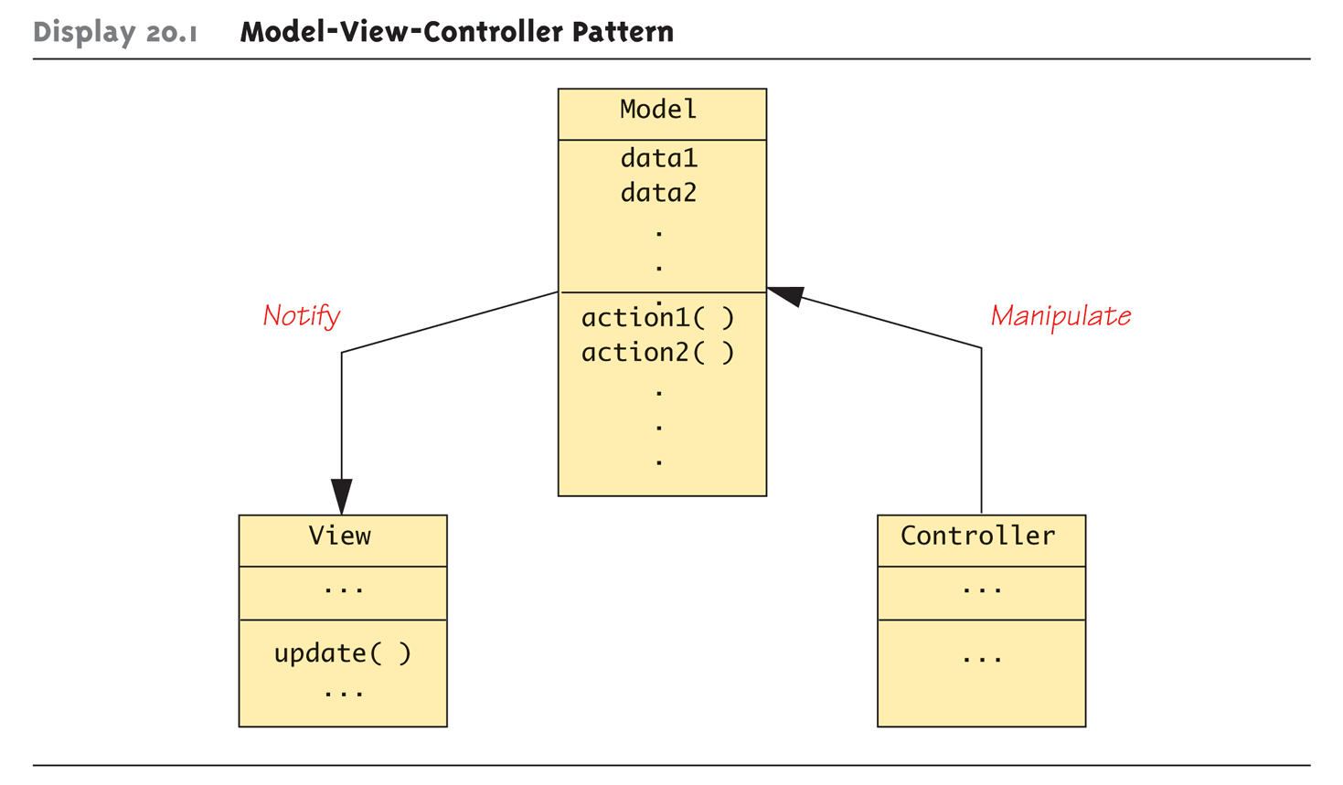
Display 20.1
Model-View-Controller Pattern

Slide 12
A Sorting Pattern Example
Similar pattern among "most-efficient"
sorting algorithms:
  Recursive
  Divide list into smaller lists
  Then recursively sort smaller lists
  Recombine two sorted lists obtaining one
  final sorted list

Slide 13
Sorting Pattern
Clearly a divide-and-conquer strategy
Heart of pattern:
int splitPt = split(a, begin, end);
sort(a, begin, splitPt);
sort(a, splitPt, end);
join(a, begin, splitPt, end);
Note no details on how split and join
are defined
  Different definitions will yield different
  sorting algorithms

Slide 14
Function split
Rearranges elements
  In interval [begin, end]
Divides interval at split point, splitPt
Two new intervals then sorted
  [begin, splitPt) – first half
  [splitPt, end) – second half
No details in pattern
  Nothing about how rearrange and divide
  takes place

Slide 15
Function join
Combines two sorted intervals
  Produces final sorted version
Again, no details
  join function could perform many ways

Slide 16
Sample Realization of Sorting Pattern: Mergesort
Simplest "realization" of sorting pattern is
mergesort
Definition of split very simple
  Just divides array into two intervals
  No rearranging of elements
Definition of join complex!
  Must sort subintervals
  Then merge, copying to temporary array

Slide 17
Mergesort’s join Function
Sequence:
  Compare smallest elements in
  each interval
  Smaller of two → next position in
  temporary array
    Repeated until through both intervals
  Result is final sorted array

Slide 18
Sort Pattern Complexity
Trade-off between split and join
  Either can be simple at expense of other
  e.g., In mergesort, split function simple at
  expense of complicated join function
  Could vary in other algorithms
Comes down to "who does work?"

Slide 19
Consider Quicksort
Complexity switch
  join function simple, split function complex
Library files
  Include files "mergesort.cpp", "quicksort.cpp"
  both give two different realizations of same
  sort pattern
  Provide same input and output!

Slide 20
Quicksort Realization
A sophisticated split function
  Arbitrary value chosen, called "splitting value"
  Array elements rearranged "around" splitting value
    Those less than in front, greater than in back
    Splitting value essentially "divides" array
  Two "sides" then sorted recursively
Finally combined with join
  Which does nothing!

Slide 21
Sorting Pattern Efficiency
Most efficient realizations "divide" list into
two chunks
  Such as half and half
  Inefficient if divided into "few" and "rest"
Mergesort: O(N log N)
Quicksort:
  Worst case: O(N²) (if split uneven)
  Average case: O(N log N)
    In practice, one of best sort algorithms

Slide 22
Pragmatics and Patterns
Patterns are guides, not requirements
  Not compelled to follow all fine details
  Can take "liberties" and adjust for particular needs
    Like efficiency issues
Pattern formalism
  Standard techniques exist for using patterns
  Place of patterns in sofware design process
  not yet clear
    Is clear that many basic patterns are useful

Slide 23
UML
Unified Modeling Language
Attempt to produce "human-oriented"
ways of representing programs
  Like pseudocode: think of problem, without
  details of language
Pseudocode very standard, very used
  But it’s a linear, algebraic representation
Prefer "graphical" representation
  Enter UML

Slide 24
UML Design
Designed to reflect/be used with
object-oriented programming philosophy
A promising effort!
Many companies have adopted UML
formalism in software design process

Slide 25
History of UML
Developed with OOP
Different groups developed own graphical
representations for OOP design
1996:
  Booch, Jacobsen, Rumbaugh released
  early version of UML
  Intended to "bring together" various other
  representations to produce standard for all
  object-oriented design

Slide 26
UML Lately
Since 1996:
  Developed and revised with feedback from
  OOP community
Today:
  UML standard maintained and certified by
  Object Management Group (OMG)
    Non-profit organization that promotes use of
    object-oriented techniques

Slide 27
UML Class Diagrams
As classes are central to OOP…
Class diagram is simplest of UML
graphical representations to use
  Three-sectioned box contains:
    Class name
    Data specifications
    Actions (class member functions)

Slide 28
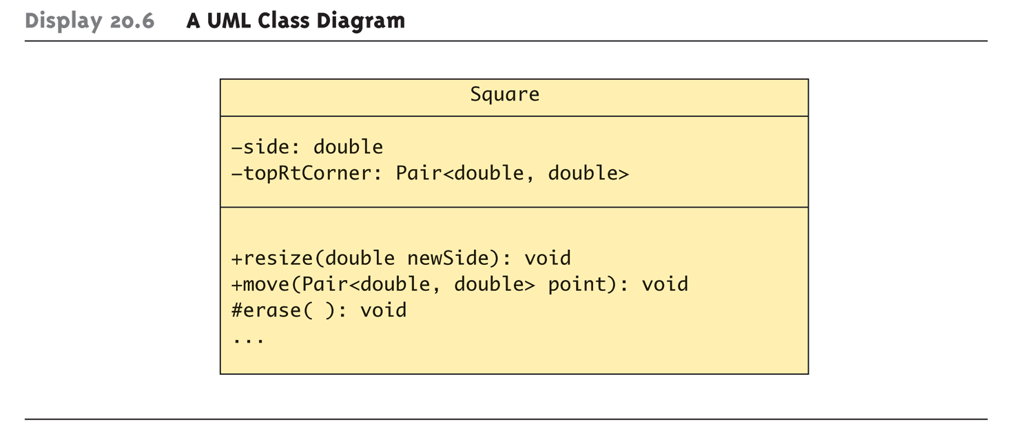
Class Diagrams Example:
Display 20.6 A UML Class Diagram

Slide 29
Class Diagrams Example Notes
Data section:
  + sign indicates public member
  - sign indicates private member
  # indicates protected member
  Our example: both private (Typical in OOP)
Actions:
  Same +, -, # for public, private, protected
Need not provide all details
  Missing members indicated with ellipsis (…)

Slide 30
Class Interactions
Class diagrams alone of little value
  Just repeat of class interface, often "less"
Must show how objects of various
classes interact
  Annotated arrows show information flow
  between class objects
    Recall Model-View-Controller Pattern
  Annotations also for class groupings into
  library-like aggregates
    Such as for inheritance

Slide 31
More Class Interactions
UML is extensible
  If your needs not in UML, add them
  to UML!
Framework exists for this purpose
  Prescribed standard for additions
  Ensures different software developers
  understand each other’s UML

Slide 32
Summary
Patterns are design principles
  Apply across variety of software applications
Pattern can provide framework for
comparing related algorithms" efficiency
Unified Modeling Language (UML)
  Graphical representation language
  Designed for object-oriented software design
UML is one formalism used to
express patterns

