Slide 1
Chapter 1
Introduction

Slide 2
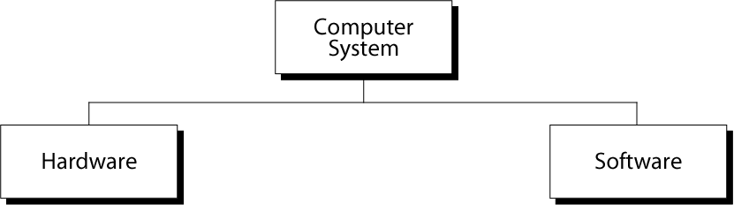
Figure 1-1
Computer System

Slide 3
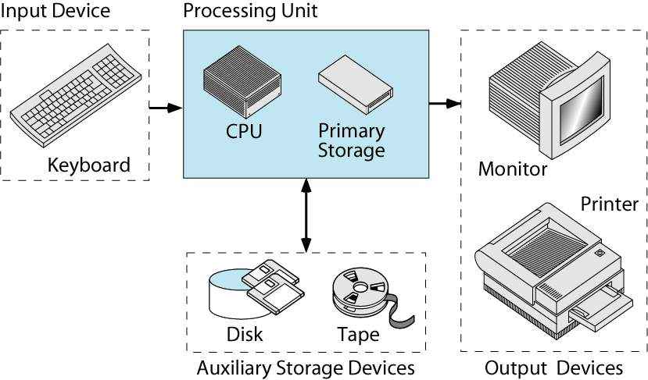
Figure 1-2
Components of Computer Hardware

Slide 4
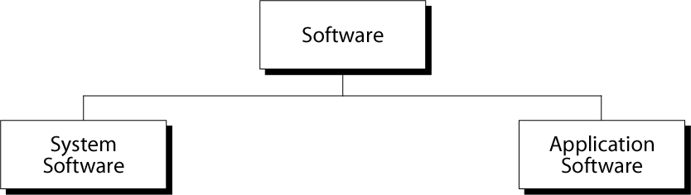
Figure 1-3
Types of Software

Slide 5
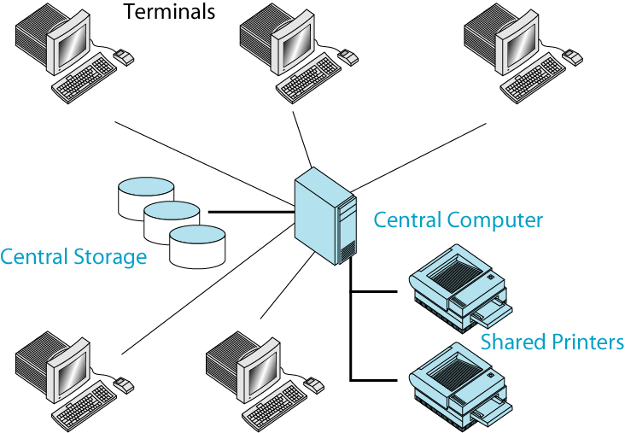
Figure 1-4
The Time-Sharing Environment

Slide 6
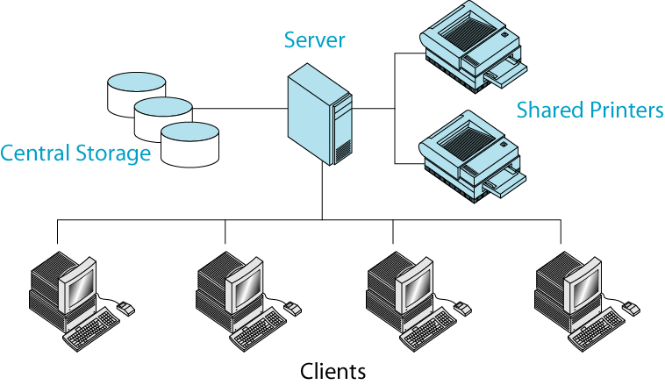
Figure 1-5
The Client/Server Environment

Slide 7
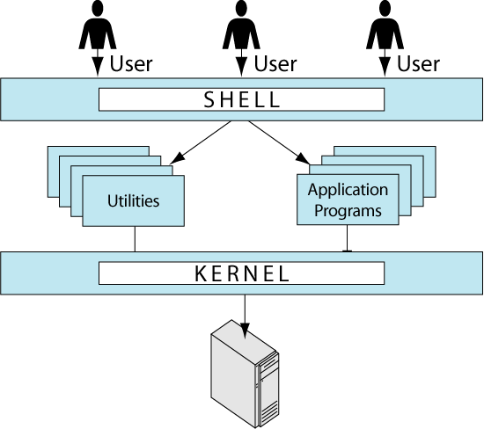
Figure 1-6
Components of UNIX

Slide 8
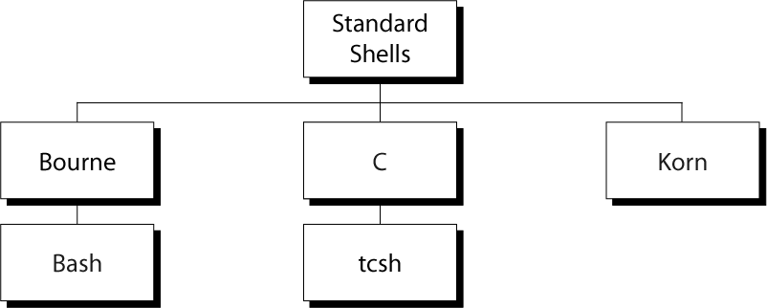
Figure 1-7
Some Standard UNIX Shells

Slide 9
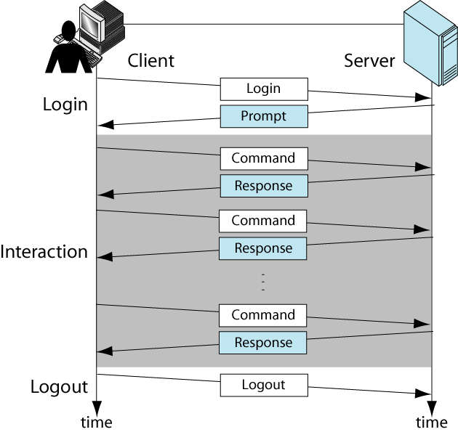
Figure 1-8
Interactive Session

Slide 10
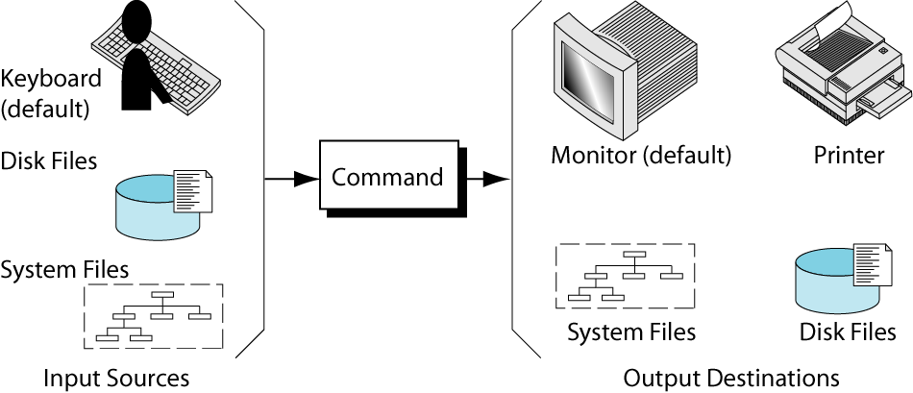
Figure 1-9
Command Source and Destination

Slide 11
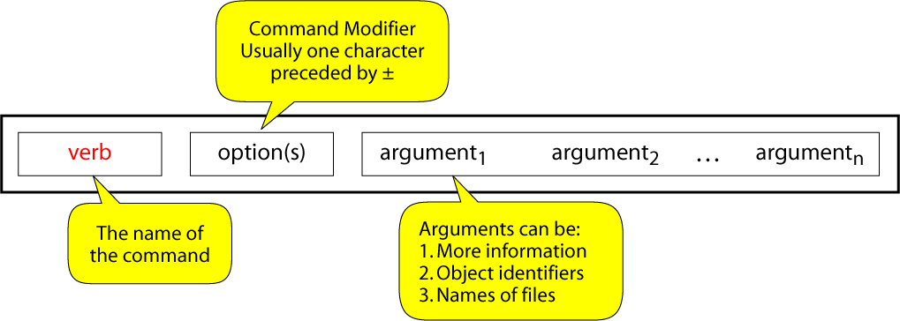
Figure 1-10
General Command Format

Slide 12
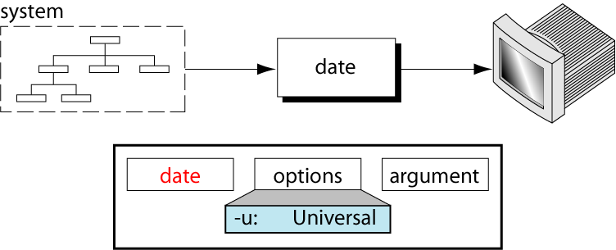
Figure 1-11
The date Command

Slide 13
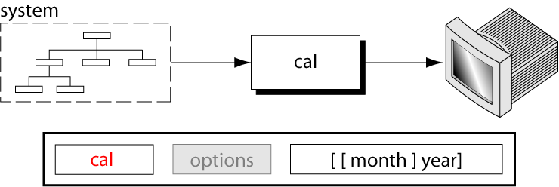
Figure 1-12
The calendar Command

Slide 14
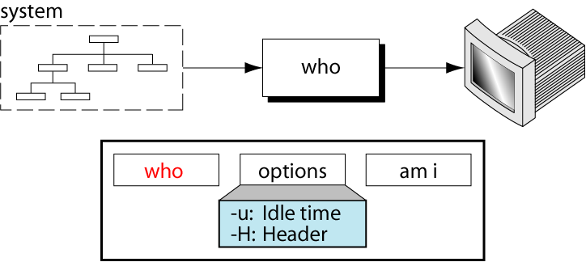
Figure 1-13
The who Command

Slide 15
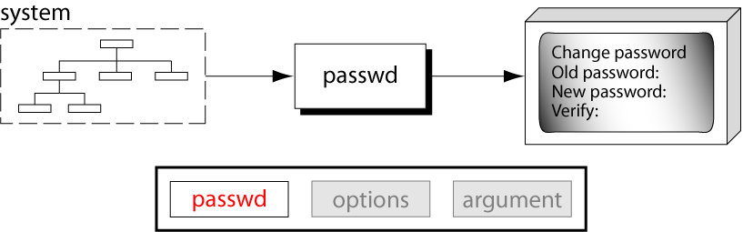
Figure 1-14
The passwd Command

Slide 16
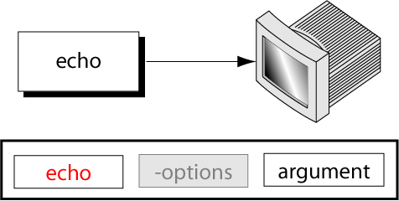
Figure 1-15
The echo Command

Slide 17
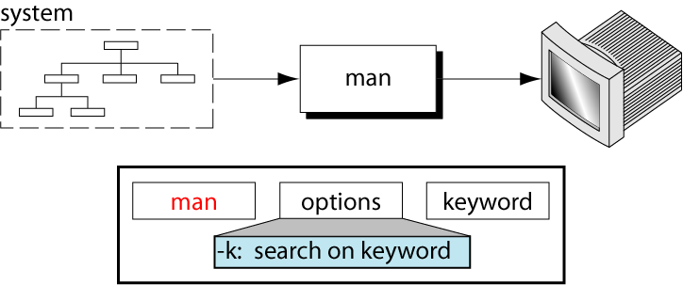
Figure 1-16
The man Command

Slide 18
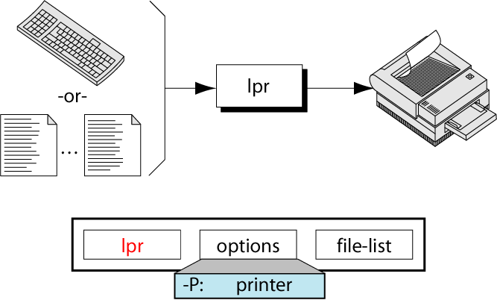
Figure 1-17
The lpr Command

Slide 19
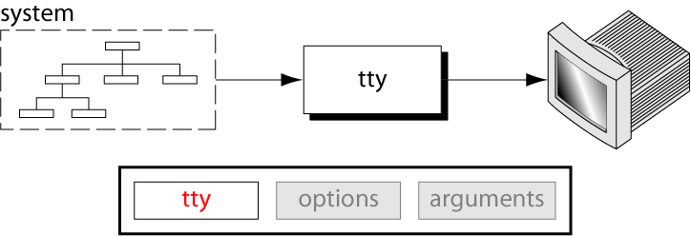
Figure 1-18
The tty Command

Slide 20
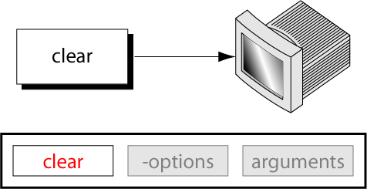
Figure 1-19
The clear Command

Slide 21
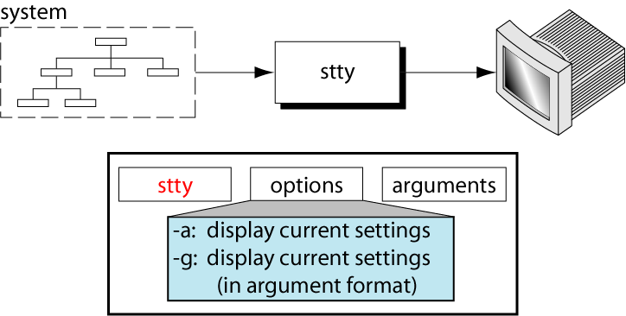
Figure 1-20
The stty Command

Slide 22
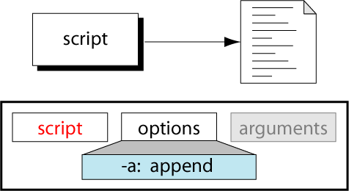
Figure 1-21
The script Command

Slide 23
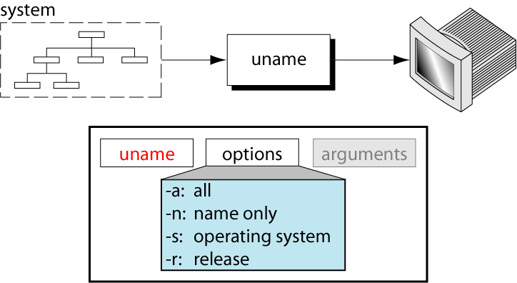
Figure 1-22
The uname Command

Slide 24
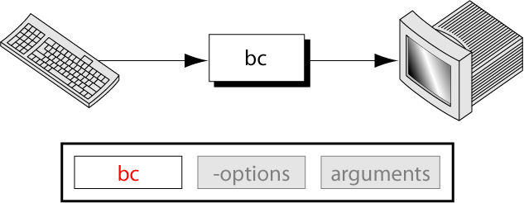
Figure 1-23
The bc Command

