Slide 1
Chapter 2
Basic
vi
Editor

Slide 2
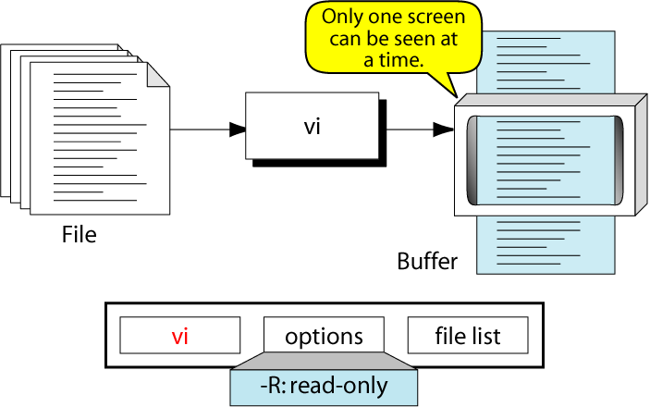
Figure 2-1
The vi Editor

Slide 3
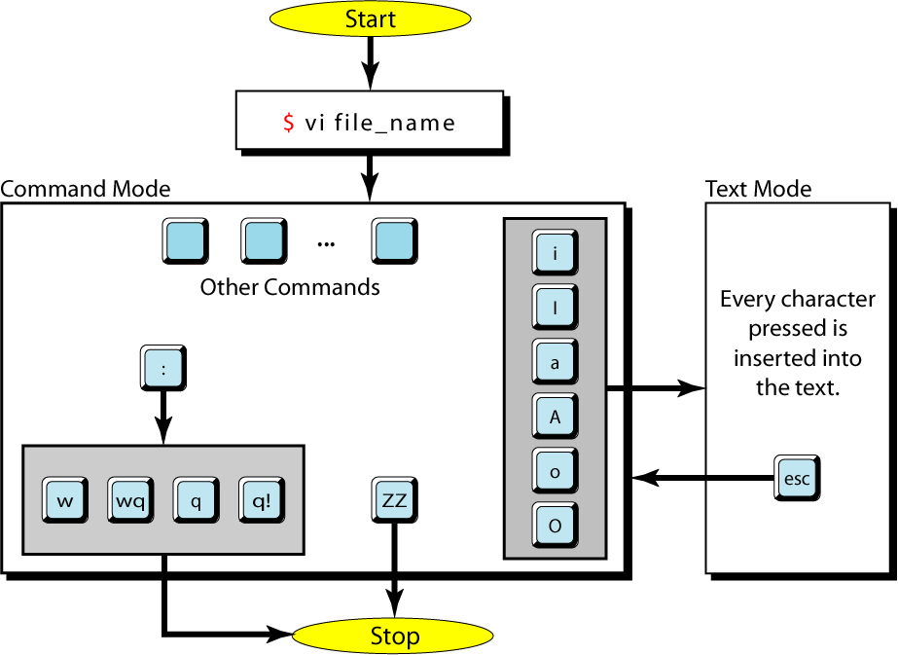
Figure 2-2
vi Modes

Slide 4
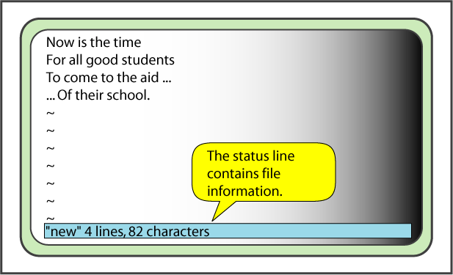
Figure 2-3
A Small File in vi

Slide 5
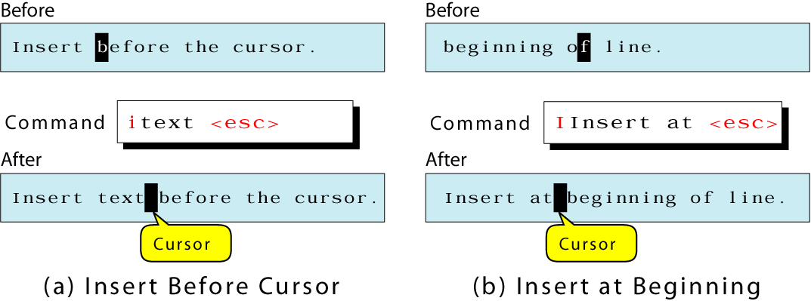
Figure 2-4
Insert Text Before the Cursor and Line

Slide 6
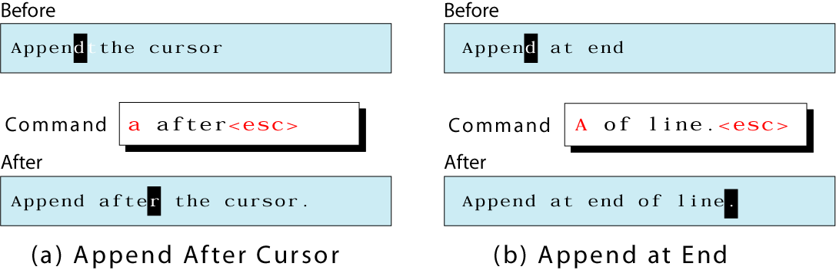
Figure 2-5
Insert Text After the Cursor and Line

Slide 7
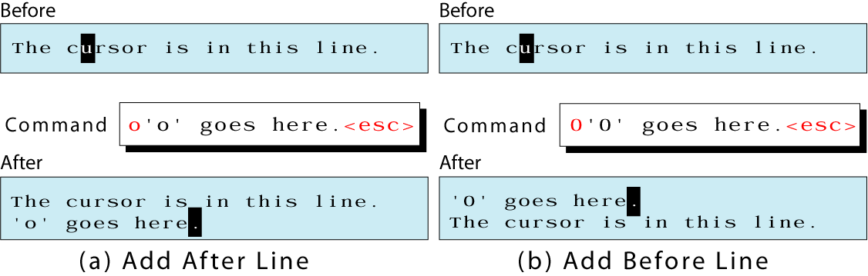
Figure 2-6
Insert New Line

Slide 8
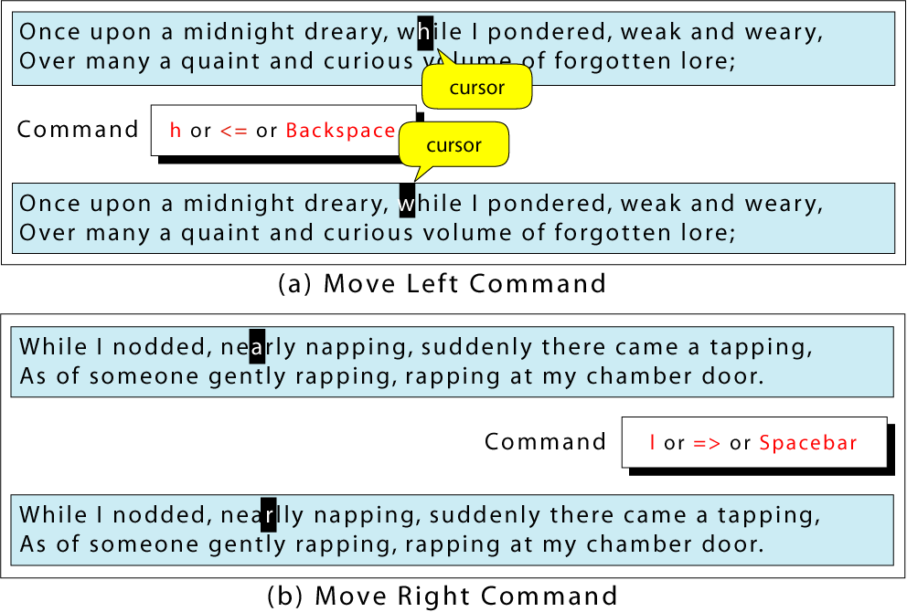
Figure 2-7 (a and b)
Horizontal Moves

Slide 9
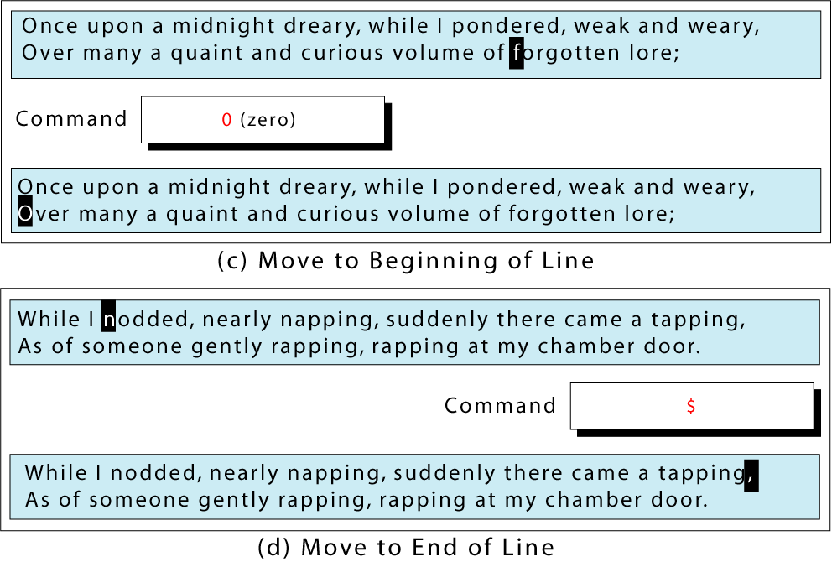
Figure 2-7 (c and d)
Horizontal Moves

Slide 10
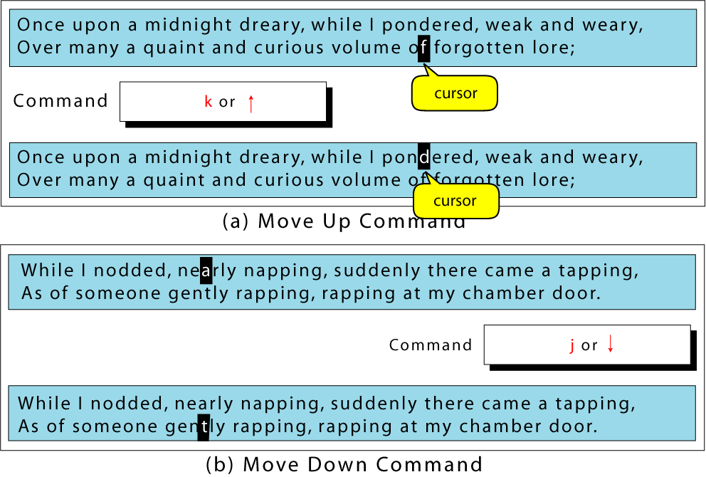
Figure 2-8 (a and b)
Vertical Moves

Slide 11
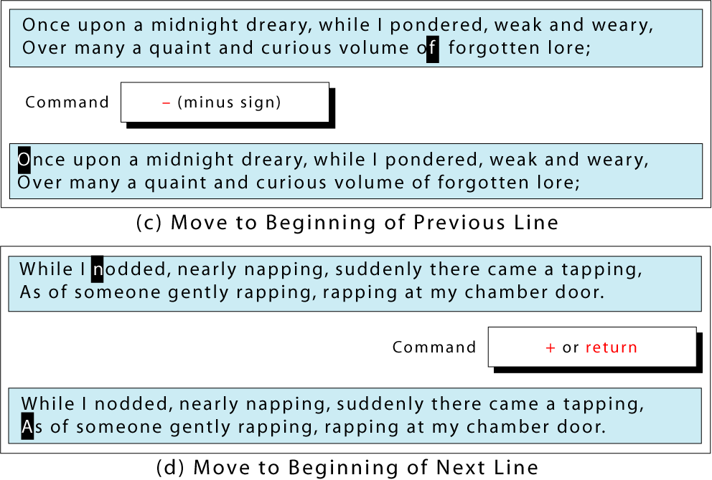
Figure 2-8 (c and d)
Vertical Moves

Slide 12
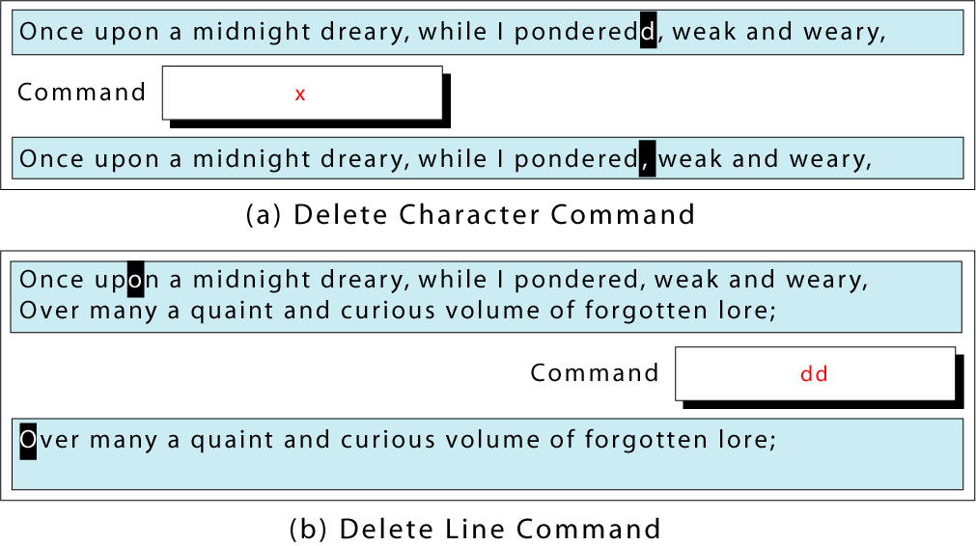
Figure 2-9
Delete Commands

Slide 13
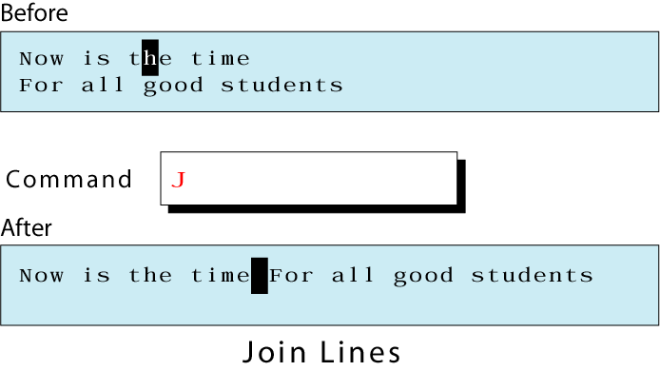
Figure 2-10
The join Command

Slide 14
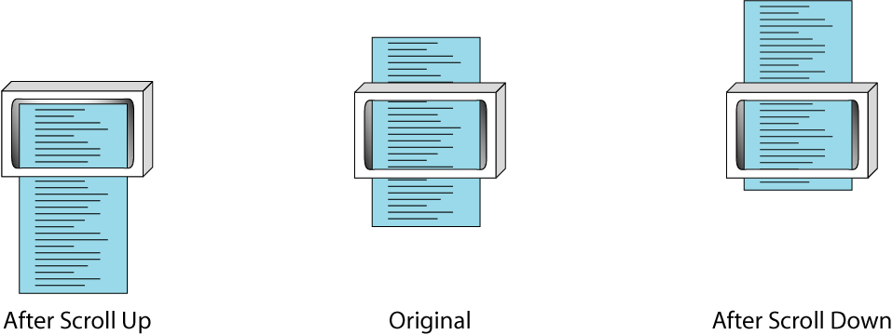
Figure 2-11
Scrolling

Slide 15
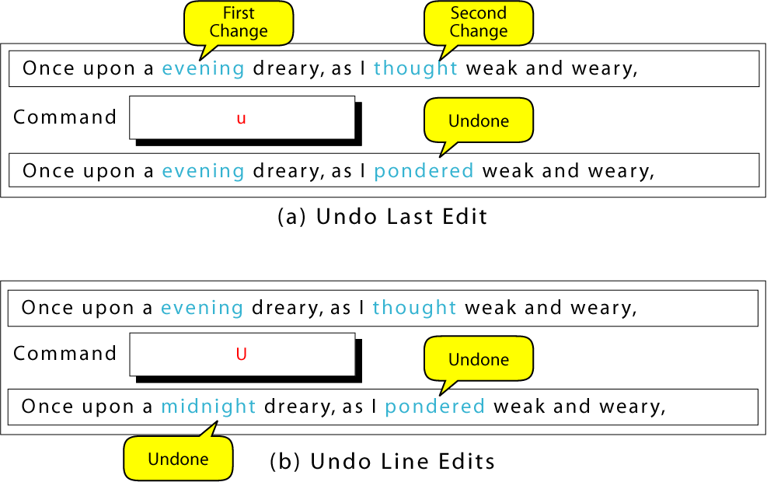
Figure 2-12
Undo Commands

