Slide 1
Chapter 3
File
Systems

Slide 2
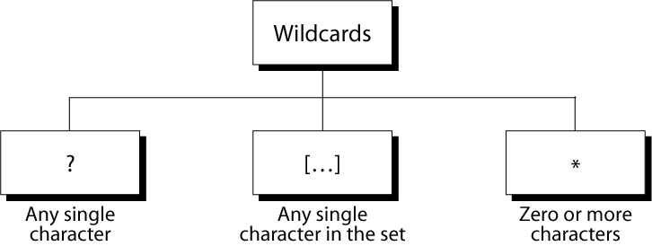
Figure 3-1
Wild Cards

Slide 3
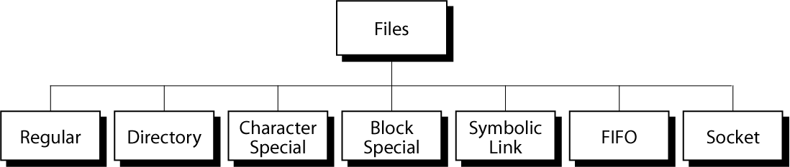
Figure 3-2
Files in Unix

Slide 4
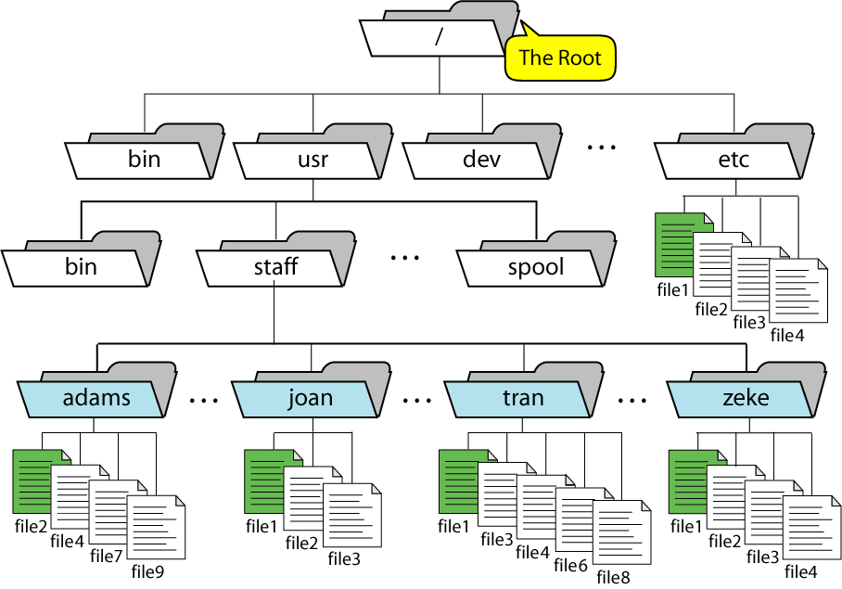
Figure 3-3
A Directory Hierarchy

Slide 5
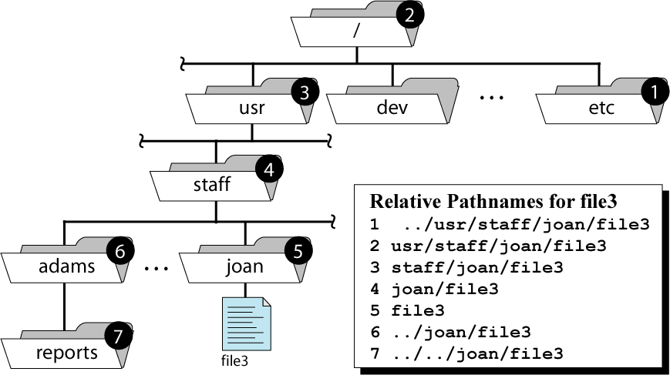
Figure 3-4
Relative Pathnames for file3

Slide 6
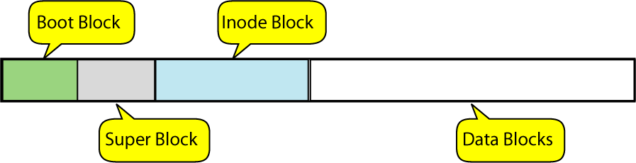
Figure 3-5
A Disk File Format

Slide 7
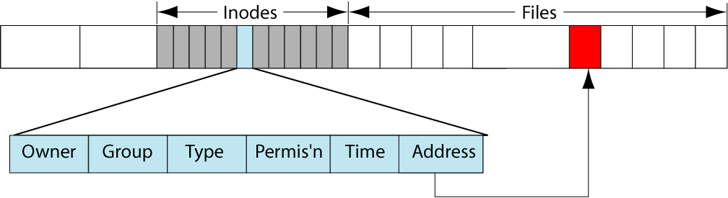
Figure 3-6
Inodes

Slide 8
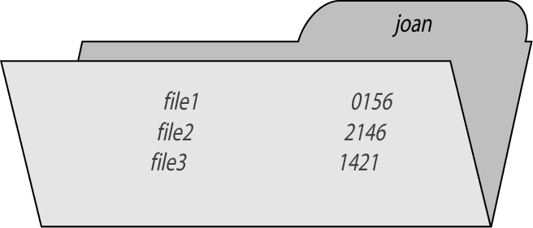
Figure 3-7
A Directory of Three Files

Slide 9
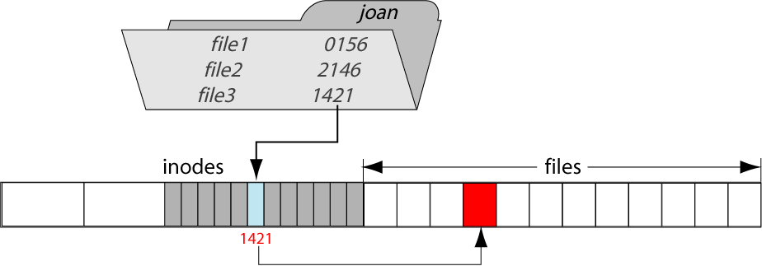
Figure 3-8
A Hard Link

Slide 10
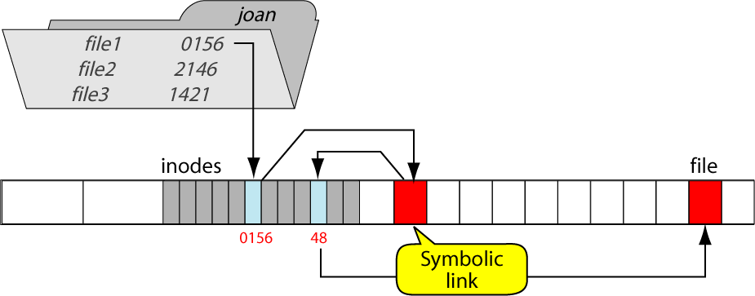
Figure 3-09
A Symbolic Link

Slide 11
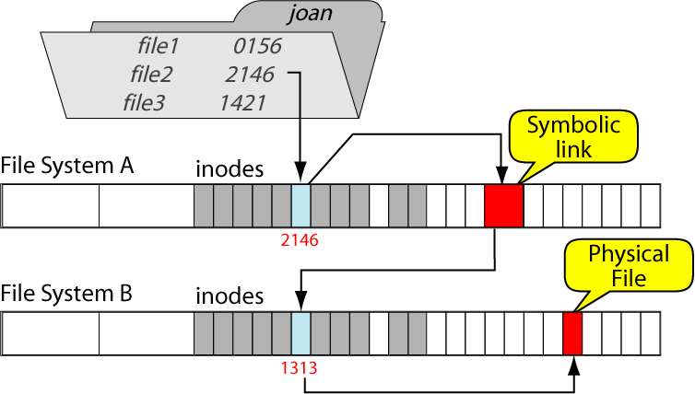
Figure 3-10
Symbolic Links to Different File Systems

Slide 12
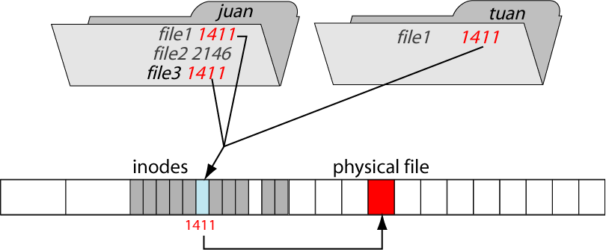
Figure 3-11
Multiple Links to One File

Slide 13
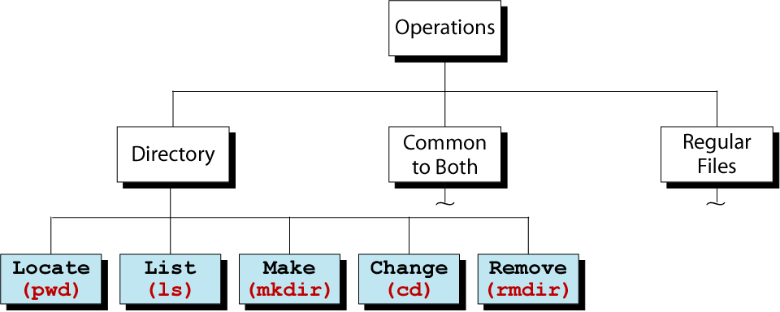
Figure 3-12
Directory Operations

Slide 14
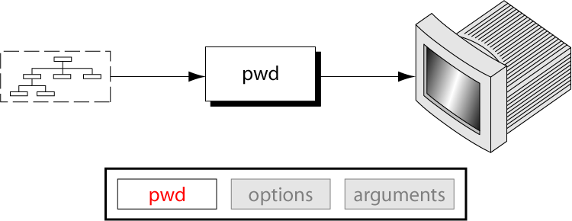
Figure 3-13
The pwd Command

Slide 15
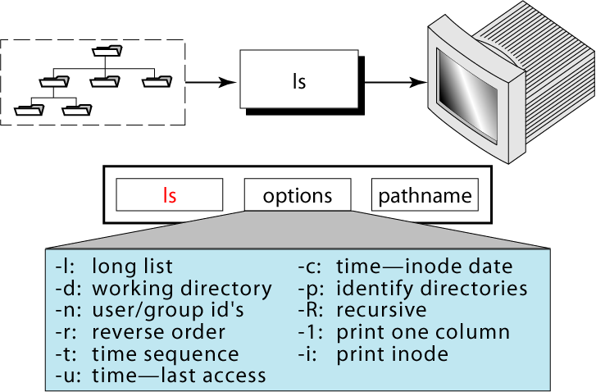
Figure 3-14
The ls Command

Slide 16
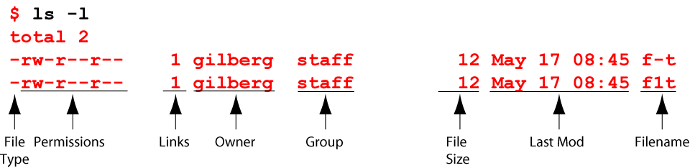
Figure 3-15
Long List Option

Slide 17
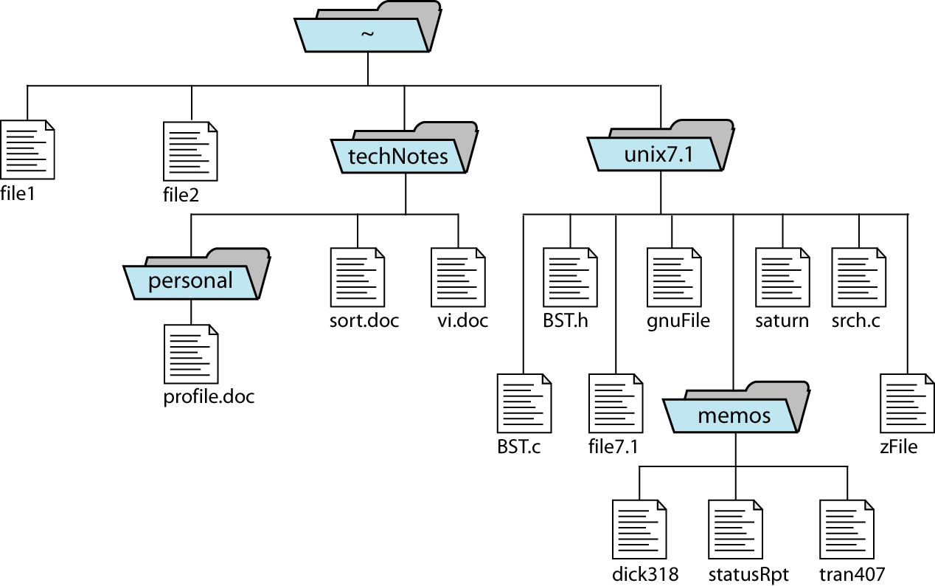
Figure 3-16
Directory Structure Recursive List

Slide 18
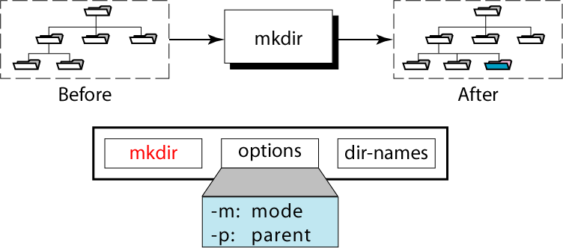
Figure 3-17
The mkdir Command

Slide 19
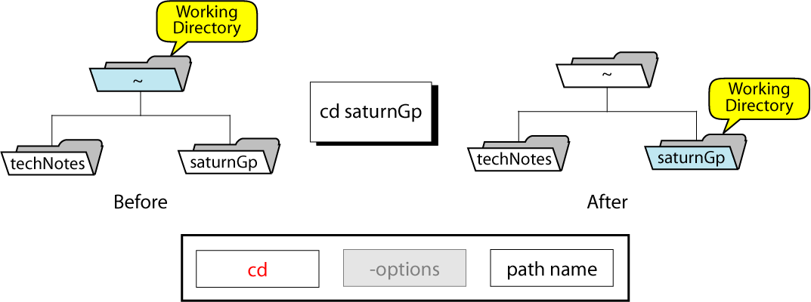
Figure 3-18
The cd Command

Slide 20
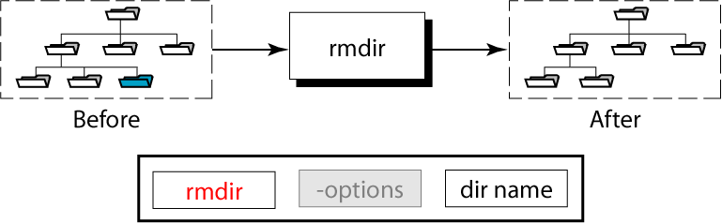
Figure 3-19
The rmdir Command

Slide 21
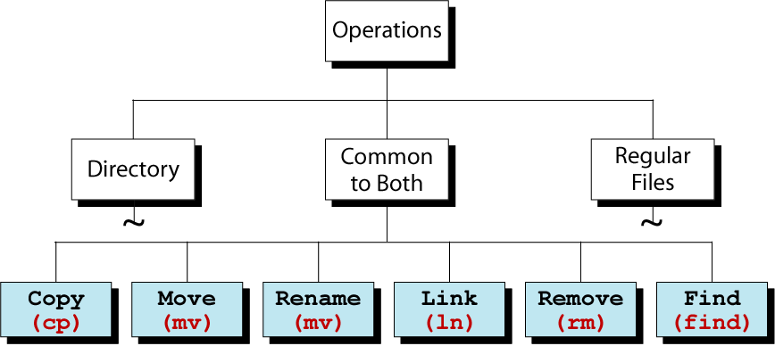
Figure 3-20
Regular File Utilities

Slide 22
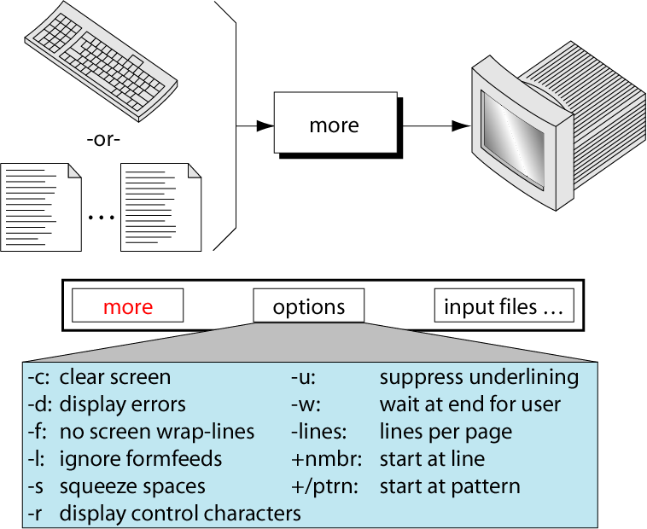
Figure 3-21
The more Command

Slide 23
Figure 3-22
Operations Common to Directories and Files

Slide 24
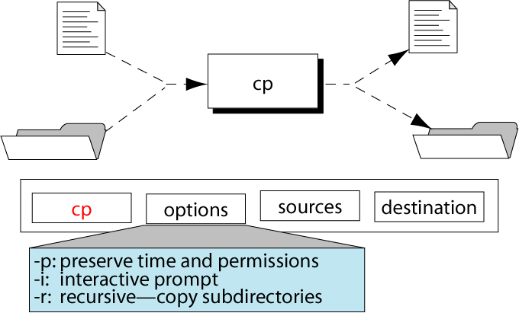
Figure 3-23
The cp Command

Slide 25
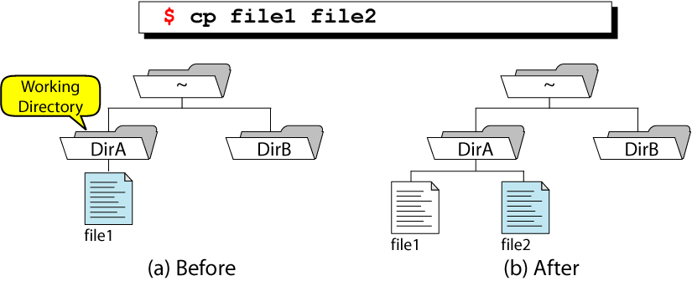
Figure 3-24
Simple File Copy

Slide 26
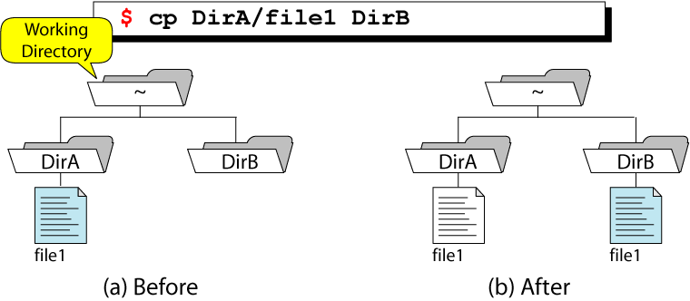
Figure 3-25
Copy File to A Directory From Home

Slide 27
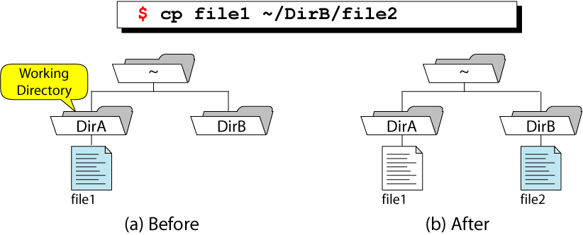
Figure 3-26
Copy and Rename File

Slide 28
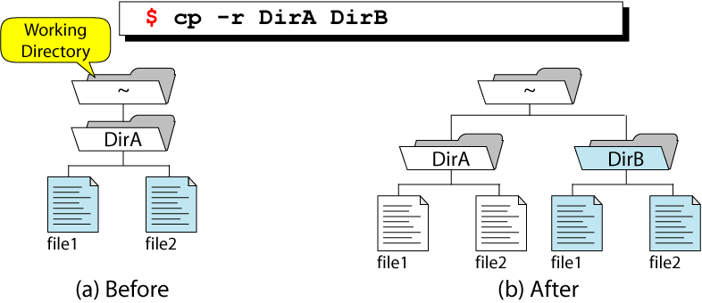
Figure 3-27
Recursive Copy

Slide 29
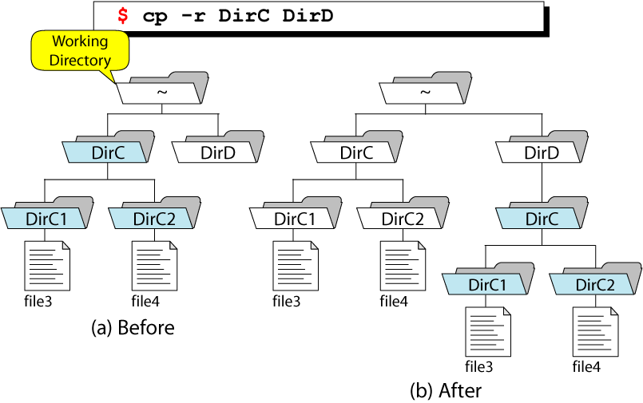
Figure 3-28
Recursive Copy with Subdirectories

Slide 30
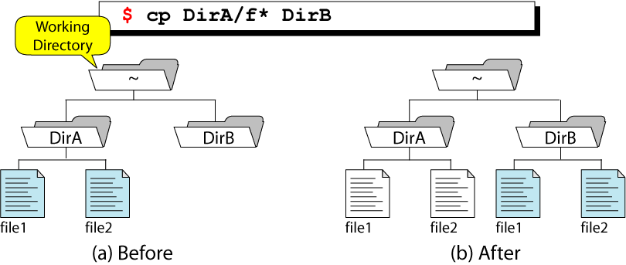
Figure 3-29
Wildcard Copies

Slide 31
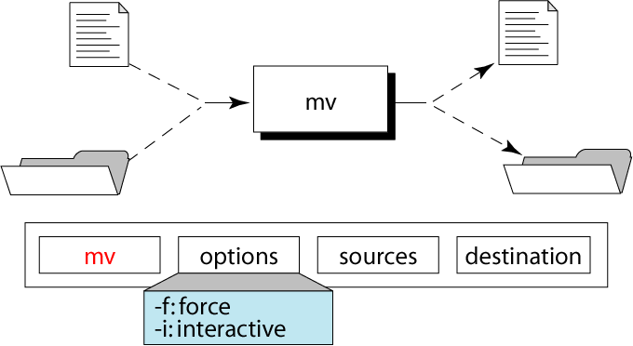
Figure 3-30
The mv Command

Slide 32
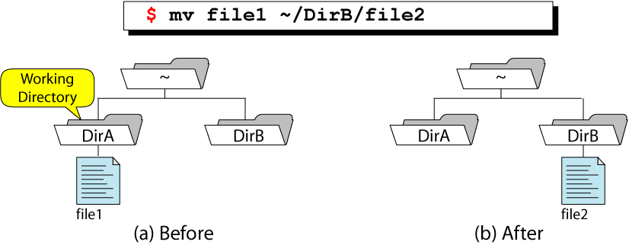
Figure 3-31
Move File

Slide 33
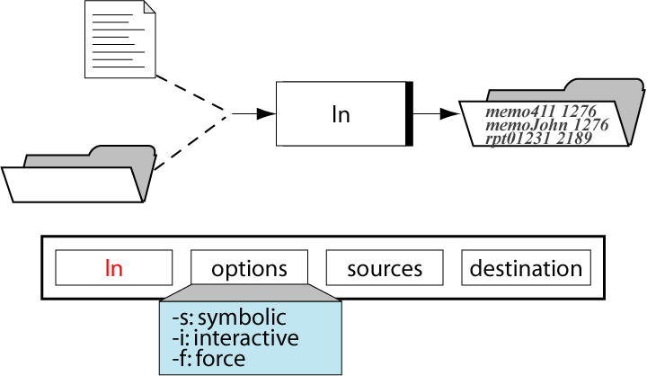
Figure 3-32
The ln Command

Slide 34
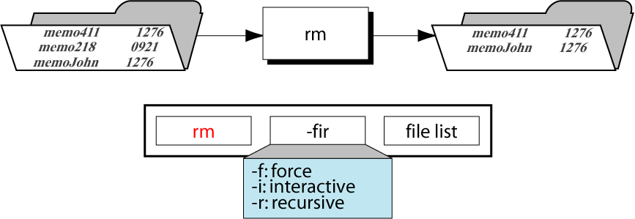
Figure 3-33
The rm Command

Slide 35
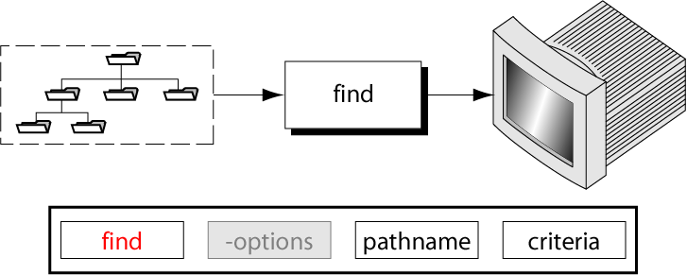
Figure 3-34
The find Command

