Slide 1
Chapter 4
Security
and
File
Permission

Slide 2
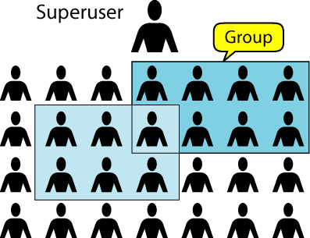
Figure 4-1
Users

Slide 3
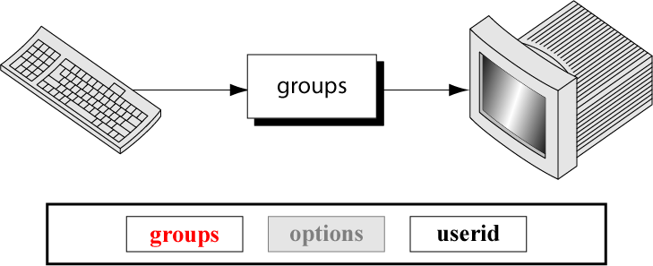
Figure 4-2
The groups Command

Slide 4
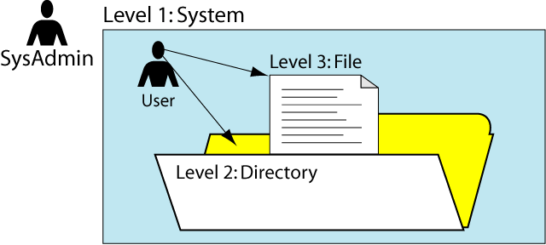
Figure 4-3
Security Levels

Slide 5
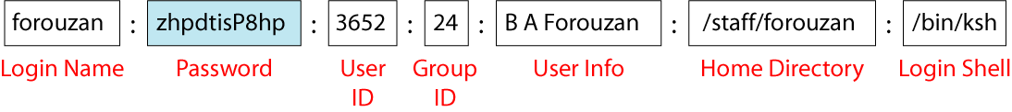
Figure 4-4
A Typical Password File Entry

Slide 6
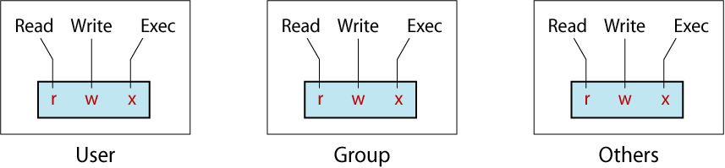
Figure 4-5
Directory and File Permission

Slide 7
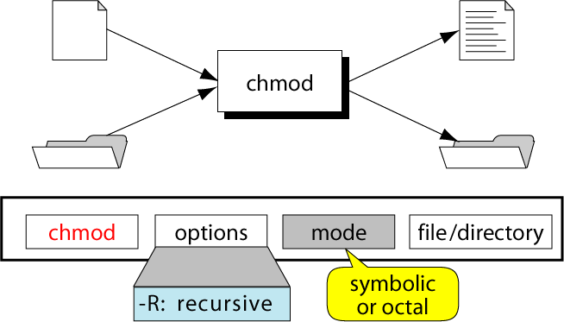
Figure 4-6
The chmod Command

Slide 8
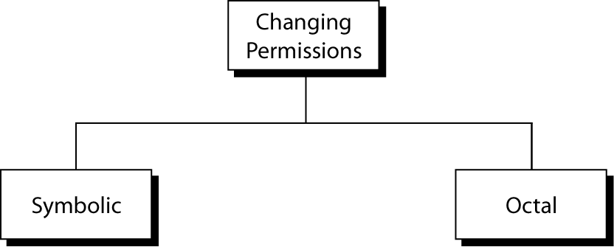
Figure 4-7
Changing Permissions

Slide 9
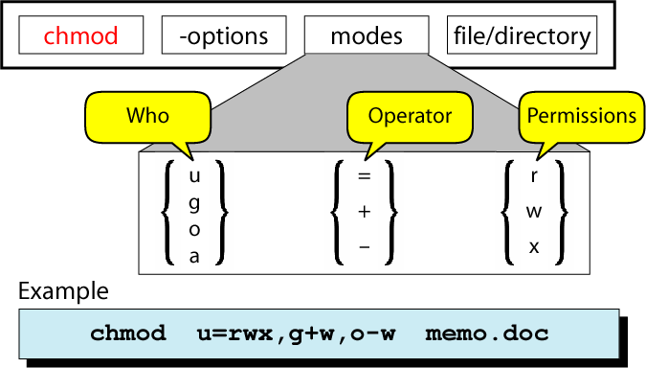
Figure 4-8
Symbolic chmod Codes

Slide 10
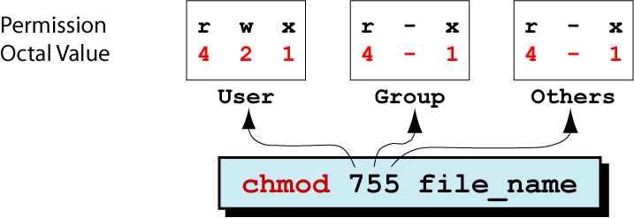
Figure 4-9
Octal chmod Commands

Slide 11
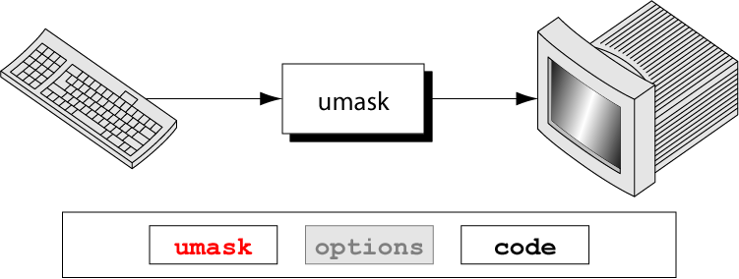
Figure 4-10
The umask Command

Slide 12
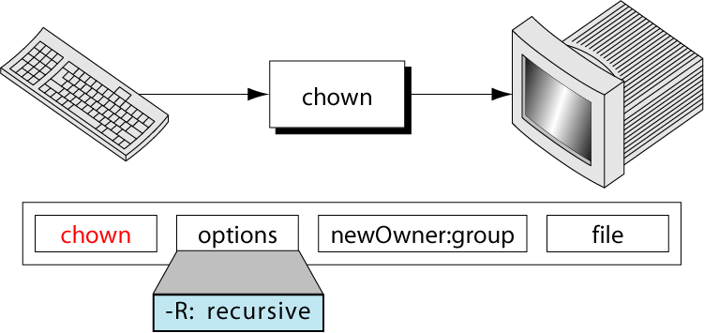
Figure 4-11
The chown Command

Slide 13
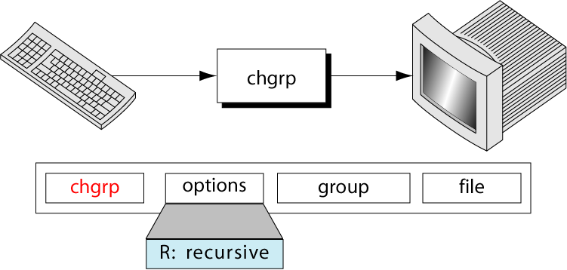
Figure 4-12
The chgrp Command

