Slide 1
Chapter 5
Introduction
to
Shells

Slide 2
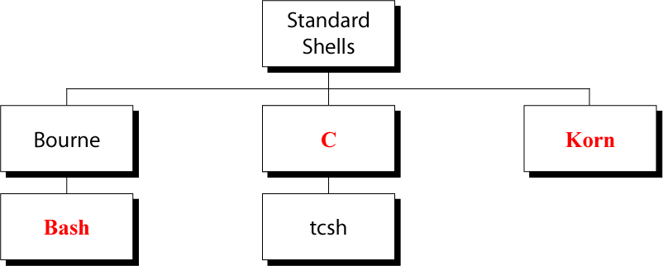
Figure 5-1
Five Standard UNIX Shells

Slide 3
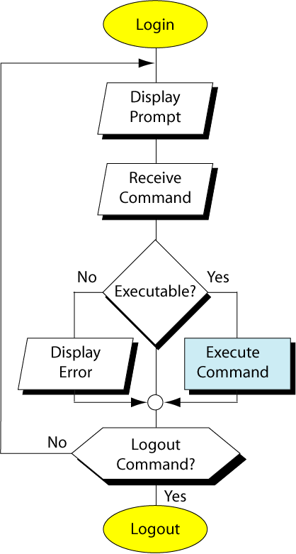
Figure 5-2
UNIX
Work
Flow

Slide 4
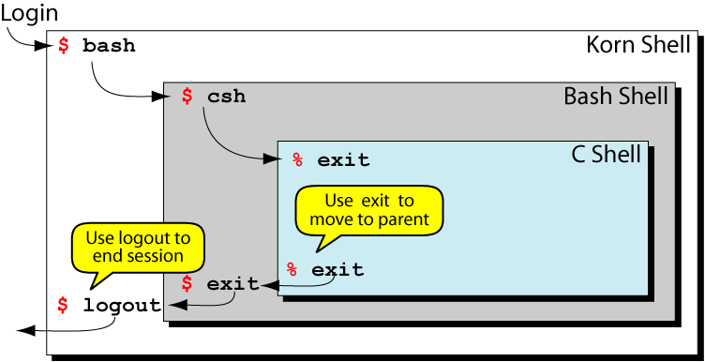
Figure 5-3
Shell Relationship

Slide 5
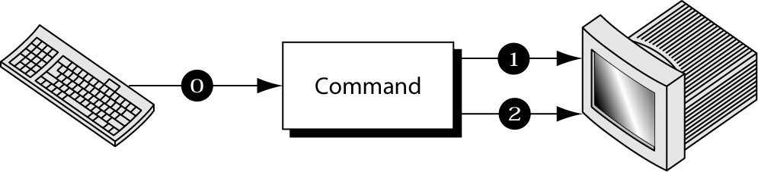
Figure 5-4
Standard Streams

Slide 6
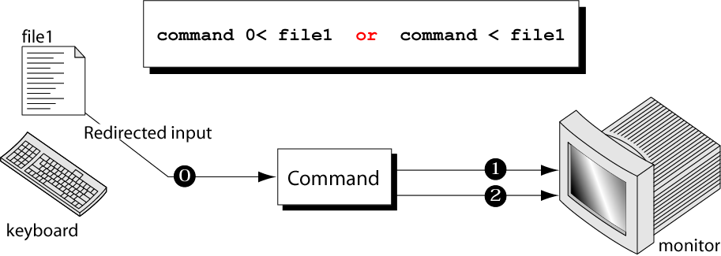
Figure 5-5
Redirecting Standard Input

Slide 7
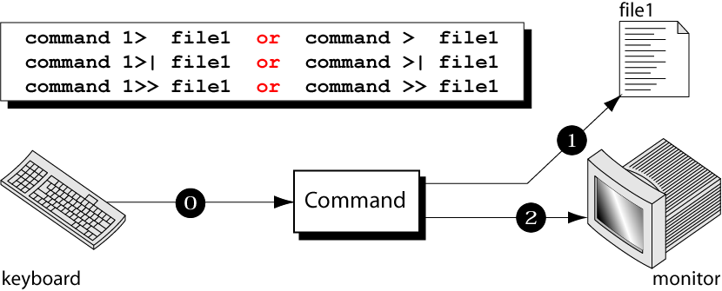
Figure 5-6
Redirecting Standard Output

Slide 8
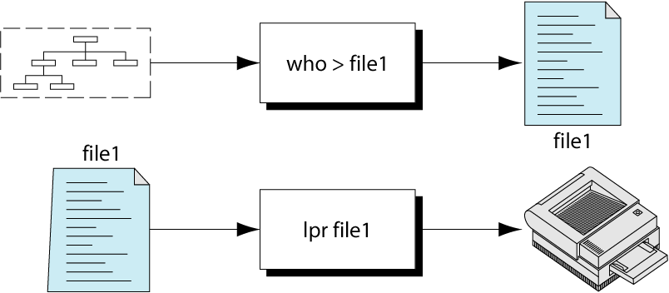
Figure 5-7
Print who Output

Slide 9
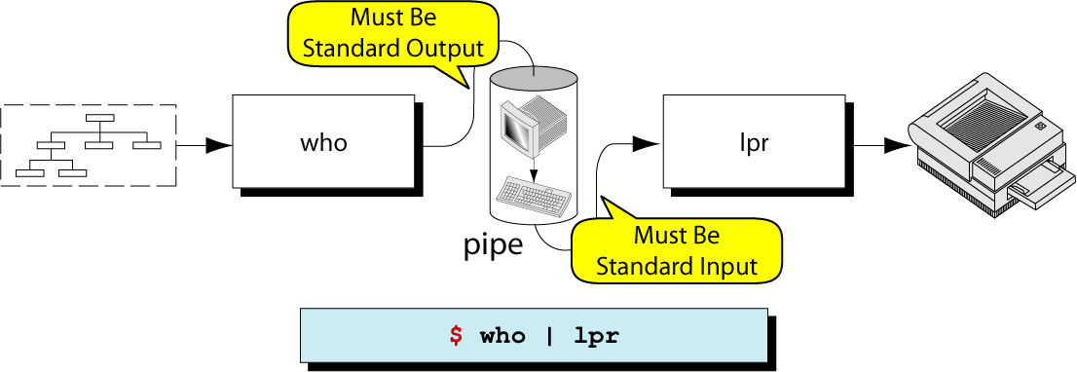
Figure 5-8
Piping Output to Next Command

Slide 10
Figure 5-9
The tee Command

Slide 11
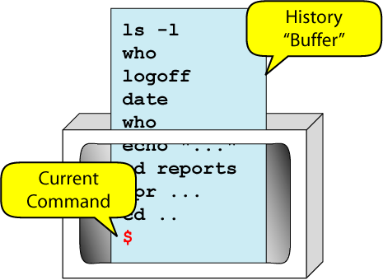
Figure 5-10
Command Line Editing Concept

Slide 12
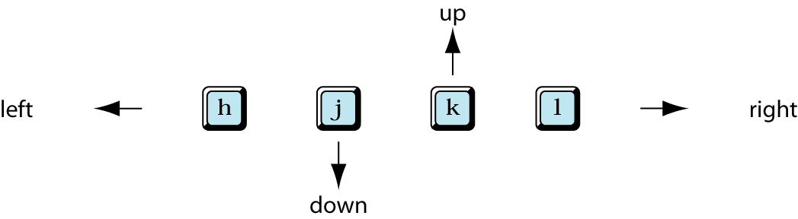
Figure 5-11
vi Directional Keys

Slide 13
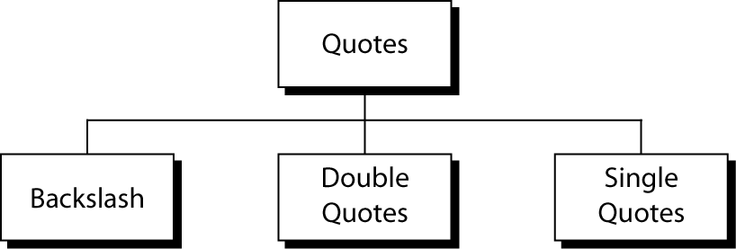
Figure 5-12
Quotes

Slide 14
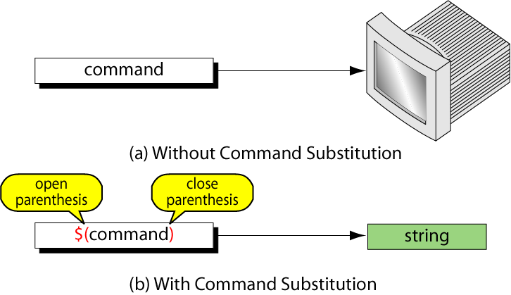
Figure 5-13
Command Substitution

Slide 15
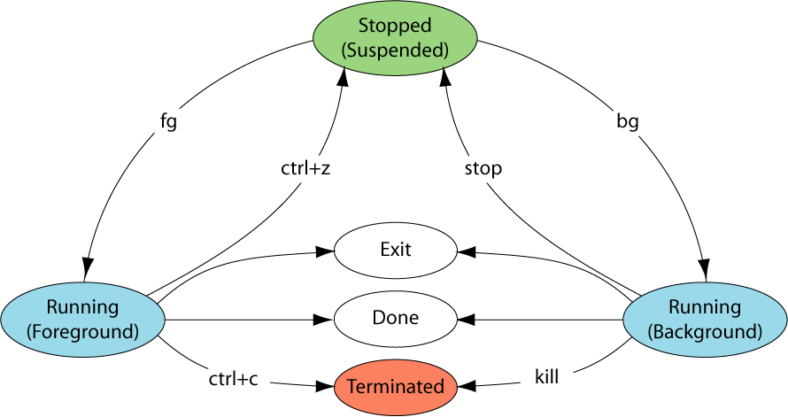
Figure 5-14
Job States

Slide 16
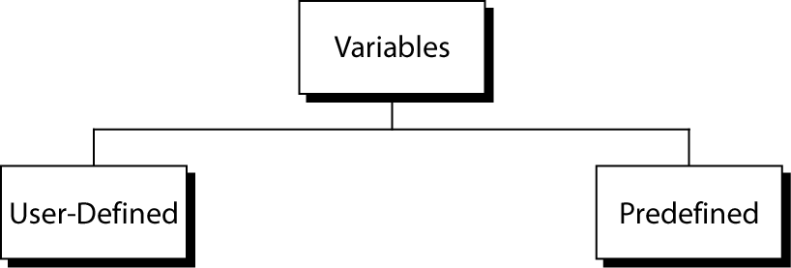
Figure 5-15
Variables

Slide 17
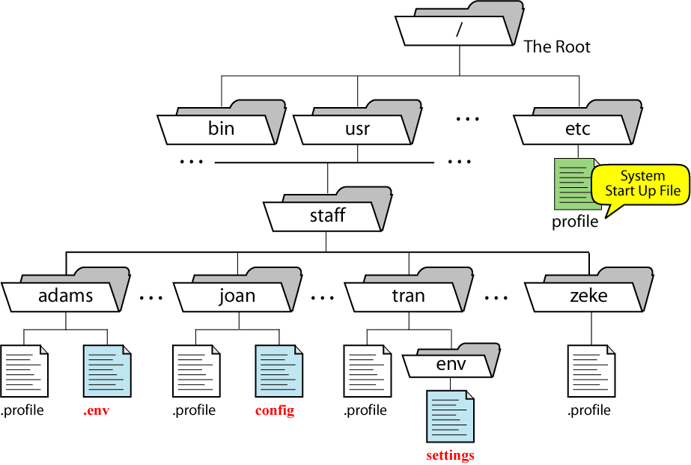
Figure 5-16
Korn’s Environmental File

