Slide 1
Chapter 6
Filters

Slide 2
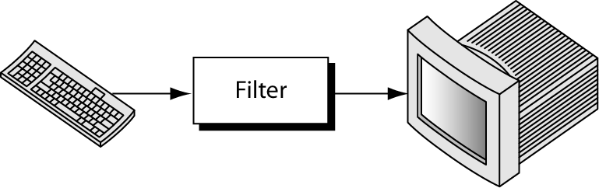
Figure 6-1
Concept Of A Filter

Slide 3
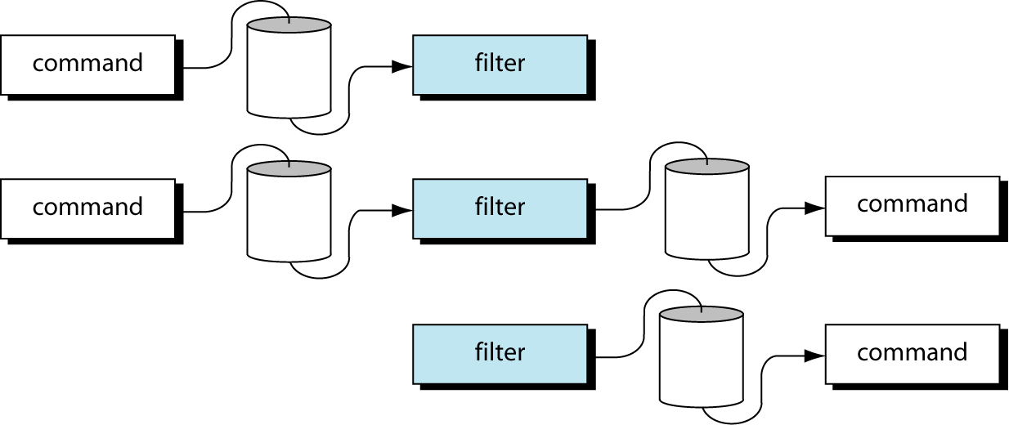
Figure 6-2
Using Filters with Pipes

Slide 4
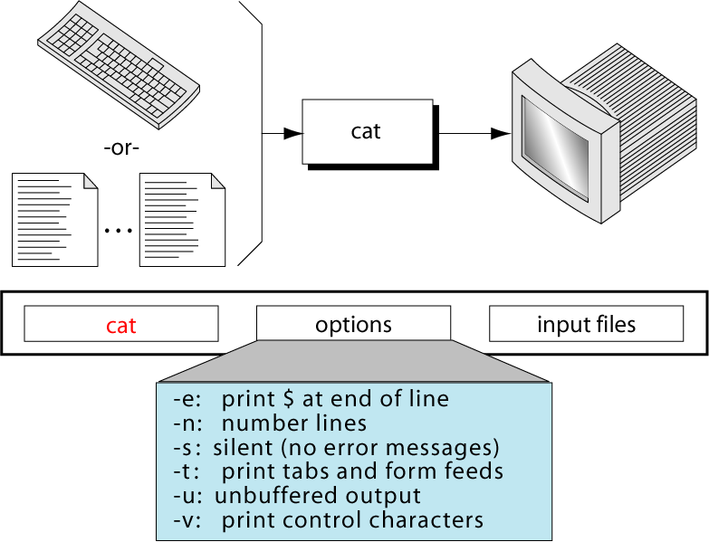
Figure 6-3
The cat Command

Slide 5
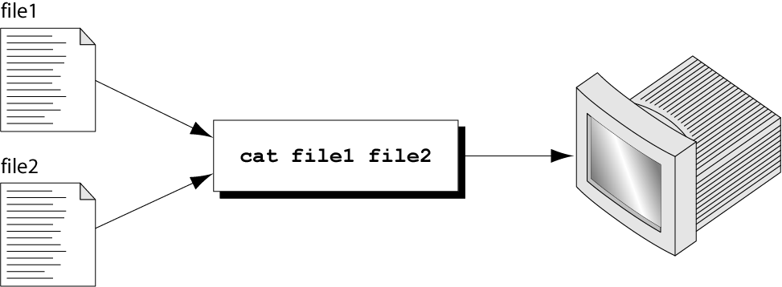
Figure 6-4
Using cat To Combine Files

Slide 6
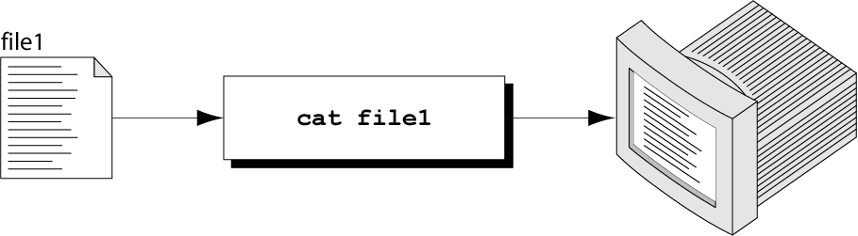
Figure 6-5
Displaying a File with cat

Slide 7
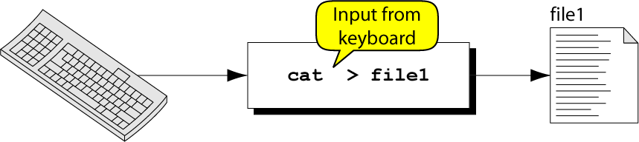
Figure 6-6
Creating A File With cat

Slide 8
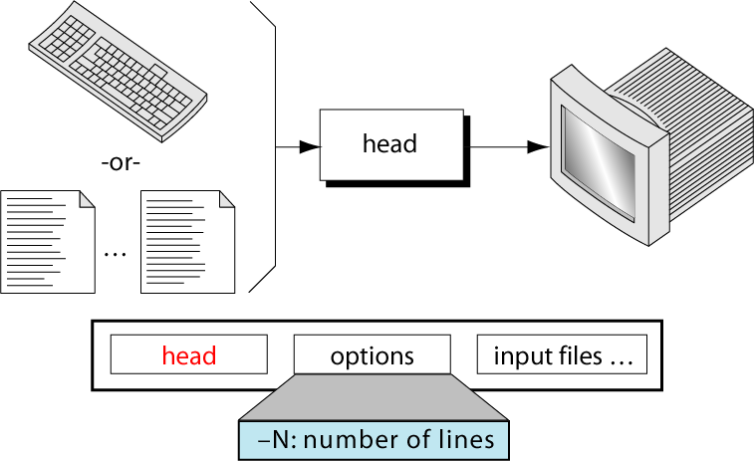
Figure 6-7
The head Command

Slide 9
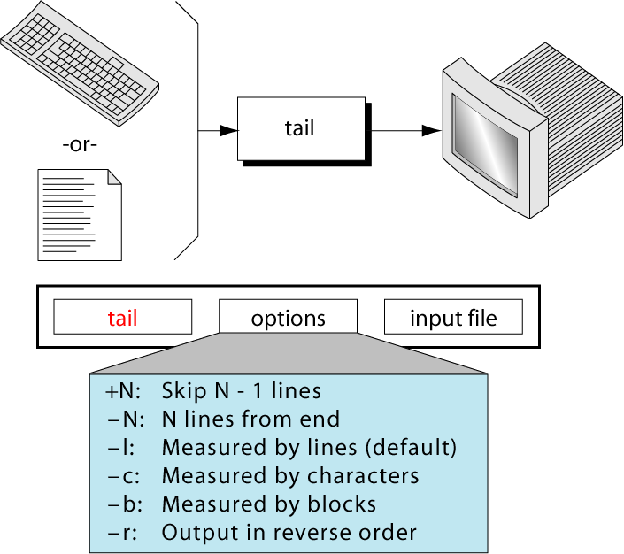
Figure 6-8
The tail Command

Slide 10
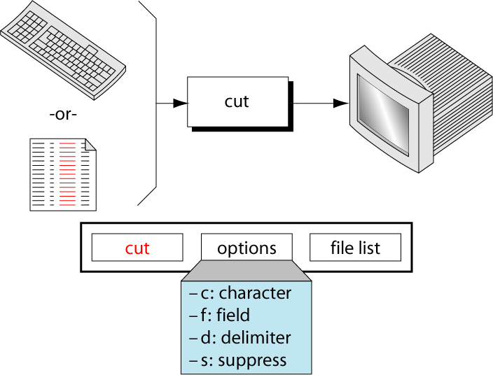
Figure 6-9
The cut Command

Slide 11
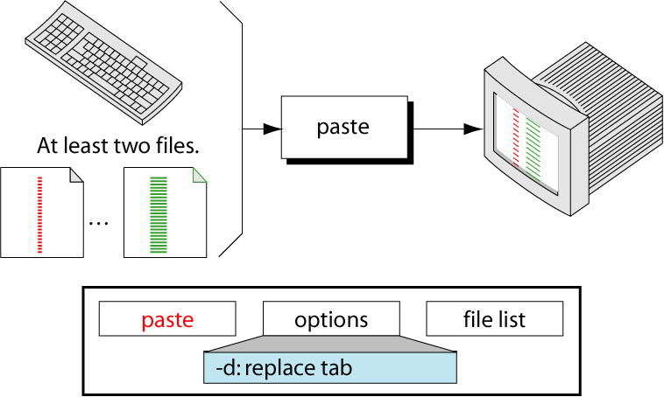
Figure 6-10
The paste Command

Slide 12
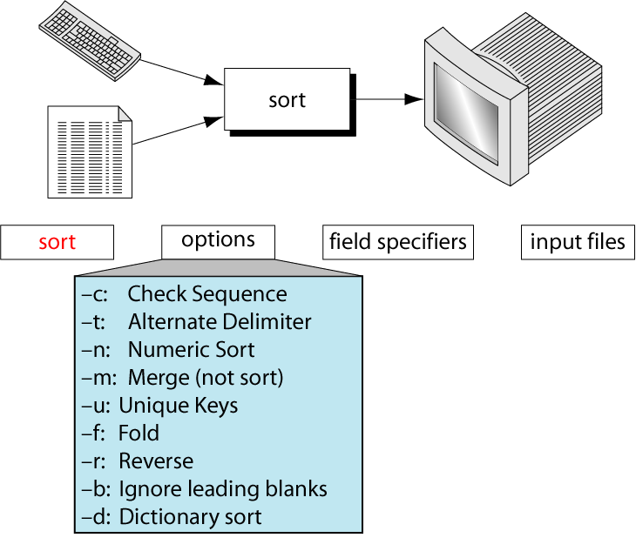
Figure 6-11
The sort Command

Slide 13
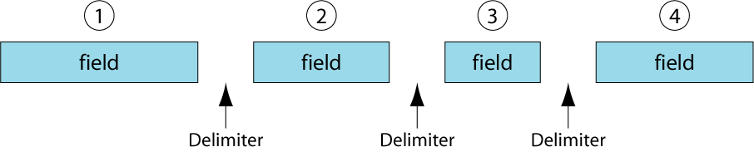
Figure 6-12
Fields Within A Line

Slide 14
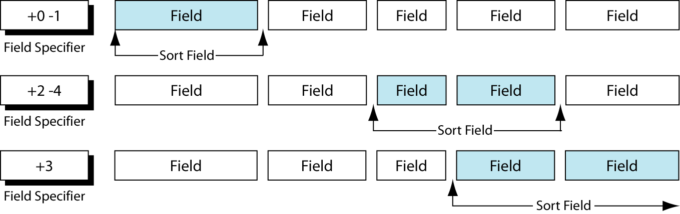
Figure 6-13
Field Specifier Examples

Slide 15
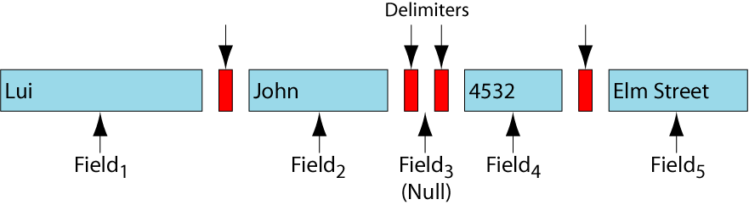
Figure 6-14
Null Field Impact

Slide 16
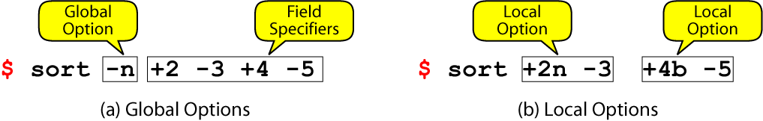
Figure 6-15
Global and Local Options

Slide 17
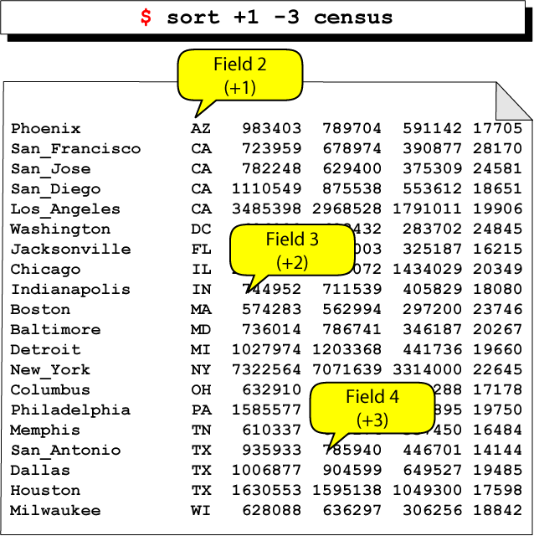
Figure 6-16
Sorting Adjacent Fields

Slide 18
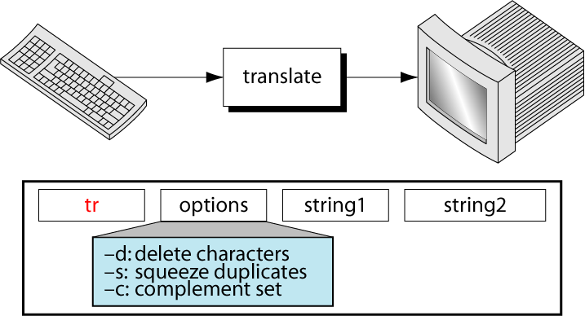
Figure 6-17
The tr Command

Slide 19
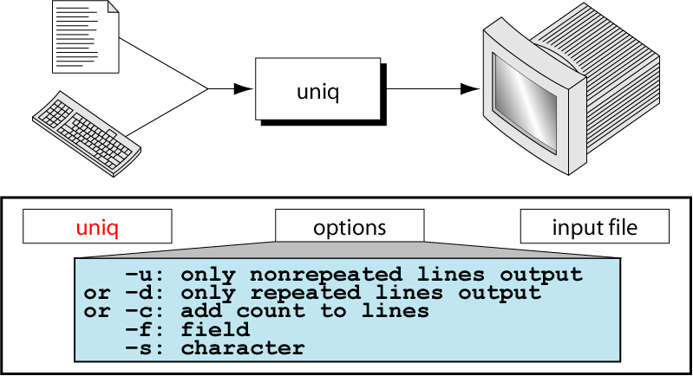
Figure 6-18
The unique Command

Slide 20
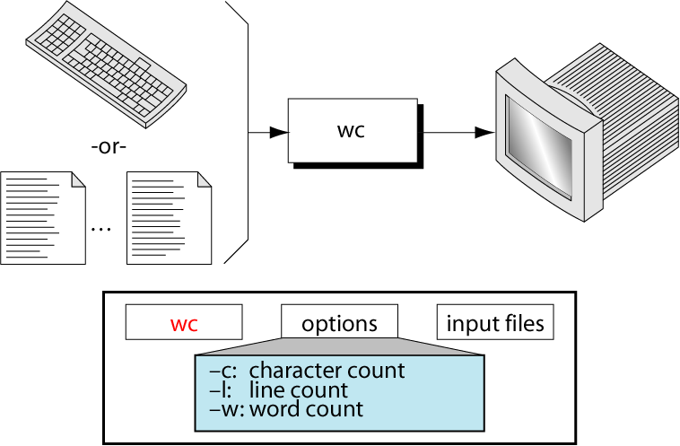
Figure 6-19
The wc Command

Slide 21
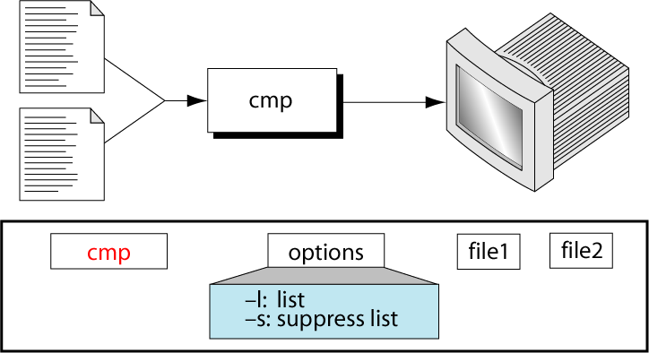
Figure 6-20
The cmp Command

Slide 22
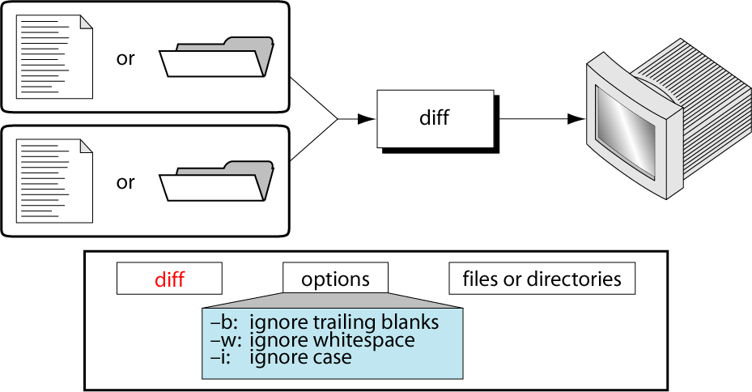
Figure 6-21
The diff Command

Slide 23
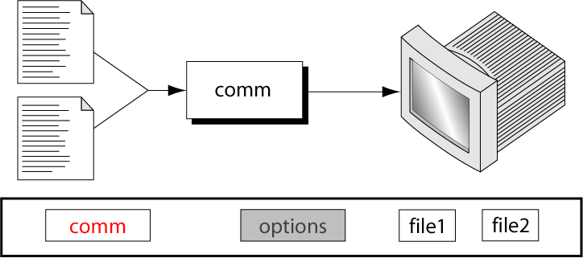
Figure 6-22
The comm Command

