Slide 1
Chapter 7
Communications

Slide 2
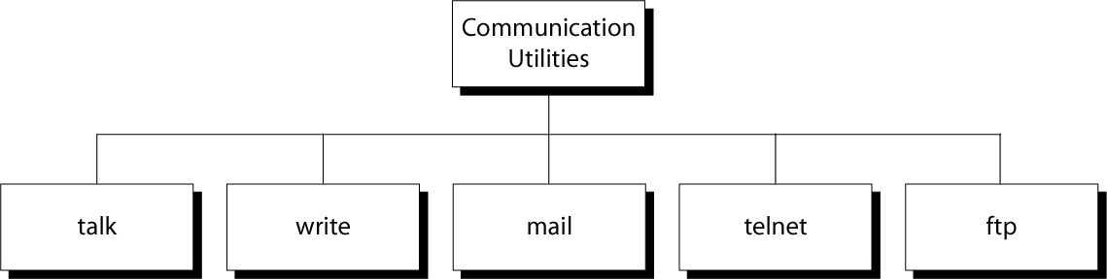
Figure 7-1
Communication Utilities in UNIX

Slide 3
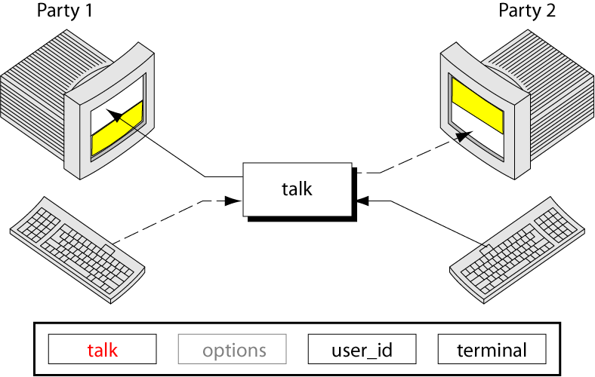
Figure 7-2
The talk Command

Slide 4
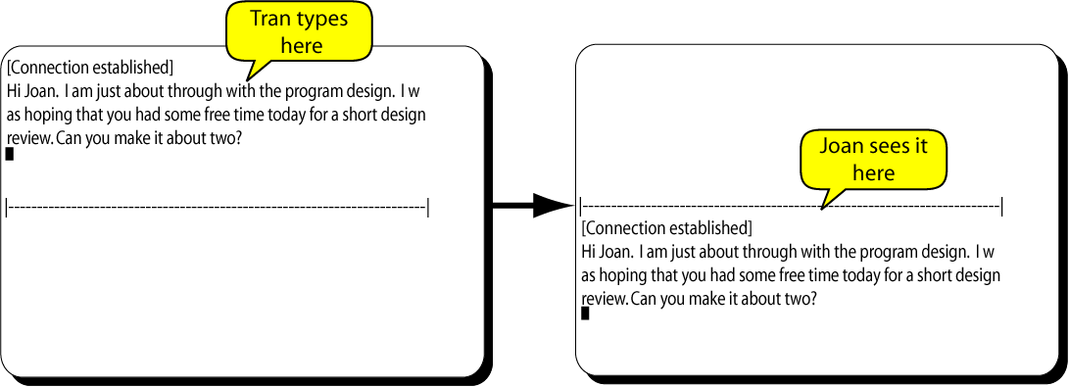
Figure 7-3 (first part)
A Complete talk Session

Slide 5
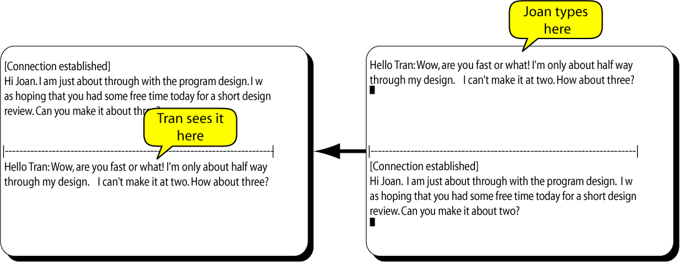
Figure 7-3 (Second Part)
A Complete talk Session

Slide 6
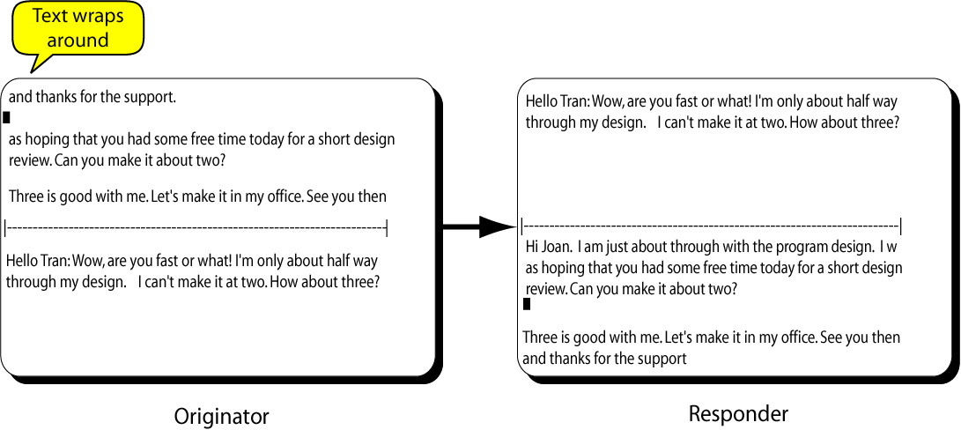
Figure 7-3 (Third Part)
A Complete talk Session

Slide 7
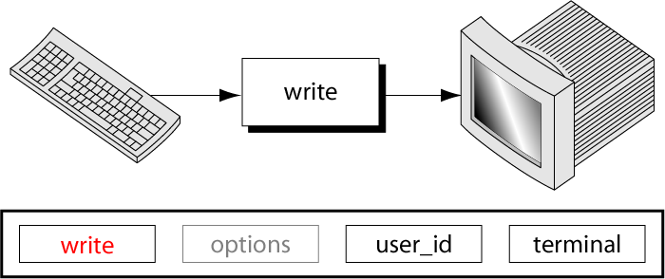
Figure 7-4
The write Command

Slide 8
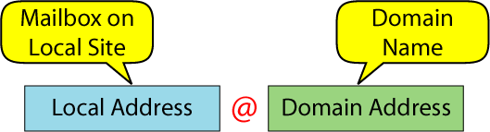
Figure 7-5
Email Address

Slide 9
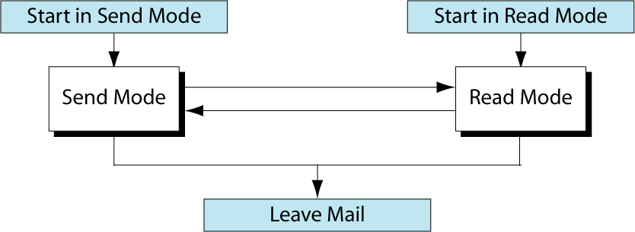
Figure 7-6
The mail System

Slide 10
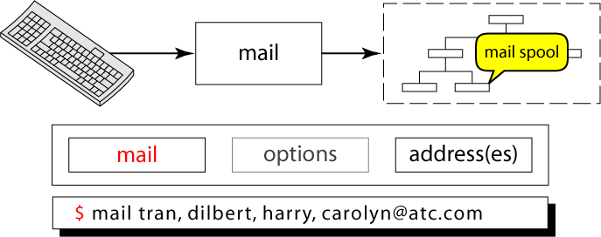
Figure 7-7
The mail Command (Sending Mail)

Slide 11
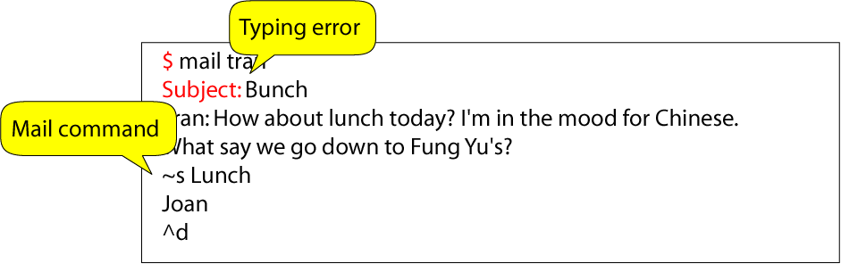
Figure 7-8
Mail Command Example

Slide 12
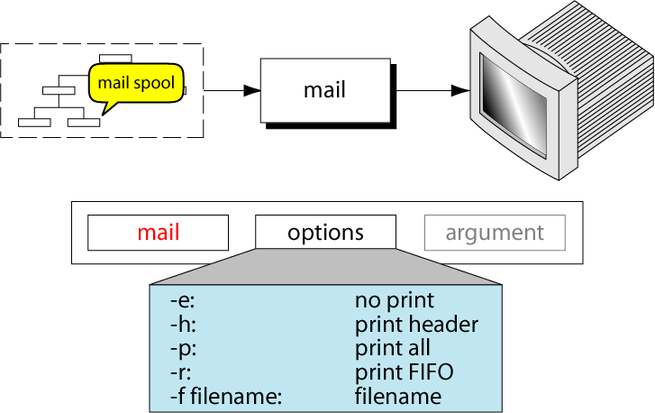
Figure 7-9
The mail Command (Read Mail)

Slide 13
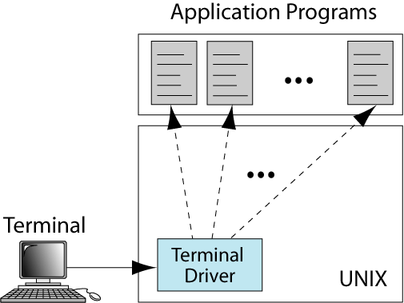
Figure 7-10
Local login

Slide 14
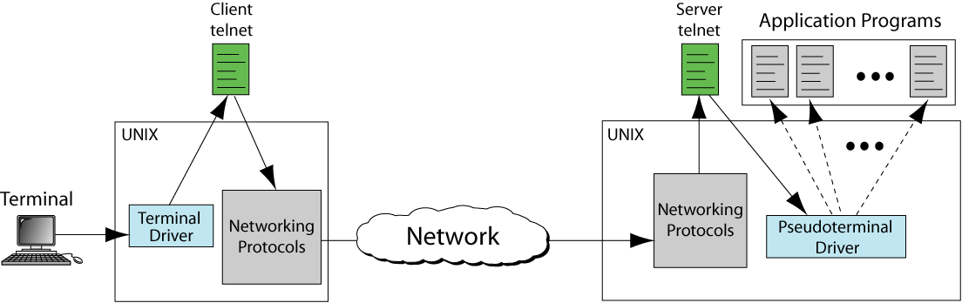
Figure 7-11
Remote Login

Slide 15
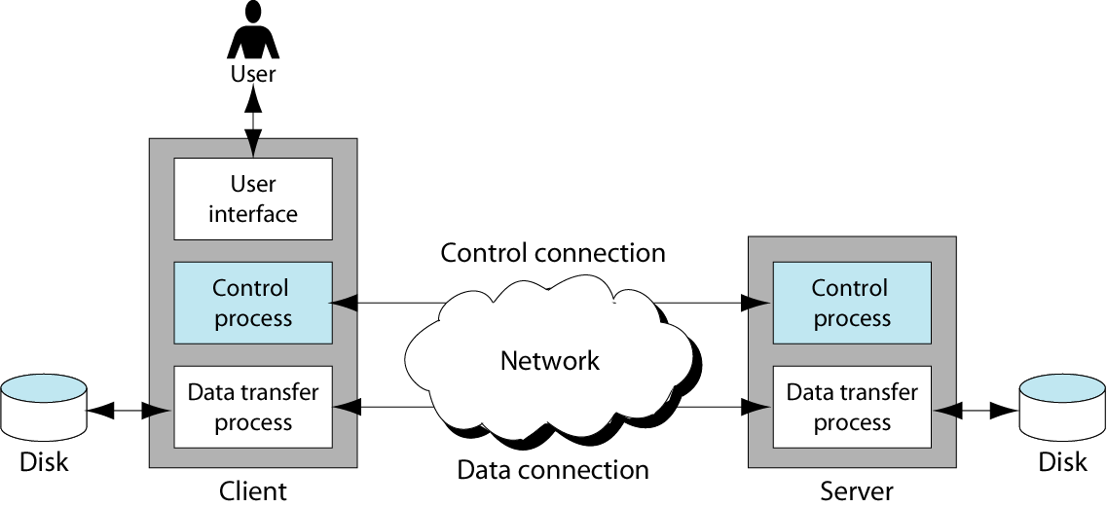
Figure 7-12
File Transfer Protocol

Slide 16
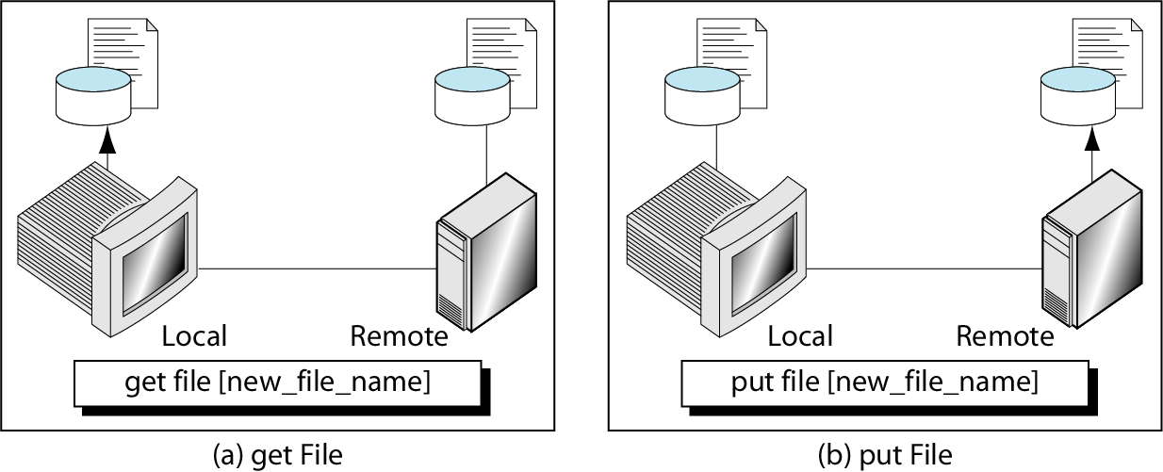
Figure 7-13
get and put Commands

