Slide 1
Chapter 8
vi and ex

Slide 2
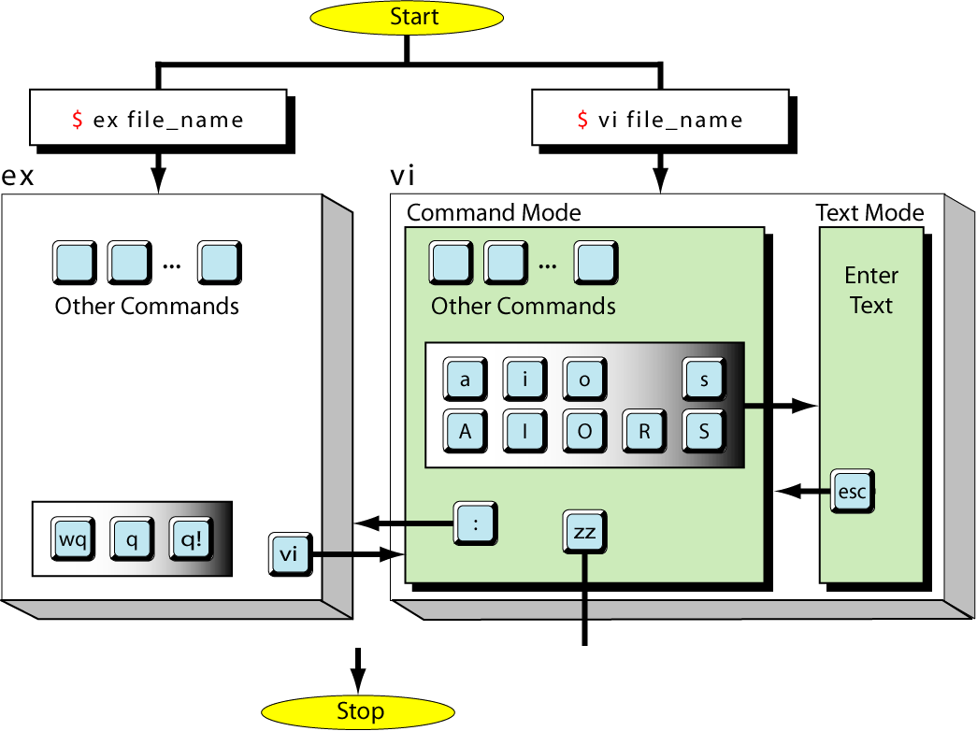
Figure 8-1
The vi and ex Editors

Slide 3
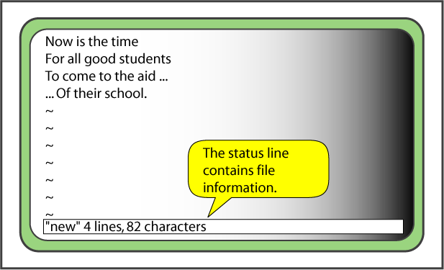
Figure 8-2
A Small File in vi

Slide 4
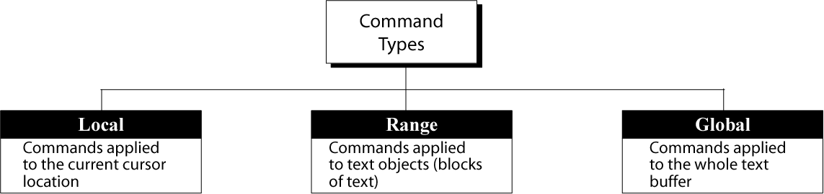
Figure 8-3
vi Commands

Slide 5
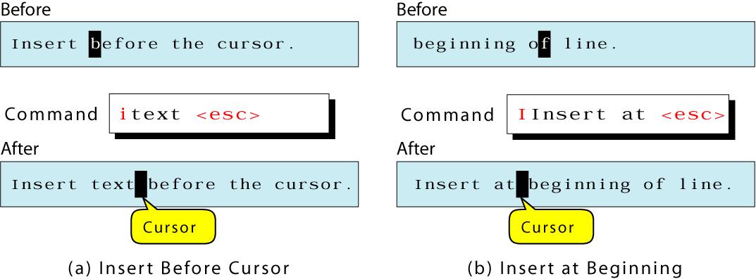
Figure 8-4
Insert Text at Current Character/Line

Slide 6
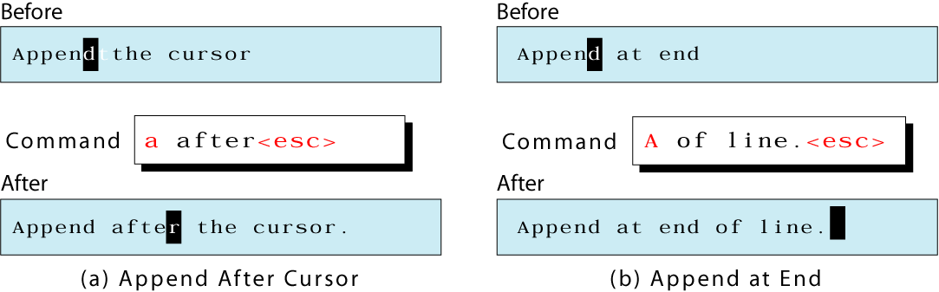
Figure 8-5
Append Text at Current Character/Line

Slide 7
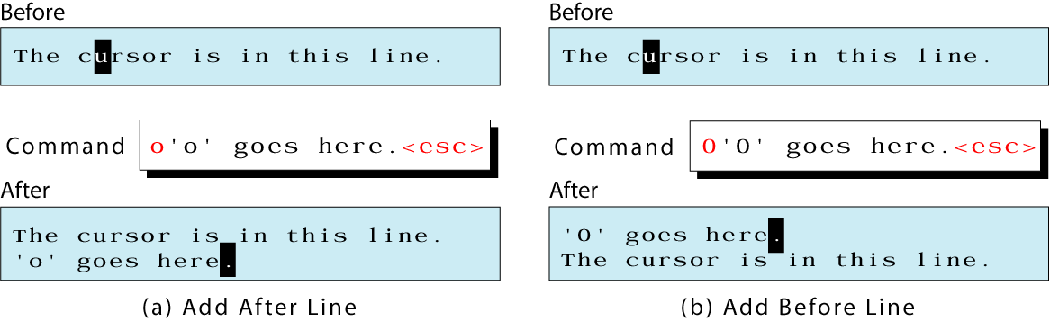
Figure 8-6
The New Line Commands

Slide 8
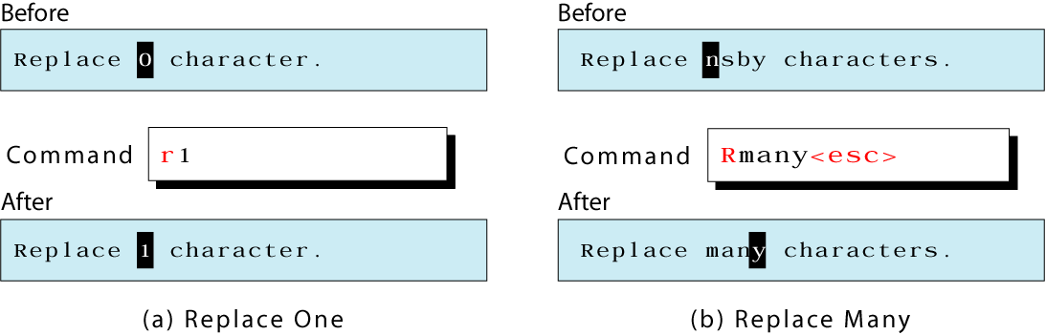
Figure 8-7
Replace Commands

Slide 9
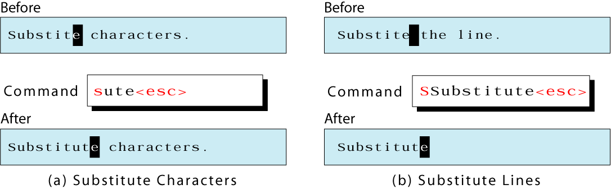
Figure 8-8
Substitute Commands

Slide 10
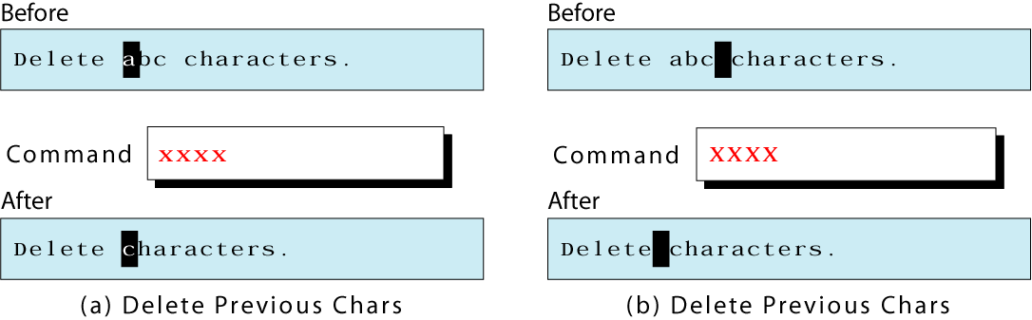
Figure 8-9
Delete Character Commands

Slide 11
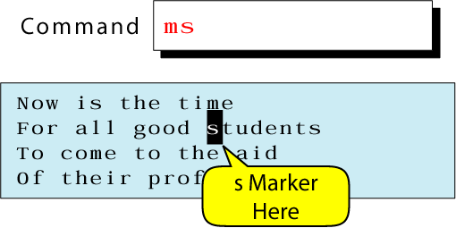
Figure 8-10
Mark Location

Slide 12
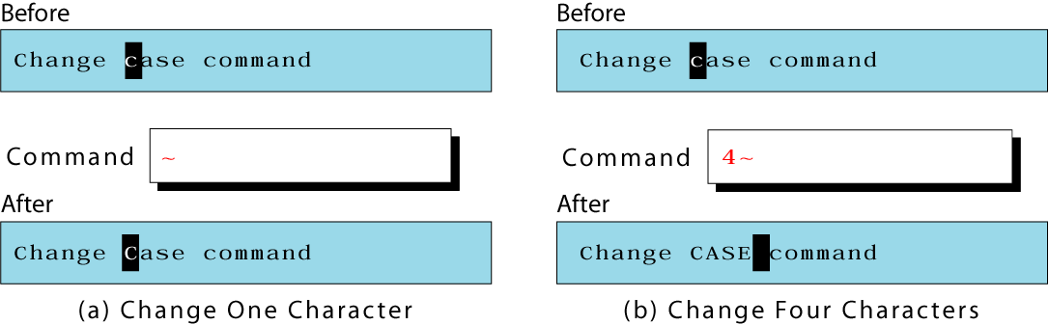
Figure 8-11
Change Case

Slide 13
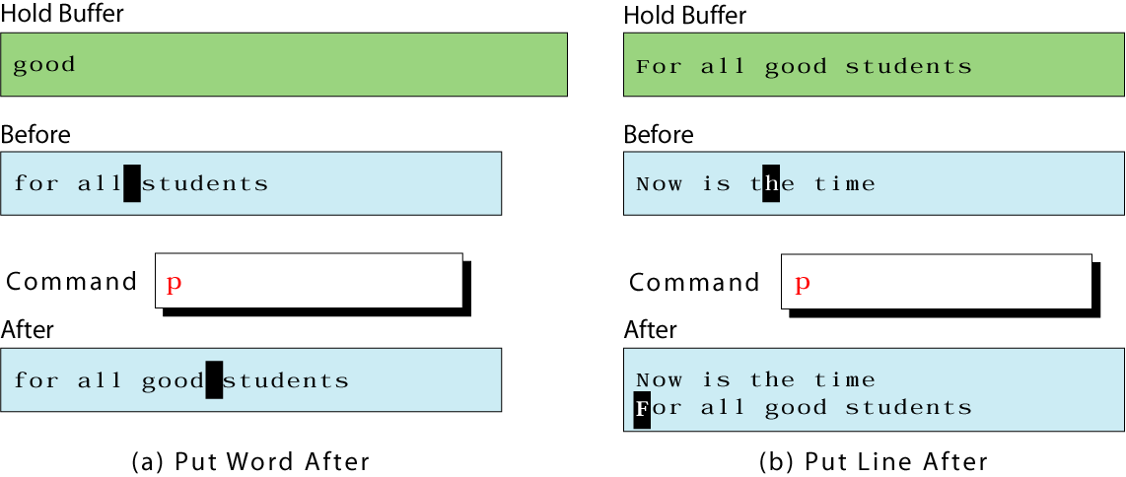
Figure 8-12
Put Command

Slide 14
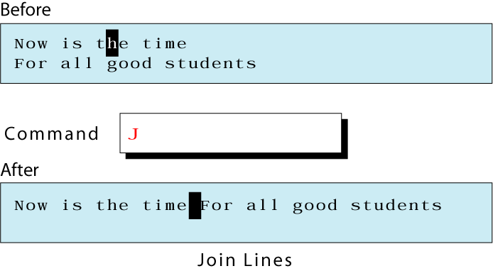
Figure 8-13
Join Command

Slide 15
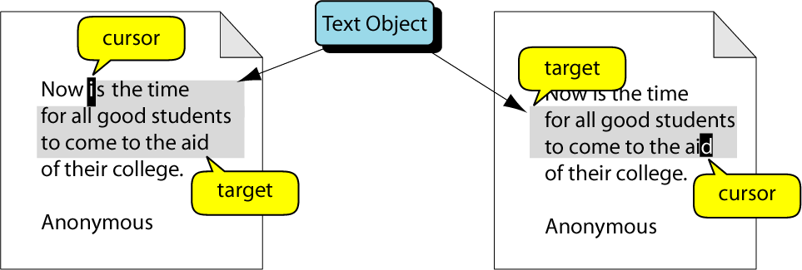
Figure 8-14
Range Command Scope

Slide 16
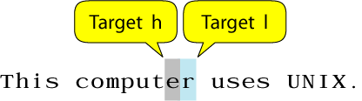
Figure 8-15
Character Objects

Slide 17
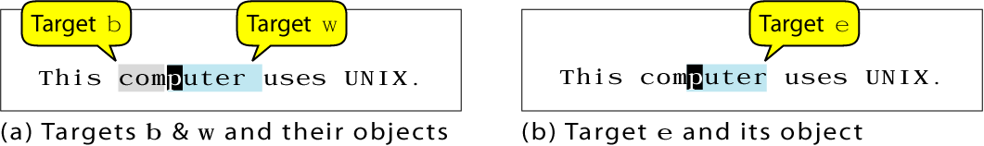
Figure 8-16
Word Objects

Slide 18
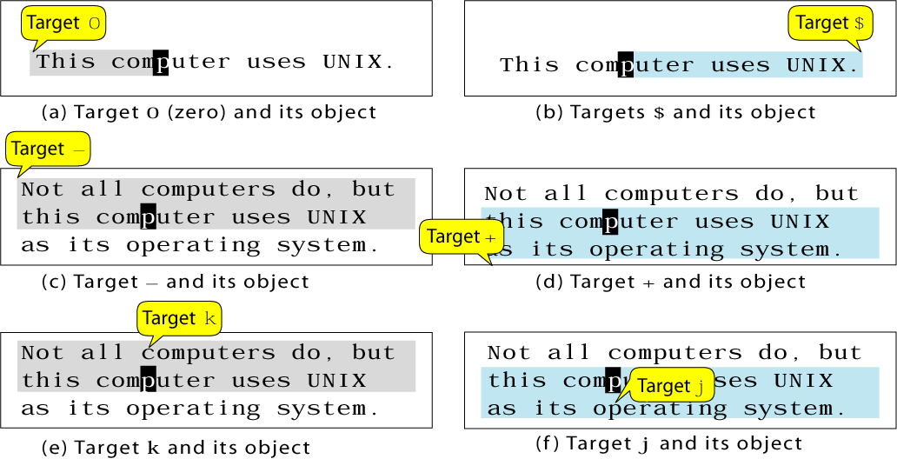
Figure 8-17
Line Objects

Slide 19
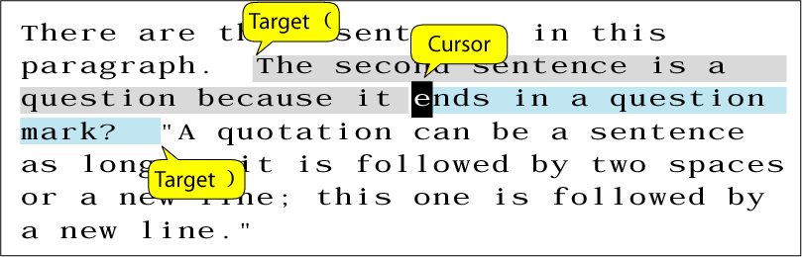
Figure 8-18
Sentence Objects

Slide 20
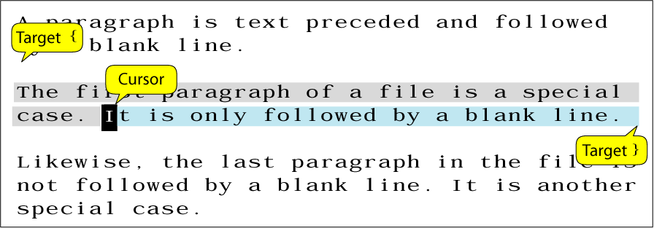
Figure 8-19
Paragraph Objects

Slide 21
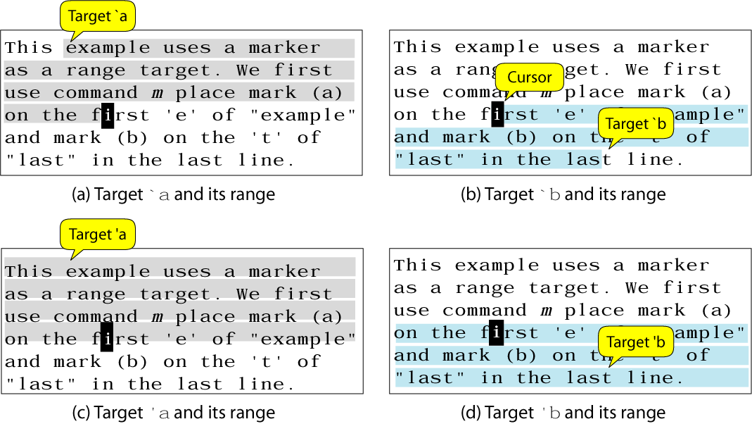
Figure 8-20
Block Objects

Slide 22
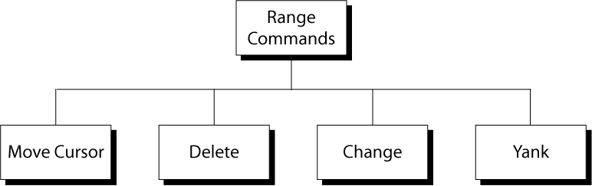
Figure 8-21
Range Commands

Slide 23
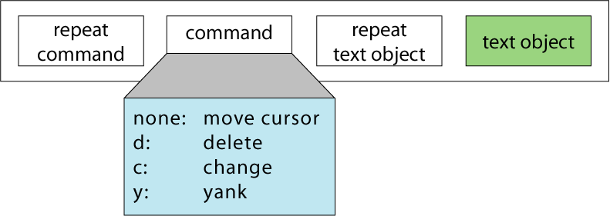
Figure 8-22
Range Command Format

Slide 24

Figure 8-23
ex Instruction Format

Slide 25
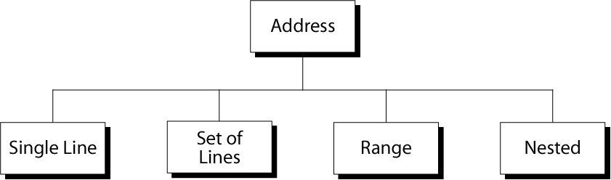
Figure 8-24
ex Addresses

Slide 26
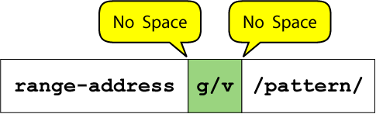
Figure 8-25
Nested Addresses

