Slide 1
Chapter 9
Regular
Expressions

Slide 2
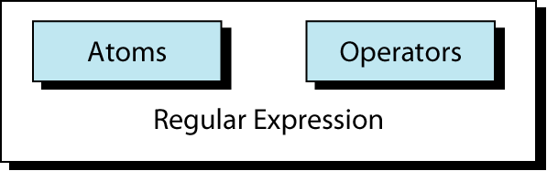
Figure 9-1
Regular Expression

Slide 3
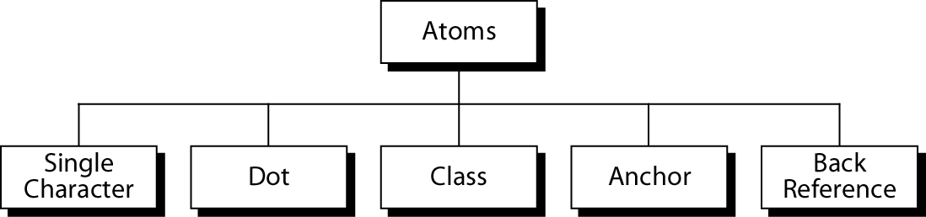
Figure 9-2
Atoms

Slide 4
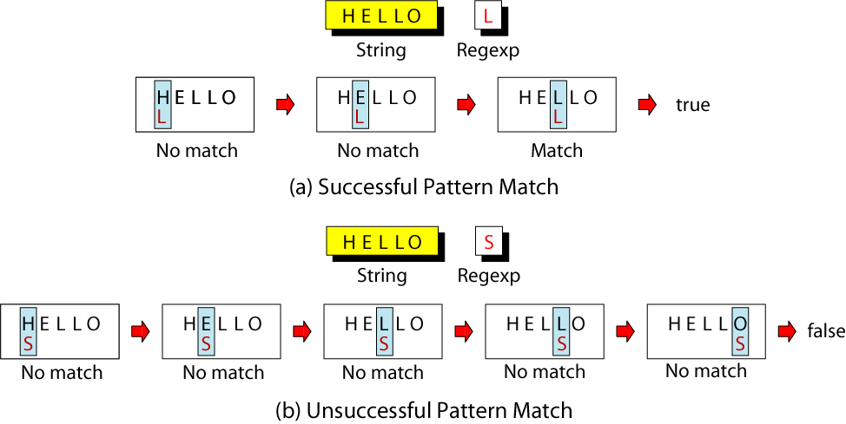
Figure 9-3
Single-Character Pattern Example

Slide 5
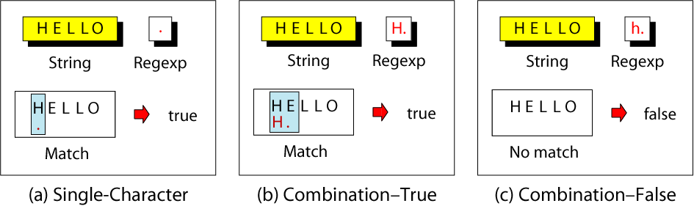
Figure 9-4
Dot Atom Example

Slide 6
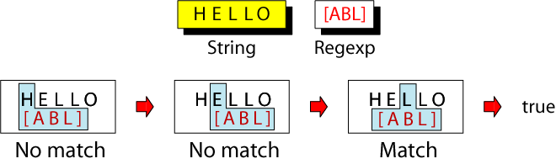
Figure 9-5
Class Atom Example

Slide 7
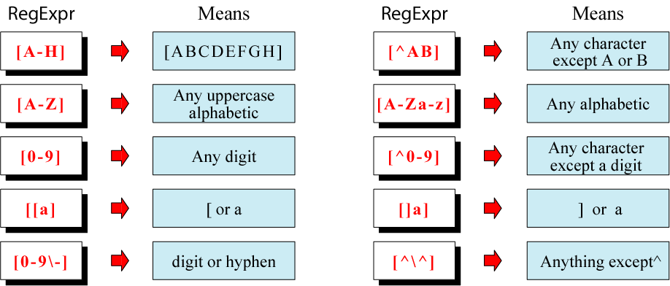
Figure 9-6
Example of Classes

Slide 8
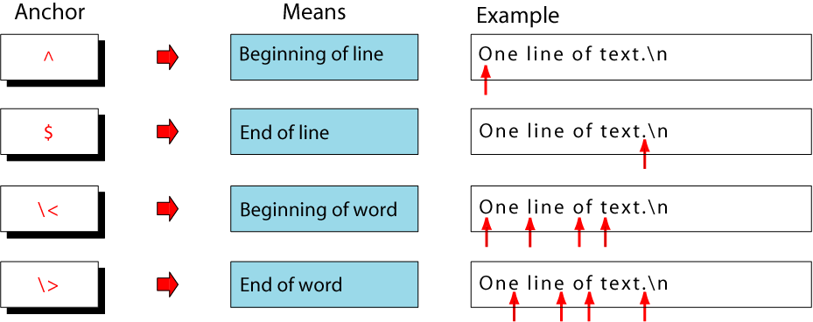
Figure 9-7
Anchors

Slide 9
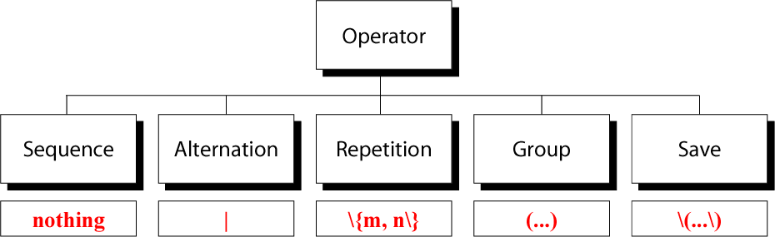
Figure 9-8
Operators

Slide 10
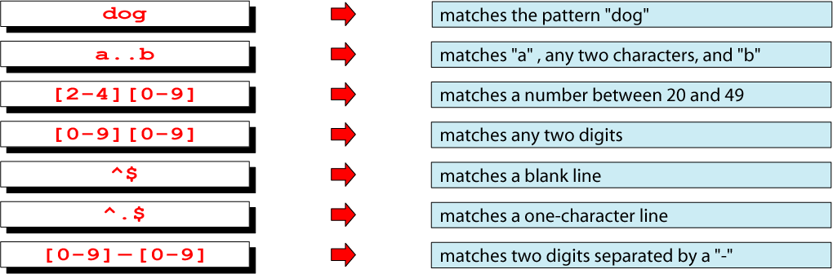
Figure 9-9
Example of Sequence Operator

Slide 11
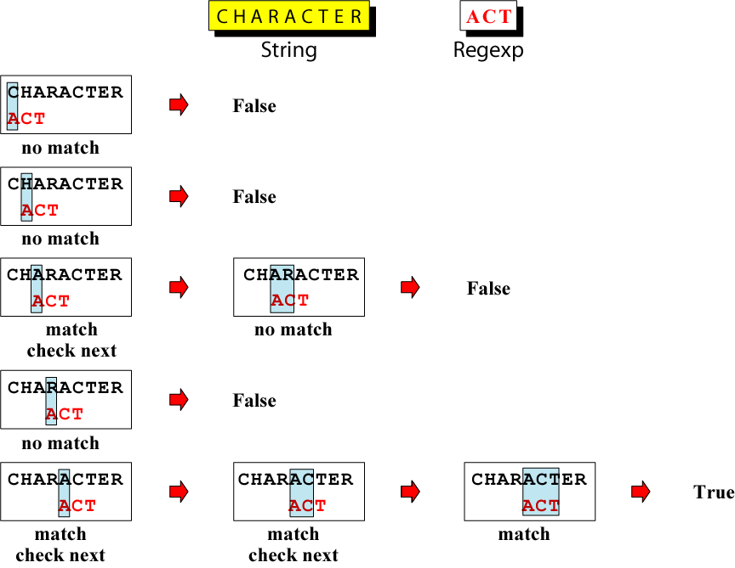
Figure 9-10
Evaluation of a String
Using Sequence Operator

Slide 12

Figure 9-11
Alternation Operator

Slide 13
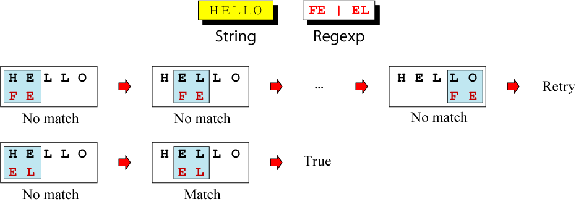
Figure 9-12
Matching Alternation Operators

Slide 14
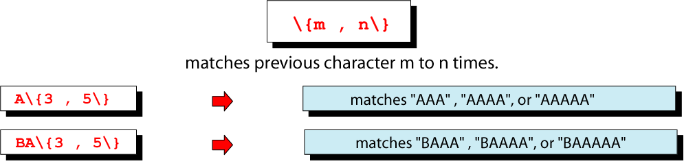
Figure 9-13
Repetition Operator

Slide 15
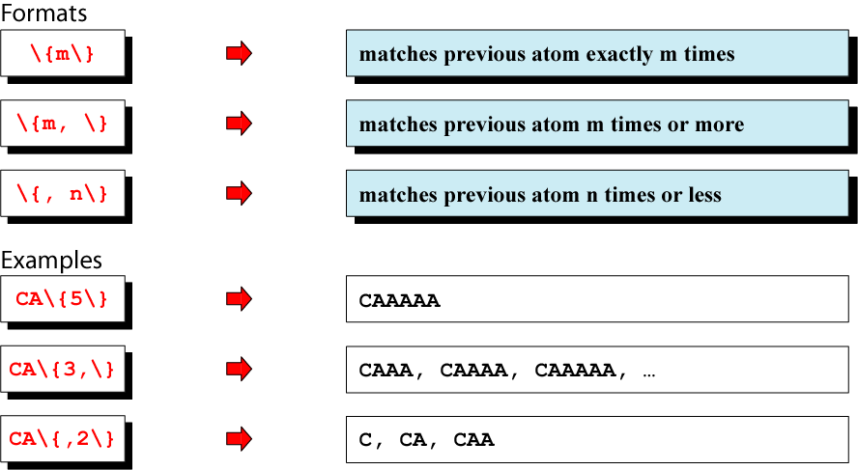
Figure 9-14
Basic Repetition Forms

Slide 16
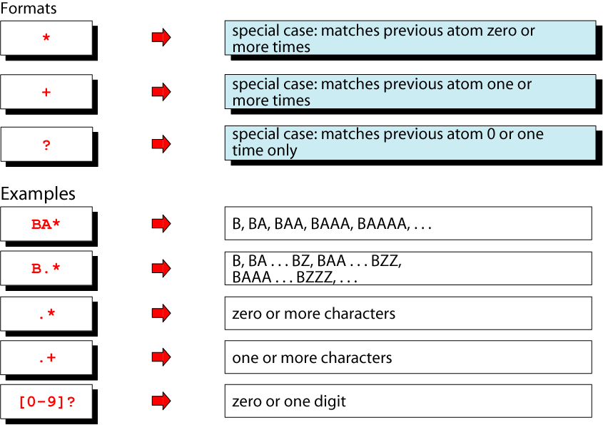
Figure 9-15
Example of Short Form
Repetition Operators

Slide 17
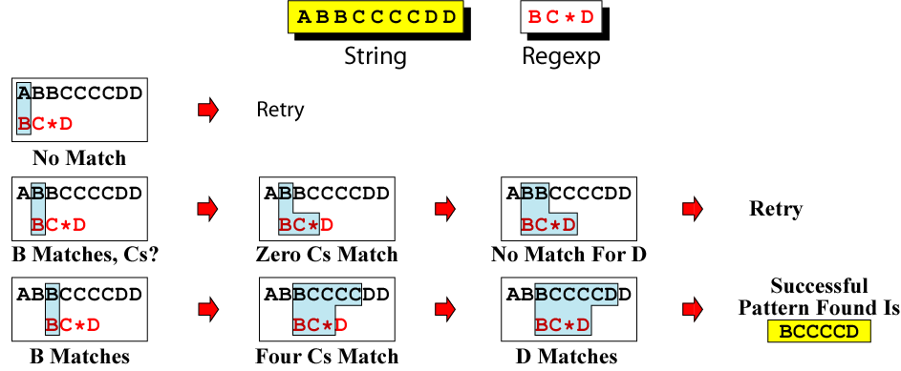
Figure 9-16
Repeating Pattern Matching

Slide 18
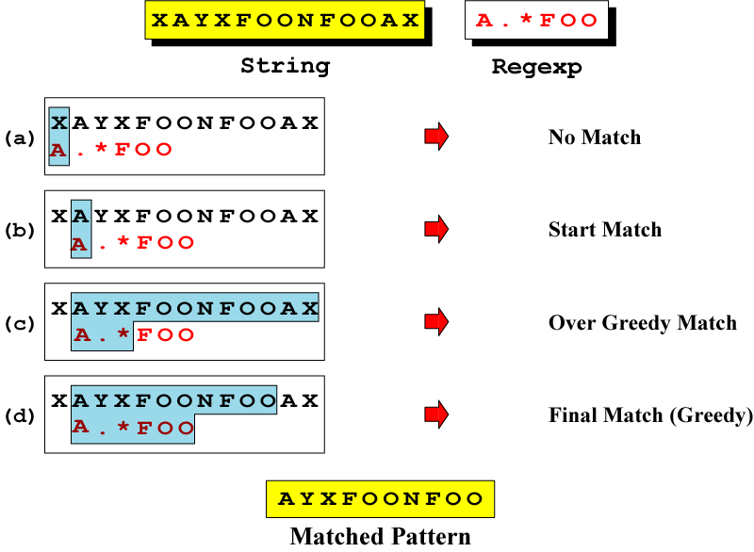
Figure 9-17
Greedy Matching

Slide 19
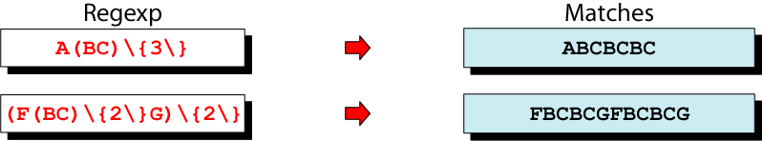
Figure 9-18
Group Operator

Slide 20
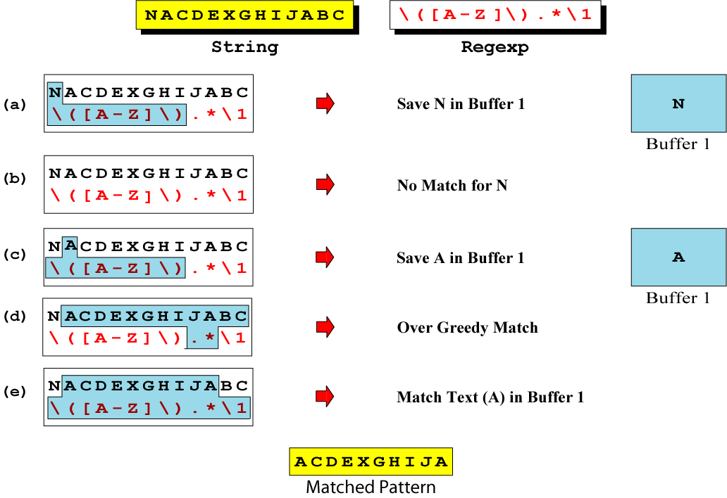
Figure 9-19
Saving

