Slide 1
Chapter 10
grep

Slide 2
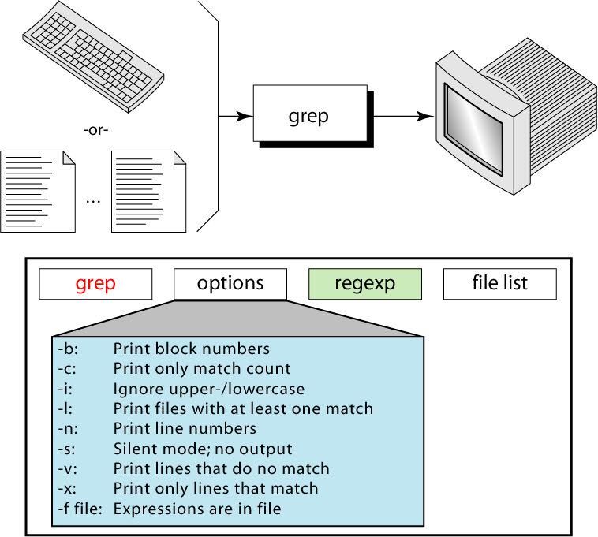
Figure 10-1
grep

Slide 3
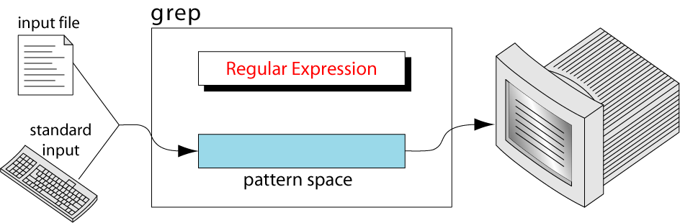
Figure 10-2
grep Operation

Slide 4
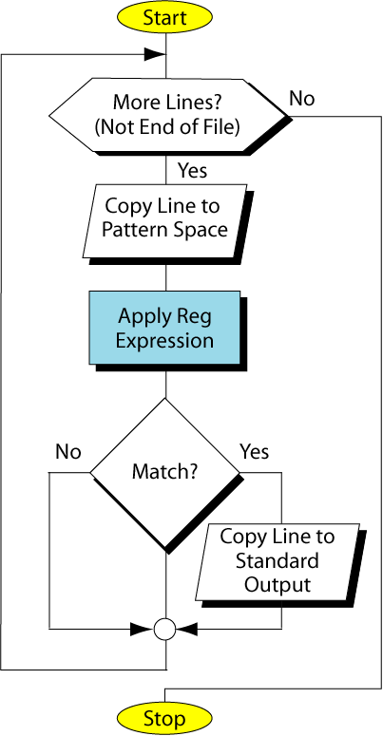
Figure 10-3
grep
Flowchart

Slide 5
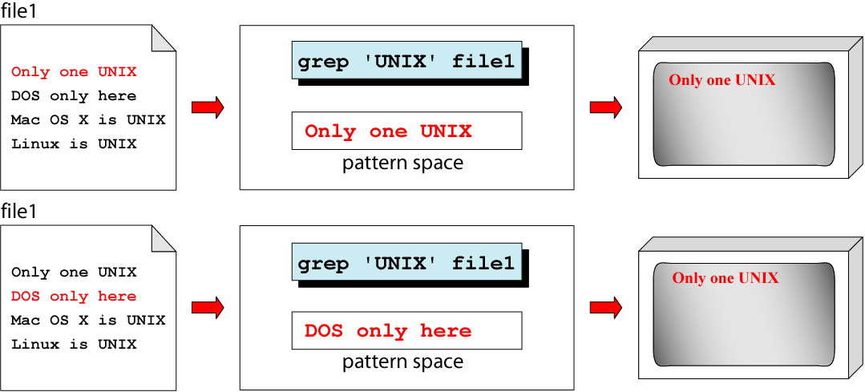
Figure 10-4 (part I)
grep Example

Slide 6
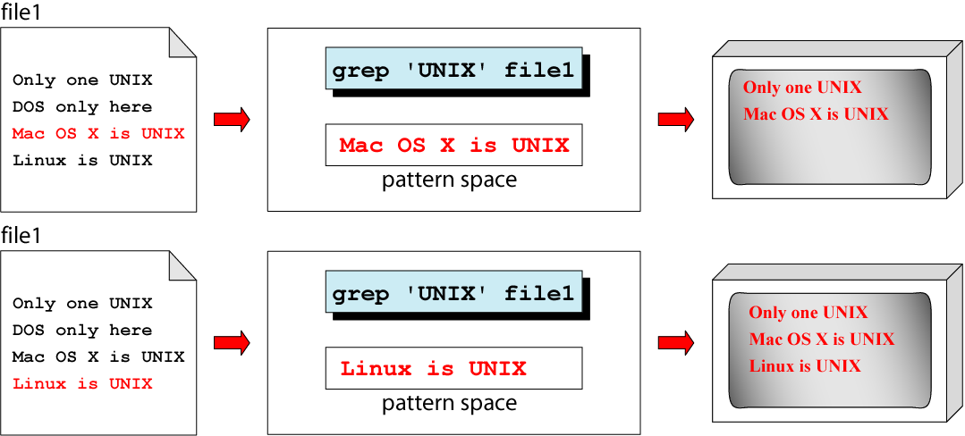
Figure 10-4 (part II)
Example

Slide 7
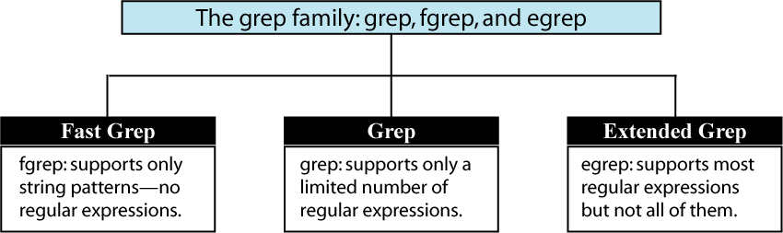
Figure 10-5
The grep Family

