Slide 1
Chapter 11
sed

Slide 2
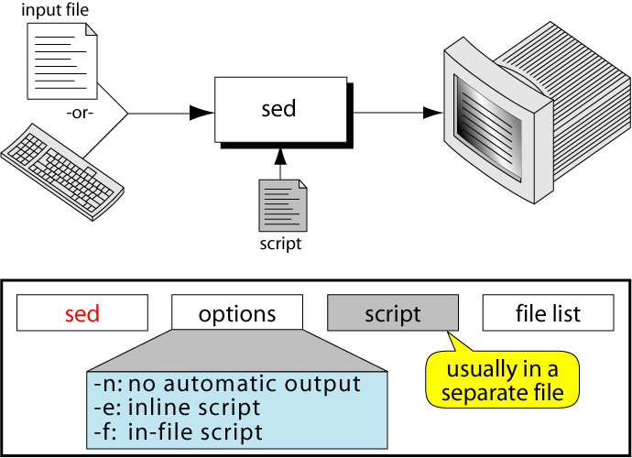
Figure 11-1
The sed Command

Slide 3
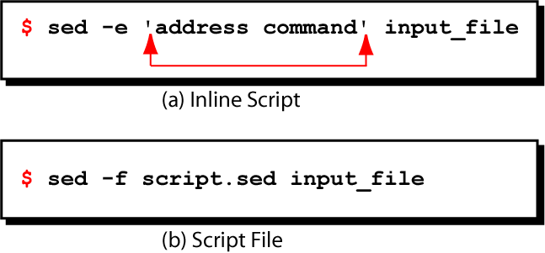
Figure 11-2
Example of sed Scripts

Slide 4
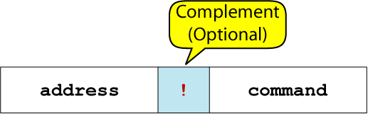
Figure 11-3
Instruction Format

Slide 5
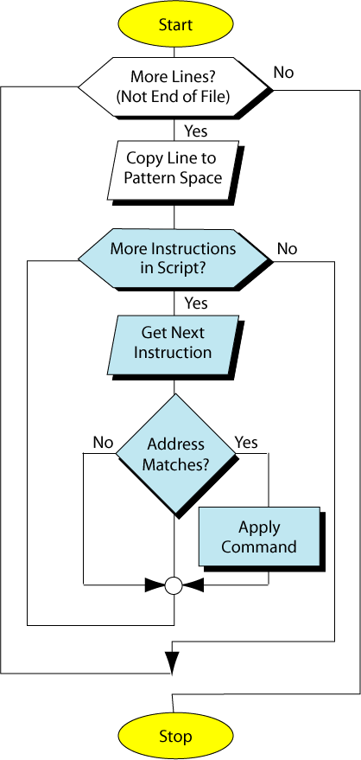
Figure 11-4
Processing
Flow

Slide 6
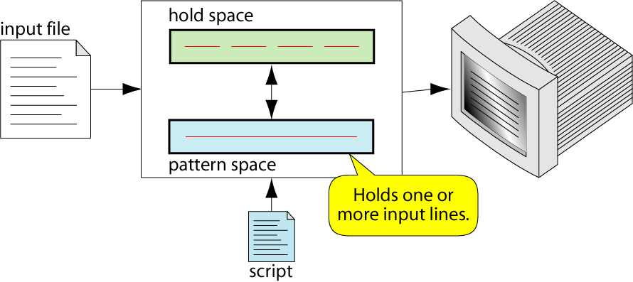
Figure 11-5
sed Operation

Slide 7
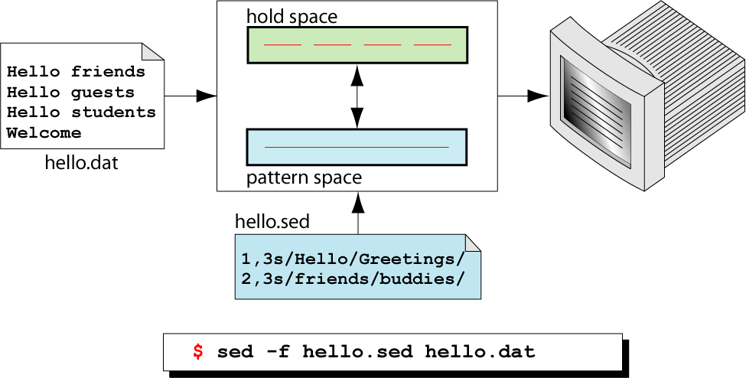
Figure 11-6
Script Execution

Slide 8
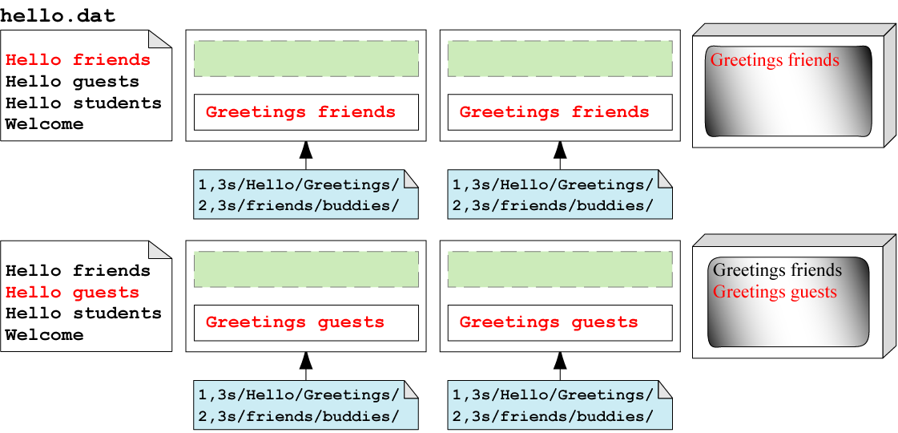
Figure 11-7- Part I
Trace Script Execution

Slide 9
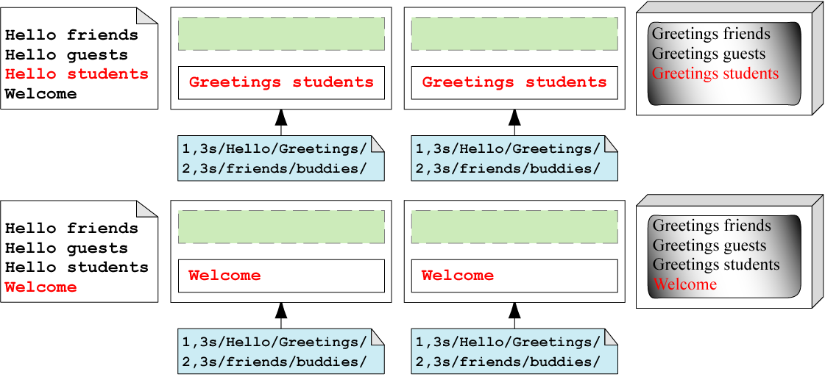
Figure 11-7 –Part II
Trace Script Execution

Slide 10
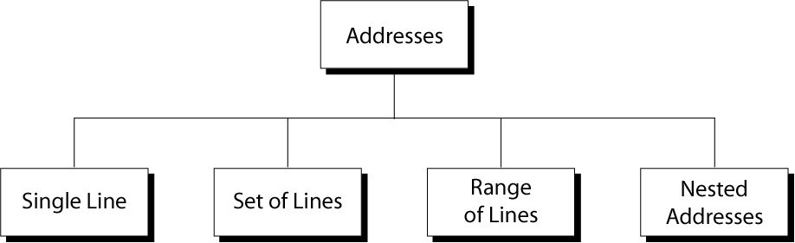
Figure 11-8
Line Addresses in sed

Slide 11
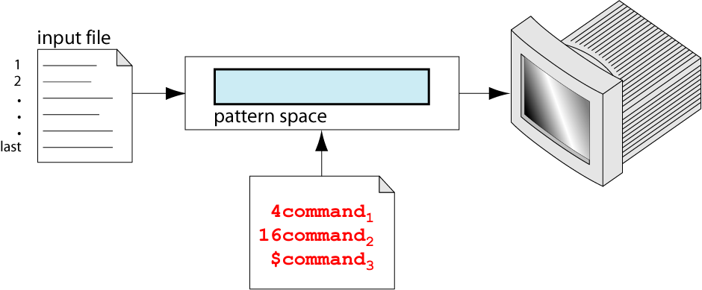
Figure 11-9
Single-Line Address

Slide 12
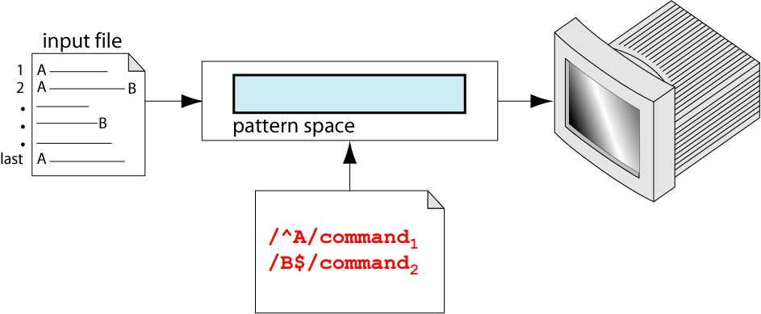
Figure 11-10
Set-of-Line Addresses

Slide 13
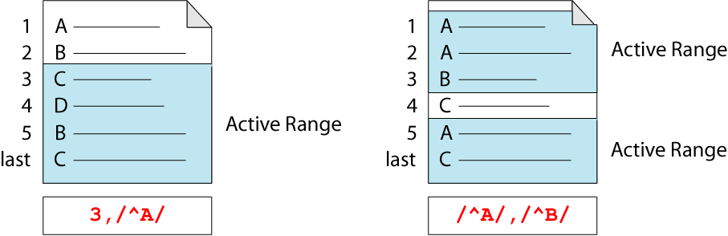
Figure 11-11
Address Range

Slide 14
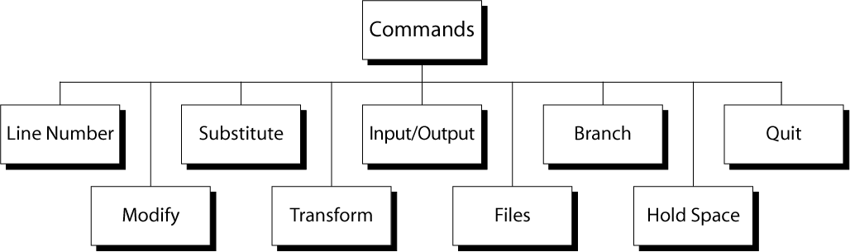
Figure 11-12
Commands

Slide 15
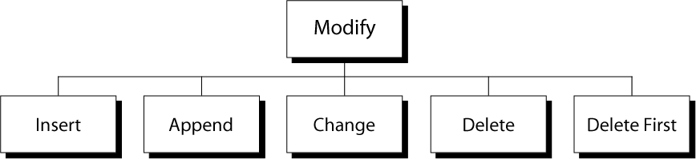
Figure 11-13
Modify Commands

Slide 16
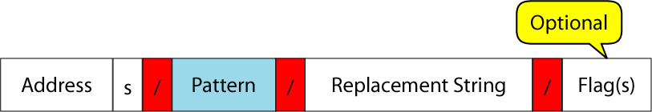
Figure 11-14
Substitute Command

Slide 17
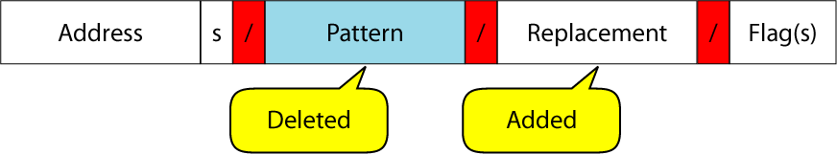
Figure 11-15
Substitute Operation

Slide 18
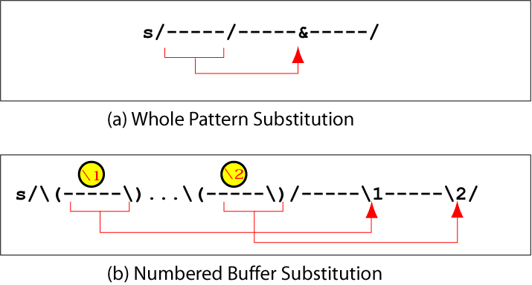
Figure 11-16
Substitution Back References

Slide 19
Figure 11-17
Translate Format

Slide 20
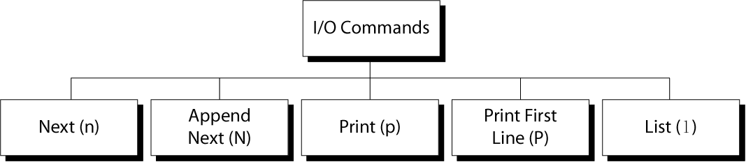
Figure 11-18
sed Input/Output Commands

Slide 21
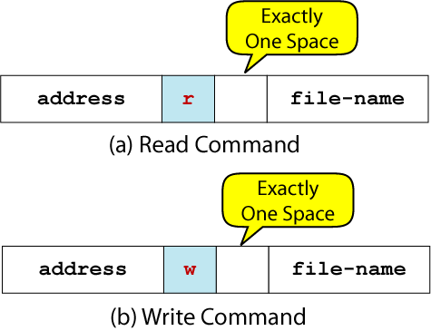
Figure 11-19
Read and Write Command Formats

Slide 22
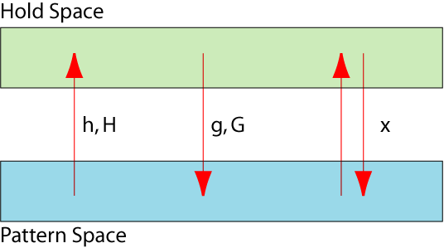
Figure 11-20
Hold Space Operations

