Slide 1
Chapter 12
AWK

Slide 2
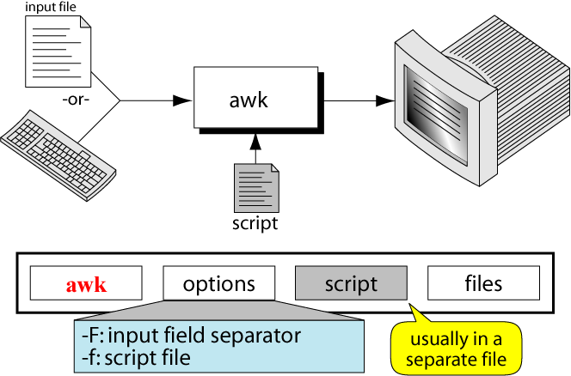
Figure 12-1
The awk Concept

Slide 3
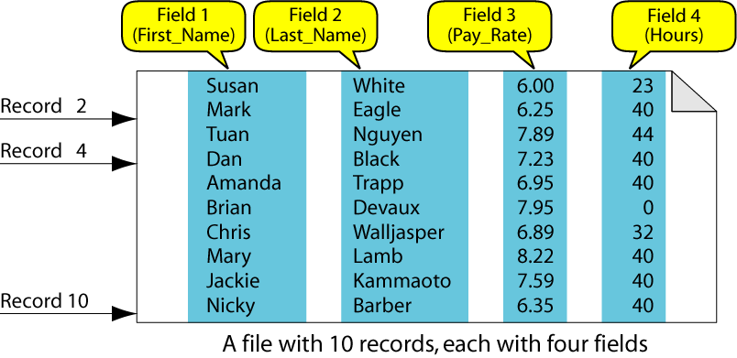
Figure 12-2
A Data File

Slide 4
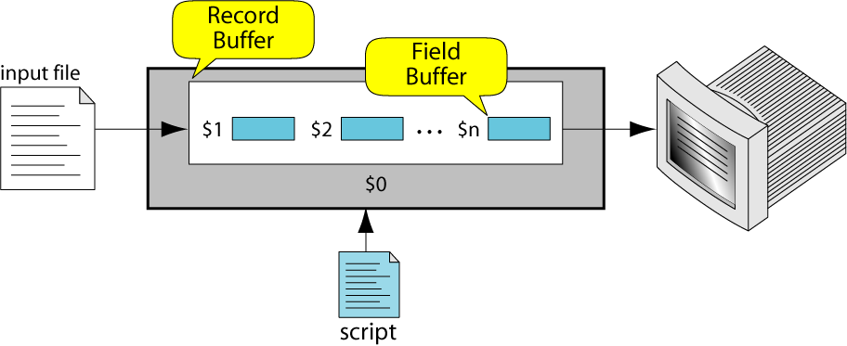
Figure 12-3
awk Buffers

Slide 5
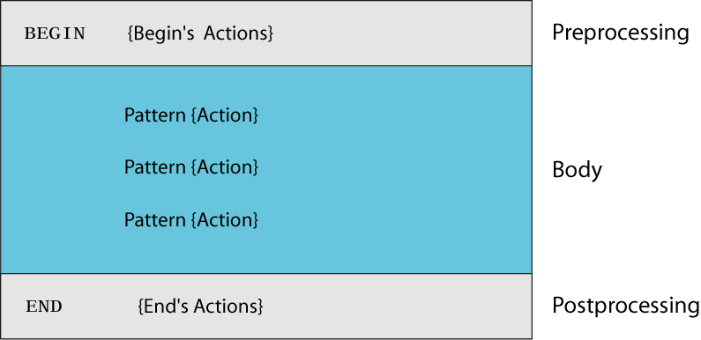
Figure 12-4
awk Script Design

Slide 6
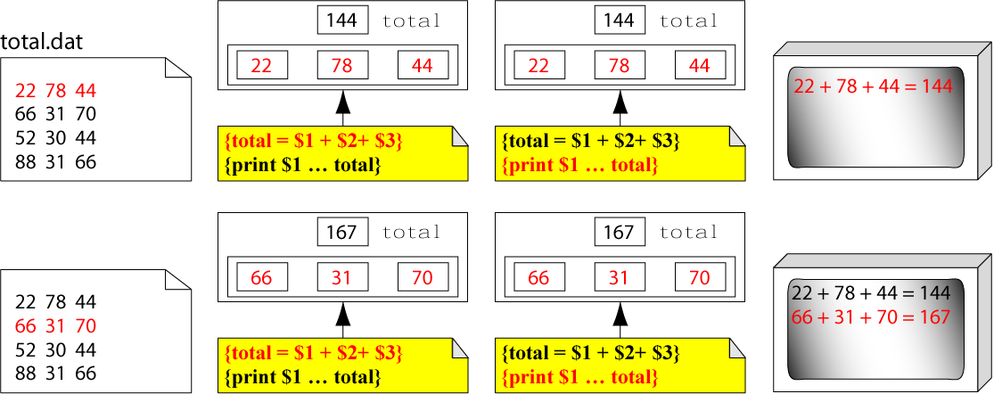
Figure 12-5-Part I
Example 1 Execution

Slide 7
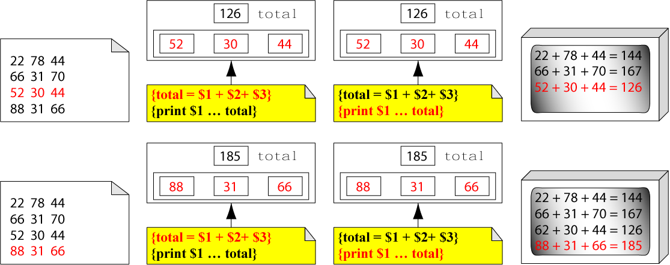
Figure 12-5-Part II
Example 1 Execution

Slide 8
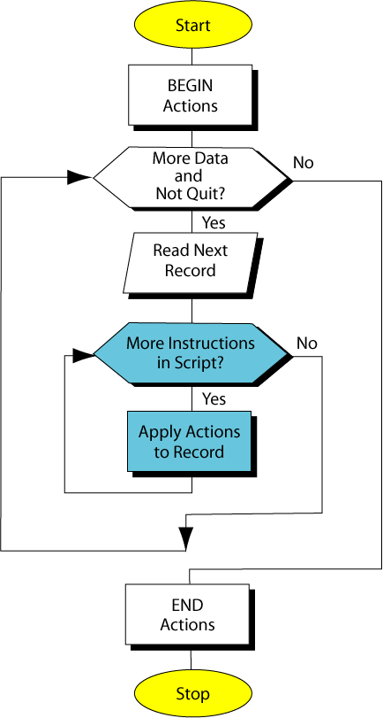
Figure 12-6
awk Process Flow

Slide 9
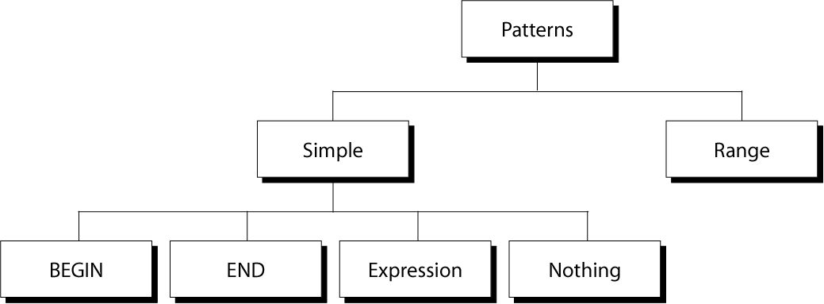
Figure 12-7
Categories of Patterns

Slide 10
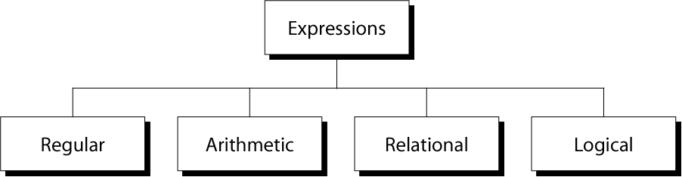
Figure 12-8
awk Expressions

Slide 11
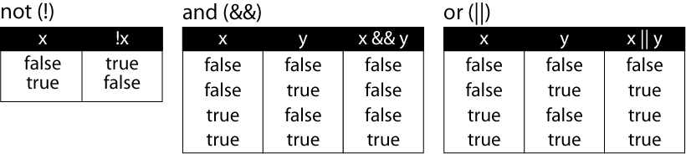
Figure 12-9
Logical Expression Truth Table

Slide 12
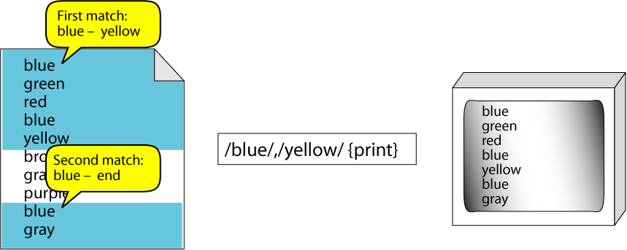
Figure 12-10
Range Patterns

Slide 13
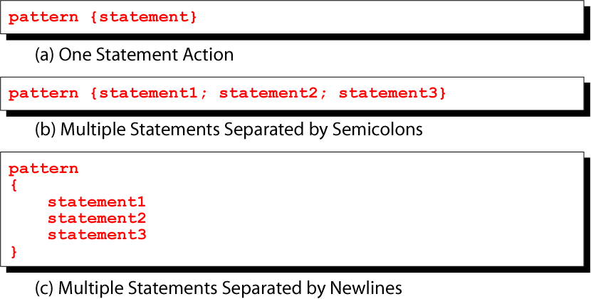
Figure 12-11
Pattern/Action Syntax

Slide 14
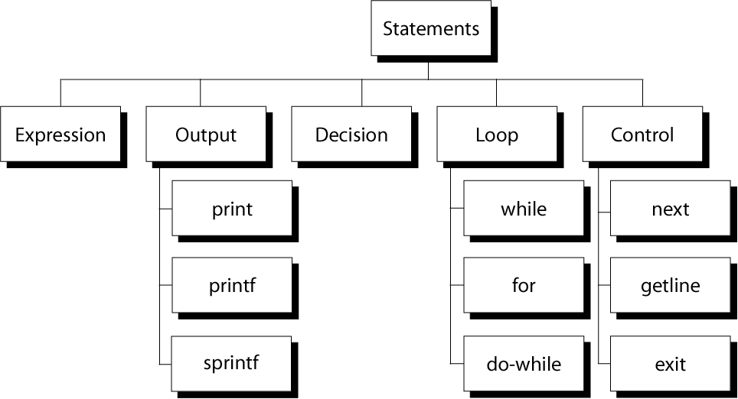
Figure 12-12
Basic awk Statements

Slide 15
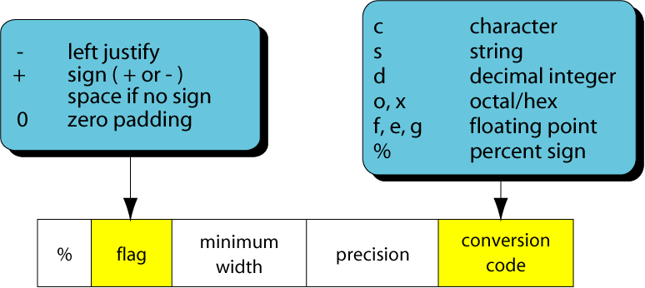
Figure 12-13
Summary of printf Codes

Slide 16
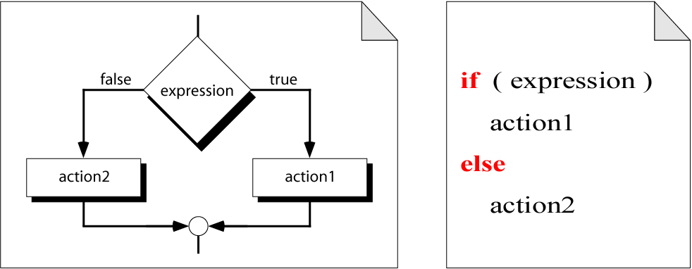
Figure 12-14
Decision Flow

Slide 17
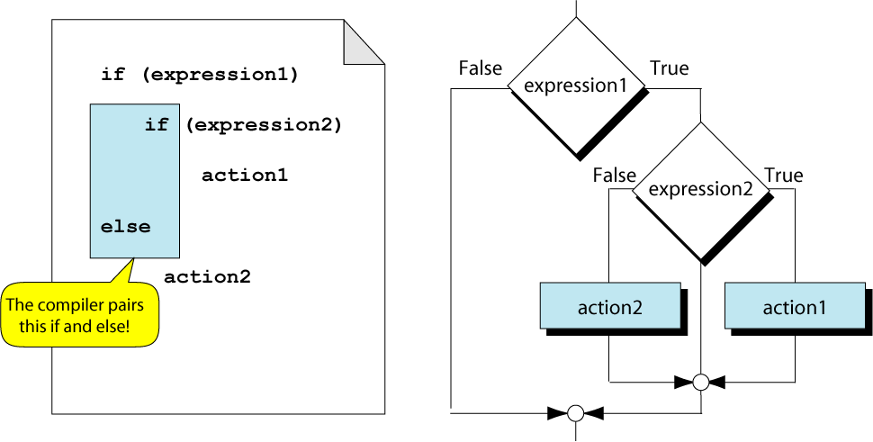
Figure 12-15
Dangling Else

Slide 18
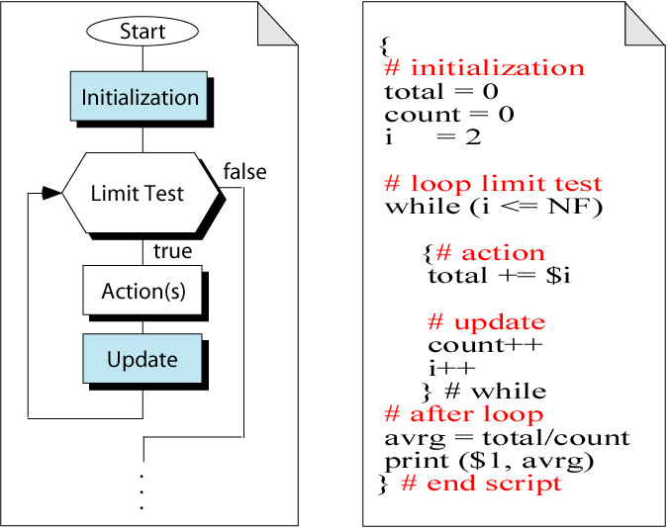
Figure 12-16
The while Loop

Slide 19
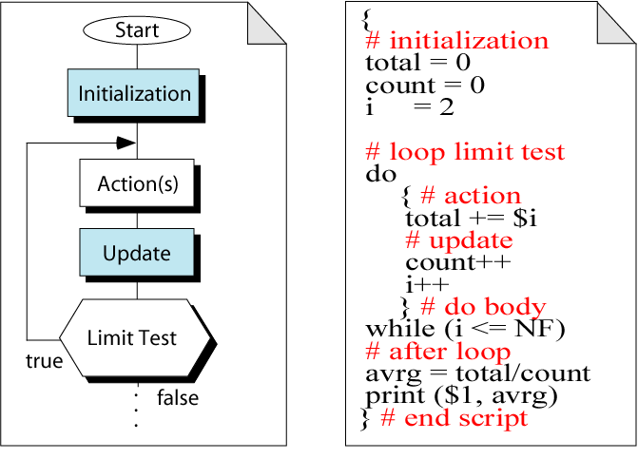
Figure 12-17
The do-while Posttest Loop

Slide 20
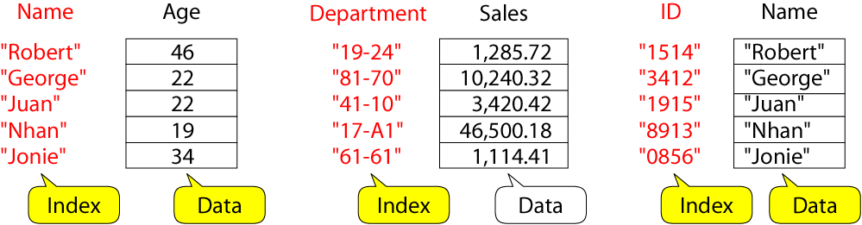
Figure 12-18
Associate Array

Slide 21
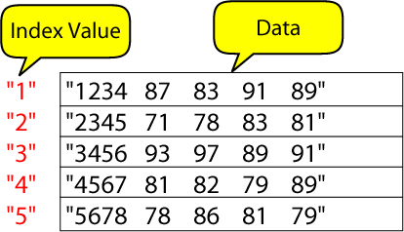
Figure 12-19
Associative Array of Students

Slide 22
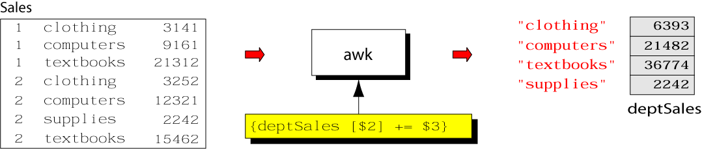
Figure 12-20
An Associative Array on Departments

Slide 23
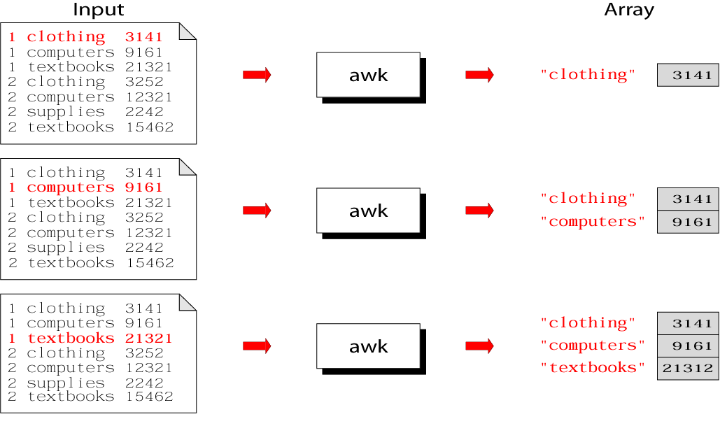
Figure 12-21.Part I
Bookstore Sales

Slide 24
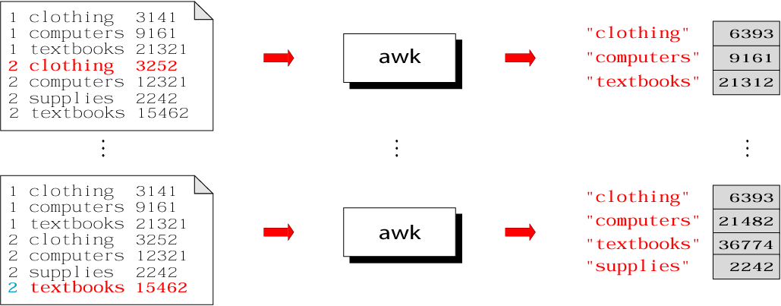
Figure 12-21.Part II
Bookstore Sales

Slide 25
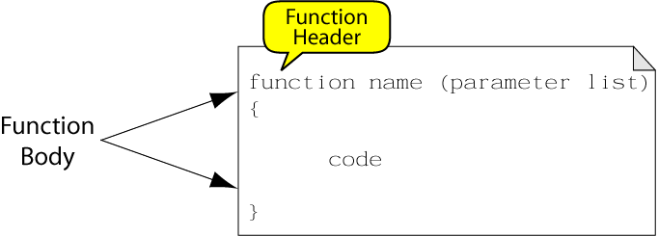
Figure 12-22
awk Function Definition

