Slide 1
Chapter 13
Interactive
Korn
Shell

Slide 2
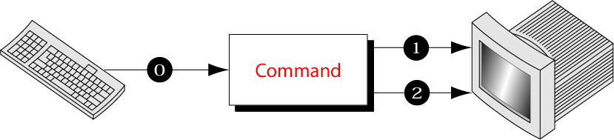
Figure 13-1
Standard Streams

Slide 3
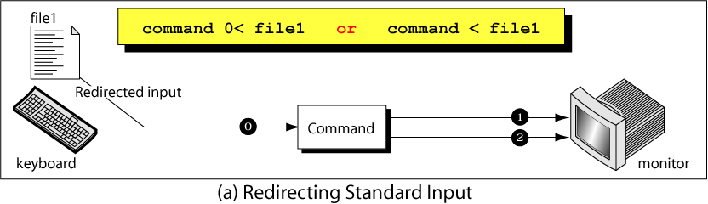
Figure 13-2, part a
Redirecting Standard Streams

Slide 4
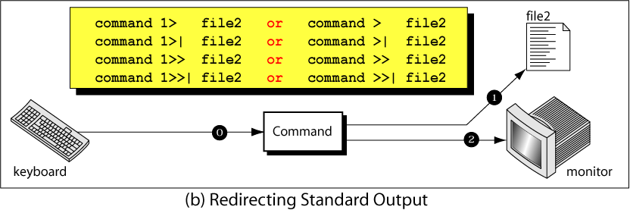
Figure 13-2, part b
Redirecting Standard Streams

Slide 5
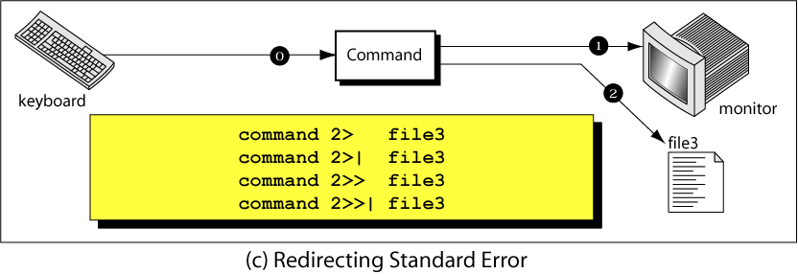
Figure 13-2, part c
Redirecting Standard Streams

Slide 6
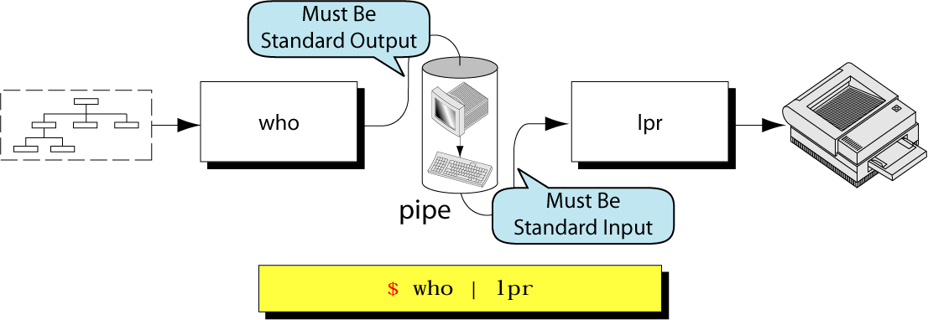
Figure 13-3
Pipes

Slide 7
Figure 13-4
Korn
Command substitution

Slide 8
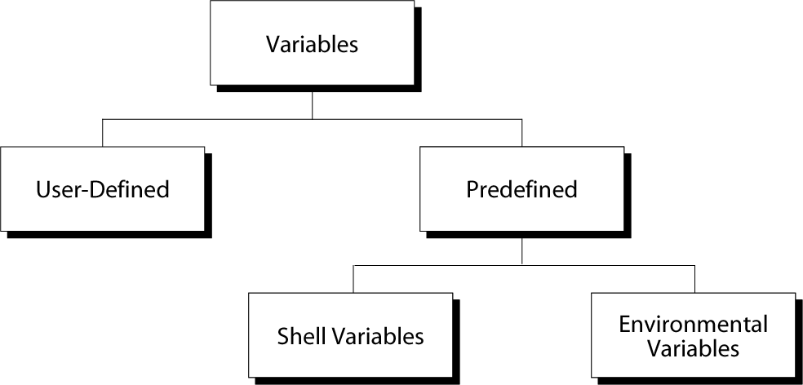
Figure 13-5
Variables

Slide 9
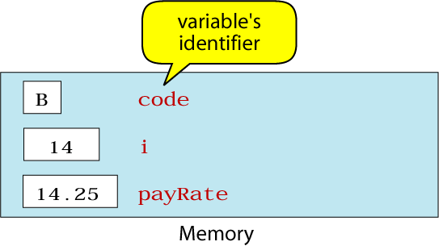
Figure 13-6
Examples of Variables

Slide 10
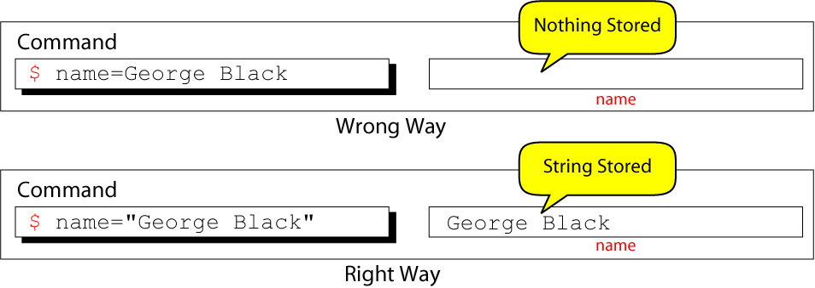
Figure 13-7
The Effect of Using Quotes

Slide 11
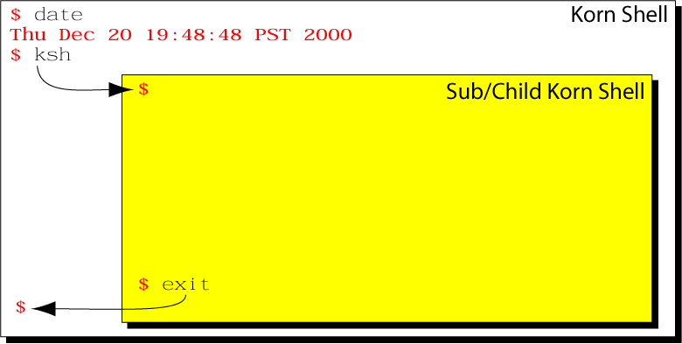
Figure 13-8
Forking a Subshell

Slide 12
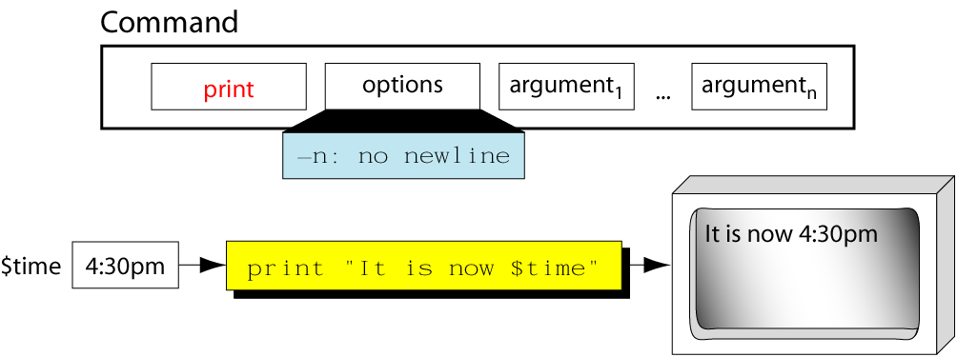
Figure 13-9
The print Command

Slide 13
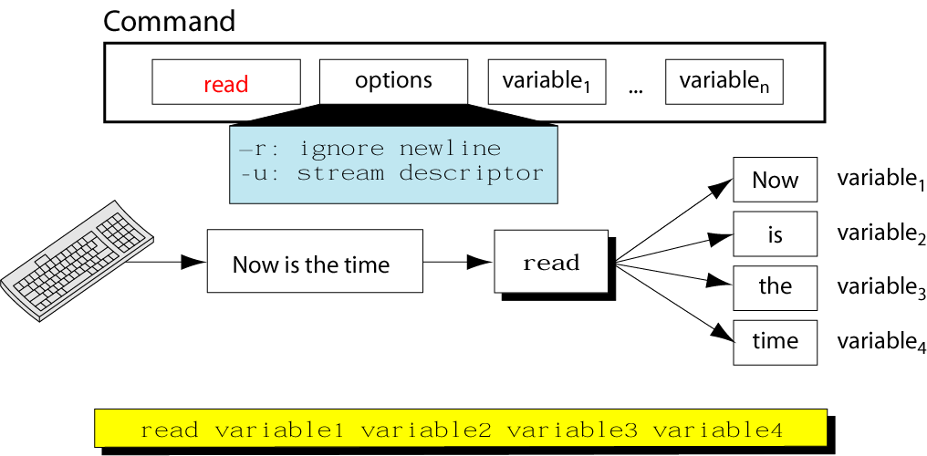
Figure 13-10
Format of the read Command

Slide 14
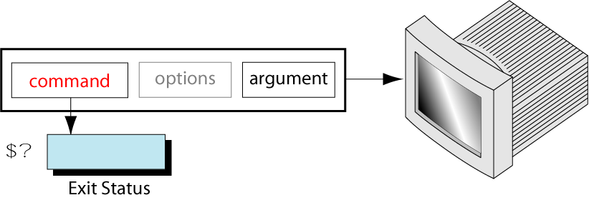
Figure 13-11
Exit Status of a Command

Slide 15
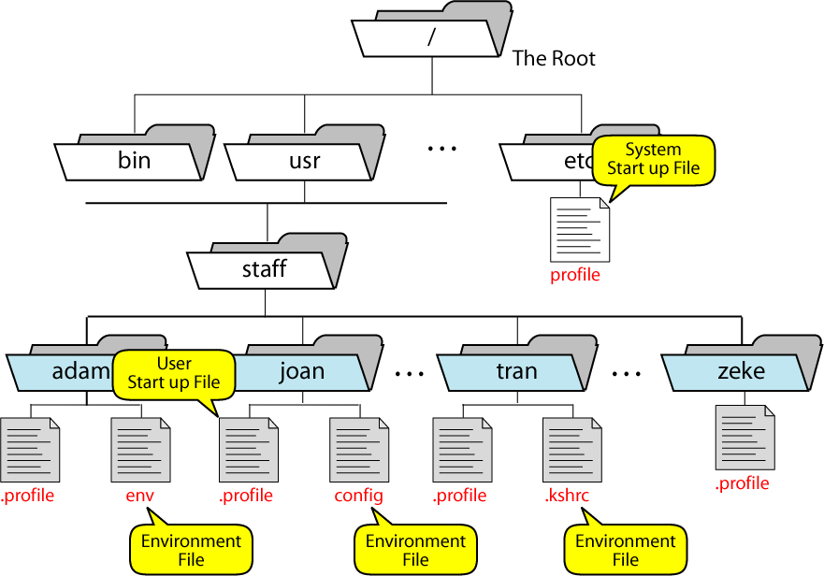
Figure 13-12
Korn Shell Startup Files

Slide 16
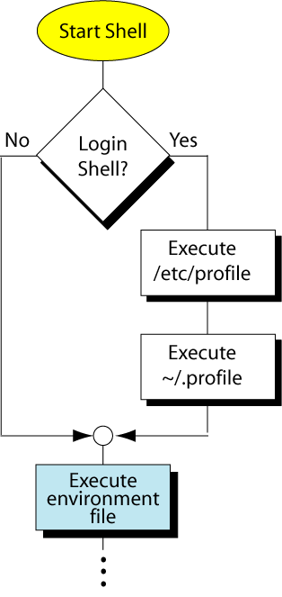
Figure 13-13
Korn Shell Startup Process

