Slide 1
Chapter 14
Korn Shell
Programming

Slide 2
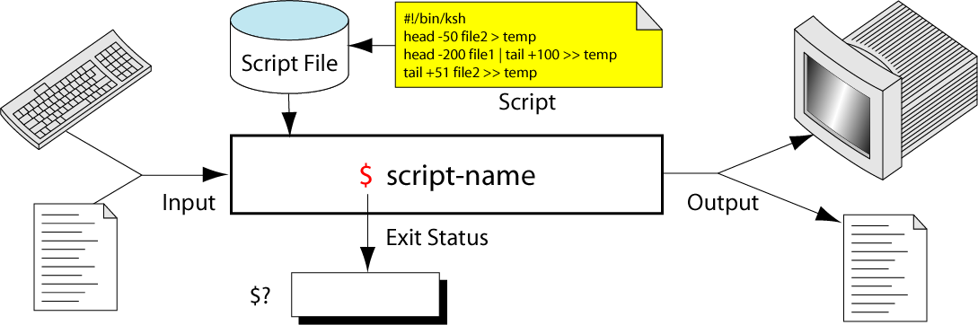
Figure 14-1
Script Concept

Slide 3
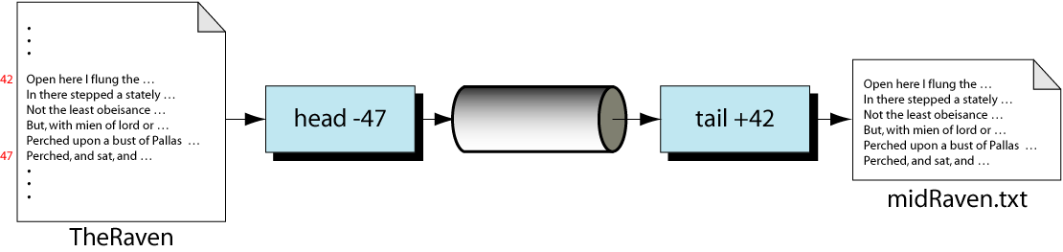
Figure 14-2
MidRaven.scr Design

Slide 4
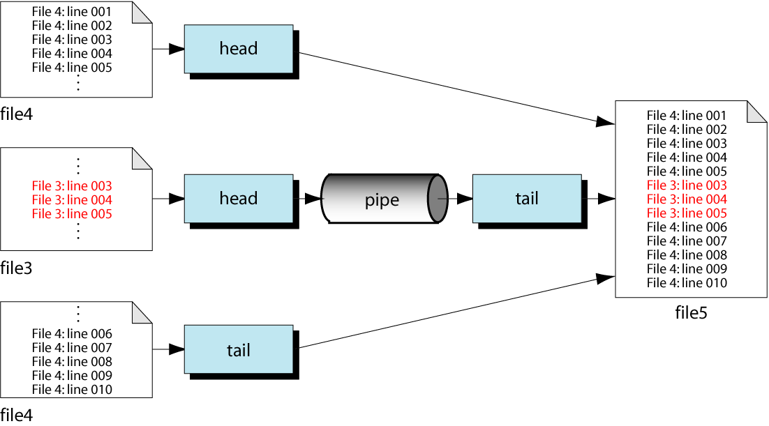
Figure 14-3
Design for insert.scr

Slide 5
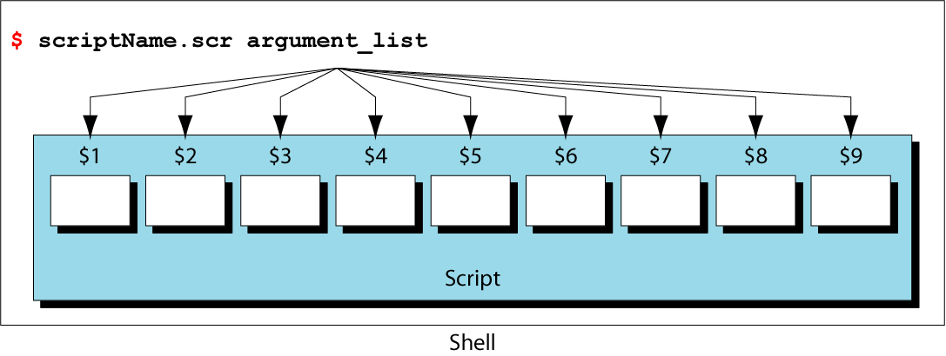
Figure 14-4
Arguments and Positional Parameters

Slide 6
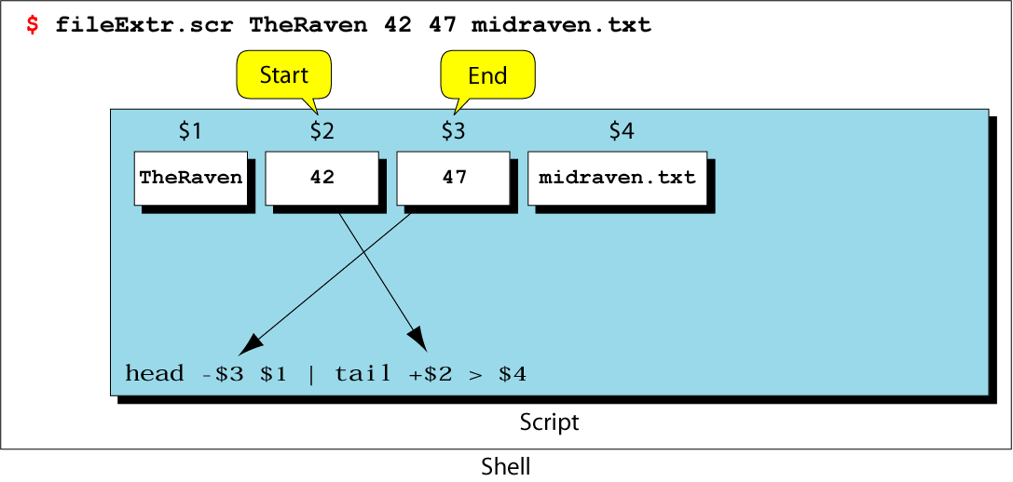
Figure 14-5
Matching Arguments and Positional Parameters

Slide 7
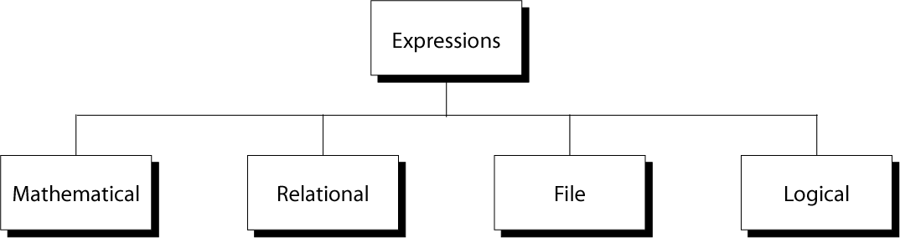
Figure 14-6
Expression Forms

Slide 8
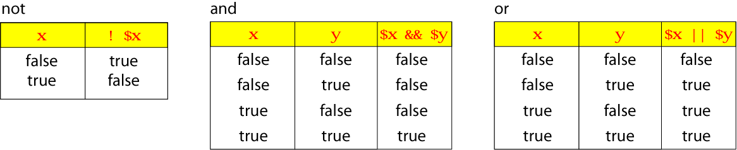
Figure 14-7
Logical Operators Truth Table

Slide 9
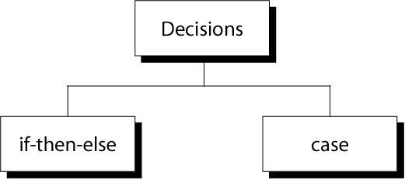
Figure 14-8
Decisions

Slide 10
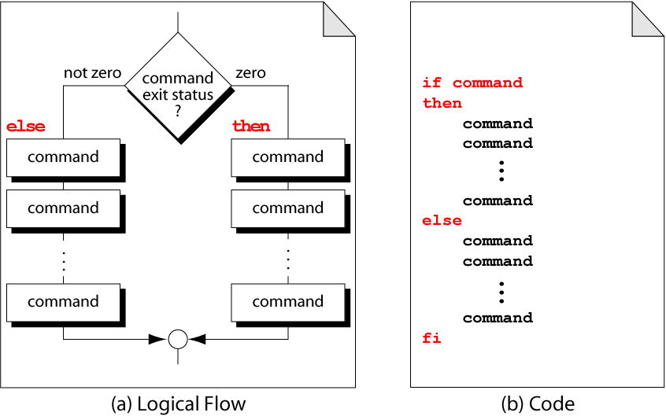
Figure 14-9
If-then-else Format

Slide 11
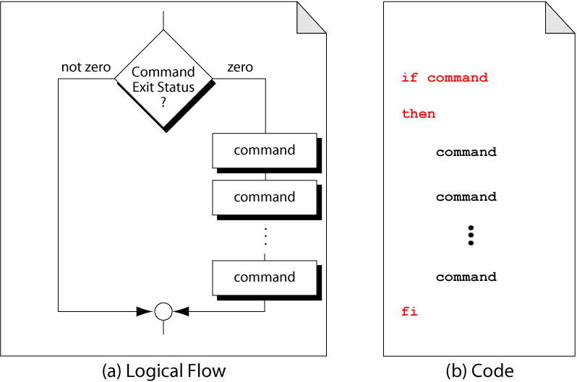
Figure 14-10
Example of if-then

Slide 12
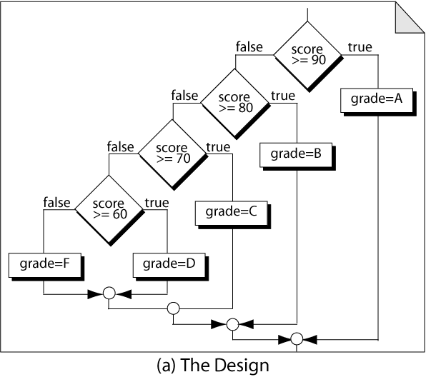
Figure 14-11, part a
Nested if-then-else

Slide 13
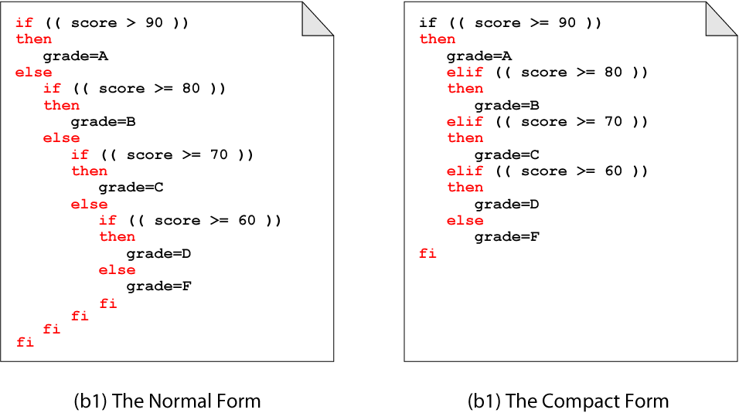
Figure 14-11, part b and c
Nested if-then-else

Slide 14
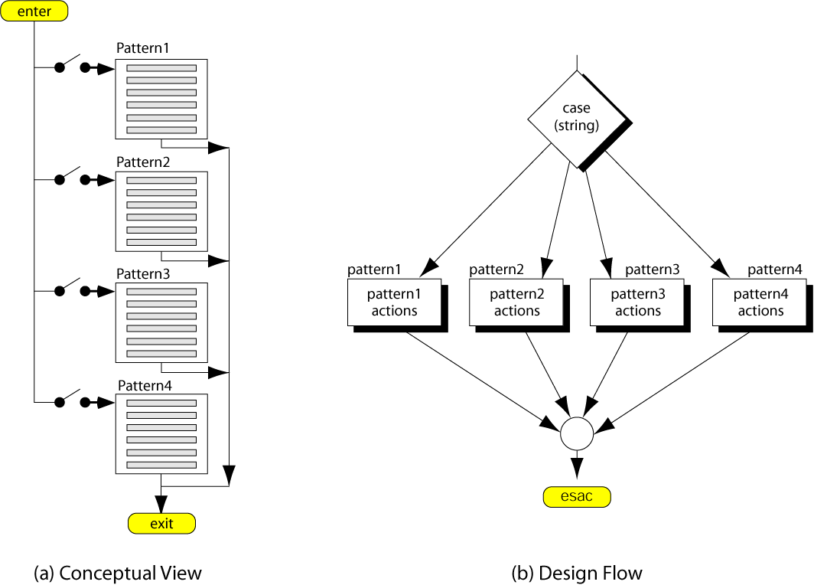
Figure 14-12
Case Decision logic

Slide 15
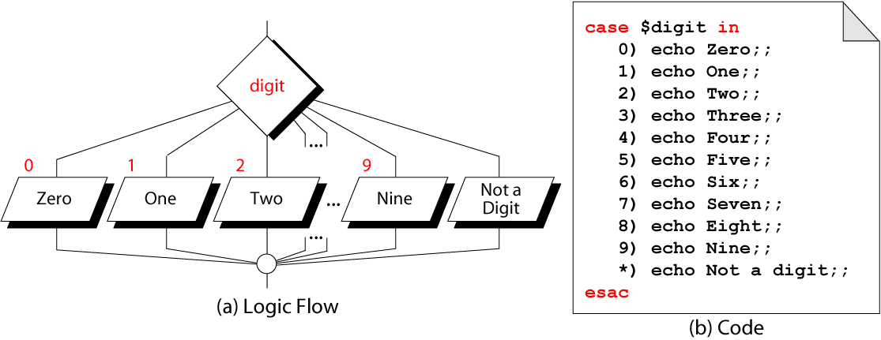
Figure 14-13
Print Digit Text

Slide 16
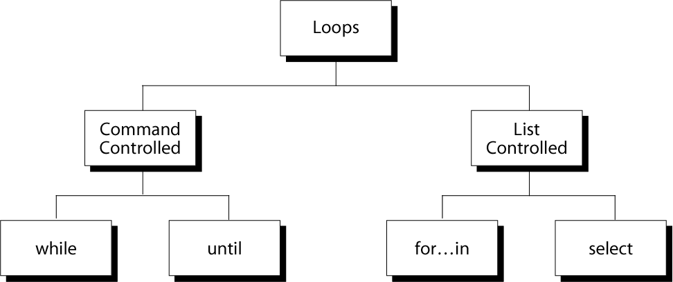
Figure 14-14
Loop Constructs

Slide 17
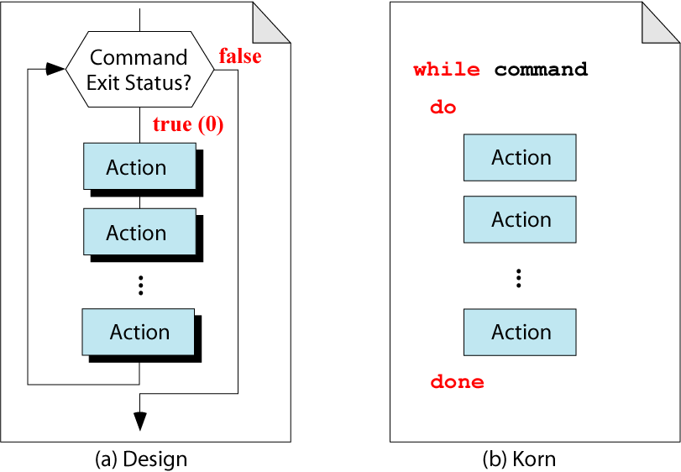
Figure 14-15
The while Loop

Slide 18
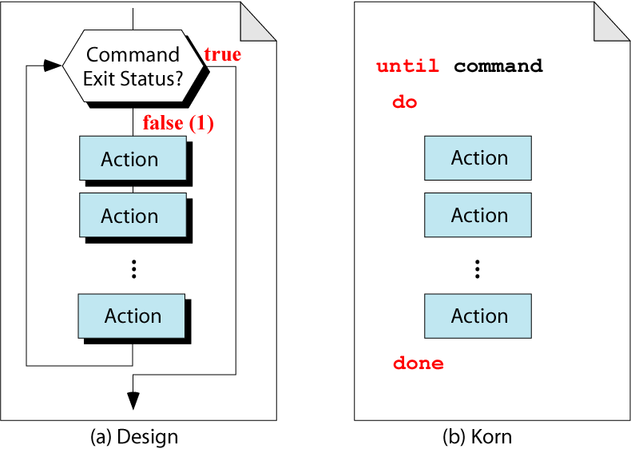
Figure 14-16
The until Loop

Slide 19
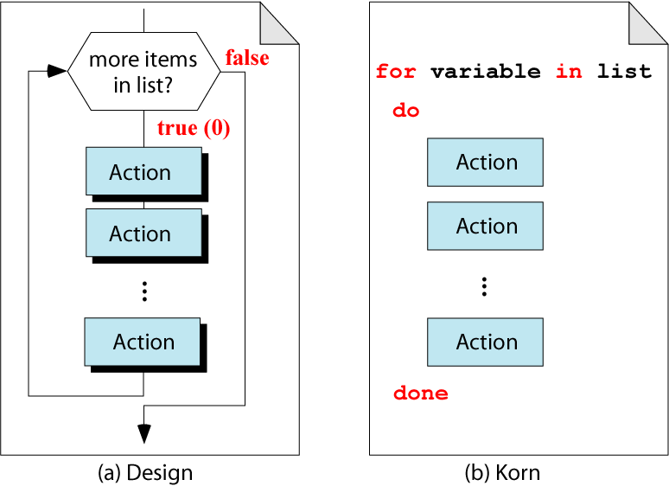
Figure 14-17
The for-in Loop

Slide 20
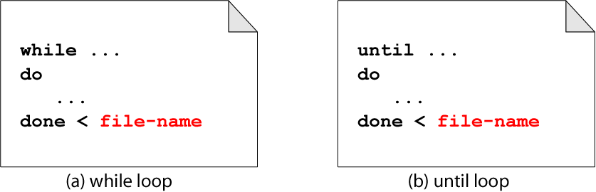
Figure 14-18
Input File Redirection

Slide 21
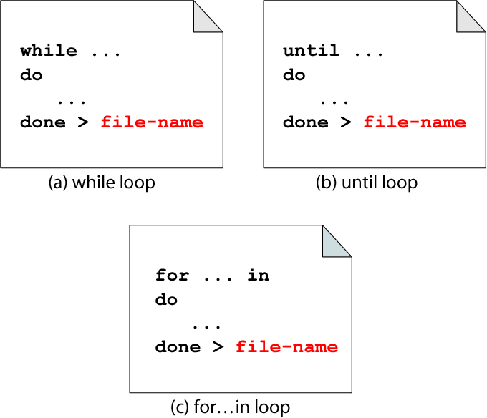
Figure 14-19
Loop Output Redirection

Slide 22
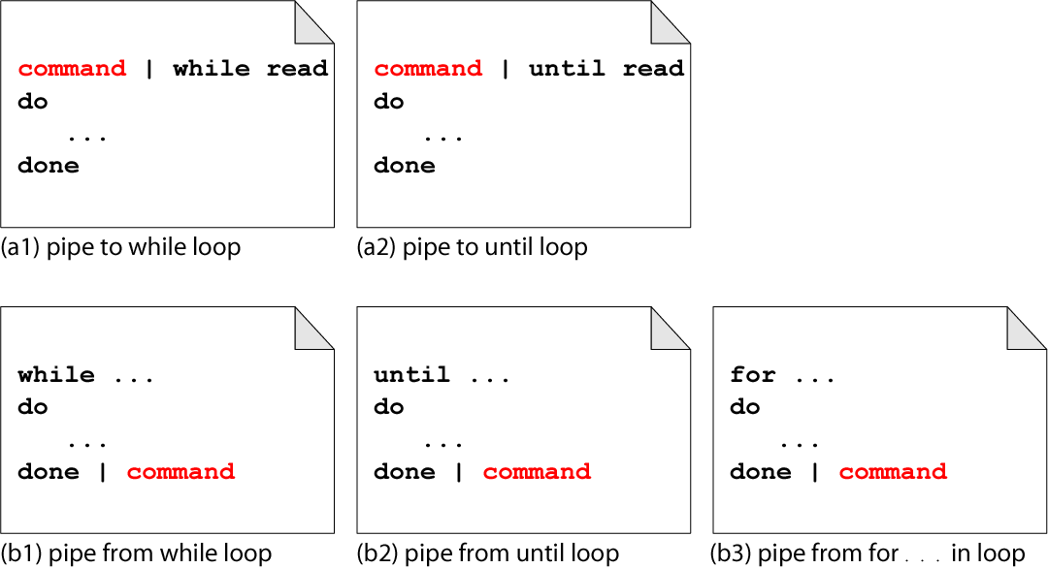
Figure 14-20
Loop Input and Output Pipes

Slide 23
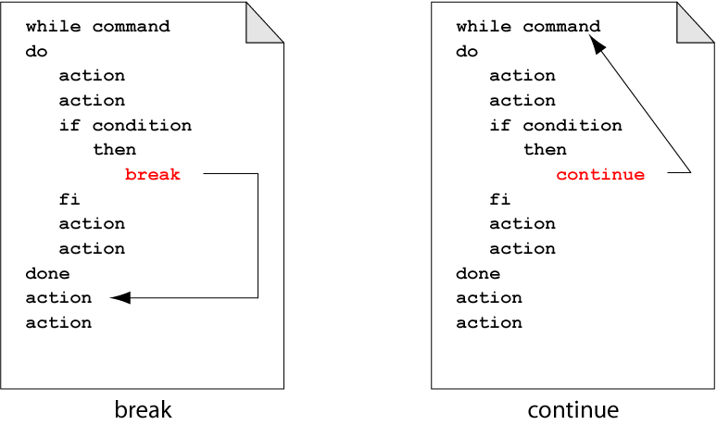
Figure 14-21
break and continue

Slide 24
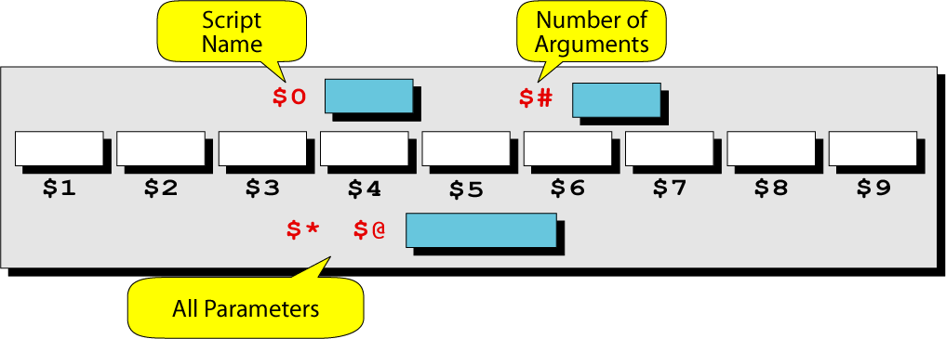
Figure 14-22
Parameters in the Korn Shell

Slide 25
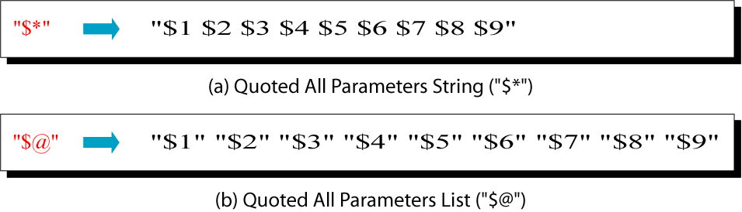
Figure 14-23
Quoted All Parameters

Slide 26
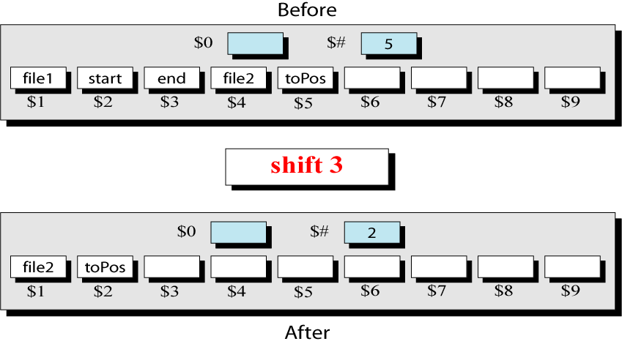
Figure 14-24
shift Command

