Slide 1
Chapter 15
Korn Shell
Advanced
Programming

Slide 2
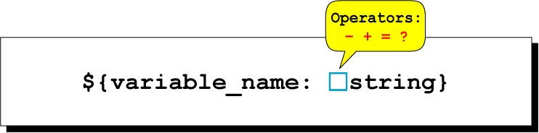
Figure 15-1
Variable Substitution

Slide 3
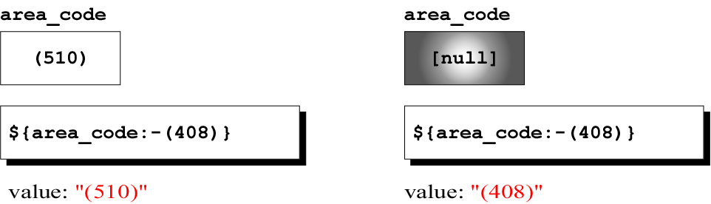
Figure 15-2
Substitute If Variable Null

Slide 4
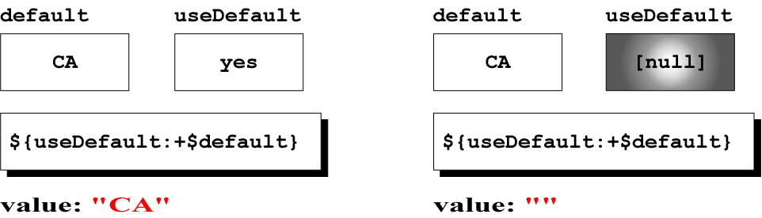
Figure 15-3
Substitute If Variable Not Null

Slide 5
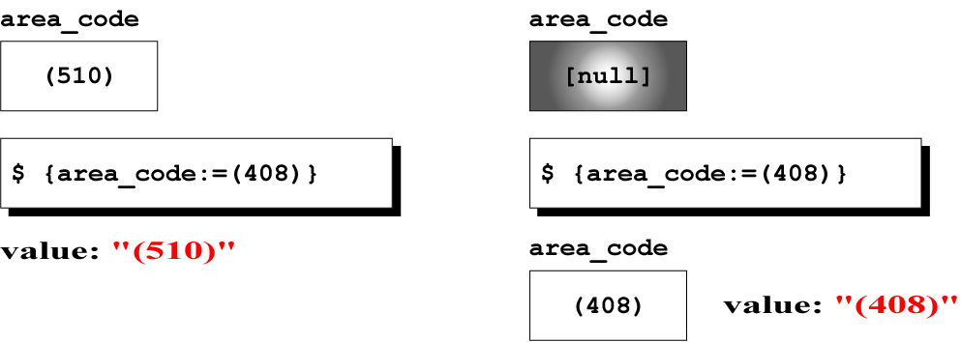
Figure 15-4
Substitute Assignment

Slide 6
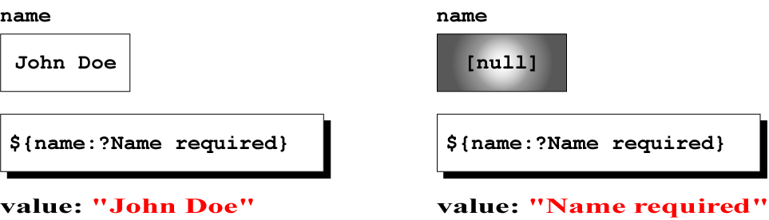
Figure 15-5
SubstituteValidation

Slide 7
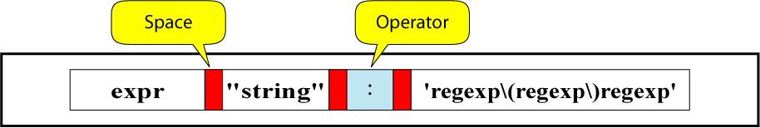
Figure 15-6
expr String Match Command

Slide 8
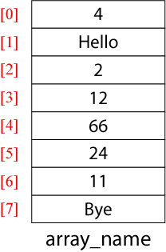
Figure 15-7
An Array

Slide 9
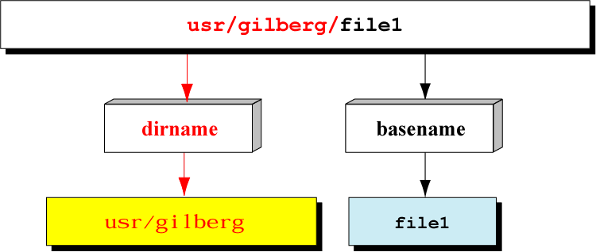
Figure 15-8
Using dirname and basename

