Slide 1
Chapter 16
Interactive
C
Shell

Slide 2
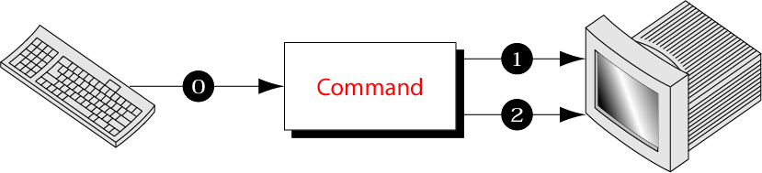
Figure 16-1
Standard Streams

Slide 3
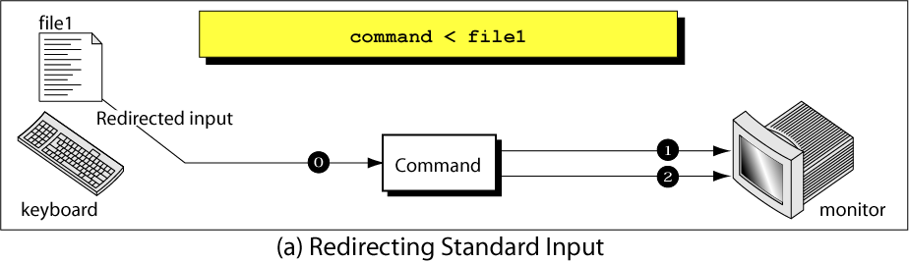
Figure 16-2, part a
Redirecting Standard Streams

Slide 4
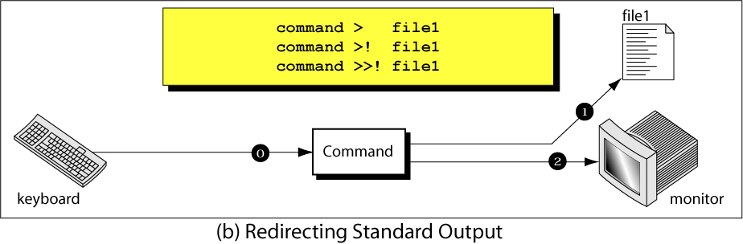
Figure 16-2, part b
Redirecting Standard Streams

Slide 5
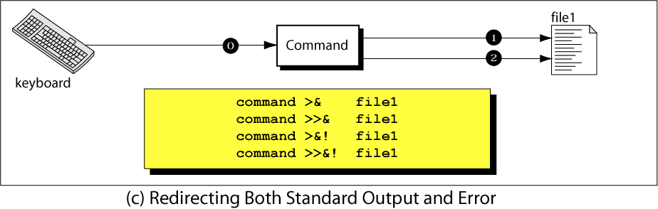
Figure 16-2, part c
Redirecting Standard Streams

Slide 6
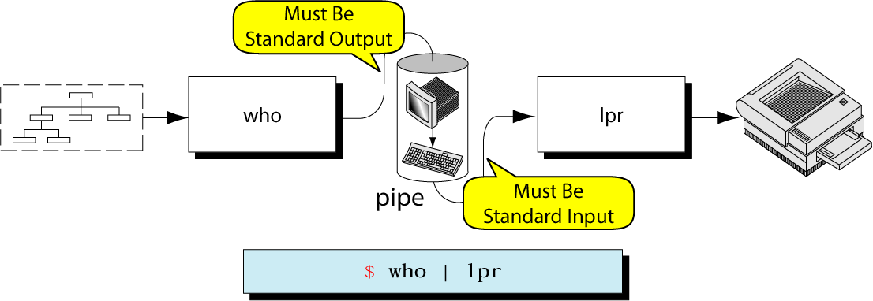
Figure 16-3
Pipes

Slide 7
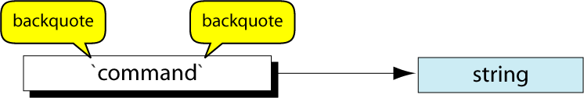
Figure 16-4
C Shell
Command substitution

Slide 8
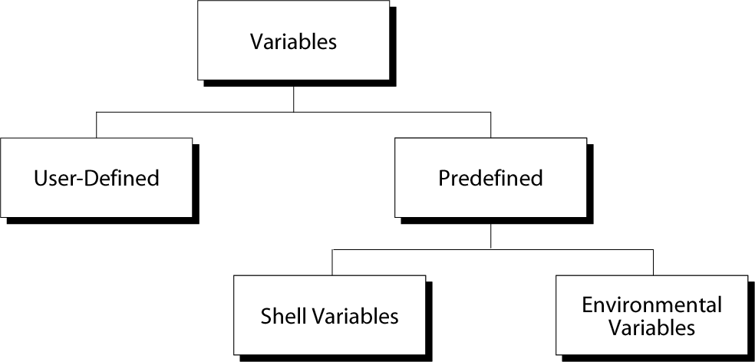
Figure 16-5
Variables

Slide 9
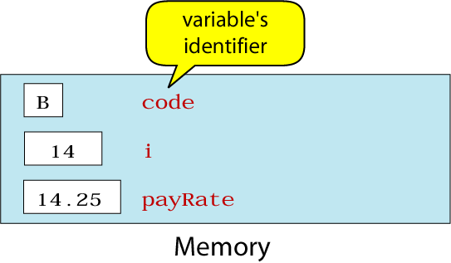
Figure 16-6
Variables Example

Slide 10
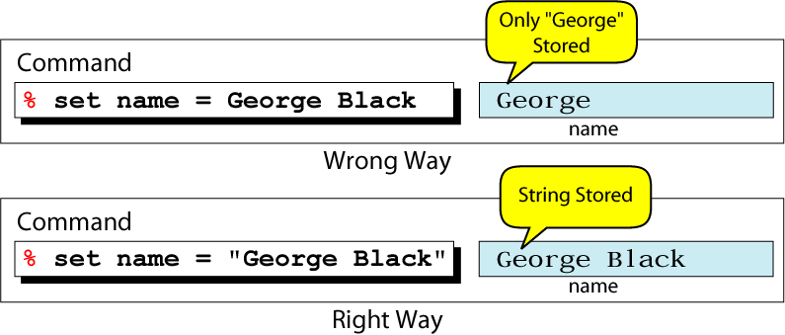
Figure 16-7
The Effect of Using Quotes

Slide 11
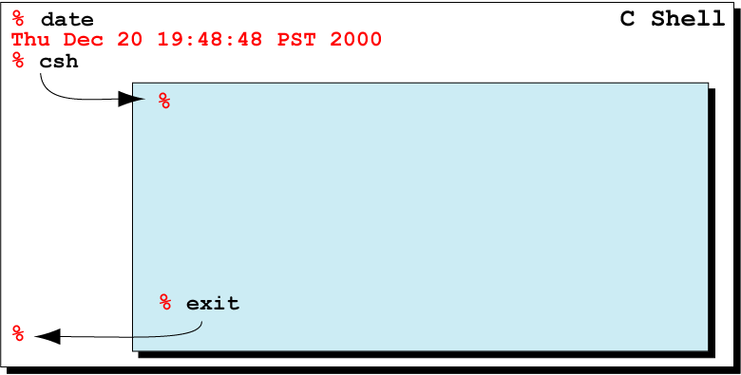
Figure 16-8
Forking a Subshell

Slide 12
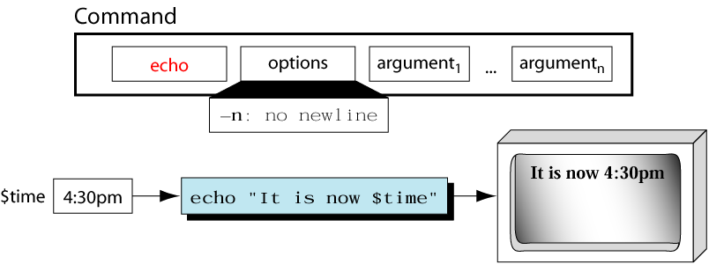
Figure 16-9
The echo Command

Slide 13
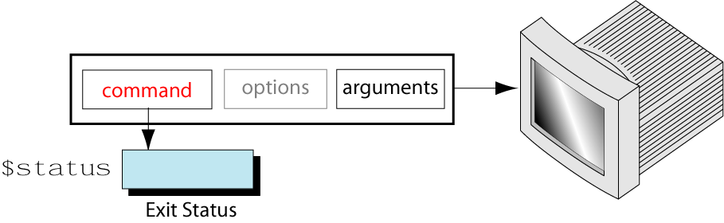
Figure 16-10
Exit Status of a Command

Slide 14
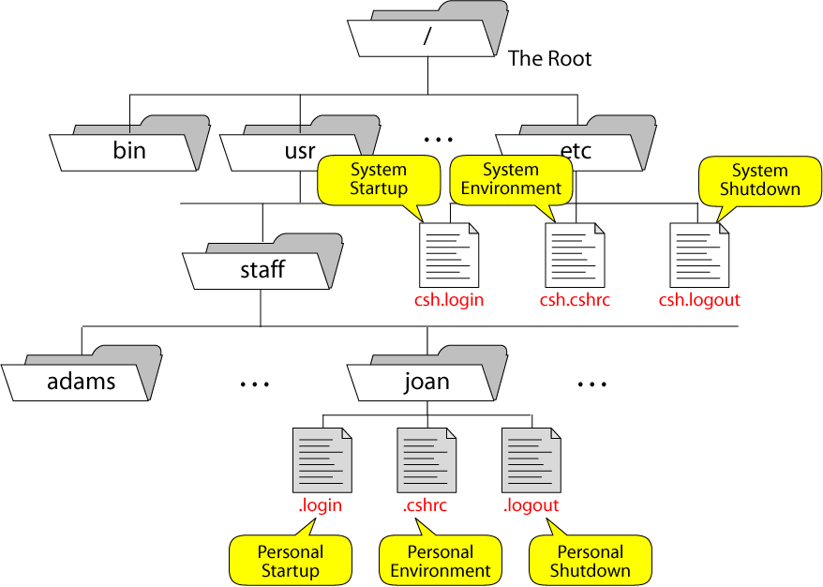
Figure 16-11
C Shell Startup and Shutdown Files

Slide 15
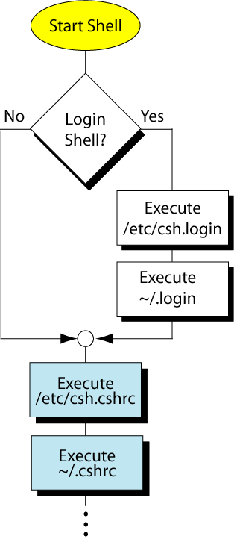
Figure 16-12
Startup Process

