Slide 1
Chapter 17
C Shell
Programming

Slide 2
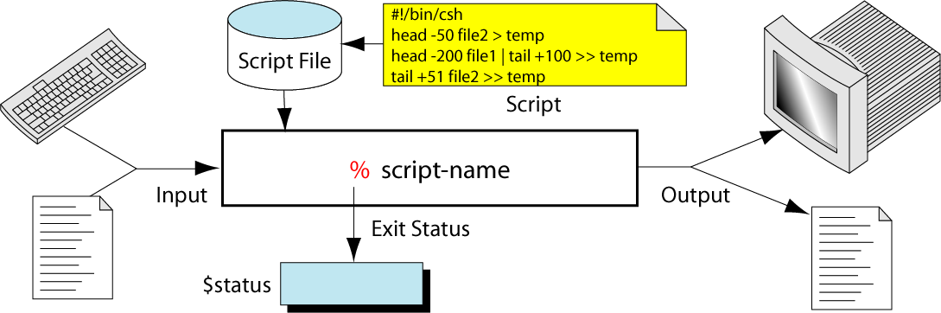
Figure 17-1
Script Concept

Slide 3
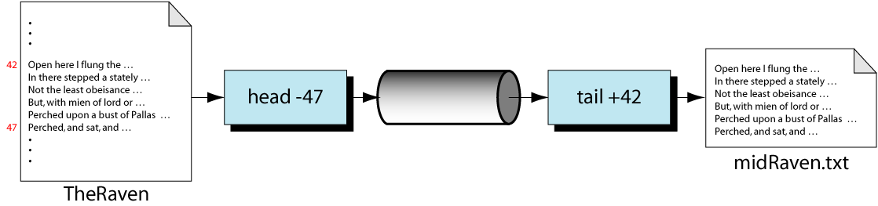
Figure 17-2
MidRaven.scr Design

Slide 4
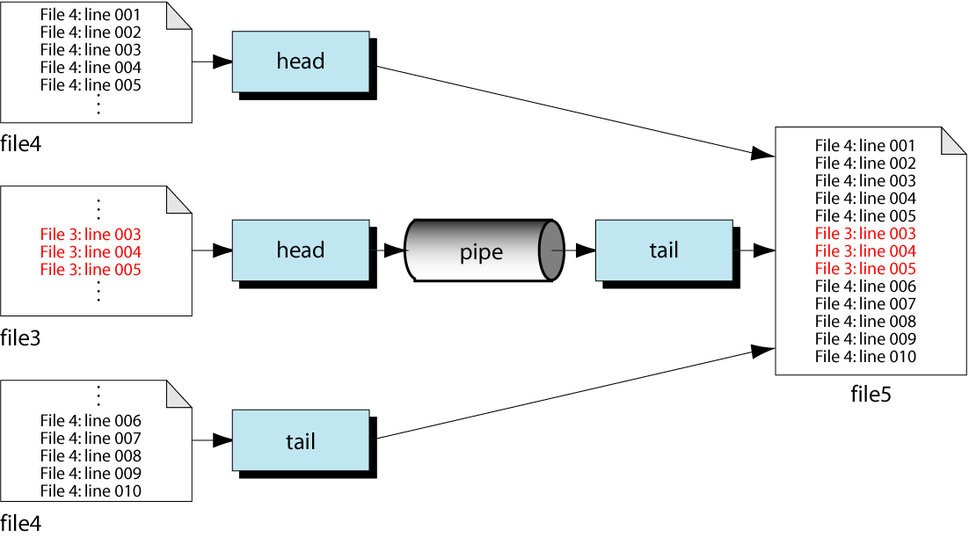
Figure 17-3
Design for insert.scr

Slide 5
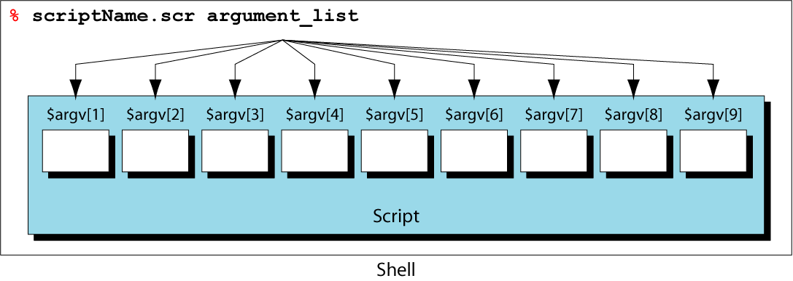
Figure 17-4
Arguments and Positional Parameters

Slide 6
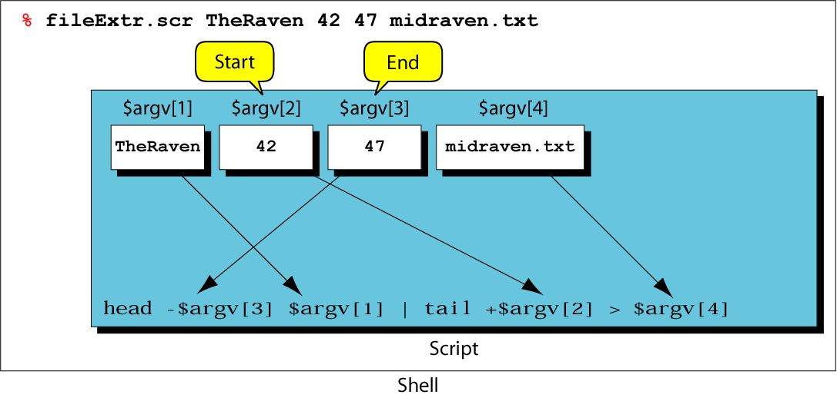
Figure 17-5
Matching Arguments and Positional Parameters

Slide 7
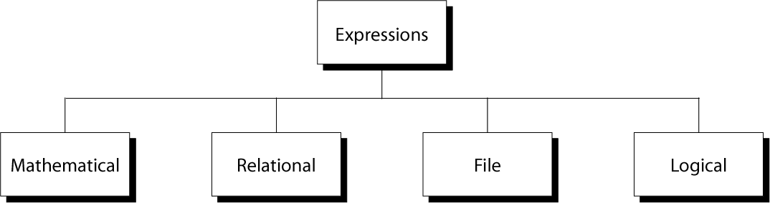
Figure 17-6
Expression Forms and Operators

Slide 8
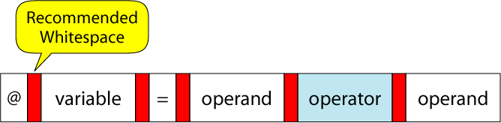
Figure 17-7
Format of the @ Command

Slide 9
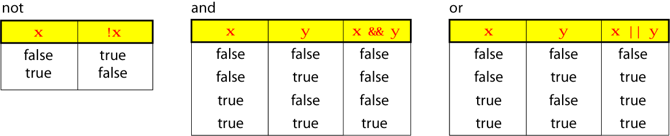
Figure 17-8
Logical Operators Truth Table

Slide 10
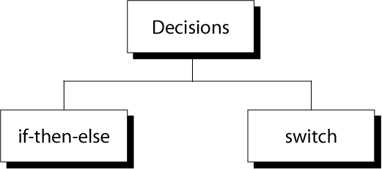
Figure 17-9
Decisions

Slide 11
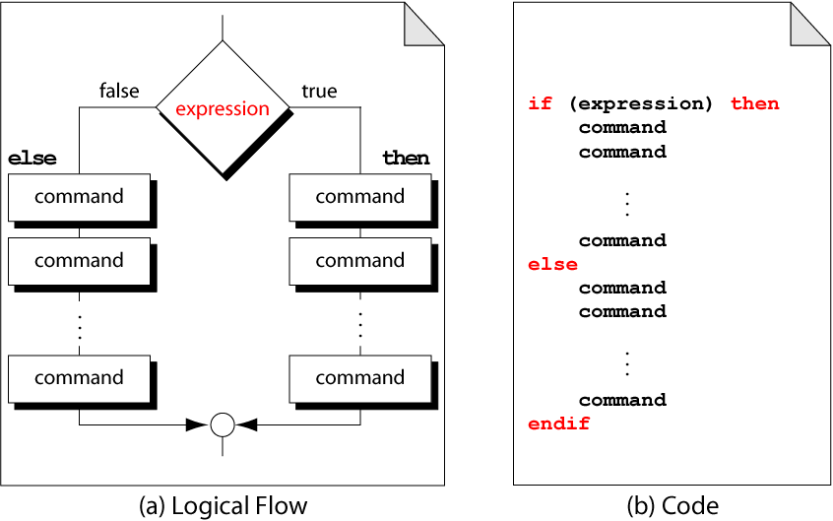
Figure 17-10
if-then-else Format

Slide 12
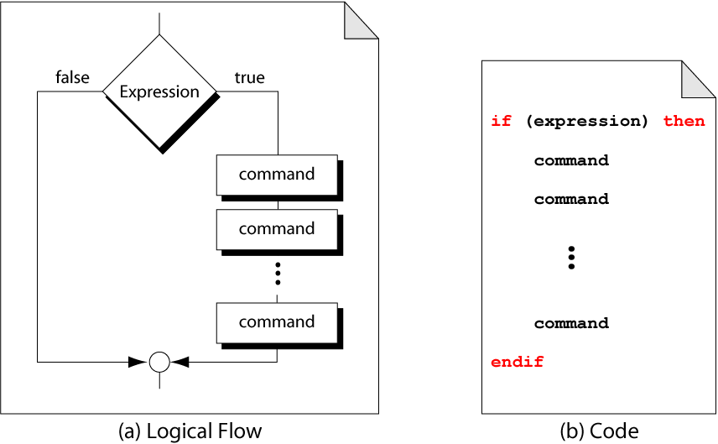
Figure 17-11
Example of if-then

Slide 13
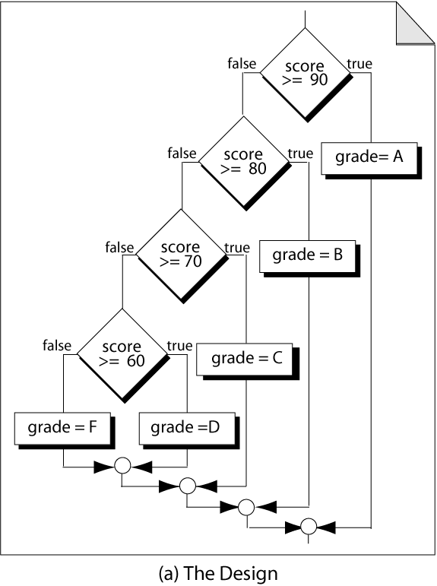
Figure 17-12, part a
Nested if-then-else

Slide 14
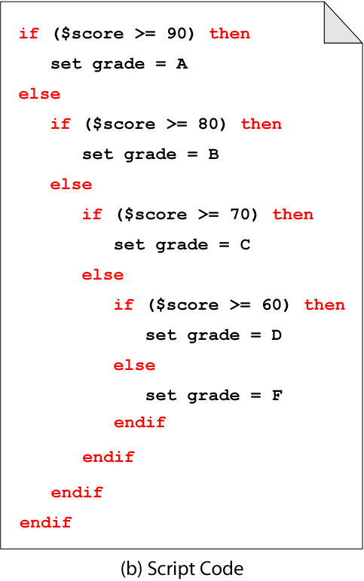
Figure 17-12, part b
Nested if-then-else

Slide 15
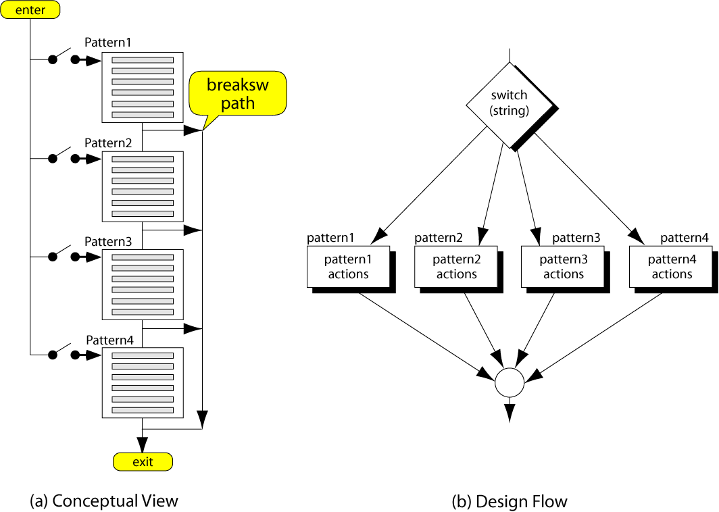
Figure 17-13
Switch Decision logic

Slide 16
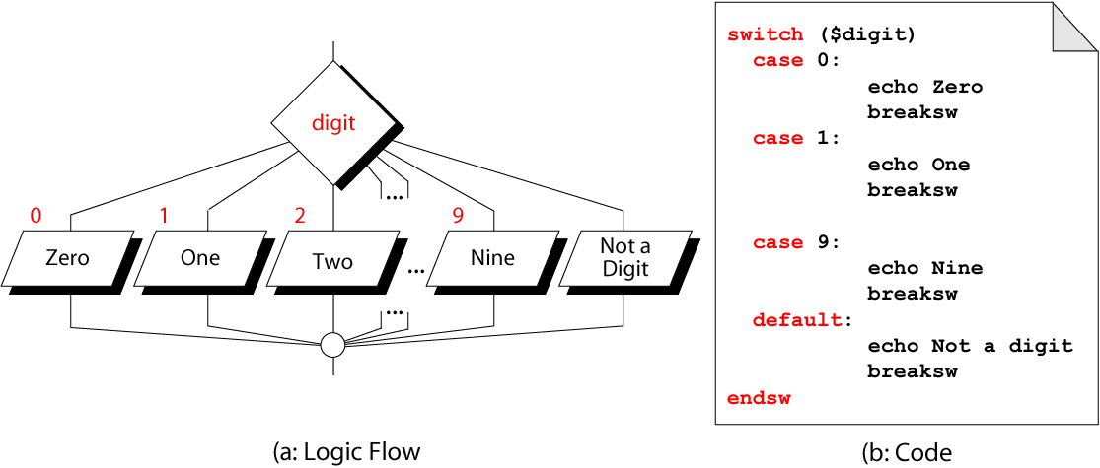
Figure 17-14
Echo Digit Text

Slide 17
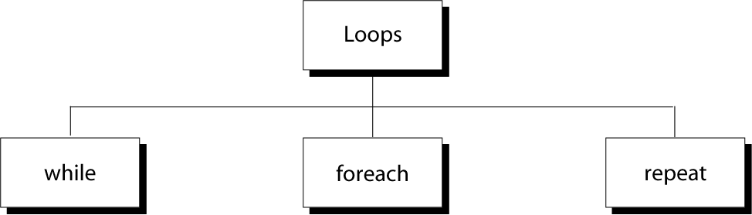
Figure 17-15
Loop Constructs

Slide 18
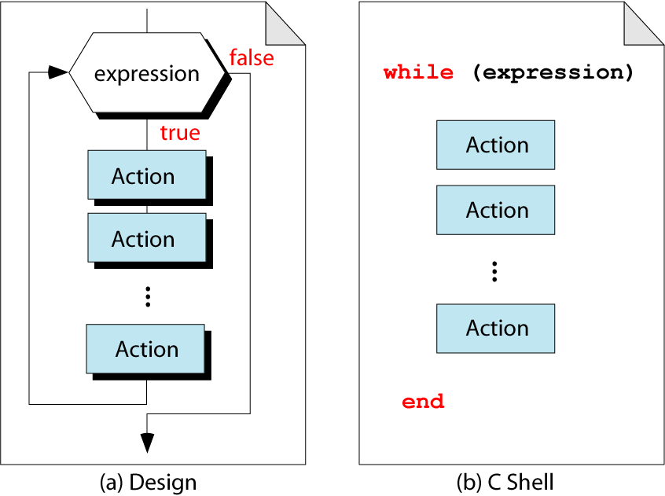
Figure 17-16
The while Loop

Slide 19
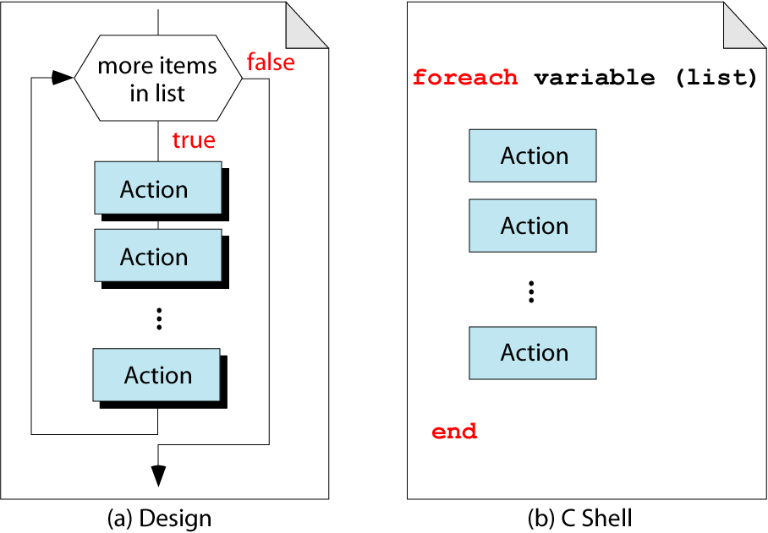
Figure 17-17
The foreach Command

Slide 20
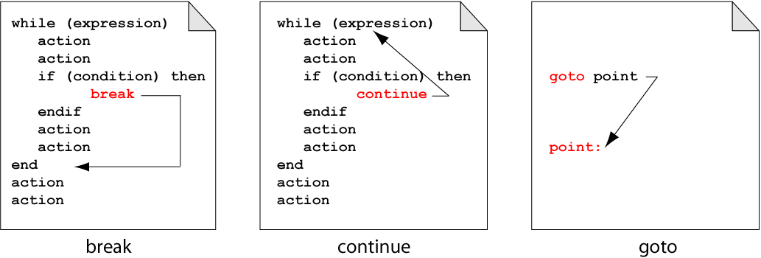
Figure 17-18
break, continue, and goto

Slide 21
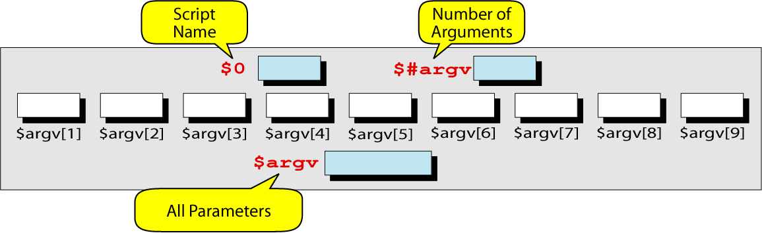
Figure 17-19
Parameters in the C Shell

Slide 22
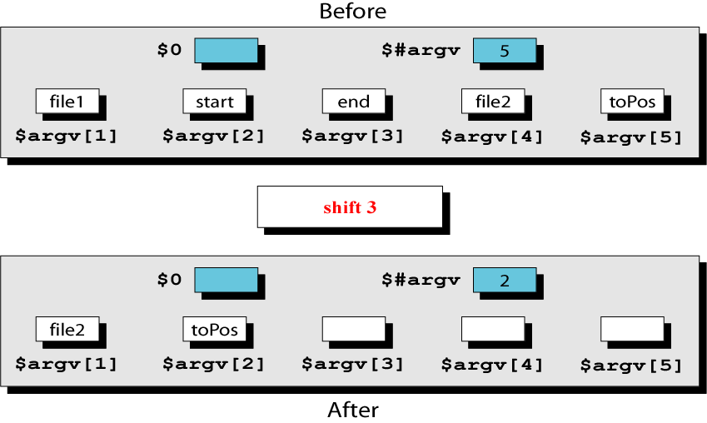
Figure 17-20
shift Command

