Slide 1
Chapter 18
C Shell
Advanced
Programming

Slide 2
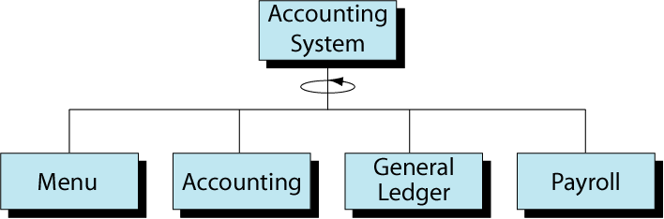
Figure 18-1
Accounting System Design

