Slide 1
Chapter 1: Principles of
Programming and Software Engineering
Data Abstraction & Problem Solving with
C++
Fifth Edition
by Frank M. Carrano

Slide 2
Software Engineering and
Object-Oriented Design
Coding without a solution design increases debugging time
A team of programmers for a large software development project requires
  An overall plan
  Organization
  Communication
Software engineering
  Provides techniques to facilitate the development of computer programs

Slide 3
An Examination of Problem Solving
Problem solving
  The process of taking the statement of a problem and developing a computer program that solves that problem
Object-oriented analysis and design (OOA / D)
  A process for problem solving
  A problem solution is a program consisting of a system of interacting classes of objects
    Each object has characteristics and behaviors related to the solution
    A class is a set of objects having the same type

Slide 4
Aspects of an Object-Oriented Solution
A solution is a C++ program consisting of:
  Modules
    A single, stand-alone function
    A method of a class
    A class
    Several functions or classes working closely together
    Other blocks of code

Slide 5
Aspects of an Object-Oriented Solution
Functions and methods implement algorithms
  Algorithm: a step-by-step recipe for performing a task within a finite period of time
  Algorithms often operate on a collection of data

Slide 6
Aspects of an Object-Oriented Solution
Create a good set of modules
  Modules must store, move, and alter data
  Modules use algorithms to communicate with one another
Organize your data collection to facilitate operations on the data

Slide 7
Abstraction and Information Hiding
Abstraction
  Separates the purpose of a module from its implementation
  Specifications for each module are written before implementation
  Functional abstraction
    Separates the purpose of a module from its implementation

Slide 8
Abstraction and Information Hiding
  Data abstraction
    Focuses on the operations of data, not on the implementation of the operations
  Abstract data type (ADT)
    A collection of data and a set of operations on the data
    You can use an ADT’s operations without knowing their implementations or how data is stored, if you know the operations’ specifications

Slide 9
Abstraction and Information Hiding
  Data structure
    A construct that you can define within a programming language to store a collection of data
  Develop algorithms and ADTs in tandem

Slide 10
Abstraction and Information Hiding
Information hiding
  Hide details within a module
  Ensure that no other module can tamper with these hidden details
  Public view of a module
    Described by its specifications
  Private view of a module
    Implementation details that the specifications should not describe

Slide 11
Principles of Object-Oriented Programming (OOP)
Object-oriented languages enable us to build classes of objects
A class combines
  Attributes (characteristics) of objects of a single type
    Typically data
    Called data members
  Behaviors (operations)
    Typically operate on the data
    Called methods or member functions

Slide 12
Principles of Object-Oriented Programming
Three principles of object-oriented programming
  Encapsulation
    Objects combine data and operations
    Hides inner details
  Inheritance
    Classes can inherit properties from other classes
    Existing classes can be reused
  Polymorphism
    Objects can determine appropriate operations at execution time

Slide 13
Object-Oriented Analysis and Design
Analysis
  Process to develop
    An understanding of the problem
    The requirements of a solution
      What a solution must be and do
      Not how to design or implement it
  Generates an accurate understanding of what end users will expect the solution to be and do
  Think about the problem, not how to solve it

Slide 14
Object-Oriented Analysis and Design
Object-oriented analysis (OOA)
  Expresses an understanding of the problem and the requirements of a solution in terms of objects within the problem domain
  Objects can represent
    Real-world objects
    Software systems
    Ideas
  OOA describes objects and their interactions among one another

Slide 15
Object-Oriented Analysis and Design
Object-oriented design (OOD)
  Expresses an understanding of a solution that fulfills the requirements discovered during OOA
  Describes a solution in terms of
    Software objects
    The collaborations of these objects with one another
      Objects collaborate when they send messages (call each other’s operations)
      Collaborations should be meaningful and minimal
  Creates one or more models of a solution
    Some emphasize interactions among objects
    Others emphasize relationships among objects

Slide 16
Applying the UML to OOA/D
Unified Modeling Language (UML)
  A tool for exploration and communication during the design of a solution
  Models a problem domain in terms of objects independently of a programming language
  Visually represents object-oriented solutions as diagrams
  Its visual nature is an advantage, since we are visual creatures
  Enables members of a programming team to communicate visually with one another and gain a common understanding of the system being built

Slide 17
Applying the UML to OOA/D
UML use case for OOA
  A set of textual scenarios (stories) of the solution
    Each scenario describes the system’s behavior under certain circumstances from the perspective of the user
      Focus on the responsibilities of the system to meeting a user’s goals
    Main success scenario (happy path): interaction between user and system when all goes well
    Alternate scenarios: interaction between user and system under exceptional circumstances
  Find noteworthy objects, attributes, and associations within the scenarios

Slide 18
Applying the UML to OOA/D
  An example of a main success scenario
    Customer asks to withdraw money from a bank account
    Bank identifies and authenticates customer
    Bank gets account type, account number, and withdrawal amount from customer
    Bank verifies that account balance is greater than withdrawal amount
    Bank generates receipt for the transaction
    Bank counts out the correct amount of money for customer
    Customer leaves bank

Slide 19
Applying the UML to OOA/D
  An example of an alternate scenario
    Customer asks to withdraw money from a bank account
    Bank identifies, but fails to authenticate customer
    Bank refuses to process the customer’s request
    Customer leaves bank

Slide 20
Applying the UML to OOA/D
UML sequence (interaction) diagram for OOD
  Models the scenarios in a use case
  Shows the interactions among objects over time
  Lets you visualize the messages sent among objects in a scenario and their order of occurrence
  Helps to define the responsibilities of the objects
    What must an object remember?
    What must an object do for other objects?

Slide 21
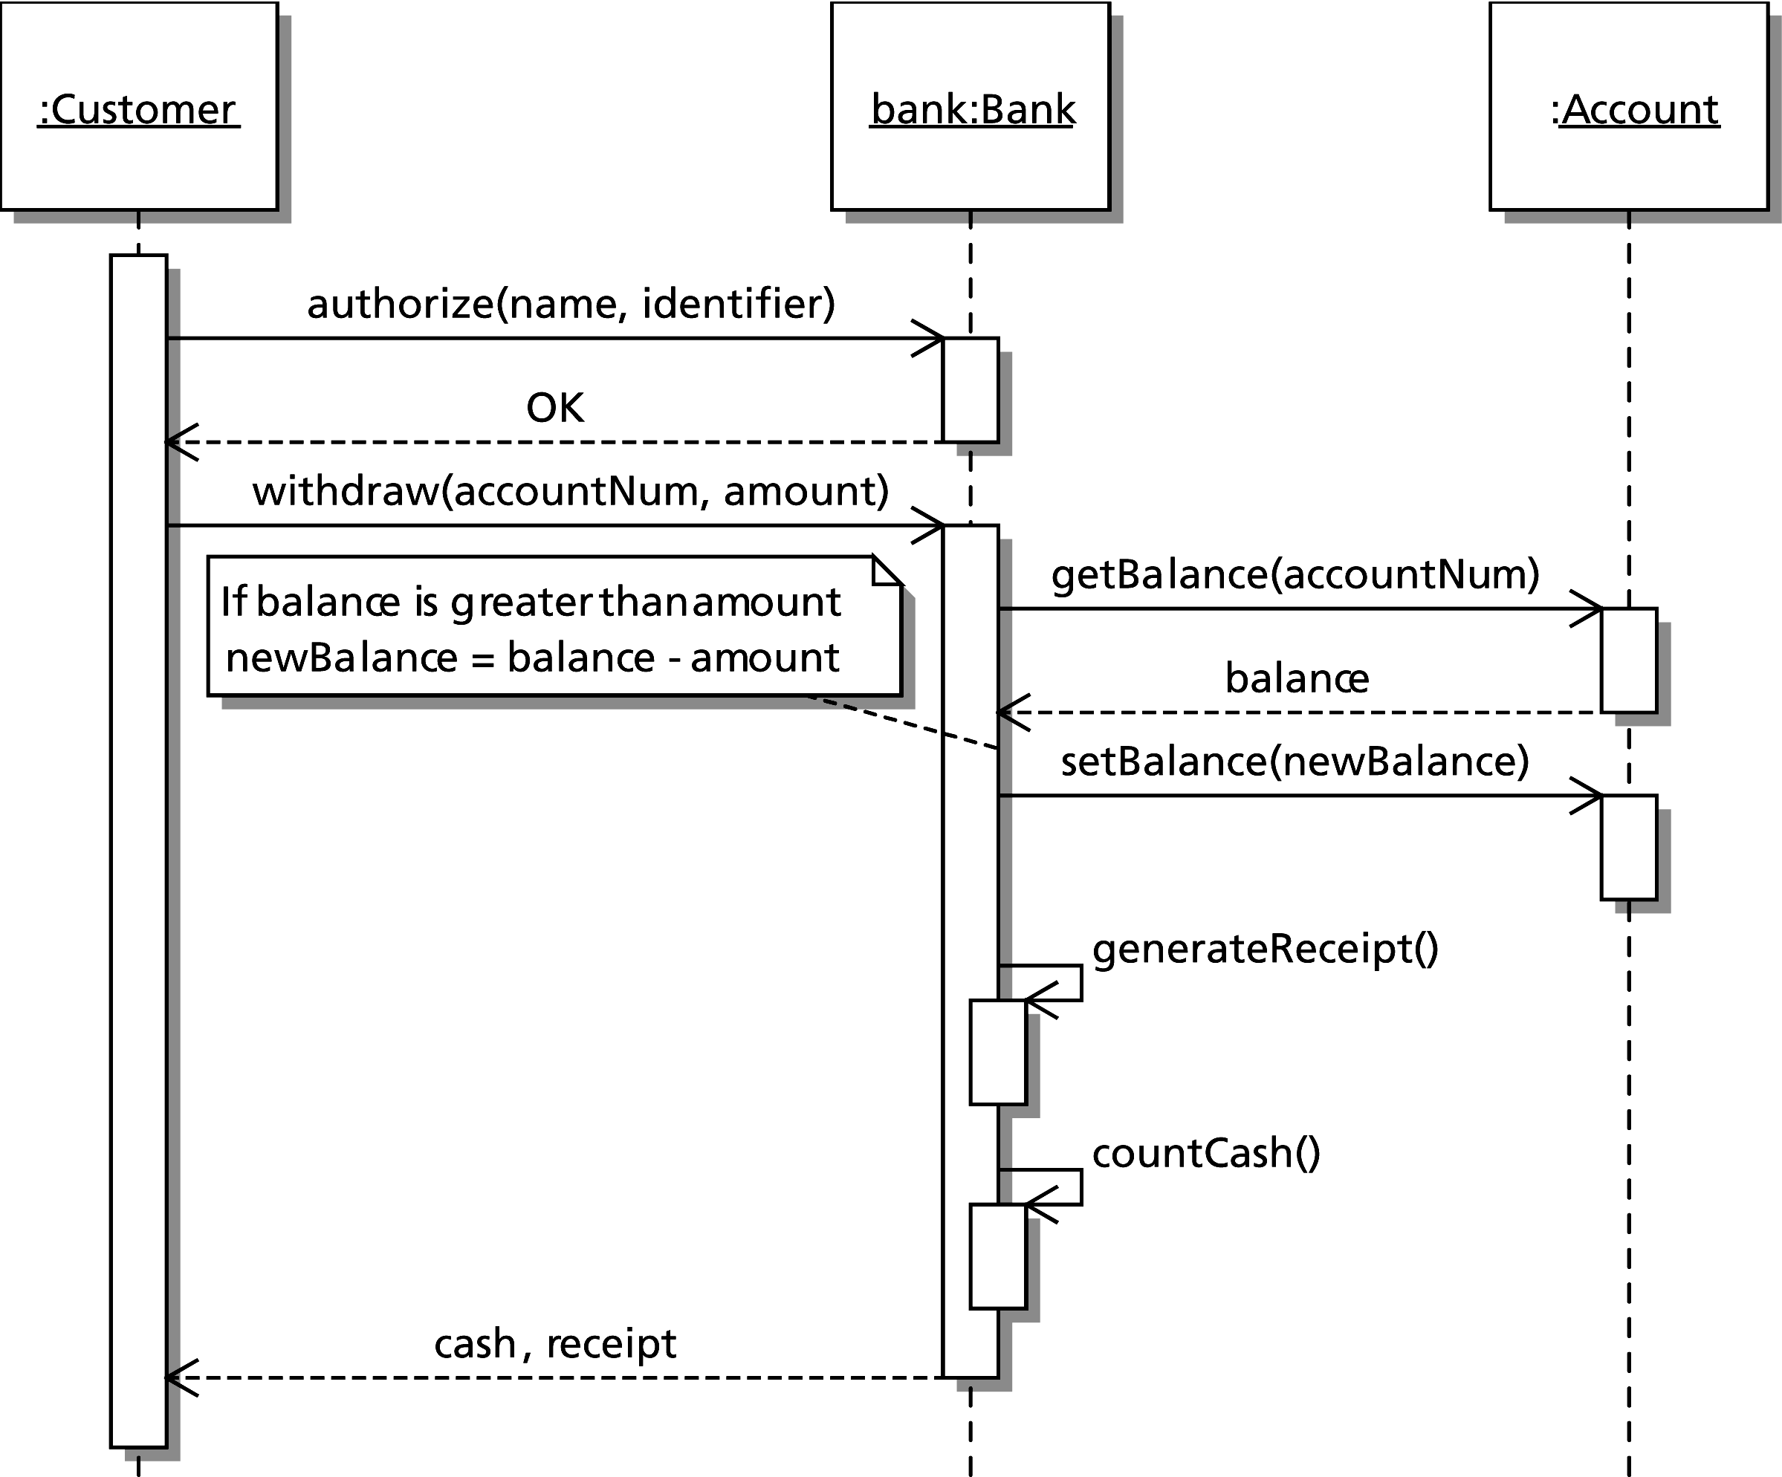
Applying the UML to OOA/D
Figure 1-2 Sequence diagram for the main success scenario
Notes:
Each object is represented as a box containing its name followed by a colon and its type, all underlined.
Each object has a lifeline denoted by a vertical dashed line.
Each lifeline can have one or more activations bars (open boxes) that show when the object is active and the responsibilities of the class.
A method call appears as a solid arrow from the calling object’s activation bar to the top of a new activation bar on the lifeline of the called object.
Such arrows are labeled with a message expression that describes the task performed.

Slide 22
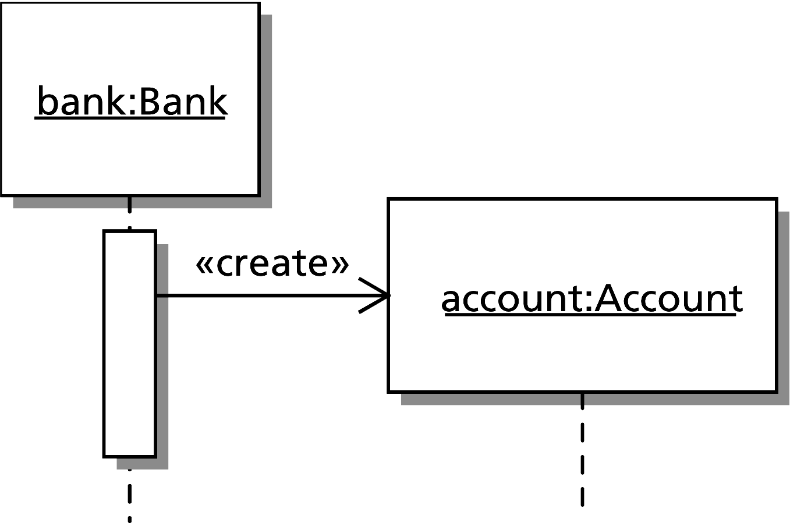
Applying the UML to OOA/D
Figure 1-3 Sequence diagram showing the creation of a new object
Notes:
The creation of a new object is represented by a stereotype (<<create>>)

Slide 23
Applying the UML to OOA/D
UML class (static) diagram
  Represents a conceptual model of a class of objects in a language-independent way
  Shows the name, attributes, and operations of a class
  Shows how multiple classes are related to one another

Slide 24
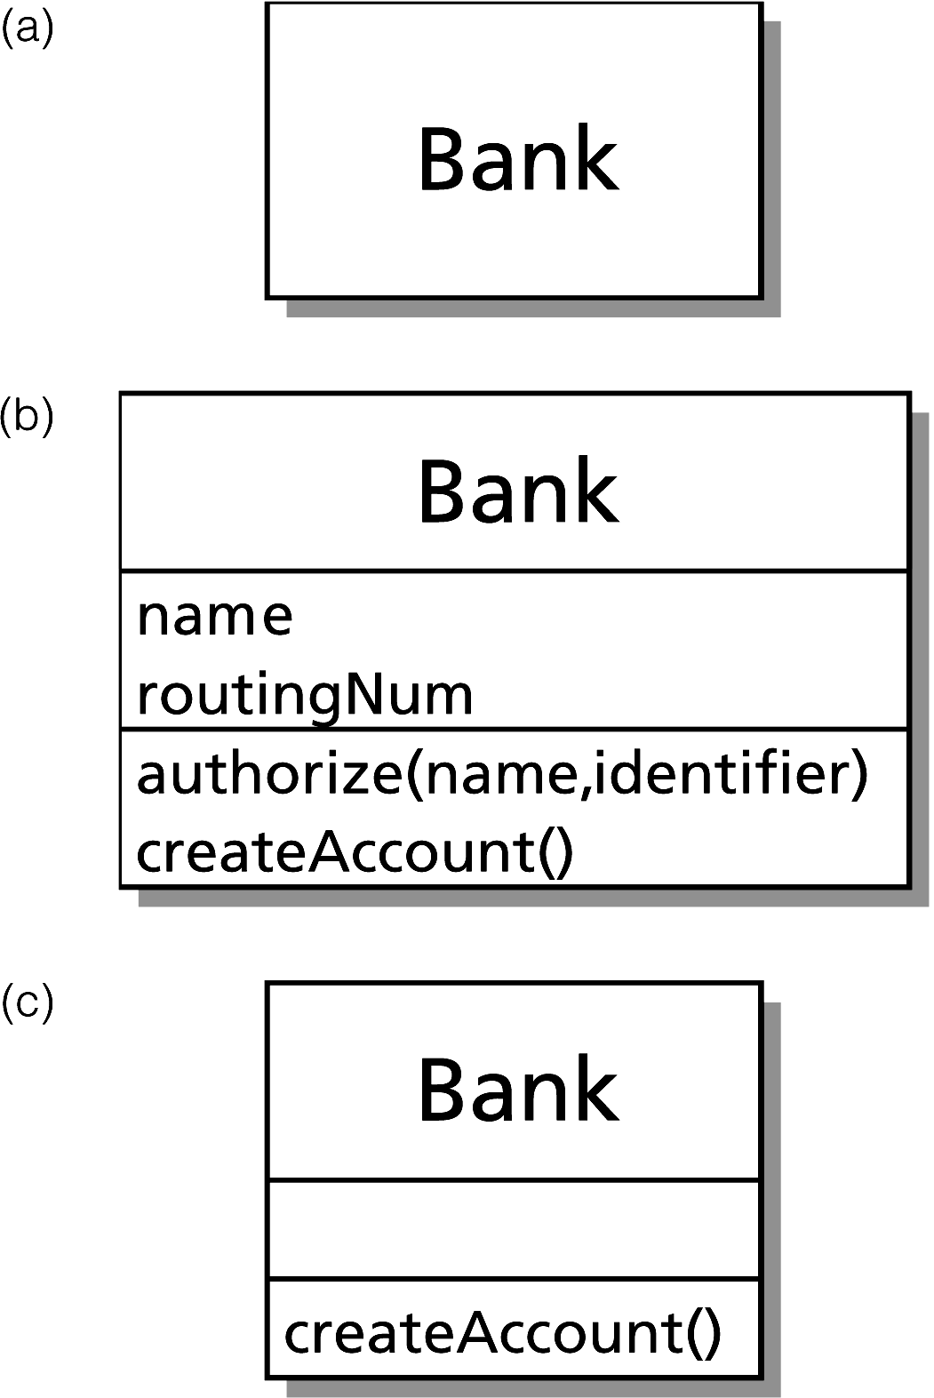
Applying the UML to OOA/D
Figure 1-4 Three possible class diagrams for a class of banks

Slide 25
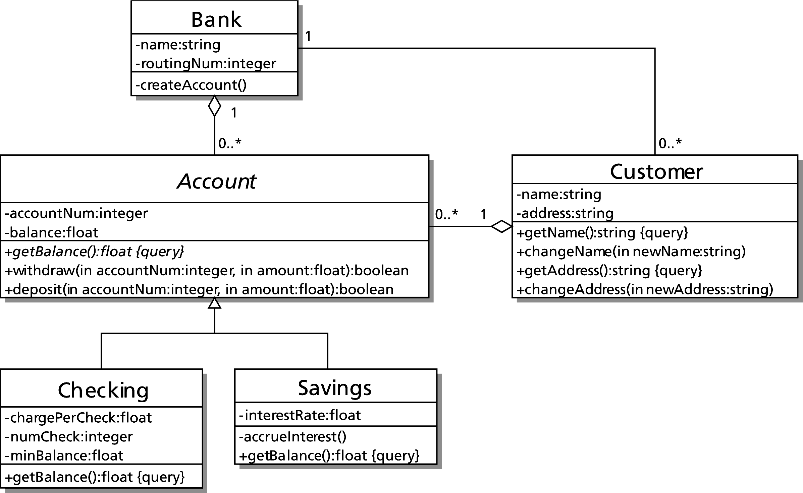
Applying the UML to OOA/D
Figure 1-5 A UML class diagram of a banking system

Slide 26
Applying the UML to OOA/D
Class relationships
  Association
    The classes know about each other
    Example: The Bank and Customer classes
  Aggregation (Containment)
    One class contains an instance of another class
    Example: The Bank and Account classes
    The lifetime of the containing object and the object contained are not necessarily the same
      Banks “live” longer than the accounts they contain

Slide 27
Applying the UML to OOA/D
Class relationships (Continued)
  Composition
    A stronger form of aggregation
    The lifetime of the containing object and the object contained are the same
    Example: A ballpoint pen
      When the pen “dies,” so does the ball

Slide 28
Applying the UML to OOA/D
Class relationships (Continued)
  Generalization
    Indicates a family of classes related by inheritance
    Example: Account is an ancestor class; the attributes and operations of Account are inherited by the descendant classes, Checking and Savings

Slide 29
Applying the UML to OOA/D
Notation
  Association
    A relationship between two classes is shown by a connecting solid line
    Relationships more specific than association are indicated with arrowheads, as you will see
    Multiplicities: Optional numbers at the end(s) of an association or other relationship
      Each bank object is associated with zero or more customers (denoted 0..*), but each customer is associated with one bank
      Each customer can have multiple accounts of any type, but an account can belong to only one customer

Slide 30
Applying the UML to OOA/D
Notation (Continued)
  Aggregation (Containment)
    Denoted by an open diamond arrowhead pointing to the containing class
  Composition
    Denoted by a filled-in diamond arrowhead pointing to the containing class
  Generalization (Inheritance)
    Denoted by an open triangular arrowhead pointing to the ancestor (general or parent) class
  UML also provides notation to specify visibility, type, parameter, and default value information

Slide 31
The Software Life Cycle
Describes the phases of software development from conception to deployment to replacement to deletion
  We will examine the phases from project conception to deployment to end users
  Beyond this development process, software needs maintenance to correct errors and add features
  Eventually software is retired

Slide 32
Iterative and Evolutionary Development
Iterative development of a solution to a problem
  Many short, fixed-length iterations
  Each iteration builds on the previous iteration until a complete solution is achieved
  Each iteration cycles through analysis, design, implementation, testing, and integration of a small portion of the problem domain
  Early iterations create the core of the system; further iterations build on that core

Slide 33
Iterative and Evolutionary Development
Each iteration has a duration called the timebox
  Chosen at beginning of project
  Typically 2 to 4 weeks
The partial system at the end of each iteration should be functional and completely tested
Each iteration makes relatively few changes to the previous iteration
End users can provide feedback at the end of each iteration

Slide 34
Rational Unified Process (RUP) Development Phases
RUP gives structure to the software development process
RUP uses the OOA/D tools we introduced
Four development phases:
  Inception: feasibility study, project vision, time/cost estimates
  Elaboration: refinement of project vision, time/cost estimates, and system requirements; development of core system
  Construction: iterative development of remaining system
  Transition: testing and deployment of the system

Slide 35
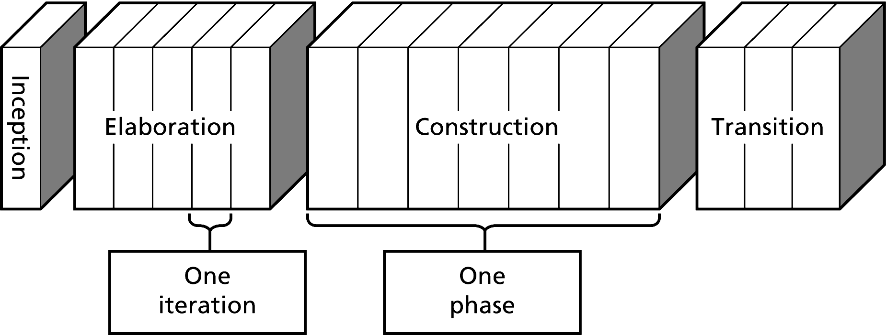
Rational Unified Process (RUP) Development Phases
Figure 1-7 RUP development phases

Slide 36
Rational Unified Process (RUP) Development Phases
Inception phase
  Define initial set of system requirements
  Generate a core set of use case scenarios (about 10% of total number)
  Identify highest-risk aspects of solution
  Choose iteration timebox length

Slide 37
Rational Unified Process (RUP) Development Phases
Elaboration phase
  Iteratively develop core architecture of system
  Address highest-risk aspects of system
    Most potential for system failure, so deal with them first
  Define most of the system requirements
  Extends over at least 2 iterations to allow for feedback
  Each iteration progresses through OO analysis and design (use case scenarios, sequence diagrams, class diagrams), coding, testing, integration, and feedback

Slide 38
Rational Unified Process (RUP) Development Phases
Construction phase
  Begins once most of the system requirements are formalized
  Develops the remaining system
  Each iteration requires less analysis and design
  Focus is on implementation and testing
Transition phase
  Beta testing with advanced end users
  System moves into a production environment

Slide 39
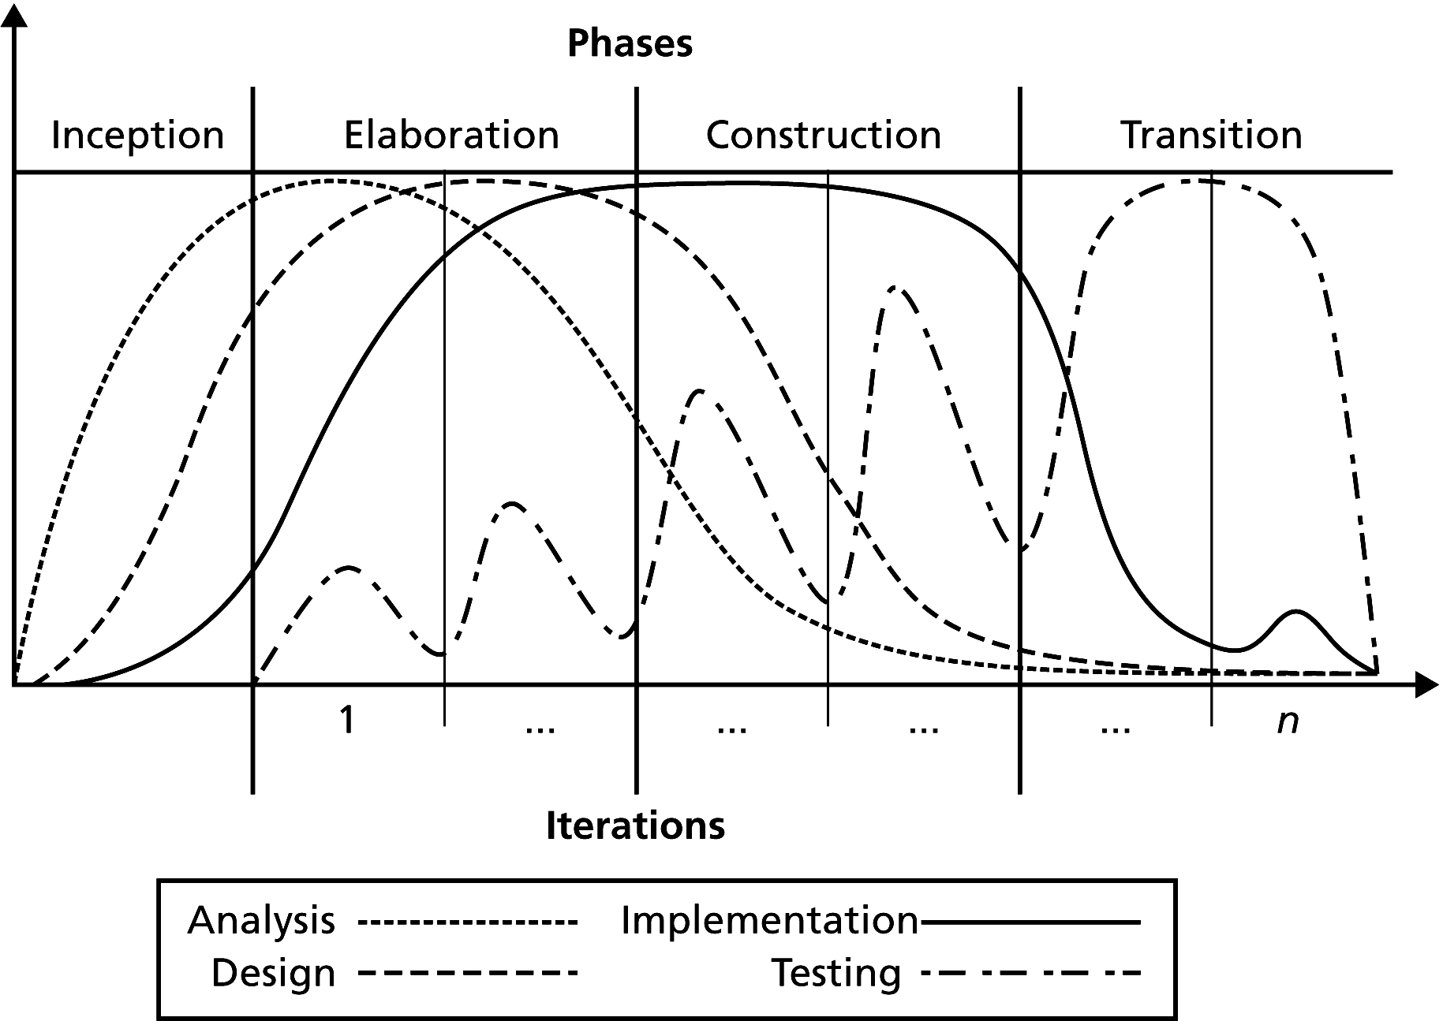
Rational Unified Process (RUP) Development Phases
Figure 1-8 Relative amounts of work done in each development phase

Slide 40
What About the Waterfall Method of Development?
Develops a solution sequentially by moving through phases: requirements analysis, design, implementation, testing, deployment
Hard to correctly specify a system without early feedback
Wrong analysis leads to wrong solution
Outdated and should not be used
Do not impose this method on RUP development

Slide 41
Achieving a Better Solution
Analysis and design improve solutions
What aspects of one solution make it better than another?
What aspects lead to better solutions?

Slide 42
Evaluation of Designs and Solutions
Cohesion
  A highly cohesive module performs one well-defined task
    A person with low cohesion has “too many irons in the fire”
  Promotes self-documenting, easy-to-understand code
  Easy to reuse in other software projects
  Easy to revise or correct
  Robust: less likely to be affected by change; performs well under unusual conditions
  Promotes low coupling

Slide 43
Evaluation of Designs and Solutions
Coupling
  Modules with low coupling are independent of one another
  System of modules with low coupling is
    Easier to change: A change to one module won’t affect another
    Easier to understand
  Module with low coupling is
    Easier to reuse
    Has increased cohesion
  Coupling cannot be and should not be eliminated entirely
    Objects must collaborate
  Class diagrams show dependencies among classes, and hence coupling

Slide 44
Evaluation of Designs and Solutions
Minimal and complete interfaces
  A class interface declares publicly accessible methods (and data)
    Describes only way for programmers to interact with the class
  Classes should be easy to understand, and so have few methods
    Desire to provide power is at odds with this goal
  Complete interface
    Provides methods for any reasonable task consistent with the responsibilities of the class
    Important that an interface is complete
  Minimal interface
    Provides only essential methods
    Classes with minimal interfaces are easier to understand, use, and maintain
    Less important than completeness

Slide 45
Evaluation of Designs and Solutions
  Signature: the interface for a method or function
    Name of method/function
    Arguments (number, order, type)
    Qualifiers such as const

Slide 46
Operation Contracts
A module’s operation contract specifies its
  Purpose
  Assumptions
  Input
  Output
Begin the contract during analysis, finish during design
Use to document code, particularly in header files

Slide 47
Operation Contracts
Specify data flow among modules
  What data is available to a module?
  What does the module assume?
  What actions take place?
  What effect does the module have on the data?

Slide 48
Operation Contracts
Contract shows the responsibilities of one module to another
Does not describe how the module will perform its task
Precondition: Statement of conditions that must exist before a module executes
Postcondition: Statement of conditions that exist after a module executes

Slide 49
Operation Contracts
First draft specifications
sort(anArray, num)
// Sorts an array.
// Precondition: anArray is an array of num integers; num > 0.
// Postcondition: The integers in anArray are sorted.

Slide 50
Operation Contracts
Revised specifications
sort(anArray, num)
// Sorts an array into ascending order.
// Precondition: anArray is an array of num
// integers; 1 <= num <= MAX_ARRAY, where
// MAX_ARRAY is a global constant that specifies
// the maximum size of anArray.
// Postcondition: anArray[0] <= anArray[1] <= ...
// <= anArray[num-1], num is unchanged.

Slide 51
Verification
Assertion: A statement about a particular condition at a certain point in an algorithm
  Preconditions and postconditions are examples of assertions
Invariant: A condition that is always true at a certain point in an algorithm
Loop invariant: A condition that is true before and after each execution of an algorithm’s loop
  Can be used to detect errors before coding is started

Slide 52
Verification
Loop invariant (continued)
  The invariant for a correct loop is true:
    Initially, after any initialization steps, but before the loop begins execution
    Before every iteration of the loop
    After every iteration of the loop
    After the loop terminates

Slide 53
Verification
It is possible to prove the correctness of some algorithms
  Like proving a theorem in geometry
  Starting with a precondition, you prove that each assertion before a step in an algorithm leads to the assertion after the step until you reach the postcondition

Slide 54
What is a Good Solution?
A solution is good if:
  The total cost it incurs over all phases of its life cycle is minimal
The cost of a solution includes:
  Computer resources that the program consumes
  Difficulties encountered by users
  Consequences of a program that does not behave correctly
Programs must be well structured and documented
Efficiency is one aspect of a solution’s cost

Slide 55
Key Issues in Programming
Modularity
Style
Modifiability
Ease of Use
Fail-safe programming
Debugging
Testing

Slide 56
Key Issues in Programming: Modularity
Modularity has a favorable impact on
  Constructing programs
  Debugging programs
  Reading programs
  Modifying programs
  Eliminating redundant code

Slide 57
Key Issues in Programming: Style
Use of private data members
Proper use of reference arguments
Proper use of methods
Avoidance of global variables in modules
Error handling
Readability
Documentation

Slide 58
Key Issues in Programming: Modifiability
Modifiability is easier through the use of
  Named constants
  The typedef statement

Slide 59
Key Issues in Programming:
Ease of Use
  In an interactive environment, the program should prompt the user for input in a clear manner
  A program should always echo its input
  The output should be well labeled and easy to read

Slide 60
Key Issues in Programming:
Fail-Safe Programming
  Fail-safe programs will perform reasonably no matter how anyone uses it
  Test for invalid input data and program logic errors
  Check invariants
  Enforce preconditions
  Check argument values

Slide 61
Key Issues in Programming: Debugging
  Programmer must systematically check a program’s logic to find where an error occurs
  Tools to use while debugging:
    – Single-stepping
    – Watches
    – Breakpoints
    – cout statements
    – Dump functions

Slide 62
Key Issues in Programming:
Testing
Levels
  Unit testing: Test methods, then classes
  Integration testing: Test interactions among modules
  System testing: Test entire program
  Acceptance testing: Show that system complies with requirements

Slide 63
Key Issues in Programming:
Testing
Types
  Open-box (white-box or glass-box) testing
    Test knowing the implementation
    Test all lines of code (decision branches, etc.)
  Closed-box (black-box or functional) testing
    Test knowing only the specifications

Slide 64
Key Issues in Programming:
Testing
Developing test data
  Include boundary values
  Need to know expected results

Slide 65
Key Issues in Programming:
Testing
Techniques
  assert statements to check invariants
  Disable, but do not remove, code used for testing
    /* and */
    Booleans
    Macros

Slide 66
Key Issues in Programming:
Testing
Stubs
  An incompletely implemented method that simply acknowledges that it was called
Drivers
  A module that tests another module
  For example, a main function

Slide 67
Summary
Software engineering
  Techniques to facilitate development of programs
Software life cycle
  Phases through which software progresses, from conception to deployment to replacement to deletion
Loop invariant
  Property that is true before and after each iteration of a loop
Evaluating the quality of a solution
  Correctness, efficiency, development time, ease of use, cost of modification

Slide 68
Summary
Practice abstraction: Focus on what a module does, not how
  For data-management problems
    Encapsulate data with operations by forming classes
  For algorithmic tasks
    Break into subtasks
UML is a modeling language used to express OO designs visually

Slide 69
Summary
A solution should be easy to modify
  Modular
  Independent of implementation of it modules
Each function/method should be as independent as possible and perform one well-defined task
Each function/method should include a comment: purpose, precondition, and postcondition
A program should be as fail-safe as possible
Effective use of available diagnostic aids is one of the keys to debugging
Use “dump functions” to help to examine and debug the contents of data structures

