Slide 1
Chapter 2:
Recursion: The Mirrors
Data Abstraction & Problem Solving with
C++
Fifth Edition
by Frank M. Carrano

Slide 2
Recursive Solutions
Recursion is an extremely powerful problem-solving technique
  Breaks problem into smaller identical problems
  An alternative to iteration, which involves loops
A binary search is recursive
  Repeatedly halves the data collection and searches the one half that could contain the item
  Uses a divide and conquer strategy

Slide 3
Recursive Solutions
Facts about a recursive solution
  A recursive function calls itself
  Each recursive call solves an identical, but smaller, problem
  The solution to at least one smaller problem— the base case—is known
  Eventually, one of the smaller problems must be the base case; reaching the base case enables the recursive calls to stop

Slide 4
Recursive Solutions
Four questions for constructing recursive solutions
  How can you define the problem in terms of a smaller problem of the same type?
  How does each recursive call diminish the size of the problem?
  What instance of the problem can serve as the base case?
  As the problem size diminishes, will you reach this base case?

Slide 5
A Recursive Valued Function:
The Factorial of n
Problem
  Compute the factorial of an integer n
An iterative definition of factorial(n)
  factorial(n) = n * (n – 1) * (n – 2) * … * 1
  for any integer n > 0
  factorial(0) = 1

Slide 6
A Recursive Valued Function:
The Factorial of n
A recursive definition of factorial(n)
  factorial(n) = 1 if n = 0
  = n * factorial(n–1) if n > 0

Slide 7
A Recursive Valued Function:
The Factorial of n
A recurrence relation
  A mathematical formula that generates the terms in a sequence from previous terms
  Example
  factorial(n) = n * [(n – 1) * (n – 2) * … * 1]
  = n * factorial(n – 1)

Slide 8
A Recursive Valued Function:
The Factorial of n
Box trace
  A systematic way to trace the actions of a recursive function
  Each box roughly corresponds to an activation record
  Contains a function’s local environment at the time of and as a result of the call to the function

Slide 9
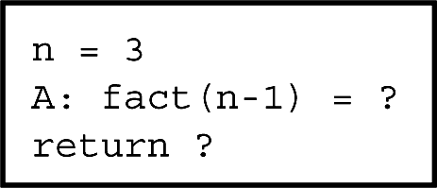
A Recursive Valued Function:
The Factorial of n
Figure 2-3 A box

Slide 10
A Recursive Valued Function:
The Factorial of n
A function’s local environment includes:
  The function’s local variables
  A copy of the actual value arguments
  A return address in the calling routine
  The value of the function itself

Slide 11
A Recursive void Function:
Writing a String Backward
Problem
  Given a string of characters, write it in reverse order
Recursive solution
  Each recursive step of the solution diminishes by 1 the length of the string to be written backward
  Base case: write the empty string backward

Slide 12
A Recursive void Function:
Writing a String Backward
Execution of writeBackward can be traced using the box trace
Temporary cout statements can be used to debug a recursive method

Slide 13
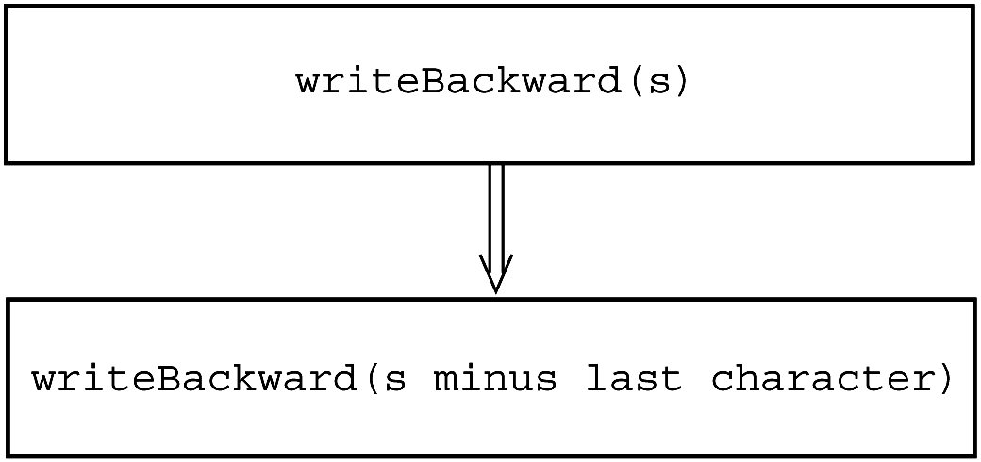
A Recursive void Function:
Writing a String Backward
Figure 2-6 A recursive solution

Slide 14
Multiplying Rabbits
(The Fibonacci Sequence)
“Facts” about rabbits
  Rabbits never die
  A rabbit reaches sexual maturity exactly two months after birth, that is, at the beginning of its third month of life
  Rabbits are always born in male-female pairs. At the beginning of every month, each sexually mature male-female pair gives birth to exactly one male-female pair

Slide 15
Multiplying Rabbits
(The Fibonacci Sequence)
Problem
  How many pairs of rabbits are alive in month n?
Recurrence relation
  rabbit(n) = rabbit(n – 1) + rabbit(n – 2)

Slide 16
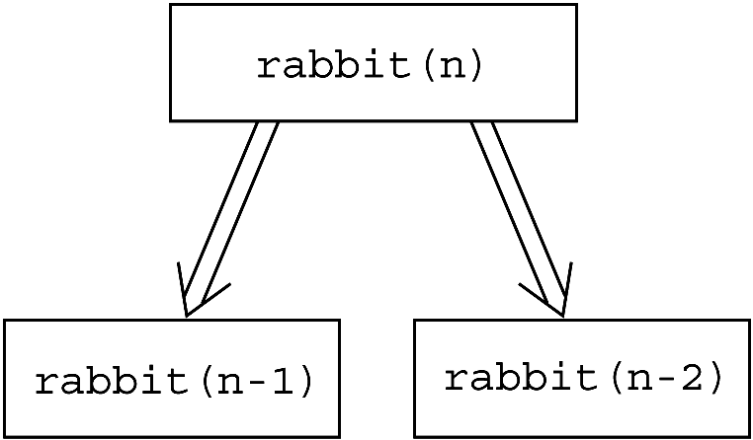
Multiplying Rabbits
(The Fibonacci Sequence)
Figure 2-10 Recursive solution to the rabbit problem

Slide 17
Multiplying Rabbits
(The Fibonacci Sequence)
Base cases
  rabbit(2), rabbit(1)
Recursive definition
  rabbit(n) = 1 if n is 1 or 2
  rabbit(n – 1) + rabbit(n – 2) if n > 2
Fibonacci sequence
  The series of numbers rabbit(1), rabbit(2), rabbit(3),
  and so on; that is, 1, 1, 2, 3, 5, 8, 13, 21, 34, …

Slide 18
Organizing a Parade
Problem
  How many ways can you organize a parade of length n?
  The parade will consist of bands and floats in a single line
  One band cannot be placed immediately after another

Slide 19
Organizing a Parade
Let:
  P(n) be the number of ways to organize a parade of length n
  F(n) be the number of parades of length n that end with a float
  B(n) be the number of parades of length n that end with a band
Then
  P(n) = F(n) + B(n)

Slide 20
Organizing a Parade
Number of acceptable parades of length n that end with a float
  F(n) = P(n – 1)
Number of acceptable parades of length n that end with a band
  B(n) = F(n – 1)
Number of acceptable parades of length n
  P(n) = P(n – 1) + P(n – 2)

Slide 21
Organizing a Parade
Base cases
  P(1) = 2 (The parades of length 1 are
  float and band.)
  P(2) = 3 (The parades of length 2 are float- float, band- float, and float-band.)

Slide 22
Organizing a Parade
Solution
  P(1) = 2
  P(2) = 3
  P(n) = P(n – 1) + P(n – 2) for n > 2

Slide 23
Mr. Spock’s Dilemma
(Choosing k out of n Things)
Problem
  How many different choices are possible for exploring k planets out of n planets in a solar system?

Slide 24
Mr. Spock’s Dilemma
(Choosing k out of n Things)
Let c(n, k) be the number of groups of k planets chosen from n
In terms of Planet X:
  c(n, k) = the number of groups of k planets that
  include Planet X
  +
  the number of groups of k planets that
  do not include Planet X

Slide 25
Mr. Spock’s Dilemma
(Choosing k out of n Things)
The number of ways to choose k out of n things is the sum of
  The number of ways to choose k – 1 out of n – 1 things
  and the number of ways to choose k out of n – 1 things
  c(n, k) = c(n – 1, k – 1) + c(n – 1, k)

Slide 26
Mr. Spock’s Dilemma
(Choosing k out of n Things)
Base cases
  There is one group of everything
  c(k, k) = 1
  There is one group of nothing
  c(n, 0) = 1
  Although k cannot exceed n here, we want our solution to be general
  c(n, k) = 0 if k > n

Slide 27
Mr. Spock’s Dilemma
(Choosing k out of n Things)
Recursive solution
c(n, k) =
  1 if k = 0
  1 if k = n
  0 if k > n
  c(n – 1, k – 1) + c(n – 1, k) if 0 < k < n

Slide 28
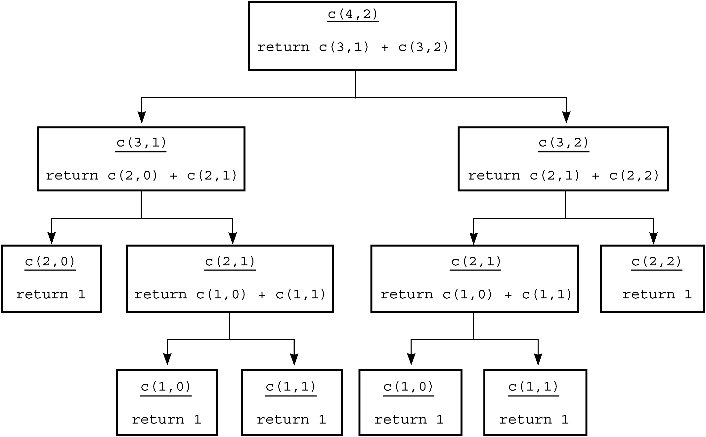
Mr. Spock’s Dilemma
(Choosing k out of n Things)
Figure 2-12 The recursive calls that c(4, 2) generates

Slide 29
Searching an Array:
Finding the Largest Item in an Array
A recursive solution
  if (anArray has only one item)
  maxArray(anArray) is the item in anArray
  else if (anArray has more than one item) maxArray(anArray) is the maximum of
  maxArray(left half of anArray) and
  maxArray(right half of anArray)

Slide 30
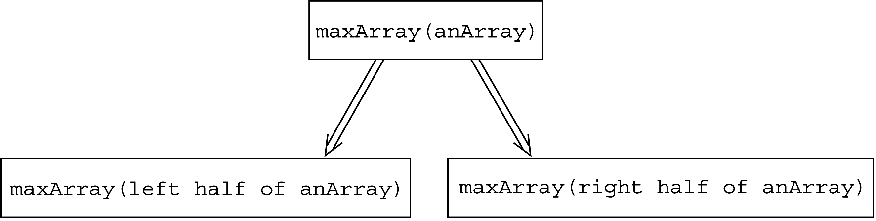
Searching an Array:
Finding the Largest Item in an Array
Figure 2-13 Recursive solution to the largest-item problem

Slide 31
Binary Search
A high-level binary search
  binarySearch(in anArray:ArrayType, in value:ItemType)
  if (anArray is of size 1)
  Determine if anArray’s item is equal to value
  else
  { Find the midpoint of anArray
  Determine which half of anArray contains value
  if (value is in the first half of anArray) binarySearch(first half of anArray, value)
  else
  binarySearch(second half of anArray, value)
  }

Slide 32
Binary Search
Implementation issues:
  How will you pass “half of anArray” to the recursive calls to binarySearch?
  How do you determine which half of the array contains value?
  What should the base case(s) be?
  How will binarySearch indicate the result of the search?

Slide 33
Finding the k^{th} Smallest Item in an Array
The recursive solution proceeds by:
  Selecting a pivot item in the array
  Cleverly arranging, or partitioning, the items in the array about this pivot item
  Recursively applying the strategy to one of the partitions

Slide 34
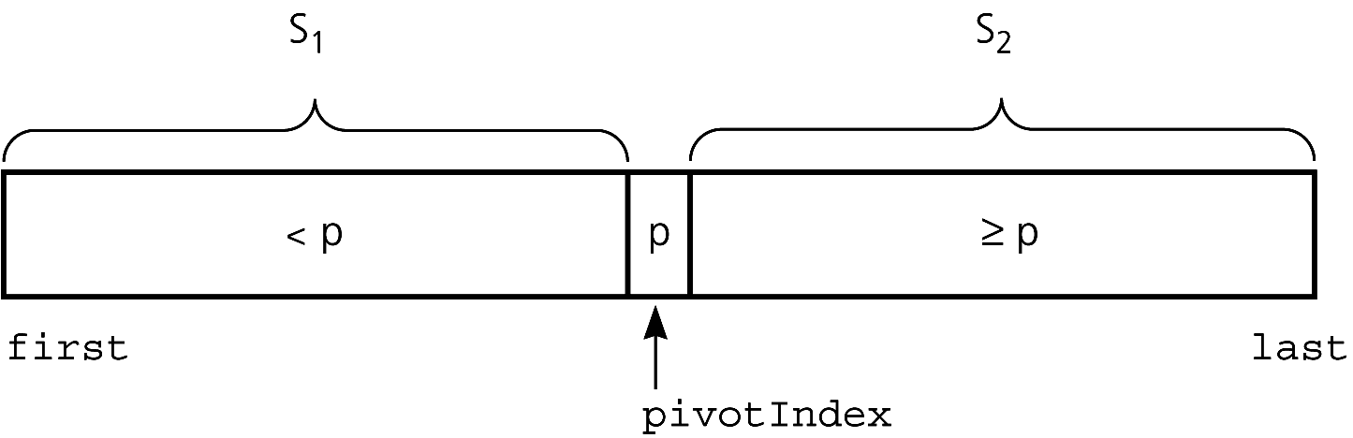
Finding the k^{th} Smallest Item in an Array
Figure 2-18 A partition about a pivot

Slide 35
Finding the k^{th} Smallest Item in an Array
Let:
  kSmall(k, anArray, first, last) =
  k^{th} smallest item in anArray[first..last]

Slide 36
Finding the k^{th} Smallest Item in an Array
Solution:
  kSmall(k, anArray, first, last)
  = kSmall(k,anArray,first,pivotIndex-1)
  if k < pivotIndex – first + 1
  = p if k = pivotIndex – first + 1
  = kSmall(k-(pivotIndex-first+1), anArray,
  pivotIndex+1, last)
  if k > pivotIndex – first + 1

Slide 37
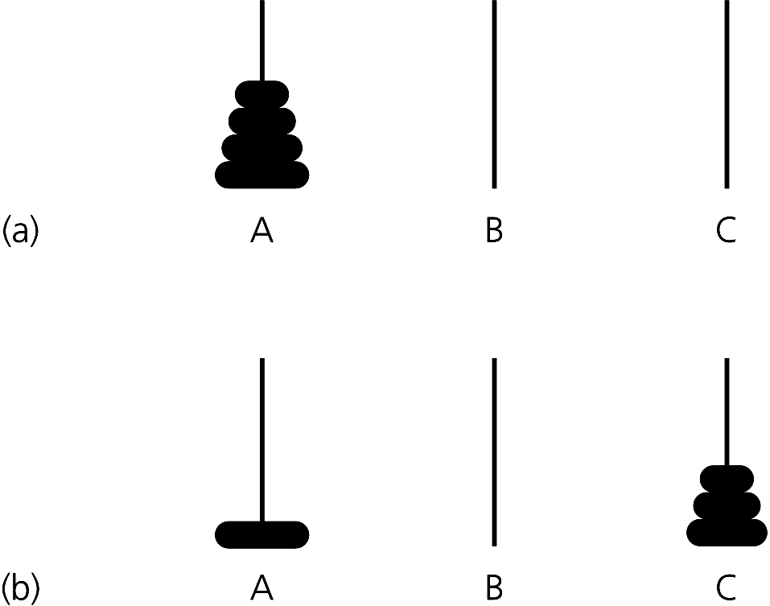
Organizing Data:
The Towers of Hanoi
Figure 2-19a and b (a) The initial state; (b) move n - 1 disks from A to C

Slide 38
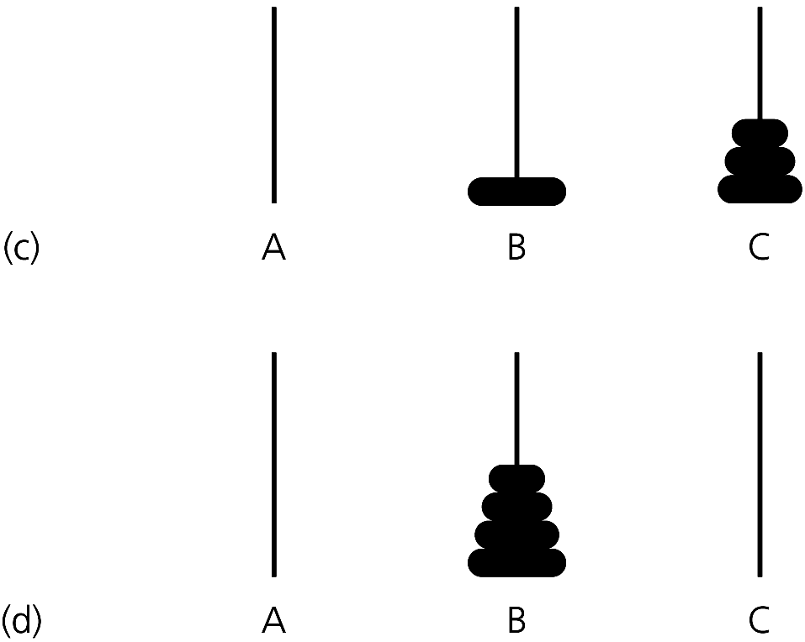
The Towers of Hanoi
Figure 2-19c and d (c) move one disk from A to B; (d) move n - 1 disks from C to B

Slide 39
The Towers of Hanoi
Pseudocode solution
  solveTowers(count, source, destination, spare)
  if (count is 1)
  Move a disk directly from source to
  destination
  else
  { solveTowers(count-1, source, spare,
  destination)
  solveTowers(1, source, destination, spare)
  solveTowers(count-1, spare, destination,
  source)
  } //end if

Slide 40
Recursion and Efficiency
Some recursive solutions are so inefficient that they should not be used
Factors that contribute to the inefficiency of some recursive solutions
  Overhead associated with function calls
  Inherent inefficiency of some recursive algorithms

Slide 41
Recursion and Efficiency
Do not use a recursive solution if it is inefficient and there is a clear, efficient iterative solution

Slide 42
Summary
Recursion solves a problem by solving a smaller problem of the same type
Four questions:
  How can you define the problem in terms of a smaller problem of the same type?
  How does each recursive call diminish the size of the problem?
  What instance(s) of the problem can serve as the base case?
  As the problem size diminishes, will you reach a base case?

Slide 43
Summary
To construct a recursive solution, assume a recursive call’s postcondition is true if its precondition is true
The box trace can be used to trace the actions of a recursive method
Recursion can be used to solve problems whose iterative solutions are difficult to conceptualize

Slide 44
Summary
Some recursive solutions are much less efficient than a corresponding iterative solution due to their inherently inefficient algorithms and the overhead of function calls
If you can easily, clearly, and efficiently solve a problem by using iteration, you should do so

