Slide 1
Chapter 6:
Stacks
Data Abstraction & Problem Solving with
C++
Fifth Edition
by Frank M. Carrano

Slide 2
The Abstract Data Type
Specifications of an abstract data type for a particular problem
  Can emerge during the design of the problem’s solution
  Examples
    readAndCorrect algorithm
    displayBackward algorithm

Slide 3
Developing an ADT During the Design of a Solution
ADT stack operations
  Create an empty stack
  Destroy a stack
  Determine whether a stack is empty
  Add a new item to the stack
  Remove the item that was added most recently
  Retrieve the item that was added most recently

Slide 4
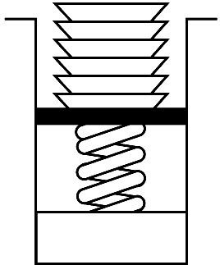
Developing an ADT During the Design of a Solution
A stack
  Last-in, first-out (LIFO) property
    The last item placed on the stack will be the first item removed
  Analogy
    A stack of dishes in a cafeteria
Figure 6-1
Stack of cafeteria dishes

Slide 5
Refining the Definition of the ADT Stack
Operation Contract for the ADT Stack
  isEmpty():boolean {query}
  push(in newItem:StackItemType)
  throw StackException
  pop() throw StackException
  pop(out stackTop:StackItemType)
  throw StackException
  getTop(out stackTop:StackItemType) {query}
  throw StackException

Slide 6
Using the ADT Stack in a Solution
A program can use a stack independently of the stack’s implementation
  displayBackward and readAndCorrect algorithms can be refined using stack operations
Use axioms to define an ADT stack formally
  Example: Specify that the last item inserted is the first item to be removed
    (aStack.push(newItem)).pop()= aStack

Slide 7
Checking for Balanced Braces
A stack can be used to verify whether a program contains balanced braces
  An example of balanced braces
    abc{defg{ijk}{l{mn}}op}qr
  An example of unbalanced braces
    abc{def}}{ghij{kl}m

Slide 8
Checking for Balanced Braces
Requirements for balanced braces
  Each time you encounter a “}”, it matches an already encountered “{”
  When you reach the end of the string, you have matched each “{”

Slide 9
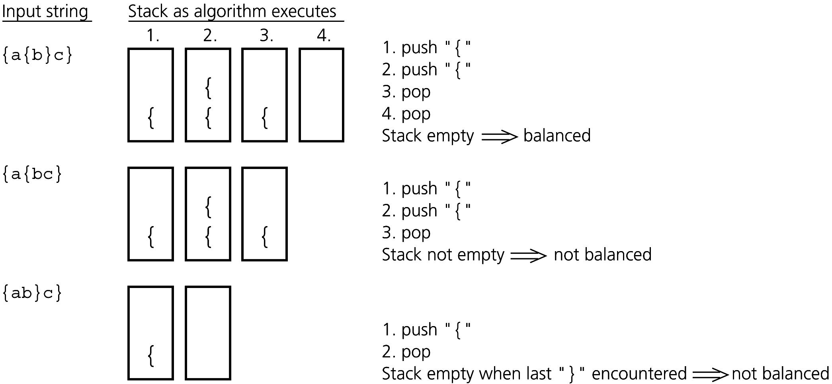
Checking for Balanced Braces
Figure 6-3
Traces of the algorithm that checks for balanced braces

Slide 10
Recognizing Strings in a Language
L = {w$w’ : w is a possibly empty string of
characters other than $,
w’ = reverse(w) }
A solution using a stack
  Traverse the first half of the string, pushing each character onto a stack
  Once you reach the $, for each character in the second half of the string, match a popped character off the stack

Slide 11
Implementations of the ADT Stack
The ADT stack can be implemented using
  An array
  A linked list
  The ADT list
All three implementations use a StackException class to handle possible exceptions

Slide 12
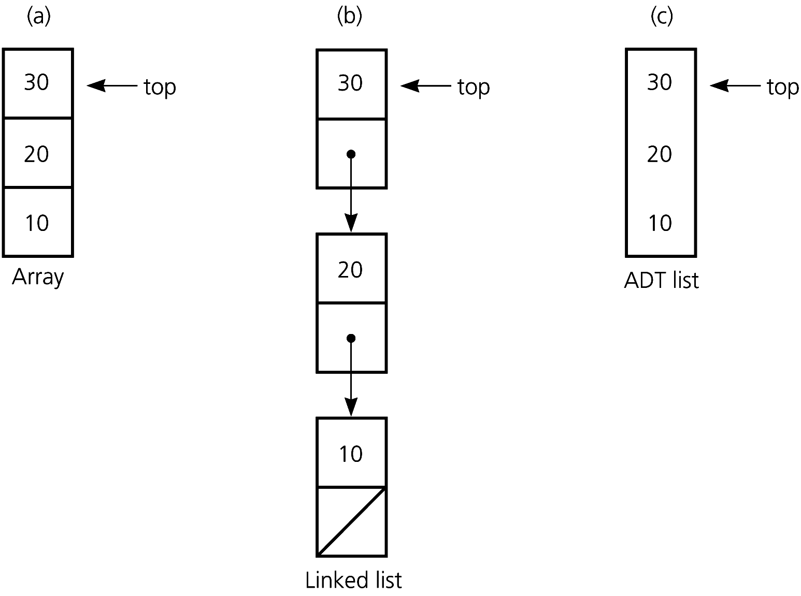
Implementations of the ADT Stack
Figure 6-4
Implementations of the ADT stack that use (a) an array; (b) a linked list; (c) an ADT list

Slide 13
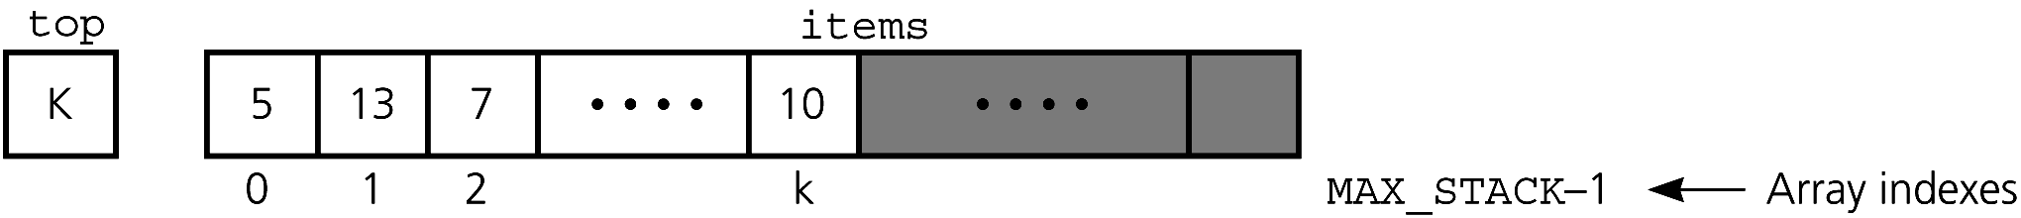
An Array-Based Implementation of the ADT Stack
Private data fields
  An array of items of type StackItemType
  The index top to the top item
Compiler-generated destructor and copy constructor
Figure 6-5
An array-based implementation

Slide 14
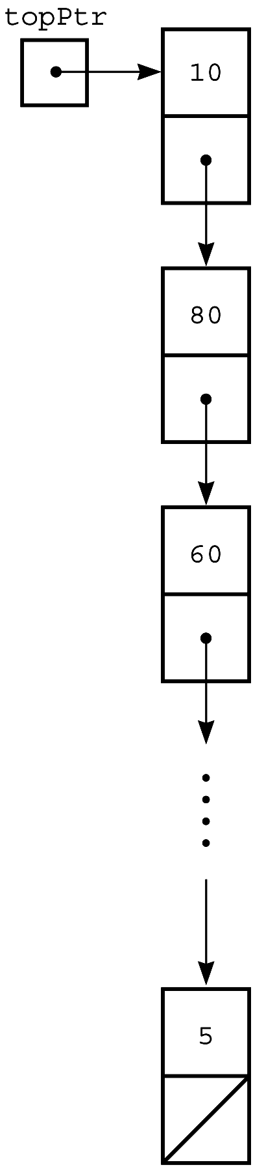
A Pointer-Based Implementation of the ADT Stack
A pointer-based implementation
  Enables the stack to grow and shrink dynamically
topPtr is a pointer to the head of a linked list of items
A copy constructor and destructor must be supplied
Figure 6-6 A pointer-based implementation

Slide 15
An Implementation That Uses the ADT List
The ADT list can represent the items in a stack
Let the item in position 1 of the list be the top
  push(newItem)
    insert(1, newItem)
  pop()
    remove(1)
  getTop(stackTop)
    retrieve(1, stackTop)

Slide 16
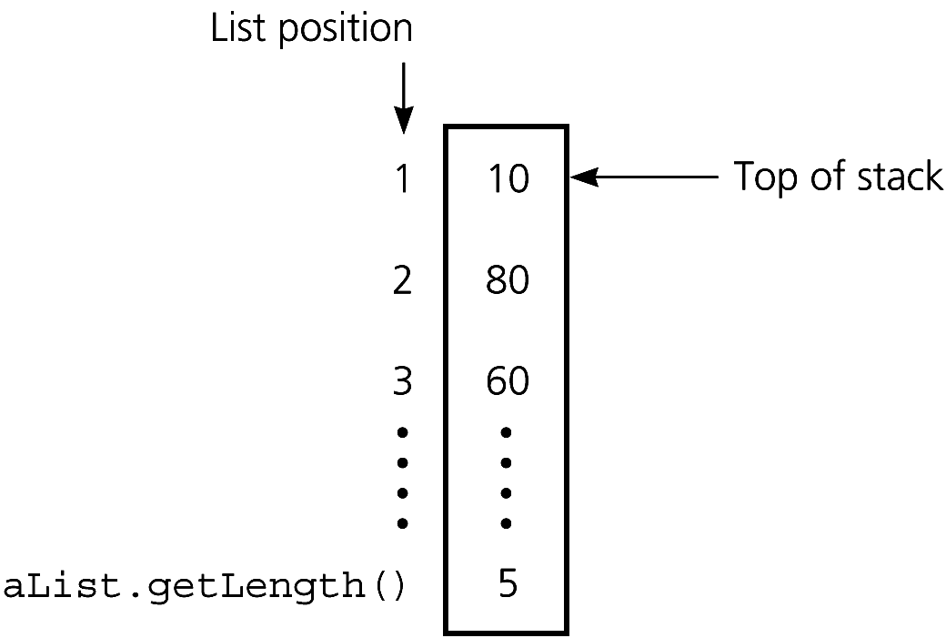
An Implementation That Uses the ADT List
Figure 6-7
An implementation that uses the ADT list

Slide 17
Comparing Implementations
Fixed size versus dynamic size
  A statically allocated array-based implementation
    Fixed-size stack that can get full
    Prevents the push operation from adding an item to the stack, if the array is full
  A dynamically allocated array-based implementation or a pointer-based implementation
    No size restriction on the stack

Slide 18
Comparing Implementations
A pointer-based implementation vs. one that uses a pointer-based implementation of the ADT list
  Pointer-based implementation is more efficient
  ADT list approach reuses an already implemented class
    Much simpler to write
    Saves programming time

Slide 19
The STL Class stack
Provides a size function
Has two data type parameters
  T, the data type for the stack items
  Container, the container class that the STL uses in its implementation of the stack
Uses the keyword explicit in the constructor’s declaration to prevent use of the assignment operator to invoke the constructor

Slide 20
Application:
Algebraic Expressions
When the ADT stack is used to solve a problem, the use of the ADT’s operations should not depend on its implementation
To evaluate an infix expression
  Convert the infix expression to postfix form
  Evaluate the postfix expression

Slide 21
Evaluating Postfix Expressions
A postfix calculator
  When an operand is entered, the calculator
    Pushes it onto a stack
  When an operator is entered, the calculator
    Applies it to the top two operands of the stack
    Pops the operands from the stack
    Pushes the result of the operation onto the stack

Slide 22
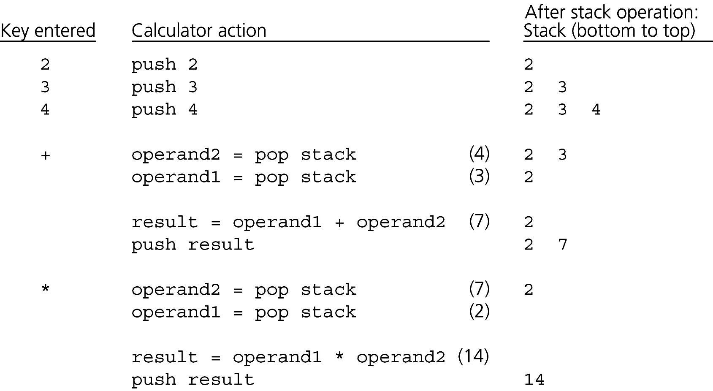
Evaluating Postfix Expressions
Figure 6-8
The action of a postfix calculator when evaluating the expression 2 * (3 + 4)

Slide 23
Evaluating Postfix Expressions
To evaluate a postfix expression entered as a string of characters
  Use the same steps as a postfix calculator
  Simplifying assumptions
    The string is a syntactically correct postfix expression
    No unary operators are present
    No exponentiation operators are present
    Operands are single lowercase letters that represent integer values

Slide 24
Converting Infix Expressions to Equivalent Postfix Expressions
You can evaluate an infix expression by first converting it into an equivalent postfix expression
Facts about converting from infix to postfix
  Operands always stay in the same order with respect to one another
  An operator will move only “to the right” with respect to the operands
  All parentheses are removed

Slide 25
Converting Infix Expressions to Equivalent Postfix Expressions
Steps as you process the infix expression:
  Append an operand to the end of an initially empty string postfixExpr
  Push ( onto a stack
  Push an operator onto the stack, if stack is empty; otherwise pop operators and append them to postfixExpr as long as they have a precedence >= that of the operator in the infix expression
  At ), pop operators from stack and append them to postfixExpr until ( is popped

Slide 26
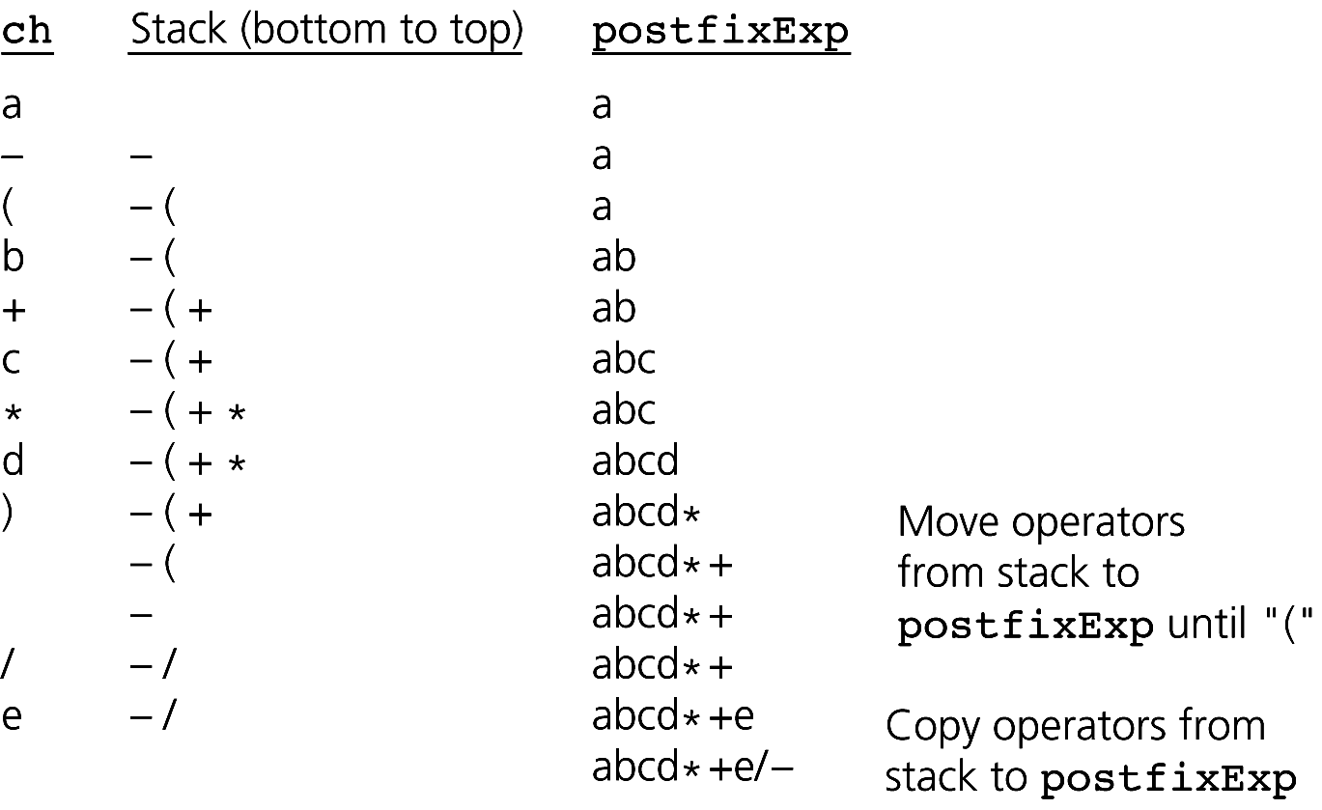
Converting Infix Expressions to Equivalent Postfix Expressions
Figure 6-9
A trace of the algorithm that converts the infix expression a - (b + c * d) / e to postfix form

Slide 27
Application: A Search Problem
High Planes Airline Company (HPAir)
  For each customer request, indicate whether a sequence of HPAir flights exists from the origin city to the destination city
The flight map for HPAir is a graph
  Adjacent vertices are two vertices that are joined by an edge
  A directed path is a sequence of directed edges

Slide 28
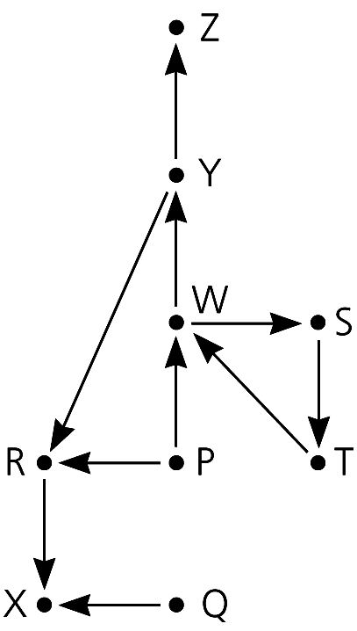
Application: A Search Problem
Figure 6-10
Flight map for HPAir

Slide 29
A Nonrecursive Solution That Uses a Stack
The solution performs an exhaustive search
  Beginning at the origin city, the solution will try every possible sequence of flights until either
    It finds a sequence that gets to the destination city
    It determines that no such sequence exists
Backtracking can be used to recover from choosing a wrong city

Slide 30
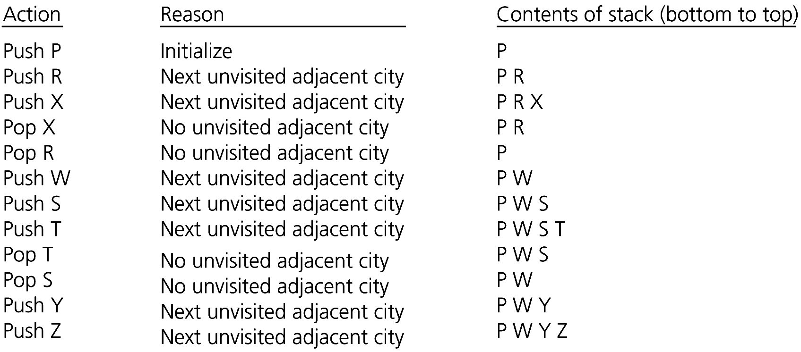
A Nonrecursive Solution That Uses a Stack
Figure 6-13
A trace of the search algorithm, given the flight map in Figure 6-10

Slide 31
A Recursive Solution
Possible outcomes of the recursive search strategy
  You eventually reach the destination city and can conclude that it is possible to fly from the origin to the destination
  You reach a city C from which there are no departing flights
  You go around in circles

Slide 32
A Recursive Solution
A refined recursive search strategy
  +searchR(in originCity:City,
  in destinationCity:City):boolean
  Mark originCity as visited
  if (originCity is destinationCity)
  Terminate -- the destination is reached
  else
  for (each unvisited city C adjacent to
  originCity)
  searchR(C, destinationCity)

Slide 33
The Relationship Between Stacks and Recursion
Typically, stacks are used by compilers to implement recursive methods
  During execution, each recursive call generates an activation record that is pushed onto a stack
Stacks can be used to implement a nonrecursive version of a recursive algorithm

Slide 34
Summary
ADT stack operations have a last-in, first-out (LIFO) behavior
Stack applications
  Algorithms that operate on algebraic expressions
  Flight maps
A strong relationship exists between recursion and stacks

