Slide 1
Chapter 7:
Queues
Data Abstraction & Problem Solving with
C++
Fifth Edition
by Frank M. Carrano

Slide 2
The Abstract Data Type Queue
A queue
  New items enter at the back, or rear, of the queue
  Items leave from the front of the queue
  First-in, first-out (FIFO) property
    The first item inserted into a queue is the first item to leave

Slide 3
The Abstract Data Type Queue
Queues
  Are appropriate for many real-world situations
    Example: A line to buy a movie ticket
  Have applications in computer science
    Example: A request to print a document
  Simulation
    A study to see how to reduce the wait involved in an application

Slide 4
The Abstract Data Type Queue
ADT queue operations
  Create an empty queue
  Destroy a queue
  Determine whether a queue is empty
  Add a new item to the queue
  Remove the item that was added earliest
  Retrieve the item that was added earliest

Slide 5
The Abstract Data Type Queue
Operation Contract for the ADT Queue
  isEmpty():boolean {query}
  enqueue(in newItem:QueueItemType)
  throw QueueException
  dequeue() throw QueueException
  dequeue(out queueFront:QueueItemType)
  throw QueueException
  getFront(out queueFront:QueueItemType) {query}
  throw QueueException

Slide 6
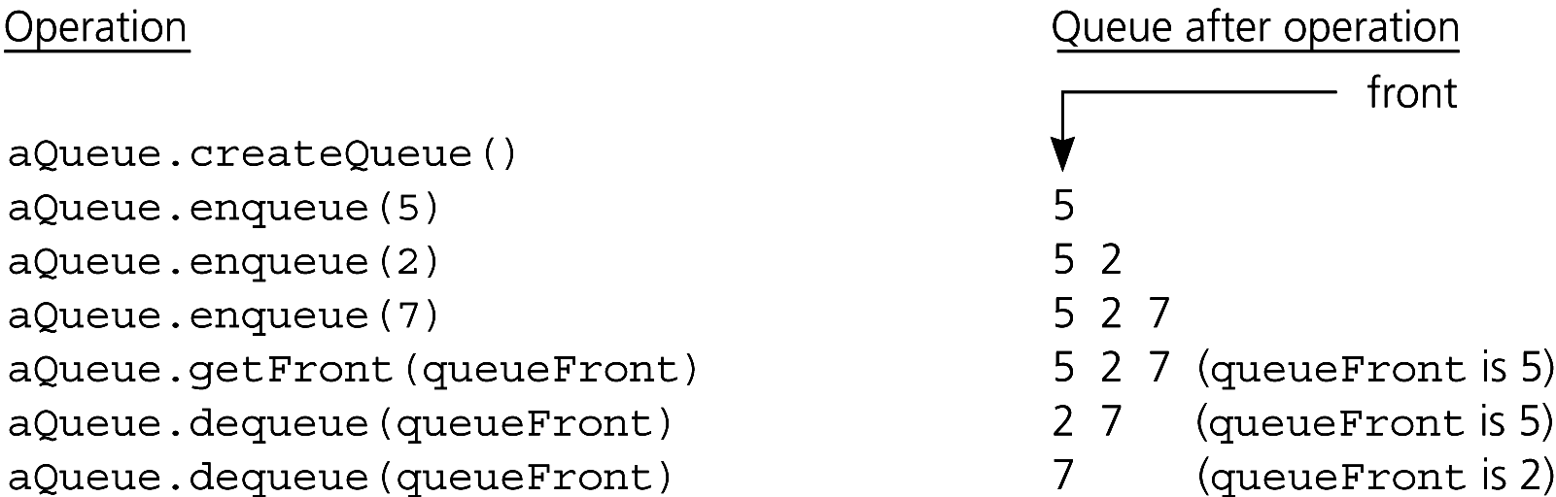
The Abstract Data Type Queue
Figure 7-2 Some queue operations

Slide 7
Reading a String of Characters
A queue can retain characters in the order in which they are typed
  aQueue.createQueue()
  while (not end of line)
  { Read a new character ch
  aQueue.enqueue(ch)
  } // end while
Once the characters are in a queue, the system can process them as necessary

Slide 8
Recognizing Palindromes
A palindrome
  A string of characters that reads the same from left to right as its does from right to left
To recognize a palindrome, you can use a queue in conjunction with a stack
  A stack reverses the order of occurrences
  A queue preserves the order of occurrences

Slide 9
Recognizing Palindromes
A nonrecursive recognition algorithm for palindromes
  As you traverse the character string from left to right, insert each character into both a queue and a stack
  Compare the characters at the front of the queue and the top of the stack

Slide 10
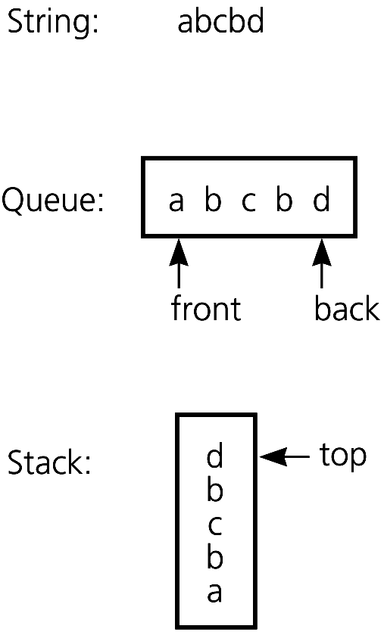
Recognizing Palindromes
Figure 7-3
The results of inserting a string into both a queue and a stack

Slide 11
Implementations of the ADT Queue
An array-based implementation
Possible implementations of a pointer-based queue
  A linear linked list with two external references
    A reference to the front
    A reference to the back
  A circular linked list with one external reference
    A reference to the back

Slide 12
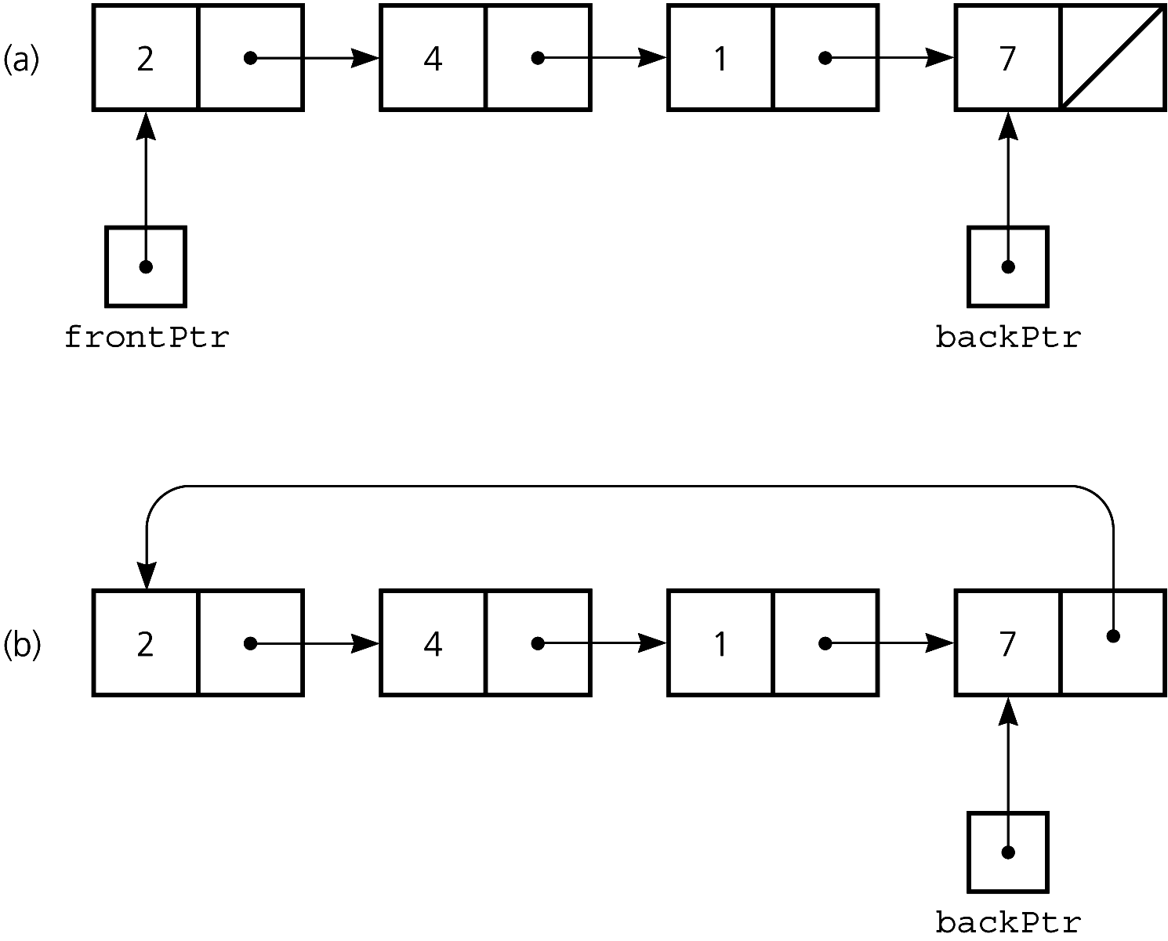
A Pointer-Based Implementation
Figure 7-4 A pointer-based implementation of a queue: (a) a linear linked list with two external pointers; (b) a circular linear linked list with one external pointer

Slide 13
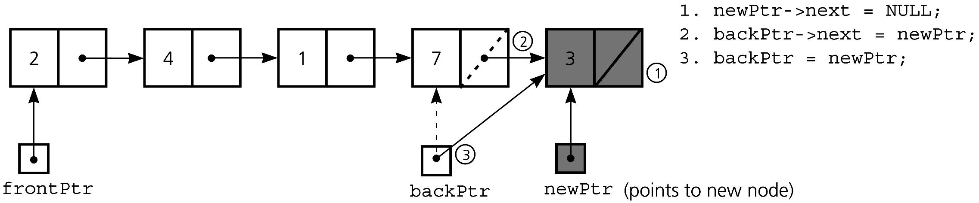
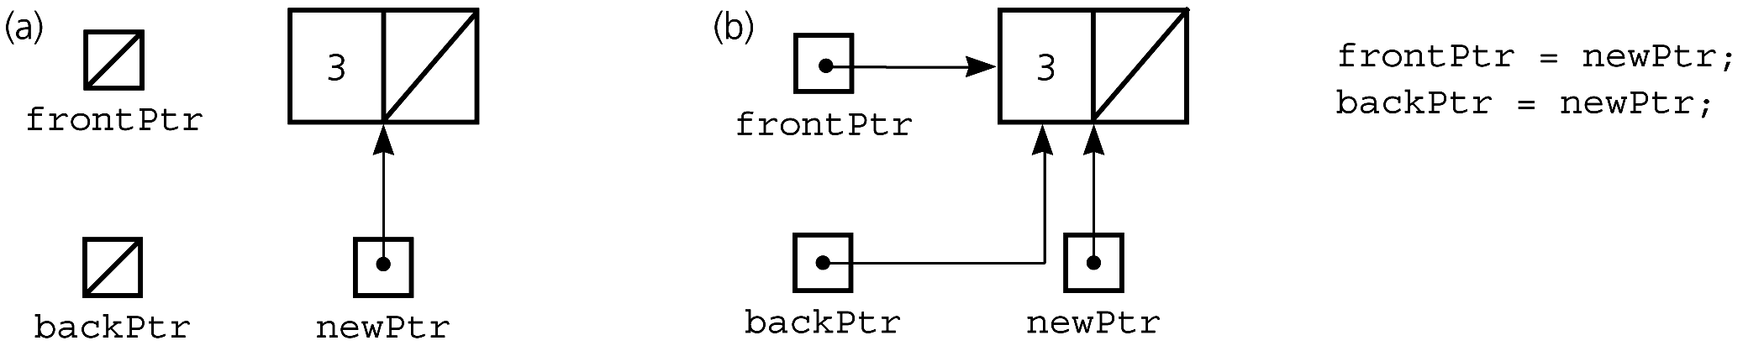
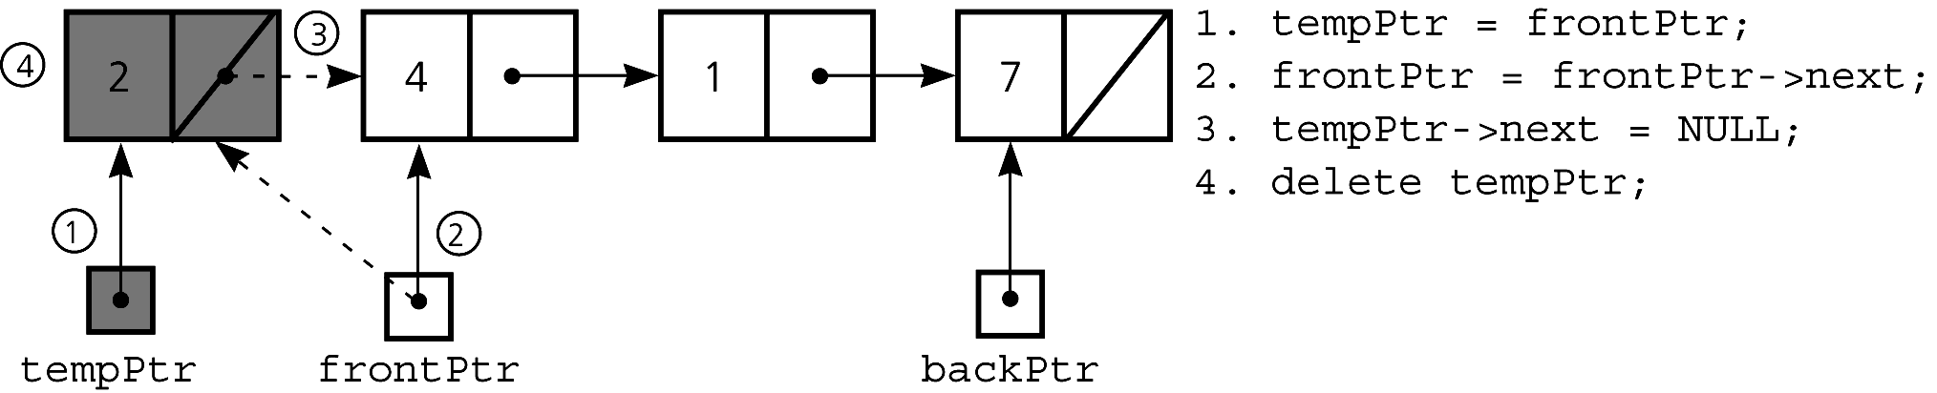
A Pointer-Based Implementation
Figure 7-5 Inserting an item into a nonempty queue
Figure 7-6 Inserting an item into an empty queue: (a) before insertion;
(b) after insertion
Figure 7-7 Deleting an item from a queue of more than one item

Slide 14
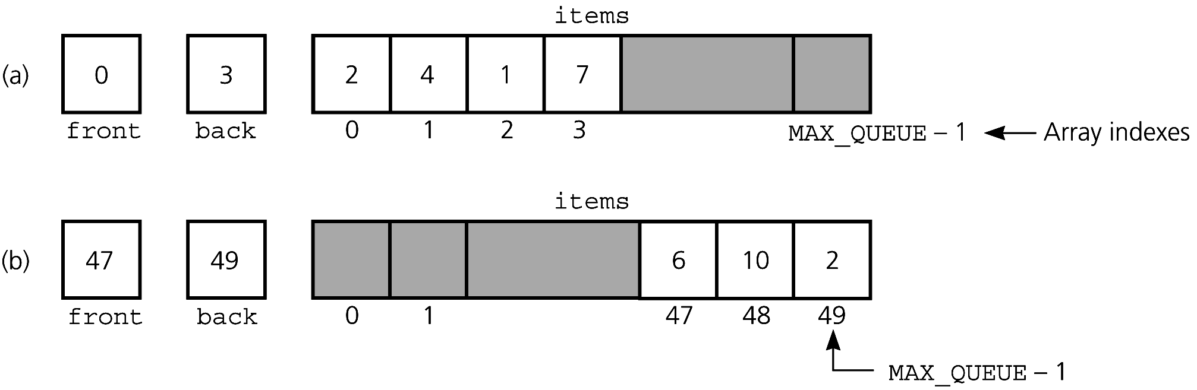
An Array-Based Implementation
Figure 7-8
a) A naive array-based implementation of a queue; (b) rightward drift can cause the queue to appear full

Slide 15
An Array-Based Implementation
A circular array
  Eliminates the problem of rightward drift
  BUT front and back cannot be used to distinguish between queue-full and queue-empty conditions

Slide 16
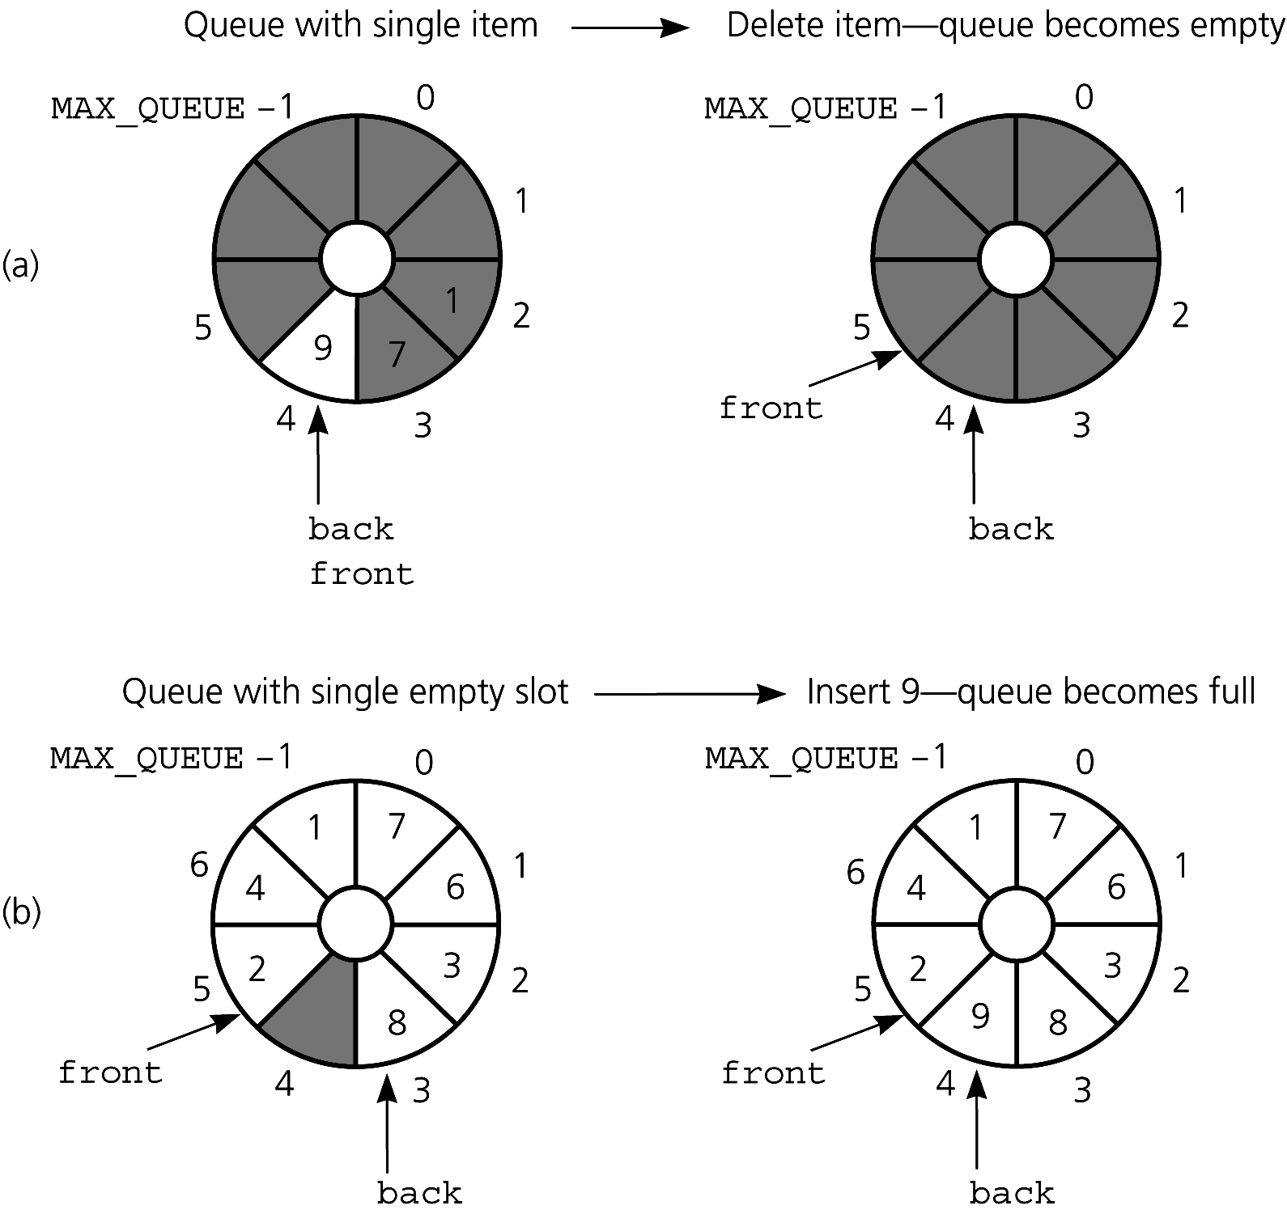
An Array-Based Implementation
Figure 7-11
(a) front passes back when the queue becomes empty; (b) back catches up to front when the queue becomes full

Slide 17
An Array-Based Implementation
To detect queue-full and queue-empty conditions
  Keep a count of the queue items
To initialize the queue, set
  front to 0
  back to MAX_QUEUE – 1
  count to 0

Slide 18
An Array-Based Implementation
Inserting into a queue
  back = (back+1) % MAX_QUEUE;
  items[back] = newItem;
  ++count;
Deleting from a queue
  front = (front+1) % MAX_QUEUE;
  --count;

Slide 19
An Array-Based Implementation
Variations of the array-based implementation
    Use a flag isFull to distinguish between the full and empty conditions
    Declare MAX_QUEUE + 1 locations for the array items, but use only MAX_QUEUE of them for queue items

Slide 20
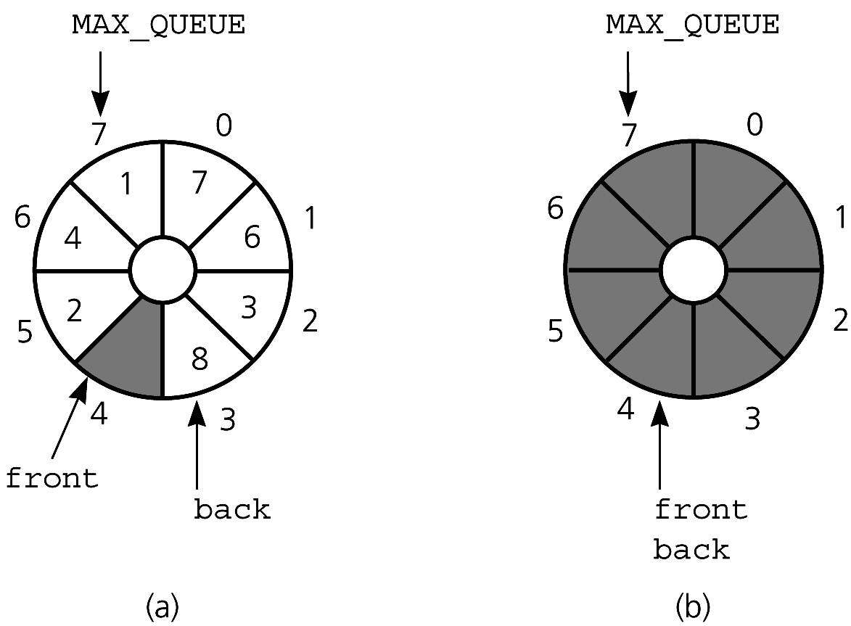
An Array-Based Implementation
Figure 7-12
A more efficient circular implementation: (a) a full queue; (b) an empty queue

Slide 21
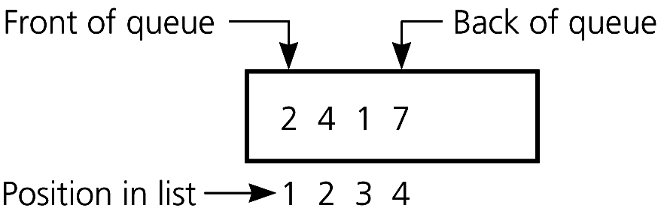
An Implementation That Uses the ADT List
The front of the queue is at position 1 of the list;
The back of the queue is at the end of the list
Figure 7-13
An implementation that uses the ADT list

Slide 22
An Implementation That Uses the ADT List
aList enqueue()
    aList.insert(aList.getLength()+1,
    newItem)
dequeue()
    aList.remove(1)
getFront(queueFront)
    aList.retrieve(1, queueFront)

Slide 23
The Standard Template Library Class queue
Some operations in the STL queue
  Enqueue and dequeue operations are called push and pop, respectively, as for a stack
  The back method returns a reference to the last item
  The size method returns the number of items
An adaptor container
  Implemented using a more basic container type
  The default queue container class is deque

Slide 24
Comparing Implementations
Fixed size versus dynamic size
  A statically allocated array-based implementation
    Fixed-size queue that can get full
    Prevents the enqueue operation from adding an item to the queue, if the array is full
  A dynamically allocated array-based implementation or a pointer-based implementation
    No size restriction on the queue

Slide 25
Comparing Implementations
A pointer-based implementation vs. one that uses a pointer-based implementation of the ADT list
  Pointer-based implementation is more efficient
  ADT list approach reuses an already implemented class
    Much simpler to write
    Saves programming time

Slide 26
A Summary of Position-Oriented ADTs
Position-oriented ADTs
  List
  Stack
  Queue
Stacks and queues
  Only the end positions can be accessed
Lists
  All positions can be accessed

Slide 27
A Summary of Position-Oriented ADTs
Stacks and queues are very similar
  Operations of stacks and queues can be paired off as
    createStack and createQueue
    Stack isEmpty and queue isEmpty
    push and enqueue
    pop and dequeue
    Stack getTop and queue getFront

Slide 28
A Summary of Position-Oriented ADTs
ADT list operations generalize stack and queue operations
  getLength
  insert
  remove
  retrieve

Slide 29
Application: Simulation
Simulation
  A technique for modeling the behavior of both natural and human-made systems
  Goal
    Generate statistics that summarize the performance of an existing system
    Predict the performance of a proposed system
  Example
    A simulation of the behavior of a bank

Slide 30
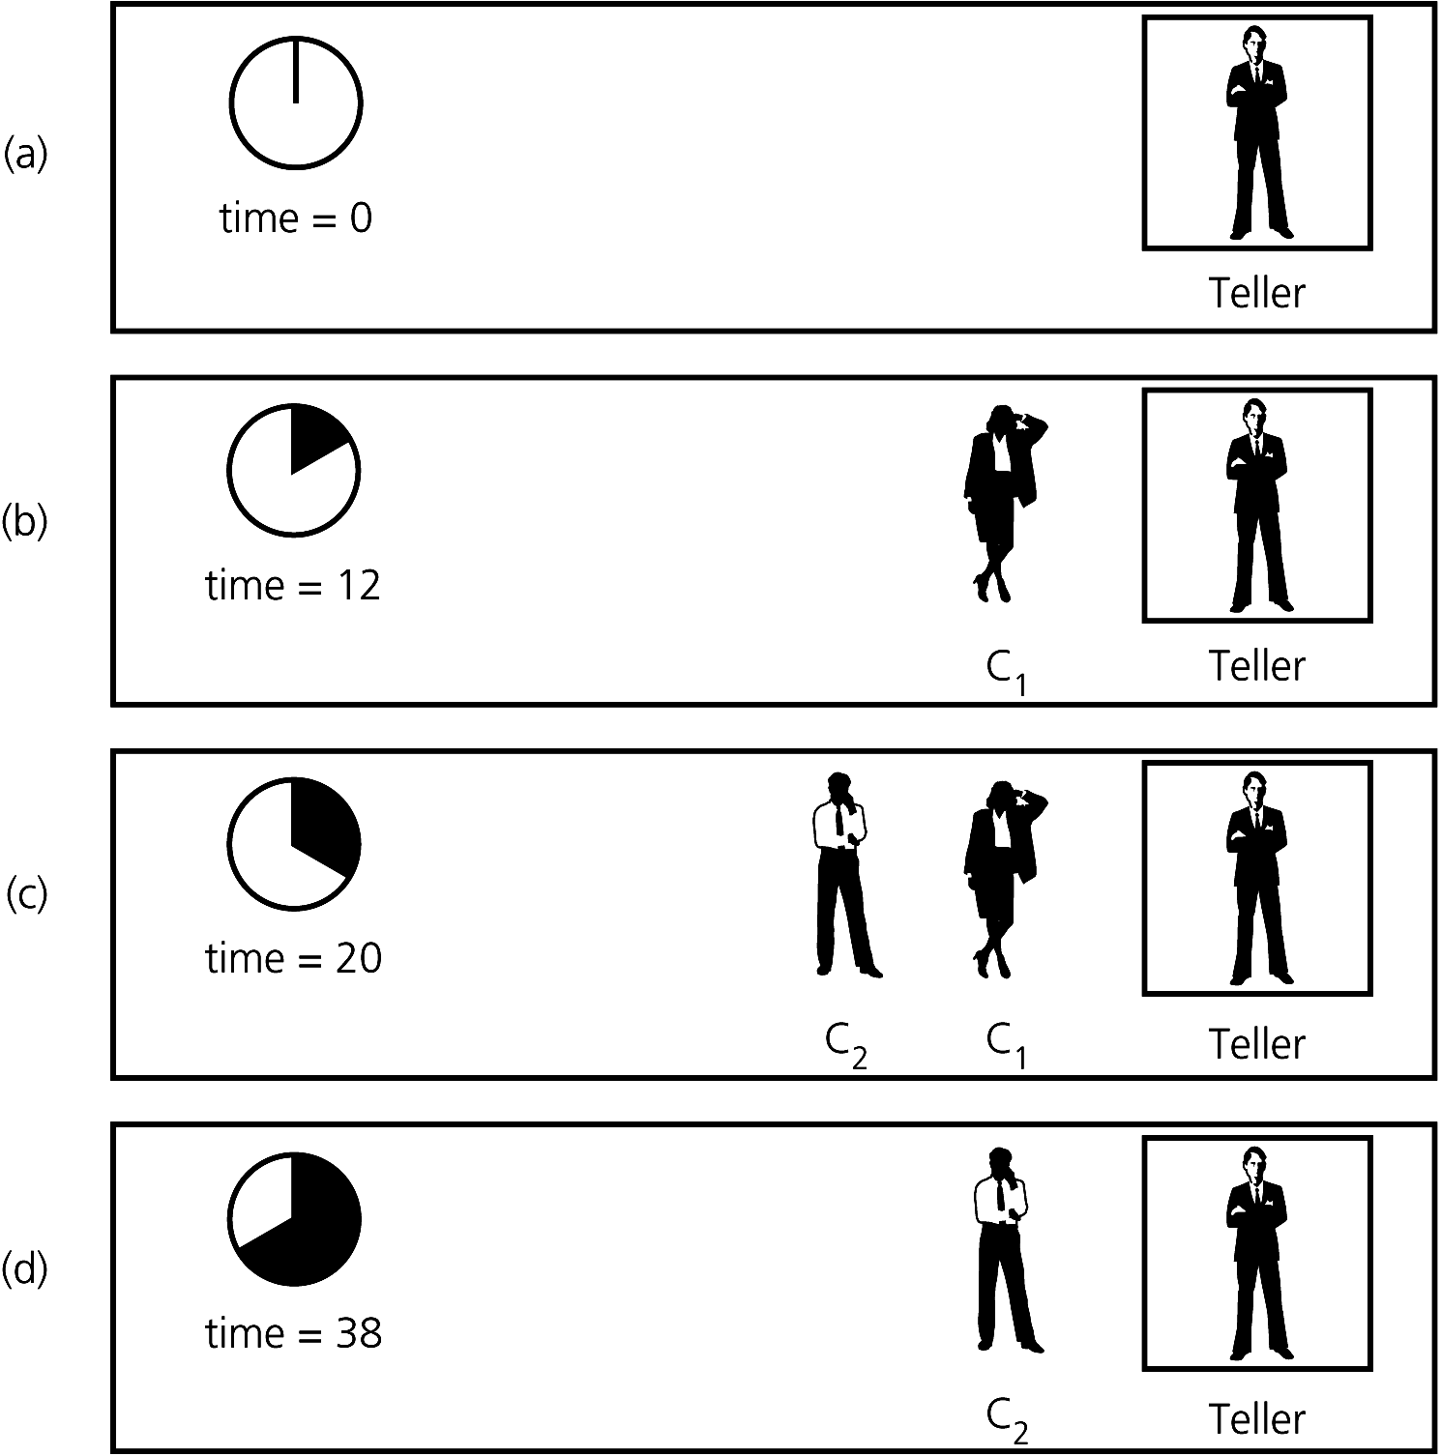
Application: Simulation
Figure 7-14 A bank line at time (a) 0; (b) 12; (c) 20;
(d) 38

Slide 31
Application: Simulation
A time-driven simulation
  Simulated time advances by one time unit
  The time of an event is determined randomly and compared with the simulated time

Slide 32
Application: Simulation
An event-driven simulation
  Simulated time advances to time of next event
  Events are generated by using a mathematical model based on statistics and probability

Slide 33
Application: Simulation
The bank simulation is concerned with
  Arrival events
    External events: the input file specifies the times at which the arrival events occur
  Departure events
    Internal events: the simulation determines the times at which the departure events occur

Slide 34
Application: Simulation
Bank simulation is event-driven and uses an event list
  Keeps track of arrival and departure events that will occur but have not occurred yet
  Contains at most one arrival event and one departure event

Slide 35
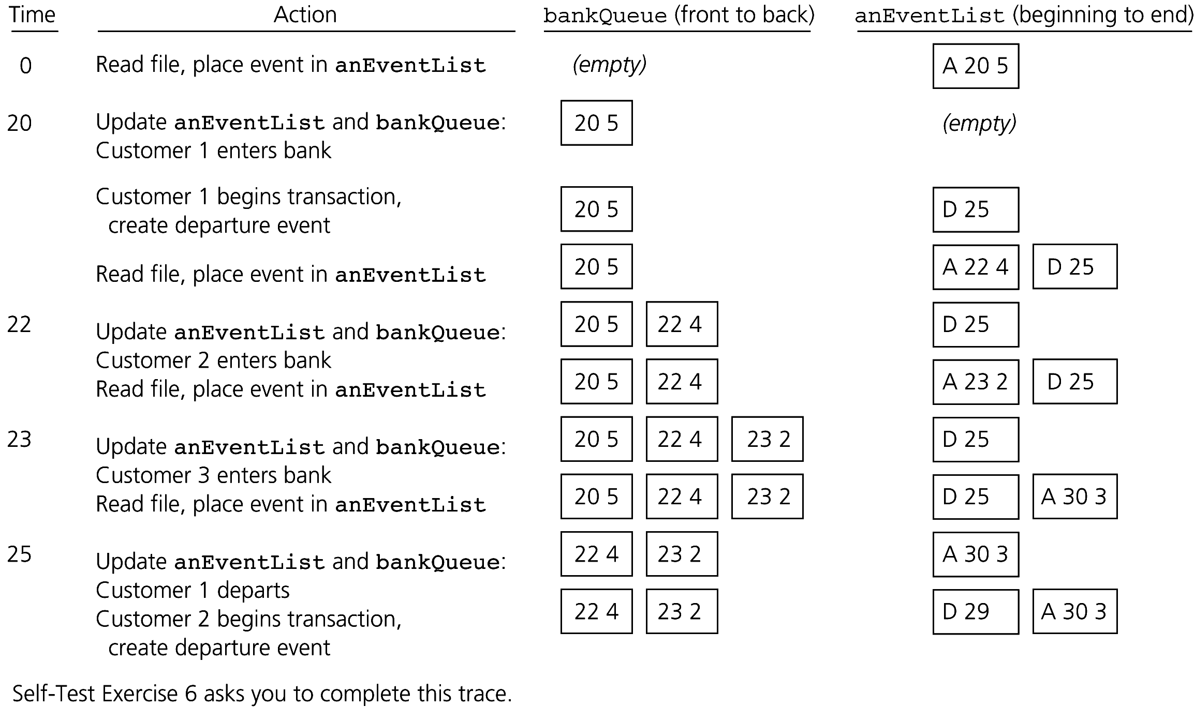
Application: Simulation
Figure 7-16 A partial trace of the bank simulation for the data 20 5, 22 4, 23 2, 30 3

Slide 36
Summary
The definition of the queue operations gives the ADT queue first-in, first-out (FIFO) behavior
A pointer-based implementation of a queue uses either
  A circular linked list
  A linear linked list with both a head pointer and a tail pointer

Slide 37
Summary
A circular array eliminates the problem of rightward drift in an array-based implementation
To distinguish between the queue-full and queue-empty conditions in a circular array
  Count the number of items in the queue
  Use an isFull flag
  Leave one array location empty

Slide 38
Summary
Simulations
  In a time-driven simulation
    Time advances by one time unit
  In an event-driven simulation
    Time advances to the time of the next event
  To implement an event-driven simulation, you maintain an event list that contains events that have not yet occurred

