Slide 1
Chapter 9:
Algorithm Efficiency and Sorting
Data Abstraction & Problem Solving with
C++
Fifth Edition
by Frank M. Carrano

Slide 2
Measuring the Efficiency of Algorithms
Analysis of algorithms
  Provides tools for contrasting the efficiency of different methods of solution
    Time efficiency, space efficiency
A comparison of algorithms
  Should focus on significant differences in efficiency
  Should not consider reductions in computing costs due to clever coding tricks

Slide 3
Measuring the Efficiency of Algorithms
Three difficulties with comparing programs instead of algorithms
  How are the algorithms coded?
  What computer should you use?
  What data should the programs use?

Slide 4
Measuring the Efficiency of Algorithms
Algorithm analysis should be independent of
  Specific implementations
  Computers
  Data

Slide 5
The Execution Time of Algorithms
Counting an algorithm's operations is a way to assess its time efficiency
  An algorithm’s execution time is related to the number of operations it requires
  Example: Traversal of a linked list of n nodes
    n + 1 assignments, n + 1 comparisons, n writes
  Example: The Towers of Hanoi with n disks
    2^{n} - 1 moves

Slide 6
Algorithm Growth Rates
An algorithm’s time requirements can be measured as a function of the problem size
  Number of nodes in a linked list
  Size of an array
  Number of items in a stack
  Number of disks in the Towers of Hanoi problem
Algorithm efficiency is typically a concern for large problems only

Slide 7
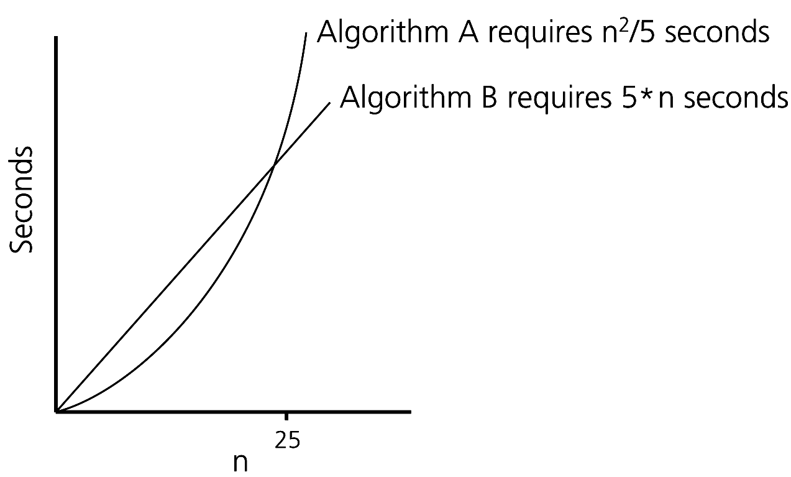
Algorithm Growth Rates
Figure 9-1 Time requirements as a function of the problem size n
Algorithm A requires time proportional to n²
Algorithm B requires time proportional to n

Slide 8
Algorithm Growth Rates
An algorithm’s growth rate
  Enables the comparison of one algorithm with another
  Algorithm A requires time proportional to n²
  Algorithm B requires time proportional to n
  Algorithm B is faster than Algorithm A
  n² and n are growth-rate functions
  Algorithm A is O(n²) - order n²
  Algorithm B is O(n) - order n
    Big O notation

Slide 9
Order-of-Magnitude Analysis and Big O Notation
Definition of the order of an algorithm
  Algorithm A is order f(n) – denoted O (f(n)) – if constants k and n₀ exist such that A requires no more than k * f(n) time units to solve a problem of size n ≥ n₀
Growth-rate function f(n)
  A mathematical function used to specify an algorithm’s order in terms of the size of the problem

Slide 10
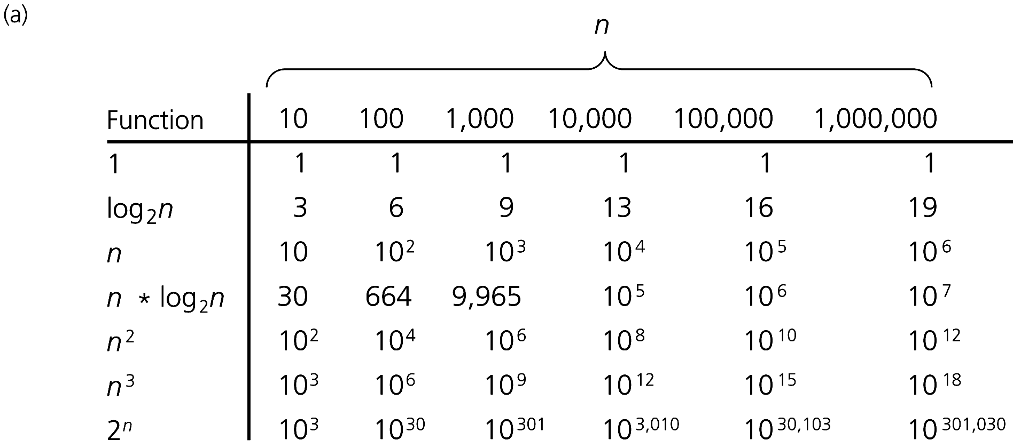
Order-of-Magnitude Analysis and Big O Notation
Figure 9-3a A comparison of growth-rate functions: (a) in tabular form

Slide 11
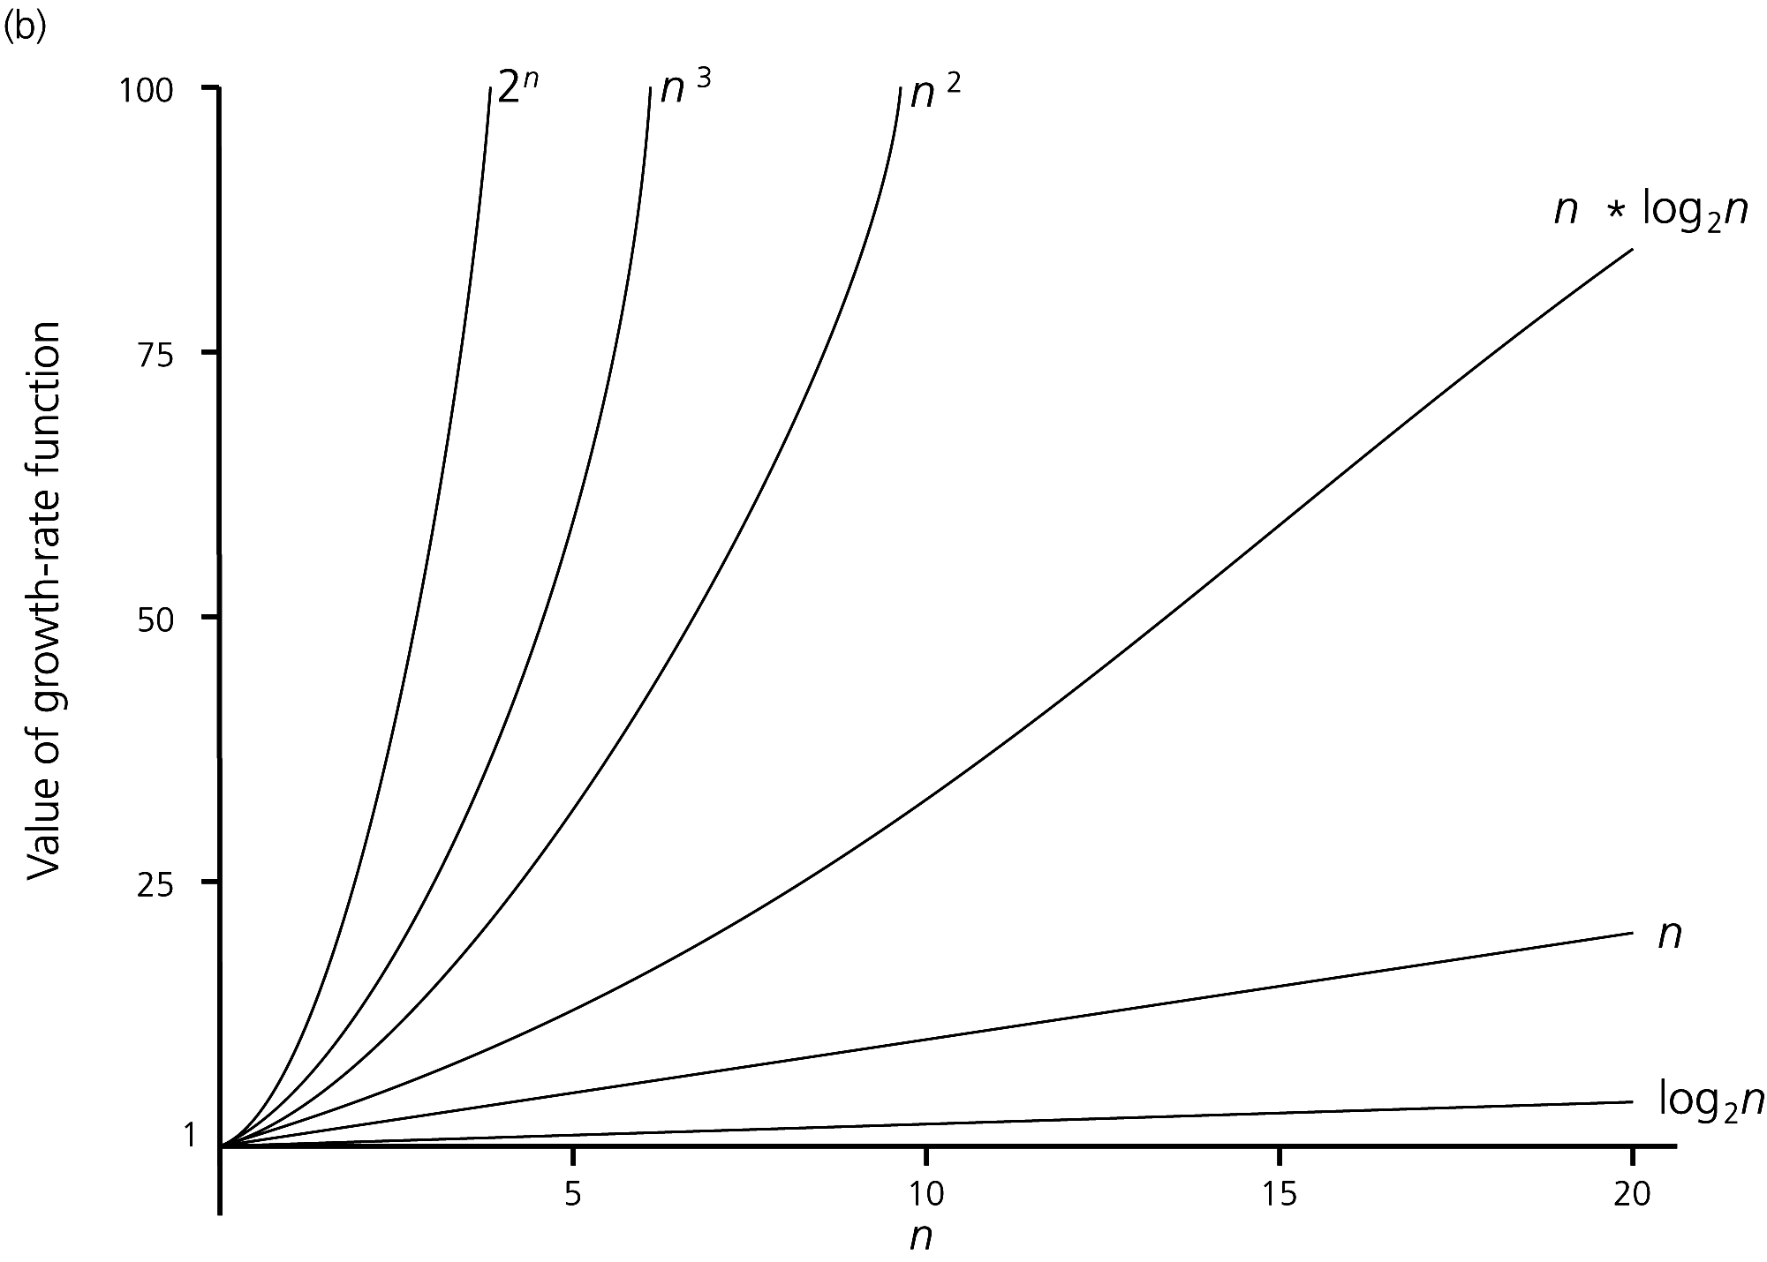
Order-of-Magnitude Analysis and Big O Notation
Figure 9-3b A comparison of growth-rate functions: (b) in graphical form

Slide 12
Order-of-Magnitude Analysis and Big O Notation
Order of growth of some common functions
  O(1) < O(log₂n) < O(n) < O(n * log₂n) < O(n²) < O(n³) < O(2^{n})
Properties of growth-rate functions
  O(n³ + 3n) is O(n³): ignore low-order terms
  O(5 f(n)) = O(f(n)): ignore multiplicative constant in the high-order term
  O(f(n)) + O(g(n)) = O(f(n) + g(n))

Slide 13
Order-of-Magnitude Analysis and Big O Notation
Worst-case analysis
  A determination of the maximum amount of time that an algorithm requires to solve problems of size n
Average-case analysis
  A determination of the average amount of time that an algorithm requires to solve problems of size n
Best-case analysis
  A determination of the minimum amount of time that an algorithm requires to solve problems of size n

Slide 14
Keeping Your Perspective
Only significant differences in efficiency are interesting
Frequency of operations
  When choosing an ADT’s implementation, consider how frequently particular ADT operations occur in a given application
  However, some seldom-used but critical operations must be efficient

Slide 15
Keeping Your Perspective
If the problem size is always small, you can probably ignore an algorithm’s efficiency
  Order-of-magnitude analysis focuses on large problems
Weigh the trade-offs between an algorithm’s time requirements and its memory requirements
Compare algorithms for both style and efficiency

Slide 16
The Efficiency of Searching Algorithms
Sequential search
  Strategy
    Look at each item in the data collection in turn
    Stop when the desired item is found, or the end of the data is reached
  Efficiency
    Worst case: O(n)
    Average case: O(n)
    Best case: O(1)

Slide 17
The Efficiency of Searching Algorithms
Binary search of a sorted array
  Strategy
    Repeatedly divide the array in half
    Determine which half could contain the item, and discard the other half
  Efficiency
    Worst case: O(log₂n)
    For large arrays, the binary search has an enormous advantage over a sequential search
      At most 20 comparisons to search an array of one million items

Slide 18
Sorting Algorithms and Their Efficiency
Sorting
  A process that organizes a collection of data into either ascending or descending order
  The sort key
    The part of a data item that we consider when sorting a data collection

Slide 19
Sorting Algorithms and Their Efficiency
Categories of sorting algorithms
  An internal sort
    Requires that the collection of data fit entirely in the computer’s main memory
  An external sort
    The collection of data will not fit in the computer’s main memory all at once, but must reside in secondary storage

Slide 20
Selection Sort
Strategy
  Place the largest (or smallest) item in its correct place
  Place the next largest (or next smallest) item in its correct place, and so on
Analysis
  Worst case: O(n²)
  Average case: O(n²)
Does not depend on the initial arrangement of the data
Only appropriate for small n

Slide 21
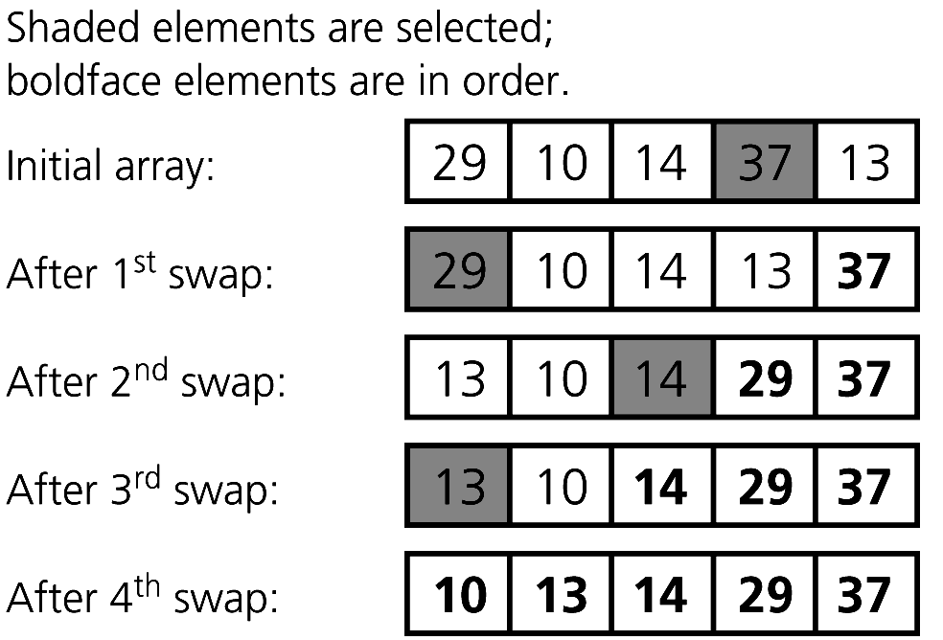
Selection Sort
Figure 9-4 A selection sort of an array of five integers

Slide 22
Bubble Sort
Strategy
  Compare adjacent elements and exchange them if they are out of order
    Moves the largest (or smallest) elements to the end of the array
    Repeating this process eventually sorts the array into ascending (or descending) order
Analysis
  Worst case: O(n²)
  Best case: O(n)

Slide 23
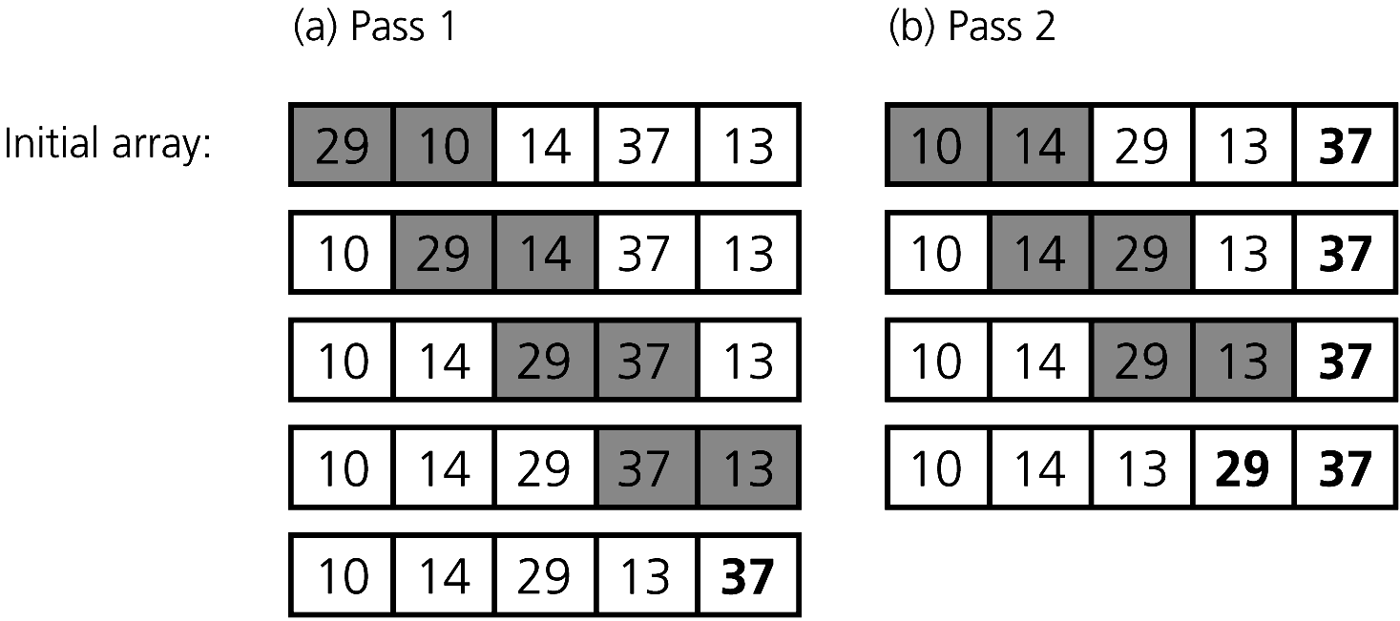
Bubble Sort
Figure 9-5
The first two passes of a bubble sort of an array of five integers: (a) pass 1; (b) pass 2

Slide 24
Insertion Sort
Strategy
  Partition the array into two regions: sorted and unsorted
    Take each item from the unsorted region and insert it into its correct order in the sorted region
Analysis
  Worst case: O(n²)
    Appropriate for small arrays due to its simplicity
    Prohibitively inefficient for large arrays

Slide 25
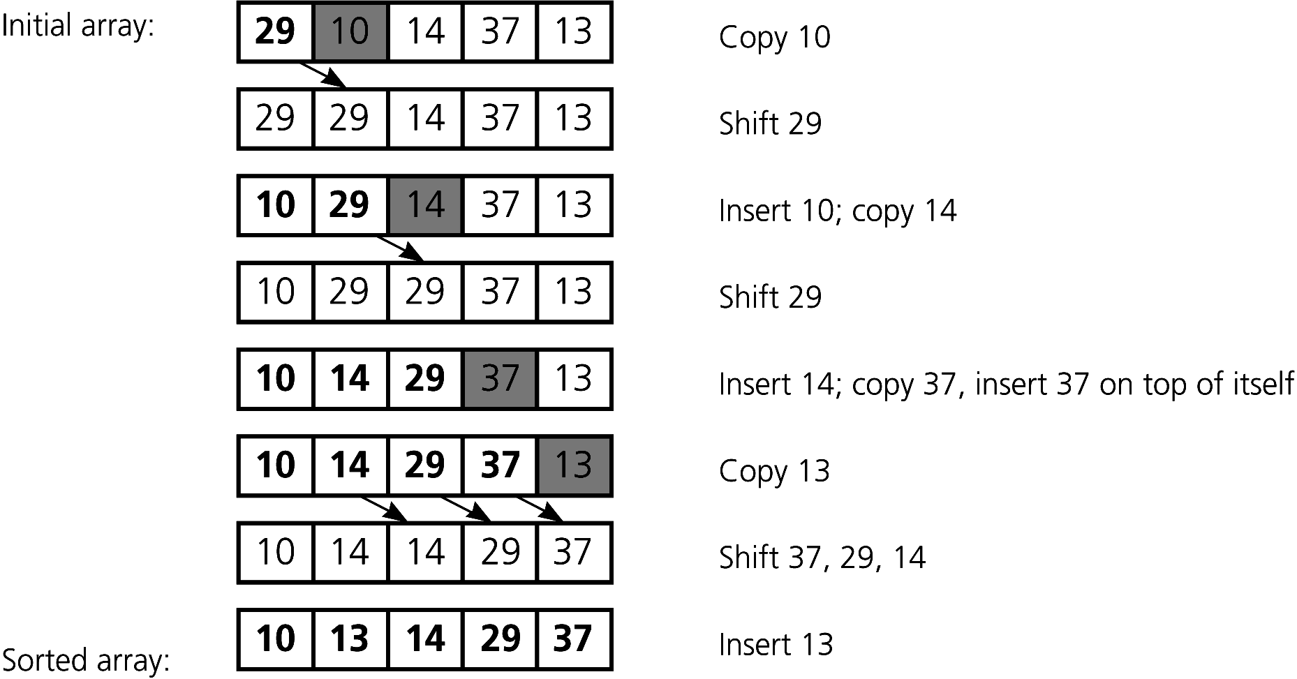
Insertion Sort
Figure 9-7 An insertion sort of an array of five integers.

Slide 26
Mergesort
A recursive sorting algorithm
Performance is independent of the initial order of the array items
Strategy
  Divide an array into halves
  Sort each half
  Merge the sorted halves into one sorted array
  Divide-and-conquer

Slide 27
Mergesort
Analysis
  Worst case: O(n * log₂n)
  Average case: O(n * log₂n)
  Advantage
    Mergesort is an extremely fast algorithm
  Disadvantage
    Mergesort requires a second array as large as the original array

Slide 28
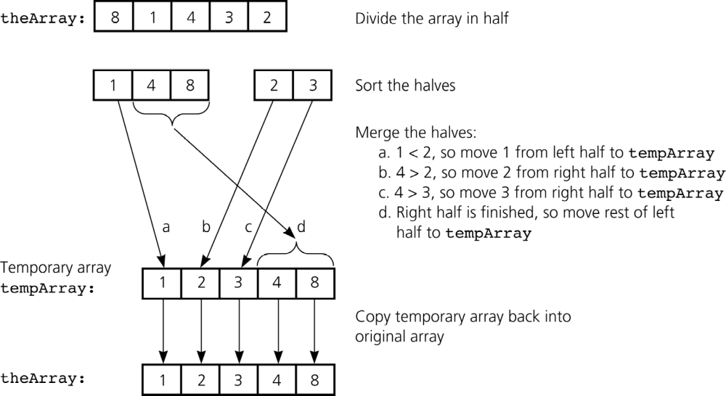
Mergesort
Figure 9-8 A mergesort with an auxiliary temporary array

Slide 29
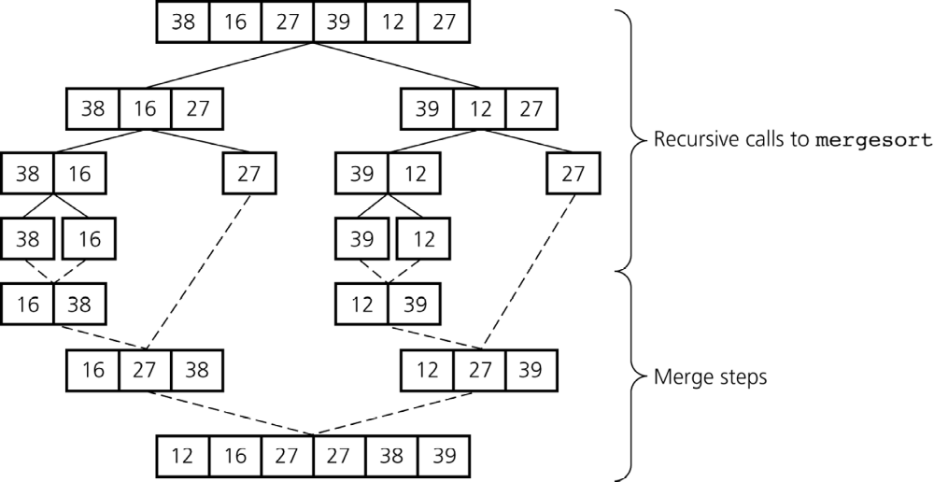
Mergesort
Figure 9-9 A mergesort of an array of six integers

Slide 30
Quicksort
A divide-and-conquer algorithm
Strategy
  Choose a pivot
  Partition the array about the pivot
    items < pivot
    items >= pivot
    Pivot is now in correct sorted position
  Sort the left section
  Sort the right section

Slide 31
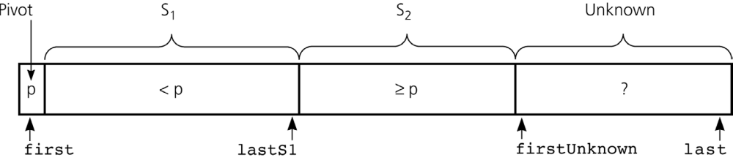
Quicksort
Using an invariant to develop a partition algorithm
  The items in region S₁ are all less than the pivot, and those in S₂ are all greater than or equal to the pivot
Figure 9-14 Invariant for the partition algorithm

Slide 32
Quicksort
Analysis
  Average case: O(n * log₂n)
  Worst case: O(n²)
    When the array is already sorted and the smallest item is chosen as the pivot
  Quicksort is usually extremely fast in practice
  Even if the worst case occurs, quicksort’s performance is acceptable for moderately large arrays

Slide 33
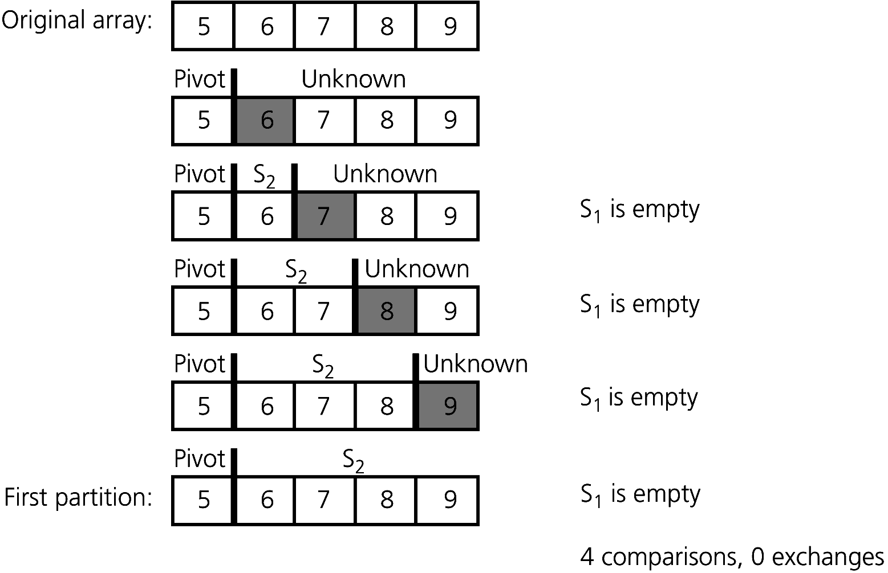
Quicksort
Figure 9-19 A worst-case partitioning with quicksort

Slide 34
Radix Sort
Strategy
  Treats each data element as a character string
  Repeatedly organizes the data into groups according to the i^{th} character in each element
Analysis
  Radix sort is O(n)

Slide 35
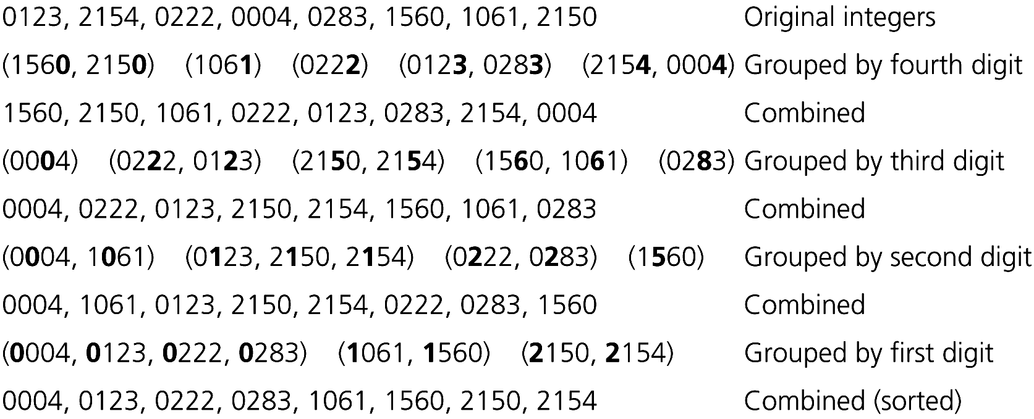
Radix Sort
Figure 9-21 A radix sort of eight integers

Slide 36
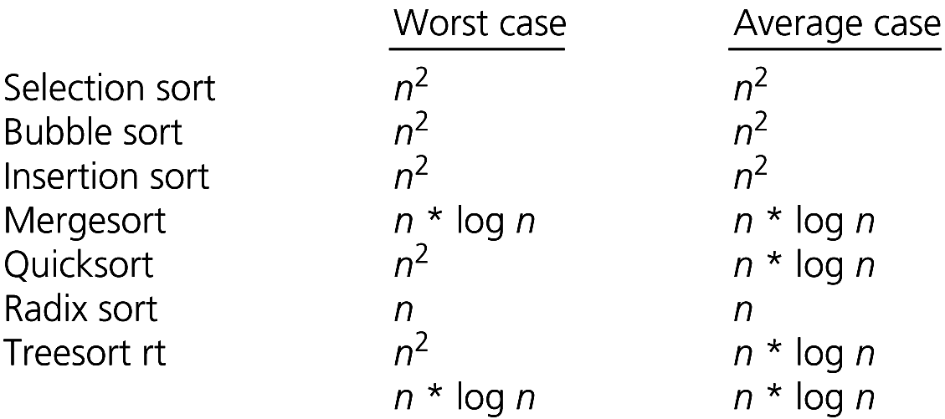
A Comparison of Sorting Algorithms
Figure 9-22 Approximate growth rates of time required for eight sorting algorithms

Slide 37
The STL Sorting Algorithms
Some sort functions in the STL library header <algorithm>
  sort
    Sorts a range of elements in ascending order by default
  stable_sort
    Sorts as above, but preserves original ordering of equivalent elements

Slide 38
The STL Sorting Algorithms
  partial_sort
    Sorts a range of elements and places them at the beginning of the range
  nth_element
    Partitions the elements of a range about the n^{th} element
    The two subranges are not sorted
  partition
    Partitions the elements of a range according to a given predicate

Slide 39
Summary
Order-of-magnitude analysis and Big O notation measure an algorithm’s time requirement as a function of the problem size by using a growth-rate function
To compare the efficiency of algorithms
  Examine growth-rate functions when problems are large
  Consider only significant differences in growth-rate functions

Slide 40
Summary
Worst-case and average-case analyses
  Worst-case analysis considers the maximum amount of work an algorithm will require on a problem of a given size
  Average-case analysis considers the expected amount of work that an algorithm will require on a problem of a given size

Slide 41
Summary
Order-of-magnitude analysis can be the basis of your choice of an ADT implementation
Selection sort, bubble sort, and insertion sort are all O(n²) algorithms
Quicksort and mergesort are two very fast recursive sorting algorithms

