Slide 1
Chapter 9:
Algorithm Efficiency and Sorting
Data Abstraction & Problem Solving with
C++
Fifth Edition
by Frank M. Carrano

Slide 2
Measuring the Efficiency of Algorithms
Analysis of algorithms
  Provides tools for contrasting the efficiency of different methods of solution
    Time efficiency, space efficiency
A comparison of algorithms
  Should focus on significant differences in efficiency
  Should not consider reductions in computing costs due to clever coding tricks

Slide 3
Measuring the Efficiency of Algorithms
Three difficulties with comparing programs instead of algorithms
  How are the algorithms coded?
  What computer should you use?
  What data should the programs use?

Slide 4
Measuring the Efficiency of Algorithms
Algorithm analysis should be independent of
  Specific implementations
  Computers
  Data

Slide 5
The Execution Time of Algorithms
Counting an algorithm's operations is a way to assess its time efficiency
  An algorithm’s execution time is related to the number of operations it requires
  Example: Traversal of a linked list of n nodes
    n + 1 assignments, n + 1 comparisons, n writes
  Example: The Towers of Hanoi with n disks
    2^{n} - 1 moves

Slide 6
Algorithm Growth Rates
An algorithm’s time requirements can be measured as a function of the problem size
  Number of nodes in a linked list
  Size of an array
  Number of items in a stack
  Number of disks in the Towers of Hanoi problem
Algorithm efficiency is typically a concern for large problems only

Slide 7
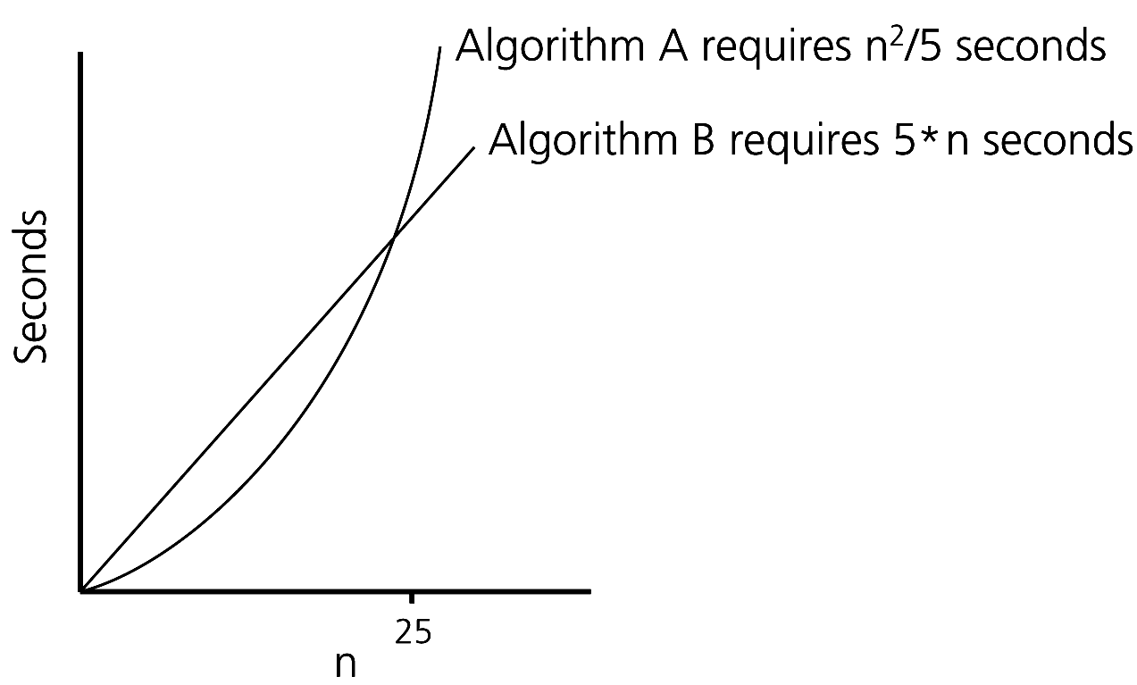
Algorithm Growth Rates
Figure 9-1 Time requirements as a function of the problem size n
Algorithm A requires time proportional to n²
Algorithm B requires time proportional to n

Slide 8
Algorithm Growth Rates
An algorithm’s growth rate
  Enables the comparison of one algorithm with another
  Algorithm A requires time proportional to n²
  Algorithm B requires time proportional to n
  Algorithm B is faster than Algorithm A
  n² and n are growth-rate functions
  Algorithm A is O(n²) - order n²
  Algorithm B is O(n) - order n
    Big O notation

Slide 9
Order-of-Magnitude Analysis and Big O Notation
Definition of the order of an algorithm
  Algorithm A is order f(n) – denoted O (f(n)) – if constants k and n₀ exist such that A requires no more than k * f(n) time units to solve a problem of size n ≥ n₀
Growth-rate function f(n)
  A mathematical function used to specify an algorithm’s order in terms of the size of the problem

Slide 10
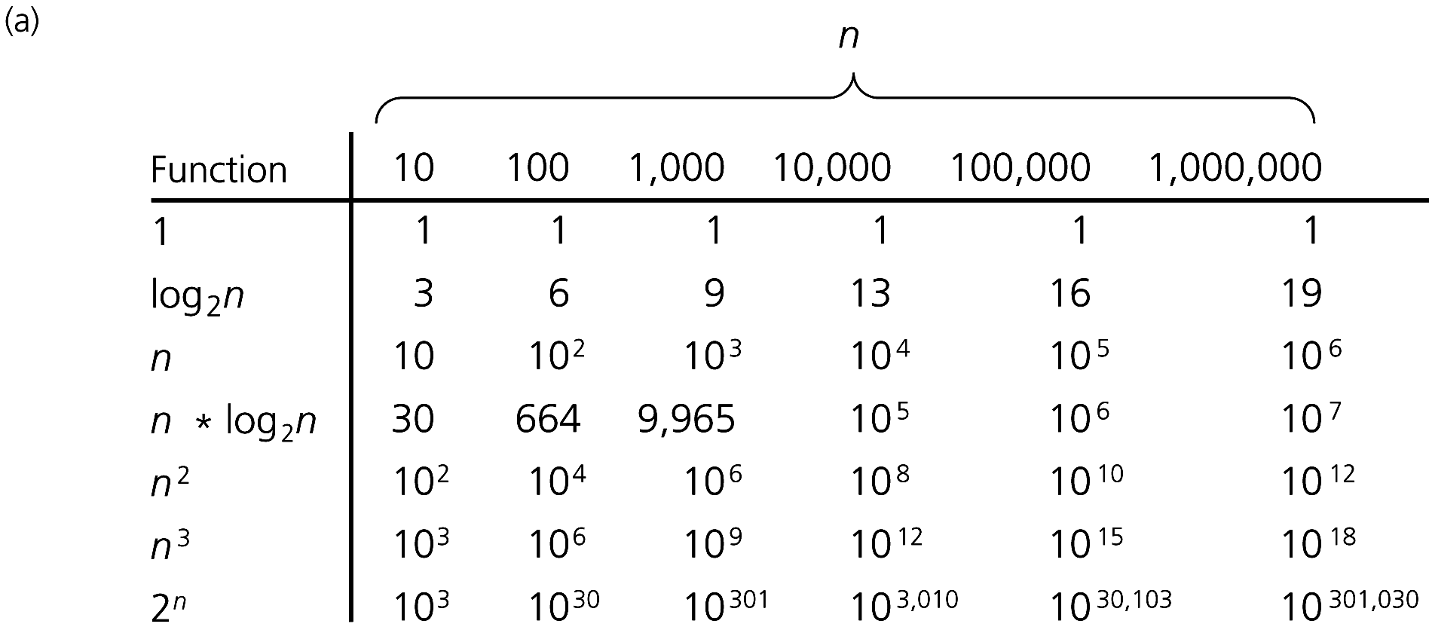
Order-of-Magnitude Analysis and Big O Notation
Figure 9-3a A comparison of growth-rate functions: (a) in tabular form

Slide 11
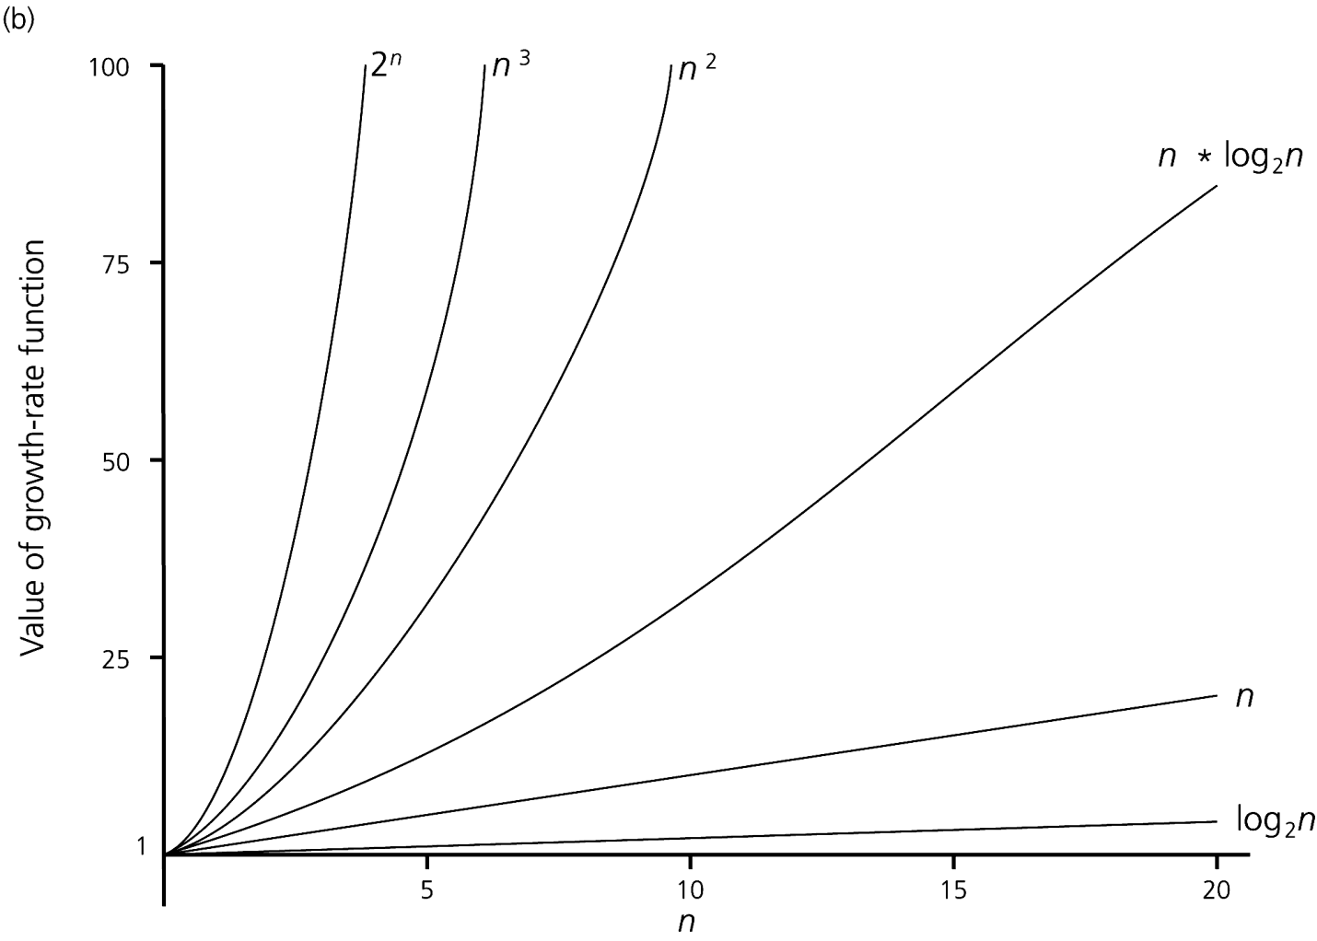
Order-of-Magnitude Analysis and Big O Notation
Figure 9-3b A comparison of growth-rate functions: (b) in graphical form

Slide 12
Order-of-Magnitude Analysis and Big O Notation
Order of growth of some common functions
  O(1) < O(log₂n) < O(n) < O(n * log₂n) < O(n²) < O(n³) < O(2^{n})
Properties of growth-rate functions
  O(n³ + 3n) is O(n³): ignore low-order terms
  O(5 f(n)) = O(f(n)): ignore multiplicative constant in the high-order term
  O(f(n)) + O(g(n)) = O(f(n) + g(n))

Slide 13
Order-of-Magnitude Analysis and Big O Notation
Worst-case analysis
  A determination of the maximum amount of time that an algorithm requires to solve problems of size n
Average-case analysis
  A determination of the average amount of time that an algorithm requires to solve problems of size n
Best-case analysis
  A determination of the minimum amount of time that an algorithm requires to solve problems of size n

Slide 14
Keeping Your Perspective
Only significant differences in efficiency are interesting
Frequency of operations
  When choosing an ADT’s implementation, consider how frequently particular ADT operations occur in a given application
  However, some seldom-used but critical operations must be efficient

Slide 15
Keeping Your Perspective
If the problem size is always small, you can probably ignore an algorithm’s efficiency
  Order-of-magnitude analysis focuses on large problems
Weigh the trade-offs between an algorithm’s time requirements and its memory requirements
Compare algorithms for both style and efficiency

Slide 16
The Efficiency of Searching Algorithms
Sequential search
  Strategy
    Look at each item in the data collection in turn
    Stop when the desired item is found, or the end of the data is reached
  Efficiency
    Worst case: O(n)
    Average case: O(n)
    Best case: O(1)

Slide 17
The Efficiency of Searching Algorithms
Binary search of a sorted array
  Strategy
    Repeatedly divide the array in half
    Determine which half could contain the item, and discard the other half
  Efficiency
    Worst case: O(log₂n)
    For large arrays, the binary search has an enormous advantage over a sequential search
      At most 20 comparisons to search an array of one million items

Slide 18
Sorting Algorithms and Their Efficiency
Sorting
  A process that organizes a collection of data into either ascending or descending order
  The sort key
    The part of a data item that we consider when sorting a data collection

Slide 19
Sorting Algorithms and Their Efficiency
Categories of sorting algorithms
  An internal sort
    Requires that the collection of data fit entirely in the computer’s main memory
  An external sort
    The collection of data will not fit in the computer’s main memory all at once, but must reside in secondary storage

Slide 20
Selection Sort
Strategy
  Place the largest (or smallest) item in its correct place
  Place the next largest (or next smallest) item in its correct place, and so on
Analysis
  Worst case: O(n²)
  Average case: O(n²)
Does not depend on the initial arrangement of the data
Only appropriate for small n

Slide 21
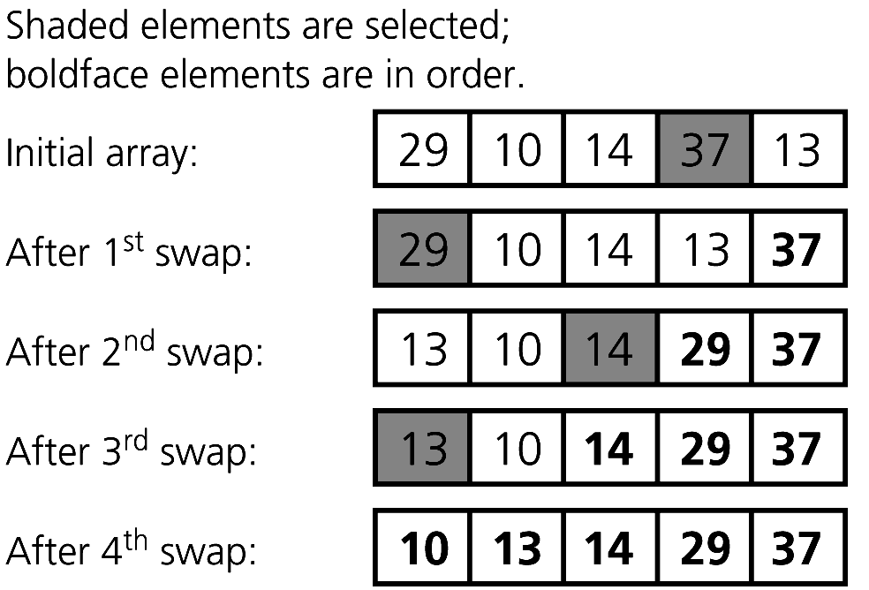
Selection Sort
Figure 9-4 A selection sort of an array of five integers

Slide 22
Bubble Sort
Strategy
  Compare adjacent elements and exchange them if they are out of order
    Moves the largest (or smallest) elements to the end of the array
    Repeating this process eventually sorts the array into ascending (or descending) order
Analysis
  Worst case: O(n²)
  Best case: O(n)

Slide 23
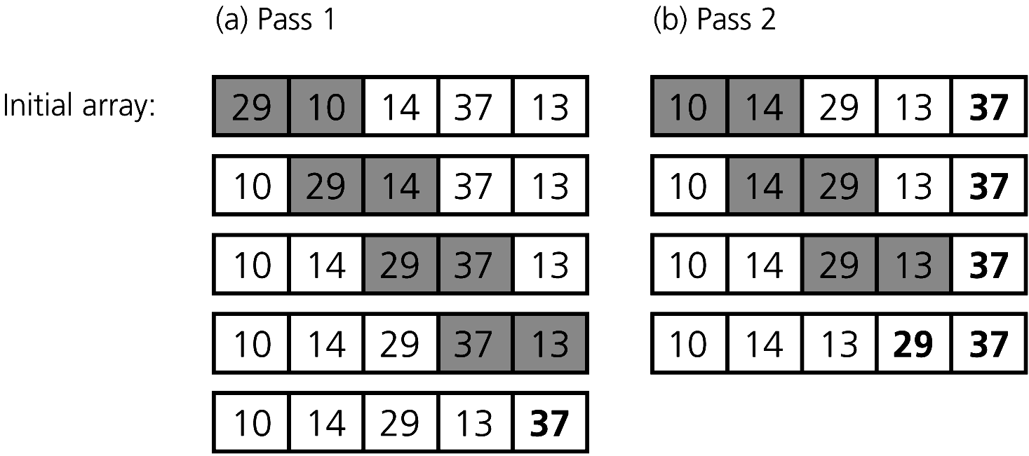
Bubble Sort
Figure 9-5
The first two passes of a bubble sort of an array of five integers: (a) pass 1; (b) pass 2

Slide 24
Insertion Sort
Strategy
  Partition the array into two regions: sorted and unsorted
    Take each item from the unsorted region and insert it into its correct order in the sorted region
Analysis
  Worst case: O(n²)
    Appropriate for small arrays due to its simplicity
    Prohibitively inefficient for large arrays

Slide 25
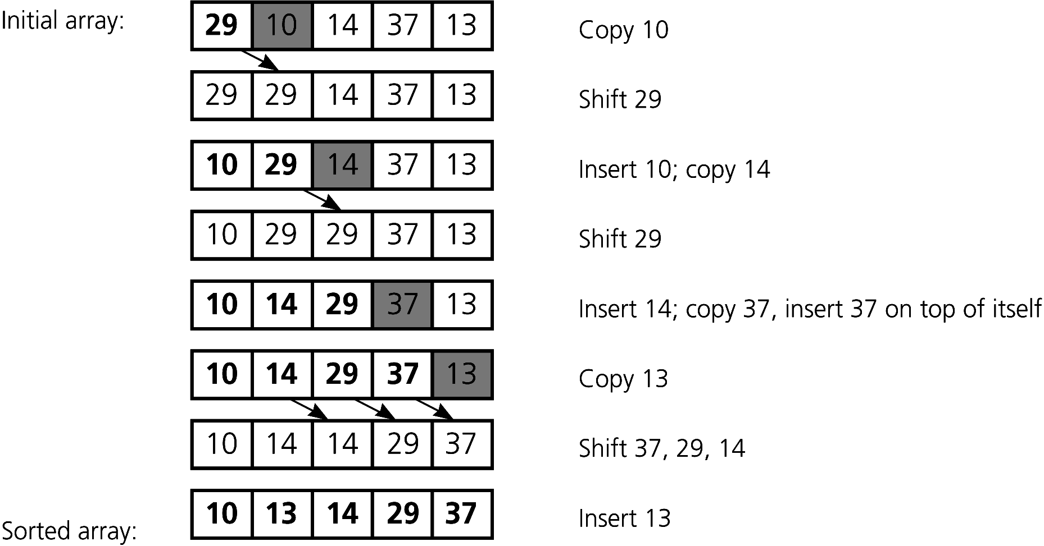
Insertion Sort
Figure 9-7 An insertion sort of an array of five integers.

Slide 26
Mergesort
A recursive sorting algorithm
Performance is independent of the initial order of the array items
Strategy
  Divide an array into halves
  Sort each half
  Merge the sorted halves into one sorted array
  Divide-and-conquer

Slide 27
Mergesort
Analysis
  Worst case: O(n * log₂n)
  Average case: O(n * log₂n)
  Advantage
    Mergesort is an extremely fast algorithm
  Disadvantage
    Mergesort requires a second array as large as the original array

Slide 28
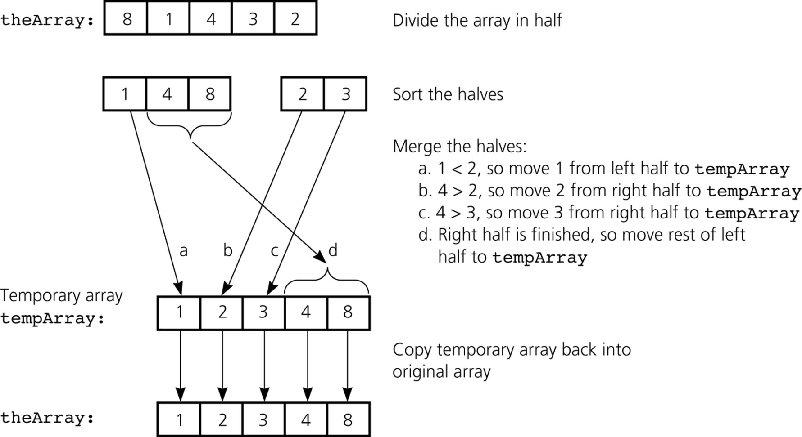
Mergesort
Figure 9-8 A mergesort with an auxiliary temporary array

Slide 29
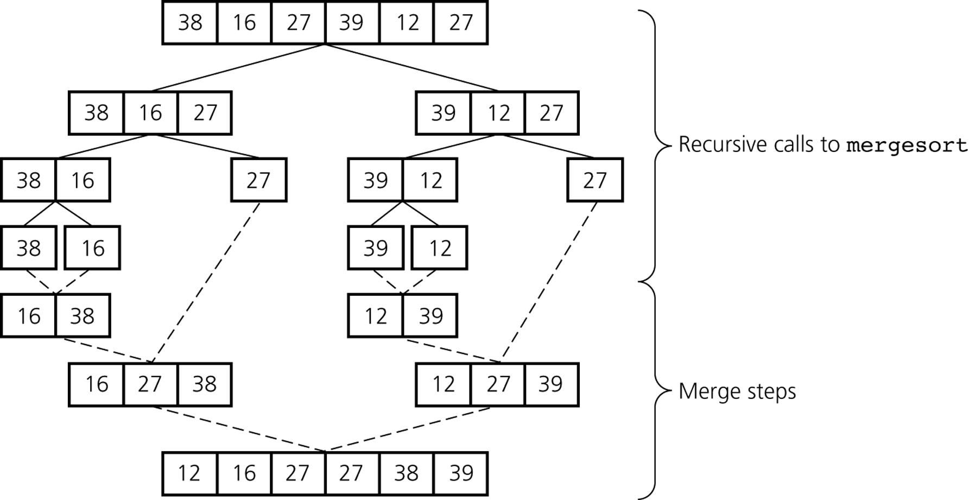
Mergesort
Figure 9-9 A mergesort of an array of six integers

Slide 30
Quicksort
A divide-and-conquer algorithm
Strategy
  Choose a pivot
  Partition the array about the pivot
    items < pivot
    items >= pivot
    Pivot is now in correct sorted position
  Sort the left section
  Sort the right section

Slide 31
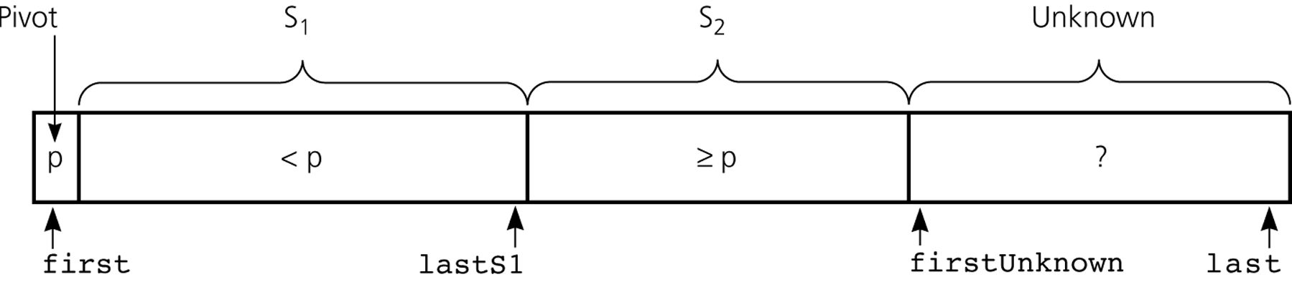
Quicksort
Using an invariant to develop a partition algorithm
  The items in region S₁ are all less than the pivot, and those in S₂ are all greater than or equal to the pivot
Figure 9-14 Invariant for the partition algorithm

Slide 32
Quicksort
Analysis
  Average case: O(n * log₂n)
  Worst case: O(n²)
    When the array is already sorted and the smallest item is chosen as the pivot
  Quicksort is usually extremely fast in practice
  Even if the worst case occurs, quicksort’s performance is acceptable for moderately large arrays

Slide 33
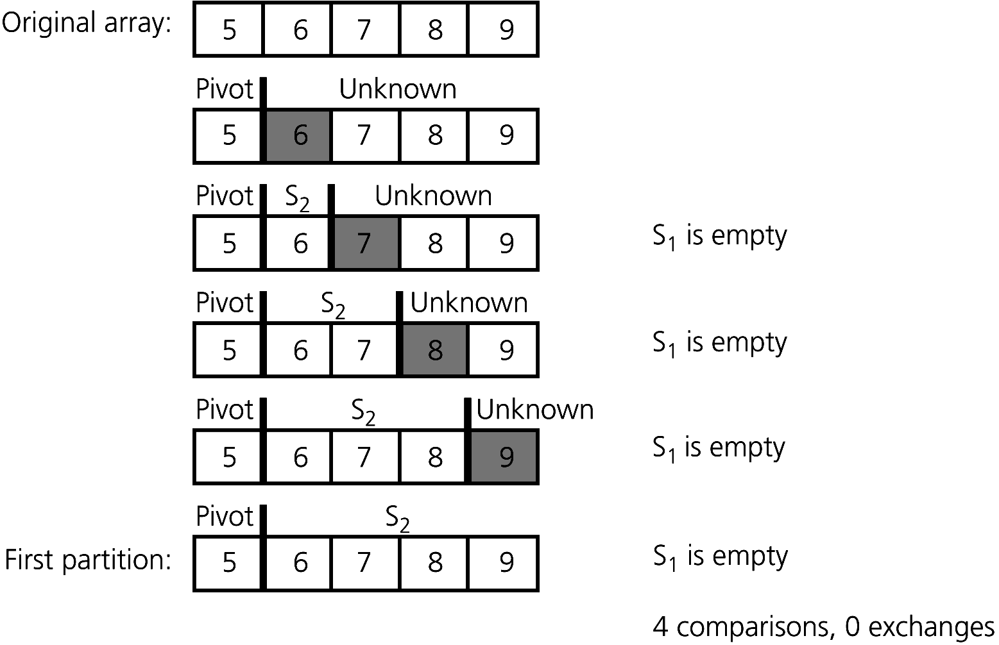
Quicksort
Figure 9-19 A worst-case partitioning with quicksort

Slide 34
Stack Depth
An important consideration with any recursive algorithm is the depth of the call stack.
Each recursive call means additional memory devoted to storing the values of local variables and other information.
In the worst case, quicksort can have a stack as deep as the number of elements in the array.
One way to deal with this is to ensure that the smaller of the two subarrays is processed first.
This does not affect the correctness.
Even this idea will not work in a truly recursive implementation without compiler optimization.
The most memory-efficient implementation is a non-recursive one that explicitly maintains the stack of subarrays to be sorted.

Slide 35
Nonrecursive Quicksort
// Use explicit stack instead of recursive calls. Sort smaller of two subfiles first.
#include<stack>
void quicksort(Item a[ ], int l, int r)
{
int i;
stack<int> s;
s.push(l); s.push( r);
while (!s.empty())
{
r = s.pop(); l = s.pop();
if (r <= l) continue;
partition(a, l, r, i);
if (i-l > r-i)
{ s.push(l); s.push(i-1); s.push(i+1); s.push(r); }
else
{ s.push(i+1); s.push(r); s.push(l); s.push(i-1); }
}
}

Slide 36
Sorting in Linear Time
Counting sort
Radix sort
Bucket sort

Slide 37
Sorting So Far
Insertion sort:
  Easy to code
  Fast on small inputs (less than ~50 elements)
  Fast on nearly-sorted inputs
  O(n²) worst case
  O(n²) average (equally-likely inputs) case
  O(n²) reverse-sorted case

Slide 38
Sorting So Far
Merge sort:
  Divide-and-conquer:
    Split array in half
    Recursively sort subarrays
    Linear-time merge step
  O(n lg n) worst case
  Doesn’t sort in place (need extra memory space)

Slide 39
Sorting So Far
Quick sort:
  Divide-and-conquer:
    Partition array into two subarrays, recursively sort
    All of first subarray < all of second subarray
    No merge step needed!
  O(n lg n) average case
  Fast in practice
  O(n²) worst case
    Naïve implementation: worst case on sorted input
    Address this with randomized quicksort

Slide 40
How Fast Can We Sort?
First, an observation: all of the sorting algorithms so far are comparison sorts
  The only operation used to gain ordering information about a sequence is the pairwise comparison of two elements
  Comparisons sorts must do at least n comparisons
  What do you think is the best comparison sort running time?

Slide 41
Lower Bound For Comparison Sorts
The time to comparison sort n elements is Ω(n lg n)
Corollary: Heapsort* and Mergesort are asymptotically optimal comparison sorts.

Slide 42
Counting Sort – Sort small numbers
Why it’s not a comparison sort:
  Assumption: input - integers in the range 0..k
  No comparisons made!
Basic idea:
  determine for each input element x its rank: the number of elements less than x.
  once we know the rank r of x, we can place it in position r+1

Slide 43
Counting Sort
The Algorithm
Counting-Sort(A)
  Initialize two arrays B and C of size n and set all entries to 0
Count the number of occurrences of every A[i]
  for i = 1..n
  do C[A[i]] ← C[A[i]] + 1
Count the number of occurrences of elements <= A[i]
  for i = 2..k //k is the range of input array elements
  do C[i] ← C[i] + C[i – 1]
Move every element to its final position
  for i = n..1
  do B[C[A[i]] ← A[i]
  C[A[i]] ← C[A[i]] – 1

Slide 44
Counting-sort example
1
2
3
4
5
1
2
3
4
A:
4
1
3
4
3
C:
B:

Slide 45
Loop 1
1
2
3
4
5
1
2
3
4
A:
4
1
3
4
3
0
0
0
0
C:
B:
for i ← 1 to k
  _{do C[i] ← 0}

Slide 46
Loop 2
1
2
3
4
5
1
2
3
4
A:
4
1
3
4
3
0
0
0
1
C:
B:
for j ← 1 to n
  do C[A[ j]] ← C[A[ j]] + 1 ⊳ C[i] = |{key = i}|

Slide 47
Loop 2
1
2
3
4
5
1
2
3
4
A:
4
1
3
4
3
1
0
0
1
C:
B:
for j ← 1 to n
  do C[A[ j]] ← C[A[ j]] + 1 ⊳ C[i] = |{key = i}|

Slide 48
Loop 2
1
2
3
4
5
1
2
3
4
A:
4
1
3
4
3
1
0
1
1
C:
B:
for j ← 1 to n
  do C[A[ j]] ← C[A[ j]] + 1 ⊳ C[i] = |{key = i}|

Slide 49
Loop 2
1
2
3
4
5
1
2
3
4
A:
4
1
3
4
3
1
0
1
2
C:
B:
for j ← 1 to n
  do C[A[ j]] ← C[A[ j]] + 1 ⊳ C[i] = |{key = i}|

Slide 50
Loop 2
1
2
3
4
5
1
2
3
4
A:
4
1
3
4
3
1
0
2
2
C:
B:
for j ← 1 to n
  do C[A[ j]] ← C[A[ j]] + 1 ⊳ C[i] = |{key = i}|

Slide 51
Loop 3
1
2
3
4
5
1
2
3
4
A:
4
1
3
4
3
1
0
2
2
C:
B:
C':
1
1
2
2
for i ← 2 to k
  do C[i] ← C[i] + C[i–1] ⊳ C[i] = |{key ≤ i}|

Slide 52
Loop 3
1
2
3
4
5
1
2
3
4
A:
4
1
3
4
3
1
0
2
2
C:
B:
C':
1
1
3
2
for i ← 2 to k
  do C[i] ← C[i] + C[i–1] ⊳ C[i] = |{key ≤ i}|

Slide 53
Loop 3
1
2
3
4
5
1
2
3
4
A:
4
1
3
4
3
1
0
2
2
C:
B:
C':
1
1
3
5
for i ← 2 to k
  do C[i] ← C[i] + C[i–1] ⊳ C[i] = |{key ≤ i}|

Slide 54
Loop 4
1
2
3
4
5
1
2
3
4
A:
4
1
3
4
3
1
1
3
5
C:
B:
3
C':
1
1
2
5
for j ← n downto 1
  _{do B[C[A[ j]]] ← A[ j]}
  _{C[A[ j]] ← C[A[ j]] – 1}

Slide 55
Loop 4
1
2
3
4
5
1
2
3
4
A:
4
1
3
4
3
1
1
2
5
C:
B:
3
4
C':
1
1
2
4
for j ← n downto 1
  _{do B[C[A[ j]]] ← A[ j]}
  _{C[A[ j]] ← C[A[ j]] – 1}

Slide 56
Loop 4
1
2
3
4
5
1
2
3
4
A:
4
1
3
4
3
1
1
2
4
C:
B:
3
3
4
C':
1
1
1
4
for j ← n downto 1
  _{do B[C[A[ j]]] ← A[ j]}
  _{C[A[ j]] ← C[A[ j]] – 1}

Slide 57
Loop 4
1
2
3
4
5
1
2
3
4
A:
4
1
3
4
3
1
1
1
4
C:
B:
1
3
3
4
C':
0
1
1
4
for j ← n downto 1
  _{do B[C[A[ j]]] ← A[ j]}
  _{C[A[ j]] ← C[A[ j]] – 1}

Slide 58
Loop 4
1
2
3
4
5
1
2
3
4
A:
4
1
3
4
3
0
1
1
4
C:
B:
1
3
3
4
4
C':
0
1
1
3
for j ← n downto 1
  _{do B[C[A[ j]]] ← A[ j]}
  _{C[A[ j]] ← C[A[ j]] – 1}

Slide 59
Counting Sort
1 CountingSort(A, B, k)
2 for i=1 to k
3 C[i]= 0;
4 for j=1 to n
5 C[A[j]] += 1;
6 for i=2 to k
7 C[i] = C[i] + C[i-1];
8 for j=n downto 1
9 B[C[A[j]]] = A[j];
10 C[A[j]] -= 1;
Takes time O(k)
Takes time O(n)
What will be the running time?

Slide 60
Counting Sort
Total time: O(n + k)
  Usually, k = O(n)
  Thus counting sort runs in O(n) time
But sorting is Ω(n lg n)!
  No contradiction--this is not a comparison sort (in fact, there are no comparisons at all!)
  Notice that this algorithm is stable
    If numbers have the same value, they keep their original order

Slide 61
Counting Sort
Linear Sort! Cool! Why don’t we always use counting sort?
Because it depends on range k of elements
Could we use counting sort to sort 32 bit integers? Why or why not?
Answer: no, k too large (2³² = 4,294,967,296)

Slide 62
Radix Sort
Why it’s not a comparison sort:
  Assumption: input has d digits each ranging from 0 to k
  Example: Sort a bunch of 4-digit numbers, where each digit is 0-9
Basic idea:
  Sort elements by digit starting with least significant
  Use a stable sort (like counting sort) for each stage

Slide 63
Radix Sort
The Algorithm
Radix Sort takes parameters: the array and the number of digits in each array element
Radix-Sort(A, d)
1 for i = 1..d
2 do sort the numbers in arrays A by their i-th digit from the right, using a stable sorting algorithm

Slide 64
Radix Sort Example
329
457
657
839
436
720
355
720
355
436
457
657
329
839
720
329
436
839
355
457
657
329
355
436
457
657
720
839

Slide 65
Radix Sort
Correctness and Running Time
What is the running time of radix sort?
  Each pass over the d digits takes time O(n+k), so total time O(dn+dk)
        When d is constant and k=O(n), takes O(n) time
Stable, Fast
Doesn’t sort in place (because counting sort is used)

Slide 66
Radix Sort
In general, radix sort based on counting sort is
  Fast
  Asymptotically fast (i.e., O(n))
  Simple to code
  A good choice

Slide 67
Bucket Sort
Assumption: input - n real numbers from [0, 1)
Basic idea:
  Create n linked lists (buckets) to divide interval [0,1) into subintervals of size 1/n
  Add each input element to appropriate bucket and sort buckets with insertion sort
Uniform input distribution → O(1) bucket size
  Therefore the expected total time is O(n)

Slide 68
Bucket Sort
Bucket-Sort(A)
n ← length(A)
for i ← 0 to n-1
do insert A[i] into list B[floor(n*A[i])]
for i ← 0 to n –1
do Insertion-Sort(B[i])
Concatenate lists B[0], B[1], … B[n –1] in order
Distribute elements over buckets
Sort each bucket

Slide 69
Bucket Sort Example
.78
.17
.39
.26
.72
.94
.21
.12
.23
.68
0
.12
1
.12
.17
.17
2
.21
.23
.26
.21
3
.39
.23
4
.26
5
.39
6
.68
.68
7
.72
.78
.72
8
.78
9
.94
.94

Slide 70
Bucket Sort – Running Time
All lines except line 5 (Insertion-Sort) take O(n) in the worst case.
In the worst case, O(n) numbers will end up in the same bucket, so in the worst case, it will take O(n²) time.
Lemma: Given that the input sequence is drawn uniformly at random from [0,1), the expected size of a bucket is O(1).
So, in the average case, only a constant number of elements will fall in each bucket, so it will take O(n)
Use a different indexing scheme (hashing) to distribute the numbers uniformly.

Slide 71
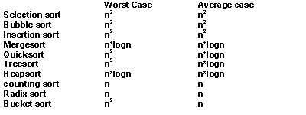
A Comparison of Sorting Algorithms
Figure Approximate growth rates of time required for eight sorting algorithms

Slide 72
Summary
Every comparison-based sorting algorithm has to take
Ω(n lg n) time.
Merge Sort and Quick Sort are comparison-based and take O(n lg n) time. Hence, they are optimal.
Other sorting algorithms can be faster by exploiting assumptions made about the input
Counting Sort and Radix Sort take linear time for integers in a bounded range.
Bucket Sort takes linear average-case time for uniformly distributed real numbers.

Slide 73
The STL Sorting Algorithms
Some sort functions in the STL library header <algorithm>
  sort
    Sorts a range of elements in ascending order by default
  stable_sort
    Sorts as above, but preserves original ordering of equivalent elements

Slide 74
The STL Sorting Algorithms
  partial_sort
    Sorts a range of elements and places them at the beginning of the range
  nth_element
    Partitions the elements of a range about the n^{th} element
    The two subranges are not sorted
  partition
    Partitions the elements of a range according to a given predicate

Slide 75
Summary
Order-of-magnitude analysis and Big O notation measure an algorithm’s time requirement as a function of the problem size by using a growth-rate function
To compare the efficiency of algorithms
  Examine growth-rate functions when problems are large
  Consider only significant differences in growth-rate functions

Slide 76
Summary
Worst-case and average-case analyses
  Worst-case analysis considers the maximum amount of work an algorithm will require on a problem of a given size
  Average-case analysis considers the expected amount of work that an algorithm will require on a problem of a given size

Slide 77
Summary
Order-of-magnitude analysis can be the basis of your choice of an ADT implementation
Selection sort, bubble sort, and insertion sort are all O(n²) algorithms
Quicksort and mergesort are two very fast recursive sorting algorithms
Linear sort O(n): counting sort, radix sort and bucket sort.

