Slide 1
Chapter 10:
Trees
Data Abstraction & Problem Solving with
C++
Fifth Edition
by Frank M. Carrano

Slide 2
Categories of Data-Management Operations
General: Operations that
  Insert data into a data collection
  Delete data from a data collection
  Ask questions about the data in a data collection
Position-oriented ADTs: Operations that
  Insert data into the i^{th} position
  Delete data from the i^{th} position
  Ask a question about the data in the i^{th} position
  Examples: list, stack, queue, binary tree

Slide 3
Categories of Data-Management Operations
Value-oriented ADTs: Operations that
  Insert data according to its value
  Delete data knowing only its value
  Ask a question about data knowing only its value
  Examples: sorted list, binary search tree

Slide 4
Terminology
Trees are composed of nodes and edges
Trees are hierarchical
  Parent-child relationship between two nodes
  Ancestor-descendant relationships among nodes
Subtree of a tree: Any node and its descendants

Slide 5
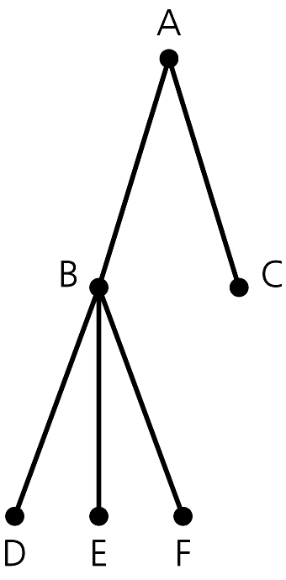
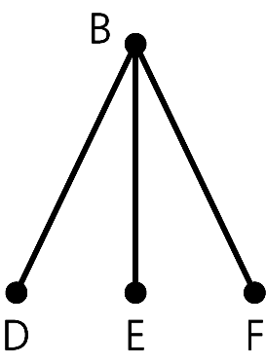
Terminology
Figure 10-1 A general tree
Figure 10-2
A subtree of the tree in Figure 10-1

Slide 6
Terminology
General tree
  A general tree T is a set of one or more nodes such that T is partitioned into disjoint subsets:
    A single node r, the root
    Sets that are general trees, called subtrees of r

Slide 7
Terminology
Parent of node n
  The node directly above node n in the tree
Child of node n
  A node directly below node n in the tree
Root
  The only node in the tree with no parent
Subtree of node n
  A tree that consists of a child (if any) of node n and the child’s descendants

Slide 8
Terminology
Leaf
  A node with no children
Siblings
  Nodes with a common parent
Ancestor of node n
  A node on the path from the root to n
Descendant of node n
  A node on a path from n to a leaf

Slide 9
A Binary Tree
A binary tree is a set T of nodes such that either
  T is empty, or
  T is partitioned into three disjoint subsets:
    A single node r, the root
    Two possibly empty sets that are binary trees, called the left subtree of r and the right subtree of r

Slide 10
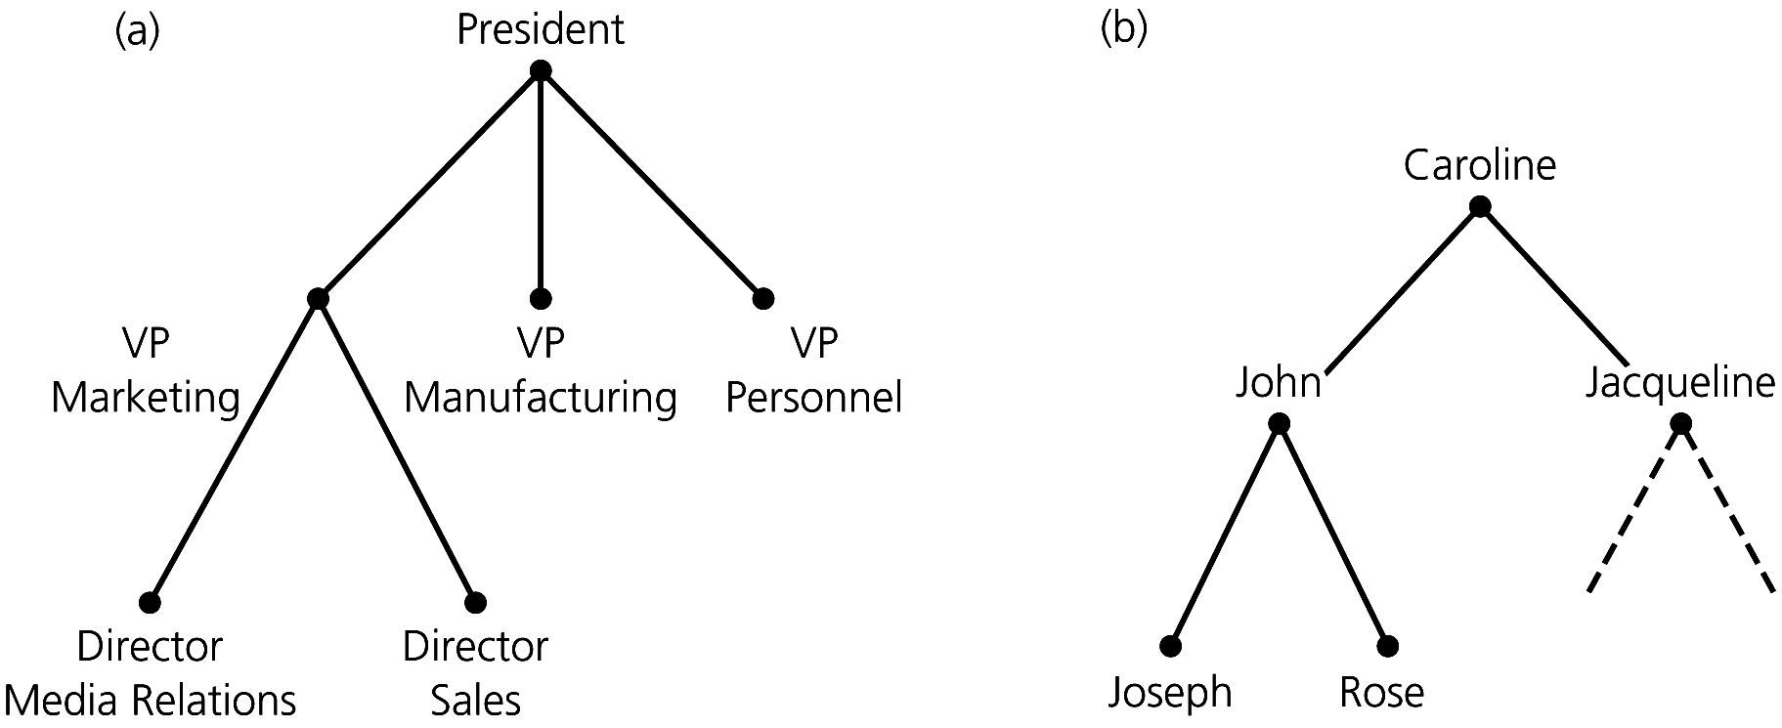
A General Tree & A Binary Tree
Figure 10-3 (a) An organization chart; (b) a family tree

Slide 11
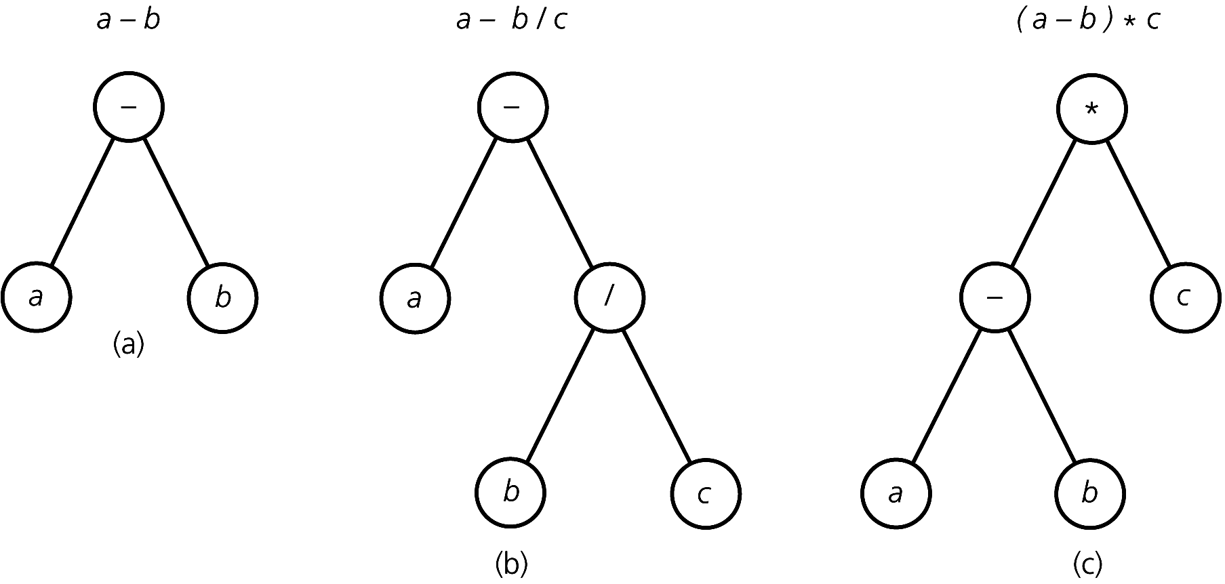
More Binary Trees
Figure 10-4 Binary trees that represent algebraic expressions

Slide 12
A Binary Search Tree
A binary search tree
  A binary tree that has the following properties for each node n
    n’s value is > all values in n’s left subtree T_{L}
    n’s value is < all values in n’s right subtree T_{R}
    Both T_{L} and T_{R} are binary search trees

Slide 13
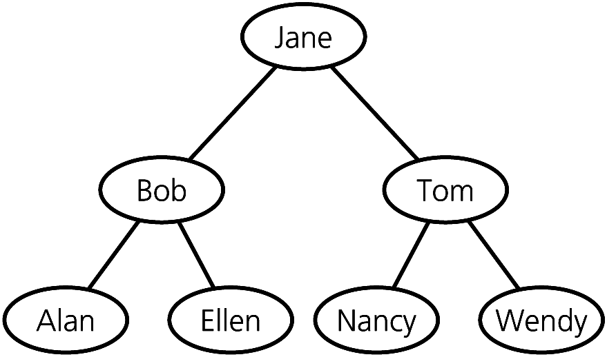
A Binary Search Tree
Figure 10-5
A binary search tree of names

Slide 14
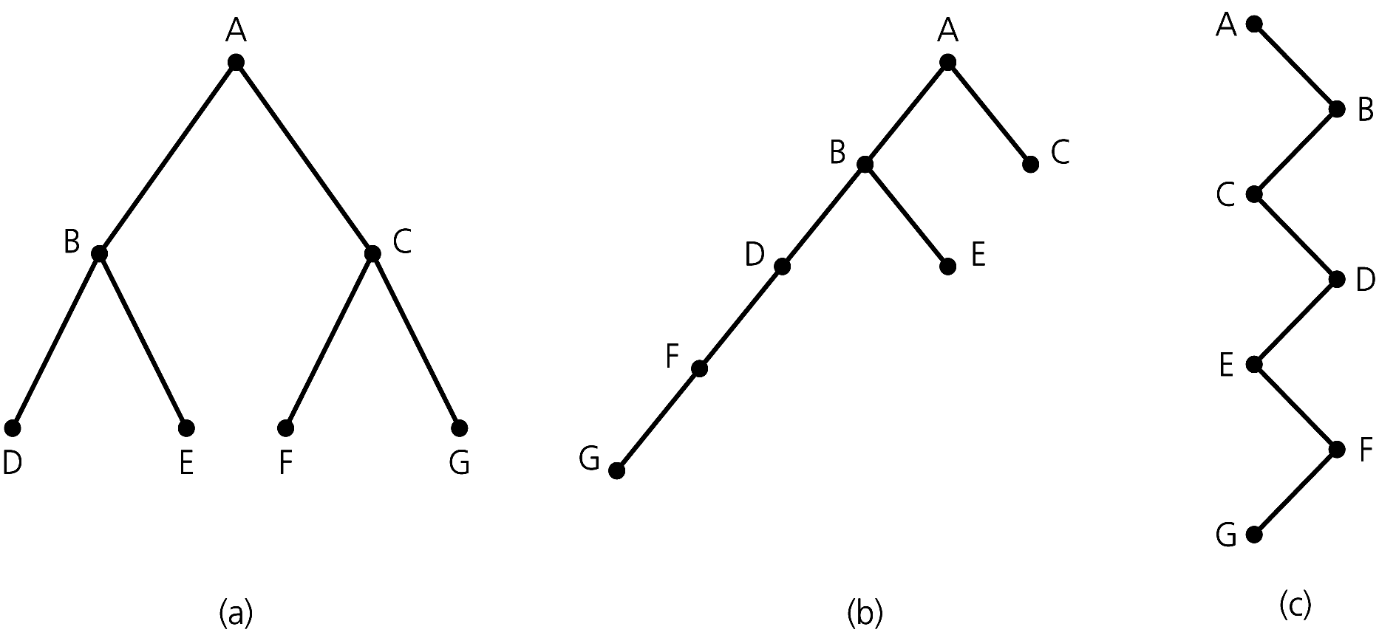
The Height of Trees
Height of a tree
  Number of nodes along the longest path from the root to a leaf
  Height 3 Height 5 Height 7
Figure 10-6
Binary trees with the same nodes but different heights

Slide 15
The Height of Trees
Level of a node n in a tree T
  If n is the root of T, it is at level 1
  If n is not the root of T, its level is 1 greater than the level of its parent
Height of a tree T defined in terms of the levels of its nodes
  If T is empty, its height is 0
  If T is not empty, its height is equal to the maximum level of its nodes

Slide 16
The Height of Trees
A recursive definition of height
  If T is empty, its height is 0
  If T is not empty,
  height(T) = 1 + max{height(T_{L}), height(T_{R})}
  r
  / \
  T_{L} T_{R}

Slide 17

Full Binary Trees
A binary tree of height h is full if
  Nodes at levels < h have two children each
Recursive definition
  If T is empty, T is a full binary tree of height 0
  If T is not empty and has height h > 0, T is a full binary tree if its root’s subtrees are both full binary trees of height h – 1
Figure 10-7
A full binary tree of height 3

Slide 18
Complete Binary Trees
A binary tree of height h is complete if
  It is full to level h – 1, and
  Level h is filled from left to right

Slide 19
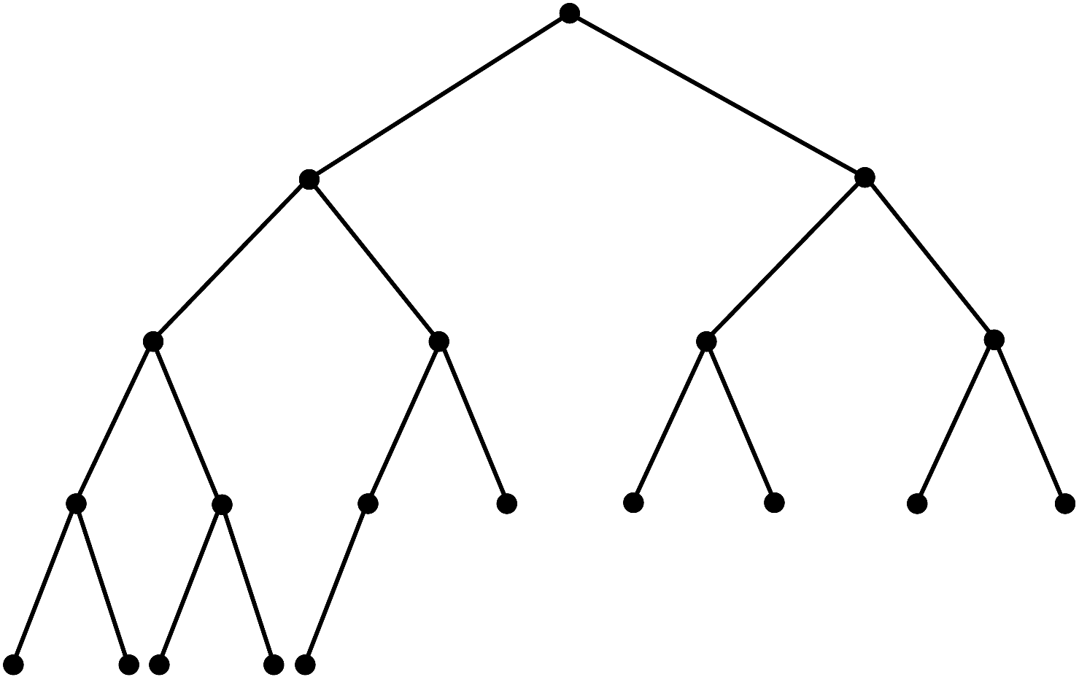
Complete Binary Trees
Figure 10-8 A complete binary tree

Slide 20
Complete Binary Trees
Another definition:
A binary tree of height h is complete if
  All nodes at levels <= h – 2 have two children each, and
  When a node at level h – 1 has children, all nodes to its left at the same level have two children each, and
  When a node at level h – 1 has one child, it is a left child

Slide 21
Balanced Binary Trees
A binary tree is balanced if the heights of any node’s two subtrees differ by no more than 1
Complete binary trees are balanced
Full binary trees are complete and balanced

Slide 22
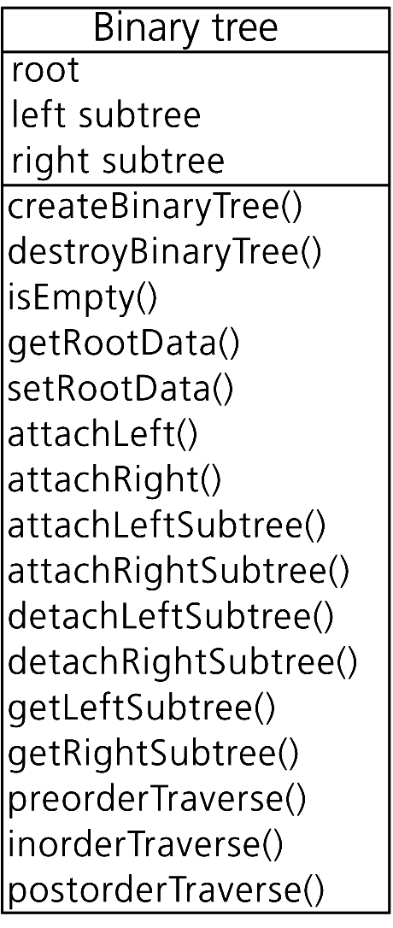
The ADT Binary Tree
Figure 10-9
UML diagram for the class BinaryTree

Slide 23
The ADT Binary Tree
Building the ADT binary tree in Fig. 10-6b
    tree1.setRootData(‘F’)
    tree1.attachLeft(‘G’)
    tree2.setRootData(‘D’)
    tree2.attachLeftSubtree(tree1)
    tree3.setRootData(‘B’)
    tree3.attachLeftSubtree(tree2)
    tree3.attachRight(‘E)
    tree4.setRootData(‘C’)
    tree10_6.createBinaryTree(‘A’,tree3,tree4)

Slide 24
Traversals of a Binary Tree
A traversal visits each node in a tree
You do something with or to the node during a visit
  For example, display the data in the node
General form of a recursive traversal algorithm
  traverse (in binTree:BinaryTree)
    if (binTree is not empty)
    { traverse(Left subtree of binTree’s root)
    traverse(Right subtree of binTree’s root)
    }

Slide 25
Traversals of a Binary Tree
Preorder traversal
  Visit root before visiting its subtrees
    i. e. Before the recursive calls
Inorder traversal
  Visit root between visiting its subtrees
    i. e. Between the recursive calls
Postorder traversal
  Visit root after visiting its subtrees
    i. e. After the recursive calls

Slide 26
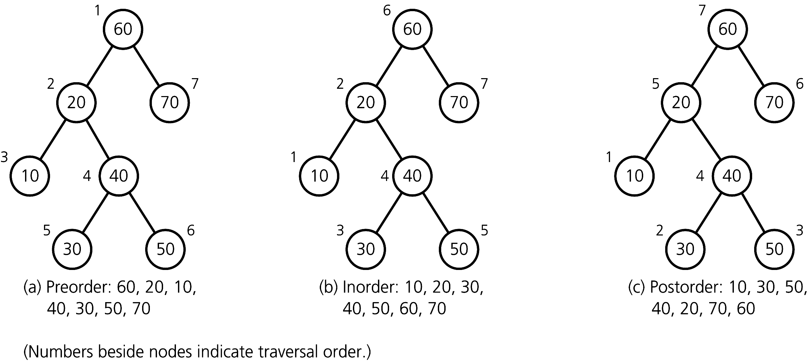
Traversals of a Binary Tree
Figure 10-10
Traversals of a binary tree: (a) preorder; (b) inorder; (c) postorder

Slide 27
Traversals of a Binary Tree
A traversal operation can call a function to perform a task on each item in the tree
  This function defines the meaning of “visit”
  The client defines and passes this function as an argument to the traversal operation

Slide 28
Possible Representations of a Binary Tree
An array-based representation
  Uses an array of tree nodes
  Requires the creation of a free list that keeps track of available nodes
A pointer-based representation
  Nodes have two pointers that link the nodes in the tree

Slide 29
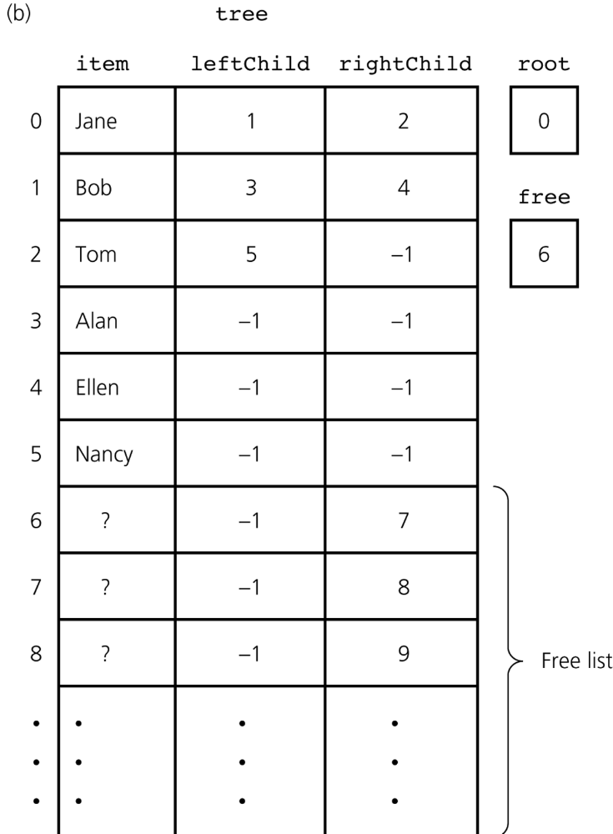
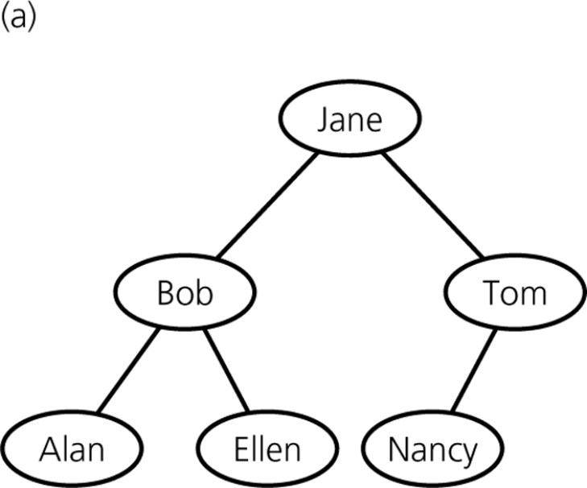
Array-based ADT Binary Tree
Figure 10-11 (a) A binary tree of names; (b) its array-based implementation

Slide 30
Array-based Representation of a Complete Binary Tree
If a binary tree is complete and remains complete
  A memory-efficient array-based implementation is possible AND attractive

Slide 31
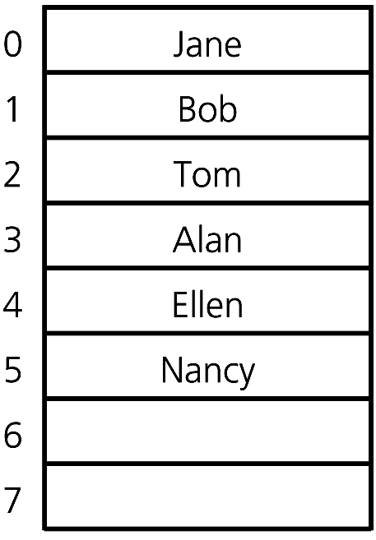
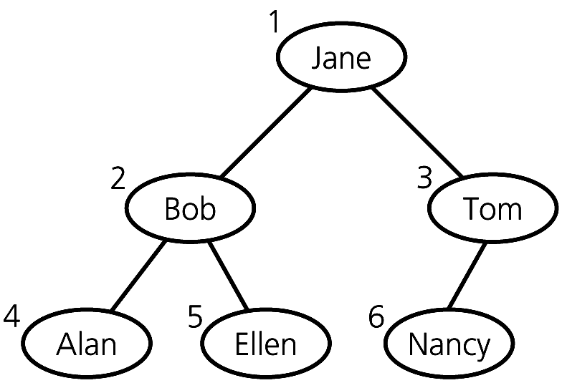
Array-based Representation of a Complete Binary Tree
Figure 10-12 Level-by-level numbering of a complete binary tree
Figure 10-13 An array-based implementation of the complete tree in Figure 10-12

Slide 32
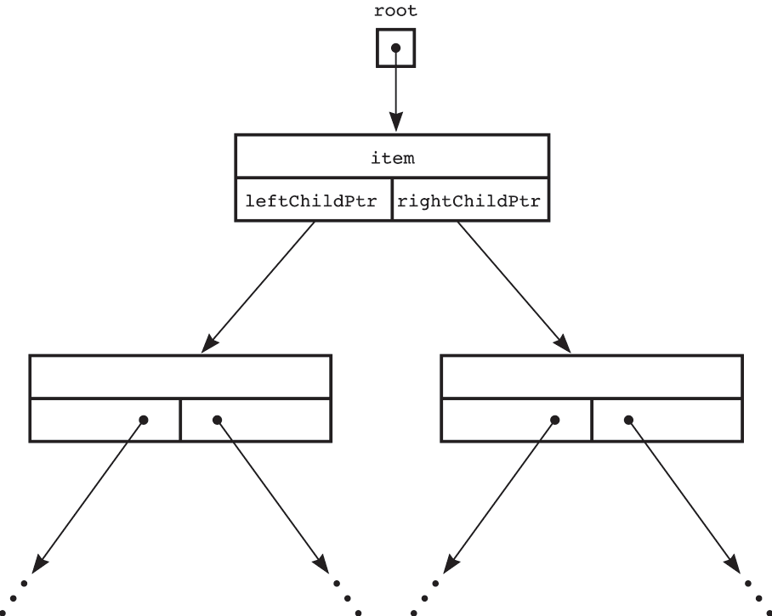
Pointer-based ADT Binary Tree
Figure 10-14 A pointer-based implementation of a binary tree

Slide 33
Pointer-based ADT Binary Tree
TreeException and TreeNode classes
BinaryTree class
  Several constructors, including a
    Protected constructor whose argument is a pointer to a root node; prohibits client access
    Copy constructor that calls a private function to copy each node during a traversal of the tree
  Destructor

Slide 34
Pointer-based ADT Binary Tree
BinaryTree class (continued)
  isEmpty, getRootData, setRootData
  attachLeft, attachRight
  attachLeftSubtree, attachRightSubtree
  detachLeftSubtree, detachRightSubtree
  getLeftSubtree, getRightSubtree
  Overloaded assignment operator

Slide 35
Pointer-based ADT Binary Tree:
Tree Traversals
BinaryTree class (continued)
  Public methods for traversals so that visiting a node remains on the client’s side of the wall
  void inorderTraverse(FunctionType visit);
  typedef void (*FunctionType)(TreeItemType&
  item);
  Protected methods, such as inorder, that enable the recursion
  void inorder(TreeNode *treeptr,
  FunctionType visit);
  inorderTraverse calls inorder, passing it a node pointer and the client-defined function visit

Slide 36
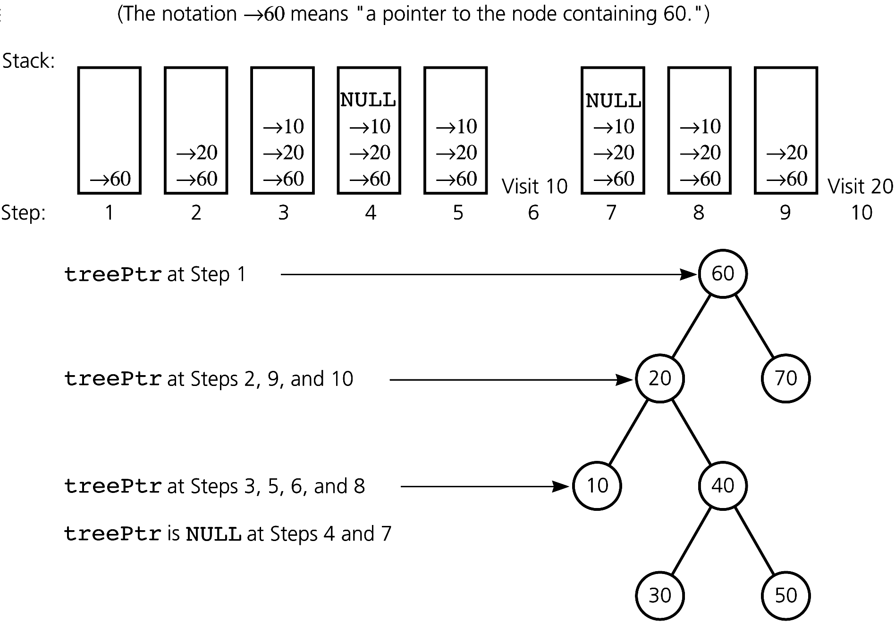
Pointer-based ADT Binary Tree:
Recursive Inorder Traversal
Figure 10-15 Contents of the implicit stack as treePtr progresses through a given tree
during a recursive inorder traversal

Slide 37
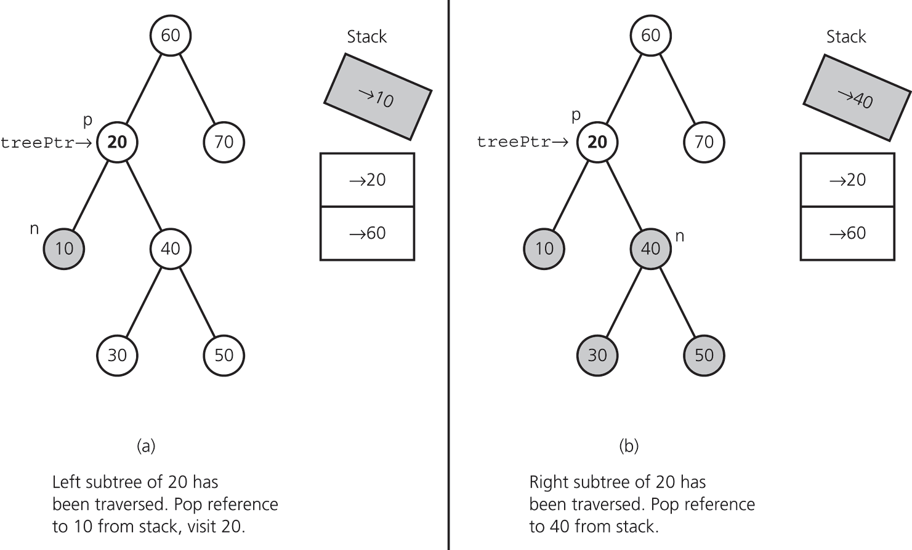
Pointer-based ADT Binary Tree:
Nonrecursive Inorder Traversal
An iterative method and an explicit stack can mimic the actions of a return from a recursive call to inorder
Figure 10-16
Traversing (a) the left and (b) the right subtrees of 20

Slide 38
Copying a Binary Tree
To copy a tree
  Traverse it in preorder
  Insert each item visited into a new tree
  Use in copy constructor
To deallocate a tree
  Traverse in postorder
  Delete each node visited
  “Visit” follows deallocation of a node’s subtrees
  Use in destructor

Slide 39
The ADT Binary Search Tree
The ADT binary tree is not suitable when you need to search for a particular item
The ADT binary search tree is suitable for this task
Record
  A group of related items, called fields, that are not necessarily of the same data type
Field
  A data element within a record

Slide 40
The ADT Binary Search Tree
A data item in a binary search tree has a specially designated search key
  A search key is the part of a record that identifies it within a collection of records
KeyedItem class
  Contains the search key as a data field and a method for accessing the search key
  Prevents modification of the search-key value once an item is created
    Has only a constructor for initializing the search key

Slide 41
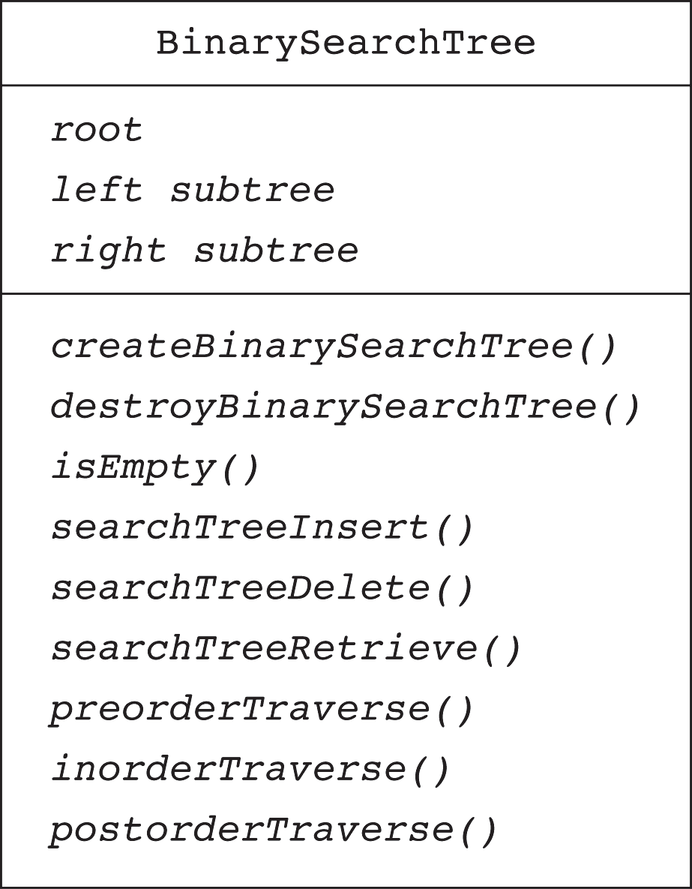
The ADT Binary Search Tree
Figure 10-18 UML diagram for the class BinarySearchTree

Slide 42
ADT Binary Search Tree:
Search Algorithm
Search the binary search tree bst for the item whose search key is searchKey
search(in bst:BinarySearchTree,
  in searchKey:KeyType)
  if (bst is empty)
  Item not found
  else if (searchKey equals root item)
  Item is found
  else if(searchKey < root item)
  search(bst’s left subtree,searchKey)
  else // searchKey > root item
  search(bst’s right subtree,searchKey)

Slide 43
ADT Binary Search Tree: Insertion
Insert newItem into the binary search tree to which treePtr points
insertItem(in treePtr:TreeNodePtr,
in newItem:TreeItemType)
if (Search stops at n’s left subtree)
Make n’s leftChildPtr point to newItem
else
Make n’s rightChildPtr point to newItem

Slide 44
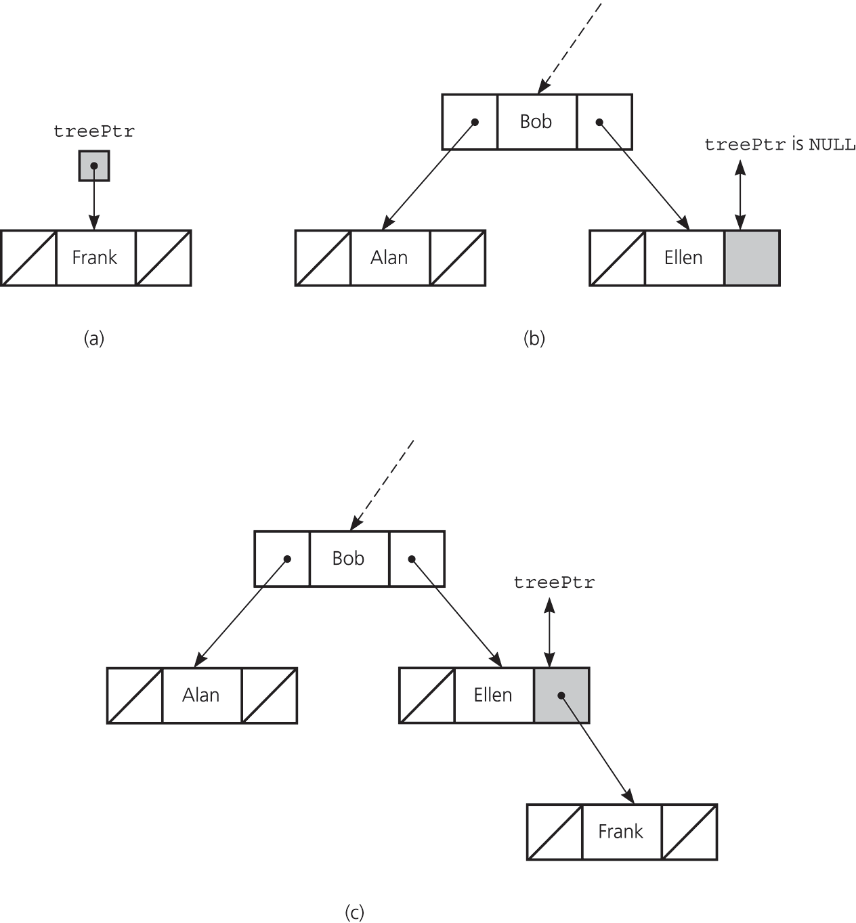
ADT Binary Search Tree: Insertion
Figure 10-23
(a) Insertion into an empty tree;
(b) search terminates at a leaf;
(c) insertion at a leaf

Slide 45
ADT Binary Search Tree: Deletion
Three possible cases for deleting the item in node N
  N is a leaf
    Set the pointer in N’s parent to NULL
  N has only one child
    Let N’s parent adopt N’s child
  N has two children

Slide 46
ADT Binary Search Tree: Deletion
Deleting the item in node N when N has two children (continued)
  Locate another node M that is easier to delete
    M is the leftmost node in N’s right subtree
    M will have no more than one child
    M’s search key is called the inorder successor of N’s search key
  Copy the item that is in M to N
  Remove the node M from the tree

Slide 47
ADT Binary Search Tree:
Retrieval and Traversal
The retrieval operation can be implemented by refining the search algorithm
  Return the item with the desired search key if it exists
  Otherwise, throw TreeException
Traversals for a binary search tree are the same as the traversals for a binary tree
Theorem 10-1
  The inorder traversal of a binary search tree T will visit its nodes in sorted search-key order

Slide 48
Height of a Binary Tree
Theorem 10-2
  A full binary tree of height h ≥ 0 has 2^{h} – 1 nodes
Theorem 10-3
  The maximum number of nodes that a binary tree of height h can have is 2^{h} – 1
Theorem 10-4
  The minimum height of a binary tree with n nodes is ⎡log₂(n+1)⎤
  Complete trees and full trees have minimum height
The maximum height of a binary tree with n nodes is n

Slide 49
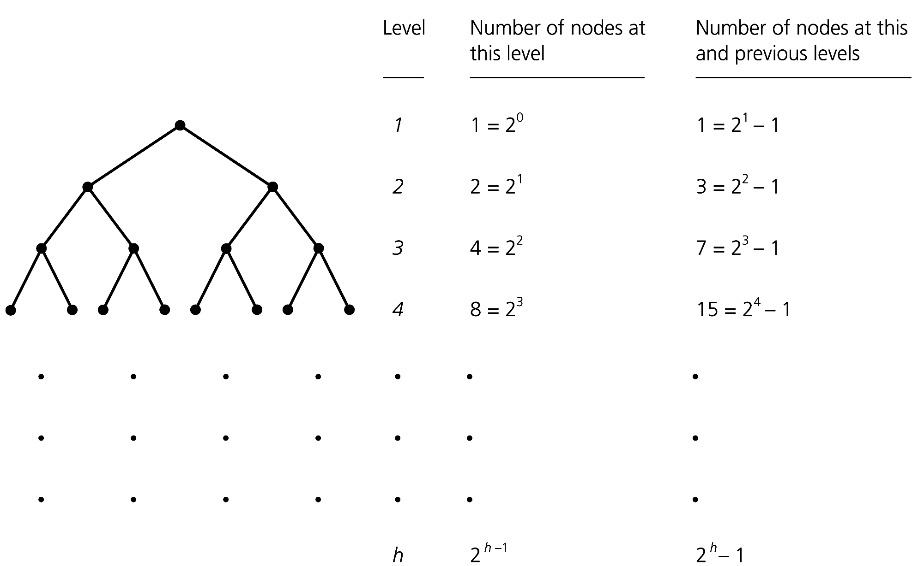
Height of a Binary Tree
Figure 10-32 Counting the nodes in a full binary tree of height h

Slide 50
The Efficiency of Binary Search Tree Operations
The maximum number of comparisons required by any b. s. t. operation is the number of nodes along the longest path from root to a leaf—that is, the tree’s height
The order in which insertion and deletion operations are performed on a binary search tree affects its height
Insertion in random order produces a binary search tree that has near-minimum height

Slide 51
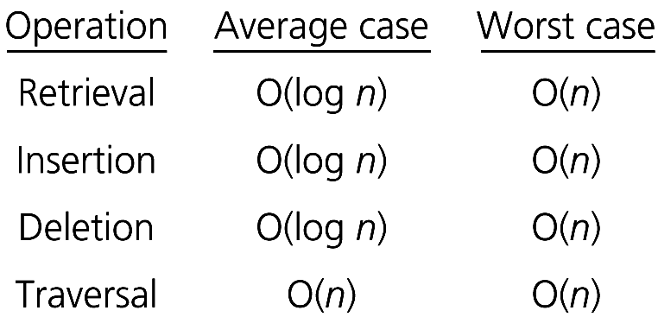
The Efficiency of Binary Search Tree Operations
Figure 10-34 The order of the retrieval, insertion, deletion, and traversal operations for the pointer-based implementation of the ADT binary search tree

Slide 52
Applications
Treesort
  Uses the ADT binary search tree to sort an array of records into search-key order
    Average case: O(n * log n)
    Worst case: O(n²)

Slide 53
Applications
Algorithms for saving a binary search tree
  Saving a binary search tree and then restoring it to its original shape
    Uses preorder traversal to save the tree to a file
  Saving a binary search tree and then restoring it to a balanced shape
    Uses inorder traversal to save the tree to a file
    To restore, need the number of nodes in the tree

Slide 54
The STL Search Algorithms
binary_search
  Returns true if a specified value appears in the given sorted range
lower_bound; upper_bound
  Returns an iterator to the first (one past the last) occurrence of a value
equal_range
  Returns a pair of iterators: One is to the first occurrence of a value in the given sorted range, the other is to one past the last occurrence

Slide 55
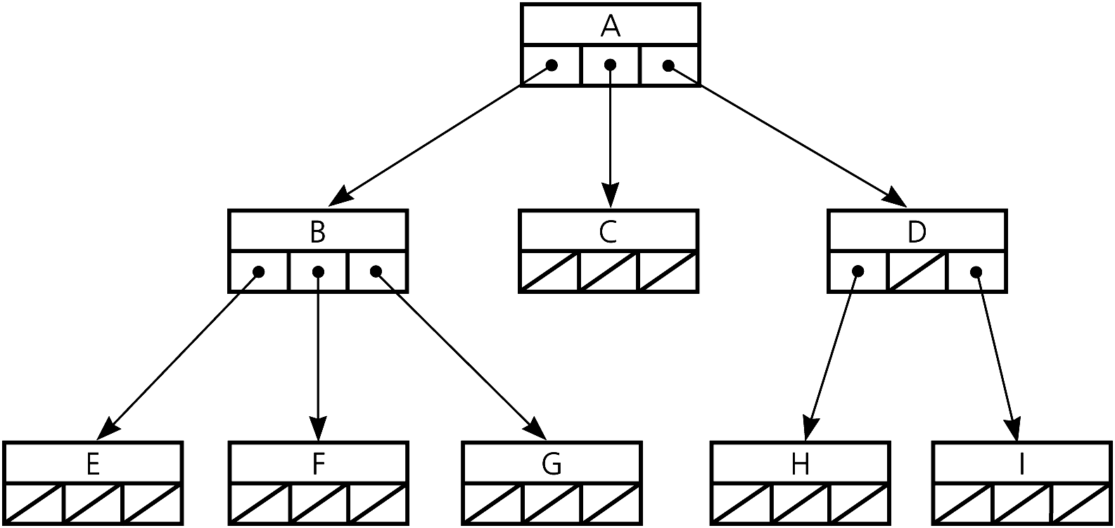
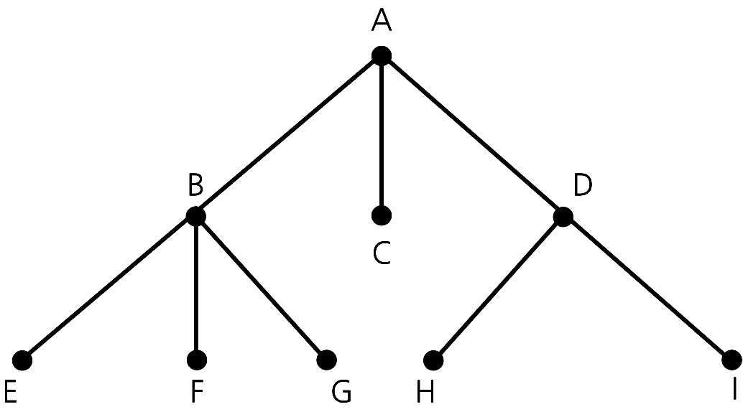
n-ary Trees
An n-ary tree is a general tree whose nodes can have no more than n children each
  A generalization of a binary tree
Figure 10-38 A general tree
Figure 10-41
An implementation of the n-ary tree in Figure 10-38

Slide 56
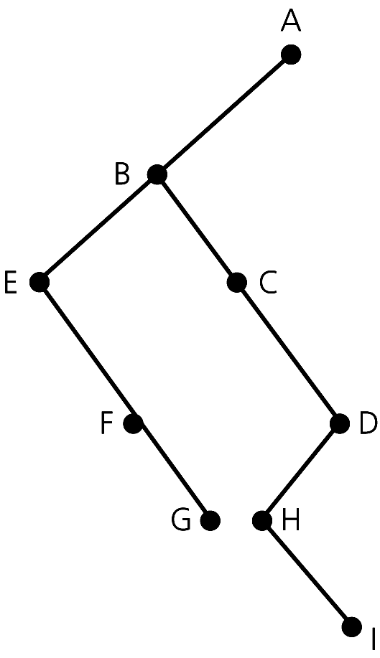
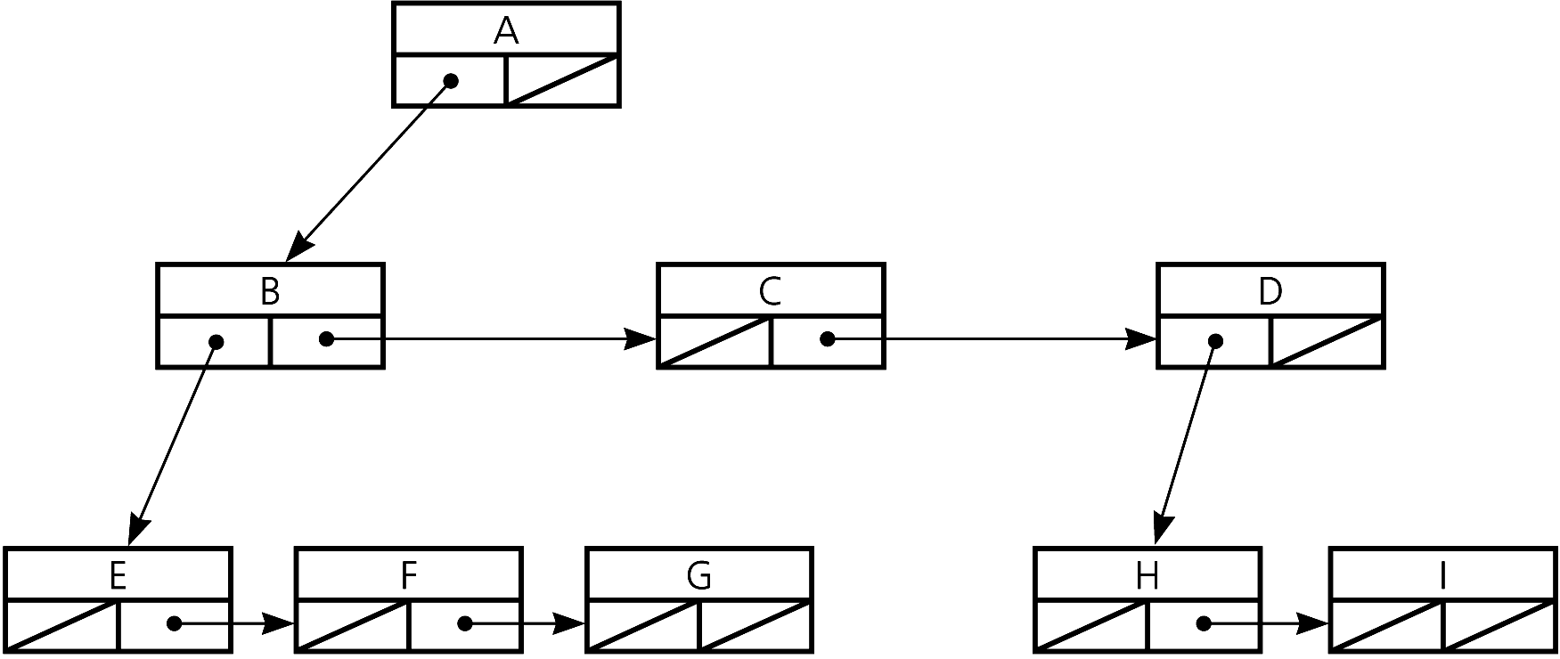
n-ary Trees
A binary tree can represent an n-ary tree
Figure 10-39 Another implementation of the tree in Figure 10-38
Figure 10-40 The binary tree that Figure 10-39 represents

Slide 57
Summary
Binary trees provide a hierarchical organization of data
The implementation of a binary tree is usually pointer-based
If the binary tree is complete, an efficient array-based implementation is possible
Traversing a tree to “visit”—that is, do something to or with—each node is useful
You pass a client-defined “visit” function to the traversal operation to customize its effect on the items in the tree

Slide 58
Summary
The binary search tree allows you to use a binary search-like algorithm to search for an item having a specified value
Binary search trees come in many shapes
  The height of a binary search tree with n nodes can range from a minimum of ⎡log₂(n + 1)⎤ to a maximum of n
  The shape of a binary search tree determines the efficiency of its operations

Slide 59
Summary
An inorder traversal of a binary search tree visits the tree’s nodes in sorted search-key order
The treesort algorithm efficiently sorts an array by using the binary search tree’s insertion and traversal operations

Slide 60
Summary
Saving a binary search tree to a file while performing
  An inorder traversal enables you to restore the tree as a binary search tree of minimum height
  A preorder traversal enables you to restore the tree to its original form

