Slide 1
Chapter 11:
Tables and Priority Queues
Data Abstraction & Problem Solving with
C++
Fifth Edition
by Frank M. Carrano

Slide 2
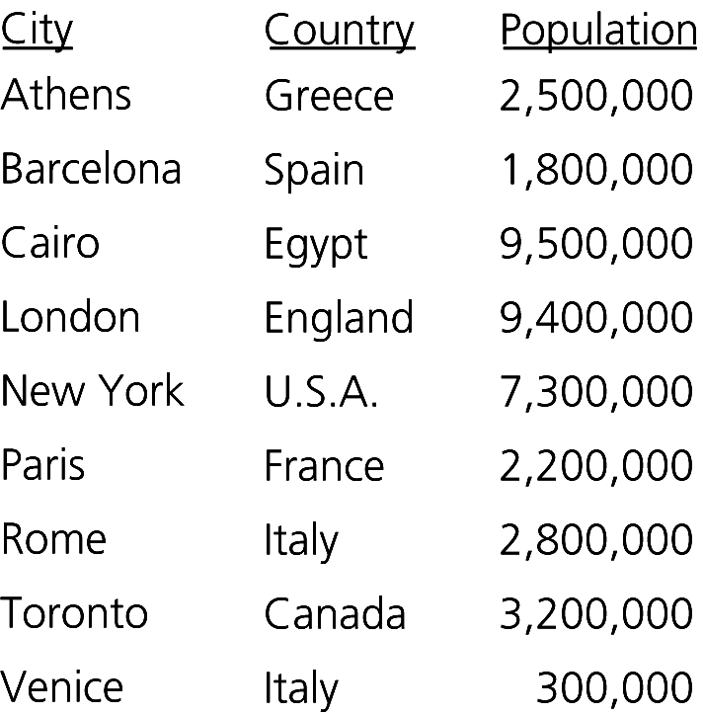
The ADT Table
The ADT table, or dictionary
  Uses a search key to identify its items
  Its items are records that contain several pieces of data
Figure 11-1
An ordinary table of cities

Slide 3
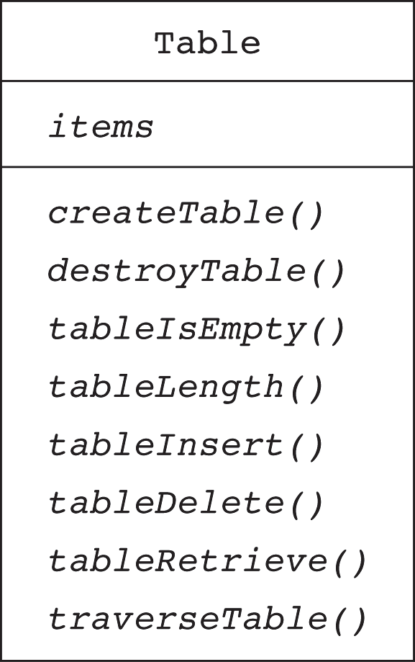
The ADT Table
Various sets of table operations are possible
Figure 11-2 UML diagram for class Table

Slide 4
The ADT Table
Our table assumes distinct search keys
  Other tables could allow duplicate search keys
The traverseTable operation visits table items in a specified order
  One common order is by sorted search key
  A client-defined visit function is supplied as an argument to the traversal
    Called once for each item in the table

Slide 5
The ADT Table
KeyedItem class
  Same as for the ADT binary search tree
  Contains an item’s search key and a method for accessing the search-key data field
  Prevents modification of the search-key value once an item is created
    Has only a constructor for initializing the search key
      Also true of a class that extends KeyedItem

Slide 6
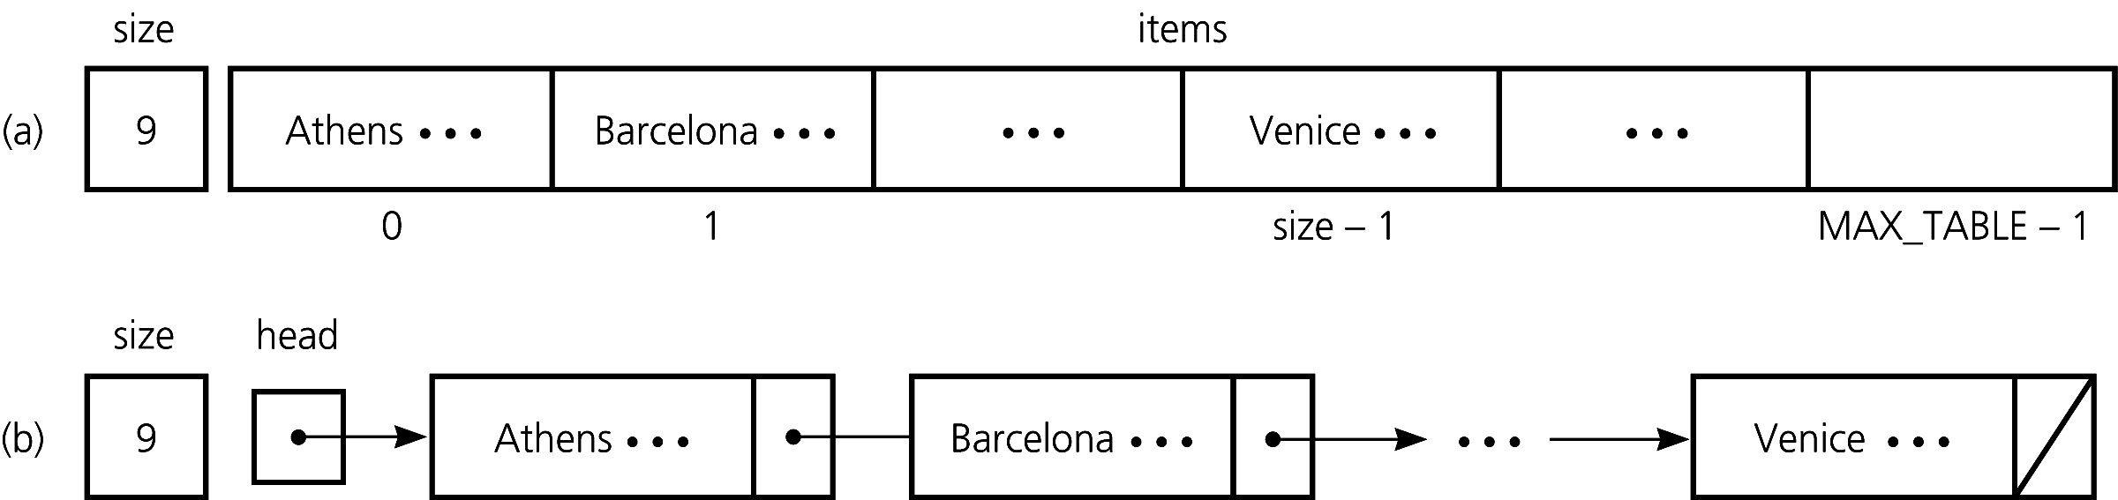
Selecting an Implementation
Linear implementations: Four categories
  Unsorted: array based or pointer based
  Sorted (by search key): array based or pointer based
Figure 11-3 The data members for two sorted linear implementations of the ADT table for the data in Figure 11-1: (a) array based; (b) pointer based

Slide 7
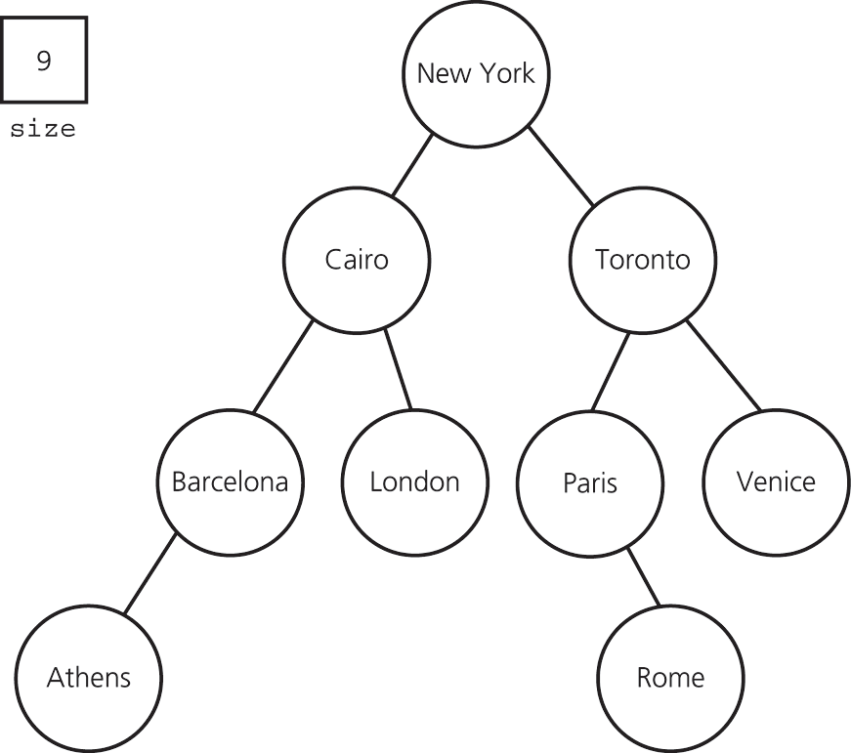
Selecting an Implementation
Nonlinear implementations
  Binary search tree implementation
    Offers several advantages over linear implementations
Figure 11-4 The data members for a binary search tree implementation of the ADT table for the data in Figure 11-1

Slide 8
Selecting an Implementation
The requirements of a particular application influence the selection of an implementation
  Questions to be considered about an application before choosing an implementation
    What operations are needed?
    How often is each operation required?
    Are frequently used operations efficient given a particular implementation?

Slide 9
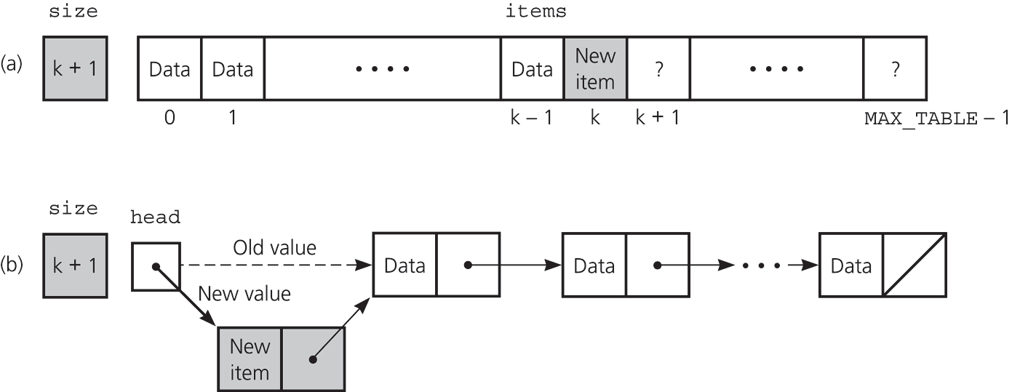
Comparing Linear Implementations
Unsorted array-based implementation
  Insertion is made efficiently after the last table item in an array
  Deletion usually requires shifting data
  Retrieval requires a sequential search
Figure 11-5a Insertion for unsorted linear implementations: array based

Slide 10
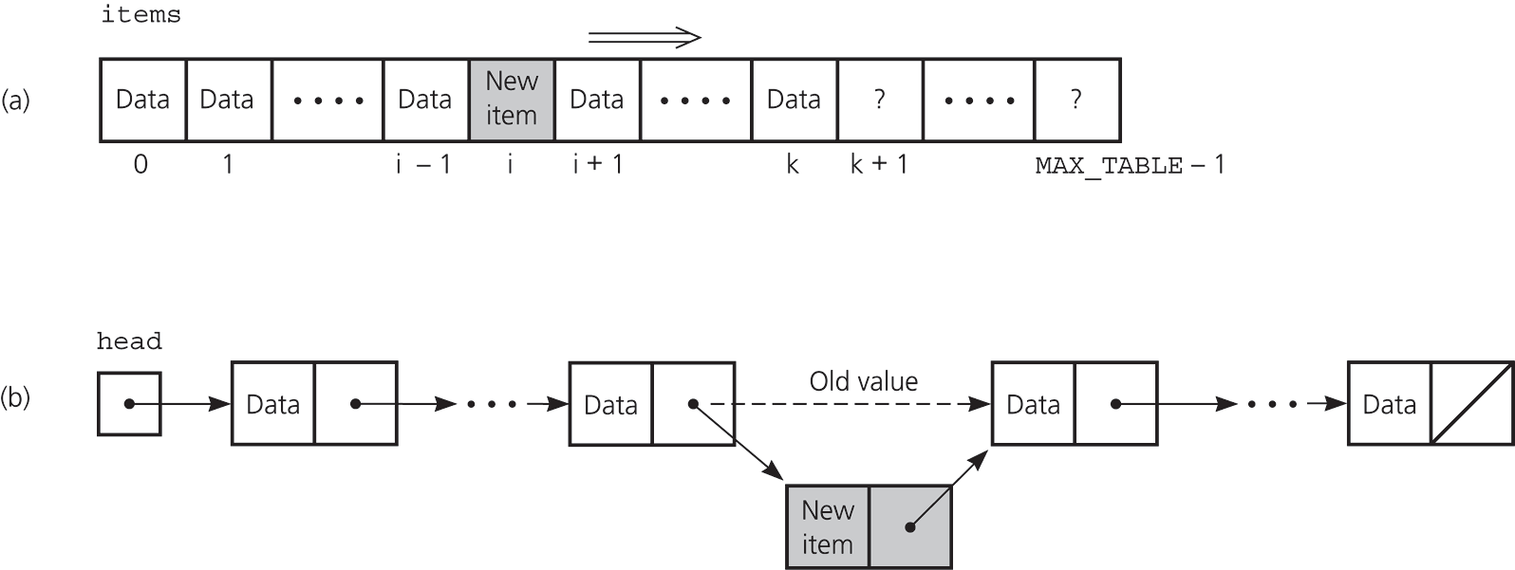
Comparing Linear Implementations
Sorted array-based implementation
  Both insertions and deletions require shifting data
  Retrieval can use an efficient binary search
Figure 11-6a Insertion for sorted linear implementations: array based

Slide 11
Comparing Linear Implementations
Unsorted pointer-based implementation
  No data shifts
  Insertion is made efficiently at the beginning of a linked list
  Deletion requires a sequential search
  Retrieval requires a sequential search
Figure 11-5b Insertion for unsorted linear implementations: pointer based

Slide 12
Comparing Linear Implementations
Sorted pointer-based implementation
  No data shifts
  Insertions, deletions, and retrievals each require a sequential search
Figure 11-6b Insertion for sorted linear implementations: pointer based

Slide 13
Selecting an Implementation
Linear
  Easy to understand conceptually
  May be appropriate for small tables or unsorted tables with few deletions
Nonlinear
  Is usually a better choice than a linear implementation
  A balanced binary search tree
    Increases the efficiency of the table operations

Slide 14
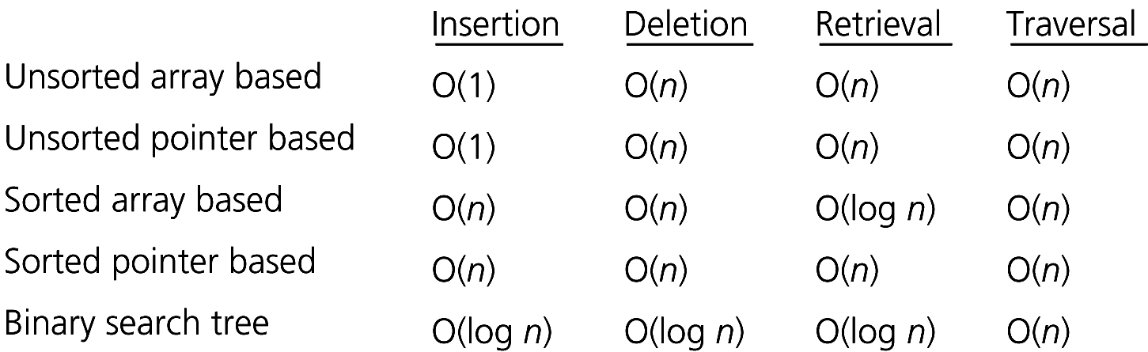
Selecting an Implementation
Figure 11-7 The average-case order of the ADT table operations for various implementations

Slide 15
Selecting an Implementation for a Particular Application
Frequent insertions and infrequent traversals in no particular order
  Unsorted linear implementation
Frequent retrievals
  Sorted array-based implementation
    Binary search
  Balanced binary search tree
Frequent retrievals, insertions, deletions, traversals
  Binary search tree (preferably balanced)

Slide 16
A Sorted Array-Based Implementation of the ADT Table
Default constructor and virtual destructor
Copy constructor supplied by the compiler
Has a typedef declaration for a “visit” function
Public methods are virtual
Protected methods: setSize, setItem, and position

Slide 17
A Binary Search Tree Implementation of the ADT Table
Reuses BinarySearchTree
  An instance is a private data member
Default constructor and virtual destructor
Copy constructor supplied by the compiler
Public methods are virtual
Protected method: setSize

Slide 18
The ADT Priority Queue:
A Variation of the ADT Table
Orders items by a priority value
The deletion operation for a priority queue is different from the one for a table
  The item removed is the one having the highest priority value
Priority queues do not have retrieval and traversal operations

Slide 19
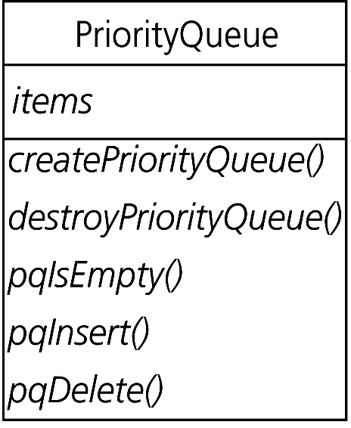
The ADT Priority Queue:
A Variation of the ADT Table
Figure 11-8 UML diagram for the class PriorityQueue

Slide 20
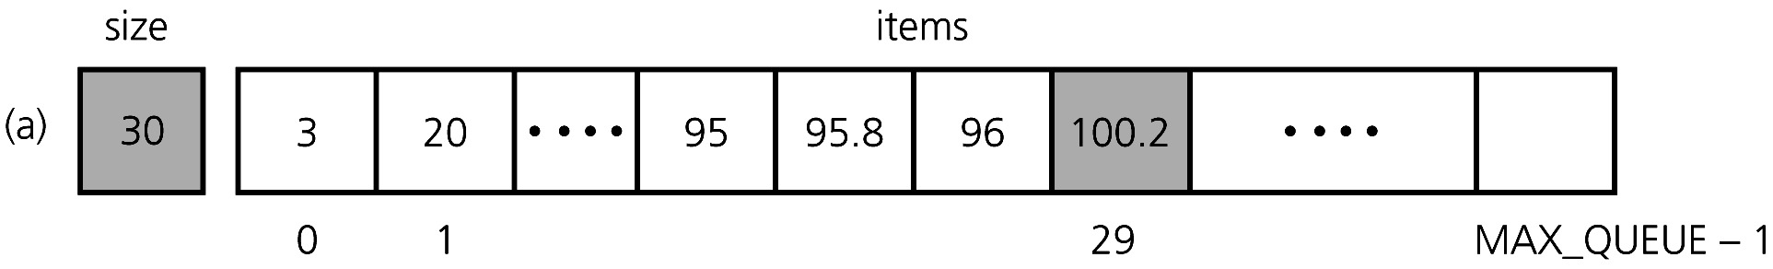
The ADT Priority Queue:
Possible Implementations
Sorted linear implementations
  Appropriate if the number of items in the priority queue is small
  Array-based implementation
    Maintains the items sorted in ascending order of priority value
    items[size - 1] has the highest priority
Figure 11-9a An array-based implementation of the ADT priority queue

Slide 21
The ADT Priority Queue:
Possible Implementations
Sorted linear implementations (continued)
  Pointer-based implementation
    Maintains the items sorted in descending order of priority value
    Item having the highest priority is at beginning of linked list
Figure 11-9b A pointer-based implementation of the ADT priority queue

Slide 22
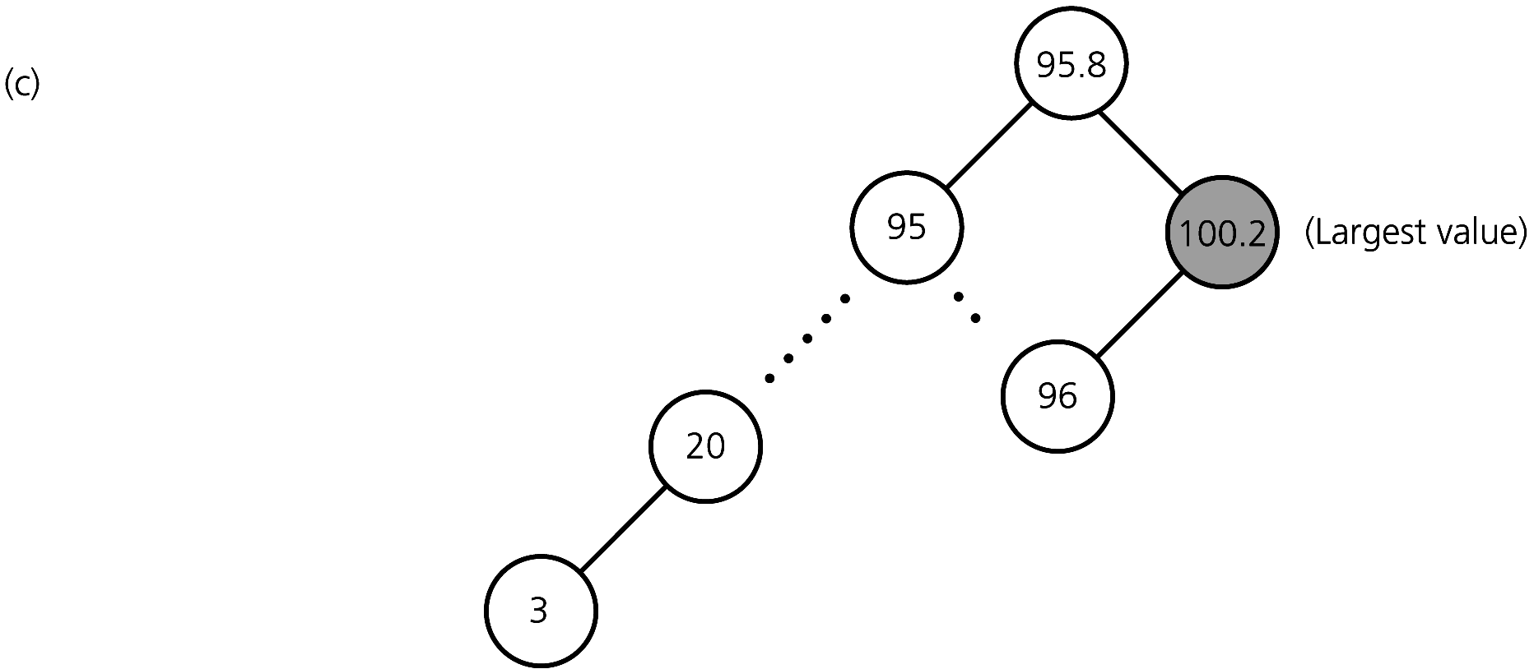
The ADT Priority Queue:
A Variation of the ADT Table
Binary search tree implementation
  Appropriate for any priority queue
  Largest item is rightmost and has at most one child
Figure 11-9c A binary search tree implementation of the ADT priority queue

Slide 23
Heaps
A heap is a complete binary tree
  That is empty
or
  Whose root contains a search key >=
  the search key in each of its children, and
  Whose root has heaps as its subtrees

Slide 24
Heaps
Note:
  The search key in each heap node is >=
the search keys in each of the node’s
children
  The search keys of a node’s children have no required relationship

Slide 25
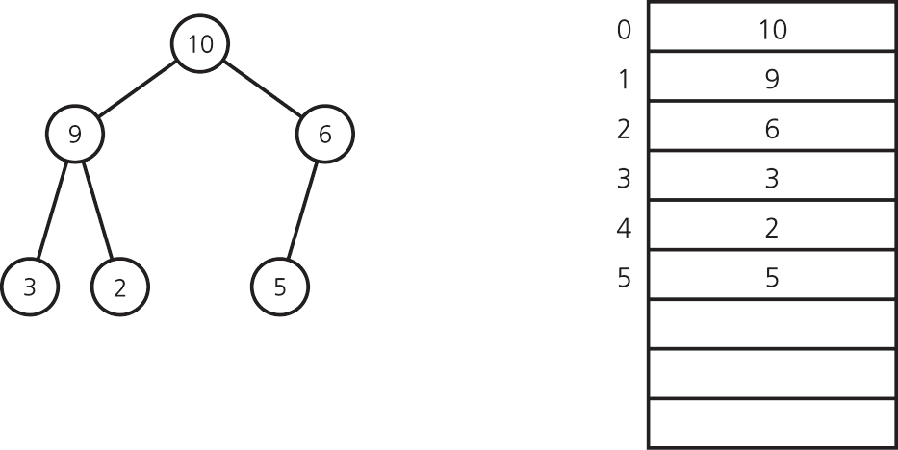
Heaps
The heap is a complete binary tree
  An array-based representation is attractive
  But need to know the heap’s maximum size
Figure 11-11
A heap with its array representation

Slide 26
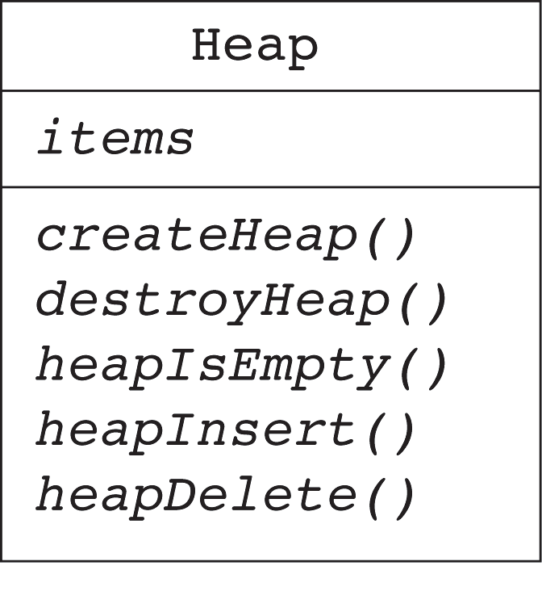
Heaps
Figure 11-10 UML diagram for the class Heap

Slide 27
Heaps
Maxheap
  A heap in which the root contains the item with the largest search key
Minheap
  A heap in which the root contains the item with the smallest search key

Slide 28
Heaps: An Array-based Implementation of a Heap
Constant MAX_HEAP
Data members
  items: an array of heap items
  size: an integer equal to the current number of items in the heap

Slide 29
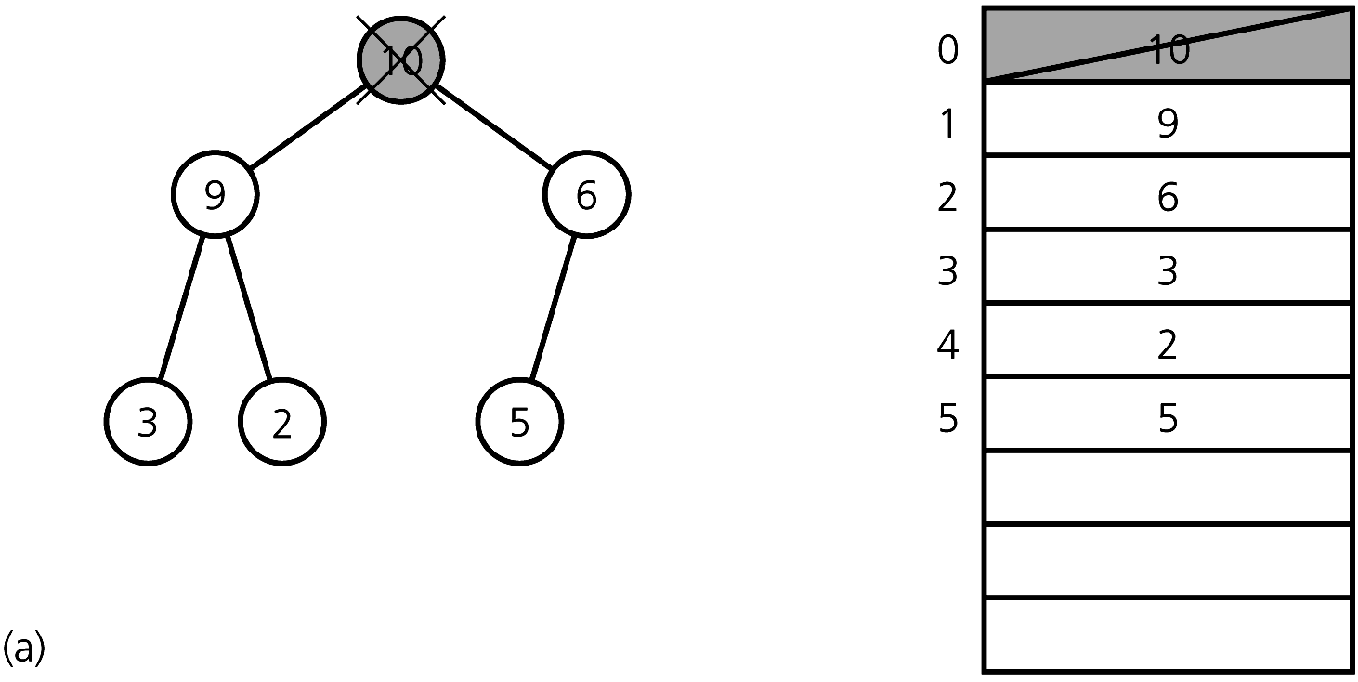
Heaps: heapDelete
Strategy
Step 1: Return the item in the root
  rootItem = items[0]
  Results in disjoint heaps
Figure 11-12a Disjoint heaps

Slide 30
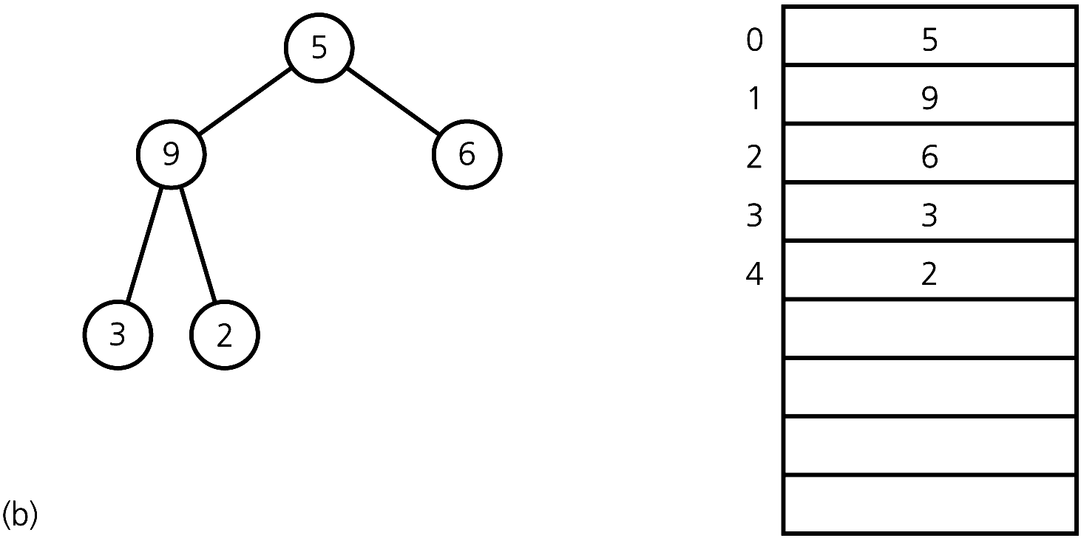
Heaps: heapDelete
Step 2: Copy the item from the last node into the root: items[0]= items[size-1]
Step 3: Remove the last node: --size
  Results in a semiheap
Figure 11-12b A semiheap

Slide 31
Heaps: heapDelete
Step 3: Transform the semiheap back into a heap
  Use the recursive algorithm heapRebuild
    The root value trickles down the tree until it is not out of place
      If the root has a smaller search key than the larger of the search keys of its children, swap the item in the root with that of the larger child

Slide 32
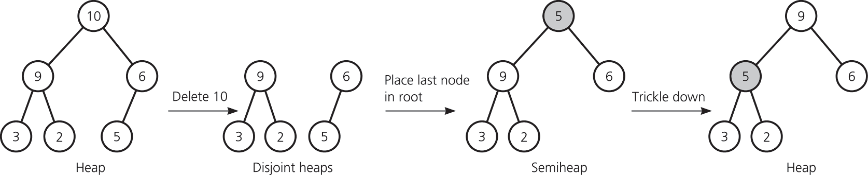
Heaps: heapDelete
Figure 11-13 Deletion from a heap
Efficiency
  heapDelete is O(log n)

Slide 33
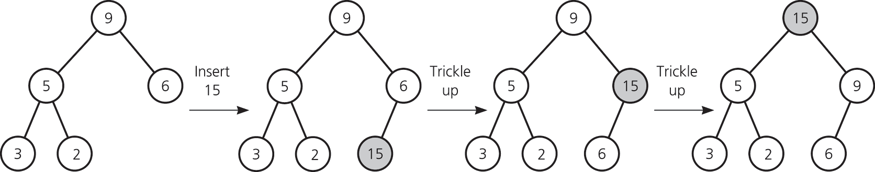
Heaps: heapInsert
Strategy
  Insert newItem into the bottom of the tree
  newItem trickles up to an appropriate spot in the tree
Figure 11-15 Insertion into a heap
Efficiency: O(log n)

Slide 34
A Heap Implementation of the ADT Priority Queue
Priority-queue operations and heap operations are analogous
  The priority value in a priority-queue corresponds to a heap item’s search key
One implementation
  Has an instance of the Heap class as a private data member
  Methods call analogous heap operations

Slide 35
A Heap Implementation of the ADT Priority Queue
  Disadvantage
    Requires the knowledge of the priority queue’s maximum size
  Advantage
    A heap is always balanced
Another implementation
  A heap of queues
  Useful when a finite number of distinct priority values are used, which can result in many items having the same priority value

Slide 36
Heapsort
Strategy
  Transform the array into a heap
  Remove the heap's root (the largest element) by exchanging it with the heap’s last element
  Transforms the resulting semiheap back into a heap

Slide 37
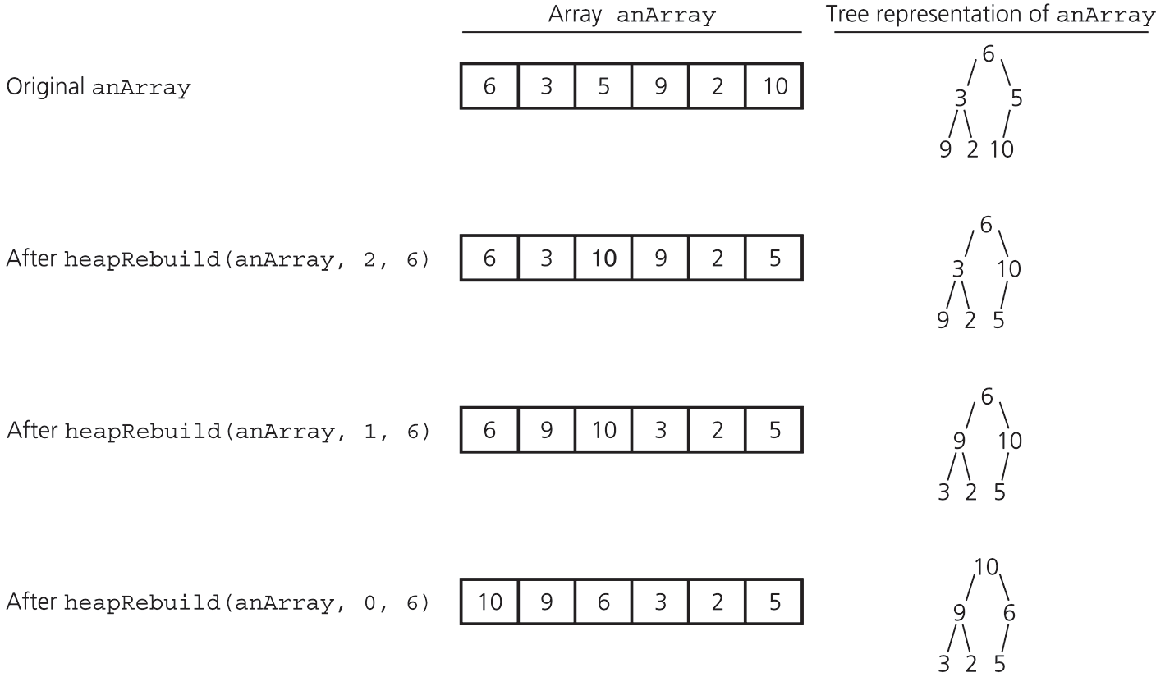
Heapsort
Figure 11-17 Transforming the array anArray into a heap

Slide 38
Heapsort
Compared to mergesort
  Both heapsort and mergesort are O(n * log n) in both the worst and average cases
  However, heapsort does not require a second array
Compared to quicksort
  Quicksort is O(n * log n) in the average case
  It is generally the preferred sorting method, even though it has poor worst-case efficiency : O(n²)

Slide 39
The STL Associative Containers
Act as tables
Elements are retrieved using a key that need not be an integral type
The interfaces to all associative containers are similar
Bidirectional iterators are provided
Comparison is determined by either
  The default comparison operator < , or
  A comparison function object as a parameter

Slide 40
The STL Associative Containers
map
  A sorted collection of (key, value) pairs
    Unique keys
  Provides the operator [ ] using keys as subscripts
    Month[“December”] = 31;
set
  A sorted collection of objects, which represent both the key and value
multimap and multiset
  Like map and set, except that they allow duplicate keys

Slide 41
The STL priority_queue
The STL class priority_queue is an adaptor container
  The default underlying container is a vector
  Allows for insertion, but not iteration through its elements
    Only the top element can be accessed
  Priority is determined by either
    The default comparison operator < , or
    A comparison function object

Slide 42
The STL Heap Algorithms
Heap algorithms for containers
  make_heap
    Turns an existing container into a heap
  sort_heap
    Turns the heap back into the original container
  push_heap
    Adds an item to a heap
  pop_heap
    Removes the first item from a heap
      Has the highest priority

Slide 43
Summary
The ADT table supports value-oriented operations
The linear implementations (array based and pointer based) of a table are adequate only in limited situations
  When the table is small
  For certain operations
A nonlinear pointer based (binary search tree) implementation of the ADT table provides the best aspects of the two linear implementations
  Dynamic growth
  Insertions/deletions without extensive data movement
  Efficient searches

Slide 44
Summary
A priority queue is a variation of the ADT table
  Its operations allow you to retrieve and remove the item with the largest priority value
A heap that uses an array-based representation of a complete binary tree is a good implementation of a priority queue when you know the maximum number of items that will be stored at any one time

Slide 45
Summary
Heapsort, like mergesort, has good worst-case and average-case behaviors, but neither sort is as good as quicksort in the average case
Heapsort has an advantage over mergesort in that it does not require a second array

