Slide 1
Chapter 12:
Advanced Implementations of Tables
Data Abstraction & Problem Solving with
C++
Fifth Edition
by Frank M. Carrano

Slide 2
Balanced Search Trees
The efficiency of the binary search tree implementation of the ADT table is related to the tree’s height
  Height of a binary search tree of n items
    Maximum: n
    Minimum: ⎡log₂(n + 1)⎤
    Sensitive to the order of insertions and deletions

Slide 3
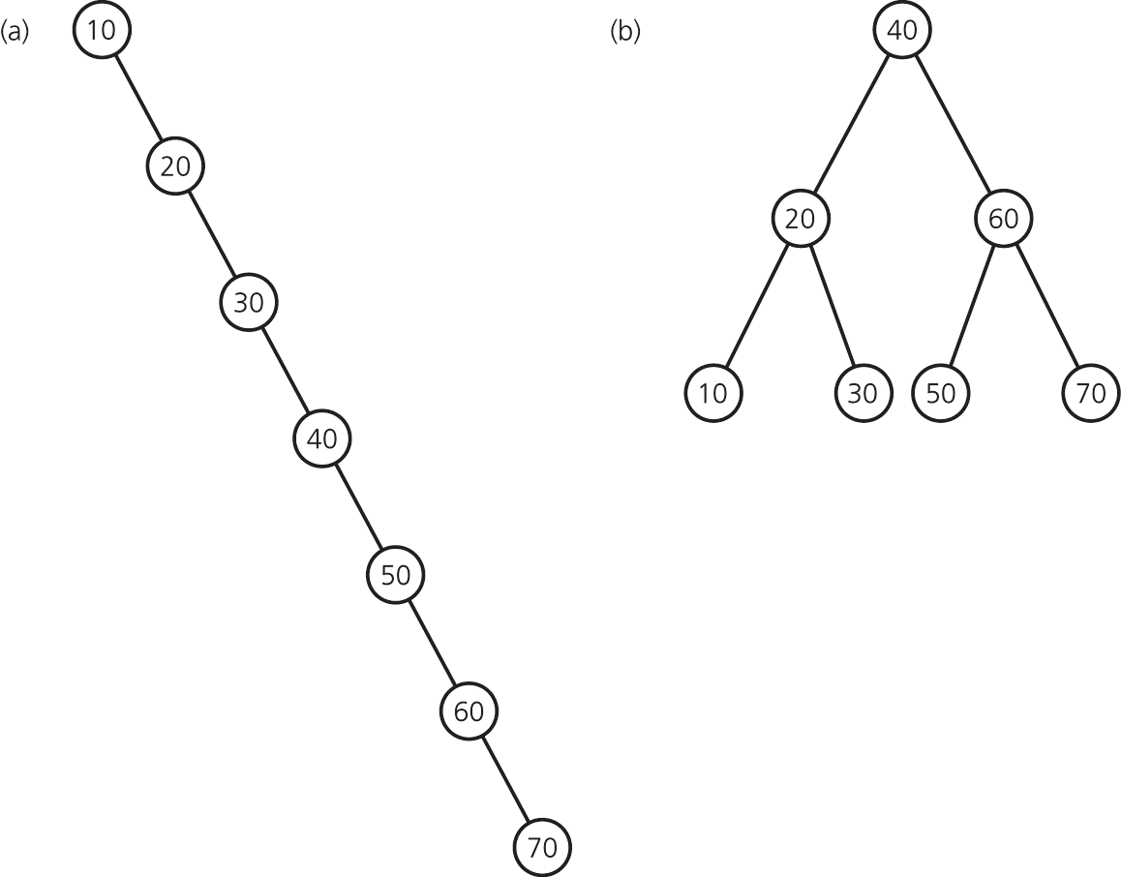
Balanced Search Trees
Figure 12-1 (a) A search tree of maximum height; (b) a search tree of minimum height
  Minimum height is best: Results in most efficient table operations

Slide 4
Balanced Search Trees
Other search trees can retain their balance despite insertions and deletions
  2-3 trees
  2-3-4 trees
  Red-black trees
  AVL trees

Slide 5
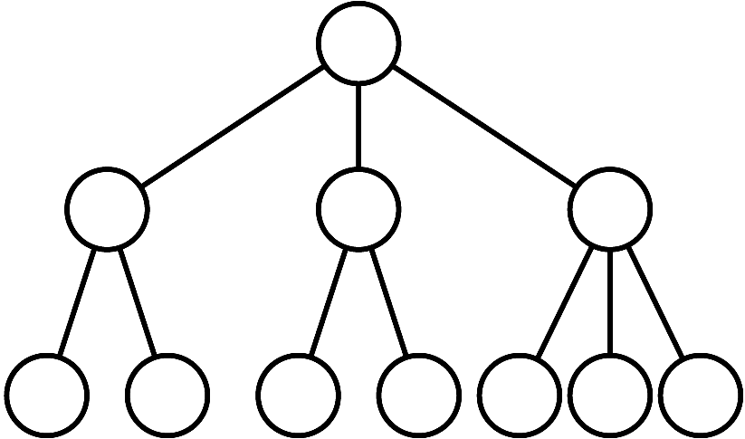
2-3 Trees
Have 2-nodes and 3-nodes
  A 2-node has one data item and two children
  A 3-node has two data items and three children
Figure 12-2 A 2-3 tree of height 3

Slide 6
2-3 Trees
Are general trees, not binary trees
Are never taller than a minimum-height binary tree
  A 2-3 tree with n nodes never has height greater than ⎡log₂(n + 1)⎤

Slide 7
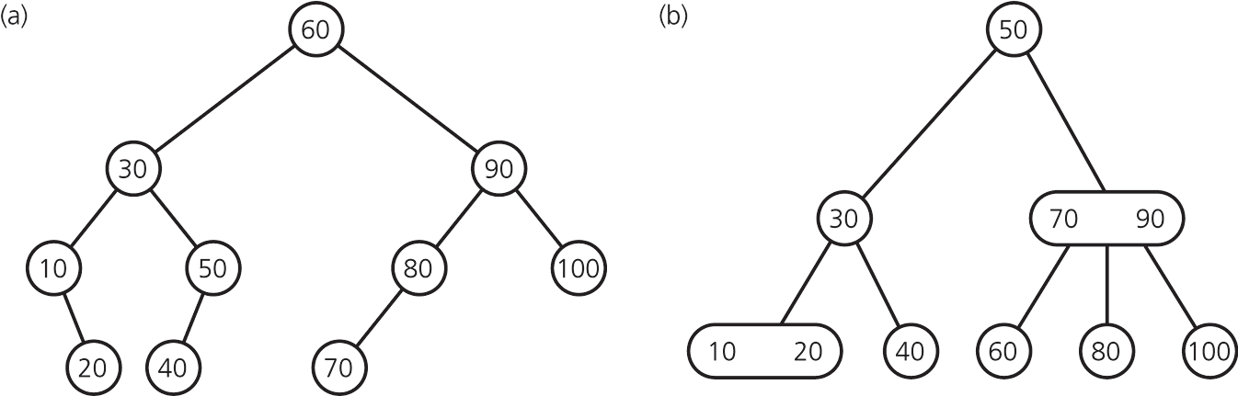
2-3 Trees
Figure 12-5 (a) A balanced binary search tree; (b) a 2-3 tree with the same elements

Slide 8
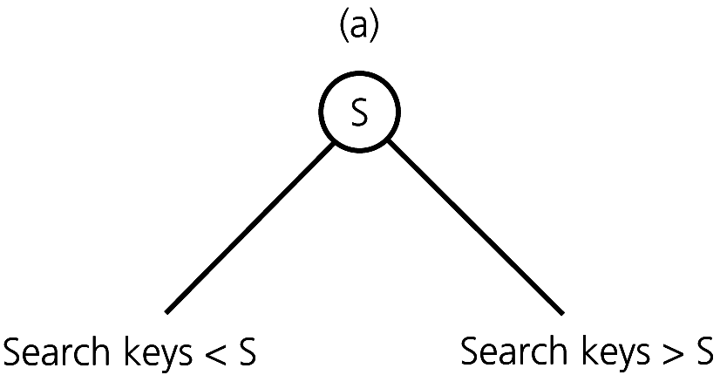
Placing Data Items in a 2-3 Tree
A 2-node contains a single data item whose search key S satisfies the following:
  S > the left child’s search key(s)
  S < the right child’s search key(s)
Figure 12-3a
A 2-node in a 2-3 tree

Slide 9
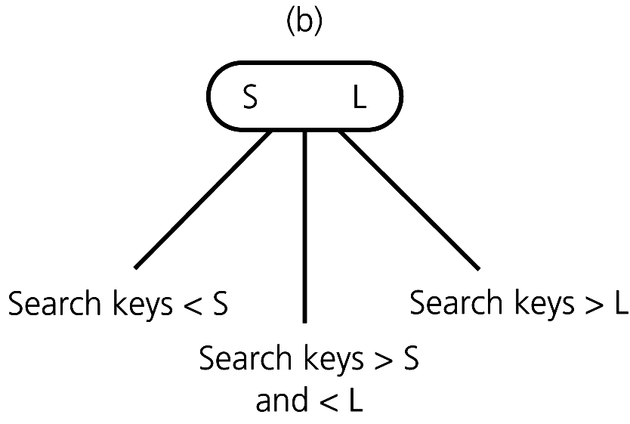
Placing Data Items in a 2-3 Tree
A 3-node contains two data items whose search keys S and L satisfy the following:
  S > the left child’s search key(s)
  S < the middle child’s search key(s)
  L > the middle child’s search key(s)
  L < the right child’s search key(s)
Figure 12-3b
A 3-node in a 2-3 tree

Slide 10
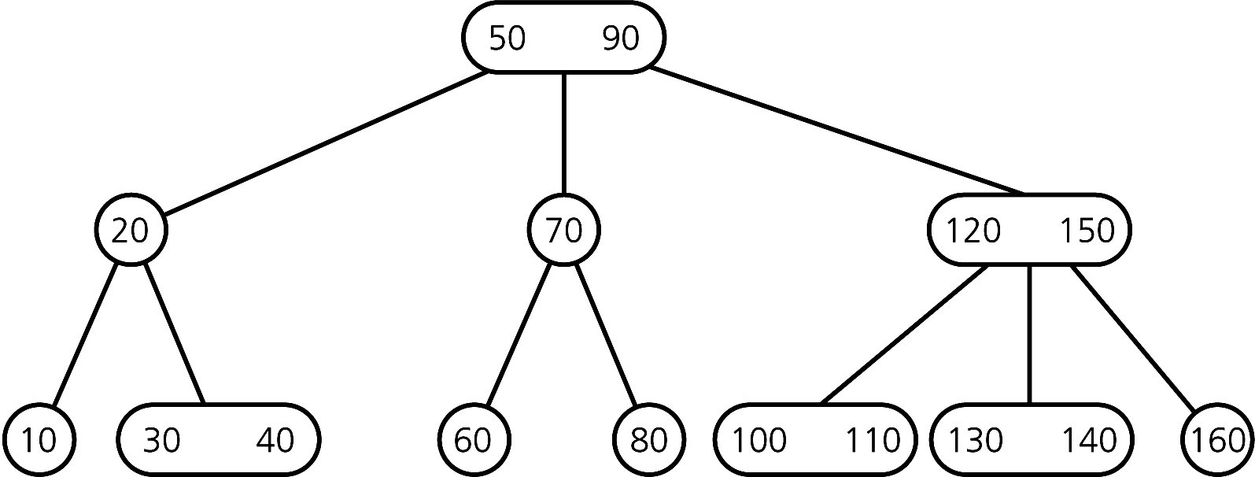
Placing Data Items in a 2-3 Tree
A leaf may contain either one or two data items
Figure 12-4 A 2-3 tree

Slide 11
2-3 Trees
To traverse a 2-3 tree
  Perform the analogue of an inorder traversal
Searching a 2-3 tree is as efficient as searching the shortest binary search tree
  O(log₂ n)
Insertion into a 2-node leaf is simple
Insertion into a 3-node causes it to divide

Slide 12
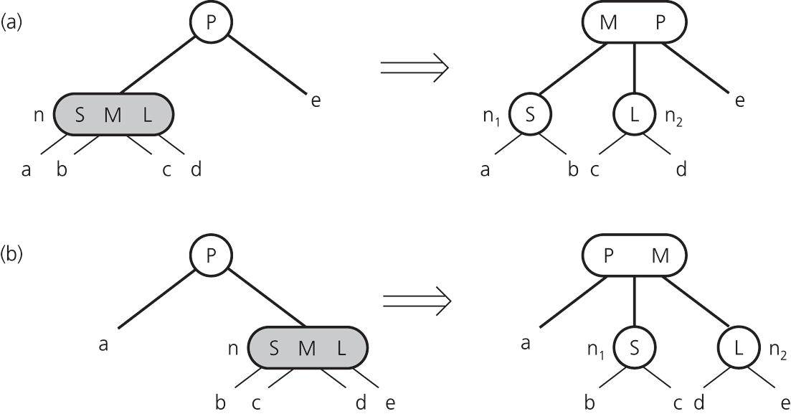
2-3 Trees: Inserting Into a 2-3 Tree
Figure 12-13 Splitting an internal node in a 2-3 tree

Slide 13
2-3 Trees: Inserting Into a 2-3 Tree
To insert an item I into a 2-3 tree
  Locate the leaf at which the search for I would terminate
  Insert the new item I into the leaf
  If the leaf now contains only two items, you are done
  If the leaf now contains three items, split the leaf into two nodes, n₁ and n₂

Slide 14
2-3 Trees: Inserting Into a 2-3 Tree
When an internal node contains three items
  Split the node into two nodes
  Accommodate the node’s children
When the root contains three items
  Split the root into two nodes
  Create a new root node
  Tree grows in height

Slide 15
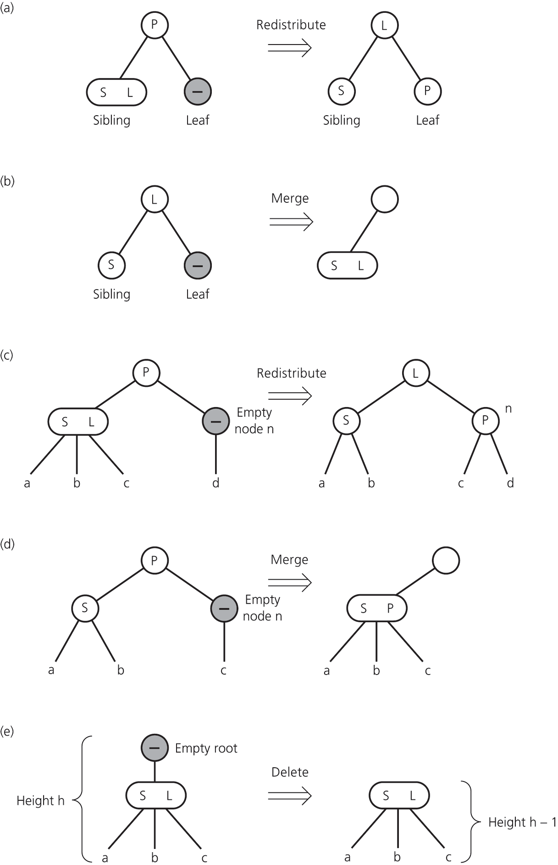
2-3 Trees: The Deletion Algorithm
Figure 12-19
Redistributing values;
merging a leaf;
redistributing values and children

Slide 16
2-3 Trees: The Deletion Algorithm
Figure 12-19 (d) merging internal nodes; (e) deleting the root

Slide 17
2-3 Trees
Advantages of a 2-3 tree over a balanced binary search tree
  Maintaining the balance of a 2-3 tree is relatively easy
    Maintaining the balance of a binary search tree is difficult
  A 2-3 implementation of a table is O(log₂ n) for all table operations

Slide 18
2-3 Trees
A 2-3 tree is a compromise
  Searching a 2-3 tree is not more efficient than searching a binary search tree of minimum height
    The 2-3 tree might be shorter, but that advantage is offset by the extra comparisons in a node having two values
  A 2-3 tree is relatively simple to maintain

Slide 19
2-3-4 Trees
2-3-4 trees have 2-nodes, 3-nodes, and 4-nodes
  A 2-node has one data item and two children
  A 3-node has two data items and three children
  A 4-node has three data items and four children
Are general trees, not binary trees
Are never taller than a 2-3 tree
Search and traversal algorithms for a 2-3-4 tree are simple extensions of the corresponding algorithms for a 2-3 tree

Slide 20
Nodes in a 2-3-4 Tree
A 2-node contains a single data item and has at most two children
A 3-node contains two data items and has at most three children
A 4-node contains three data items and has at most three children

Slide 21
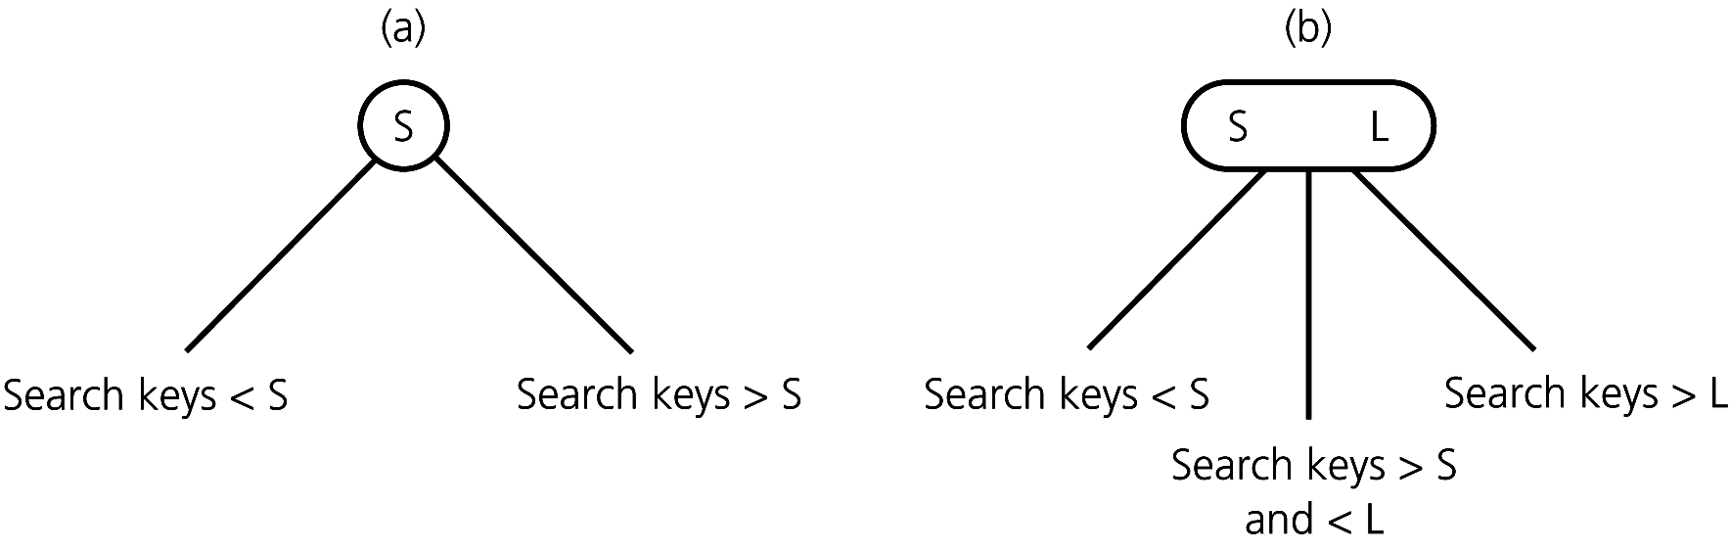
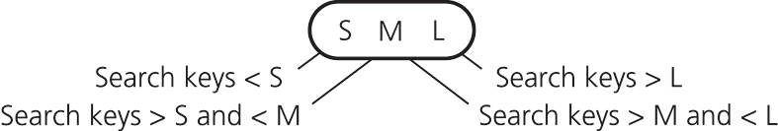
Nodes in a 2-3-4 Tree
Figure 12-3 (a) A 2-node; (b) a 3-node
Figure 12-21 A 4-node in a 2-3-4 tree

Slide 22
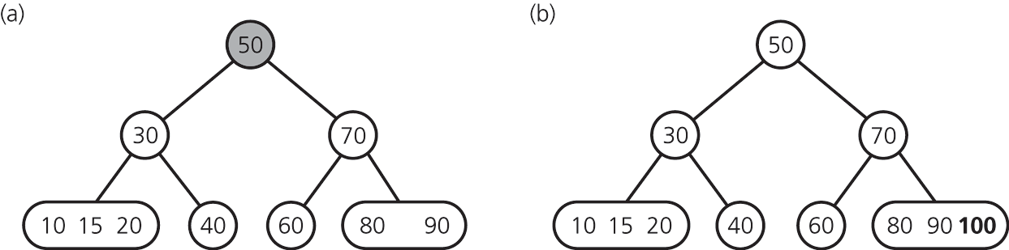
Nodes in a 2-3-4 Tree
A leaf can contain either one, two, or three data items
Figure 12-27 The steps for inserting 100

Slide 23
2-3-4 Trees: Splitting 4-nodes During Insertion
The insertion algorithm for a 2-3-4 tree
  Splits a 4-node by moving one of its items up to its parent node
  Splits 4-nodes as soon as its encounters them during a search from the root to a leaf

Slide 24
2-3-4 Trees: Splitting 4-nodes During Insertion
A 4-node that is split will
  Be the root, or
  Have a 2-node parent, or
  Have a 3-node parent
Result: When a 4-node is split, the parent cannot possibly be a 4-node, so it can accommodate the item moved up from the 4-node

Slide 25
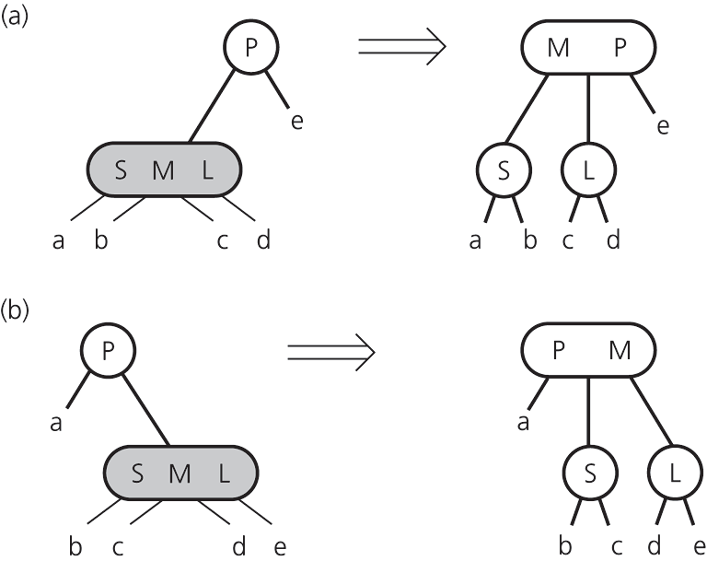
2-3-4 Trees: Splitting 4-nodes During Insertion
Figure 12-29 Splitting a 4-node root whose parent is a 2-node during insertion

Slide 26
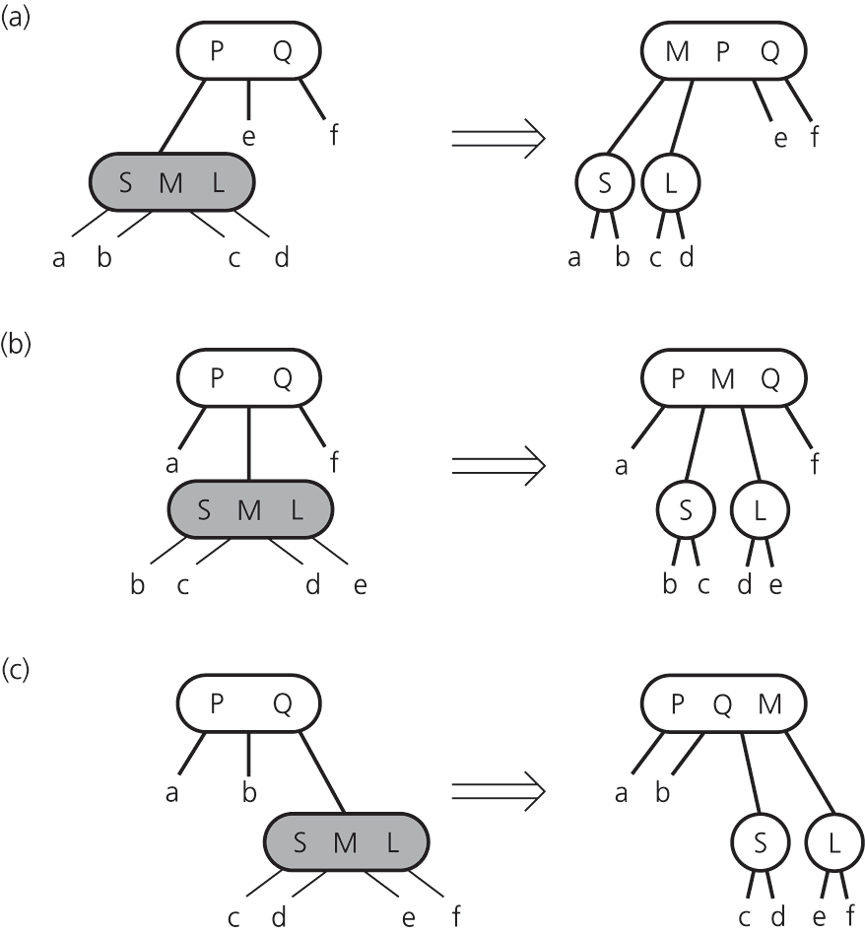
2-3-4 Trees: Splitting 4-nodes During Insertion
Figure 12-30
Splitting a 4-node whose parent is a 3-node during insertion

Slide 27
2-3-4 Trees: Deleting
Locate the node n that contains the item theItem
Find theItem’s inorder successor and swap it with theItem (deletion will always be at a leaf)
If that leaf is a 3-node or a 4-node, remove theItem

Slide 28
2-3-4 Trees: Deleting
To ensure that theItem does not occur in a 2-node
  Transform each 2-node encountered into a 3-node or a 4-node
  Apply the appropriate transformation for splitting nodes during insertions, but in reverse

Slide 29
2-3-4 Trees: Conclusions
Insertion/deletion algorithms for a 2-3-4 tree require fewer steps than those for a 2-3 tree
  Only one pass from root to a leaf
A 2-3-4 tree is always balanced
A 2-3-4 tree requires more storage than a binary search tree
Allowing nodes with more data and children is counterproductive, unless the tree is in external storage

Slide 30
Red-Black Trees
A red-black tree
  A special binary search tree
  Used to represent a 2-3-4 tree
  Has the advantages of a 2-3-4 tree, without the storage overhead
Represent each 3-node and 4-node in a 2-3-4 tree as an equivalent binary tree

Slide 31
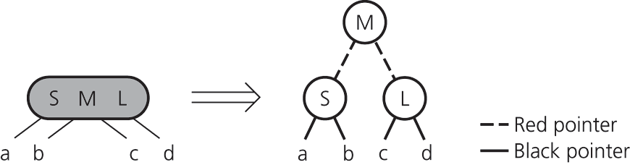
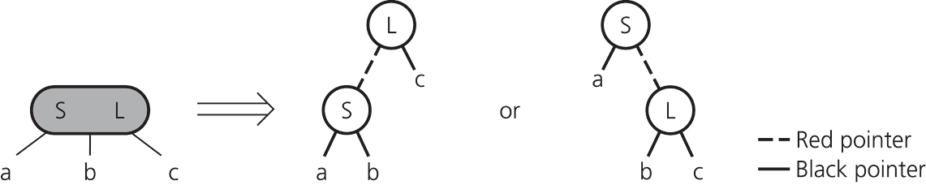
Red-Black Trees
Figure 12-31 Red-black representation of a 4-node
Figure 12-32 Red-black representation of a 3-node

Slide 32
Red-Black Trees
Red and black pointers to children
  Used to distinguish between kinds of 2-nodes
    Those that appeared in the original 2-3-4 tree
      Child pointers are black
    Those that are generated from split 3-nodes and 4-nodes
      Child pointers are red

Slide 33
Red-Black Tree Operations
Searching and traversing a red-black tree
  Same algorithms as for a binary search tree
Insertion/deletion algorithms
  Adjust the 2-3-4 algorithms to accommodate the red-black representation
  In a red-black tree, splitting the equivalent of a 4-node requires only simple color changes
  Pointer changes called rotations result in a shorter tree

Slide 34
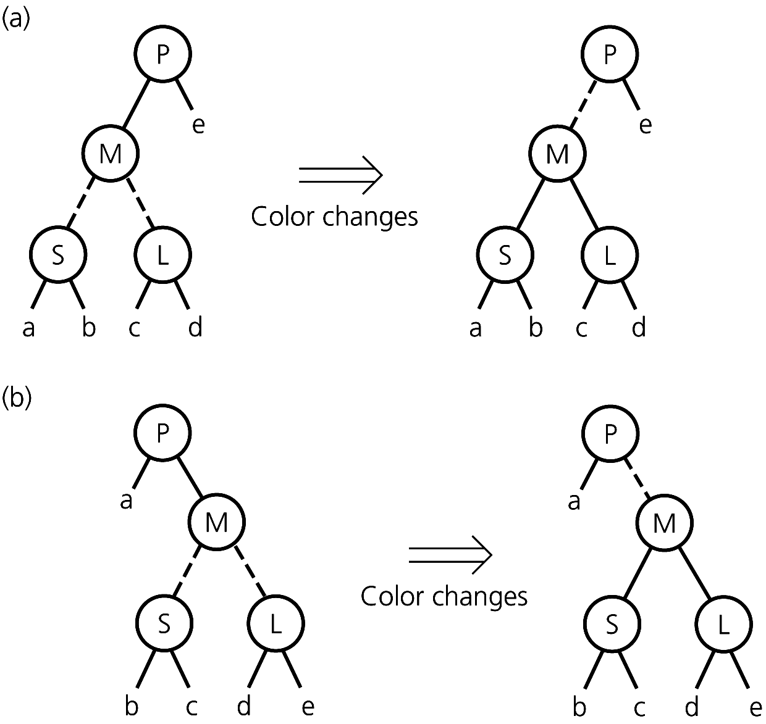
Red-Black Tree Operations
Figure 12-35 Splitting a red-black representation of a 4-node whose parent is a 2-node

Slide 35
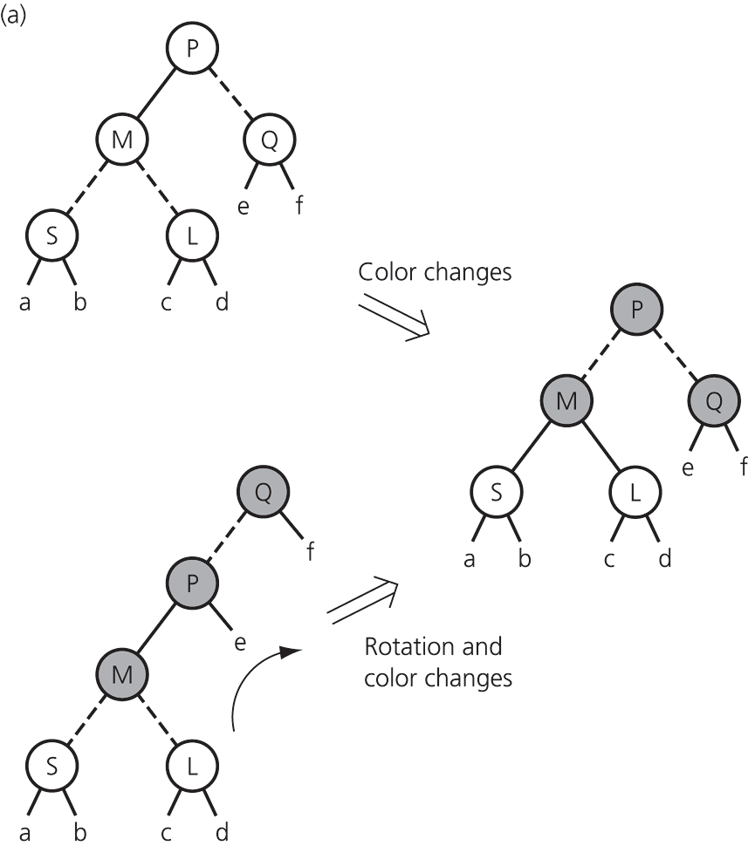
Red-Black Tree Operations
Figure 12-36 Splitting a red-black representation of a 4-node whose parent is a 3-node

Slide 36
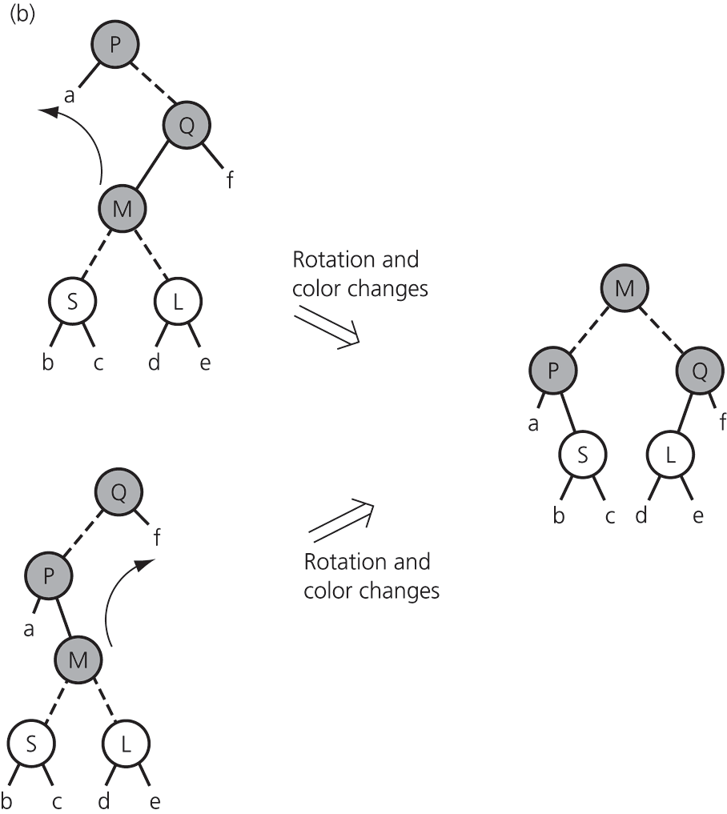
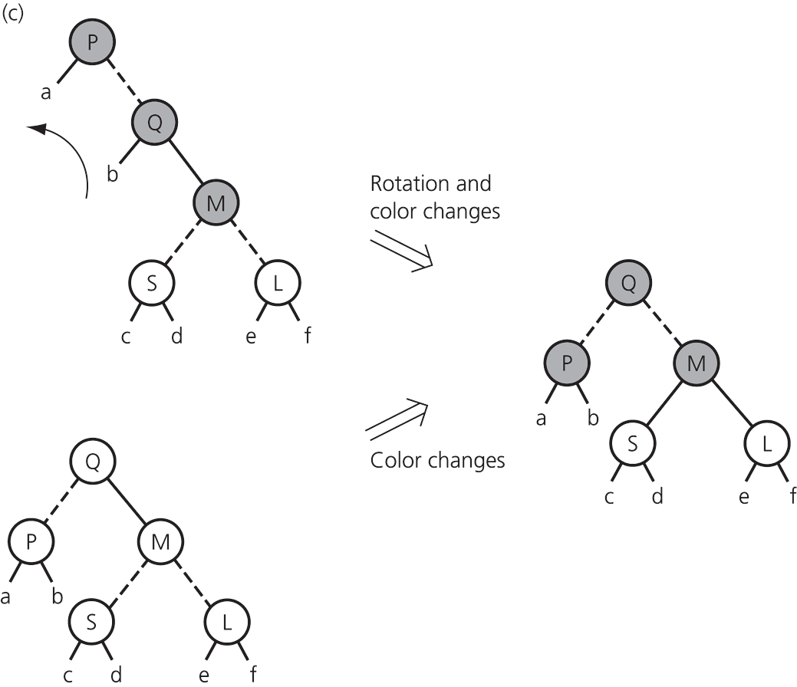
Red-Black Tree Operations
Figure 12-36 continued
Splitting a red-black representation of a 4-node whose parent is a 3-node

Slide 37
AVL Trees
An AVL tree
  A balanced binary search tree
  Can be searched almost as efficiently as a minimum-height binary search tree
  Maintains a height close to the minimum
  Requires far less work than would be necessary to keep the height exactly equal to the minimum

Slide 38
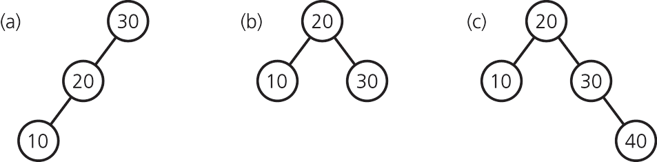
AVL Trees
After each insertion or deletion
  Check whether the tree is still balanced
  If the tree is unbalanced, rotate to restore the balance
Figure 12-37 (a) An unbalanced binary search tree; (b) a balanced tree after rotation; (c) a balanced tree after insertion

Slide 39
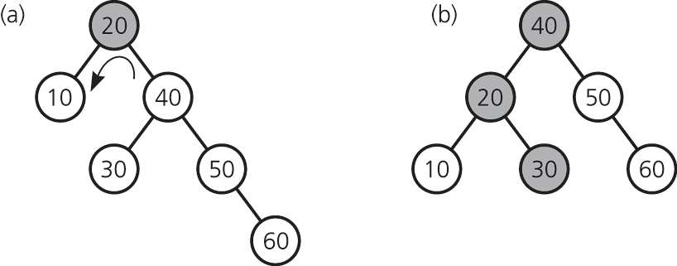
AVL Trees: Rotations
Rotations to restore the tree’s balance
  Single rotation
  Double rotation
Figure 12-38 (a) An unbalanced binary search tree;
(b) a balanced tree after a single left rotation

Slide 40
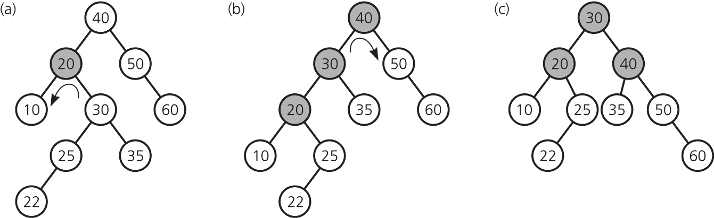
AVL Trees: Rotations
Figure 12-42 (a) Before; (b) during, and (c) after a double rotation

Slide 41
AVL Trees
Advantage
  Height of an AVL tree with n nodes is always very close to the theoretical minimum
Disadvantage
  An AVL tree implementation of a table is more difficult than other implementations

Slide 42
Hashing
Hashing
  Enables access to table items in time that is relatively constant regardless of their locations
Hash function
  Maps the search key of a table item into a location that will contain the item
Hash table
  An array that contains the table items, as assigned by a hash function

Slide 43
Hashing
A perfect hash function
  Maps each search key into a unique location
  Possible if all the search keys are known
Collision
  Occurs when the hash function maps two or more items—all having different search keys— into the same array location
Collision-resolution scheme
  Assigns distinct locations in the hash table to items involved in a collision

Slide 44
Hashing
Requirements for a hash function
  Is easy and fast to compute
  Places items evenly throughout the hash table
  Involves the entire search key
  Uses a prime base, if it uses modulo arithmetic

Slide 45
Hash Functions
Simple hash functions
  Selecting digits
    Does not distribute items evenly
  Folding
  Modulo arithmetic
    The table size should be prime
  Converting a character string to an integer
    Use the integer in the hash function instead of the string search key

Slide 46
Resolving Collisions
Approach 1: Open addressing
  A category of collision resolution schemes that probe for an empty, or open, location in the hash table
  As the hash table fills, collisions increase
    The size of the hash table must be increased
    Need to hash the items again

Slide 47
Resolving Collisions
Approach 1: Open addressing
  Linear probing
    Searches the hash table sequentially, starting from the original location specified by the hash function
  Quadratic probing
    Searches the hash table beginning at the original location specified by the hash function and continuing at increments of 1², 2², 3², and so on
  Double hashing
    Uses two hash functions
    One specifies the first location, the other gives the step size

Slide 48
Resolving Collisions
Approach 2: Restructuring the hash table
  Allows the hash table to accommodate more than one item in the same location
  Buckets
    Each location in the hash table is itself an array
  Separate chaining
    Each hash table location is a linked list
    Successfully resolves collisions
    The size of the hash table is dynamic

Slide 49
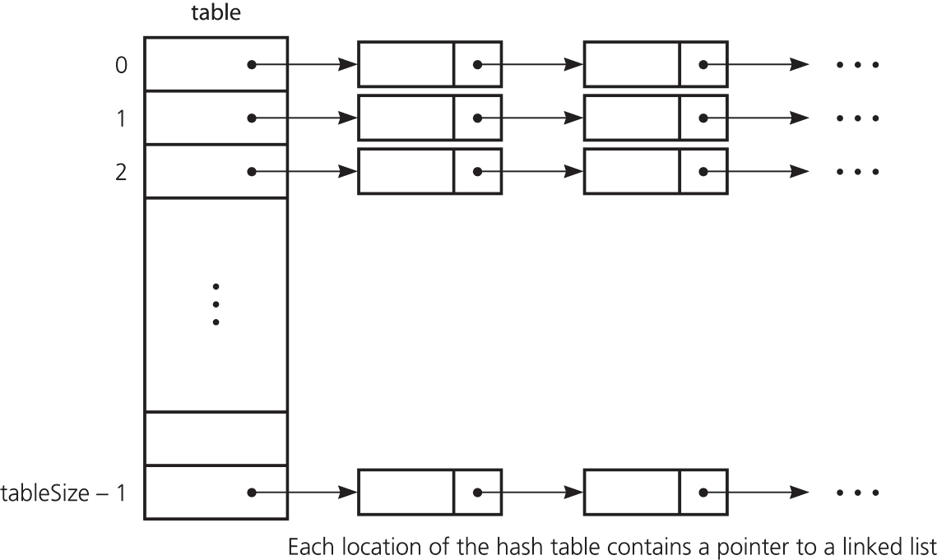
Resolving Collisions
Figure 12-49 Separate chaining

Slide 50
The Efficiency of Hashing
An analysis of the average-case efficiency
  Load factor α
    Ratio of the current number of items in the table to the maximum size of the array table
    Measures how full a hash table is
    Should not exceed 2/3
  Hashing efficiency for a particular search also depends on whether the search is successful
    Unsuccessful searches generally require more time than successful searches

Slide 51
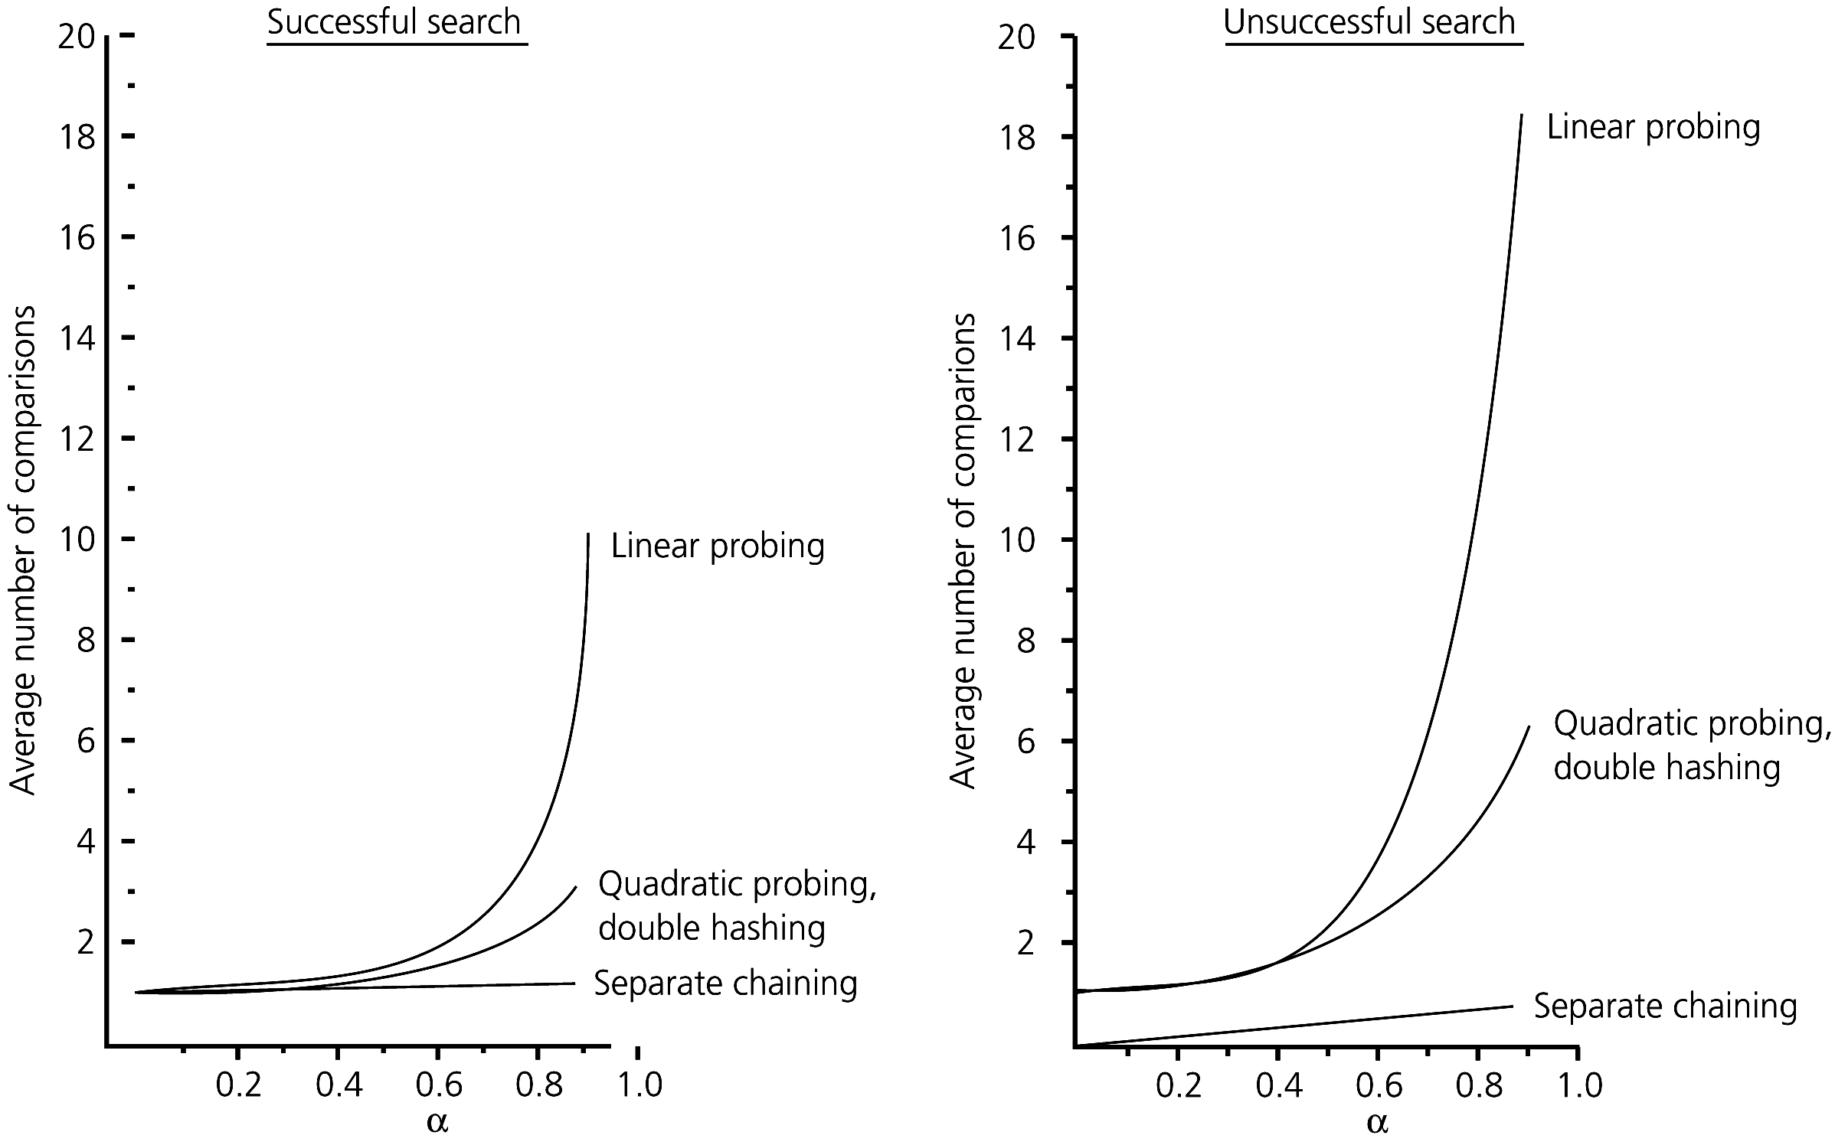
The Efficiency of Hashing
Figure 12-50 The relative efficiency of four collision-resolution methods

Slide 52
Table Traversal: An Inefficient Operation Under Hashing
Hashing as an implementation of the ADT table
  For many applications, hashing provides the most efficient implementation
  Hashing is a poor choice for certain operations
    Traversal in sorted order
    Finding the item that has the smallest or largest search key
    Range query

Slide 53
Implementing a HashMap Class Using the STL
A template class HashMap can be derived from existing STL containers
An implementation using separate chaining
  A vector holds the dynamic hash buckets
  Each bucket is a map that holds elements having the same hash value
  The hash function is supplied as a template parameter
  template <typename Key, typename T, typename Hash>
  class HashMap : private vector<map<Key, T> >

Slide 54
Data With Multiple Organizations
Many applications require a data organization that simultaneously supports several different data-management tasks
    Several independent data structures
      Do not support all operations efficiently
      Waste space
    Interdependent data structures
      Provide a better way to support a multiple organization of data

Slide 55
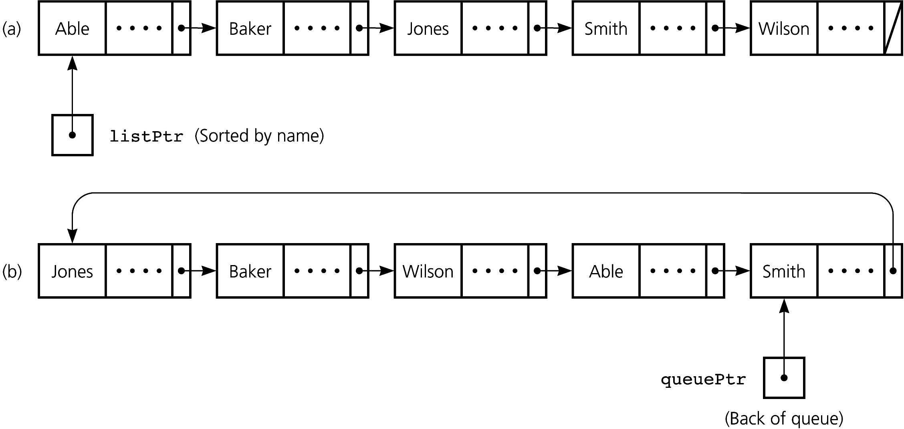
Data With Multiple Organizations
Figure 12-51 Independent data structures: (a) a sorted linked list; (b) a pointer-based queue

Slide 56
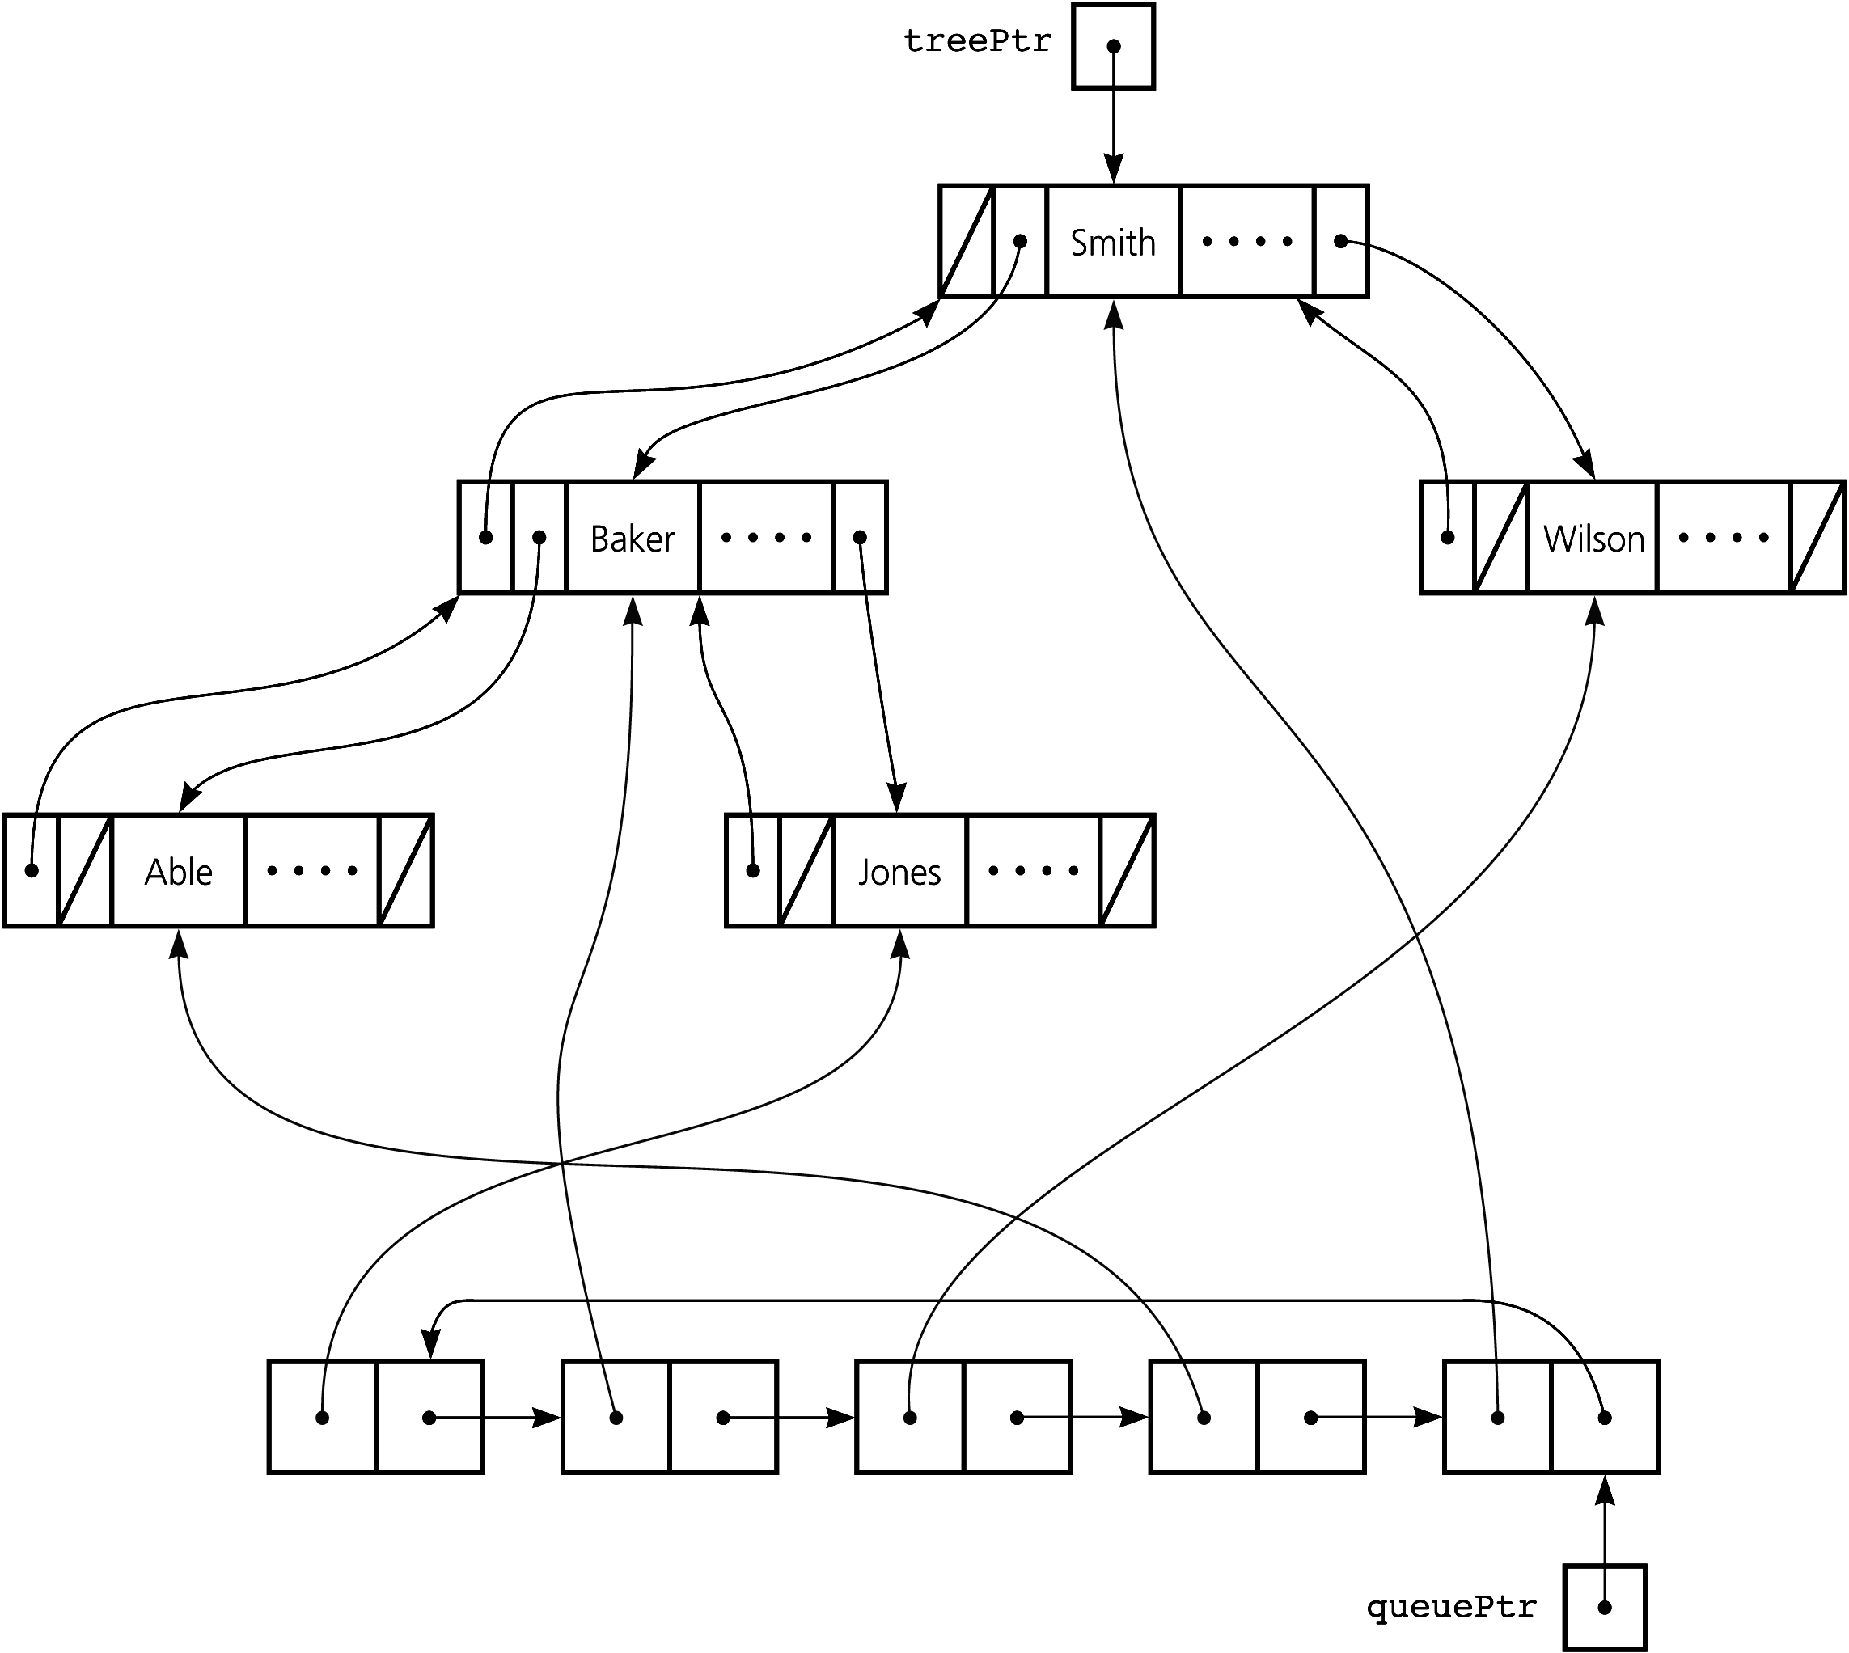
Data With Multiple Organizations
Figure 12-54 A queue pointing into a doubly linked binary search tree

Slide 57
Summary
A 2-3 tree and a 2-3-4 tree are variants of a binary search tree in which nodes can contain more than one data item and have more than two children
The balance of a 2-3 tree or a 2-3-4 tree is easily maintained
The insertion and deletion algorithms for a 2-3-4 tree are more efficient than the corresponding algorithms for a 2-3 tree

Slide 58
Summary
A red-black tree is a binary tree representation of a 2-3-4 tree that requires less storage than a 2-3-4 tree
An AVL tree is a binary search tree that is guaranteed to remain balanced using rotations
Hashing as a table implementation calculates where the data item should be rather than searching for it

Slide 59
Summary
A hash function should be extremely easy to compute and should scatter the search keys evenly throughout the hash table
A collision occurs when two different search keys hash into the same array location
Probing and chaining are two ways to resolve a collision

Slide 60
Summary
Hashing as a table implementation
  Does not efficiently support operations that require the table items to be ordered
  Is simpler and faster than balanced search tree implementations when
    Traversals are not important
    The maximum number of table items is known
    Ample storage is available

Slide 61
Summary
Some applications require data organized in more than one way
  Several independent data structures can be inefficient and waste space
  Several data structures linked together can be a good choice

