Slide 1
Chapter 13:
Graphs
Data Abstraction & Problem Solving with
C++
Fifth Edition
by Frank M. Carrano

Slide 2
Terminology
A graph G consists of two sets
  A set V of vertices, or nodes
  A set E of edges
G = {V, E}
A subgraph
  Consists of a subset of a graph’s vertices and a subset of its edges

Slide 3
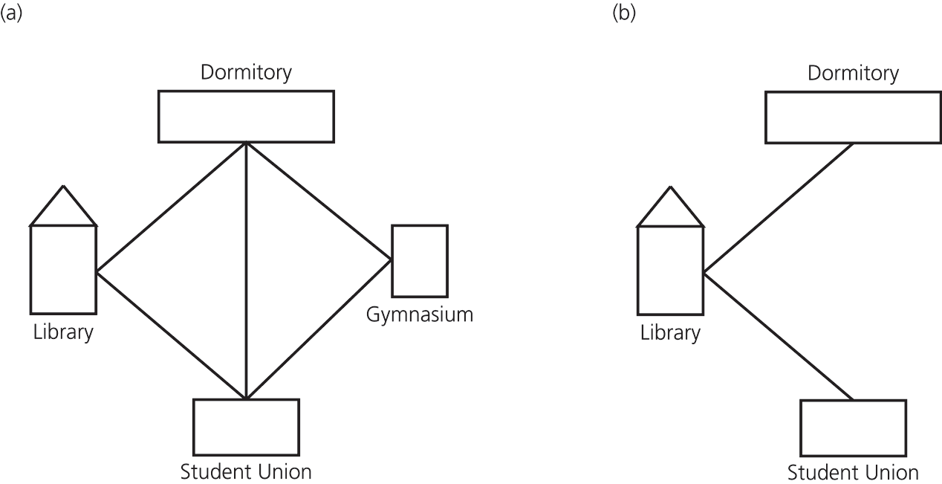
Terminology
Figure 13-2 (a) A campus map as a graph; (b) a subgraph

Slide 4
Terminology
Adjacent vertices
  Two vertices that are joined by an edge
A path between two vertices
  A sequence of edges that begins at one vertex and ends at another vertex
  May pass through the same vertex more than once
A simple path
  A path that passes through a vertex only once

Slide 5
Terminology
A cycle
  A path that begins and ends at the same vertex
A simple cycle
  A cycle that does not pass through a vertex more than once
A connected graph
  A graph that has a path between each pair of distinct vertices

Slide 6
Terminology
A disconnected graph
  A graph that has at least one pair of vertices without a path between them
A complete graph
  A graph that has an edge between each pair of distinct vertices
A multigraph
  Not a graph
  Allows multiple edges between vertices

Slide 7
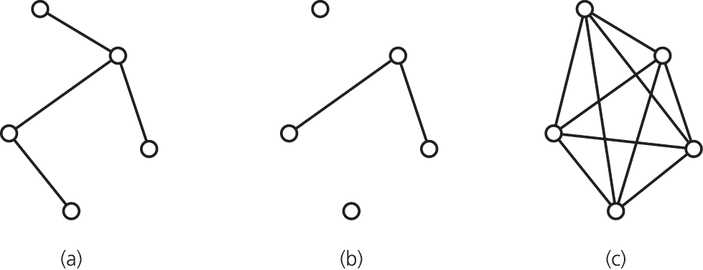
Terminology
Figure 13-3 Graphs that are (a) connected; (b) disconnected; and (c) complete

Slide 8
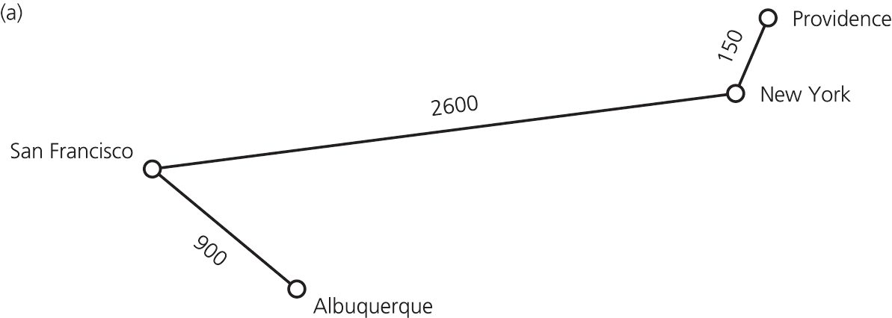
Terminology
Weighted graph
  A graph whose edges have numeric labels
Undirected graph
  Edges do not indicate a direction
Figure 13-5a A weighted, undirected graph

Slide 9
Terminology
Directed Graph
  Each edge has a direction; directed edges
  Can have two edges between a pair of vertices, one in each direction
  Directed path is a sequence of directed edges between two vertices
  Vertex y is adjacent to vertex x if there is a directed edge from x to y

Slide 10
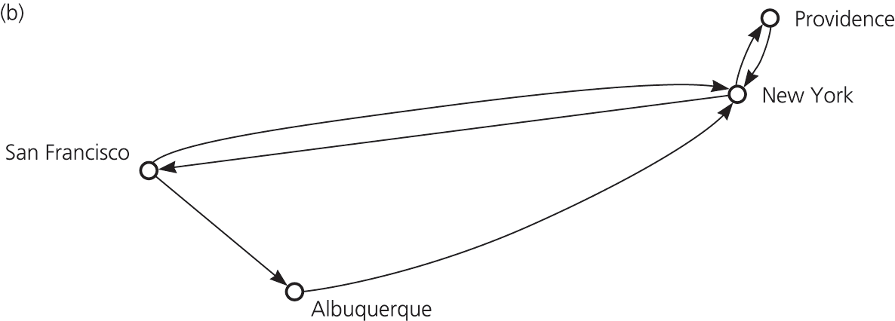
Terminology
Figure 13-5b A directed, unweighted graph

Slide 11
Graphs As ADTs
Variations of an ADT graph are possible
  Vertices may or may not contain values
    Many problems have no need for vertex values
    Relationships among vertices is what is important
  Either directed or undirected edges
  Either weighted or unweighted edges
Insertion and deletion operations for graphs apply to vertices and edges
Graphs can have traversal operations

Slide 12
Implementing Graphs
Most common implementations of a graph
  Adjacency matrix
  Adjacency list
Adjacency matrix for a graph that has n vertices numbered 0, 1, …, n – 1
  An n by n array matrix such that matrix[i][j] indicates whether an edge exists from vertex i to vertex j

Slide 13
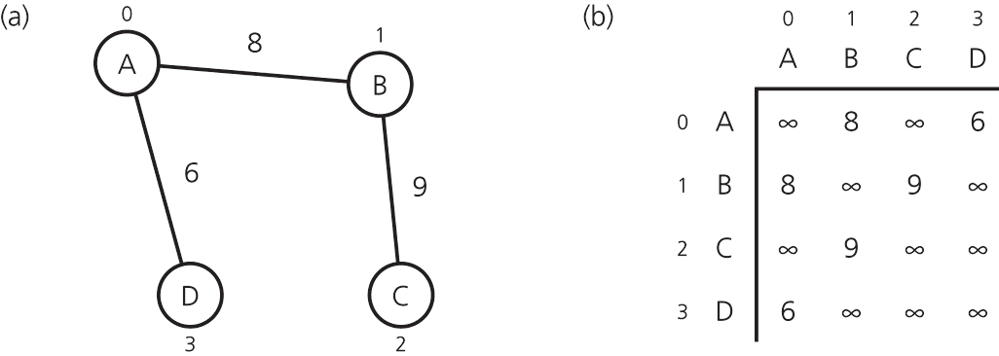
Implementing Graphs
  For an unweighted graph, matrix[i][j] is
    1 (or true) if an edge exists from vertex i to vertex j
    0 (or false) if no edge exists from vertex i to vertex j
  For a weighted graph, matrix[i][j] is
    The weight of the edge from vertex i to vertex j
    ∞ if no edge exists from vertex i to vertex j
Figure 13-7 (a) A weighted undirected graph and (b) its adjacency matrix

Slide 14
Implementing Graphs
Adjacency list for a directed graph that has n vertices numbered 0, 1, …, n – 1
  An array of n linked lists
  The i^{th} linked list has a node for vertex j if and only if an edge exists from vertex i to vertex j
  The list’s node can contain either
    Vertex j’s value, if any
    An indication of vertex j’s identity

Slide 15
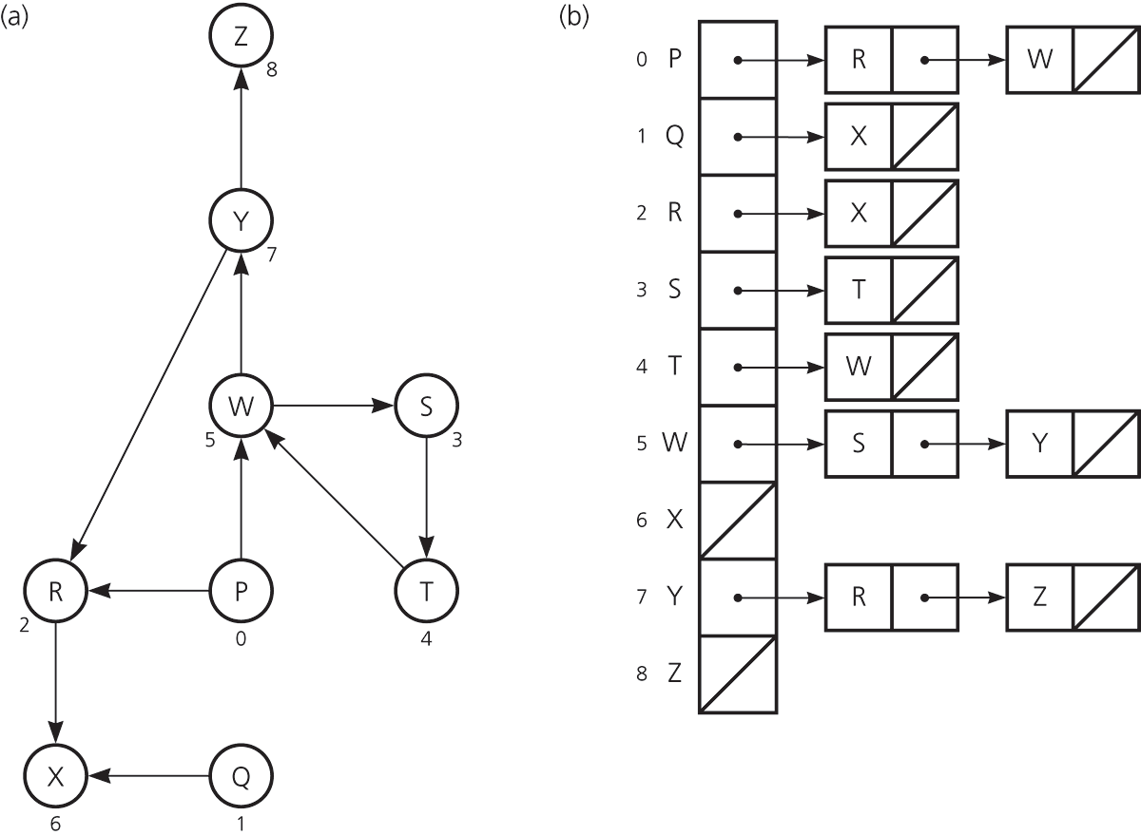
Implementing Graphs
Figure 13-8
(a) A directed graph (b) its adjacency list
  For an undirected graph, treat each edge as if it were two directed edges in opposite directions

Slide 16
Implementing Graphs
Two common operations on graphs
  Determine whether there is an edge from vertex i to vertex j
  Find all vertices adjacent to a given vertex i
Adjacency matrix
  Supports operation 1 more efficiently
Adjacency list
  Supports operation 2 more efficiently
  Often requires less space than an adjacency matrix

Slide 17
Implementing a Graph class Using the STL
An adjacency list representation of a graph can be implemented using a vector of maps
For a weighted graph
  The vector elements represent the vertices of a graph
  The map for each vertex contains element pairs
    Each pair consists of an adjacent vertex and an edge weight

Slide 18
Graph Traversals
Visits all the vertices that it can reach
Visits all vertices of the graph if and only if the graph is connected
  A connected component
    The subset of vertices visited during a traversal that begins at a given vertex
To prevent indefinite loops
    Mark each vertex during a visit, and
    Never visit a vertex more than once

Slide 19
DFS and BFS Traversals
Depth-First Search (DFS) Traversal
  Proceeds along a path from a vertex v as deeply into the graph as possible before backing up
  A “last visited, first explored” strategy
  Has a simple recursive form
  Has an iterative form that uses a stack

Slide 20
DFS and BFS Traversals
Breadth-First Search (BFS) Traversal
  Visits every vertex adjacent to a vertex v that it can before visiting any other vertex
  A “first visited, first explored” strategy
  An iterative form uses a queue
  A recursive form is possible, but not simple

Slide 21
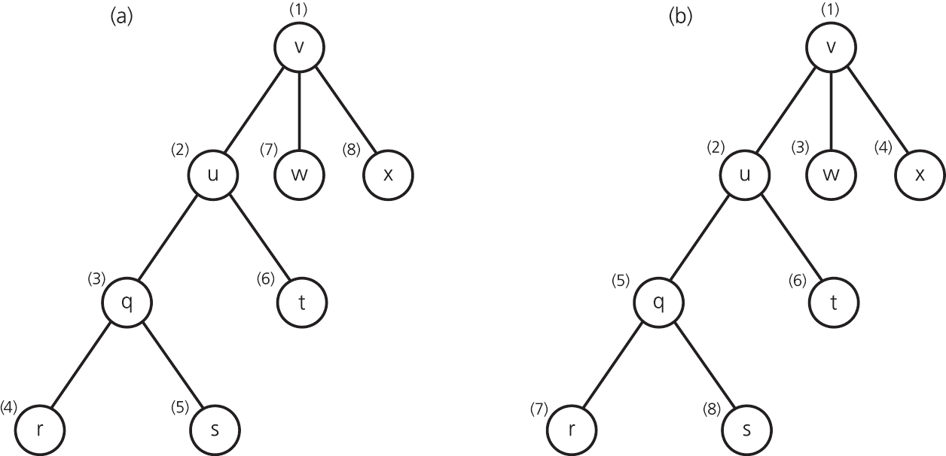
DFS and BFS Traversals
Figure 13-10 Visitation order for (a) a depth-first search; (b) a breadth-first search

Slide 22
Implementing a BFS Class Using the STL
A class providing a BFS traversal can be implemented using the STL vector and queue containers
  Two vectors of integers
    mark stores vertices that have been visited
    parents stores the parent of each vertex for use by other graph algorithms.
  A queue of Edges
    BFS processes the edges from each vertex’s adjacency list in the order that they were pushed onto the queue

Slide 23
Applications of Graphs: Topological Sorting
Topological order
  A list of vertices in a directed graph without cycles such that vertex x precedes vertex y if there is a directed edge from x to y in the graph
  Several topological orders are possible for a given graph
Topological sorting
  Arranging the vertices into a topological order

Slide 24
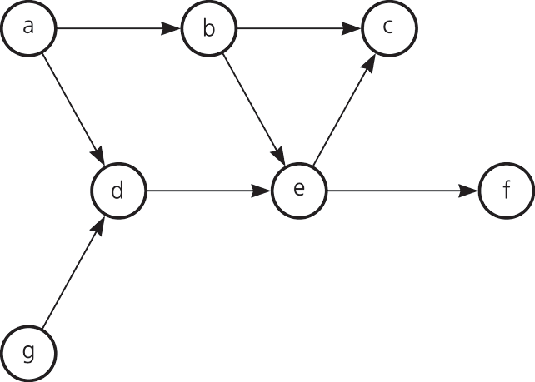
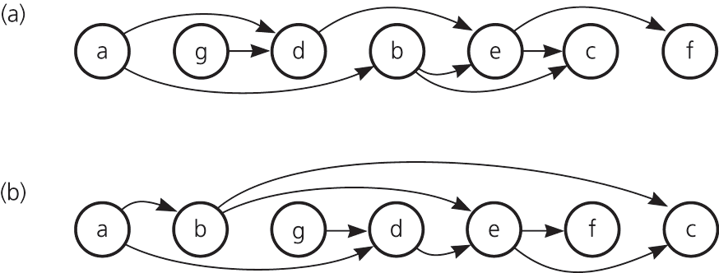
Topological Sorting
Figure 13-14 A directed graph without cycles
Figure 13-15 The graph in Figure 13-14 arranged according to the topological orders (a) a, g, d, b, e, c, f and (b) a, b, g, d, e, f, c

Slide 25
Topological Sorting Algorithms
topSort1
  Find a vertex that has no successor
  Add the vertex to the beginning of a list
  Remove that vertex from the graph, as well as all edges that lead to it
  Repeat the previous steps until the graph is empty
    When the loop ends, the list of vertices will be in topological order

Slide 26
Topological Sorting Algorithms
topSort2
  A modification of the iterative DFS algorithm
  Push all vertices that have no predecessor onto a stack
  Each time you pop a vertex from the stack, add it to the beginning of a list of vertices
  When the traversal ends, the list of vertices will be in topological order

Slide 27
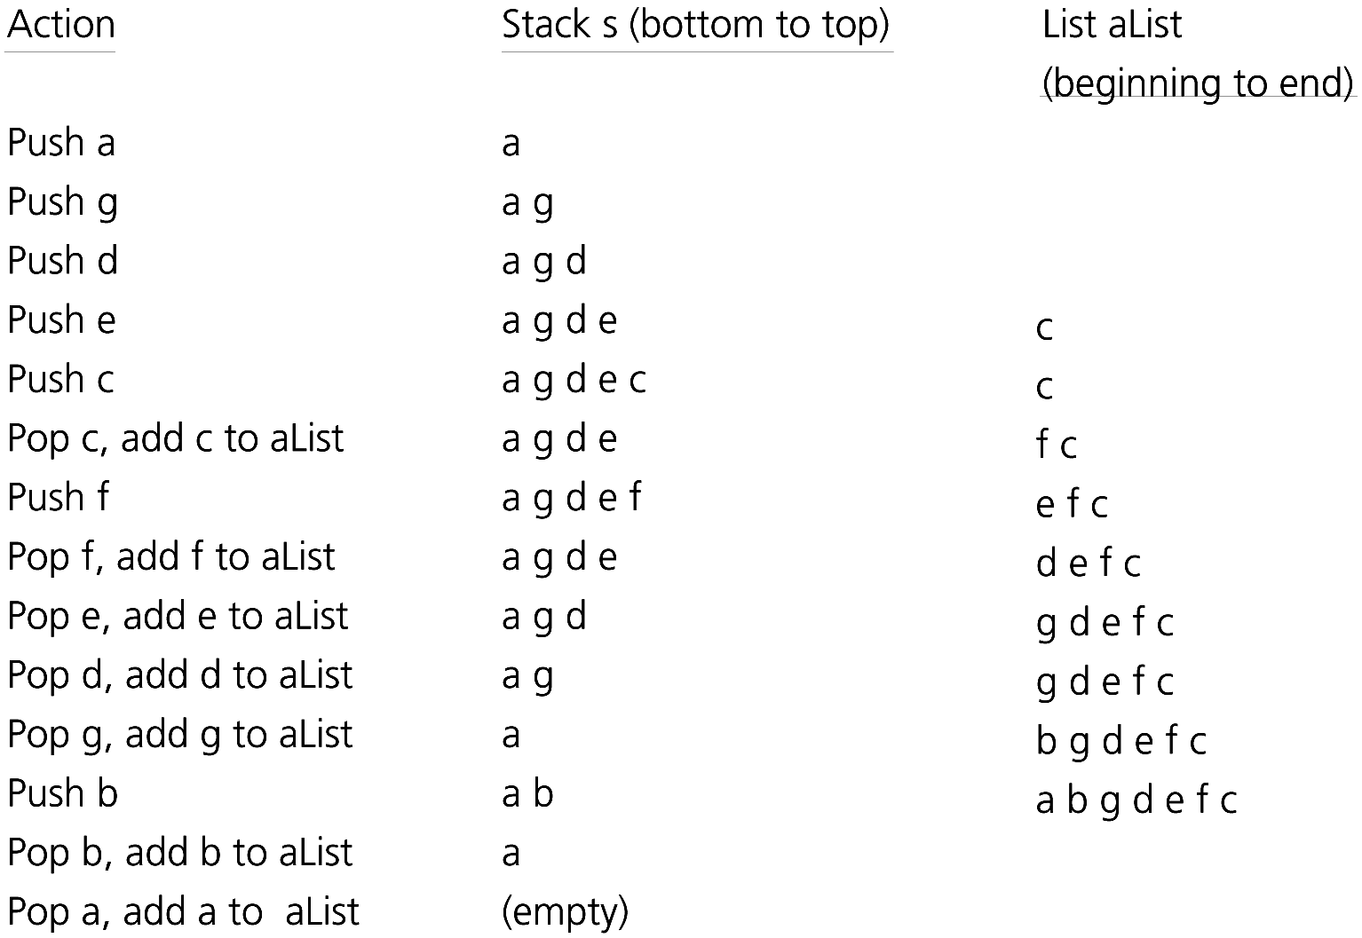
A Trace of topSort2
Figure 13-14
Figure 13-17 A trace of topSort2 for the graph in Figure 13-14

Slide 28
Spanning Trees
A tree is an undirected connected graph without cycles
A spanning tree of a connected undirected graph G is
  A subgraph of G that contains all of G’s vertices and enough of its edges to form a tree

Slide 29
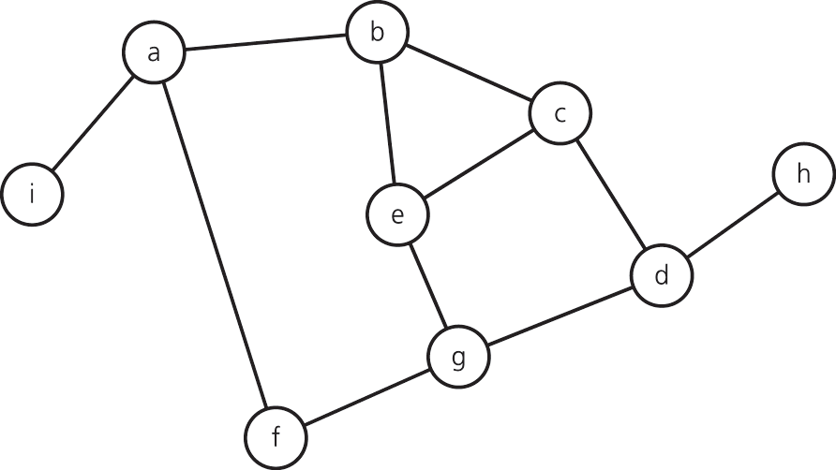
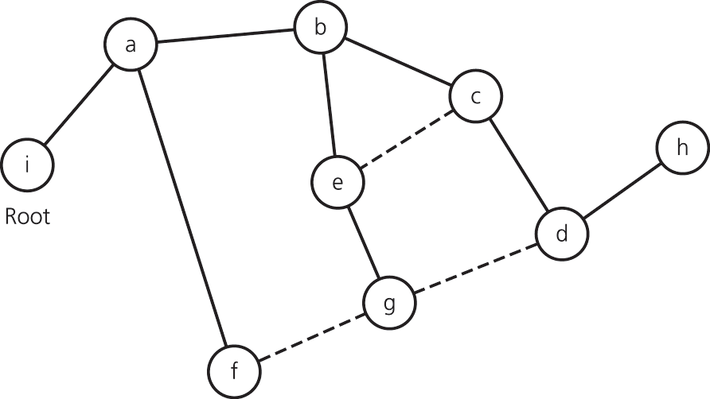
Spanning Trees
To obtain a spanning tree from a connected undirected graph with cycles
  Remove edges until there are no cycles
Figure 13-11 A connected graph with cycles
Figure 13-18 A spanning tree for the graph

Slide 30
Spanning Trees
Detecting a cycle in an undirected connected graph
  A connected undirected graph that has n vertices must have at least n – 1 edges
  A connected undirected graph that has n vertices and exactly n – 1 edges cannot contain a cycle
  A connected undirected graph that has n vertices and more than n – 1 edges must contain at least one cycle

Slide 31
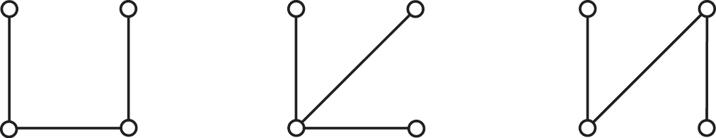
Spanning Trees
Figure 13-19 Connected graphs that each have four vertices and three edges

Slide 32
The DFS Spanning Tree
To create a depth-first search (DFS) spanning tree
  Traverse the graph using a depth-first search and mark the edges that you follow
  After the traversal is complete, the graph’s vertices and marked edges form the spanning tree

Slide 33
The BFS Spanning Tree
To create a breath-first search (BFS) spanning tree
  Traverse the graph using a bread-first search and mark the edges that you follow
  When the traversal is complete, the graph’s vertices and marked edges form the spanning tree

Slide 34
Minimum Spanning Trees
Cost of the spanning tree
  Sum of the costs of the edges of the spanning tree
A minimum spanning tree of a connected undirected graph has a minimal edge-weight sum
  A particular graph could have several minimum spanning trees

Slide 35
Minimum Spanning Trees:
Prim’s Algorithm
Find a minimum spanning tree that begins at any given vertex
  Find the least-cost edge (v, u) from a visited vertex v to some unvisited vertex u
  Mark u as visited
  Add the vertex u and the edge (v, u) to the minimum spanning tree
  Repeat the above steps until all vertices are visited

Slide 36
Shortest Paths
Shortest path between two vertices in a weighted graph is
  The path that has the smallest sum of its edge weights

Slide 37
Shortest Paths:
Dijkstra’s Algorithm
Find the shortest paths between a given origin and all other vertices
Dijkstra’s algorithm uses
  A set vertexSet of selected vertices
  An array weight, where weight[v] is the weight of the shortest (cheapest) path from vertex 0 to vertex v that passes through vertices in vertexSet

Slide 38
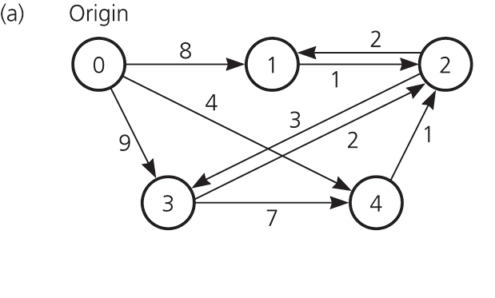
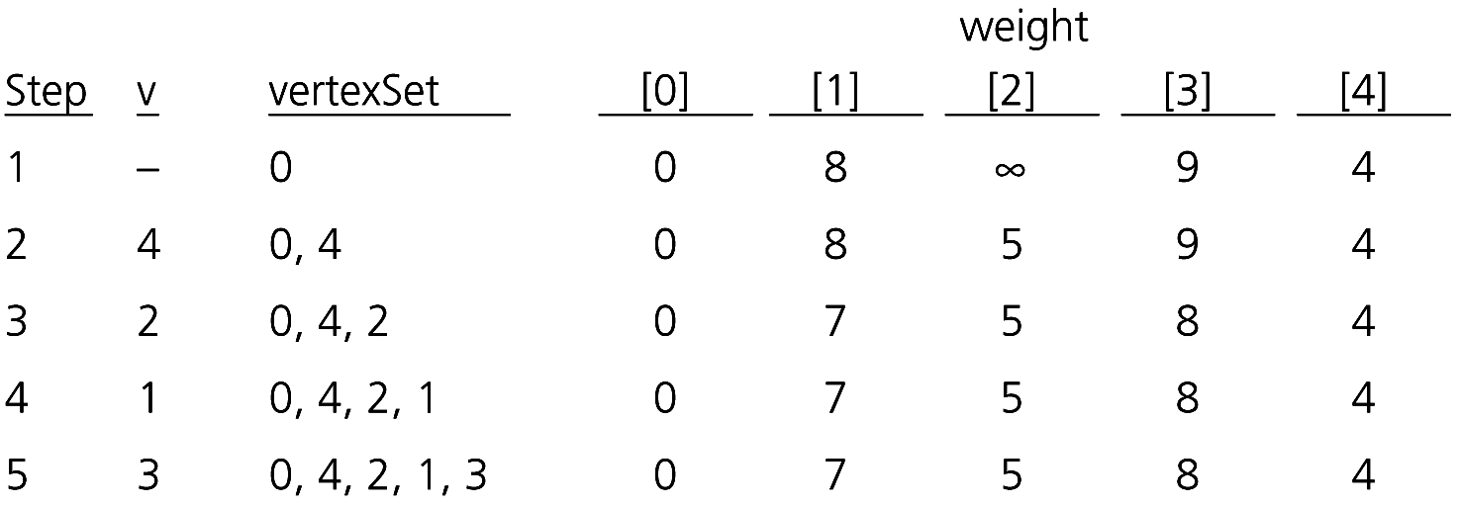
Shortest Paths:
Dijkstra’s Algorithm
Figure 13-24a
A weighted directed graph
Figure 13-25 A trace of the shortest-path algorithm applied to the graph

Slide 39
Circuits
A circuit
  A special cycle that passes through every vertex (or edge) in a graph exactly once
Euler circuit
  A circuit that begins at a vertex v, passes through every edge exactly once, and terminates at v
  Exists if and only if each vertex touches an even number of edges

Slide 40
Circuits
A Hamilton circuit
  Begins at a vertex v, passes through every vertex exactly once, and terminates at v
  The traveling salesman problem
A planar graph
  Can be drawn so that no two edges cross
  The three utilities problem
  The four-color problem

Slide 41
Summary
The most common implementations of a graph use either an adjacency matrix or an adjacency list
Graph searching
  Depth-first search goes as deep into the graph as it can before backtracking
    Uses a stack
  Bread-first search visits all possible adjacent vertices before traversing further into the graph
    Uses a queue

Slide 42
Summary
Topological sorting produces a linear order of the vertices in a directed graph without cycles
Trees are connected undirected graphs without cycles
A spanning tree of a connected undirected graph is
  A subgraph that contains all the graph’s vertices and enough of its edges to form a tree

Slide 43
Summary
A minimum spanning tree for a weighted undirected graph is
  A spanning tree whose edge-weight sum is minimal
The shortest path between two vertices in a weighted directed graph is
  The path that has the smallest sum of its edge weights

Slide 44
Summary
An Euler circuit in an undirected graph is
  A cycle that begins at vertex v, passes through every edge in the graph exactly once, and terminates at v
A Hamilton circuit in an undirected graph is
  A cycle that begins at vertex v, passes through every vertex in the graph exactly once, and terminates at v

