Slide 1
Chapter 14:
External Methods
Data Abstraction & Problem Solving with
C++
Fifth Edition
by Frank M. Carrano

Slide 2
A Look At External Storage
External storage
  Hard disk, CD, DVD
  Data exists beyond the execution period of a program
  Generally, a computer has more external storage than internal memory
A program represents external storage as files

Slide 3
A Look At External Storage
Sequential access file
  To access particular data, you advance the file window over intervening data
  Resembles a linked list
Random access file
  Data can be accessed at a given position directly
  Resembles an array
  Essential for external tables

Slide 4
A Look At External Storage
A file consists of data records
  Records are organized into one or more blocks
    The size of a block is a function of both hardware and software
    The number of records in a block is a function of the size of the records and of the block

Slide 5
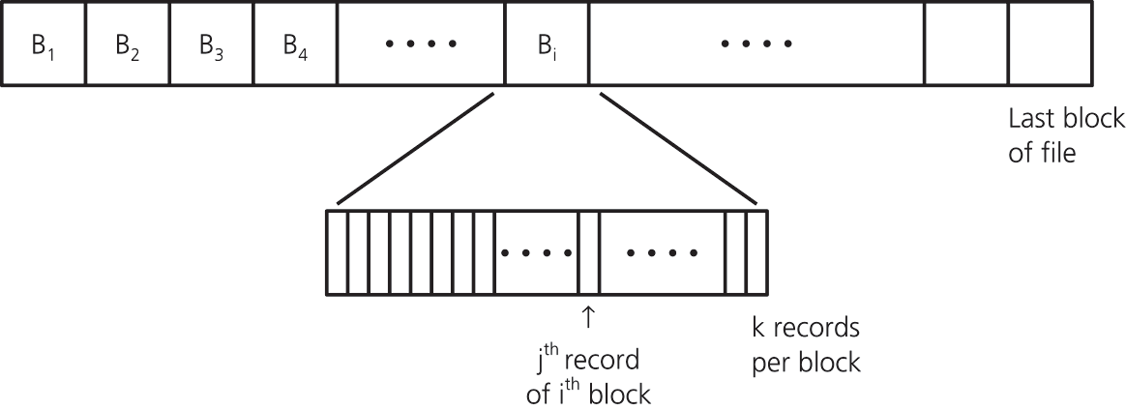
A Look At External Storage
Figure 14-2 A file partitioned into blocks of records

Slide 6
A Look At External Storage
Random access file
  All input and output is at the block level
Buffer
  A location that temporarily stores data as it makes its way from one process or location to another
  Used while transferring data between internal and external memory

Slide 7
A Look At External Storage
Once the system has read a block into the buffer buf, the program can process the records in the block
If the program modifies the records in buf, it must write buf to the file
File access time is the dominant factor when considering an algorithm’s efficiency

Slide 8
Sorting Data in An External File
An external file typically is too large to fit into internal memory all at once
To sort external data, use a modified version of mergesort
  At any step, the merge never needs to look beyond the leading edge of either segment

Slide 9
External Mergesort
Phase 1
  Read a block from F (data file to be sorted) into internal memory
  Sort its records by using an internal sort
  Write the sorted block to F₁ (a work file) before reading the next block from F
  Repeat the above steps for all the blocks of F

Slide 10
External Mergesort
Phase 2 (a sequence of merge steps)
  Each merge step
    Merges pairs of sorted runs to form larger sorted runs
    Doubles the number of blocks in each sorted run
    Halves the total number of sorted runs
  At the end
    F₁ will contain all the records of the original file in sorted order

Slide 11
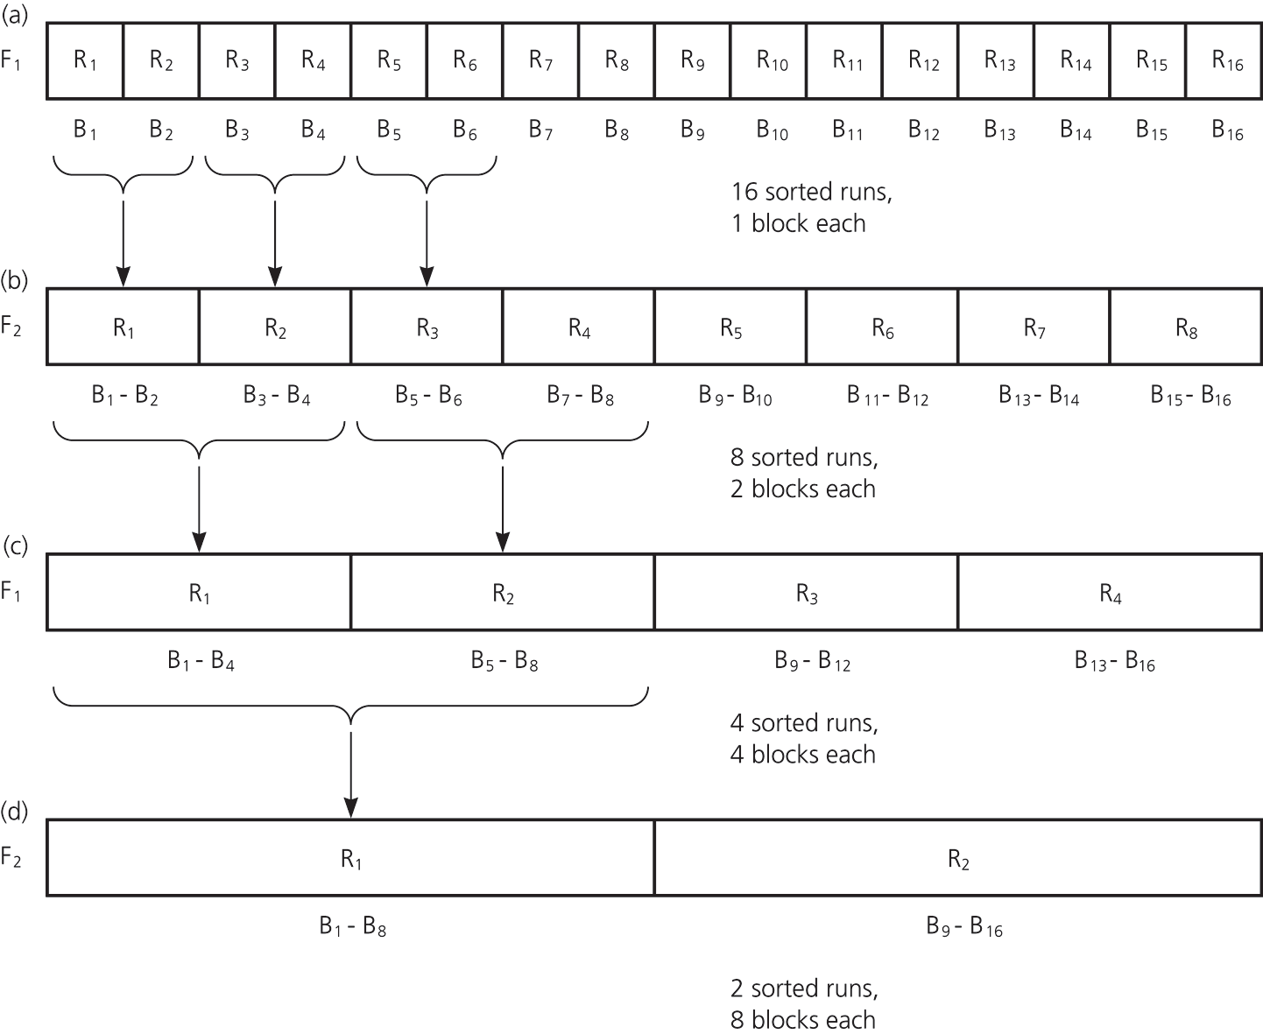
External Mergesort
Figure 14-3
(a)16 sorted runs, 1 block each, in file F₁;
(b) 8 sorted runs, 2 blocks each, in file F₂;
(c) 4 sorted runs, 4 blocks each, in file F₁;
(d) 2 sorted runs, 8 blocks each, in file F₂

Slide 12
External Tables
External implementation of the ADT table
  Records are stored in search-key order
    The file can be traversed in sorted order
    Main advantage
      A binary search can be used to locate the block that contains a given search key
    Main disadvantage
      tableInsert and tableDelete operations can require many costly block accesses because records need to be shifted

Slide 13
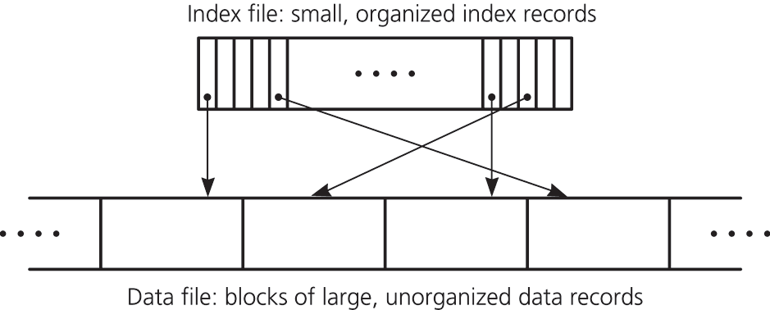
Indexing An External File
An index (or index file)
  Used to locate items in an external data file
  Contains an index record for each record in the data file
Figure 14-6 A data file with an index

Slide 14
Indexing An External File
An index record has two parts
  A key contains the same value as the search key of its corresponding record in the data file
  A pointer shows the number of the block in the data file that contains the data record

Slide 15
Indexing An External File
Advantages of an index file
  An index file can often be manipulated using fewer block accesses than would be needed to manipulate the data file
  Data records do not need to be shifted during insertions and deletions
  Allows multiple indexing

Slide 16
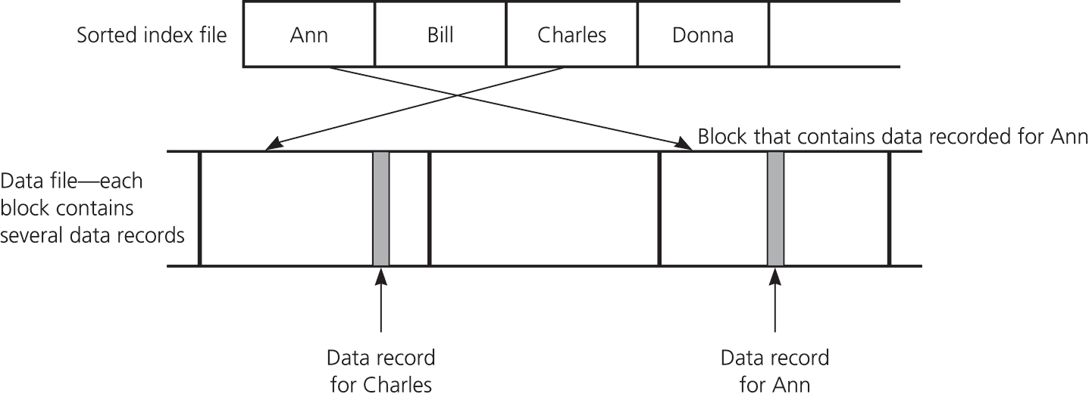
Indexing An External File
Store index records sequentially
  More efficient than having a sorted data file
  Not as efficient as using hashing or search trees to organize the index file
Figure 14-7
A data file with a sorted index file

Slide 17
Indexing An External File
Storing index records sequentially
  tableRetrieve operation
    Can be performed by using a binary search on the index file
  tableInsert and tableDelete operations
    Require only the shifting of index records, not data records
      Reduction in the maximum number of block accesses required
      Reduction in the time required for a single shift

Slide 18
External Hashing
The index file, not the data file, is hashed
  Each entry table[i] is associated with a linked list of blocks of the index file
  Each block of table[i]’s linked list contains index records whose keys hash into location i
  To form the linked list, reserve space in each block for a block pointer
    A block pointer is the integer block number of the next block in the chain

Slide 19
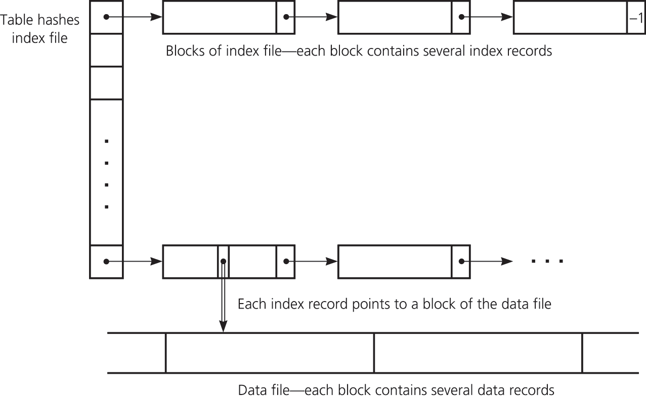
External Hashing
Figure 14-8 A hashed index file

Slide 20
Retrieval Under External Hashing of an Index File
Apply the hash function to the search key
Find the first block in the chain of index blocks (these blocks contain index records that hash into location i)
Search for the block with the desired index record
Retrieve the data item, if present

Slide 21
Insertion Under External Hashing of an Index File
Step 1: Insert the data record into the data file
  New record can be inserted anywhere in the data file
    Insert where a previous deletion has left a free slot
    Insert at the end of the last block
    Append a new block to the end of the data file and store the record there

Slide 22
Insertion under external hashing of an index file
Step 2: Insert a corresponding index record into the index file
  For an index record whose key value is searchKey and pointer value is p
    Apply the hash function to searchKey, letting
      i = h(searchKey)
    Insert the index record
    < searchKey, p>
    into the chain of blocks to which the entry table[i] points

Slide 23
Deletion Under External Hashing of an Index File
Step 1: Search the index file for the index record whose search key is searchKey
  Apply the hash function to searchKey
  Search the chain of index blocks pointed to by the entry table[i] for an index record whose key value equals searchKey
  If index record < searchKey,p> is found
    Note the block number p
    Delete the index record

Slide 24
Deletion Under External Hashing of an Index File
Step 2: Delete the data record from the data file
  Access the block p
  Search the block for the record
  Delete the record
  Write the block back to the file

Slide 25
External Hashing
External hashing implementation
  Good for the following operations on a large external table
    tableRetrieve
    tableInsert
    tableDelete
  Not practical for some operations, such as
    Sorted traversal
    Retrieval of the smallest or largest item
    Range queries that require ordered data

Slide 26
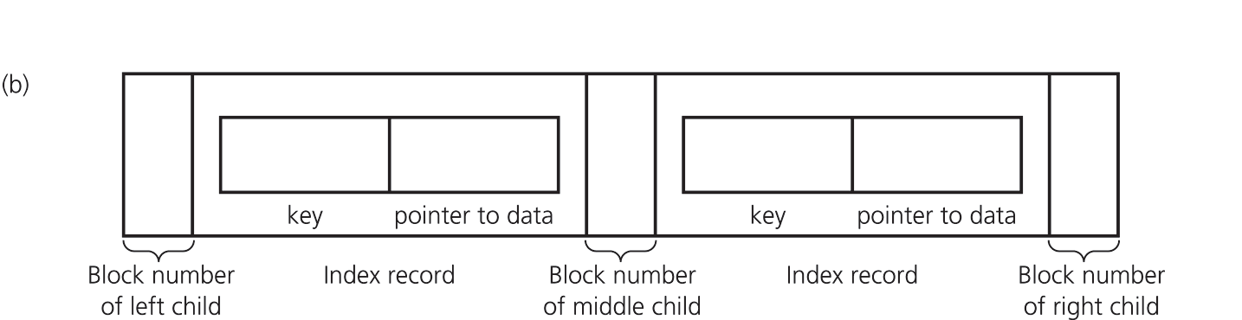
B-Trees
Organize the index file as an external search tree that is balanced
  Use block numbers for child pointers
    A value of –1 is used as a NULL child pointer
Figure 14-10b
A single node of a
2-3 tree

Slide 27
B-Trees
If the index file is organized into a 2-3 tree
  Each node would contain
    Either one or two index records, each of the form <key, pointer>
      pointer indicates the block (in the data file) that contains the data record whose search key equals key
    Three child pointers
      Refers to the pointers in the tree structure of the index file

Slide 28
B-Trees
An external 2-3 tree is adequate, but an improvement is possible
To improve efficiency, allow each node to have as many children as possible
  The advantage of keeping a search tree short far outweighs the disadvantage of performing extra work at each node
  Block size should be the only limiting factor for the number of children

Slide 29
B-Trees
Binary search tree
  If a node has two children, it must contain one key value
2-3 tree
  If a node has three children, it must contain two key values
General search tree
  If a node has m children, it must contain m – 1 key values

Slide 30
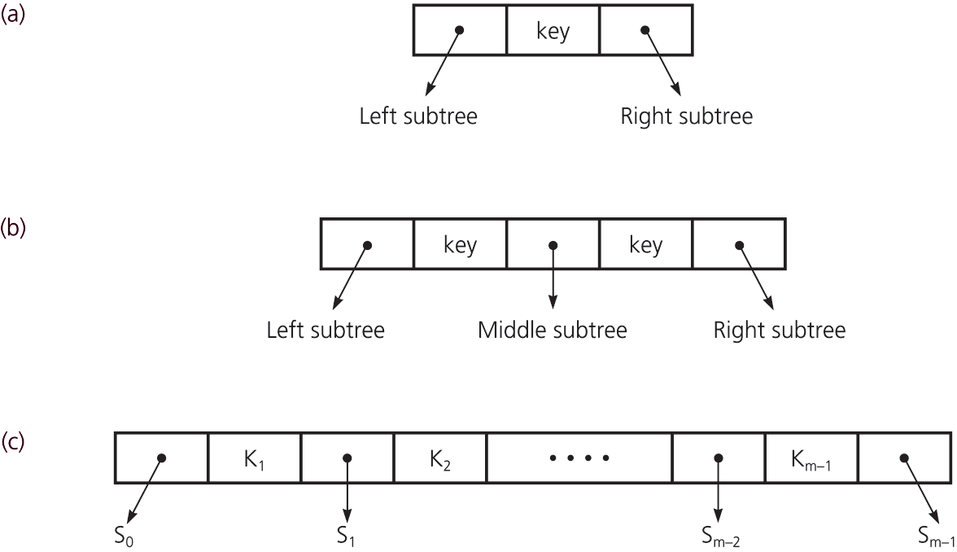
B-Trees
Figure 14-11
(a) A node with two children; (b) a node with three children; (c) a node with m children

Slide 31
B-Trees
B-tree of degree m
  All leaves are at the same level
  Nodes
    Each node contains between m – 1 and [m/2] records
    Each internal node has one more child than it has records
    Exception: The root can contain as few as one record and can have as few as two children

Slide 32
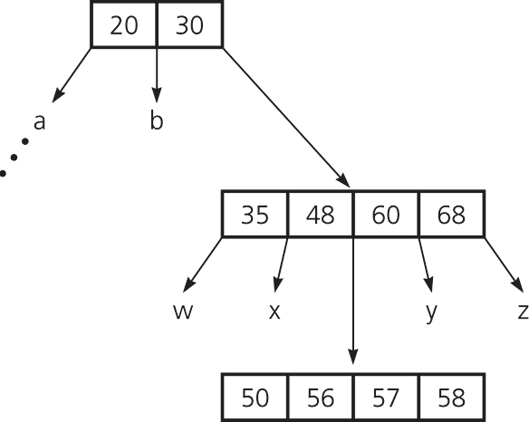
B-Trees
Figure 14-13 A B-tree of degree 5

Slide 33
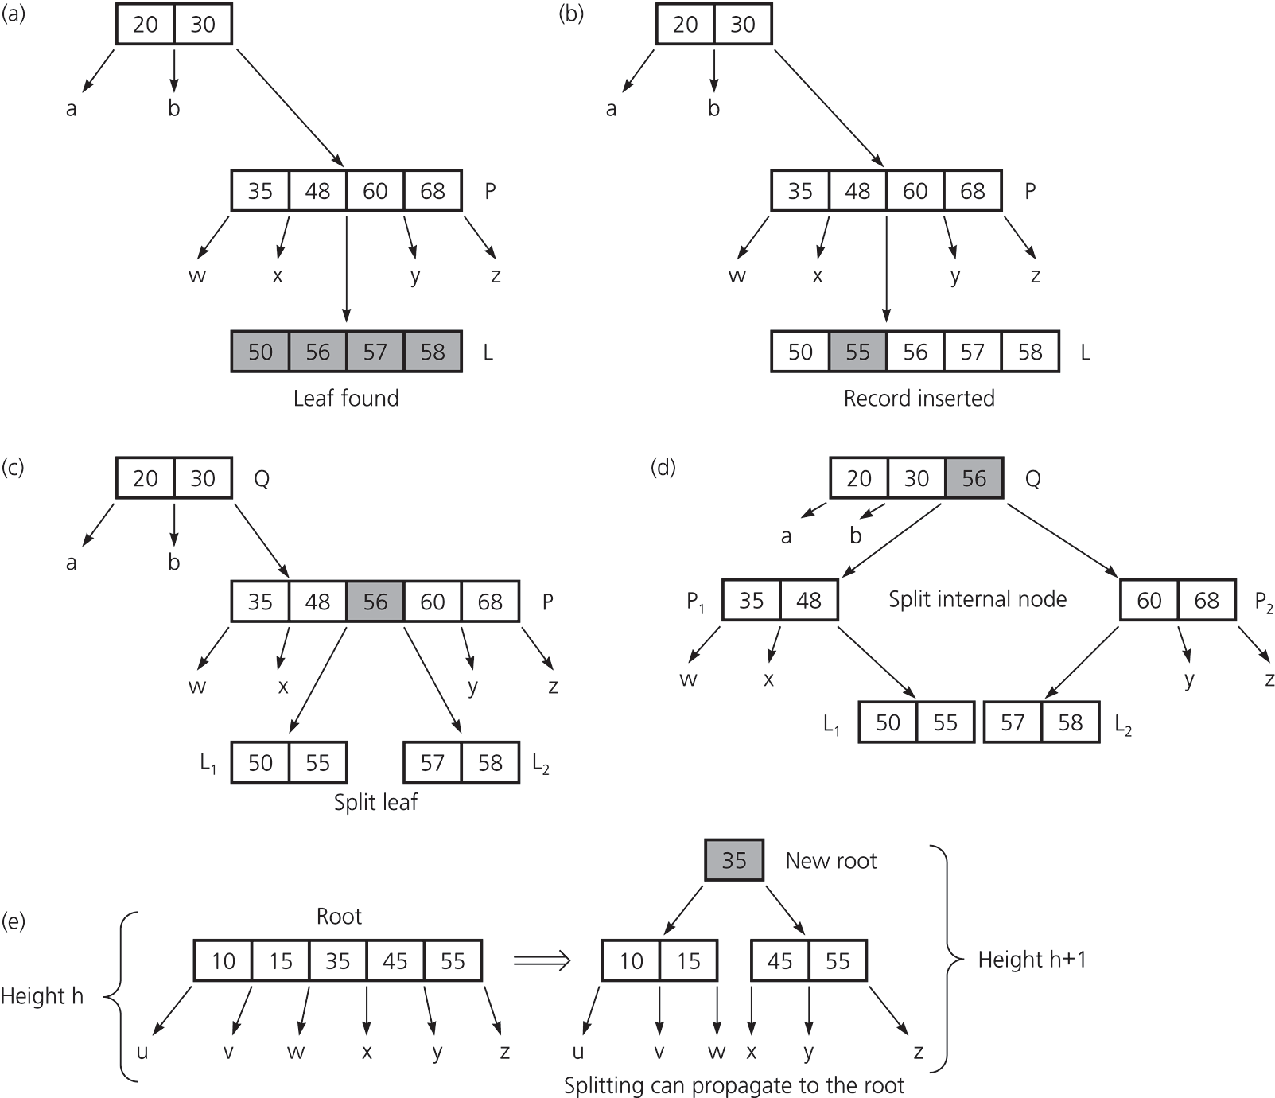
Insertion into a B-tree
Step 1
  Insert the data record into the data file
Step 2
  Insert a corresponding index record into the index file
Figure 14-14a and b
The steps for inserting 55

Slide 34
Insertion into a B-tree
Figure 14-14c, d, e The steps for inserting 55

Slide 35
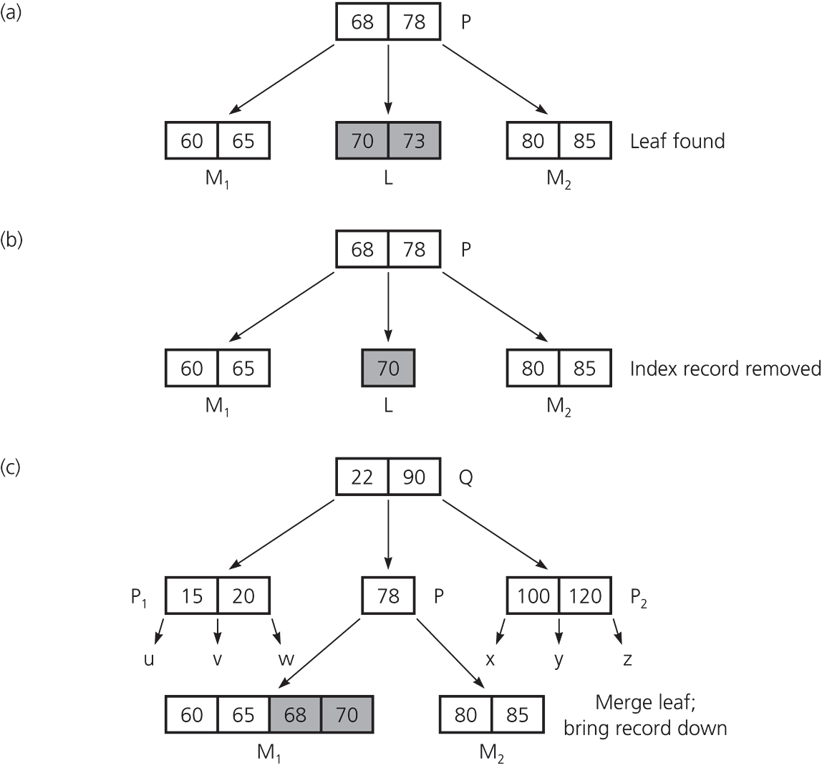
Deletion from a B-tree
Step 1
  Locate the index record in the index file
Step 2
  Delete the data record from the data file
Figure 14-15a, b, c The steps for deleting 73

Slide 36
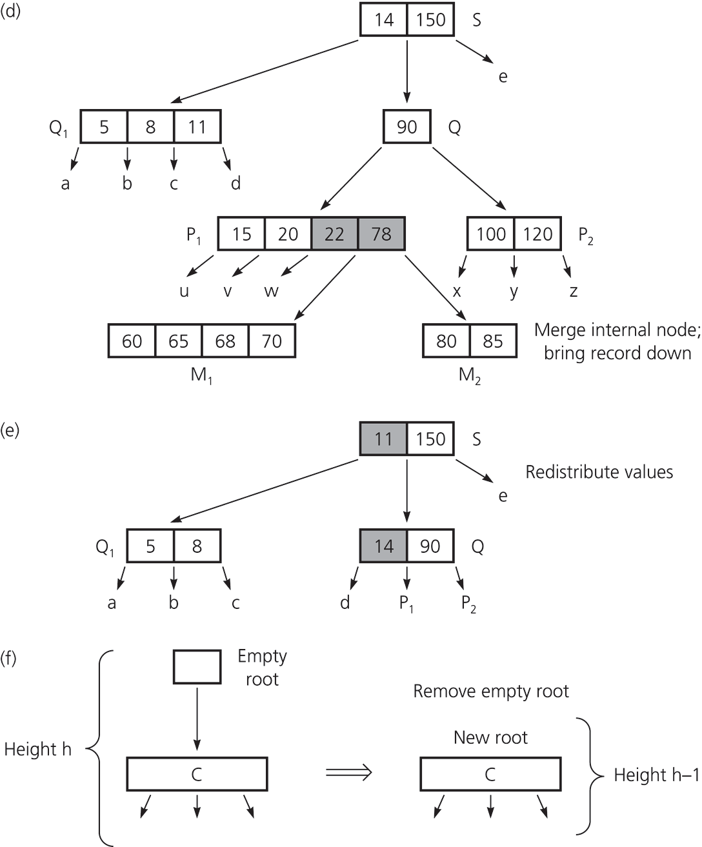
Deletion from a B-tree
Figure 14-15 d, e, f
The steps for deleting 73

Slide 37
Traversals
Accessing only the search key of each record, not the data file
  Not efficiently supported by the hashing implementation
  Efficiently supported by the B-tree implementation
Accessing the entire data record
  Not efficiently supported by the B-tree implementation

Slide 38
Multiple Indexing
Advantage
  Allows multiple organizations of data
Disadvantage
  More storage space
  Additional overhead for updating each index whenever the data file is modified

Slide 39
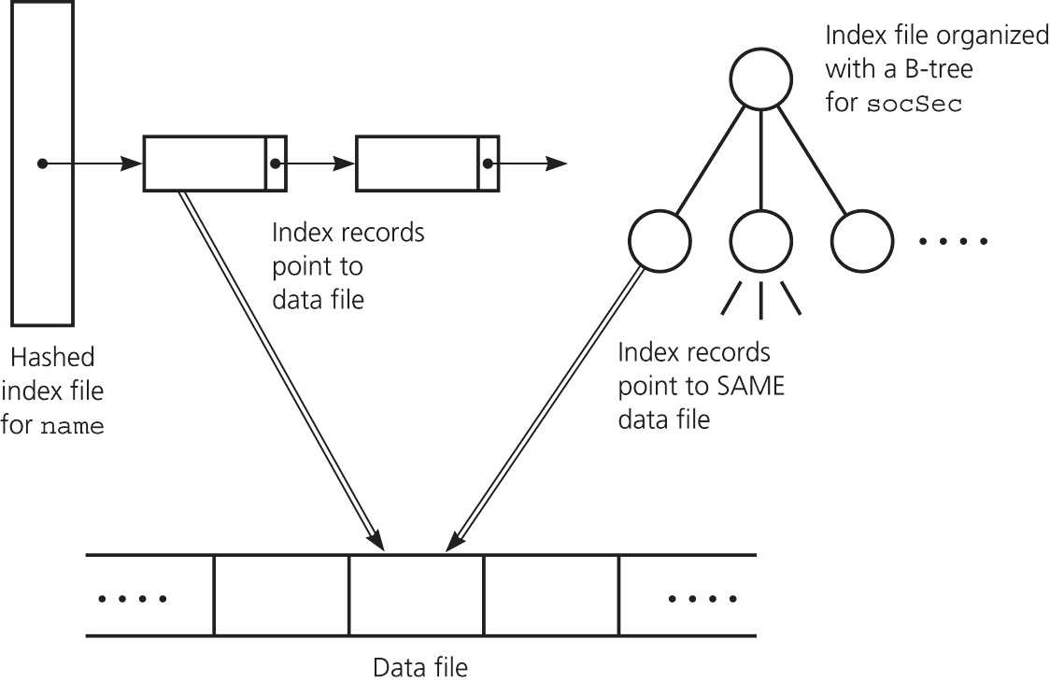
Multiple Indexing
Figure 14-16 Multiple index files

Slide 40
Summary
An external file is partitioned into blocks
  Each block typically contains many data records
  A block is generally the smallest unit of transfer between internal and external memory
  To access a record, you first access its block
In a random access file, you can access the i^{th} block without accessing the blocks that precede it

Slide 41
Summary
A modified mergesort algorithm can sort an external file of records
An index to a data file is a file that contains an index record for each record in the data file
  An index record contains the data record’s search key and block number

Slide 42
Summary
The index file can be organized using either hashing or a B-tree
  You can perform the basic table operations by using only a few block accesses
A data file can have several index files
  Different types of operations can be performed efficiently

