Slide 1
Pointers,
Polymorphism, and
Memory Allocation
C++ Interlude 2
Data Structures and Problem Solving with C++: Walls and Mirrors, Frank Carrano, © 2012

Slide 2
Early Binding
A function’s local variables are placed into an activation record
These activation records are stored in an area of your application’s memory called the run-time stack
Each time a function is called, an activation record is automatically created on the run-time stack; when the function ends, the activation record is destroyed, freeing the memory used for the local variables and parameters.
Data Structures and Problem Solving with C++: Walls and Mirrors, Frank Carrano, © 2012

Slide 3
Early Binding
When you create an object, the storage for the data members of that object are also placed into an activation record for the currently executing function or method.
  plainBox<string> myPlainBox;
  MagicBox<string> myMagicBox = MagicBox<string>();
  myPlainBox.setItem(“Fun Item”); //PlainBox version
  myMagicBox.setItem(“Secret Item”);
  //MagicBox version
  early binding!
Data Structures and Problem Solving with C++: Walls and Mirrors, Frank Carrano, © 2012

Slide 4
Early Binding
  The compiler determines the version of the method to invoke from the type of the parameter instead of the type of its corresponding arguments.
Data Structures and Problem Solving with C++: Walls and Mirrors, Frank Carrano, © 2012

Slide 5
A problem with Early Binding
See an example of early binding (Section C2-2, “main.cpp”)
To solve this problem, we need late binding
Data Structures and Problem Solving with C++: Walls and Mirrors, Frank Carrano, © 2012

Slide 6
Late Binding
  A way to communicate to the compiler that the code to execute is not determined until the program is running.
    So the types of the function are the ones of its corresponding arguments
    Late binding is an aspect of polymorphism
    Need two tools: pointers and virtual methods
Data Structures and Problem Solving with C++: Walls and Mirrors, Frank Carrano, © 2012

Slide 7
Pointers & the Program’s Free Store
When a C++ program begins, in addition to the run time stack, the operating system sets aside memory for the code – called code storage or text storage -- and for any global variables and static variables – called static storage.
Your program is also given extra memory, called the heap, or free store, which a programmer can use to store data.
Data Structures and Problem Solving with C++: Walls and Mirrors, Frank Carrano, © 2012

Slide 8
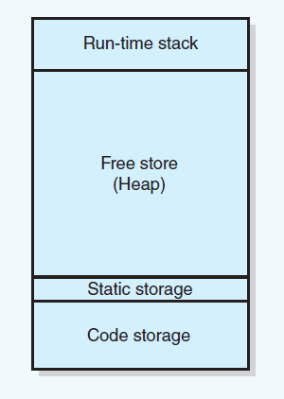
Pointers and Program’s Free Store
FIGURE C2-2 Sample program memory layout
Data Structures and Problem Solving with C++: Walls and Mirrors, Frank Carrano, © 2012

Slide 9
Pointers & the Program’s Free Store
You allocate memory for a variable on the free store by using the new operator.
If you allocate memory on the free store, you eventually must deallocate it
Data Structures and Problem Solving with C++: Walls and Mirrors, Frank Carrano, © 2012

Slide 10
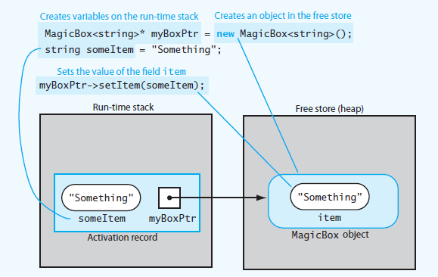
Pointers and Program’s Free Store
FIGURE C2-3 Run-time stack and free store after myboxPtr points to a MagicBox object and its data member item is set
Data Structures and Problem Solving with C++: Walls and Mirrors, Frank Carrano, © 2012

Slide 11
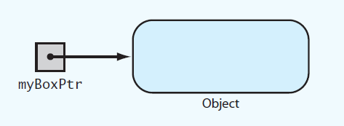
Pointers and Program’s Free Store
FIGURE C2-4 myBoxPtr and the object
to which it points
Data Structures and Problem Solving with C++: Walls and Mirrors, Frank Carrano, © 2012

Slide 12
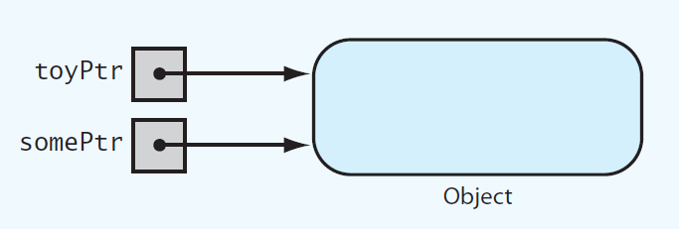
Pointers and Program’s Free Store
FIGURE C2-5 Two pointer variables that
point to the same object
Data Structures and Problem Solving with C++: Walls and Mirrors, Frank Carrano, © 2012

Slide 13
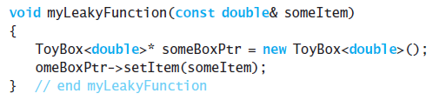
Pointers and Program’s Free Store
Other issues:
Deallocating Memory
Avoiding Memory Leaks
LISTING C2-1 Poorly written function that allocates memory in the free store

Slide 14
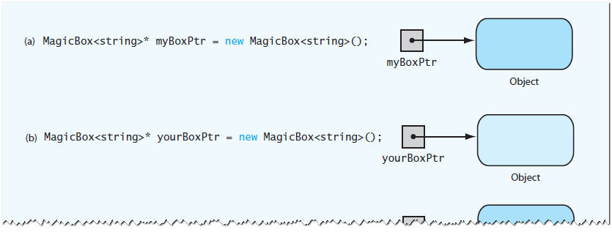
Pointers and Program’s Free Store
FIGURE C2-6 (a) Creating the first object;
(b) creating the second object;
Data Structures and Problem Solving with C++: Walls and Mirrors, Frank Carrano, © 2012

Slide 15
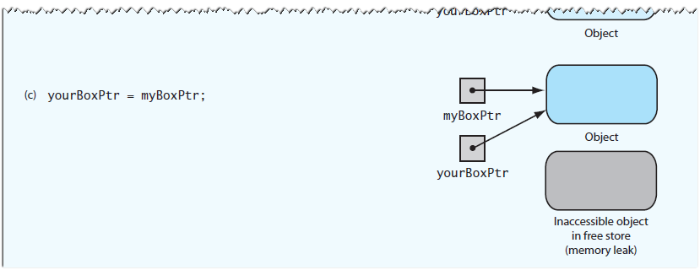
Pointers and Program’s Free Store
FIGURE C2-6 (c) assignment causes an inaccessible object
Data Structures and Problem Solving with C++: Walls and Mirrors, Frank Carrano, © 2012

Slide 16
Dangling Pointers
A dangling pointer is a pointer variable that no longer reference a valid object.
Data Structures and Problem Solving with C++: Walls and Mirrors, Frank Carrano, © 2012

Slide 17
Dangling Pointers
If you do not set a pointer variable to NULL after using delete, you leave the pointer dangling
If you declare a pointer variable but do not assign it a value, the result is a dangling pointer. C++ does not automatically initialize the memory that a variable represents.
  MagicBox<int>* myMagicBoxPtr;
  myMgicBoxPtr->setItem<20>; //segment fault error
Data Structures and Problem Solving with C++: Walls and Mirrors, Frank Carrano, © 2012

Slide 18
Dangling Pointers
The third situation causing a dangling pointer is subtle and best way to guard against it is careful programming.
MagicBox<string>* myBoxPtr = new MagicBox<string>;
MagicBox<string>* yourBoxPtr = myBoxPtr;
…….
delete myBoxPtr;
myBoxPtr = NULL;
cout << yourBoxPtr -> getItem() <<endl;
//yourBoxPtr is a dangling pointer, the program aborts
Data Structures and Problem Solving with C++: Walls and Mirrors, Frank Carrano, © 2012

Slide 19
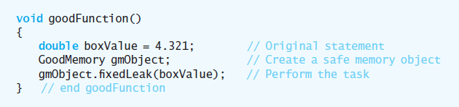
Pointers and Program’s Free Store
View Listing C2-2 Header file for the class GoodMemory
Consider Listing C2-3 Implementation file for the class GoodMemory
Contrast myLeakyFunction
.htm code listing files must be in the same folder as the .ppt files for these links to work
Data Structures and Problem Solving with C++: Walls and Mirrors, Frank Carrano, © 2012

Slide 20
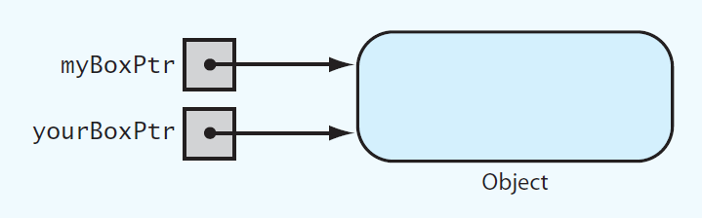
Avoiding Dangling Pointers
FIGURE C2-7 Two pointers referencing
(pointing to) the same object
Data Structures and Problem Solving with C++: Walls and Mirrors, Frank Carrano, © 2012

Slide 21
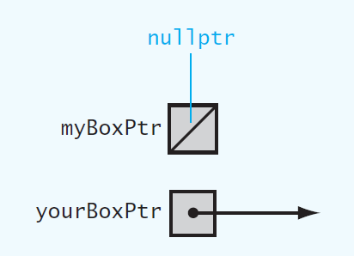
Avoiding Dangling Pointers
FIGURE C2-8 Example of a dangling pointer
Data Structures and Problem Solving with C++: Walls and Mirrors, Frank Carrano, © 2012

Slide 22
Avoiding Dangling Pointers
How to avoid dangling pointers
Set pointer variables to nullptr either initially or when you no longer need them
Test whether a pointer variable contains nullptr before using
Don’t delete object in free store until certain no other alias needs it
Set all aliases that reference a deleted object to nullptr when object is deleted
Data Structures and Problem Solving with C++: Walls and Mirrors, Frank Carrano, © 2012

Slide 23
Virtual Methods and Polymorphism
Consider Listing C2-4 Revised header file for the class PlainBox
Key points about virtual methods
A derived class can override
Must implement a class’s virtual methods
Derived class does not need to override existing implementation of inherited virtual method.
Data Structures and Problem Solving with C++: Walls and Mirrors, Frank Carrano, © 2012

Slide 24
Virtual Methods and Polymorphism
Key points about virtual methods
Any of a class’s methods may be virtual.
Constructors cannot be virtual
Destructors can and should be virtual. If you do not want derived class to override a particular method, it should not be virtual
Virtual method’s return type cannot be overridden
Data Structures and Problem Solving with C++: Walls and Mirrors, Frank Carrano, © 2012

Slide 25
Dynamic Allocation of Arrays
Ordinary C++ array is statically allocated
Use new operator to allocate an array dynamically
delete returns dynamically allocated array to system for reuse
You can increase size of dynamically allocated array
Data Structures and Problem Solving with C++: Walls and Mirrors, Frank Carrano, © 2012

Slide 26
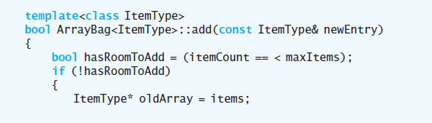
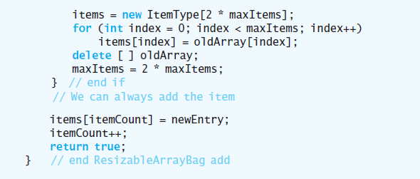
A Resizable Array-Based Bag
Data Structures and Problem Solving with C++: Walls and Mirrors, Frank Carrano, © 2012

Slide 27
End
Chapter C++ Interlude 2
Data Structures and Problem Solving with C++: Walls and Mirrors, Frank Carrano, © 2012

