Slide 1
Array-Based Implementations
Chapter 3
Data Structures and Problem Solving with C++: Walls and Mirrors, Frank Carrano, © 2012

Slide 2
Contents
The Approach
An Array-Based Implementation of the ADT Bag
An Array-Based Implementation of the ADT Bag
Data Structures and Problem Solving with C++: Walls and Mirrors, Frank Carrano, © 2012

Slide 3
The Approach
Review of an ADT
  A collection of data and a set of operations on that data
  Specifications indicate what the operations do, not how to implement
Implementing as class provides way to enforce a wall
  Prevents access of data structure in any way other than by using the operations.
Data Structures and Problem Solving with C++: Walls and Mirrors, Frank Carrano, © 2012

Slide 4
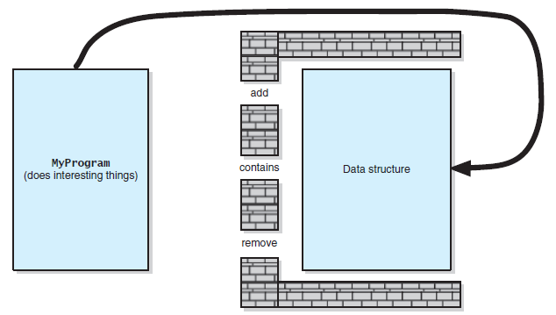
The Approach
FIGURE 3-1 Violating the wall of ADT operations
Data Structures and Problem Solving with C++: Walls and Mirrors, Frank Carrano, © 2012

Slide 5
Core Methods
Methods which do basic tasks
  Add
  Remove
  toVector (for display contents)
  Constructors
Add and remove methods designed first
Data Structures and Problem Solving with C++: Walls and Mirrors, Frank Carrano, © 2012

Slide 6
Using Fixed-Size Arrays
Must store
  Data item
  Its number in the array
Keep track of
  Max size of the array
  Number of items currently stored
  Where items were removed from array
Data Structures and Problem Solving with C++: Walls and Mirrors, Frank Carrano, © 2012

Slide 7
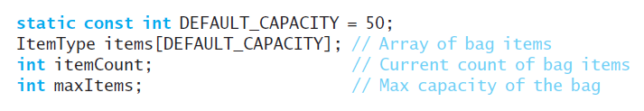
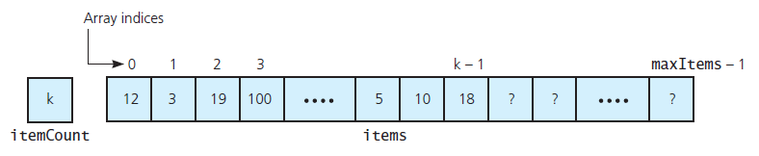
Array-Based Implementation
Private data, see header file, Listing 3-1
FIGURE 3-2 An array-based
implementation of the ADT bag
.htm code listing files must be in the same folder as the .ppt files for these links to work
Data Structures and Problem Solving with C++: Walls and Mirrors, Frank Carrano, © 2012

Slide 8
Defining the Core Methods
Core methods defined
  ArrayBag<ItemType>::ArrayBag(): itemCount(0), maxItems(DEFAULT_CAPACITY)add
  bool ArrayBag<ItemType>::add( const ItemType& newEntry)
  vector<ItemType> ArrayBag<ItemType>:: toVector() const
  int ArrayBag<ItemType>::getCurrentSize() const
  bool ArrayBag<ItemType>::isEmpty() const
Data Structures and Problem Solving with C++: Walls and Mirrors, Frank Carrano, © 2012

Slide 9
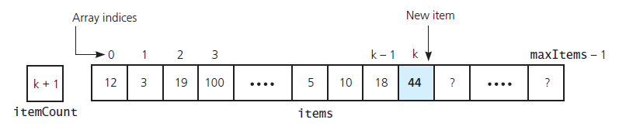
Defining the Core Methods
FIGURE 3-3 Inserting a new entry into an array-based bag
View test program, Listing 3-2 and
Output
Data Structures and Problem Solving with C++: Walls and Mirrors, Frank Carrano, © 2012

Slide 10
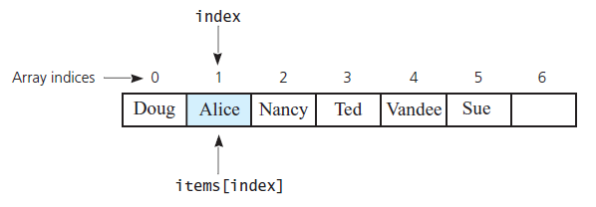
Implementing More Methods
int ArrayBag<ItemType>:: getFrequencyOf
( const ItemType& anEntry) const
bool ArrayBag<ItemType>::contains( const ItemType& target) const
FIGURE 3-4 The array items after a successful search for the string "Alice"
Data Structures and Problem Solving with C++: Walls and Mirrors, Frank Carrano, © 2012

Slide 11
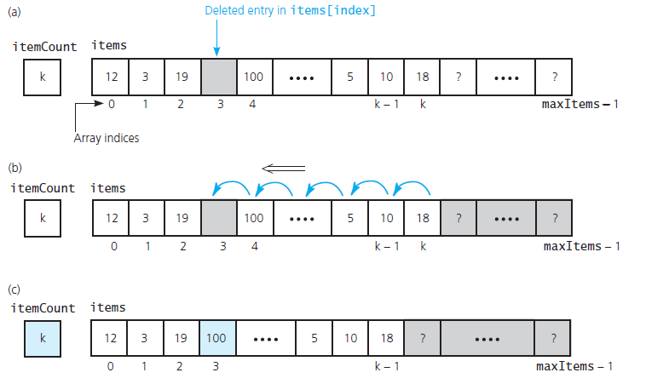
Implementing More Methods
FIGURE 3-5 (a) A gap in the array items after deleting the entry in items[index] and decrementing itemCount;
Data Structures and Problem Solving with C++: Walls and Mirrors, Frank Carrano, © 2012

Slide 12
Implementing More Methods
FIGURE 3-5 (b) shifting subsequent entries to avoid a gap;
Data Structures and Problem Solving with C++: Walls and Mirrors, Frank Carrano, © 2012

Slide 13
Implementing More Methods
FIGURE 3-5 (c) the array after shifting;
Data Structures and Problem Solving with C++: Walls and Mirrors, Frank Carrano, © 2012

Slide 14
Implementing More Methods
int ArrayBag<ItemType>::getIndexOf
(const ItemType& target) const
bool ArrayBag<ItemType>::remove( const ItemType& anEntry)
void ArrayBag<ItemType>::clear()
Data Structures and Problem Solving with C++: Walls and Mirrors, Frank Carrano, © 2012

Slide 15
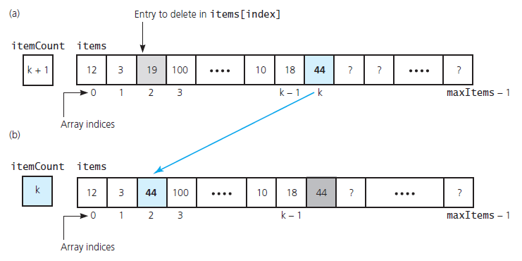
Implementing More Methods
FIGURE 3-6 Avoiding a gap in the array
while removing an entry
Data Structures and Problem Solving with C++: Walls and Mirrors, Frank Carrano, © 2012

Slide 16
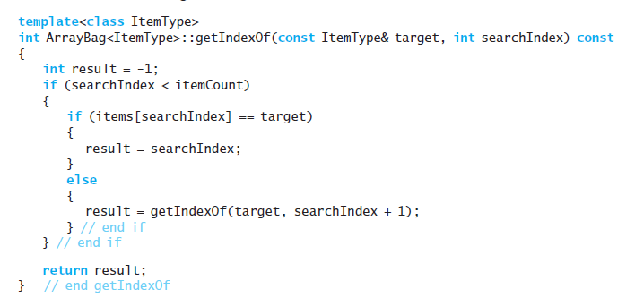
Using Recursion in the Implementation
Recursive version of getIndexOf
Data Structures and Problem Solving with C++: Walls and Mirrors, Frank Carrano, © 2012

Slide 17
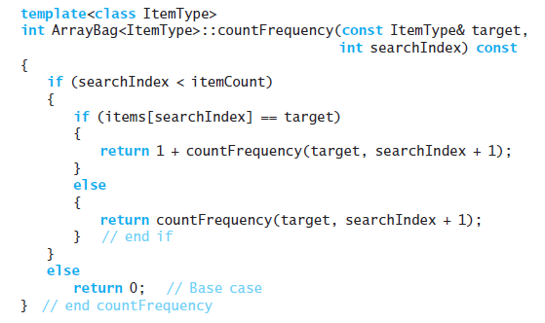
Using Recursion in the Implementation
Recursive version of getFrequencyOf
Data Structures and Problem Solving with C++: Walls and Mirrors, Frank Carrano, © 2012

Slide 18
End
Chapter 3
Data Structures and Problem Solving with C++: Walls and Mirrors, Frank Carrano, © 2012

