Slide 1
Stacks
Chapter 6
Data Structures and Problem Solving with C++: Walls and Mirrors, Frank Carrano, © 2012

Slide 2
Contents
The Abstract Data Type Stack
Simple Uses of a Stack
Using Stacks with Algebraic Expressions
Using a Stack to Search a Flight Map
The Relationship Between Stacks and Recursion
Data Structures and Problem Solving with C++: Walls and Mirrors, Frank Carrano, © 2012

Slide 3
The Abstract Data Type Stack
Developing an ADT during the design of a solution
Consider entering keyboard text
  Mistakes require use of backspace
  abcdd←←efgg←
We seek a programming solution to read these keystrokes
Data Structures and Problem Solving with C++: Walls and Mirrors, Frank Carrano, © 2012

Slide 4
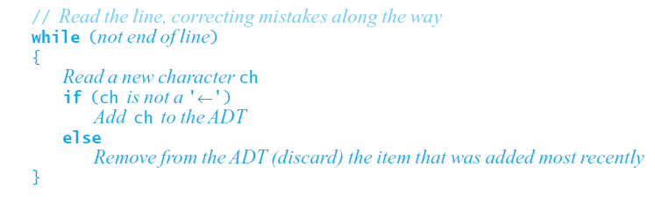
The Abstract Data Type Stack
Pseudocode of first attempt
Requires
  Add new item to ADT
  Remove most recently added item
Data Structures and Problem Solving with C++: Walls and Mirrors, Frank Carrano, © 2012

Slide 5
Specifications for the ADT Stack
We have identified the following operations:
  See whether stack is empty.
  Add a new item to stack.
  Remove from the stack item added most recently.
  Get item that was added to stack most recently.
Stack uses LIFO principle
  Last In First Out
Data Structures and Problem Solving with C++: Walls and Mirrors, Frank Carrano, © 2012

Slide 6
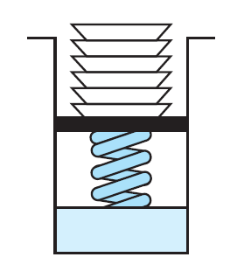
Specifications for the ADT Stack
FIGURE 6-1 A stack of cafeteria plates
Data Structures and Problem Solving with C++: Walls and Mirrors, Frank Carrano, © 2012

Slide 7
Abstract Data Type: Stack
A finite number of objects
  Not necessarily distinct
  Having the same data type
  Ordered by when they were added
Operations
  isEmpty()
  push(newEntry)
  pop()
  peek()
Data Structures and Problem Solving with C++: Walls and Mirrors, Frank Carrano, © 2012

Slide 8
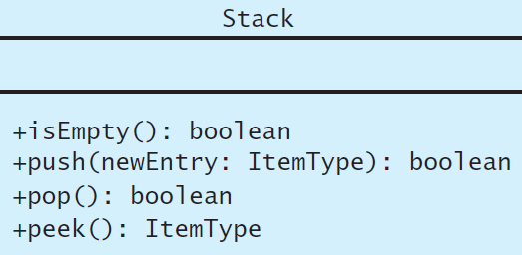
Abstract Data Type: Stack
View C++ Stack interface, Listing 6-1
FIGURE 6-2 UML diagram for the class Stack
.htm code listing files must be in the same folder as the .ppt files for these links to work
Data Structures and Problem Solving with C++: Walls and Mirrors, Frank Carrano, © 2012

Slide 9
Axioms for the ADT Stack
new Stack()).isEmpty() = true
new Stack()).pop() = false
new Stack()).peek() = error
aStack.push(item)).isEmpty() = false
aStack.push(item)).peek() = item
aStack.push(item)).pop() = true
Data Structures and Problem Solving with C++: Walls and Mirrors, Frank Carrano, © 2012

Slide 10
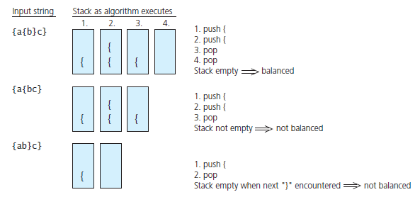
Simple Uses of a Stack
FIGURE 6-3 Traces of the algorithm that
checks for balanced braces
Data Structures and Problem Solving with C++: Walls and Mirrors, Frank Carrano, © 2012

Slide 11
Simple Uses of a Stack
Recognizing strings in a language
Consider
L = { s$s' : s is a possibly empty string of characters other than $ , s' = reverse( s )}
View algorithm to verify a string for a given language, Listing 6-A
Data Structures and Problem Solving with C++: Walls and Mirrors, Frank Carrano, © 2012

Slide 12
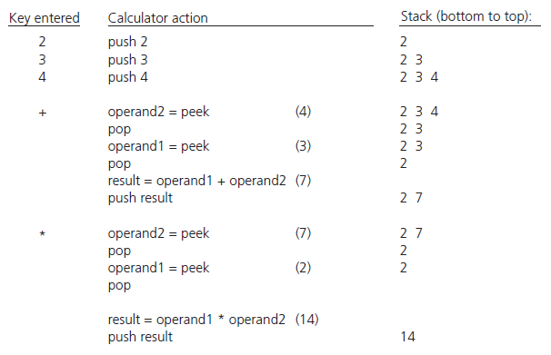
Using Stacks with Algebraic Expressions
Evaluating postfix expressions
FIGURE 6-4 The effect of a postfix calculator on a stack when evaluating the expression 2 * (3 + 4)
Data Structures and Problem Solving with C++: Walls and Mirrors, Frank Carrano, © 2012

Slide 13
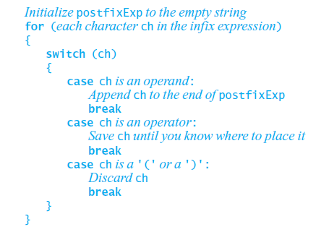
Using Stacks with Algebraic Expressions
Converting infix expressions to equivalent postfix expressions
Possible pseudocode solution
Data Structures and Problem Solving with C++: Walls and Mirrors, Frank Carrano, © 2012

Slide 14
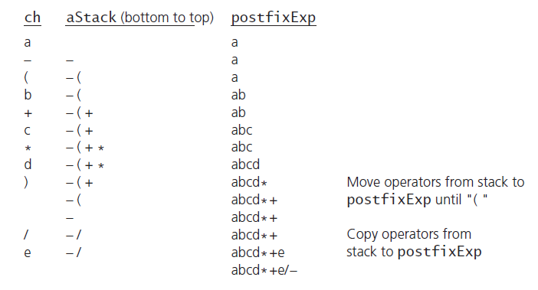
Using Stacks with Algebraic Expressions
View pseudocode algorithm that converts infix to postfix
Listing 6-B
FIGURE 6-5 A trace of the algorithm that converts the infix expression a – ( b + c * d ) / e to postfix form
Data Structures and Problem Solving with C++: Walls and Mirrors, Frank Carrano, © 2012

Slide 15
End
Chapter 6
Data Structures and Problem Solving with C++: Walls and Mirrors, Frank Carrano, © 2012

