Slide 1
Implementations of the ADT Stack
Chapter 7
Data Structures and Problem Solving with C++: Walls and Mirrors, Frank Carrano, © 2012

Slide 2
Contents
An Array-Based Implementation
A Link-Based implementation
Implementations That Use Exceptions
Data Structures and Problem Solving with C++: Walls and Mirrors, Frank Carrano, © 2012

Slide 3
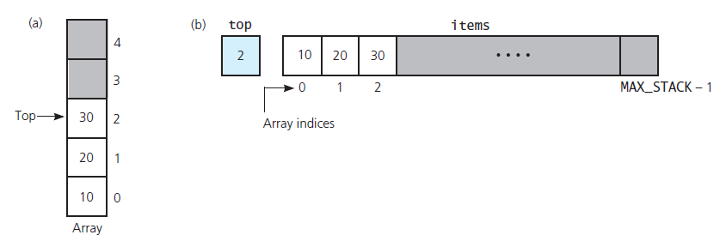
An Array Based Implementation
FIGURE 7-1 Using an array to store a stack’s entries:
(a) a preliminary sketch; (b) implementation details
Data Structures and Problem Solving with C++: Walls and Mirrors, Frank Carrano, © 2012

Slide 4
An Array Based Implementation
Consider a header file for an array based implementation, Listing 7-1
View the accompanying implementation file, Listing 7-2
.htm code listing files must be in the same folder as the .ppt files for these links to work
Data Structures and Problem Solving with C++: Walls and Mirrors, Frank Carrano, © 2012

Slide 5
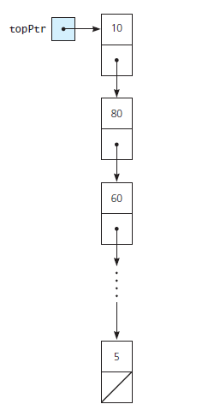
A Link-Based implementation
FIGURE 7-2 A link-based implementation of a stack
Data Structures and Problem Solving with C++: Walls and Mirrors, Frank Carrano, © 2012

Slide 6
A Link-Based implementation
View header file for an link-based implementation, Listing 7-3
Note the accompanying implementation file, Listing 7-4
Data Structures and Problem Solving with C++: Walls and Mirrors, Frank Carrano, © 2012

Slide 7
Implementations That Use Exceptions
Note header file for the class PrecondViolatedExcep, Listing 7-5
View the accompanying implementation file, Listing 7-6
Data Structures and Problem Solving with C++: Walls and Mirrors, Frank Carrano, © 2012

Slide 8
End
Chapter 7
Data Structures and Problem Solving with C++: Walls and Mirrors, Frank Carrano, © 2012

