Slide 1
List Implementations
Chapter 9
Data Structures and Problem Solving with C++: Walls and Mirrors, Frank Carrano, © 2012

Slide 2
Contents
An Array-Based Implementation of the ADT List
A Link-Based Implementation of the ADT List
Comparing Implementations
Data Structures and Problem Solving with C++: Walls and Mirrors, Frank Carrano, © 2012

Slide 3
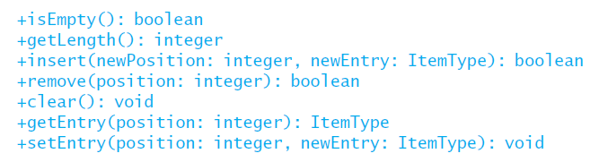
Array-Based Implementation of ADT List
Recall list operations in UML form
Data Structures and Problem Solving with C++: Walls and Mirrors, Frank Carrano, © 2012

Slide 4
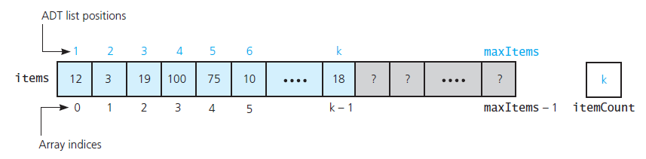
The Header File
View header file for the class ArrayList, Listing 9-1
.htm code listing files must be in the same folder as the .ppt files for these links to work
FIGURE 9-1 An array-based implementation of the ADT list
Data Structures and Problem Solving with C++: Walls and Mirrors, Frank Carrano, © 2012

Slide 5
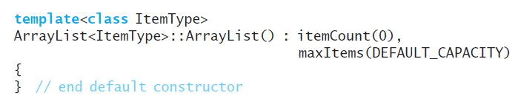
The Implementation File
Constructor
Data Structures and Problem Solving with C++: Walls and Mirrors, Frank Carrano, © 2012

Slide 6
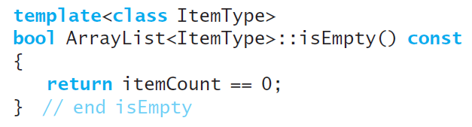
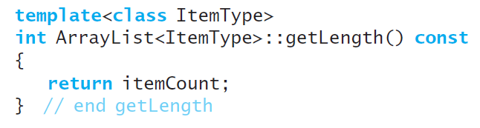
The Implementation File
isEmpty tests whether itemCount is zero
getLength simply returns the value of itemCount :
Data Structures and Problem Solving with C++: Walls and Mirrors, Frank Carrano, © 2012

Slide 7
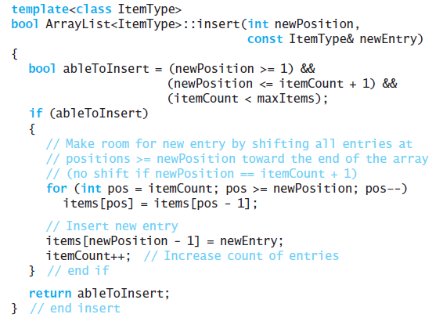
The Implementation File
Definition of the method insert
Data Structures and Problem Solving with C++: Walls and Mirrors, Frank Carrano, © 2012

Slide 8
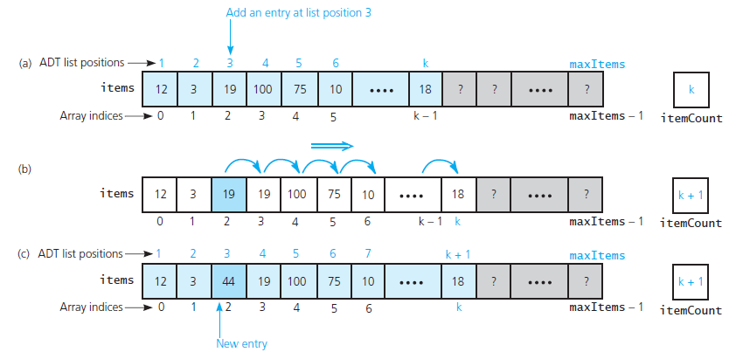
The Implementation File
FIGURE 9-2 Shifting items for insertion: (a) the list before the insertion; (b) copy items to produce room at position 3; (c) the result
Data Structures and Problem Solving with C++: Walls and Mirrors, Frank Carrano, © 2012

Slide 9

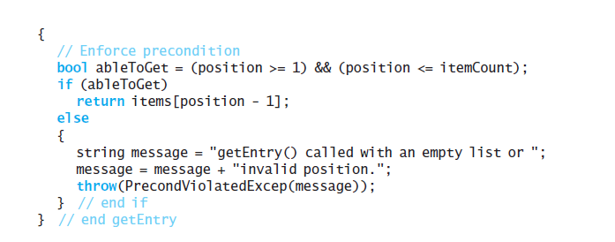
The Implementation File
The method getEntry.
Data Structures and Problem Solving with C++: Walls and Mirrors, Frank Carrano, © 2012

Slide 10
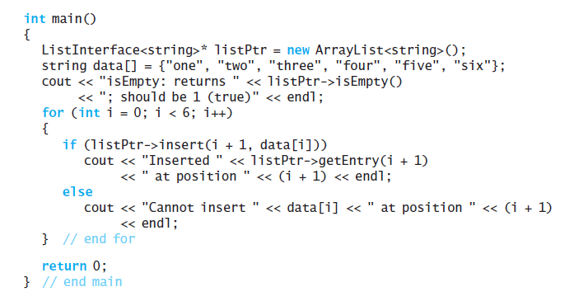
The Implementation File
Testing core group of methods
Data Structures and Problem Solving with C++: Walls and Mirrors, Frank Carrano, © 2012

Slide 11
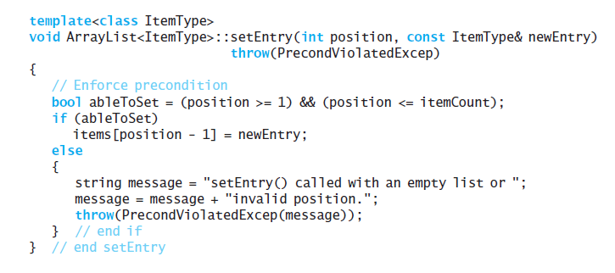
The Implementation File
The method setEntry
Data Structures and Problem Solving with C++: Walls and Mirrors, Frank Carrano, © 2012

Slide 12
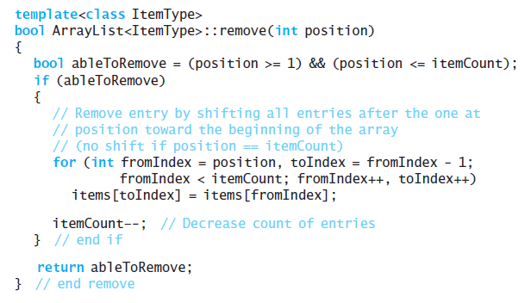
The Implementation File
The definition of remove
Data Structures and Problem Solving with C++: Walls and Mirrors, Frank Carrano, © 2012

Slide 13
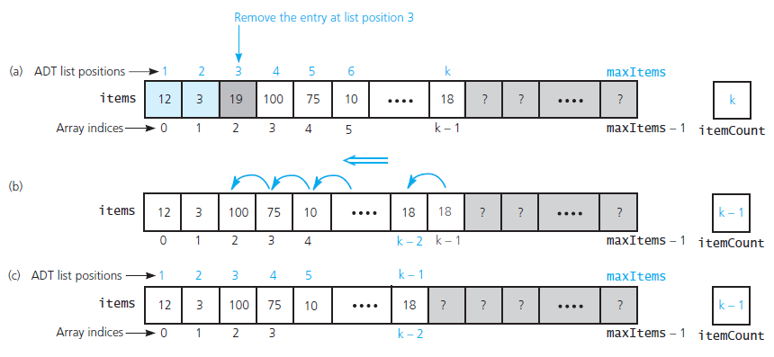
The Implementation File
FIGURE 9-3 (a) Deletion can cause a gap; (b) shift items to prevent a gap at position 3; (c) the result
Data Structures and Problem Solving with C++: Walls and Mirrors, Frank Carrano, © 2012

Slide 14
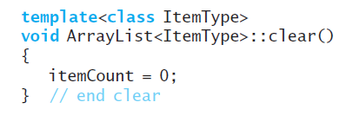
The Implementation File
The method clear.
Data Structures and Problem Solving with C++: Walls and Mirrors, Frank Carrano, © 2012

Slide 15
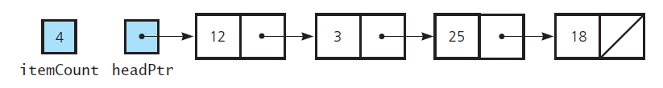
A Link-Based Implementation of the ADT List
FIGURE 9-4 A link-based implementation of the ADT list
Data Structures and Problem Solving with C++: Walls and Mirrors, Frank Carrano, © 2012

Slide 16
End
Chapter 9
Data Structures and Problem Solving with C++: Walls and Mirrors, Frank Carrano, © 2012

