Slide 1
Queues and Priority Queues
Chapter 13
Data Structures and Problem Solving with C++: Walls and Mirrors, Frank Carrano, © 2012

Slide 2
Content
The ADT Queue
Simple Applications of the ADT Queue
The ADT Priority Queue
The ADT Priority Queue
Position-Oriented and Value-Oriented ADTs
Data Structures and Problem Solving with C++: Walls and Mirrors, Frank Carrano, © 2012

Slide 3
The ADT Queue
A queue is like a line of people
  New items enter at the back (rear) of the queue
  Items leave the queue from the front
ADT Queue operations
  Test whether a queue is empty.
  Add new entry to back of queue.
  Remove entry at front of queue
  Get the entry added earliest to queue.
Data Structures and Problem Solving with C++: Walls and Mirrors, Frank Carrano, © 2012

Slide 4
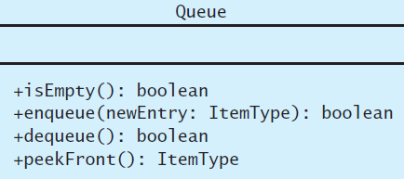
The ADT Queue
FIGURE 13-1 UML diagram for the class Queue
Data Structures and Problem Solving with C++: Walls and Mirrors, Frank Carrano, © 2012

Slide 5
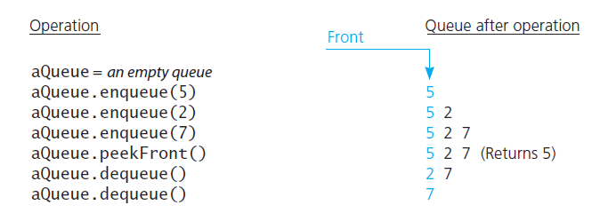
The ADT Queue
View interface for queues,
Listing 13-1
FIGURE 13-2 Some queue operations
.htm code listing files must be in the same folder as the .ppt files for these links to work
Data Structures and Problem Solving with C++: Walls and Mirrors, Frank Carrano, © 2012

Slide 6
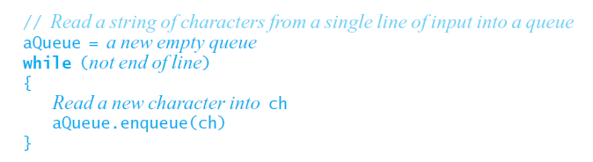
Simple Applications of the ADT Queue
Reading a string of characters
Data Structures and Problem Solving with C++: Walls and Mirrors, Frank Carrano, © 2012

Slide 7
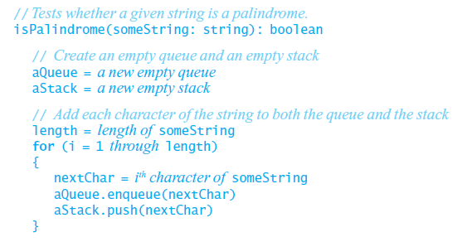
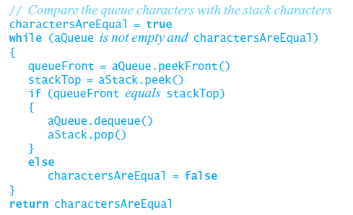
Simple Applications of the ADT Queue
Recognizing palindromes
Data Structures and Problem Solving with C++: Walls and Mirrors, Frank Carrano, © 2012

Slide 8
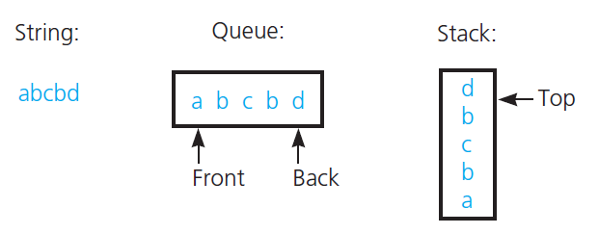
Recognizing Palindromes
FIGURE 13-3 The results of inserting the characters a, b, c, b, d into both a queue and a stack
Data Structures and Problem Solving with C++: Walls and Mirrors, Frank Carrano, © 2012

Slide 9
The ADT Priority Queue
Example : triage in a hospital emergency room
Operations
  Test whether priority queue empty.
  Add new entry to priority queue in sorted position based on priority value.
  Remove from priority queue entry with highest priority
  Get entry in priority queue with highest priority.
Data Structures and Problem Solving with C++: Walls and Mirrors, Frank Carrano, © 2012

Slide 10
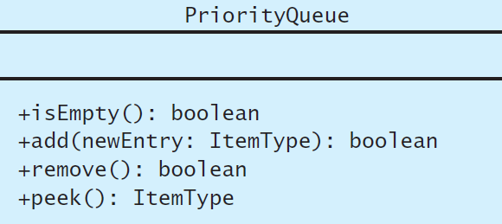
The ADT Priority Queue
FIGURE 13-4 UML diagram for the class PriorityQueue
Data Structures and Problem Solving with C++: Walls and Mirrors, Frank Carrano, © 2012

Slide 11
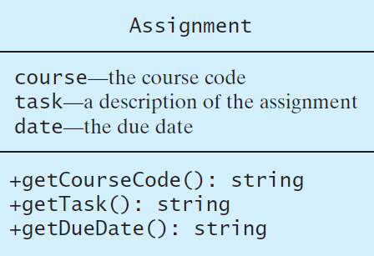
Tracking Your Assignments
FIGURE 13-5 UML diagram for the class Assignment
Data Structures and Problem Solving with C++: Walls and Mirrors, Frank Carrano, © 2012

Slide 12
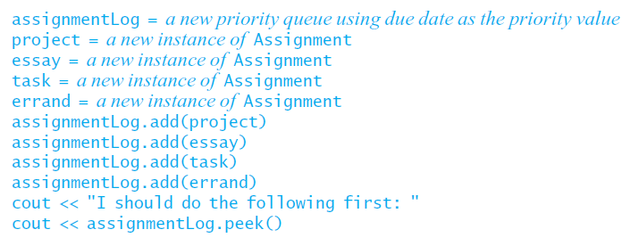
Tracking Your Assignments
Pseudocode for tracking assignments
Data Structures and Problem Solving with C++: Walls and Mirrors, Frank Carrano, © 2012

Slide 13
Application: Simulation
Simulation: technique for modeling behavior of natural and human-made systems.
Problem to simulate: model bank queue wait times
  Average time customer waits to begin service from current single teller
  Decrease in customer wait time with each new teller added
Data Structures and Problem Solving with C++: Walls and Mirrors, Frank Carrano, © 2012

Slide 14
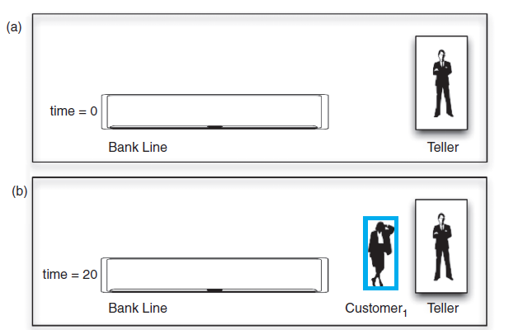
Application: Simulation
FIGURE 13-6 A bank line at time (a) 0; (b) 20;
Data Structures and Problem Solving with C++: Walls and Mirrors, Frank Carrano, © 2012

Slide 15
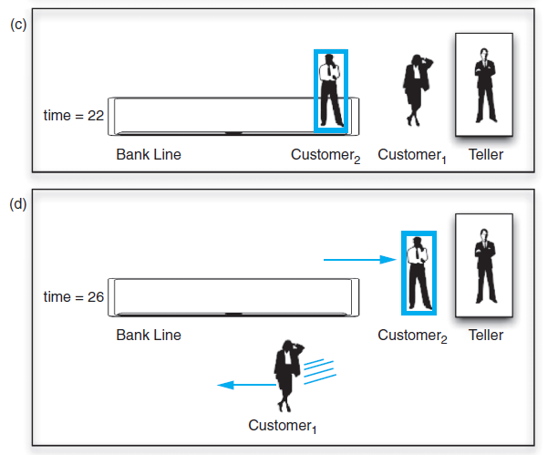
Application: Simulation
FIGURE 13-6 A bank line at time (c) 22; (d) 26
Data Structures and Problem Solving with C++: Walls and Mirrors, Frank Carrano, © 2012

Slide 16
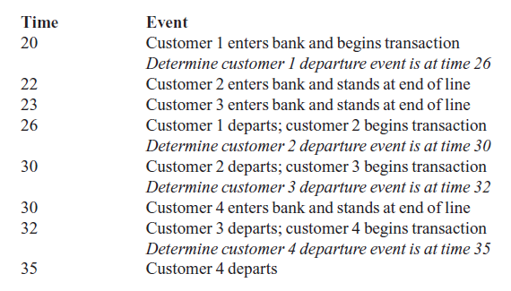
Application: Simulation
Results of a simulation:
Data Structures and Problem Solving with C++: Walls and Mirrors, Frank Carrano, © 2012

Slide 17
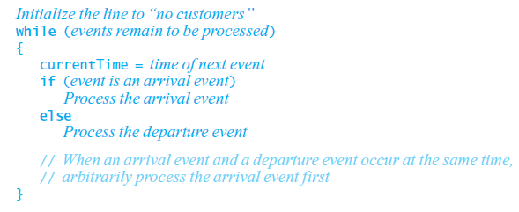
Application: Simulation
An event-driven simulation considers only times of certain events
  In this case, arrivals and departures
Algorithm
Data Structures and Problem Solving with C++: Walls and Mirrors, Frank Carrano, © 2012

Slide 18
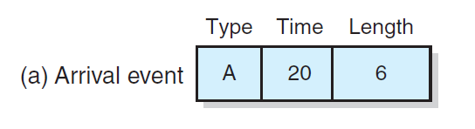
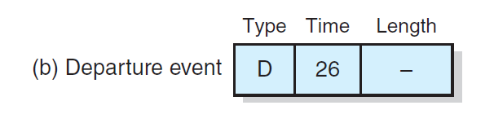
Application: Simulation
FIGURE 13-7 A typical instance of (a) an arrival event; (b) a departure event
Data Structures and Problem Solving with C++: Walls and Mirrors, Frank Carrano, © 2012

Slide 19
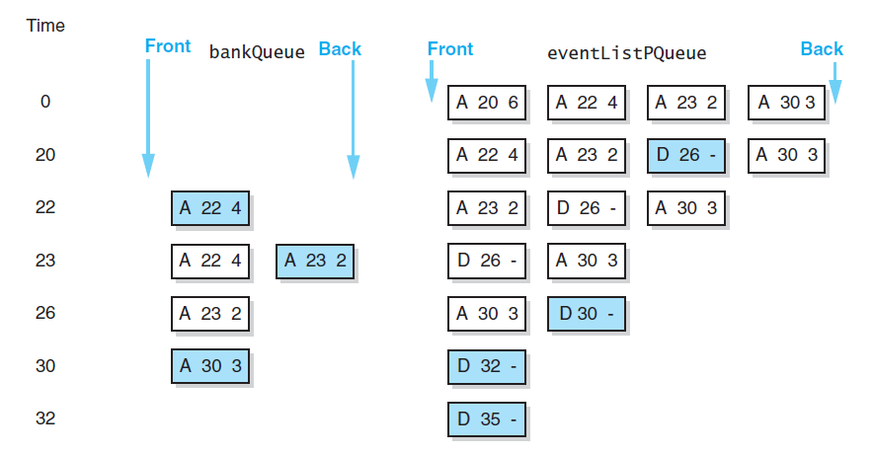

Application: Simulation
View final algorithm, Listing 13-A
FIGURE 13-8 A trace of the bank
simulation algorithm for the data
Data Structures and Problem Solving with C++: Walls and Mirrors, Frank Carrano, © 2012

Slide 20
Comparison of Stack and Queue Operations
Note same task of isEmpty functions
push and enqueue similar job
pop and dequeue similar tasks
Also peek and peekFront
Differences are whether function manipulates front or back of ADT
Data Structures and Problem Solving with C++: Walls and Mirrors, Frank Carrano, © 2012

Slide 21
ADT List Generalizes
Stack and Queue
List has getLength
insert replicates push and enqueue
remove replicates pop and dequeue
getEntry replicates peek and peekFront
Data Structures and Problem Solving with C++: Walls and Mirrors, Frank Carrano, © 2012

Slide 22
End
Chapter 13
Data Structures and Problem Solving with C++: Walls and Mirrors, Frank Carrano, © 2012

