Slide 1
Trees
Chapter 15
Data Structures and Problem Solving with C++: Walls and Mirrors, Frank Carrano, © 2012

Slide 2
Content
Terminology
The ADT Binary Tree
The ADT Binary Search Tree
Data Structures and Problem Solving with C++: Walls and Mirrors, Frank Carrano, © 2012

Slide 3
Terminology
Use trees to represent relationships
Trees are hierarchical in nature
  “Parent-child” relationship exists between nodes in tree.
  Generalized to ancestor and descendant
  Lines between the nodes are called edges
A subtree in a tree is any node in the tree together with all of its descendants
Data Structures and Problem Solving with C++: Walls and Mirrors, Frank Carrano, © 2012

Slide 4
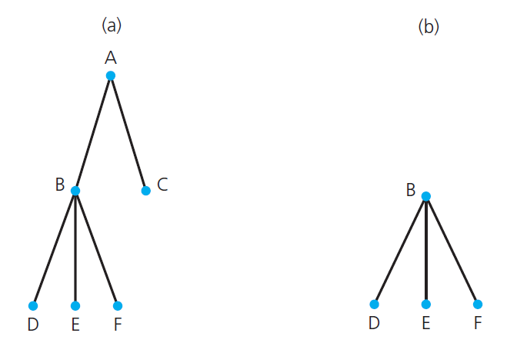
Terminology
FIGURE 15-1 (a) A tree;
(b) a subtree of the tree in part a
Data Structures and Problem Solving with C++: Walls and Mirrors, Frank Carrano, © 2012

Slide 5
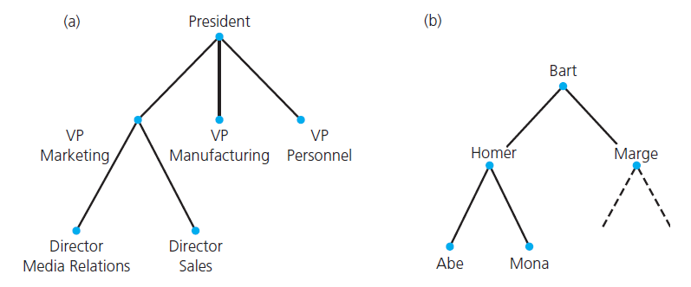
Terminology
FIGURE 15-2 (a) An organization chart; (b) a family tree
Data Structures and Problem Solving with C++: Walls and Mirrors, Frank Carrano, © 2012

Slide 6
Kinds of Trees
General Tree
  Set T of one or more nodes such that T is partitioned into disjoint subsets
  A single node r , the root
  Sets that are general trees, called subtrees of r
Data Structures and Problem Solving with C++: Walls and Mirrors, Frank Carrano, © 2012

Slide 7
Kinds of Trees
n -ary tree
  set T of nodes that is either empty or partitioned into disjoint subsets:
  A single node r , the root
  n possibly empty sets that are n -ary subtrees of r
Data Structures and Problem Solving with C++: Walls and Mirrors, Frank Carrano, © 2012

Slide 8
Kinds of Trees
Binary tree
  Set T of nodes that is either empty or partitioned into disjoint subsets
  Single node r , the root
  Two possibly empty sets that are binary trees, called left and right subtrees of r
Data Structures and Problem Solving with C++: Walls and Mirrors, Frank Carrano, © 2012

Slide 9
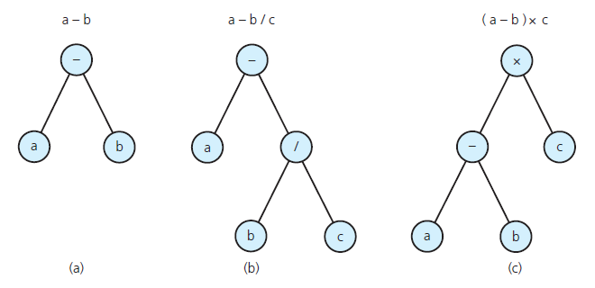
Example: Algebraic Expressions.
FIGURE 15-3 Binary trees that represent
algebraic expressions
Data Structures and Problem Solving with C++: Walls and Mirrors, Frank Carrano, © 2012

Slide 10
Binary Search Tree
For each node n, a binary search tree satisfies the following three properties:
  n ’s value is greater than all values in its left subtree T _{L} .
  n ’s value is less than all values in its right subtree T _{R} .
  Both T _{L} and T _{R} are binary search trees.
Data Structures and Problem Solving with C++: Walls and Mirrors, Frank Carrano, © 2012

Slide 11
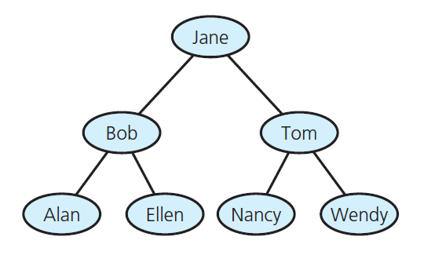
Binary Search Tree
FIGURE 15-4 A binary search tree of names
Data Structures and Problem Solving with C++: Walls and Mirrors, Frank Carrano, © 2012

Slide 12
The Height of Trees
Definition of the level of a node n :
  If n is the root of T , it is at level 1.
  If n is not the root of T , its level is 1 greater than the level of its parent.
Height of a tree T in terms of the levels of its nodes
  If T is empty, its height is 0.
  If T is not empty, its height is equal to the maximum level of its nodes.
Data Structures and Problem Solving with C++: Walls and Mirrors, Frank Carrano, © 2012

Slide 13
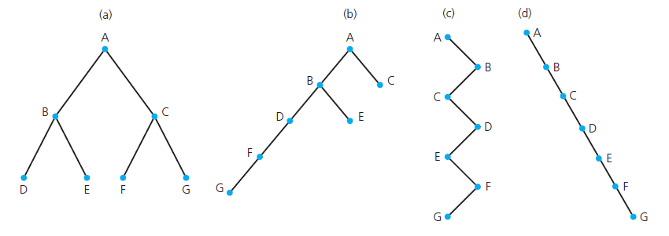
The Height of Trees
FIGURE 15-5 Binary trees with the same
nodes but different heights
Data Structures and Problem Solving with C++: Walls and Mirrors, Frank Carrano, © 2012

Slide 14
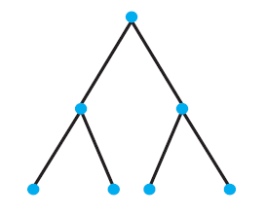
Full, Complete, and Balanced Binary Trees
FIGURE 15-6 A full binary tree of height 3
Data Structures and Problem Solving with C++: Walls and Mirrors, Frank Carrano, © 2012

Slide 15
Full, Complete, and Balanced Binary Trees
Definition of a full binary tree
  If T is empty, T is a full binary tree of height 0.
  If T is not empty and has height h > 0, T is a full binary tree if its root’s subtrees are both full binary trees of height h – 1.
Data Structures and Problem Solving with C++: Walls and Mirrors, Frank Carrano, © 2012

Slide 16
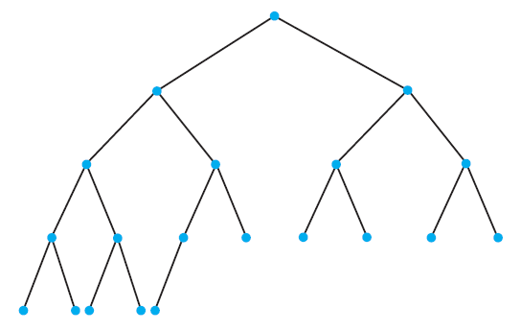
Full, Complete, and Balanced Binary Trees
FIGURE 15-7 A complete binary tree
Data Structures and Problem Solving with C++: Walls and Mirrors, Frank Carrano, © 2012

Slide 17
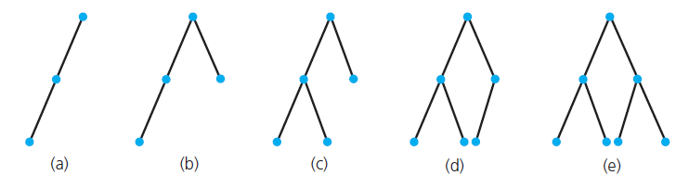
The Maximum and Minimum Heights of a Binary Tree
The maximum height of an n -node binary tree is n .
FIGURE 15-8 Binary trees of height 3
Data Structures and Problem Solving with C++: Walls and Mirrors, Frank Carrano, © 2012

Slide 18
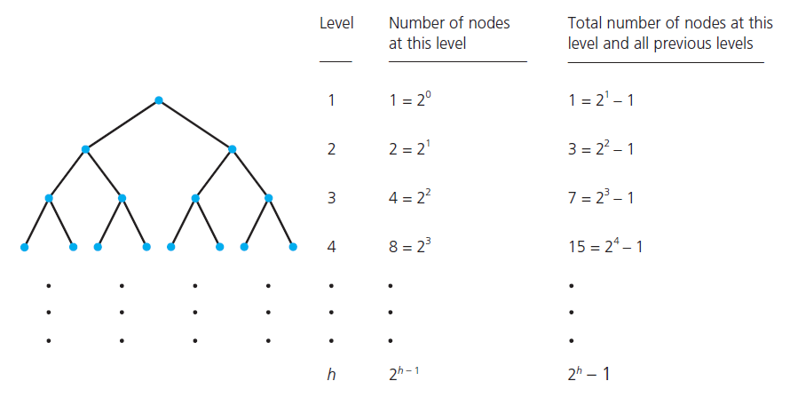
The Maximum and Minimum Heights of a Binary Tree
FIGURE 15-9 Counting the nodes in a
full binary tree of height h
Data Structures and Problem Solving with C++: Walls and Mirrors, Frank Carrano, © 2012

Slide 19
Facts about Full Binary Trees
A full binary tree of height h ≥ 0 has 2 ^{h} – 1 nodes.
You cannot add nodes to a full binary tree without increasing its height.
The maximum number of nodes that a binary tree of height h can have is 2 ^{h} – 1.
The minimum height of a binary tree with n nodes is [log ₂ ( n + 1)]
Data Structures and Problem Solving with C++: Walls and Mirrors, Frank Carrano, © 2012

Slide 20
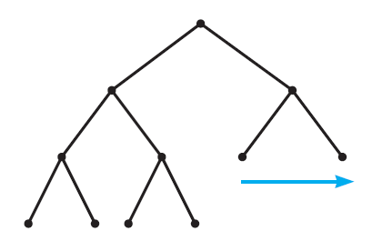
The Maximum and Minimum Heights of a Binary Tree
FIGURE 15-10 Filling in the last level of a tree
Data Structures and Problem Solving with C++: Walls and Mirrors, Frank Carrano, © 2012

Slide 21
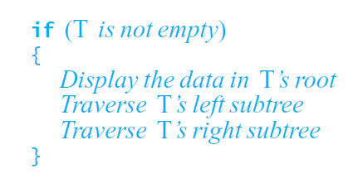
Traversals of a Binary Tree
General form of recursive transversal algorithm
Data Structures and Problem Solving with C++: Walls and Mirrors, Frank Carrano, © 2012

Slide 22
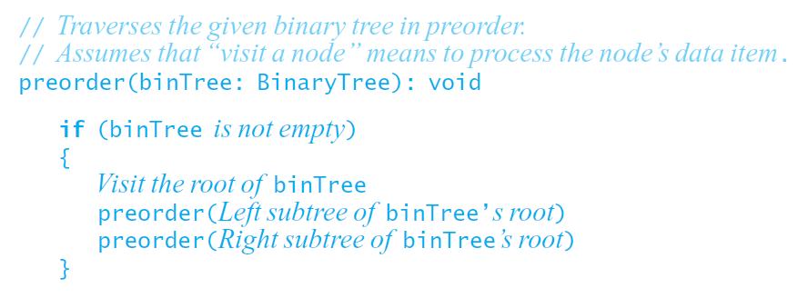
Traversals of a Binary Tree
Preorder traversal.
Data Structures and Problem Solving with C++: Walls and Mirrors, Frank Carrano, © 2012

Slide 23
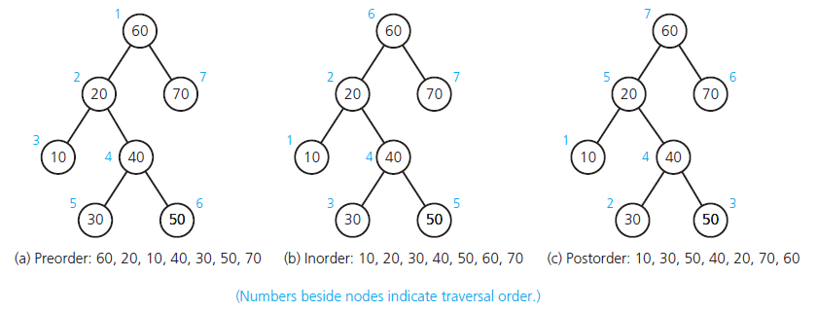
Traversals of a Binary Tree
FIGURE 15-11 Three traversals of a binary tree
Data Structures and Problem Solving with C++: Walls and Mirrors, Frank Carrano, © 2012

Slide 24
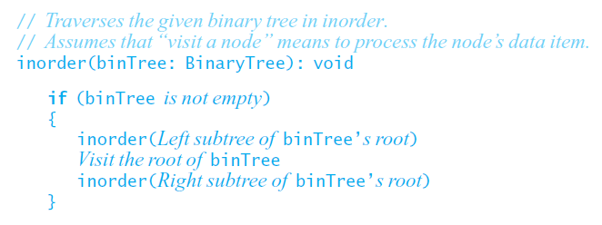
Traversals of a Binary Tree
Inorder traversal.
Data Structures and Problem Solving with C++: Walls and Mirrors, Frank Carrano, © 2012

Slide 25
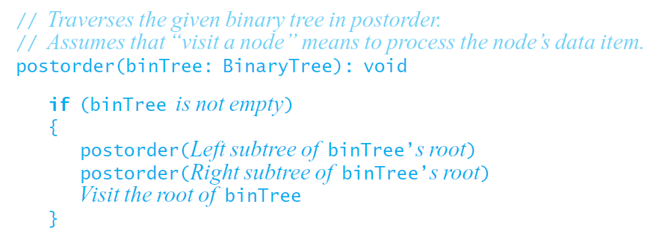
Traversals of a Binary Tree
Postorder traversal.
Data Structures and Problem Solving with C++: Walls and Mirrors, Frank Carrano, © 2012

Slide 26
Binary Tree Operations
Test whether a binary tree is empty.
Get the height of a binary tree.
Get the number of nodes in a binary tree.
Get the data in a binary tree’s root.
Set the data in a binary tree’s root.
Add a new node containing a given data item to a binary tree.
Data Structures and Problem Solving with C++: Walls and Mirrors, Frank Carrano, © 2012

Slide 27
Binary Tree Operations
Remove the node containing a given data item from a binary tree.
Remove all nodes from a binary tree.
Retrieve a specific entry in a binary tree.
Test whether a binary tree contains a specific entry.
Traverse the nodes in a binary tree in preorder, inorder, or postorder.
Data Structures and Problem Solving with C++: Walls and Mirrors, Frank Carrano, © 2012

Slide 28
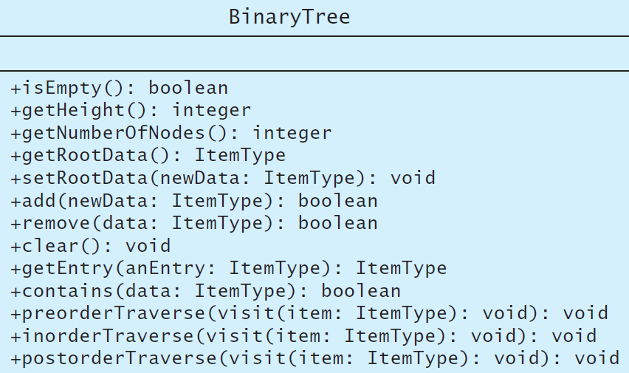
Binary Tree Operations
FIGURE 15-12 UML diagram for the class BinaryTree
Data Structures and Problem Solving with C++: Walls and Mirrors, Frank Carrano, © 2012

Slide 29
Binary Tree Operations
Formalized specifications demonstrated in interface template for binary tree
  Listing 15-1
Note method names matching UML diagram
  Figure 15-12
Data Structures and Problem Solving with C++: Walls and Mirrors, Frank Carrano, © 2012

Slide 30
The ADT Binary Search Tree
ADT binary tree ill suited for search for specific item
Binary search tree solves problem
Properties of each node, n
  n ’s value greater than all values in left subtree T_{L}
  n ’s value less than all values in right subtree T_{R}
  Both T_{R} and T_{L} are binary search trees.
Data Structures and Problem Solving with C++: Walls and Mirrors, Frank Carrano, © 2012

Slide 31
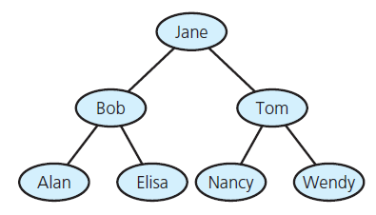
The ADT Binary Search Tree
FIGURE 15-13 A binary search tree of names
Data Structures and Problem Solving with C++: Walls and Mirrors, Frank Carrano, © 2012

Slide 32
End
Chapter 15
Data Structures and Problem Solving with C++: Walls and Mirrors, Frank Carrano, © 2012

