Slide 1
Designing An ADT
Notes:
This lecture builds on the foundation of the object oriented programming concepts of encapsulation and data abstraction and it develops the notion of an abstract data type.

Slide 2



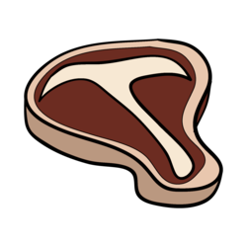




Abstract Data Type
Abstract Data Type (ADT)
Specification for a group of values and operations on those values
Data Structure
Implementation of an ADT within a programming language
Collection
Object that groups other objects together
Provides various services to clients
add
remove
query
??
Bag
Notes:
As you probably know, a data type such as integer or double is a group of values and operations on those values that is defined within a specific programming language. In contrast, an abstract data type, or ADT, is a specification for a group of values and the operations on those values that is defined conceptually and independently of any programming language.
@@ A data structure is an implementation of an ADT within a programming language.
@@ This lecture also begins to generalize the idea of grouping objects. A collection is an object that groups other objects and provides various services to its client. Various collections exist for different purposes and we specify the behaviors of collections abstractly.
So, a collection is an abstract data type. However, an ADT is not necessarily a collection.
@@ For an example of a collection and of an abstract data type, let's look at the Abstract Data Type bag.
@@ A typical collection enables a client perform several actions
@@ such as to adding items to the collection
@@ remove or retrieve items
@@ and query the objects it represents.

Slide 3



A Bag's Behaviors
Get the number of items currently in the bag
See whether the bag is empty
Add a given object to the bag
Remove an occurrence of a particular object from the bag, if possible
Remove all objects from the bag
(empty or clear the bag)
Count the number of times an object occurs in the bag
Test whether the bag contains a particular object
Look at all objects in the bag
√
??
??
Bag
Notes:
Let's look more closely at the specific behaviors our ADT Bag needs.
We need to check the bag's status so we need to Get the number of items currently in the bag, and See whether the bag is empty
@@ Add a given object to the bag
@@ If possible, Remove a particular object from the bag,
and Remove all objects from the bag such as when we want to empty or clear the bag
@@ Count the number of times an object occurs in the bag
@@ Test whether the bag contains a particular object
@@ and finally, Look at all objects in the bag

Slide 4
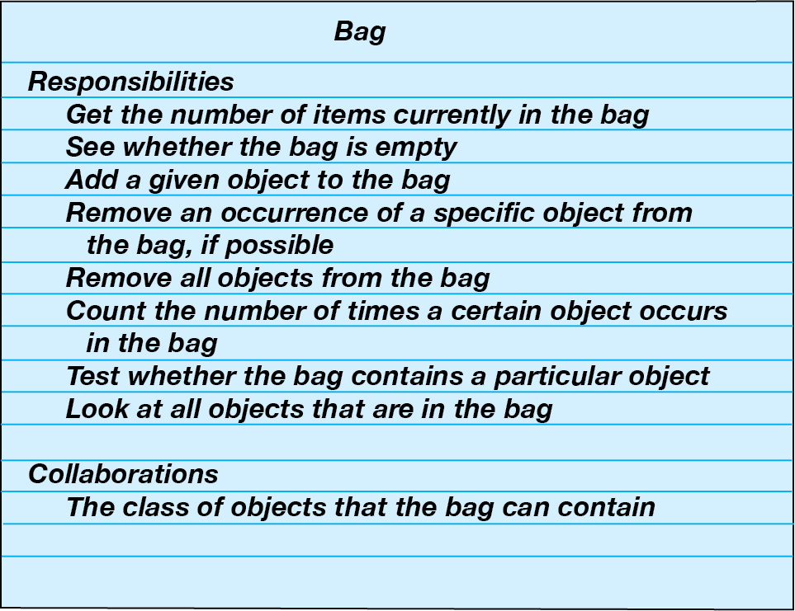
A Bag's Behaviors
Get the number of items currently in the bag
See whether the bag is empty
Add a given object to the bag
Remove an occurrence of a particular object from the bag, if possible
Remove all objects from the bag
(empty or clear the bag)
Count the number of times an object occurs in the bag
Test whether the bag contains a particular object
Look at all objects in the bag
CRC Card
Notes:
We can take these behaviors and write them on a class-responsibility-collaboration or CRC Card. Since a bag is an abstract data type, we only describe its data and specify its operations. We don't indicate how to store the data or how to implement its operations.
For example, don’t think about arrays. We first need to clearly understand what the bag operations do, not on how they do them.
That is, you need a detailed set of specifications before you can use a bag in a program. In fact, when we design ADT's, we should specify the ADT's operations before we even decide on a programming language.

Slide 5
A Bag's Behaviors
CRC Card
UML Notation
Bag
Understand what
the operations do
before thinking about
how to perform
the them.
+getCurrentSize(): integer
+isEmpty(): boolean
+add(someItem: T): boolean
+remove(someItem: T): boolean
+clear(): void
+getFrequencyOf(target: T): integer
+contains(target: T): boolean
+toVector(): vector<T>
Notes:
Before we can implement a bag in C++, we need to describe its data and specify in detail the methods that correspond to the bag’s behaviors.
We’ll name the methods, choose their parameters, decide their return types, and write comments to fully describe their effect on the bag’s data.
Our eventual goal, of course, is to write a Java header and comments for each method, but first we will express the methods in Unified Modeling Language or UML notation.
@@ As behaviors, our method names should begin with action verbs. For example, when finding the number of items currently in the bag, we GET the current size. This method returns the number of items so it should return an integer type. It doesn't need any parameters since it operates on the bag itself.
@@ Similarly, isEmpty, does not need parameters. This method is only checking the status of the Bag. As a predicate, or yes-no question it can return a boolean value.
@@ To add an entry to the Bag, we can call our method ADD. It needs a parameter of the type of object we are going to store in our bag — for now, we can use a generic 'T' to represent that type.
Here we have an interesting design issue, what should the add method do when it cannot add a new entry?
At this point, we have two options that we can take when add cannot complete its task:
First - Do nothing. We cannot add another item, so we ignore it and leave the bag unchanged.
Second - Leave the bag unchanged, but signal the client that the addition is impossible.
The first option is easy, but it leaves the client wondering what happened. The second option is the better one, and it is easy to specify and implement. Though displaying an error message is not a good choice, since a class should let the client manage all written output. Since adding an item is either successful or not, we can simply have the method return a boolean value.
Later we will examine using exceptions to notify the client.
@@ The remove method requires us to specify an object to be removed. If the Bag does not contain the item, we need to inform the client. Since the client already had to specify the item as a parameter, we can return a boolean to indicate whether or not the item was successfully removed.
@@ Removing all of the bag's contents can be a void method - We just want to empty the bag, not retrieve any of its contents.
@@ The next two methods report on a specific item and do not change the contents of the bag.
Then finally, we want to look at the contents of the bag. Rather than providing a method that displays the entries in the bag, let's define one that returns a vextor of these entries. The client is then free to display any or all of them in any way desired. This design decision makes our class more portable and independent of display methods - such as needing to determine if the application is console or GUI-based.

Slide 6
An Interface for the ADT Bag
BagInterface.h
#ifndef _BagInterface_h
#define _BagInterface_h
#include <vector>
template<class ItemType>
class BagInterface
{
public:
/** Gets the current number of entries in this bag.
@return the integer number of entries currently in the bag */
virtual int getCurrentSize() const = 0;
/** Sees whether this bag is empty.
@return true if the bag is empty, or false if not */
virtual bool isEmpty() const = 0;
/** Adds a new entry to this bag.
@post if successful, someItem in stored in bag and
count of items in the bag is increased by 1
@param someItem the object to be added as a new entry
@return true if addition is successful, or false if not */
virtual bool add(const ItemType& someItem) = 0;
UML Notation
Bag
+getCurrentSize(): integer
+isEmpty(): boolean
+add(someItem: T): boolean
+remove(someItem: T): boolean
+clear(): void
+getFrequencyOf(target: T): integer
+contains(target: T): boolean
+toVector(): vector<T>
Notes:
As your specifications become more detailed, they should increasingly reflect your choice of programming language. Ultimately, you can write C++ headers for the bag’s methods and organize them into a header file for the class that will implement the ADT.
@@ For now, the items in the bag will be objects of the same class. To accommodate entries of any single class type, the bag methods use a generic type ItemType for each entry. To give meaning to the identifier ItemType, we must write template<class ItemType> on the line before the class header. Once the actual data type is chosen by a client, the compiler will use that data type wherever ItemType appears.
The class BagInterface is a C++ abstract base class. An abstract base class, or simply an abstract class, in C++ contains at least one method that is declared as virtual and has no implementation. An abstract class cannot be instantiated; it can only be used as a base class. The subclass must then implement the methods specified but not defined in the abstract class.
@@ Here is a syntax example implementing the base class - BagInterface. The class Bag must provide an implementation of all the methods we are about to define in the base class BagInterface.
@@ When we are ready to instantiate or create a Bag object, we specify the type of the item we want to store in the Bag. In this example, we are storing String objects in our bag.
@@ Our methods that check the status of the bag are independent of the type of items stored in the bag.
@@ The add and remove methods use the generic type ItemType for the entry to add to or remove from the bag. Since we are not worried about implementation details yet, how these items are stored and removed is not important to us.
@@ And last we have the methods that check the status of a particular entry stored in the bag and the toVector method that returns a vector containing the entries in the bag.
Because this method returns a vector of the entries does not imply that the items are stored in a vector data member of the ADT Bag. How we store those items is an implementation detail and the topic of another lecture.

Slide 7
An Interface for the ADT Bag
BagInterface.h
/** Removes one occurrence of a given entry from this bag,
if possible.
@post if successful, target has been removed from the bag
and the count of items in the bag has decreased by 1
@param target the entry to be removed
@return true if removal was successful, or false if not */
virtual bool remove(const ItemType& target) = 0;
/** Removes all entries from this bag.
@post bag contains no items and the count of items is 0 */
virtual void clear() = 0;
/** Counts the number of times a given entry appears in bag.
@param target the entry to be counted
@return the number of times anEntry appears in the bag */
virtual int getFrequencyOf(const ItemType& target) const = 0;
/** Tests whether this bag contains a given entry.
@param target the entry to locate
@return true if bag contains target, or false otherwise */
virtual bool contains(const ItemType& target) const = 0;
/** Returns vector with copies of all entries in the bag.
@param bagContents a vector
@post bagContents contains copies of all entries in the bag */
virtual vector<ItemType> toVector() const = 0;
}; // end BagInterface
#endif
UML Notation
Bag
+getCurrentSize(): integer
+isEmpty(): boolean
+add(someItem: T): boolean
+remove(someItem: T): boolean
+clear(): void
+getFrequencyOf(target: T): integer
+contains(target: T): boolean
+toVector(): vector<T>
Notes:
As your specifications become more detailed, they should increasingly reflect your choice of programming language. Ultimately, you can write C++ headers for the bag’s methods and organize them into a header file for the class that will implement the ADT.
@@ For now, the items in the bag will be objects of the same class. To accommodate entries of any single class type, the bag methods use a generic type ItemType for each entry. To give meaning to the identifier ItemType, we must write template<class ItemType> on the line before the class header. Once the actual data type is chosen by a client, the compiler will use that data type wherever ItemType appears.
The class BagInterface is a C++ abstract base class. An abstract base class, or simply an abstract class, in C++ contains at least one method that is declared as virtual and has no implementation. An abstract class cannot be instantiated; it can only be used as a base class. The subclass must then implement the methods specified but not defined in the abstract class.
@@ Here is a syntax example implementing the base class - BagInterface. The class Bag must provide an implementation of all the methods we are about to define in the base class BagInterface.
@@ When we are ready to instantiate or create a Bag object, we specify the type of the item we want to store in the Bag. In this example, we are storing String objects in our bag.
@@ Our methods that check the status of the bag are independent of the type of items stored in the bag.
@@ The add and remove methods use the generic type ItemType for the entry to add to or remove from the bag. Since we are not worried about implementation details yet, how these items are stored and removed is not important to us.
@@ And last we have the methods that check the status of a particular entry stored in the bag and the toVector method that returns a vector containing the entries in the bag.
Because this method returns a vector of the entries does not imply that the items are stored in a vector data member of the ADT Bag. How we store those items is an implementation detail and the topic of another lecture.

Slide 8
Using Abstract Class BagInterface
Implementing the interface:
#include " BagInterface.h"
template<class ItemType>
class Bag : public BagInterface<ItemType>
{
// Implementation goes here
}
Instantiating an object of class Bag:
Bag<string> shoppingList;
Bag<string> shoppingList = Bag<string>();
BagInterface<string>* shoppingList = new Bag<string>();
Notes:
As your specifications become more detailed, they should increasingly reflect your choice of programming language. Ultimately, you can write C++ headers for the bag’s methods and organize them into a header file for the class that will implement the ADT.
@@ For now, the items in the bag will be objects of the same class. To accommodate entries of any single class type, the bag methods use a generic type ItemType for each entry. To give meaning to the identifier ItemType, we must write template<class ItemType> on the line before the class header. Once the actual data type is chosen by a client, the compiler will use that data type wherever ItemType appears.
The class BagInterface is a C++ abstract base class. An abstract base class, or simply an abstract class, in C++ contains at least one method that is declared as virtual and has no implementation. An abstract class cannot be instantiated; it can only be used as a base class. The subclass must then implement the methods specified but not defined in the abstract class.
@@ Here is a syntax example implementing the base class - BagInterface. The class Bag must provide an implementation of all the methods we are about to define in the base class BagInterface.
@@ When we are ready to instantiate or create a Bag object, we specify the type of the item we want to store in the Bag. In this example, we are storing String objects in our bag.
@@ Our methods that check the status of the bag are independent of the type of items stored in the bag.
@@ The add and remove methods use the generic type ItemType for the entry to add to or remove from the bag. Since we are not worried about implementation details yet, how these items are stored and removed is not important to us.
@@ And last we have the methods that check the status of a particular entry stored in the bag and the toVector method that returns a vector containing the entries in the bag.
Because this method returns a vector of the entries does not imply that the items are stored in a vector data member of the ADT Bag. How we store those items is an implementation detail and the topic of another lecture.

Slide 9
The ADT Bag Interface
Notes:
This lecture builds on the foundation of the object oriented programming concepts of encapsulation and data abstraction and it develops the notion of an abstract data type.

Slide 10
A Bag's Behaviors
CRC Card
UML Notation
Bag
+getCurrentSize(): integer
+isEmpty(): boolean
+add(someItem: T): boolean
+remove(someItem: T): boolean
+clear(): void
+getFrequencyOf(target: T): integer
+contains(target: T): boolean
+toVector(): vector<T>
Notes:
Before we can implement a bag in C++, we need to describe its data and specify in detail the methods that correspond to the bag’s behaviors.
We’ll name the methods, choose their parameters, decide their return types, and write comments to fully describe their effect on the bag’s data.
Our eventual goal, of course, is to write a Java header and comments for each method, but first we will express the methods in Unified Modeling Language or UML notation.
@@ As behaviors, our method names should begin with action verbs. For example, when finding the number of items currently in the bag, we GET the current size. This method returns the number of items so it should return an integer type. It doesn't need any parameters since it operates on the bag itself.
@@ Similarly, isEmpty, does not need parameters. This method is only checking the status of the Bag. As a predicate, or yes-no question it can return a boolean value.
@@ To add an entry to the Bag, we can call our method ADD. It needs a parameter of the type of object we are going to store in our bag — for now, we can use a generic 'T' to represent that type.
Here we have an interesting design issue, what should the add method do when it cannot add a new entry?
At this point, we have two options that we can take when add cannot complete its task:
First - Do nothing. We cannot add another item, so we ignore it and leave the bag unchanged.
Second - Leave the bag unchanged, but signal the client that the addition is impossible.
The first option is easy, but it leaves the client wondering what happened. The second option is the better one, and it is easy to specify and implement. Though displaying an error message is not a good choice, since a class should let the client manage all written output. Since adding an item is either successful or not, we can simply have the method return a boolean value.
Later we will examine using exceptions to notify the client.
@@ The remove method requires us to specify an object to be removed. If the Bag does not contain the item, we need to inform the client. Since the client already had to specify the item as a parameter, we can return a boolean to indicate whether or not the item was successfully removed.
@@ Removing all of the bag's contents can be a void method - We just want to empty the bag, not retrieve any of its contents.
@@ The next two methods report on a specific item and do not change the contents of the bag.
Then finally, we want to look at the contents of the bag. Rather than providing a method that displays the entries in the bag, let's define one that returns a vextor of these entries. The client is then free to display any or all of them in any way desired. This design decision makes our class more portable and independent of display methods - such as needing to determine if the application is console or GUI-based.

Slide 11
An Interface for the ADT Bag
BagInterface.h
#ifndef _BagInterface_h
#define _BagInterface_h
#include <vector>
template<class ItemType>
class BagInterface
{
public:
/** Gets the current number of entries in this bag.
@return the integer number of entries currently in the bag */
virtual int getCurrentSize() const = 0;
/** Sees whether this bag is empty.
@return true if the bag is empty, or false if not */
virtual bool isEmpty() const = 0;
/** Adds a new entry to this bag.
@post if successful, someItem in stored in bag and
count of items in the bag is increased by 1
@param someItem the object to be added as a new entry
@return true if addition is successful, or false if not */
virtual bool add(const ItemType& someItem) = 0;
/** Removes one occurrence of a given entry from this bag,
if possible.
@post if successful, target has been removed from the bag
and the count of items in the bag has decreased by 1
@param target the entry to be removed
@return true if removal was successful, or false if not */
virtual bool remove(const ItemType& target) = 0;
UML Notation
Bag
+getCurrentSize(): integer
+isEmpty(): boolean
+add(someItem: T): boolean
+remove(someItem: T): boolean
+clear(): void
+getFrequencyOf(target: T): integer
+contains(target: T): boolean
+toVector(): vector<T>
Notes:
As your specifications become more detailed, they should increasingly reflect your choice of programming language. Ultimately, you can write C++ headers for the bag’s methods and organize them into a header file for the class that will implement the ADT.
@@ For now, the items in the bag will be objects of the same class. To accommodate entries of any single class type, the bag methods use a generic type ItemType for each entry. To give meaning to the identifier ItemType, we must write template<class ItemType> on the line before the class header. Once the actual data type is chosen by a client, the compiler will use that data type wherever ItemType appears.
The class BagInterface is a C++ abstract base class. An abstract base class, or simply an abstract class, in C++ contains at least one method that is declared as virtual and has no implementation. An abstract class cannot be instantiated; it can only be used as a base class. The subclass must then implement the methods specified but not defined in the abstract class.
@@ Here is a syntax example implementing the base class - BagInterface. The class Bag must provide an implementation of all the methods we are about to define in the base class BagInterface.
@@ When we are ready to instantiate or create a Bag object, we specify the type of the item we want to store in the Bag. In this example, we are storing String objects in our bag.
@@ Our methods that check the status of the bag are independent of the type of items stored in the bag.
@@ The add and remove methods use the generic type ItemType for the entry to add to or remove from the bag. Since we are not worried about implementation details yet, how these items are stored and removed is not important to us.
@@ And last we have the methods that check the status of a particular entry stored in the bag and the toVector method that returns a vector containing the entries in the bag.
Because this method returns a vector of the entries does not imply that the items are stored in a vector data member of the ADT Bag. How we store those items is an implementation detail and the topic of another lecture.

Slide 12
An Interface for the ADT Bag
BagInterface.h
/** Removes all entries from this bag.
@post bag contains no items and the count of items is 0 */
virtual void clear() = 0;
/** Counts the number of times a given entry appears in bag.
@param target the entry to be counted
@return the number of times anEntry appears in the bag */
virtual int getFrequencyOf(const ItemType& target) const = 0;
/** Tests whether this bag contains a given entry.
@param target the entry to locate
@return true if bag contains target, or false otherwise */
virtual bool contains(const ItemType& target) const = 0;
/** Returns vector with copies of all entries in the bag.
@param bagContents a vector
@post bagContents contains copies of all entries in the bag */
virtual vector<ItemType> toVector() const = 0;
}; // end BagInterface
#endif
UML Notation
Bag
+getCurrentSize(): integer
+isEmpty(): boolean
+add(someItem: T): boolean
+remove(someItem: T): boolean
+clear(): void
+getFrequencyOf(target: T): integer
+contains(target: T): boolean
+toVector(): vector<T>
Notes:
As your specifications become more detailed, they should increasingly reflect your choice of programming language. Ultimately, you can write C++ headers for the bag’s methods and organize them into a header file for the class that will implement the ADT.
@@ For now, the items in the bag will be objects of the same class. To accommodate entries of any single class type, the bag methods use a generic type ItemType for each entry. To give meaning to the identifier ItemType, we must write template<class ItemType> on the line before the class header. Once the actual data type is chosen by a client, the compiler will use that data type wherever ItemType appears.
The class BagInterface is a C++ abstract base class. An abstract base class, or simply an abstract class, in C++ contains at least one method that is declared as virtual and has no implementation. An abstract class cannot be instantiated; it can only be used as a base class. The subclass must then implement the methods specified but not defined in the abstract class.
@@ Here is a syntax example implementing the base class - BagInterface. The class Bag must provide an implementation of all the methods we are about to define in the base class BagInterface.
@@ When we are ready to instantiate or create a Bag object, we specify the type of the item we want to store in the Bag. In this example, we are storing String objects in our bag.
@@ Our methods that check the status of the bag are independent of the type of items stored in the bag.
@@ The add and remove methods use the generic type ItemType for the entry to add to or remove from the bag. Since we are not worried about implementation details yet, how these items are stored and removed is not important to us.
@@ And last we have the methods that check the status of a particular entry stored in the bag and the toVector method that returns a vector containing the entries in the bag.
Because this method returns a vector of the entries does not imply that the items are stored in a vector data member of the ADT Bag. How we store those items is an implementation detail and the topic of another lecture.

Slide 13
Using Abstract Class BagInterface
Implementing the interface:
#include " BagInterface.h"
template<class ItemType>
class Bag : public BagInterface<ItemType>
{
// Implementation goes here
}
Instantiating an object of class Bag:
Bag<string> shoppingList;
Bag<string> shoppingList = Bag<string>();
BagInterface<string>* shoppingList = new Bag<string>();
Notes:
As your specifications become more detailed, they should increasingly reflect your choice of programming language. Ultimately, you can write C++ headers for the bag’s methods and organize them into a header file for the class that will implement the ADT.
@@ For now, the items in the bag will be objects of the same class. To accommodate entries of any single class type, the bag methods use a generic type ItemType for each entry. To give meaning to the identifier ItemType, we must write template<class ItemType> on the line before the class header. Once the actual data type is chosen by a client, the compiler will use that data type wherever ItemType appears.
The class BagInterface is a C++ abstract base class. An abstract base class, or simply an abstract class, in C++ contains at least one method that is declared as virtual and has no implementation. An abstract class cannot be instantiated; it can only be used as a base class. The subclass must then implement the methods specified but not defined in the abstract class.
@@ Here is a syntax example implementing the base class - BagInterface. The class Bag must provide an implementation of all the methods we are about to define in the base class BagInterface.
@@ When we are ready to instantiate or create a Bag object, we specify the type of the item we want to store in the Bag. In this example, we are storing String objects in our bag.
@@ Our methods that check the status of the bag are independent of the type of items stored in the bag.
@@ The add and remove methods use the generic type ItemType for the entry to add to or remove from the bag. Since we are not worried about implementation details yet, how these items are stored and removed is not important to us.
@@ And last we have the methods that check the status of a particular entry stored in the bag and the toVector method that returns a vector containing the entries in the bag.
Because this method returns a vector of the entries does not imply that the items are stored in a vector data member of the ADT Bag. How we store those items is an implementation detail and the topic of another lecture.

