Slide 1
Introducing Recursion
Notes:
This lecture presents some of the basic concepts of recursion.

Slide 2
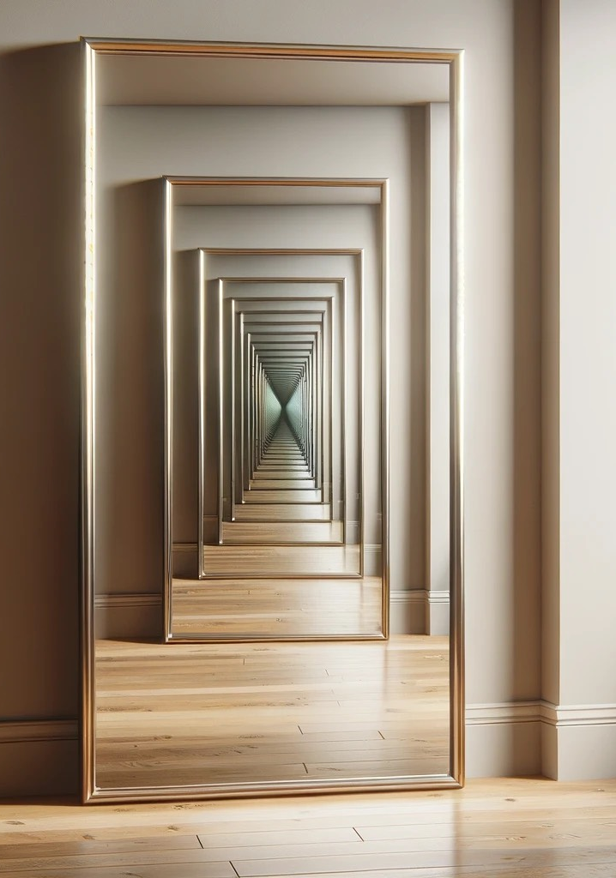

Recursion
Powerful Problem-Solving Technique
Breaks a problem into smaller, identical problems
Break each of these smaller problems into even smaller, identical problems
Eventually arrive at a stopping case
The Base Case
Problem cannot be broken down any farther
Notes:
Recursion is a very powerful problem solving technique.
It breaks a problem into smaller problems and continues breaking each smaller problem into smaller and smaller identical problems
@@until ....
you arrive at a stopping case where you cannot break the problem down any further.
This stopping case is often referred to as the base case.

Slide 3
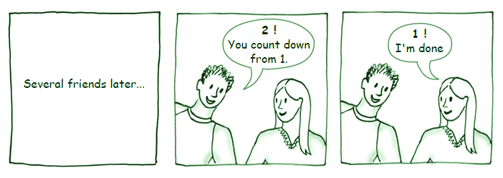
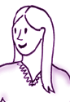
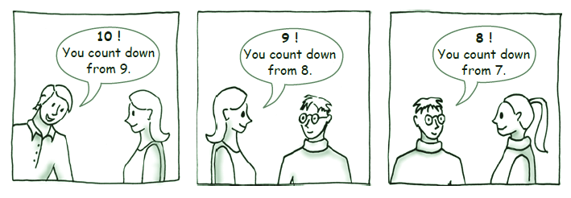
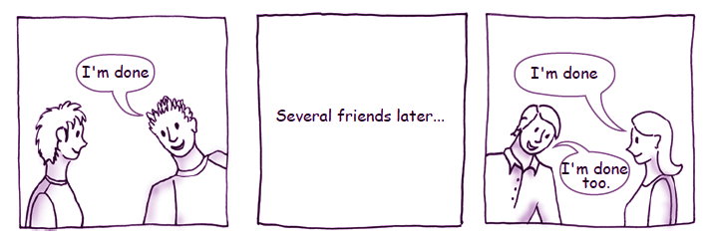
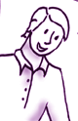
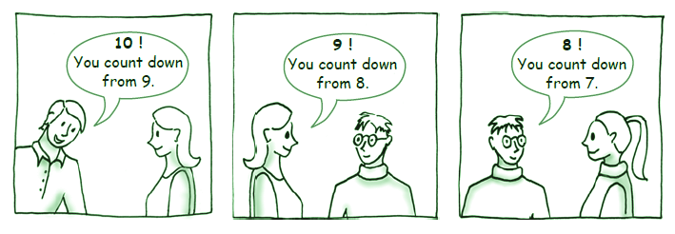
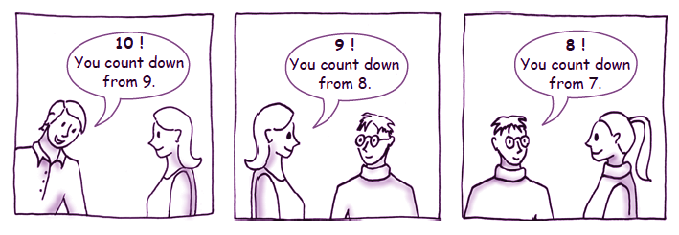
Counting Recursively
Counting Down to Zero from a Number
Say the number
Ask a friend to count down from the number minus one
When someone says zero, stop.
6
You count down from 5.
5
You count down from 4.
1
You count down from 0.
4
You count
down from 3.
3
You count down from 2.
2
You count down from 1.
0 !
Notes:
Let’s look at how we would us a recursive technique to count from any number down to zero
@@ We would say the number,
@@ and then ask a friend to count down from that number minus one.
That would be the recursion - we would ask a friend to perform the same task, but start from a smaller number.
@@ When someone finally gets to zero, we’d stop.
@@ (does count down)

Slide 4
Characteristics of Recursion
A Recursive Function
Is a function that calls itself and asks:
What part of the solution can you contribute directly?
What smaller but identical problem has a solution that, when taken with your contribution, provides the solution to the original problem?
When does the process end?
What smaller but identical problem has a known solution (the base case)?
How will you know when you have reached the base case?
void countDown(int number)
{
if (number == 0)
std::cout << number << std::endl;
else
{
std::cout << number << std::endl;
countDown(number - 1);
} // end if
} // end countDown
Notes:
Let’s look at a more formal definition of a recursive function.
This recursive function “countDown” will display a sequence of number beginning with the number passed as an initial argument down to zero.
First, a recursive function calls itself - we can see that countDown calls itself here.
@@ A recursive function asks - what part of the solution can I contribute directly? Countdown can print the number that was sent as its argument.
@@Then we ask - what smaller problem that is identical to the original task can we try to solve that when taken with the contribution I can make, will solve the original problem?
In this function, after we print our number, we only need to printout the numbers that follow it. (those beginning at “number - 1”)
@@ When does this process end - when the number we need to display is zero. AT that point, we only need to print the number - and not count down any further.
This is called the base case.
@@ How do we know we reached the base case? If the number we were asked to count down from is zero - we have reached our smallest problem that cannot be broken down any more.

Slide 5
Mechanics of Recursion
Recursive functions . . .
Must be given an input value to start
Either as an argument or input from the user
Function logic must involve this value and use it to obtain different (smaller) cases
Often an if or switch statement is used
One of these cases must not require recursion to solve. These are the base cases.
One or more of these cases must include a recursive invocation of the function.
Each of these cases must be smaller versions of the problem that converge on the base case.
void countDown(int number)
{
if (number == 0)
std::cout << number << std::endl;
else
{
std::cout << number << std::endl;
countDown(number - 1);
} // end if
} // end countDown
Notes:
Recursive functions must be given an input value to start. If it is not given an input value as a parameter to start the recursive process, it must ask the user for some value.
@@ The logic inside the recursive function must use this value in some way to create the smaller recursive problems and to determine when the base case has been reached. Often, we use a switch or if statement to test for the base case.
@@ One of the cases, must not require recursion - this is the base case. We can have more than one base case.
@@ one or more of the cases must have a recursive invocation of the function. Here is our countDown function, we have two cases.
We have the recursive case where we print out the argument and then countdown from the argument minus one and we have our base case when number is zero and we only print the number and do not make the recursive call.
@@ Each of the recursive cases must be a smaller version of the original problem and eventually converge on the base case.
If we start out with a positive number and continually subtract one from the argument with each recursive call, eventually the argument passed to the recursive function will be zero, triggering our base case. We can show this through inductive reasoning.

Slide 6

Tracing Recursion
Each recursive call assigns new values to the parameters and local variables.
void countDown(int number)
{
if (number == 0)
std::cout << number << std::endl;
else
{
std::cout << number << std::endl;
countDown(number - 1);
} // end if
} // end countDown
countdown(5)
number is assigned 5
Display 5
Call countdown(4)
countdown(4)
number is assigned 4
Display 4
Call countdown(3)
Application
Stack
or
Call Stack
countdown(3)
number is assigned 3
Display 3
Call countdown(2)
countdown(2)
number is assigned 2
Display 2
Call countdown(1)
countdown(1)
number is assigned 1
Display 1
Call countdown(0)
countdown(0)
number is assigned 0
Display 0
Activation Record
Notes:
Sometimes it’s better to trace a recursive function so that it is easier to understand what is happening.
Each time a recursive function calls itself, new values are assigned to the parameters and local variables.
@@ For example, the first time we call the function countDown, we pass it the value 6, the parameter Number is assigned six and it displays the numeral six. Then we’ll call countDown, passing it the argument 5.
@@ the parameter Number is assigned five and it displays the numeral five. Then we’ll call countDown, passing it the argument 4.
@@ in that call, Number is assigned four and the numeral four is displayed. then countDown, is passed the argument three.
@@ and we continue until we get to where we call countDown with the argument one. in that call, Number is assigned one and the numeral one is displayed. then countDown is passed the argument zero.
@@ At this point we’ve reached our base case. The parameter number is assignment zero, the function displays zero, but because this is the base case, we follow the “then” clause of the if-statement and so there is no recursive call and the sequence ends
@@ Each time our function is called, C++ creates an activation record to store the parameter values and the local variables so that it can keep track of which call it is working on. -- Each call has a separate activation record.
@@ All of these activation records are stored in your application’s memory in a structure called the application stack, or call stack. The all stack is implemented similar to the ADT Stack that was presented in earlier lectures.
The activation record for the most recent call to the recursive function is on the top of the stack. And activation record for the first call - the one that began the recursion - is closer to the bottom of the stack.

Slide 7
Recursion and Iteration
Recursive Solutions
Usually involve branching
if and switch statements
Deciding whether or not it has the base case
May involve a loop in addition to branching
Iterative Solutions
Involve loops
while, for and do-while statements
void countDown(int number)
{
if (number == 0)
std::cout << number << std::endl;
else
{
std::cout << number << std::endl;
countDown(number - 1);
} // end if
} // end countDown
Recursive Solution
void countDown(int number)
{
while (number >= 0)
std::cout << number << std::endl;
number = number - 1);
} // end while
} // end countDown
Iterative Solution
Notes:
Recursive solutions must involve some type of branch since a decision always needs to be made as to whether or not we have arrived at the base case and do not need to continue the recursive calls. So recursive functions usually have an if or switch statement.
Occasionally, a recursive solution may include a loop, but this is in addition to the primary decision logic concerning the base case and is usually part of the solution that the recursive call is contributing.
So even if there is a loop in your recursive function, you must also still include an if or switch statement in order to decide on the base case.
@@ Iterative solutions to problems always include a while, for or do/while loop.
It is important when you are implementing a recursive solution to remember that you need an an if or switch statement.
and Iterative solutions will include a while, for or do/while loop.

Slide 8
Returning a Value from Recursion
Recursive Functions that Return a Value
Compute the product of the first n positive integers
Designing our Function
Rewrite productOf in terms of itself
Make the problem smaller each time
What is the base case?
A problem that we know the answer
Function should have a parameter
The number to be processed
int productOf(int n)
{
int product = 0;
if (n == 1)
product = 1;
else
product = n * productOf(n - 1);
return product;
} // end productOf
productOf(n) = n * (n-1) * ... * 3 * 2 * 1
for any integer n > 0
productOf(n) = n * productOf(n-1)
productOf(1) = 1
Notes:
Some recursive functions return a value. For example, if we want to compute the product of the first N positive integers, we need to return a value that represents the product of those integers. Here is a formula we can use tom compute the when passed N as an argument. We write it as n times n minus 1 time n minus 2 and so on down to 3 times 2 times 1. This formula works for any integer N greater than zero.
@@ In designing our recursive solution to this problem, we want to rewrite the formula for ProductOf in terms of itself. It turns out that the product of N is equal to the result of n times the ProductOf n - 1. We can reduce the argument by one for each recursive call.
@@ What would be our base case or the problem we know the answer of?
@@ This formula is valid for any N greater than zero.
@@ So, the last integer we could process is ONE. If N is one - the ProductOF 1 is 1. So our function can return one if the argument passed is one. and that can server as our base case
@@ Our function should take a parameter or accept user input.
@@ in this case, we’ll use a parameter
@@ we’ll send the parameter N to the productOF function.
@@ inside the productOF function, we’ll create an integer variable to store the product that we will return to our user.
@@ We’ll set up our base case for when N is equal to 1, the value of product is ONE so that’s what we’ll return.
@@ else the value of product is N times the result of calling productOF with N minus one as an argument - thereby reducing the size of the problem. We set the value of product to be the value of our parameter times the result of our recursive call.
@@ then we’ll return the value of product to our client.

Slide 9
Returning a Value from Recursion
Tracing the Function
int productOf(int n)
{
int product = 0;
if (n == 1)
product = 1;
else
product = n * productOf(n - 1);
return product;
} // end productOf
int result = productOf(5)
productOf(5)
5 * productOf(4)
5 * 24
productOf(4)
4 * productOf(3)
120
4 * 6
productOf(3)
3 * productOf(2)
24
6
productOf(2)
2 * productOf(1)
3 * 2
productOf(1)
return 1
2 * 1
2
1
Notes:
Let’s trace this function for a call where the argument passed is five.
@@ Our first call takes the argument 5 and computes 5 times the PRODUCTOF(five minus one - or four)
@@ to compute the “ProductOF four - we find the result of four times PRODUCTOF (3)
@@ to compute the “ProductOF 3 - we take of 3 times PRODUCTOF (2)
@@ to compute the “ProductOF 2 - we take of 2 times PRODUCTOF (1)
@@ when one is passed as an argument, we have our base case so we return a value of one to our caller.
The function that called us was “PRODUCTOF 2”
@@ The one returned to the caller is substituted into the formula for PRODUCTOF one. And we compute 2 time one.
@@ We return the value of 2 to the caller of this activation - which was the call PRODUCTOF 3. We substitute the 2 in for the value of PRODUCTOF (2) and compute 3 times 2.
@@ the value of six is then returned to the caller of this activation - the call productOF Four. We again do the substitution and then compute the result of four times six.
@@ The value of 24 is then passed to previous call of PRODUcTOF and used to compute 5 time 24 which gives a value of 120.
@@ This final value is then returned to the client that initiated the original call. by passing the argument of five to the function ProductOF. The the client then stores the final value is in the variable result.

Slide 10
Simplifying Recursion
Simplifying the Functions
Intermediate products do not need to be stored
Can use multiple return statements
Only one return will be executed
int productOf(int n)
{
int product = 0;
if (n == 1)
product = 1;
else
product = n * productOf(n - 1);
return product;
} // end productOf
int productOf(int n)
{
if (n == 1)
return 1;
else
return n * productOf(n - 1);
} // end productOf
Notes:
Let’s look at some ways we can simplify recursive functions.
One simplification that can also help to clarify the operation of the recursive function is to NOT store intermediate values, such as product.
@@ We can directly return the value of from our base case or the value of N times the productOF N minus 1.
This is a question of style, some programmers like to have a single return statement in their function no matter what the purpose of the function may be. For those programmers, it is easier to store intermediate results and then return a final value as the last statement in the function. Generally, it is a good programming practice to only have a single return statement in a function.
Others, when writing recursive functions, feel that having the return in the base case or in the recursive branch better explains the flow of the recursion making the recursion easier to follow.
With either style, each time the function is called, only ONE of the returns will ever be executed.

Slide 11
Simplifying Recursion
Explicit Base Case
A distinct option exists to handle the base case
Implicit Base Case
A clear base case is not listed
Base Case is a "Do Nothing" option
void countDown(int number)
{
if (number == 0)
std::cout << number << std::endl;
else
{
std::cout << number << std::endl;
countDown(number - 1);
} // end if
} // end countDown
Explicit
Base Case
public static void countDown(int number)
{
if (number >= 0)
{
std::cout << number << std::endl;
countDown(number - 1);
}
else
{
// Do Nothing
}
} // end countDown
void countDown(int number)
{
if (number >= 0)
{
std::cout << number << std::endl;
countDown(number - 1);
} // end if
} // end countDown
Implicit
Base Case
Notes:
In our examples so far, we’ve had EXPLICIT base cases. These base cases have been written following their if-statement or base case test so determine if the base case should be executed.
@@ It is also possible to have an IMPLICIT base case. THis happens when a base case is not written clearly or does nothing.
For example, we could rewrite our countdown function so that anytime Number is greater than or equal to zero, we display the number and perform a recursive call with Number minus one.
When Number is zero - we again perform a recursive call passing Number minus one -which is negative one, as an argument.
when countdown recieves -1 one as it’s argument , the test Number greater than or equal to zero is now false and do not execute our recursive call.
@@ It is almost as if we had a base case where we do nothing - as in this example here. But because we have an else clause with no action or statement, we do not need to write it.

Slide 12
Recursively Processing Arrays
Notes:
In this lecture, we’ll look at recursively processing arrays and solving the towers of hanoi problem

Slide 13
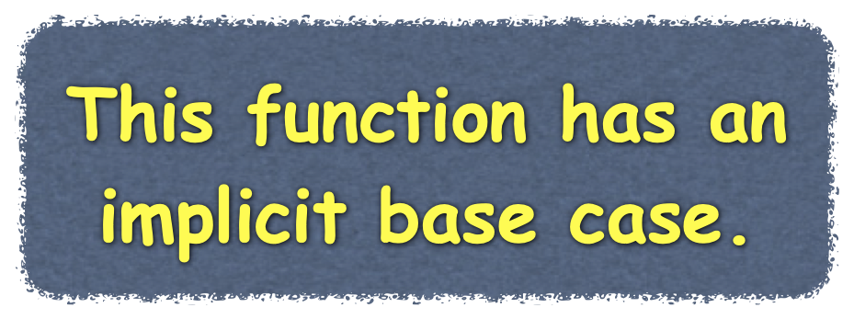


Recursive Processing - Arrays
Recursively displaying elements stored in an array
Start with first element
void displayArray(int myArray[], int first, int last)
{
std::cout << myArray[first] << " ";
if (first < last)
displayArray(myArray, first + 1, last);
} // end displayArray
// Start with myArray[first]
first
5
34
16
91
76
23
54
67
19
4
0
1
2
6
3
7
last
7
34
16
91
76
23
54
67
19
0
1
2
3
4
5
6
7
Notes:
Suppose that we have an array of integers and we want a function that displays it.
@@ So that we can display all or part of the array, the function will display the integers in the array elements whose indices range from first through last. We can declare the function like this…
This task is simple and could readily be implemented using iteration. You might not imagine, however, that we could also implement it recursively in a variety of ways. But we can and will.
@@ An iterative solution would certainly start at the first element, array[first], so it’s natural to have our first recursive function begin there also. If I ask you to display the array, you could display array[first] and then ask a friend to display the rest of the array. Displaying the rest of the array is a smaller problem than displaying the entire array.
@@ You wouldn’t have to ask a friend for help if you had to display only one element—that is, if first and last were equal. This is the base case. Thus, we could write the function displayArray as you see here and print elements until first and last are equal.
Our first call to displayArray will ask the function to print the entire array, so first is 0 and last is 7.
@@ We display the first element and then make our recursive call. For the recursive call, we ask our function to print the array starting at the second element.
@@ This is the smaller problem our recursion must solve. This call prints the second item and then calls itself again,
@@ indicating that the array should be printed starting from the third element.
@@ This continues until we ask the function to print the array beginning with the element with an index of 7. At this point our first element and last element to print are the same so we skip the recursive call.
At this point, we have printed the entire array. This function is very similar to an iterative solution, but the recursive concepts have applications in more complex array problems than printing.

Slide 14

Recursive Processing - Arrays
Recursively displaying elements stored in an array
Start with first element
Start with last element
void displayArray(int myArray[], int first, int last)
{
std::cout << myArray[first] << " ";
if (first < last)
displayArray(myArray, first + 1, last);
} // end displayArray
// Start with myArray[last]
void displayArray(int myArray[], int first, int last)
{
if (first <= last)
{
displayArray(myArray, first, last - 1);
std::cout << myArray[last] << " ";
} // end if
} // end displayArray
// Start with myArray[first]
first
std::cout << myArray[last] << " ";
displayArray(myArray, first, last - 1);
0
34
16
91
76
23
54
67
19
last
5
4
0
5
4
0
-1
6
3
7
6
3
7
1
2
1
2
34
16
91
76
23
54
67
19
0
1
2
3
4
5
6
7
Notes:
Strange as it might seem, we can begin with the last element in the array and still display the array from its beginning.
@@ Rather than displaying the last element right away, you would ask a friend to display the rest of the array and then you would print your element afterwards. Your friend would do the say with another friend, asking them to display the rest of the array and then displaying his element and so on, until someone was asked to print an element before the first entry. This cannot be done, so the recursion would be skipped and each successive person would print the last item from their part of the array.
@@ After the elements array[first] through array[last - 1] had been displayed, you would display array[last]. The resulting output would be the same as in the previous solution.
Let's see how this would work. Once again, the initial call is made with first equal to 0 and last equal to 7 asking to display the entire array.
@@ before displaying the last element, we need to display the first part of the array, so we make a recursive call with first as 0 and last as 6.
@@ again, before displaying the last element of this portion of the array, we need to display the elements before it, so we make another recursive call, with the smaller problem. This continues until we make a call where last is -1.
At this point, our function will skip the recursive function and the print statement and return to the previous call.
@@ As each call returns, the last element from the part of the array is printed - the result is our array printed from the first element to the last element.
@@ A useful modification to this would be to switch the recursive call and the print statement.
@@ This would display all of the array elements, but since the current element would be displayed before the recursive call, the array entries would be printed in reverse.

Slide 15
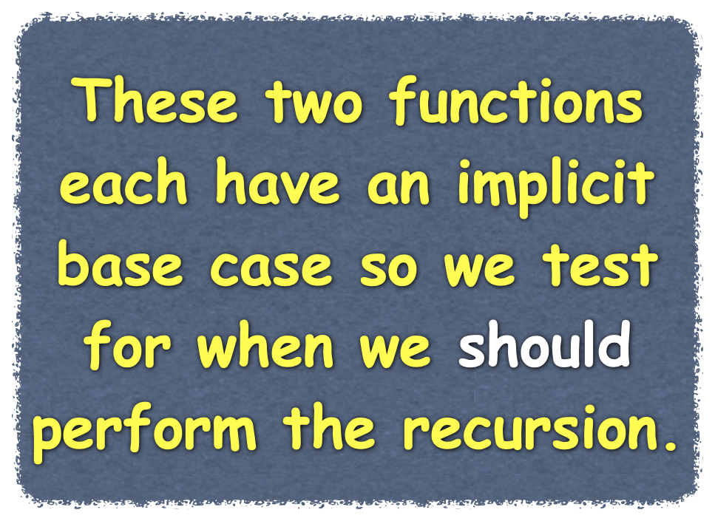


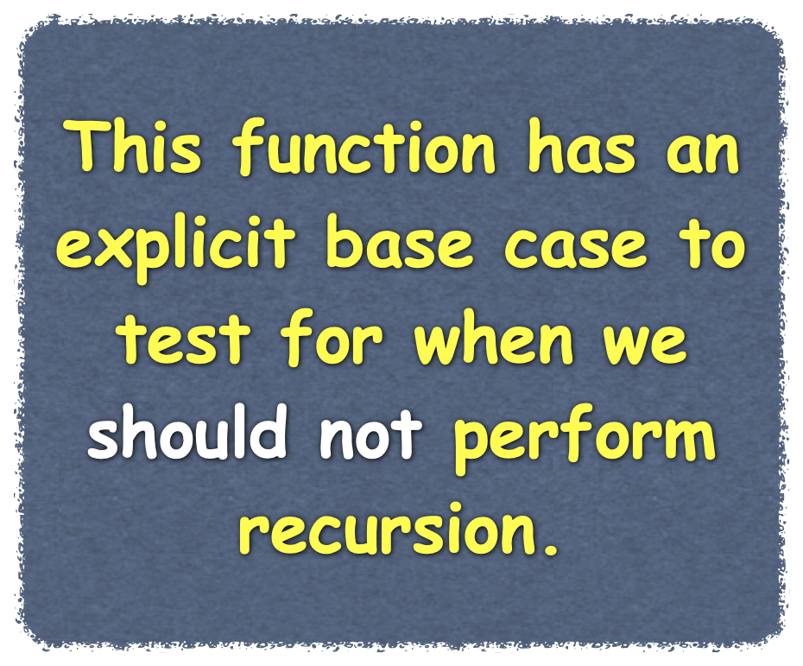

Recursive Processing - Arrays
Recursively displaying elements stored in an array
Start with first element
Start with last element
Divide the array in half
void displayArray(int myArray[], int first, int last)
{
std::cout << myArray[first] << " ";
if (first < last)
displayArray(myArray, first + 1, last);
} // end displayArray
// Start with myArray[last]
void displayArray(int myArray[], int first, int last)
{
if (first <= last)
{
displayArray(myArray, first, last - 1);
std::cout << myArray[last] << " ";
} // end if
} // end displayArray // Dividing the array in half
void displayArray(int myArray[], int first, int last)
{
if (first == last)
std::cout << myArray[first] << " ";
else
{ int mid = first + (last - first) / 2;
displayArray(myArray, first, mid);
displayArray(myArray, mid + 1, last);
} // end if
} // end displayArray
// Start with myArray[first]
first
1
34
16
91
76
23
54
67
19
0
last
mid
1
1
3
3
0
7
0
1
1
34
16
91
76
23
54
67
19
0
1
2
3
4
5
6
7
Notes:
A common way to process an array recursively divides the array into two pieces. You then process each of the pieces separately.
Since each of these pieces is an array that is smaller than the original array, each piece defines the smaller problem necessary for recursion. Our first two examples also divided the array into two pieces, but one of the pieces contained only one element.
Here we divide the array into two approximately equal pieces.
@@ To divide the array, we find the element at or near the middle of the array. The index of this element is (first + last) / 2;
Suppose that we include array[mid] in the left “half” of the array, as our diagram shows. If the part of the array we are dividing in half has an odd number of elements, the left half will have on more element than the right half. This slight difference in length won’t matter to our algorithm.
@@ Once again, the base case is an array of one element. We can display it without help. But if the array contains more than one element,
@@ We divide it into halves. We then ask a friend to display one half and another friend to display the other half. These two friends, of course, represent the two recursive calls in our function:
Let’s see how this recursive implementation looks
@@ For our first recursive call, mid will replace last so we are asked to print elements 0 through 3.
@@ We need to process the left half of this array segment so our mid point is 1.
@@ We pass that as last to the next recursive call.
@@ After the next call,
@@ we have reached our base case and display the element.
@@ We then return and perform the second recursive call and display the right half of that segment.
@@ And continue until the right half of the array has been displayed.
@@ We now return to the original function call and move to the second recursive invocation of the function and process the right half of the array in a similar fashion.
@@ In all three implementations, our base case was one element, but the function we used to test for that situation differed because how we approached the base case differed.

