Slide 1
Backtracking

Slide 2

Backtracking
Searching for a solution and backing up when an impasse (dead-end) is reached
Depth-first Search
Recursion and backtracking can be combined to solve problems
Searching Labyrinth for Item
Search for best airline route between cities
Beginning at the origin city, try every possible sequence of flights until either
A sequence that gets to the destination city is found
Can determine that no such sequence exists
Backtracking can be used to recover from choosing a wrong city

Slide 3
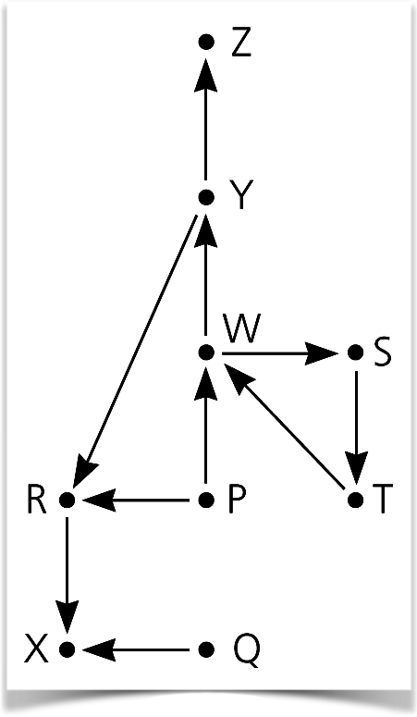
Backtracking
High Planes Airline Company (HPAir)
Goal:
Indicate whether a sequence of HPAir flights exists from the origin city to the destination city
Can we fly from P to Z?
The flight map for HPAir is a graph
Adjacent vertices are two vertices that are joined by an edge
A directed path is a sequence of directed edges

Slide 4


Backtracking
Recursive Search Problem
Possible outcomes of the recursive search strategy
You eventually reach the destination city and can conclude that it is possible to fly from the origin to the destination
You reach a city, X, from which there are no departing flights
You go around in circles
Mark visited cities to prevent cycles
Copyright © 2025 Pearson Education, Hoboken, NJ. All rights reserved

Slide 5
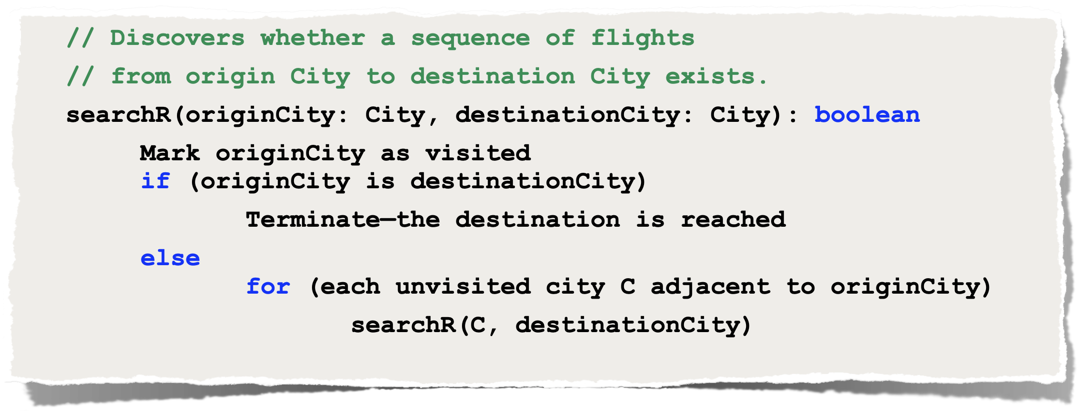
Backtracking
Recursive Search Strategy
Copyright © 2025 Pearson Education, Hoboken, NJ. All rights reserved

Slide 6
Backtracking
Eight-Queens Problem
Place eight queens on the chessboard so that no queen can attack any other queen
One strategy: Guess at a solution
There are 4,426,165,368 ways to arrange 8 queens on a chessboard of 64 squares
An observation to eliminate many arrangements
No queen can reside in a row or a column that contains another queen
Only 40,320 or 8! arrangements of queens to be checked for attacks along diagonals
Copyright © 2025 Pearson Education, Hoboken, NJ. All rights reserved

Slide 7


Eight Queens Problem
No open spot
No open spot
Searching strategy
Place queens one column at a time
If you reach an impasse, backtrack to the previous column
Base case
If there are no more columns to consider
You're finished (do nothing - implicit base case)
Recursive step
If you successfully place a queen in the current column
Consider the next column
If you cannot place a queen in the current column
You need to backtrack
Copyright © 2025 Pearson Education, Hoboken, NJ. All rights reserved

Slide 8
Processing Expressions

Slide 9
Recognizing Palindromes
Palindrome
A string that reads the same from left to right as it does from right to left
Language
Palindromes = {w : w reads the same left to right as right to left}
Grammar
<char> rule is the base case for success
<palindrome> = empty string | <char> | a <palindrome> a |
b <palindrome> b | …| Z <palindrome> Z
<char> = a | b | … | z | A | B | … | Z

Slide 10
Recognizing Palindromes
Recognition algorithm
isPal(in w:string):boolean
if (w is the empty string or w is of length 1)
return true
else if (w’s first and last characters are the same letter )
return isPal(w minus its first and last characters)
else
return false
<palindrome> = empty string | <char> | a <palindrome> a |
b <palindrome> b | …| Z <palindrome> Z
<char> = a | b | … | z | A | B | … | Z

Slide 11
Algebraic Expressions
Infix expressions
An operator appears between its operands
a + b
Prefix expressions
An operator appears before its operands
+ a b
Postfix expressions
An operator appears after its operands
a b +
Advantages of prefix and postfix expressions
No precedence rules
No association rules
No parentheses
Simple grammars
Straightforward recognition and evaluation algorithms

Slide 12
Algebraic Expressions
To convert a fully parenthesized infix expression to a prefix form
Move each operator to the position marked by its corresponding open parenthesis
Remove the parentheses
Infix expression: ( ( a + b) * c )
Prefix expression: * + a b c
To convert a fully parenthesized infix expression to a postfix form
Move each operator to the position marked by its corresponding closing parenthesis
Remove the parentheses
Infix expression: ( ( a + b) * c )
Postfix expression: a b + c *

Slide 13
Prefix Expressions
A recursive recognition algorithm
Base case: Single lowercase letter <identifier>
Recursive: <operator> <prefix> <prefix>
<prefix> = <identifier> | <operator> <prefix> <prefix>
<operator> = + | - | * | /
<identifier> = a | b | … | z

Slide 14
Prefix Expressions
evaluatePrefix(in strExp:string):float
ch = first character of expression strExp
Remove first character from strExp
if (ch is an identifier)
return value of the identifier
else if (ch is an operator named op)
{
operand1 = evaluatePrefix(strExp)
operand2 = evaluatePrefix(strExp)
return operand1 op operand2
}

Slide 15
Recursively Processing Arrays
Notes:
In this lecture, we’ll look at recursively processing arrays and solving the towers of hanoi problem

Slide 16


Recursive Linear Search
int linearSearch(string target, string[] theStrings,
int first, int last)
{
int result = -1;
if (first > last)
result = -1;
else if (target == theStrings[first])
result = first;
else
result = linearSearch(target, theStrings, first + 1, last);
return result;
} // end linearSearch
int linearSearch(string target, string[] theStrings, int size)
{
return linearSearch (target, theStrings, 0, size-1);
} // end linearSearch
Kirk
Chris
?
0
Tyler
1
Josh
2
Kirk
3
3
Mark
4
Sam
5
Derek
6

Slide 17
Recursive Binary Search
Chris
Mark
0
?
int binarySearch(string target, String[] strings, int size)
{
return binarySearch(target, strings, 0, size - 1);
} // end binarySearch
int binarySearch(string target, string[] strings,
int first, int last)
{
int result;
int mid = first + (last - first) / 2;
if(first > last)
result = -1; // target not in array
else if (target == strings[mid])
result = mid; // target found at a[mid]
else if(target < strings[mid])
result = binarySearch(target, strings, first, mid - 1);
else
result = binarySearch(target, strings, mid + 1, last);
return result;
} // end binarySearch
} // end SortedStringSearcher
Derek
first
1
4
0
Josh
mid
2
3
5
4
Kirk
last
6
3
4
Base Case
Mark
Base Case
4
Sam
5
Tyler
6

Slide 18
Recursive Binary Search
Chris
Eric
0
?
int binarySearch(string target, String[] strings)
{
return binarySearch(target, strings, 0, strings.length - 1);
} // end binarySearch
int binarySearch(string target, string[] strings,
int first, int last)
{
int result;
int mid = first + (last - first) / 2;
if(first > last)
result = -1; // target not in array
else if (target == strings[mid])
result = mid; // target found at a[mid]
else if(target < strings[mid])
result = binarySearch(target, strings, first, mid - 1);
else
result = binarySearch(target, strings, mid + 1, last);
return result;
} // end binarySearch
} // end SortedStringSearcher
Derek
first
1
0
2
Josh
mid
2
3
2
1
Kirk
last
6
3
2
1
Mark
4
Sam
5
Tyler
6

Slide 19
Towers of Hanoi
Move the disks from post A to post C
Can only move one disk at a time
Cannot place a disk on one smaller than itself
A
B
C

Slide 20
Towers of Hanoi
Move the disks from post A to post C
post A - Source (src)
post B - Spare (spare)
post C - Destination (dst)
solveTowers(count, src, dst, spare) // signature
solveTowers(5, A, C, B) // example
A
B
C

Slide 21
Towers of Hanoi
Move the disks from post A to post C
Base Case
One Disk - we can move it and not violate the rules
if (count == 1)
moveDisk(src, dst)
A
B
C

Slide 22
Towers of Hanoi
Move the disks from post A to post C
Smaller problems
move others disk out of the way so we can move red disk
solveTowers(count, src, dst, spare)
solveTowers( 4, A, B, C )
moveDisk( A, C )
solveTowers( 4, B, C, A )
solveTowers( 5, A, C, B )
A
B
C

Slide 23
Towers of Hanoi
Move the disks from post A to post C
Smaller problems
move others disk out of the way so we can move red disk
solveTowers(count, src, dst, spare)
// generic example
solveTowers( count-1, src, spare, dst )
moveDisk( src, dst )
solveTowers( count-1, spare, dst, src )
A
B
C

Slide 24

Towers of Hanoi
void solveTowers(count, src, dst, spare) {
if (count == 1)
moveDisk(src, dst)
else {
solveTowers( count-1, src, spare, dst )
moveDisk( src, dst )
solveTowers( count-1, spare, dst, src )
}
A
B
C

Slide 25
Towers of Hanoi
void solveTowers(count, src, dst, spare) {
if (count == 1)
moveDisk(src, dst)
else {
solveTowers( count-1, src, spare, dst )
moveDisk( src, dst )
solveTowers( count-1, spare, dst, src )
}
solveTowers(5, A, C, B)
solveTowers(4, A, B, C)
solveTowers(3, A, C, B)
solveTowers(2, A, B, C)
solveTowers(1, A, C, B)
diskMove(A, C) // base case
diskMove(A, B)
solveTowers(1, C, B, A)
diskMove(C, B) // base case
diskMove(A, C)
solveTowers(2, B, C, A)
A
B
C

