Slide 1
The ADT SortedList

Slide 2


The ADT Sorted List
ADT determines where entries belong
template<class ItemType>
class SortedListInterface
{
public:
virtual void insertSorted(const ItemType& newEntry) = 0;
virtual bool removeSorted(const ItemType& anEntry) = 0;
virtual int getPosition(const ItemType& anEntry) = 0;
virtual bool isEmpty() const = 0;
virtual int getLength() const = 0;
virtual bool remove(int position) = 0;
virtual void clear() = 0;
virtual ItemType getEntry(int position) const = 0;
}; // end SortedListInterface
Sorted List
Grocery List
Apples
1
2
3
4
5
6
7
8
9
10
Bread
Cheddar Cheese
Chicken Legs
Nachos
Oranges
Pears
Steak Cuts
Tomatoes
SortedListInterface.h
Notes:
This lecture describes the operations of the ADT sorted list.
If your application creates a list and then at some point needs to sort the list’s entries into numerical or alphabetical order, for example, you can add a sort operation to the ADT list. You can use one of the algorithms given in earlier lectures to implement this operation. But when your application requires only sorted data, having an ADT that orders the data for you would be more convenient than the ADT list. The sorted list is such an ADT.
When you either add an entry to or remove an entry from a sorted list, you provide only the entry. You do not specify where in the list the entry belongs or exists. The ADT determines this for you.
@@ Let’s see what the specification for this specialized list would look like:
@@ The insertSorted method takes on an entry to add to the list. The client does not specify a position - the ADT will determine the correct sorted position for the item. Since the client cannot make an error in determining the position as in the ADT list, the method does not need to return a boolean to indicate success or failure.
@@ The remove method searches for for a client specified entry and removes the first occurrence found of that entry. We’ll see in future lectures, because our list is sorted, we can implement efficient search methods. This method returns a boolean to indicate that either the entry was found and removed, or it was not found in the sorted list.
@@ To find where in the list an entry occurs, we need the getPosition method. This method searches the list for the client specified entry, If the entry is found, the position in the list is returned. If the entry is not found, a negative number is returned to the client. This allows the client to differentiate the success or failure of the method since the position of an entry cannot be negative if it exists in the list.
@@ The other methods in our ADT SortedList specification are similar to those in the AD List.

Slide 3
A Linked Sorted List
Only uses a reference to the first node
template<class ItemType>
LinkedSortedList<ItemType>::LinkedSortedList()
: headPtr(nullptr), itemCount(0)
{
} // end default constructor
Apples
Kiwis
Peaches
Pears
/
item
next
item
next
item
next
item
next
head
LinkedSortedList.cpp
Notes:
Our sorted list Only needs a reference to the first node of the list since we will not be adding to the end of the linked chain unless we’ve verified that is the correct sorted position for the entry.
Our constructor initializes head to null and numberOfEntries to zero since we are beginning with an empty list.

Slide 4
A Linked Sorted List
Only uses a reference to the first node
Adding a node to the sorted list
Finding the node before an entry
template<class ItemType>
void LinkedSortedList<ItemType>::
insertSorted(const ItemType& newEntry)
{
Node<ItemType>* newNodePtr =
new Node<ItemType>(newEntry);
Node<ItemType>* prevPtr = getNodeBefore(newEntry);
if (isEmpty() || (prevPtr == nullptr))
{
newNodePtr->setNext(headPtr);
headPtr = newNodePtr;
}
else
{
Node<ItemType>* aftPtr = prevPtr->getNext();
newNodePtr->setNext(aftPtr);
prevPtr->setNext(newNodePtr);
} // end if
itemCount++;
} // end insertSorted
template<class ItemType>
Node<ItemType>* LinkedSortedList<ItemType>::
getNodeBefore(const ItemType& anEntry) const
{
Node<ItemType>* curPtr = headPtr;
Node<ItemType>* prevPtr = nullptr;
while ( (curPtr != nullptr)
&& (anEntry > curPtr->getItem()) )
{
prevPtr = curPtr;
curPtr = curPtr->getNext();
} // end while
return prevPtr;
} // end getNodeBefore
grocerySortedList.insertSorted(“Oranges”);
Oranges
newNode
/
Apples
Kiwis
item
next
Peaches
Pears
/
item
next
item
next
item
next
item
next
head
/
prevPtr
curPtr
aftPtr
LinkedSortedList.cpp
Notes:
The challenge for the add method in our SortedList is finding the correct sorted position in the chain to insert the entry.
@@ we can see how the method behaves by using the example of inserting “Oranges” into our sorted list.
@@ First a new node is created for us to insert into the chain with the entry as its data.
@@ To add a node to our SortedList, we must have a reference to the node before this node in the sorted position and the node after. In our ADT List implementation we had a method “getNodeAt” that returned a reference to the node at a specified position in the list. When we added and removed nodes from our list, we called this method by sending the givenPosition minus 1 in order to find the node BEFORE the node we wanted to add or remove.
In our SortedList, we don’t know the position of the node to add or remove until we encounter it as we traverse the sorted list. But to add or remove a node, we still need a reference to the node prior to it in the list. We will use a private method “getNodeBefore” that searches the list for an entry, but stops at the node prior to that entry and returns a reference to that entry.
@@ Let’s see how we could implement this.
@@ We begin by creating a reference “curPtr” - this will reference each node as we iterate through the chain. We can use those to find the entry we are looking to remove, or, in the case of our add, the first entry that is greater in value than the entry we are trying to add.
@@ We then create a reference to the node prior to the currentNode in the chain. At this point, the nodeBefore is null since there is no node before the head of the chain. Our add method can test for this value when determining if the add will occur before the first node. This could happen of the value of the entry we were adding was less than the value of the current first entry in the list, for example, acorns.
@@Next is the while loop that iterates through the chain, searching for the entry, or where to add the entry.
@@ The test on this while loop stops the iteration when the currentNode has passed beyond the end of the chain, is which case “nodeBefore”points to the last node and our add will occur after the last node. The second test is for when the value of the entry in the currentNode is greater than the value of the entry to insert. At this point currentNode references the node that will come AFTER the entry we are inserting and nodeBefore references the node that comes before the node we are to insert.
The body of the while loop moves the two references until they are correctly set. Let’s see how the works for our example.
@@ The first iteration of the loop set nodeBefore and then increments currentNode
@@ After the next increment of our references, the entry sorted in the node referenced by currentNode is greater than the entry to insert so our loop terminates.
@@ When the method ends, our add method has a reference to the node with the entry in sorted order that comes before the entry we are inserting.
-- We then check to see if the node before is null or if the list is empty. In both cases we insert our node at the head of the chain.
--otherwise, we set nodeAfter to the next node in the chain.
-- and add our node as we did in the linked list add.

Slide 5
A Linked Sorted List
Only uses a reference to the first node
Adding a node to the sorted list
Recursive implementation
template<class ItemType>
void LinkedSortedList<ItemType>::
insertSorted(const ItemType& newEntry)
{
headPtr = insertSorted(newEntry, headPtr);
itemCount++;
}
template<class ItemType>
void LinkedSortedList<ItemType>::
insertSorted(const ItemType& newEntry,
Node<ItemType>* curPtr)
{
if (currentNode == nullptr ||
newEntry < curPtr->getItem())
{
curPtr = new Node<ItemType>(newEntry, curPtr);
}
else
{
Node<ItemType>* aftPtr =
insertSorted(newEntry, curPtr->getNext());
curPtr->setNext(aftPtr);
} // end if
return curPtr;
} // end insertSorted
grocerySortedList.add(“Oranges”);
curPtr
Oranges
curPtr
curPtr
item
next
Apples
Kiwis
Peaches
Pears
/
item
next
item
next
item
next
item
next
head
aftPtr
Notes:
Let’s look at a recursive implementation of our add method.
@@ our add method implements the interface of the SortedListInterface, but our recursive method needs a different signature to function properly since we need a way to pass smaller examples of the problem in our recursion.
@@ Let’s see how our recursive implementation would add Oranges to our sorted list. As we discussed in our lectures on sorting, if a method, especially a recursive method could change which node is the first node in the linked chain, it must return a reference to the new first node, even if it has not changed.
@@ the first call to our recursive method sets currentNode to reference the head of the linked list. Since this is not null and the value of this entry is not greater than oranges,
@@ we make a recursive call, passing the next node in the chain as the first node of the smaller chain to search.
@@ Kiwis is not greater than Oranges and it’s not null, so we make another recursive call
@@ For this call, currentNode references the node storing the entry “Peaches” which comes after “Oranges” so we execute our base case
@@ and create a new node that holds the entry to insert. The “next” field for this node is set to the node referenced by currentNode.
@@ then currentNode is set to reference the node just created that is to be inserted into the chain.
@@ and we return currentNode, to the recursive call before us and place that reference in nodeAfter.
@@ which is then used to setNext on the node referenced by currentNode in this call
@@ This call returns it’s currentNode, which references the node with the entry “Kiwis” and that is placed in nodeAfter.
@@ Here, since the order of the nodes does not change, nodeAfter already references the same node as the next field of the node currentNode references. so we in effect “reset” the next field to the same value.
@@ returning from the original call, we use the value in currentNode to set head to the correct first node in the chain.
@@ finally, we increment numberOfEntries to reflect that an entry has been added tot he sorted list.

Slide 6
- ADT SortedList Implementations
Test Subtitle

Slide 7
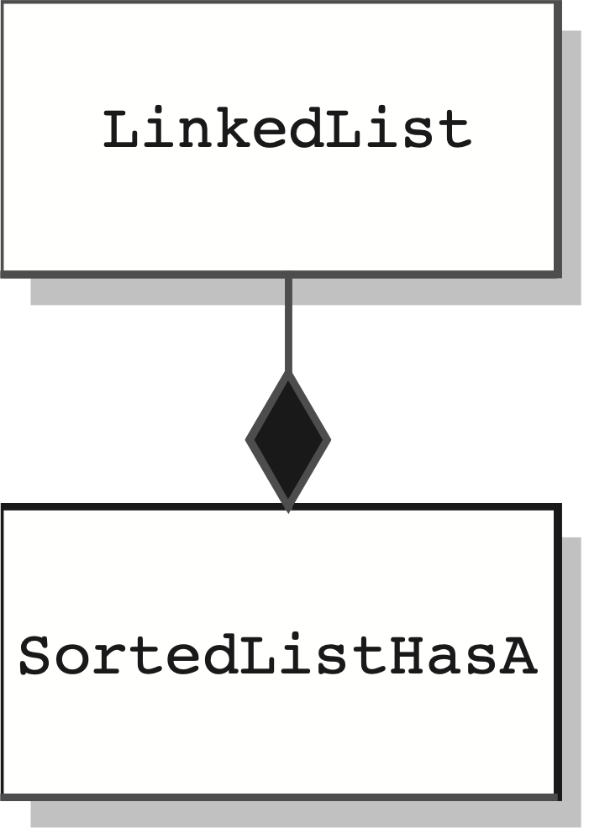
List-based Sorted List
SortedListHasA.h
Reusing Previous Work
Composition
Has-A Relationship
Our SortedList has a LinkedList data field
template<class ItemType>
class SortedListHasA : public SortedListInterface<ItemType>
{
private:
LinkedList<ItemType>* listPtr;
public:
// Constructors, destructor and SortedListInterface methods
}; // end SortedListHasA
SortedListHasA is a wrapper
or adapter for LinkedList
template<class ItemType>
SortedListHasA<ItemType>::SortedListHasA()
{
listPtr = new LinkedList<ItemType>();
} // end default constructor
template<class ItemType>
void SortedListHasA<ItemType>::
insertSorted(const ItemType& newEntry)
{
int newPosition = fabs(getPosition(newEntry));
listPtr->insert(newPosition, newEntry);
} // end insertSorted
SortedListHasA.cpp
Notes:
The method insertSorted first calls getPosition to get the intended position of the new entry, ignores the sign of this position, and uses the result and LinkedList’s insert method to complete its task. Note that since we will override insert in SortedListIsA, we must be careful not to call that implementation, but to call the base class implementation instead.

Slide 8
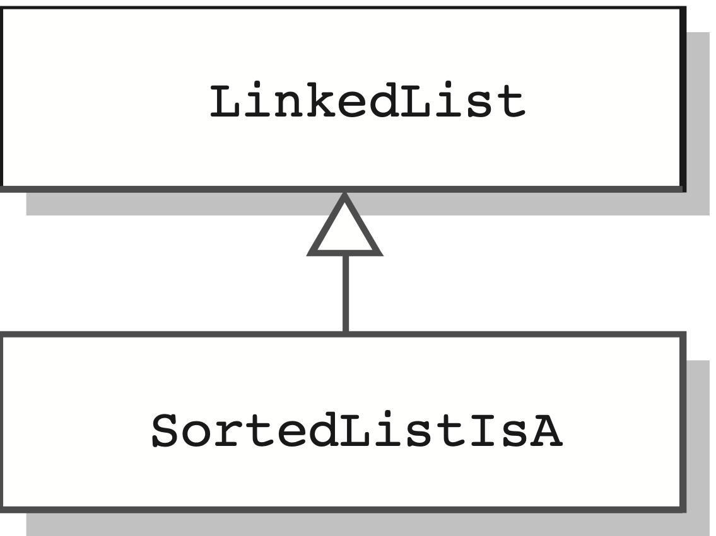
List-based Sorted List
SortedListIsA.h
Reusing Previous Work
Public Inheritance
Is-A Relationship
Our SortedList is derived from the LinkedList class
template<class ItemType>
class SortedListIsA : public LinkedList<ItemType>
{
public:
// Constructors, destructor and SortedListInterface methods
}; // end SortedListHasA
Must override LinkedList insert and setEntry to protect integrity of SortedList’s sorted entry order.
template<class ItemType>
SortedListIsA<ItemType>::SortedListIsA()
{
} // end default constructor
template<class ItemType>
void SortedListIsA<ItemType>::insertSorted(const ItemType& newEntry)
{
int newPosition = fabs(getPosition(newEntry));
LinkedList<ItemType>::insert(newPosition, newEntry);
} // end insertSorted
SortedListIsA.cpp
Notes:
The method insertSorted first calls getPosition to get the intended position of the new entry, ignores the sign of this position, and uses the result and LinkedList’s insert method to complete its task. Note that since we will override insert in SortedListIsA, we must be careful not to call that implementation, but to call the base class implementation instead.

Slide 9
List-based Sorted List
SortedListIsA.h
Reusing Previous Work
Private Inheritance
As-A Relationship
The LinkedList is hidden from clients of SortedList
template<class ItemType>
class SortedListAsA : public SortedListInterface<ItemType>,
private LinkedList<ItemType>
{
public:
// Constructors, destructor and SortedListInterface methods
}; // end SortedListHasA
SortedListAsA only receives code from LinkedList in this example of multiple inheritance since SortedListInterface is an abstract base class.
template<class ItemType>
SortedListAsA<ItemType>::SortedListAsA()
{
} // end default constructor
SortedListInterface
LinkedList
template<class ItemType>
void SortedListAsA<ItemType>::insertSorted(const ItemType& newEntry)
{
int newPosition = fabs(getPosition(newEntry));
LinkedList<ItemType>::insert(newPosition, newEntry);
} // end insertSorted
«implementation»
SortListAsA
SortedListIsA.cpp
Notes:
If do not have an is-a relationship between your new class and an existing class, you should not use public inheritance. Instead, if you want to inherit members from the existing class, you can use private inheritance. Private inheritance enables you to use the methods of a base class without giving a client access to them.

