Slide 1
The ADT Tree

Slide 2





Organizing Data By Linear Position
Top
List
Position
 | Grocery List
1 | Bread
2 | Oranges
3 | Tortillas
4 | Beans
5 | Apples
6 | Lettuce
7 | Milk
Front
Back
Stack
Queue
Notes:
The data organizations that we’ve seen so far have placed data in a linear order. Objects in a stack, queue, list, or dictionary appear one after the other. As useful as these organizations are, we often have to categorize data into groups and subgroups. Such a classification is hierarchical, or nonlinear, since the data items appear at various levels within the organization.
@@ Corporations, schools, churches, and governments all organize their staff hierarchically. For example, here is a portion of the administrative structure of a typical university. All offices ultimately report to the president. Immediately beneath the president are three vice presidents. The Vice President for Academic Affairs, for example, oversees the deans of the colleges. The deans in turn supervise the chairs of the various academic departments, such as computer science and accounting.

Slide 3

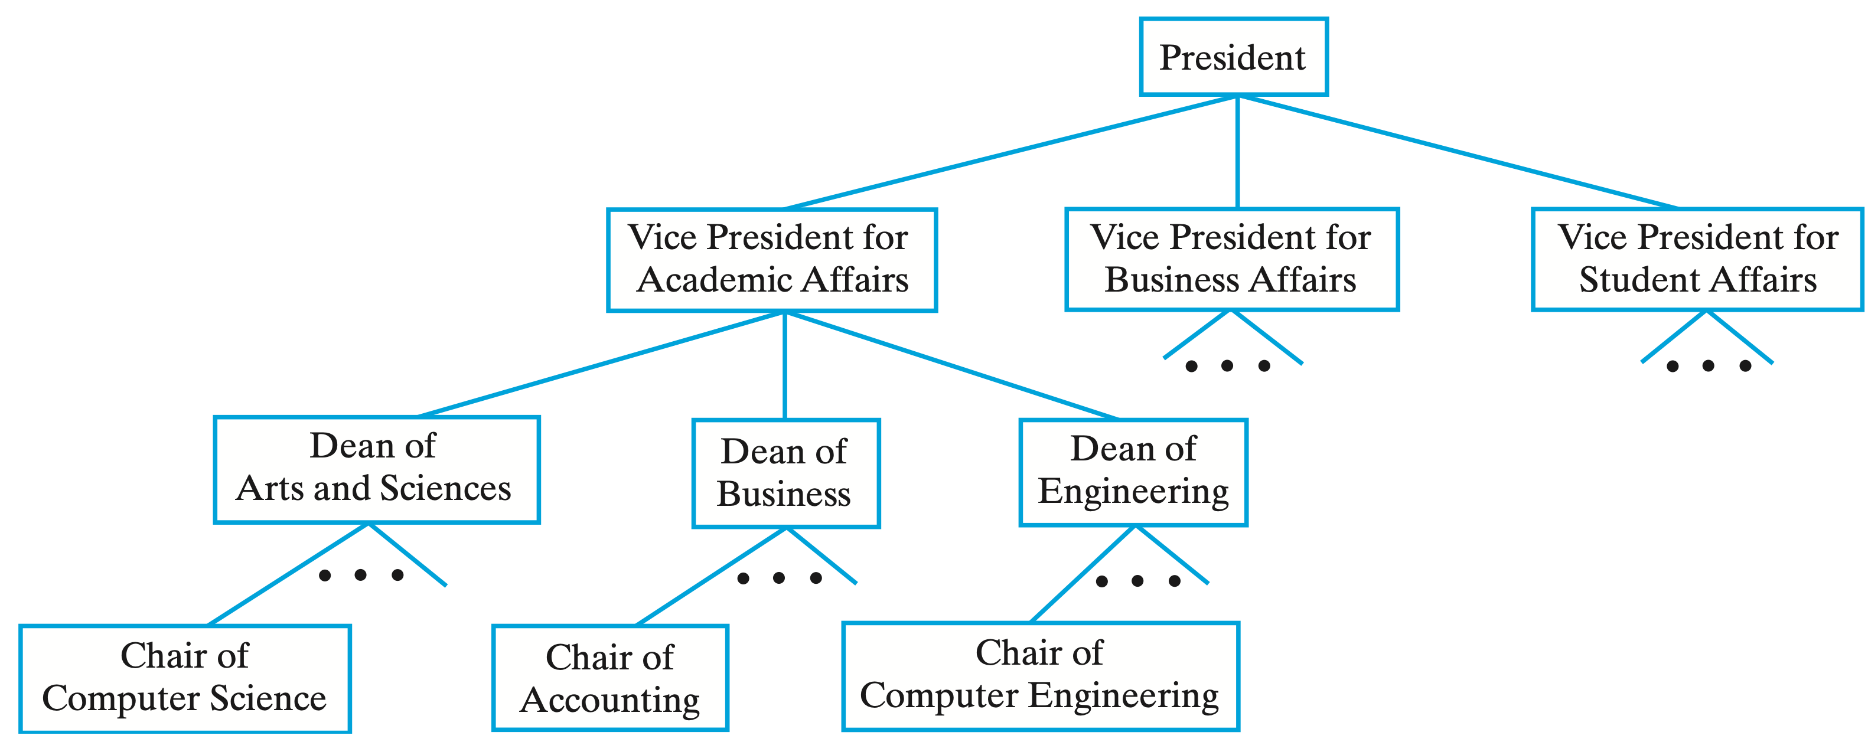
Hierarchical Data Organizations
Notes:
The data organizations that we’ve seen so far have placed data in a linear order. Objects in a stack, queue, list, or dictionary appear one after the other. As useful as these organizations are, we often have to categorize data into groups and subgroups. Such a classification is hierarchical, or nonlinear, since the data items appear at various levels within the organization.
@@ Corporations, schools, churches, and governments all organize their staff hierarchically. For example, here is a portion of the administrative structure of a typical university. All offices ultimately report to the president. Immediately beneath the president are three vice presidents. The Vice President for Academic Affairs, for example, oversees the deans of the colleges. The deans in turn supervise the chairs of the various academic departments, such as computer science and accounting.

Slide 4


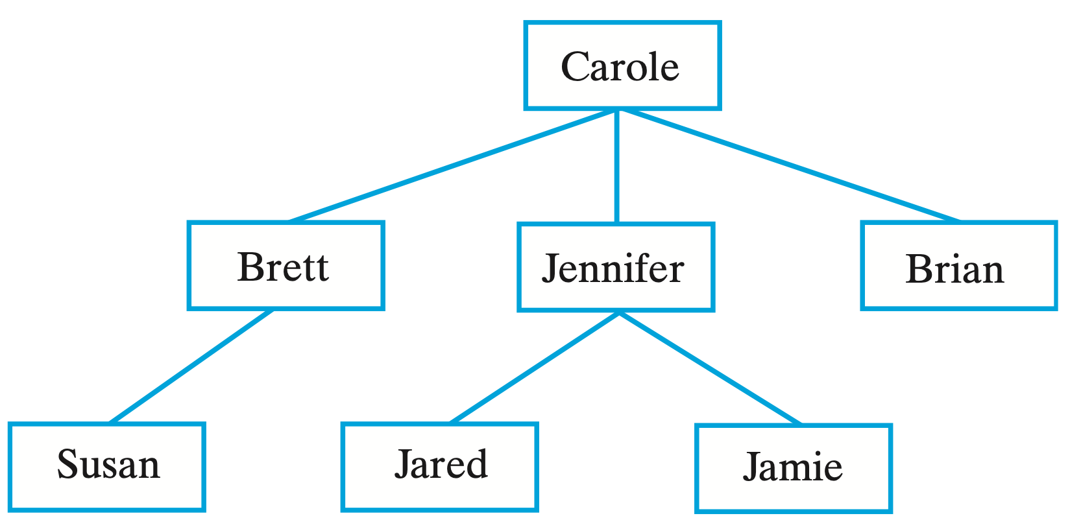
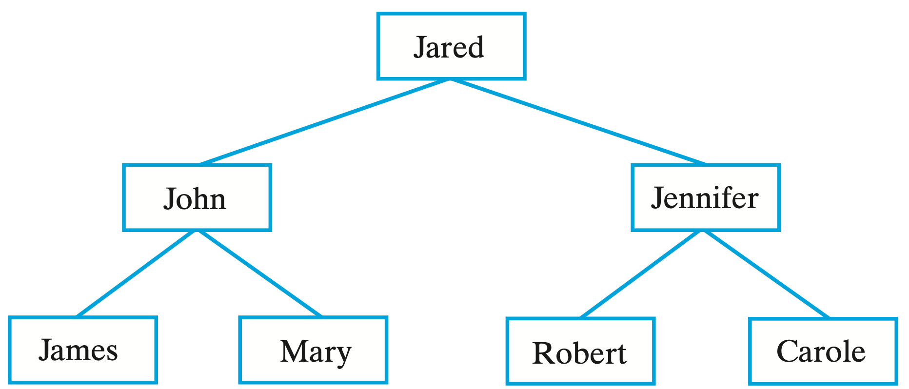
Hierarchical Data Organizations
Notes:
Your relatives can be arranged hierarchically in more than one way. HEre are Carole’s children and grandchildren. Her son Brett has one daughter, Susan. Carole’s daughter, Jennifer, has two children—Jared and Jamie.
@@ Using a different arrangement, Figure 23-2 shows Jared’s parents and grandparents. Jared’s father is John and his mother is Jennifer. John’s father and mother are James and Mary; Jennifer’s parents are Robert and Carole.

Slide 5

Trees
Tree of Height 4
A
Level 1
B
C
Level 2
Edge
D
E
F
K
G
Level 3
Nodes
H
M
J
Level 4
Notes:
Each of the previous diagrams is an example of a tree. A tree is a set of nodes connected by edges that indicate the relationships among the nodes.
@@The nodes are arranged in levels that indicate the nodes’ hierarchy.
@@ At the top level is a single node called the root.
@@ The nodes at each successive level of a tree are the children of the nodes at the previous level.
@@ A node that has children is the parent of those children. Here node C is the parent of nodes K and G.
@@ Since these children have the same parent, they are called siblings.
@@ They also are the descendants of node C, and node C is their ancestor. Furthermore, node J is a descendant of C, and C is an ancestor of J. The root is the ancestor of all nodes in the tree
@@ Notice that node M has no children. Such a node is called a leaf.
@@A node that is not a leaf—that is, one that has children—is called either an interior node or a nonleaf. Such a node is also a parent.
@@ Any node and its descendants form a subtree of the original tree. A subtree of a node is a tree rooted at a child of that node. For example, one subtree of node A is the tree rooted at B. A subtree of a tree is a subtree of the tree’s root.

Slide 6
Trees
Root
A
Interior Node
Ancestor of K, G and J
Parent of G and K
B
C
D
E
F
K
G
Child of C
K & G are Siblings
H
M
J
Descendant of C
Leaf
Notes:
Each of the previous diagrams is an example of a tree. A tree is a set of nodes connected by edges that indicate the relationships among the nodes.
@@The nodes are arranged in levels that indicate the nodes’ hierarchy.
@@ At the top level is a single node called the root.
@@ The nodes at each successive level of a tree are the children of the nodes at the previous level.
@@ A node that has children is the parent of those children. Here node C is the parent of nodes K and G.
@@ Since these children have the same parent, they are called siblings.
@@ They also are the descendants of node C, and node C is their ancestor. Furthermore, node J is a descendant of C, and C is an ancestor of J. The root is the ancestor of all nodes in the tree
@@ Notice that node M has no children. Such a node is called a leaf.
@@A node that is not a leaf—that is, one that has children—is called either an interior node or a nonleaf. Such a node is also a parent.
@@ Any node and its descendants form a subtree of the original tree. A subtree of a node is a tree rooted at a child of that node. For example, one subtree of node A is the tree rooted at B. A subtree of a tree is a subtree of the tree’s root.

Slide 7
Trees
A
B
C
D
E
F
K
G
H
M
J
Subtree Rooted at B
Notes:
Each of the previous diagrams is an example of a tree. A tree is a set of nodes connected by edges that indicate the relationships among the nodes.
@@The nodes are arranged in levels that indicate the nodes’ hierarchy.
@@ At the top level is a single node called the root.
@@ The nodes at each successive level of a tree are the children of the nodes at the previous level.
@@ A node that has children is the parent of those children. Here node C is the parent of nodes K and G.
@@ Since these children have the same parent, they are called siblings.
@@ They also are the descendants of node C, and node C is their ancestor. Furthermore, node J is a descendant of C, and C is an ancestor of J. The root is the ancestor of all nodes in the tree
@@ Notice that node M has no children. Such a node is called a leaf.
@@A node that is not a leaf—that is, one that has children—is called either an interior node or a nonleaf. Such a node is also a parent.
@@ Any node and its descendants form a subtree of the original tree. A subtree of a node is a tree rooted at a child of that node. For example, one subtree of node A is the tree rooted at B. A subtree of a tree is a subtree of the tree’s root.

Slide 8
Trees
General Tree
Binary Tree
A
A
B
C
B
C
D
E
F
K
G
D
F
K
G
H
M
J
Notes:
Each of the previous diagrams is an example of a tree. A tree is a set of nodes connected by edges that indicate the relationships among the nodes.
@@The nodes are arranged in levels that indicate the nodes’ hierarchy.
@@ At the top level is a single node called the root.
@@ The nodes at each successive level of a tree are the children of the nodes at the previous level.
@@ A node that has children is the parent of those children. Here node C is the parent of nodes K and G.
@@ Since these children have the same parent, they are called siblings.
@@ They also are the descendants of node C, and node C is their ancestor. Furthermore, node J is a descendant of C, and C is an ancestor of J. The root is the ancestor of all nodes in the tree
@@ Notice that node M has no children. Such a node is called a leaf.
@@A node that is not a leaf—that is, one that has children—is called either an interior node or a nonleaf. Such a node is also a parent.
@@ Any node and its descendants form a subtree of the original tree. A subtree of a node is a tree rooted at a child of that node. For example, one subtree of node A is the tree rooted at B. A subtree of a tree is a subtree of the tree’s root.

Slide 9
Trees
Tree of Height 4
Tree of Height 1
Tree of Height 0
(empty tree)
A
Z
Level 1
B
C
Level 2
D
E
F
K
G
Level 3
H
M
Level 4
Height of tree T = 1 + height of the tallest subtree of T
Notes:
The height of a tree is the number of levels in the tree. We number the levels in a tree beginning with the root at level 1. The tree here has four levels, and so its height is 4.
@@ The height of a one-node tree is 1, and the height of an empty tree is 0.
@@ We can express the height of a nonempty tree recursively by considering its subtrees:
Height of tree T = 1 + height of the tallest subtree of T
The root of the our tree here has two subtrees of heights 3 and 3. Since the tallest of these subtrees has height 3, the tree has height 4.
We can reach any node in a tree by following a path that begins at the root and goes from node to node along the edges that join them. The path between the root and any other node is unique. The length of a path is the number of edges that compose it.
@@ For example, the path that passes through the nodes A, B, E, and M has length 3. No other path from the root to a leaf is longer than this particular path. This tree has height 4, which is 1 more than the length of this longest path. In general, the height of a tree is 1 more than the length of the longest of the paths between its root and its leaves. Alternatively, the height of a tree is the number of nodes along the longest path between the root and a leaf.

Slide 10
Binary Trees
Each node has at most two children.
Tree T
root
A
B
C
Tleft
Tright
D
E
F
G
where Tleft and Tright are binary trees.
Notes:
As we mentioned earlier, each node in a binary tree has at most two children. They are called the left child and the right child. In this, nodes B, D, and F are left children, and nodes C, E, and G are right children. The root of this binary tree has two subtrees. The left subtree is rooted at B and the right subtree is rooted at C. Thus, the left subtree of a binary tree is the left subtree of its root; likewise for the right subtree.
Every subtree in a binary tree is also a binary tree. In fact, we can think of a binary tree recursively, as this:
@@ where our tree T is empty, or T is partitioned into: A single node called the root and Two, possibly empty, sets of nodes that are binary trees, called the left subtree of the root and the right subtree of the root
@@ When a binary tree of height h has all of its leaves at level h and every nonleaf ( or node that is a parent) has exactly two children, the tree is said to be full. Our example shows a full binary tree.
@@ If all levels of a binary tree but the last contain as many nodes as possible, and the nodes on the last level are filled in from left to right—as this second tree —the tree is complete.
@@ This last binary tree is neither full nor complete. In this case, a node can have a left child but no right child (for example, node Y), or a right child but no left child .
@ @ All leaves in a full binary tree are on the same level and every nonleaf has exactly two children. A complete binary tree is full to its next-to-last level, and its leaves on the last level are filled from left to right. Binary trees are used extensively, and these special trees will be important to our later discussions.

Slide 11
Binary Trees
Binary tree that is not full and not complete
Full Binary Tree
Complete Binary Tree
A
H
T
B
C
J
K
U
V
D
E
F
G
L
M
N
P
W
X
Q
R
S
Y
Z
Notes:
As we mentioned earlier, each node in a binary tree has at most two children. They are called the left child and the right child. In this, nodes B, D, and F are left children, and nodes C, E, and G are right children. The root of this binary tree has two subtrees. The left subtree is rooted at B and the right subtree is rooted at C. Thus, the left subtree of a binary tree is the left subtree of its root; likewise for the right subtree.
Every subtree in a binary tree is also a binary tree. In fact, we can think of a binary tree recursively, as this:
@@ where our tree T is empty, or T is partitioned into: A single node called the root and Two, possibly empty, sets of nodes that are binary trees, called the left subtree of the root and the right subtree of the root
@@ When a binary tree of height h has all of its leaves at level h and every nonleaf ( or node that is a parent) has exactly two children, the tree is said to be full. Our example shows a full binary tree.
@@ If all levels of a binary tree but the last contain as many nodes as possible, and the nodes on the last level are filled in from left to right—as this second tree —the tree is complete.
@@ This last binary tree is neither full nor complete. In this case, a node can have a left child but no right child (for example, node Y), or a right child but no left child .
@ @ All leaves in a full binary tree are on the same level and every nonleaf has exactly two children. A complete binary tree is full to its next-to-last level, and its leaves on the last level are filled from left to right. Binary trees are used extensively, and these special trees will be important to our later discussions.

Slide 12
Binary Trees
The minimum height of a complete binary tree is log2(n+1)
Number of nodes at level
Total nodes in full tree
1
1
A
Level 1
2
3
B
C
Level 2
4
7
D
E
F
G
Level 3
8
15
H
J
K
L
N
P
R
S
Level 4
For full binary tree of height h, the number of nodes n is 2^{h}-1
Notes:
In future lectures, the height of trees that are either full or complete will be important in our discussions of efficiency.
@@Here we have a tree that progressively gets taller. We add nodes in a order that maintains the structure of a complete tree.
After each row has , we have a full tree. As we begin the following row, we start at the left and add nodes left to right to maintain a complete tree.
@@ We can compute the number of nodes that a full tree contains as a function of its height. Beginning at the root of the our tree, we can see that the number of nodes at each level doubles as we move toward the leaves. The total number of nodes in this tree is 1 + 2 + 4 + 8, or, 15.
@@In general, the number of nodes in a full binary tree is 2^{h}-1 where h is the tree’s height.
@@ and the height of a full or complete binary tree of n nodes is log2 (n+1)

Slide 13
Tree Traversals

Slide 14

Binary Tree Traversals
A traversal visits each node in a tree
Process each node during a visit
For example, display the data in the node
Traversals are generally recursive algorithms
Consider the call traverse(treeRoot)
Visit the root
Traverse nodes in the root’s left subtree
Traverse nodes in the root’s right subtree
60
20
70
10
40
30
50
Notes:
This lecture discusses traversals of binary trees.
Until now, we treated the contents of the nodes in a tree simply as labels for identification. Because the tree is an ADT, however, its nodes contain data that we process. Let’s look at how we can visit each node to process it’s data.
@@ Traversing the items in a data collection is a common operation that we have seen in earlier lectures. In those cases, data was arranged linearly, so the sequence of the items in the traversal was clear. Such is not the case for a tree.
@@ In defining a traversal, or iteration, of a tree, we must visit, or process, each data item exactly once.
However, the order in which we visit items is not unique. We can choose an order suitable to our application. To simplify our discussion, we will use the phrase “visit a node” to mean “process the data within a node.” It is an action that we perform during a traversal of a tree. A traversal can pass through a node without visiting or processing it at that moment.
@@ We know that the subtrees of the root of a binary tree are themselves binary trees. Using this recursive nature of a binary tree in the definition of its traversal is natural.
@@ So for example: To visit all the nodes in a binary tree, we could
Visit the root
Visit all the nodes in the root’s left subtree
Visit all the nodes in the root’s right subtree
Visiting the nodes in the left subtree before visiting those in the right subtree is simply a convention. Whether we visit the root before, between, or after visiting these two subtrees, however, defines three common orders for a traversal.
So let’s examine for ways to traverse and process the nodes in a binary tree

Slide 15

Pre-Order Traversal
Visit root before visiting it's subtrees
before the recursive calls
if (Tree is not empty)
process (visit) root
traverse(Left subtree of Tree's root)
traverse(Right subtree of Tree's root)
60
20
70
10
40
30
50
Preorder Traversal
60
20
10
40
30
50
70
Check your work:
Root should be first
Depth-First Traversal
Notes:
In a preorder traversal, we visit the root before we visit the root’s subtrees.
We then visit all the nodes in the root’s left subtree before we visit the nodes in the right subtree. The preorder traversal is an example of a depth-first traversal. This kind of traversal fully explores one subtree before exploring another. That is, the traversal follows a path that descends the levels of a tree as deeply as possible until it reaches a leaf.
Let’s see how we would perform a pre-order traversal of this tree.
@@ We begin at the root.
@@ After first visiting the root, we visit the nodes in the root’s left subtree.
@@ Since this subtree is a binary tree, visiting its nodes in preorder means that we visit its root before visiting its left subtree.
@@ The traversal continues in this recursive manner until all nodes are visited.
@@
@@
@@
@@ To check that you correctly performed the pre-order traversal, the root should be the first node processed. The next nodes processed are the leftmost nodes in the tree.

Slide 16
In-Order Traversal
Visit root after visiting it's left subtree
between the recursive calls
if (Tree is not empty)
traverse(Left subtree of Tree's root)
process (visit) root
traverse(Right subtree of Tree's root)
60
20
70
10
40
30
50
Inorder Traversal
10
20
30
40
50
60
70
Notes:
An inorder traversal visits the root of a binary tree between visiting the nodes in the root’s sub-trees. In particular, it visits nodes in the following order:
Visit all the nodes in the root’s left subtree
Visit the root Visit all the nodes in the root’s right subtree
Let’s see how this traversal visits the nodes in our tree.
@@ Since we must process or visit the left subtree before processing the current node,
@@we “pass through” the node to the left subtree.
@@ Recursively visiting the nodes in the left subtree results in visiting the leftmost leaf first.
@@ We visit that leaf’s parent next and
@@ then the parent’s rightsubtree.
@@
@@
@@ We visit the tree’s root after we have visited all of the nodes in the root’s left subtree.
@@ Finally, we visit the nodes in the root’s right subtree in this recursive manner.

Slide 17
Post-Order Traversal
Visit root after visiting it's subtrees
after the recursive calls
if (Tree is not empty)
traverse(Left subtree of Tree's root)
traverse(Right subtree of Tree's root)
process (visit) root
60
20
70
10
40
30
50
Postorder Traversal
10
30
50
40
20
70
60
Check your work:
Root should be last
Notes:
A postorder traversal visits the root of a binary tree after visiting the nodes in the root’s subtrees.
In particular, it visits nodes in the following order:
Visit all the nodes in the root’s left subtree
Visit all the nodes in the root’s right subtree
Visit the root
@@ LEt’s see how we can perform a post-order traversal of our tree.
@@Recursively visiting the nodes in the left subtree
@@ results in visiting the leftmost leaf first.
@@ We then visit that leaf’s sibling subtree
@@
@@
@@ and then their parent.
@@
@@ After visiting all the nodes in the root’s left subtree,
@@ we visit the nodes in the root’s right subtree in this recursive manner.
@@ Finally we visit the root.
@@To check that you correctly performed the post-order traversal, the root should be the last node processed. The nodes immediately preceeding it the list should be the nodes rightmost nodes in the tree

Slide 18
Level-Order Traversal
Visit Nodes by Level
Visit each node, top down, left to right.
if (Tree is not empty)
Visit root
Visit Level 2, left to right
Visit Level n, left to right
60
20
70
10
40
30
50
Level Order Traversal
60
20
70
10
40
30
50
Check your work:
Root should be first
Breadth-First Traversal
Notes:
A level-order traversal begins at the root and visits nodes one level at a time.
Within a level, it visits nodes from left to right.
The level-order traversal is an example of a breadth-first traversal.
It follows a path that explores an entire level before moving to the next level.
Let’s see how this traversal processes the nodes in our tree.
@@ We begin at the root
@@ Then go to the second level
@@ and process the nodes there
@@ after that, we process all of the nodes at the third level of the tree
@@
@@ and then finish by processing all of the nodex at the lowest level
@@
@@ To check that you correctly performed the level-order traversal, the root should be the first node processed

