Slide 1
Implementing Binary Trees

Slide 2
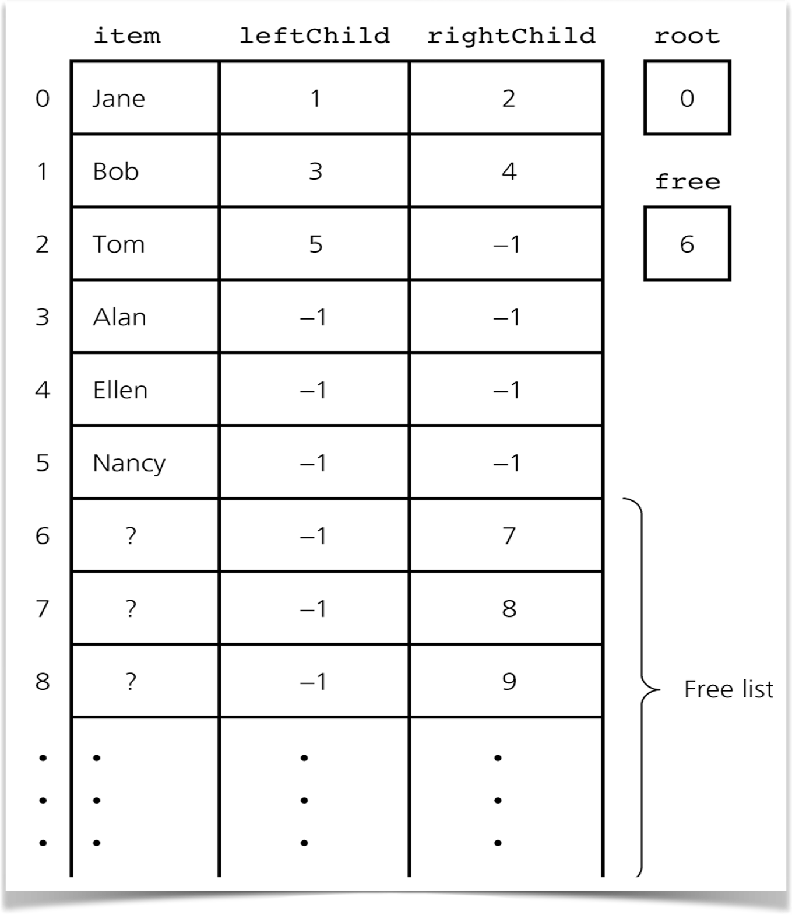
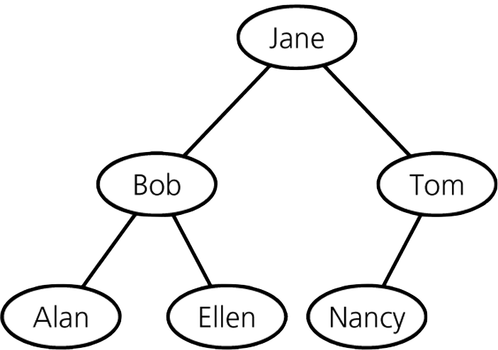

Array-based Binary Trees
Array-based Tree Representation
Each array element contains a TreeNode
Child nodes indicated by index number
If there is no left or right child, use -1
template<class ItemType>
class TreeNode
{
private:
ItemType item; // Data portion
int leftChild; // Index to left child
int rightChild; // Index to right child
public:
TreeNode();
TreeNode(const ItemType& nodeItem,
int left, int right);
// Declarations of the methods setItem, getItem,
// setLeft, getLeft, setRight, and getRight here.
//
}; // end TreeNode

Slide 3
Array-based Binary Trees
Requires three member variables
items - the array of TreeNodes
root - index of array element containing root node
free - index to a "free space" list
Keeps track of available nodes
Implemented as a linked list using array indexes
template<class ItemType>
class BinaryTree
{
private:
TreeNode<ItemType> items[MAX_TREE_SIZE];
int root;
int free;
. . .
}

Slide 4

Array-based Binary Trees
If a binary tree is complete
and will remain complete during tree use (Heap)
Use an memory-efficient array-based implementation
Use a level-order traversal of tree to store items
root is at 0
For node at index n:
index of leftChild is 2 * n + 1
index rightChild is 2 * (n + 1)
index of parent is (n - 1) / 2
0
1
2
3
4
5
6
7
0
1
2
3
4
5

Slide 5
Reference-Based Binary Trees

Slide 6

Binary Nodes
H
J
K
leftChild
data
rightChild
L
M
N
P
Q
R
S
K
leftChild
data
rightChild
leftChild
data
rightChild
/
/
/
/
N
P
Notes:
The most common implementation of a tree such as this uses a linked structure. BinaryNodes, similar to the nodes we used in a linked chain, represent each element in the tree. Each node can reference its children, which are other nodes in the tree. Although we could use either an array or a vector to implement a tree, these implementations are useful only when the tree is complete. In such cases, the link between a parent and child is not stored explicitly, so the data structure is simpler than if the tree is not complete.
@@ A binaryNodes object that represents a node in a tree references both the node’s data and the node’s children. Let’s define a class BinaryNode that represents the type of nodes we’d find in a link-based binary tree.
@@ The Binary Node will contain a reference to a data object and references to its left child and right child,
@@ which are other nodes in the tree. Either reference to a child could be nullptr. If both of them are nullptr, the node is a leaf node.
Since any class that extends our fundamental class of binary trees might need to manipulate nodes, we‘ll define our class of tree nodes outside of our binary tree class.

Slide 7
The Class BinaryNode
template<class ItemType>
class BinaryNode
{
private:
ItemType item; // Data portion
std::shared_ptr<BinaryNode<ItemType>> leftChildPtr; // Pointer to left child
std::shared_ptr<BinaryNode<ItemType>> rightChildPtr; // Pointer to right child
public:
BinaryNode();
BinaryNode(const ItemType& anItem);
BinaryNode(const ItemType& anItem,
std::shared_ptr<BinaryNode<ItemType>> leftPtr,
std::shared_ptr<BinaryNode<ItemType>> rightPtr);
void setItem(const ItemType& anItem);
ItemType getItem() const;
auto getLeftChildPtr() const;
auto getRightChildPtr() const;
void setLeftChildPtr(std::shared_ptr<BinaryNode<ItemType>> leftPtr);
void setRightChildPtr(std::shared_ptr<BinaryNode<ItemType>> rightPtr);
bool isLeaf() const;
}; // end BinaryNode
BinaryNode.h
BinaryNode.cpp
template<class ItemType>
bool BinaryNode<ItemType>::isLeaf() const
{
return ((leftChildPtr == nullptr)
&& (rightChildPtr == nullptr));
}

Slide 8


Reference-Based Binary Trees
In-Order traversal -- Visit root after visiting it's left subtree
template<class ItemType>
void BinaryNodeTree<ItemType>::inorderTraverse(std::function<void (ItemType&)> visit) const
{
inorder(visit, rootPtr);
} // end inorderTraverse
60
template<class ItemType>
void BinaryNodeTree<ItemType>::inorder(std::function<void (ItemType&)> visit,
std::shared_ptr<BinaryNode<ItemType>> treePtr) const
{
if (treePtr != nullPtr)
{
ItemType theItem = treePtr->getItem();
if (treePtr.isLeaf())
{
visit(theItem);
}
else
{
inorder(visit, treePtr->getLeftChildPtr());
visit(theItem);
inorder(visit, treePtr->getRightChildPtr());
} // end if
} // end if
} // end inorder
70
20
10
40
30
50
BinaryNodeTree.cpp

