Slide 1
The Heap Sort

Slide 2
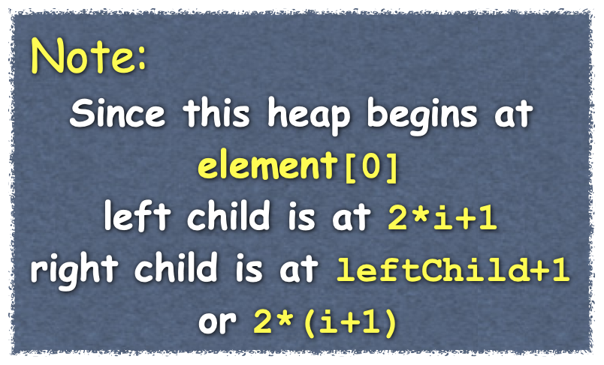




The Heap Sort
Given an an array of randomly ordered entries:
Create a heap
Repeat the following until the heap is of size two
Swap root and last entry
Decrease size of heap
Rebuild heap
Tree View
Starting at element [n/2-1]
call reheap
and repeat until at root
30
20
70
Heap
60
10
80
90
50
85
40
30
20
70
60
10
80
90
50
85
40
0 | 1 | 2 | 3 | 4 | 5 | 6 | 7 | 8 | 9 | 10 | 11

Slide 3
The Heap Sort
Given an an array of randomly ordered entries:
Create a heap
Repeat the following until the heap is of size two
Swap root and last entry
Decrease size of heap
Rebuild heap
Tree View
30
20
10
40
50
60
70
80
85
90
30
20
10
40
50
60
70
80
85
90
0 | 1 | 2 | 3 | 4 | 5 | 6 | 7 | 8 | 9 | 10 | 11

Slide 4
The Heap Sort
Given an a heap:
Repeat the following until the heap is of size two
Save the root item (maximum value)
Swap root and last entry
Decrease size of heap
Rebuild heap
Return sorted values
Recreate a heap
template<class ItemType>
void ArrayHeap<ItemType>::heapSort(std::vector<ItemType>& sortedItems)
{
sortedItems.clear();
while(itemCount >0)
{
sortedItems.push_back(items[ROOTINDEX]);
swap(items[ROOTINDEX], items[itemCount-1]);
itemCount--;
heapRebuild(ROOTINDEX);
}
itemCount = sortedItems.size(); //restore itemCount
heapCreate(); // restore heap
} // end toVector

