Slide 1
Graph Concepts and Terminology
Notes:
Tis lecture introduces graph concepts and terminology

Slide 2
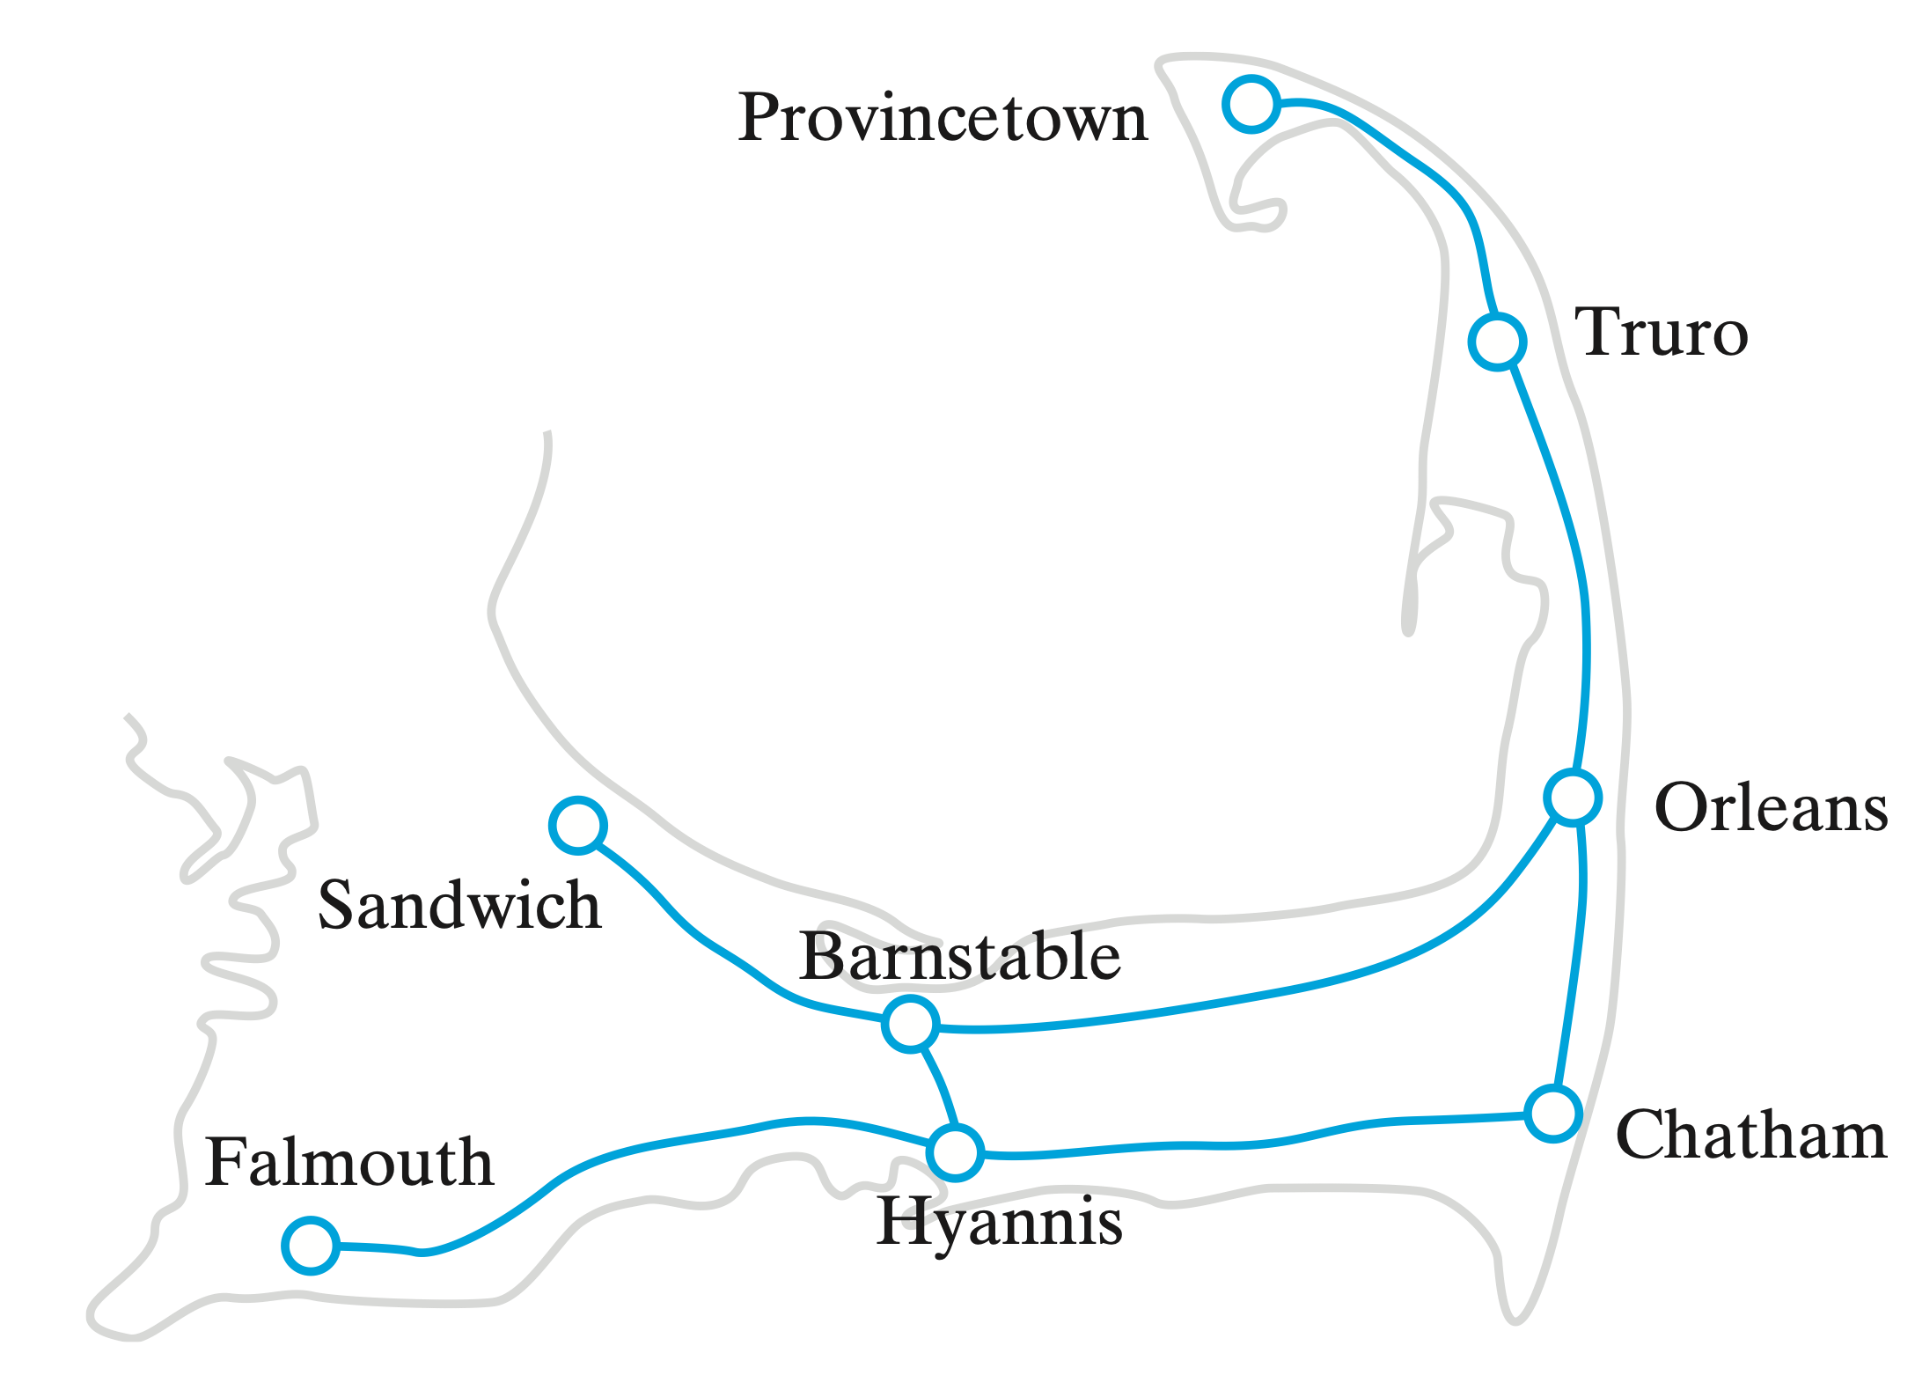


Graph Concepts
A Graph is a collection of distinct vertices and distinct edges
A subgraph is a portion of a graph
Provincetown
Truro
Vertices
Orleans
Sandwich
Barnstable
Falmouth
Chatham
Hyannis
Edges
Notes:
This image contains a portion of a road map for Cape Cod, Massachusetts. Small circles represent the towns, and the lines that join them represent the roads.
@@ A road map is a graph.
@@ In a graph, the circles are called vertices, or nodes, and
@@ the lines are called edges.
@@ A graph, then, is a collection of distinct vertices and distinct edges.
@@ A subgraph is a portion of a graph that is itself a graph, just as the road map above is actually a part of a larger map.
@@ Since you can travel in both directions along the roads on this map, the corresponding graph and its edges are said to be undirected. But cities often have one-way streets.

Slide 3
Graph Paths
Path
A sequence of edges between two vertices
Simple Path
Does not pass through any vertex more than one time
Provincetown
Truro
Sandwich
Orleans
Barnstable
1
5
4
3
Chatham
Falmouth
2
6
Hyannis
Notes:
This image contains a portion of a road map for Cape Cod, Massachusetts. Small circles represent the towns, and the lines that join them represent the roads.
@@ A road map is a graph.
@@ In a graph, the circles are called vertices, or nodes, and
@@ the lines are called edges.
@@ A graph, then, is a collection of distinct vertices and distinct edges.
@@ A subgraph is a portion of a graph that is itself a graph, just as the road map above is actually a part of a larger map.
@@ Since you can travel in both directions along the roads on this map, the corresponding graph and its edges are said to be undirected. But cities often have one-way streets.

Slide 4
Graph Paths
Path
A sequence of edges between two vertices
Simple Path
Does not pass through any vertex more than one time
Provincetown
Truro
Sandwich
Orleans
Barnstable
Chatham
Falmouth
Hyannis
Undirected Graph
Notes:
This image contains a portion of a road map for Cape Cod, Massachusetts. Small circles represent the towns, and the lines that join them represent the roads.
@@ A road map is a graph.
@@ In a graph, the circles are called vertices, or nodes, and
@@ the lines are called edges.
@@ A graph, then, is a collection of distinct vertices and distinct edges.
@@ A subgraph is a portion of a graph that is itself a graph, just as the road map above is actually a part of a larger map.
@@ Since you can travel in both directions along the roads on this map, the corresponding graph and its edges are said to be undirected. But cities often have one-way streets.

Slide 5
Directed Graphs
Directed Graph (digraph)
Graph with directed edges
Directed Path
Path in a directed graph
Must consider edge directions
Provincetown
Truro
Sandwich
Orleans
Barnstable
Chatham
Falmouth
Hyannis
Directed Graph
Notes:
This image contains a portion of a road map for Cape Cod, Massachusetts. Small circles represent the towns, and the lines that join them represent the roads.
@@ A road map is a graph.
@@ In a graph, the circles are called vertices, or nodes, and
@@ the lines are called edges.
@@ A graph, then, is a collection of distinct vertices and distinct edges.
@@ A subgraph is a portion of a graph that is itself a graph, just as the road map above is actually a part of a larger map.
@@ Since you can travel in both directions along the roads on this map, the corresponding graph and its edges are said to be undirected. But cities often have one-way streets.

Slide 6
Graph Cycles
Cycle
Path that begins and ends at the same vertex
Simple Cycle
Cycle that passes through other vertices only once
Acyclic Graph
A graph with no cycles
Provincetown
Truro
Sandwich
Orleans
Barnstable
Chatham
Falmouth
Hyannis
Notes:
This image contains a portion of a road map for Cape Cod, Massachusetts. Small circles represent the towns, and the lines that join them represent the roads.
@@ A road map is a graph.
@@ In a graph, the circles are called vertices, or nodes, and
@@ the lines are called edges.
@@ A graph, then, is a collection of distinct vertices and distinct edges.
@@ A subgraph is a portion of a graph that is itself a graph, just as the road map above is actually a part of a larger map.
@@ Since you can travel in both directions along the roads on this map, the corresponding graph and its edges are said to be undirected. But cities often have one-way streets.

Slide 7
Graph Cycles
Cycle
Path that begins and ends at the same vertex
Simple Cycle
Cycle that passes through other vertices only once
Acyclic Graph
A graph with no cycles
Provincetown
Truro
Sandwich
Orleans
Barnstable
Chatham
Falmouth
Hyannis
Undirected Graph
Notes:
This image contains a portion of a road map for Cape Cod, Massachusetts. Small circles represent the towns, and the lines that join them represent the roads.
@@ A road map is a graph.
@@ In a graph, the circles are called vertices, or nodes, and
@@ the lines are called edges.
@@ A graph, then, is a collection of distinct vertices and distinct edges.
@@ A subgraph is a portion of a graph that is itself a graph, just as the road map above is actually a part of a larger map.
@@ Since you can travel in both directions along the roads on this map, the corresponding graph and its edges are said to be undirected. But cities often have one-way streets.

Slide 8
Weighted Graphs
Weighted Graph
Graph that has values (weights) assigned to the edges
Weighted Path
Path through a weighted graph
Provincetown
10
Truro
17
Sandwich
Orleans
19
Barnstable
9
14
12
4
Chatham
19
Falmouth
20
Hyannis
Notes:
This image contains a portion of a road map for Cape Cod, Massachusetts. Small circles represent the towns, and the lines that join them represent the roads.
@@ A road map is a graph.
@@ In a graph, the circles are called vertices, or nodes, and
@@ the lines are called edges.
@@ A graph, then, is a collection of distinct vertices and distinct edges.
@@ A subgraph is a portion of a graph that is itself a graph, just as the road map above is actually a part of a larger map.
@@ Since you can travel in both directions along the roads on this map, the corresponding graph and its edges are said to be undirected. But cities often have one-way streets.

Slide 9
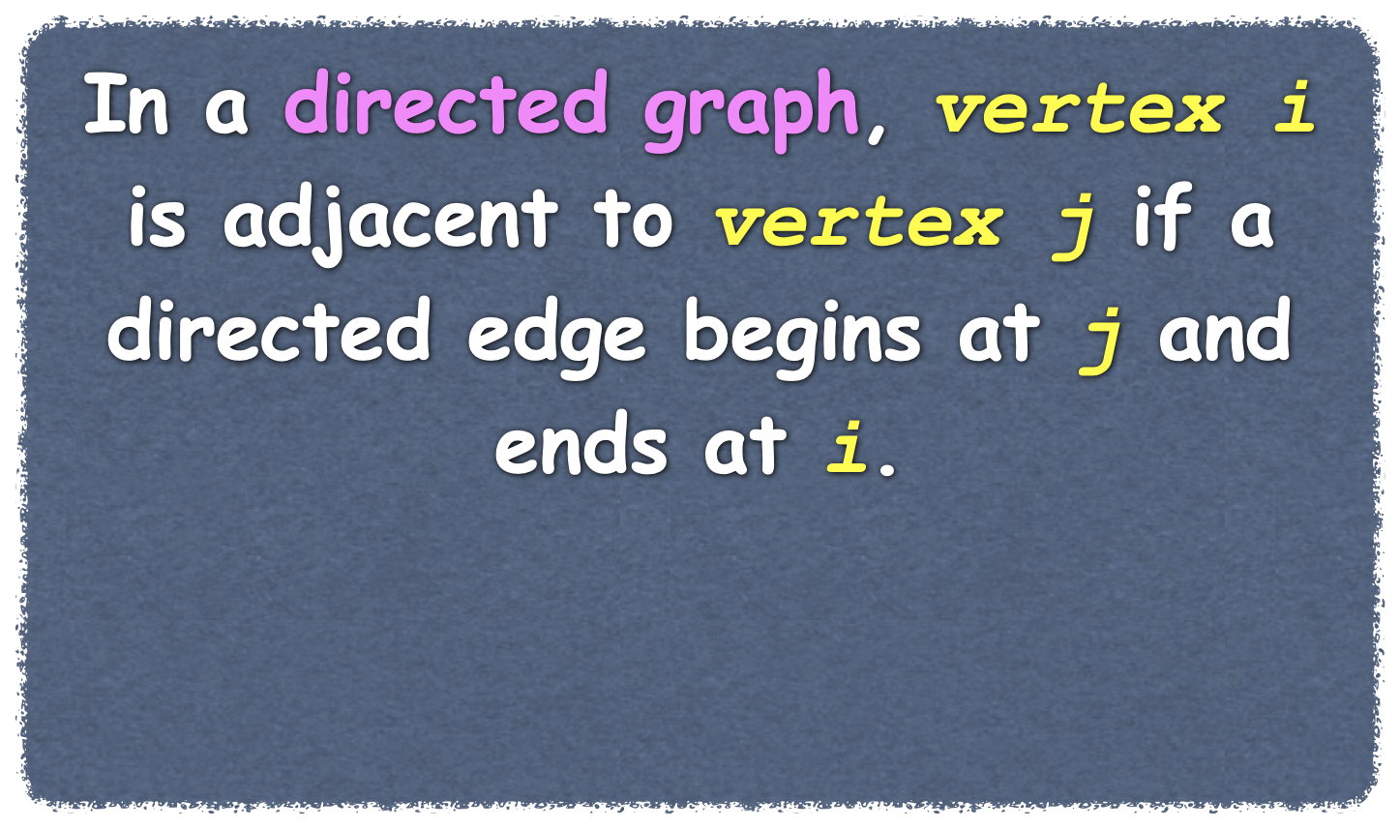
Adjacency and Connectedness
Adjacent Vertices (neighbors)
Vertices joined by an edge in an undirected graph
Connected Graph
Has a path between every pair of distinct vertices
Complete Graph
Every pair of vertices is connected
Provincetown
Truro
i
j
Sandwich
Orleans
Barnstable
Chatham
Falmouth
Hyannis
Notes:
This image contains a portion of a road map for Cape Cod, Massachusetts. Small circles represent the towns, and the lines that join them represent the roads.
@@ A road map is a graph.
@@ In a graph, the circles are called vertices, or nodes, and
@@ the lines are called edges.
@@ A graph, then, is a collection of distinct vertices and distinct edges.
@@ A subgraph is a portion of a graph that is itself a graph, just as the road map above is actually a part of a larger map.
@@ Since you can travel in both directions along the roads on this map, the corresponding graph and its edges are said to be undirected. But cities often have one-way streets.

Slide 10
Adjacency and Connectedness
Adjacent Vertices (neighbors)
Vertices joined by an edge in an undirected graph
Connected Graph
Has a path between every pair of distinct vertices
Disconnected Graph
No path from certain vertices to others
Provincetown
Truro
Sandwich
Orleans
Barnstable
Chatham
Falmouth
Hyannis
Notes:
This image contains a portion of a road map for Cape Cod, Massachusetts. Small circles represent the towns, and the lines that join them represent the roads.
@@ A road map is a graph.
@@ In a graph, the circles are called vertices, or nodes, and
@@ the lines are called edges.
@@ A graph, then, is a collection of distinct vertices and distinct edges.
@@ A subgraph is a portion of a graph that is itself a graph, just as the road map above is actually a part of a larger map.
@@ Since you can travel in both directions along the roads on this map, the corresponding graph and its edges are said to be undirected. But cities often have one-way streets.

Slide 11
Adjacency and Connectedness
Adjacent Vertices (neighbors)
Vertices joined by an edge in an undirected graph
Connected Graph
Has a path between every pair of distinct vertices
Disconnected Graph
No path from certain vertices to others
Provincetown
Truro
Sandwich
Orleans
Barnstable
Chatham
Falmouth
Hyannis
Notes:
This image contains a portion of a road map for Cape Cod, Massachusetts. Small circles represent the towns, and the lines that join them represent the roads.
@@ A road map is a graph.
@@ In a graph, the circles are called vertices, or nodes, and
@@ the lines are called edges.
@@ A graph, then, is a collection of distinct vertices and distinct edges.
@@ A subgraph is a portion of a graph that is itself a graph, just as the road map above is actually a part of a larger map.
@@ Since you can travel in both directions along the roads on this map, the corresponding graph and its edges are said to be undirected. But cities often have one-way streets.

Slide 12
Adjacency and Connectedness
Complete Graph
Every pair of vertices is connected
A graph with n vertices, can have at most
n(n-1)/2 edges if the graph is undirected
n(n-1) edges if the graph is directed
Provincetown
Truro
Sandwich
Orleans
Barnstable
A dense graph
Chatham
Falmouth
Hyannis
Notes:
This image contains a portion of a road map for Cape Cod, Massachusetts. Small circles represent the towns, and the lines that join them represent the roads.
@@ A road map is a graph.
@@ In a graph, the circles are called vertices, or nodes, and
@@ the lines are called edges.
@@ A graph, then, is a collection of distinct vertices and distinct edges.
@@ A subgraph is a portion of a graph that is itself a graph, just as the road map above is actually a part of a larger map.
@@ Since you can travel in both directions along the roads on this map, the corresponding graph and its edges are said to be undirected. But cities often have one-way streets.

Slide 13
Adjacency and Connectedness
Complete Graph
Every pair of vertices is connected
A graph with n vertices, can have at most
n(n-1)/2 edges if the graph is undirected
n(n-1) edges if the graph is directed
Provincetown
Truro
Sandwich
Orleans
Barnstable
A sparse graph
Chatham
Falmouth
Hyannis
Notes:
This image contains a portion of a road map for Cape Cod, Massachusetts. Small circles represent the towns, and the lines that join them represent the roads.
@@ A road map is a graph.
@@ In a graph, the circles are called vertices, or nodes, and
@@ the lines are called edges.
@@ A graph, then, is a collection of distinct vertices and distinct edges.
@@ A subgraph is a portion of a graph that is itself a graph, just as the road map above is actually a part of a larger map.
@@ Since you can travel in both directions along the roads on this map, the corresponding graph and its edges are said to be undirected. But cities often have one-way streets.

Slide 14
Representing Adjacency
Notes:
Tis lecture introduces graph concepts and terminology

Slide 15

Representing Vertex Relationships
Edges connect vertices
Connections represent relationship among vertices
Adjacency Matrix
Two-dimensional array
Adjacency List
List of lists
A
D
G
B
E
H
C
F
I
Directed Graph

Slide 16
The Adjacency Matrix
is connected to
 |  | 0 | 1 | 2 | 3 | 4 | 5 | 6 | 7 | 8
0
1
2
3
4
5
6
7
8
 | A | B | C | D | E | F | G | H | I
A
B
C
D
E
F
G
H
I
A
D
G
 | 1 |  | 1 | 1
 |  |  |  | 1
 | 1
 |  |  |  |  |  | 1
 |  |  |  |  | 1 |  | 1
 |  | 1 |  |  |  |  | 1
 |  |  |  |  |  |  | 1
 |  |  |  |  |  |  |  | 1
 |  |  |  |  | 1
B
E
H
Vertex
C
F
I
Directed Graph
Notes:
Now let’s look at the adjacency matrix and adjacency list as two representations of the edges in a graph.
Two common implementations of the ADT graph use either an array or a list to represent the graph’s edges. The array is typically a two-dimensional array called an adjacency matrix. The list is called an adjacency list. Each of these constructs represents the connections—that is, the edges—among the vertices in the graph.
The adjacency matrix for a graph of n vertices has n rows and n columns. Each row and each column corresponds to a vertex in the graph. You number the vertices from 0 through n - 1 to match the row indices and the column indices. If aij is the element in row i and column j of the matrix, aij indicates whether an edge exists between vertex i and vertex j. For an unweighted graph, you can use boolean values in the matrix. For a weighted graph, you can use edge weights when edges exist and a representation of infinity otherwise.
@@ The first row in our adjacency matrix identifies the neighbors of vertex A in our directed graph. By looking at the cells marked TRUE, we can see that A has neighbors B, D, and E.
@@ We can read the rest of the adjacency matrix in a similar way.
From an adjacency matrix, you quickly can see whether an edge exists between any two given vertices. This operation is Order of at most (1). But if you want to know all the neighbors of a particular vertex, you need to scan an entire row of the matrix, an Order of at most (n) task. Additionally, the matrix occupies a considerable, fixed amount of space that depends on the number of vertices but not on the number of edges. In fact, an adjacency matrix represents every possible edge in a graph, regardless of whether the edges actually exist. However, most graphs have relatively few of the many edges possible—that is, they are sparse. For such graphs, an adjacency list uses less space, as you will now see.

Slide 17
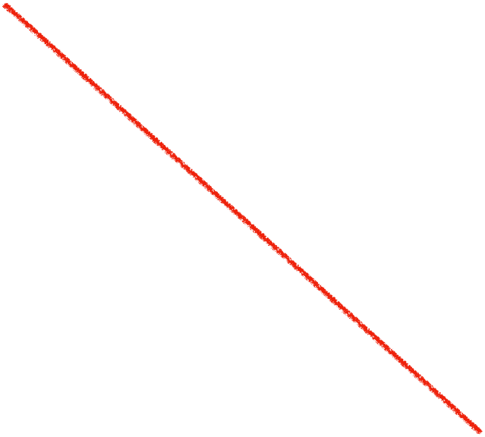
The Adjacency Matrix
is connected to
3
4
 | A | B | C | D | E | F | G | H | I
A
B
C
D
E
F
G
H
I
A
D
G
 | 3 |  | 3 | 5
 |  |  |  | 7
 | 2
 |  |  |  |  |  | 4
 |  |  |  |  | 1 |  | 4
 |  | 3 |  |  |  |  | 6
 |  |  |  |  |  |  | 2
 |  |  |  |  |  |  |  | 3
 |  |  |  |  | 5
∞ | 3 | ∞ | 3 | 5 | ∞ | ∞ | ∞ | ∞
∞ | ∞ | ∞ | ∞ | 7 | ∞ | ∞ | ∞ | ∞
∞ | 2 | ∞ | ∞ | ∞ | ∞ | ∞ | ∞ | ∞
∞ | ∞ | ∞ | ∞ | ∞ | ∞ | 4 | ∞ | ∞
∞ | ∞ | ∞ | ∞ | ∞ | 1 | ∞ | 4 | ∞
∞ | ∞ | 3 | ∞ | ∞ | ∞ | ∞ | 6 | ∞
∞ | ∞ | ∞ | ∞ | ∞ | ∞ | ∞ | 2 | ∞
∞ | ∞ | ∞ | ∞ | ∞ | ∞ | ∞ | ∞ | 3
∞ | ∞ | ∞ | ∞ | ∞ | 5 | ∞ | ∞ | ∞
3
5
2
B
7
E
4
H
Vertex
1
6
3
2
C
3
F
5
I
Weighted Directed Graph
Notes:
Now let’s look at the adjacency matrix and adjacency list as two representations of the edges in a graph.
Two common implementations of the ADT graph use either an array or a list to represent the graph’s edges. The array is typically a two-dimensional array called an adjacency matrix. The list is called an adjacency list. Each of these constructs represents the connections—that is, the edges—among the vertices in the graph.
The adjacency matrix for a graph of n vertices has n rows and n columns. Each row and each column corresponds to a vertex in the graph. You number the vertices from 0 through n - 1 to match the row indices and the column indices. If aij is the element in row i and column j of the matrix, aij indicates whether an edge exists between vertex i and vertex j. For an unweighted graph, you can use boolean values in the matrix. For a weighted graph, you can use edge weights when edges exist and a representation of infinity otherwise.
@@ The first row in our adjacency matrix identifies the neighbors of vertex A in our directed graph. By looking at the cells marked TRUE, we can see that A has neighbors B, D, and E.
@@ We can read the rest of the adjacency matrix in a similar way.
From an adjacency matrix, you quickly can see whether an edge exists between any two given vertices. This operation is Order of at most (1). But if you want to know all the neighbors of a particular vertex, you need to scan an entire row of the matrix, an Order of at most (n) task. Additionally, the matrix occupies a considerable, fixed amount of space that depends on the number of vertices but not on the number of edges. In fact, an adjacency matrix represents every possible edge in a graph, regardless of whether the edges actually exist. However, most graphs have relatively few of the many edges possible—that is, they are sparse. For such graphs, an adjacency list uses less space, as you will now see.

Slide 18


The Adjacency Matrix
is connected to
 | A | B | C | D | E | F | G | H | I
A
B
C
D
E
F
G
H
I
A
D
G
 | 1 |  | 1 | 1
1 |  | 1 |  | 1
 | 1 |  |  |  | 1
1 |  |  |  |  |  | 1
1 | 1 |  |  |  | 1 |  | 1
 |  | 1 |  | 1 |  |  | 1 | 1
 |  |  | 1 |  |  |  | 1
 |  |  |  | 1 | 1 | 1 |  | 1
 |  |  |  |  | 1 |  | 1
B
E
H
Vertex
C
F
I
Undirected Graph
Notes:
Now let’s look at the adjacency matrix and adjacency list as two representations of the edges in a graph.
Two common implementations of the ADT graph use either an array or a list to represent the graph’s edges. The array is typically a two-dimensional array called an adjacency matrix. The list is called an adjacency list. Each of these constructs represents the connections—that is, the edges—among the vertices in the graph.
The adjacency matrix for a graph of n vertices has n rows and n columns. Each row and each column corresponds to a vertex in the graph. You number the vertices from 0 through n - 1 to match the row indices and the column indices. If aij is the element in row i and column j of the matrix, aij indicates whether an edge exists between vertex i and vertex j. For an unweighted graph, you can use boolean values in the matrix. For a weighted graph, you can use edge weights when edges exist and a representation of infinity otherwise.
@@ The first row in our adjacency matrix identifies the neighbors of vertex A in our directed graph. By looking at the cells marked TRUE, we can see that A has neighbors B, D, and E.
@@ We can read the rest of the adjacency matrix in a similar way.
From an adjacency matrix, you quickly can see whether an edge exists between any two given vertices. This operation is Order of at most (1). But if you want to know all the neighbors of a particular vertex, you need to scan an entire row of the matrix, an Order of at most (n) task. Additionally, the matrix occupies a considerable, fixed amount of space that depends on the number of vertices but not on the number of edges. In fact, an adjacency matrix represents every possible edge in a graph, regardless of whether the edges actually exist. However, most graphs have relatively few of the many edges possible—that is, they are sparse. For such graphs, an adjacency list uses less space, as you will now see.

Slide 19
Adjacency Matrix Operations
Determining existence of an edge
O(1)
Determining weight of an edge
O(1)
Determining all neighbors of a vertex
O(n)
Requires storage for n² values
A
D
G
B
E
H
C
F
I
Notes:
Now let’s look at the adjacency matrix and adjacency list as two representations of the edges in a graph.
Two common implementations of the ADT graph use either an array or a list to represent the graph’s edges. The array is typically a two-dimensional array called an adjacency matrix. The list is called an adjacency list. Each of these constructs represents the connections—that is, the edges—among the vertices in the graph.
The adjacency matrix for a graph of n vertices has n rows and n columns. Each row and each column corresponds to a vertex in the graph. You number the vertices from 0 through n - 1 to match the row indices and the column indices. If aij is the element in row i and column j of the matrix, aij indicates whether an edge exists between vertex i and vertex j. For an unweighted graph, you can use boolean values in the matrix. For a weighted graph, you can use edge weights when edges exist and a representation of infinity otherwise.
@@ The first row in our adjacency matrix identifies the neighbors of vertex A in our directed graph. By looking at the cells marked TRUE, we can see that A has neighbors B, D, and E.
@@ We can read the rest of the adjacency matrix in a similar way.
From an adjacency matrix, you quickly can see whether an edge exists between any two given vertices. This operation is Order of at most (1). But if you want to know all the neighbors of a particular vertex, you need to scan an entire row of the matrix, an Order of at most (n) task. Additionally, the matrix occupies a considerable, fixed amount of space that depends on the number of vertices but not on the number of edges. In fact, an adjacency matrix represents every possible edge in a graph, regardless of whether the edges actually exist. However, most graphs have relatively few of the many edges possible—that is, they are sparse. For such graphs, an adjacency list uses less space, as you will now see.

Slide 20
The Adjacency List
A
B
D
E
B
E
A
D
G
C
B
D
G
B
E
H
E
F
H
F
C
H
G
H
C
F
I
H
I
Directed Graph
I
F
Notes:
An adjacency list for a given vertex represents only those edges that originate from the vertex.
@@ for example, here is the vertex A with it’s adjacency list - it is connected to vertices B, D and E.
@@ Similarly, we can list the other vertices with there neighbors. Each vertex of the graph references a list of adjacent vertices. Space is not reserved for edges that do not exist. Thus, the adjacency lists, taken together, use less memory than the corresponding adjacency matrix. For this reason, implementations of sparse graphs use adjacency lists.
Although the adjacency lists in our diagram contain vertices, they will actually contain edges in our implementation. Each of these edges, however, will contain the illustrated vertex as its terminal vertex. An adjacency list for a given vertex represents only those edges that originate from the vertex. For a sparse graph, an adjacency list uses less memory than an adjacency matrix. For a dense graph, an adjacency matrix can be the better choice.
Using adjacency lists, you can find all the neighbors of a particular vertex by traversing a list. If you want to know whether an edge exists between any two given vertices, you need to search a list. If the graph contains n vertices, each of these operations is O(n) at worst, but is faster on average.
So now that we have an idea of the many functions it must perform, let’s design an interface for our ADT Vertex.

Slide 21
The Adjacency List
A
B
3
D
3
E
5
B
E
7
3
4
A
D
G
C
B
2
3
5
2
D
B
4
B
7
E
4
H
E
F
1
H
4
C
3
H
6
1
6
3
F
2
C
3
F
5
I
G
H
2
H
I
3
Weighted Directed Graph
I
F
5
Notes:
An adjacency list for a given vertex represents only those edges that originate from the vertex.
@@ for example, here is the vertex A with it’s adjacency list - it is connected to vertices B, D and E.
@@ Similarly, we can list the other vertices with there neighbors. Each vertex of the graph references a list of adjacent vertices. Space is not reserved for edges that do not exist. Thus, the adjacency lists, taken together, use less memory than the corresponding adjacency matrix. For this reason, implementations of sparse graphs use adjacency lists.
Although the adjacency lists in our diagram contain vertices, they will actually contain edges in our implementation. Each of these edges, however, will contain the illustrated vertex as its terminal vertex. An adjacency list for a given vertex represents only those edges that originate from the vertex. For a sparse graph, an adjacency list uses less memory than an adjacency matrix. For a dense graph, an adjacency matrix can be the better choice.
Using adjacency lists, you can find all the neighbors of a particular vertex by traversing a list. If you want to know whether an edge exists between any two given vertices, you need to search a list. If the graph contains n vertices, each of these operations is O(n) at worst, but is faster on average.
So now that we have an idea of the many functions it must perform, let’s design an interface for our ADT Vertex.

Slide 22


The Adjacency List
A
B
D
E
B
A
C
E
A
D
G
C
B
F
D
A
G
B
E
H
E
A
B
F
H
F
C
E
H
I
G
D
H
C
F
I
H
E
F
G
I
Undirected Graph
I
F
H
Notes:
An adjacency list for a given vertex represents only those edges that originate from the vertex.
@@ for example, here is the vertex A with it’s adjacency list - it is connected to vertices B, D and E.
@@ Similarly, we can list the other vertices with there neighbors. Each vertex of the graph references a list of adjacent vertices. Space is not reserved for edges that do not exist. Thus, the adjacency lists, taken together, use less memory than the corresponding adjacency matrix. For this reason, implementations of sparse graphs use adjacency lists.
Although the adjacency lists in our diagram contain vertices, they will actually contain edges in our implementation. Each of these edges, however, will contain the illustrated vertex as its terminal vertex. An adjacency list for a given vertex represents only those edges that originate from the vertex. For a sparse graph, an adjacency list uses less memory than an adjacency matrix. For a dense graph, an adjacency matrix can be the better choice.
Using adjacency lists, you can find all the neighbors of a particular vertex by traversing a list. If you want to know whether an edge exists between any two given vertices, you need to search a list. If the graph contains n vertices, each of these operations is O(n) at worst, but is faster on average.
So now that we have an idea of the many functions it must perform, let’s design an interface for our ADT Vertex.

Slide 23
Adjacency List Operations
Determining existence of an edge
O(n) or O(logn) (implementation dependent)
Determining weight of an edge
O(n) or O(logn) (implementation dependent)
Determining all neighbors of a vertex
O(n)
Requires storage proportional to the number of edges
A
D
G
B
E
H
C
F
I
Notes:
Now let’s look at the adjacency matrix and adjacency list as two representations of the edges in a graph.
Two common implementations of the ADT graph use either an array or a list to represent the graph’s edges. The array is typically a two-dimensional array called an adjacency matrix. The list is called an adjacency list. Each of these constructs represents the connections—that is, the edges—among the vertices in the graph.
The adjacency matrix for a graph of n vertices has n rows and n columns. Each row and each column corresponds to a vertex in the graph. You number the vertices from 0 through n - 1 to match the row indices and the column indices. If aij is the element in row i and column j of the matrix, aij indicates whether an edge exists between vertex i and vertex j. For an unweighted graph, you can use boolean values in the matrix. For a weighted graph, you can use edge weights when edges exist and a representation of infinity otherwise.
@@ The first row in our adjacency matrix identifies the neighbors of vertex A in our directed graph. By looking at the cells marked TRUE, we can see that A has neighbors B, D, and E.
@@ We can read the rest of the adjacency matrix in a similar way.
From an adjacency matrix, you quickly can see whether an edge exists between any two given vertices. This operation is Order of at most (1). But if you want to know all the neighbors of a particular vertex, you need to scan an entire row of the matrix, an Order of at most (n) task. Additionally, the matrix occupies a considerable, fixed amount of space that depends on the number of vertices but not on the number of edges. In fact, an adjacency matrix represents every possible edge in a graph, regardless of whether the edges actually exist. However, most graphs have relatively few of the many edges possible—that is, they are sparse. For such graphs, an adjacency list uses less space, as you will now see.

Slide 24
Graph Concepts
Directed Graph (digraph)
Graph with directed edges
Path
A sequence of edges between two vertices
Simple Path
Does not pass through any vertex more than one time
Directed Path
Path in a directed graph
(must consider edge directions)
A directed graph
Notes:
The graph here has a vertex for each intersection in a city’s street map. The edges each have a direction and are called directed edges. A graph with directed edges is called a directed graph, or digraph. You can transform an undirected graph into a directed graph by replacing each undirected edge with two directed edges that have opposite directions.
@@ A path between two vertices in a graph is a sequence of edges.
@@ A path in a directed graph must consider the direction of the edges, and is called a directed path. The length of a path is the number of edges that it comprises.
@@ If the path does not pass through any vertex more than once, it is a simple path.

