Slide 1
C++ Iterators

Slide 2
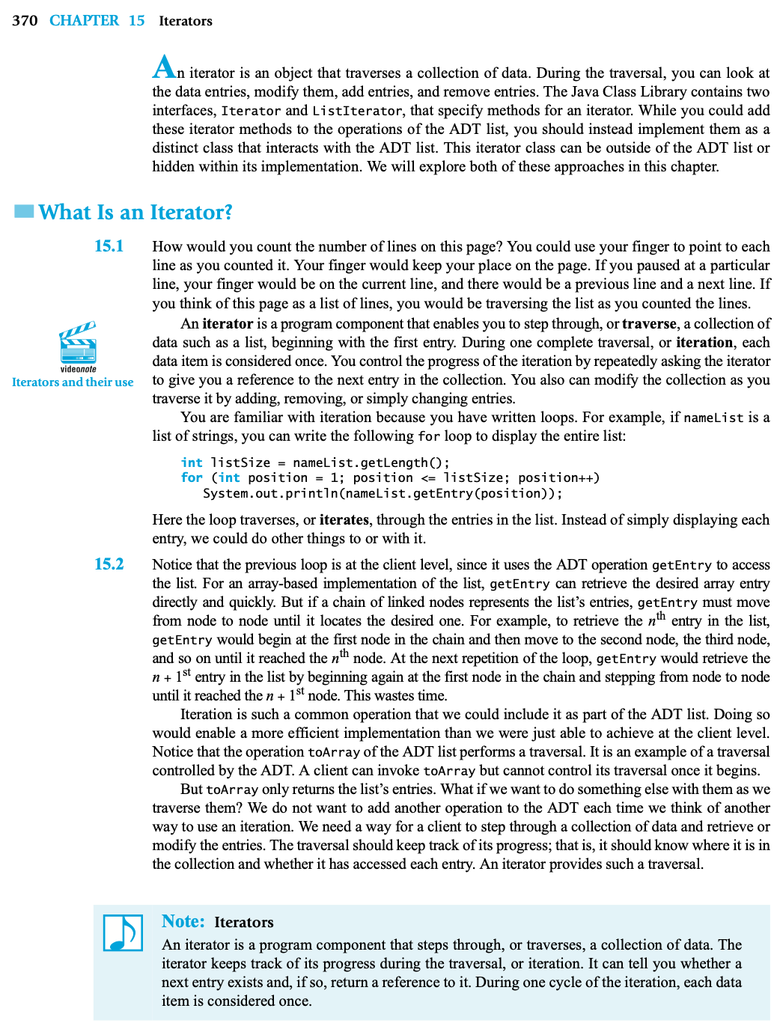


Iterators
An object that traverses a collection of data
During traversal, entries in collection can be modified, added and removed
Tracks progress through a collection
Knows
location in collection
if an item has been accessed
int listSize = nameList.getLength();
for (int position = 1; position <= listSize; position++)
std::cout << nameList.getEntry(position) << std::endl;
Notes:
This lecture introduces the concept of an iterator.
How would you count the number of lines on the page of a book?
@@ You could use your finger to point to each line as you counted it. Your finger would keep your place on the page. If you paused at a particular line, your finger would be on the current line, and there would be a previous line and a next line. If you think of this page as a list of lines, you would be traversing the list as you counted the lines.
@@ An iterator is a program component that enables you to step through, or traverse, a collection of data such as a list, by beginning at the first entry. During one complete traversal, or iteration, each data item is considered only once. You control the progress of the iteration by repeatedly asking the iterator to give you a reference to the next entry in the collection. You also can modify the collection as you traverse it by adding, removing, or simply changing entries.
We are already familiar with iteration because we’ve written loops.
@@ For example, if nameList is a list of strings, we can write a for loop such as this to display the entire list
Here the loop traverses, or iterates, through the entries in the list. Instead of simply displaying each entry, we could do other things to or with it.
@@ This loop works at the client level, since it uses the ADT operation getEntry to access the list. For an array-based implementation of the list, getEntry can retrieve the desired array entry directly and quickly. But if a chain of linked nodes represents the list’s entries, getEntry must move from node to node until it locates the desired one.
-- For example, to retrieve the nth entry in the list, getEntry would begin at the first node in the chain and then move to the second node, the third node, and so on until it reached the nth node. At the next repetition of the loop, getEntry would retrieve the n + 1st entry in the list by beginning again at the first node in the chain and stepping from node to node until it reached the n + 1st node. As you can see, this would be very inefficient and waste time - making this simple loop an order n² squared operation for the linked list.
-- Iteration is such a common operation that we could include it as part of the ADT list. Doing so would enable a more efficient implementation than we were just able to achieve at the client level.
@@We need a way for a client to step through a collection of data and retrieve or modify the entries. The traversal should keep track of its progress; that is, it should know where it is in the collection and whether it has accessed each entry. An iterator provides such a traversal.

Slide 3
Iterators
C++ Iterator Operations
Return the item that the iterator currently references
Move the iterator to the next item in the list
Move the iterator to the previous item in the list
used only for bidirectional or random iterators
Compare two iterators for equality
Compare two iterators for inequality
Return iterator to first item of container
Return iterator to last item or container
Operators
*
++
--
==
!=
begin()
end()

Slide 4
Iterators
myList is a LinkedList
Each call to getEntry requires us to count from the first entry to the entry at currentPosition
Displaying entire list in this scenario is O(n²)
An iterator maintains the current position in the list
Accessing current entry is O(1)
Process entire list is O(n)
int currentPosition = 1;
while (currentPosition <= myList.getLength())
{
std::cout << myList.getEntry(currentPosition); // O(n)
currentPosition++;
} // end while
LinkedIterator<ItemType> currentIterator = myList.begin();
while (currentIterator != myList.end())
{
std::cout << *currentIterator // O(1) operation
++currentIterator;
} // end while

Slide 5
Iterators
template<class ItemType>
class LinkedList;
template <class ItemType>
class LinkedIterator
{
private:
std::shared_ptr<Node<ItemType>> currentItemPtr;
public:
typedef std::forward_iterator_tag iterator_category;
typedef std::ptrdiff_t difference_type;
typedef ItemType value_type;
typedef ItemType* pointer;
typedef ItemType& reference;
LinkedIterator(std::shared_ptr<Node<ItemType>> nodePtr = nullptr);
const ItemType operator*();
LinkedIterator<ItemType> operator++();
bool operator==(const LinkedIterator<ItemType>& rightHandSide) const;
bool operator!=(const LinkedIterator<ItemType>& rightHandSide) const;
}; // end LinkedIterator
Input iterator
input_iterator_tag
Equality/inequality (==, !=),
access collection entry (*)
Output iterator
output_iterator_tag
Change a collection entry (*)
Forward iterator
forward_iterator_tag
Same as the input and output iterators and has a default constructor
Bidirectional iterator
bidirectional_iterator_tag
Same as the forward iterator, but also can traverse the collection backward (--)
LinkedIterator.h

Slide 6
Iterators
template<class ItemType>
class LinkedList;
template <class ItemType>
class LinkedIterator
{
private:
std::shared_ptr<Node<ItemType>> currentItemPtr;
public:
typedef std::forward_iterator_tag iterator_category;
typedef std::ptrdiff_t difference_type;
typedef ItemType value_type;
typedef ItemType* pointer;
typedef ItemType& reference;
LinkedIterator(std::shared_ptr<Node<ItemType>> nodePtr = nullptr);
const ItemType operator*();
LinkedIterator<ItemType> operator++();
bool operator==(const LinkedIterator<ItemType>& rightHandSide) const;
bool operator!=(const LinkedIterator<ItemType>& rightHandSide) const;
}; // end LinkedIterator
Random-access iterator
random_iterator_tag
Same as the bidirectional iterator and adds support for
arithmetic (+, -, +=, -=) and relational (<, <=, >, >=) operations
between iterators. Supports the [] operator to directly access
collection entries.
LinkedIterator.h

Slide 7
Iterators
template <class ItemType>
const ItemType LinkedIterator<ItemType>::operator*()
{
return currentItemPtr->getItem();
} // end operator*
template <class ItemType>
LinkedIterator<ItemType> LinkedIterator<ItemType>::operator++()
{
currentItemPtr = currentItemPtr->getNext();
return *this;
} // end prefix operator++
template <class ItemType>
bool LinkedIterator<ItemType>::operator==(const
LinkedIterator<ItemType>& rightHandSide) const
{
return (currentItemPtr == rightHandSide.currentItemPtr);
} // end operator==
LinkedIterator.cpp

Slide 8
Iterators
template<class ItemType>
class LinkedList : public ListInterface<ItemType>
{
private:
std::shared_ptr<Node<ItemType>> headPtr;
int itemCount;
auto getNodeAt(int position) const;
public:
LinkedList();
LinkedList(const LinkedList<ItemType>& aList);
virtual ~LinkedList();
bool isEmpty() const;
int getLength() const;
bool insert(int newPosition, const ItemType& newEntry);
bool remove(int position);
void clear();
ItemType getEntry(int position) const throw(PrecondViolatedExcep);
void setEntry(int position, const ItemType& newEntry)
throw(PrecondViolatedExcep);
LinkedIterator<ItemType> begin();
LinkedIterator<ItemType> end();
}; // end LinkedList
#include "LinkedList.cpp"
#endif
template <class ItemType>
LinkedIterator<ItemType> LinkedList<ItemType>::begin()
{
return LinkedIterator<ItemType>(headPtr);
} // end begin
template <class ItemType>
LinkedIterator<ItemType> LinkedList<ItemType>::end()
{
return LinkedIterator<ItemType>(nullptr);
} // end end
We can have multiple iterators that access our list.
LinkedList.cpp
LinkedList.h

