Slide 1
Chapter - 15
Simple Pointers

Slide 2
Things and Pointers to Things
There are things
and pointers to things
6
0x1000
thing_ptr
thing
0x1000

Slide 3
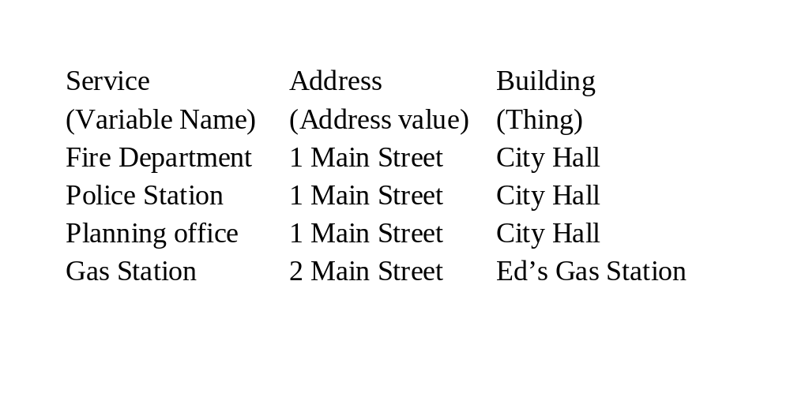
A Small Town

Slide 4
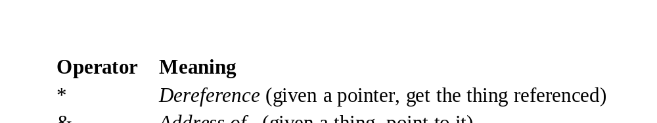
Pointer Operators
A pointer is declared by putting an asterisk (*) in front of the variable name in the declaration statement:
int thing; // define "thing"
int *thing_ptr; // define "pointer to a thing"
Pointer operations:

Slide 5
Things and pointers to things
Thing A thing.
thing = 4;
&thing A pointer to thing. thing is an object. The & (address of) operator gets the address of an object (a pointers), so &thing is a pointer.
Example:
thing_ptr = &thing; // Point to the thing
*thing_ptr = 5; // Set "thing" to 5
thing_ptr
Thing pointer.
*thing_ptr
A thing.
thing_ptr = 5; // Assign 5 to an integer
// We may or may not be
// pointing to the specific
// integer "thing"

Slide 6
Make "thing_ptr" point to "thing"
thing_ptr = &thing;
5
thing
0x156F
thing_ptr
0x156F

Slide 7
Copy data from thing pointed to by "thing_ptr" into "other"
other = *thing_ptr;
5
5
thing
0x156F
other
thing_ptr
0x156F
0x1834

Slide 8
Setting the item pointed to by "thing_ptr" to the value 6.
*thing_ptr = 6;
6
thing
0x156F
thing_ptr
0x156F

Slide 9
How not to use pointer operators
*thing
Illegal. Asks C++ to get the object pointed to by the variable thing. Since thing is not a pointer, this is an invalid operation.
&thing_ptr
Legal, but strange. thing_ptr is a pointer. The & (address of) operator gets a pointer to the object (in this case thing_ptr). Result is pointer to a pointer. (Pointers to pointers do occur in more complex programs.)

Slide 10
Pointer Usage
#include <iostream>
main()
{
int thing_var; // define a variable
int *thing_ptr; // define a pointer
thing_var = 2; // assigning a value to thing
std::cout <<"Thing " << thing_var << '\n';
thing_ptr = &thing_var; // make the pointer point to thing
*thing_ptr = 3; // thing_ptr points to thing_var so
// thing_var changes to 3
std::cout << "Thing " << thing_var << '\n';
// another way of printing the data
std::cout << "Thing " << *thing_ptr << '\n';
return (0);
}

Slide 11
Two pointers, one thing
1: int something;
2:
3: int *first_ptr; // one pointer
4: int *second_ptr; // another pointer
5:
6: something = 1; // give the thing a value
7:
8: first_ptr = &something;
9: second_ptr = first_ptr;
1
something
0x156F
0x156F
first_ptr
second_ptr
0x156F

Slide 12
Null Pointer
The null pointer points to nothing.
thing_ptr = NULL;
thing_ptr

Slide 13
const Pointers
There are several flavors of constant pointers. It’s important to know what the const apples to.
const char* first_ptr = "Forty-Two";
first_ptr = "Fifty six"; // Legal or Illegal
*first_ptr = 'X'; // Legal or Illegal
char* const second_ptr = "Forty-Two";
second_ptr = "Fifty six"; // Legal or Illegal
*second_ptr = 'X'; // Legal or Illegal
const char* const third_ptr = "Forty-Two";
third_ptr = "Fifty six"; // Legal or Illegal
*third_ptr = 'X'; // Legal or Illegal

Slide 14
Pointers and Printing
Example:
int an_integer = 5; // A simple integer
int *int_ptr = &an_integer; // Ptr to an integer
std::cout << "Integer pointer " << int_ptr << '\n';
outputs:
Integer pointer 0x58239A
Example:
// A Simple set of characters
char some_characters[10] = "Hello";
// Pointer to a character
char *char_ptr = &some_characters[0];
std::cout << "String pointer " << char_ptr << '\n';
outputs
String pointer Hello

Slide 15
Pointers and Arrays
char array[10];
char *array_ptr = &array[0];
0x5000
*array_ptr
0x5000 array[0]
0x5001 array[1]
0x5002 array[2]
0x5003 array[3]
0x5004 array[4]
0x5005 array[5]
0x5006 array[6]
0x5007 array[7]
0x5005
*(array_ptr+5)

Slide 16
Example
#include <iostream>
#include <iomanip.h>
const int ARRAY_SIZE = 10; // Number of characters in array
// Array to print
char array[ARRAY_SIZE] = "012345678";
int main()
{
int index; /* Index into the array */
for (index = 0; index < ARRAY_SIZE; ++index) {
std::cout << hex; // Trick to print hex numbers
std::cout <<
"&array[index]=0x" << int(&array[index]) <<
" (array+index)=0x" << int(array+index) <<
" array[index]=0x" << int(array[index]) << '\n',
std::cout << dec;
}
return (0);
}

Slide 17
Output
&array[index]=0x20090 (array+index)=0x20090 array[index]=0x30
&array[index]=0x20091 (array+index)=0x20091 array[index]=0x31
&array[index]=0x20092 (array+index)=0x20092 array[index]=0x32
&array[index]=0x20093 (array+index)=0x20093 array[index]=0x33
&array[index]=0x20094 (array+index)=0x20094 array[index]=0x34
&array[index]=0x20095 (array+index)=0x20095 array[index]=0x35
&array[index]=0x20096 (array+index)=0x20096 array[index]=0x36
&array[index]=0x20097 (array+index)=0x20097 array[index]=0x37
&array[index]=0x20098 (array+index)=0x20098 array[index]=0x38
&array[index]=0x20099 (array+index)=0x20099 array[index]=0x0

Slide 18
Array Shorthand
array_ptr = &array[0];
is the same as:
array_ptr = array;

Slide 19
Summing an Array (Index Version)
#include <iostream>
int array[10] = {4, 5, 8, 9, 8, 1, 0, 1, 9, 3};
int index;
int main()
{
index = 0;
while (array[index] != 0)
++index;
std::cout << "Number of elements before zero "
<< index << '\n';
return (0);
}

Slide 20
Same Program Using Pointers
#include <iostream>
int array[10] = {4, 5, 8, 9, 8, 1, 0, 1, 9, 3};
int *array_ptr;
main()
{
array_ptr = array;
while ((*array_ptr) != 0)
++array_ptr;
std::cout << "Number of elements before zero " <<
(array_ptr - array) << '\n';
return (0);
}

Slide 21
Zeroing an array
const int MAX = 10;
void init_array_1(int data[])
{
int index;
for (index = 0; index < MAX; ++index)
data[index] = 0;
}
void init_array_2(int *data_ptr)
{
int index;
for (index = 0; index < MAX; ++index)
*(data_ptr + index) = 0;
}
int main()
{
int array[MAX];
// one way of initializing the array
init_array_1(array);
// another way of initializing the array
init_array_1(&array[0]);
// Similar to the first method but
// function is different
init_array_2(array);
return (0);
}

Slide 22
Splitting a C style string
after
strchar
after
*first_ptr = '\0'
after
++first_ptr
last_ptr
S
m
i
t
h
/
J
o
h
n
last_ptr
S
m
i
t
h
\0
J
o
h
n
last_ptr
S
m
i
t
h
/
J
o
h
n
first_ptr
first_ptr
first_ptr

Slide 23
Splitting a string
#include <iostream>
#include <string.h>
#include <stdlib.h>
main() {
char line[80]; // The input line
char *first_ptr; // ptr we set to point to the first name
char *last_ptr; // ptr we set to point to the last name
std::cin.getline(line, sizeof(line));
last_ptr = line; // last name is at beginning of line
first_ptr = strchr(line, '/'); // Find slash
// Check for an error
if (first_ptr == NULL) {
cerr << "Error: Unable to find slash in " << line <<
'\n';
exit (8);
}
*first_ptr = '\0'; // Zero out the slash
++first_ptr; // Move to first character of name
std::cout << "First:" << first_ptr << " Last:" << last_ptr << '\n';
return (0);
}
char *strchr(char * string_ptr, char find) {
while (*string_ptr != find) {
// Check for end
if (*string_ptr == '\0')
return (NULL); // not found
++string_ptr;
}
return (string_ptr); // Found
}

Slide 24
Question: Why does this program print garbage?
#include <iostream>
#include <string.h>
/********************************************************
* tmp_name -- return a temporary file name *
* *
* Each time this function is called, a new name will *
* be returned. *
* *
* Returns *
* Pointer to the new file name. *
********************************************************/
char *tmp_name(void)
{
char name[30]; // The name we are generating
static int sequence = 0; // Sequence number for last digit
++sequence; // Move to the next file name
strcpy(name, "tmp");
// Put in the sequence digit
name[3] = sequence + '0';
// End the string
name[4] = '\0';
return(name);
}
int main()
{
std::cout << "Name: " << tmp_name() << '\n';
return(0);
}

Slide 25
Pointers and Structures
struct mailing {
char name[60]; // last name, first name
char address1[60];// Two lines of street address
char address2[60];
char city[40];
char state[2]; // Two character abbreviation
long int zip; // numeric zip code
} list[MAX_ENTRIES];
// Pointer to the data
struct mailing *list_ptrs[MAX_ENTRIES];
int current; // current mailing list entry
// ....
for (current = 0; current = number_of_entries; ++current)
list_ptrs = &list[current];
// Sort list_ptrs by zip code

Slide 26
Command Line Arguments
int main(int argc, char *argv[])
{
argc The number of arguments (program counts as one, so this number is always >= 1).
argv The arguments (program name is argv[0]).
Example:
args this is a test
turns into:
argc = 5
argv[0] = "args"
argv[1] = "this"
argv[2] = "is"
argv[3] = "a"
argv[4] = "test"

Slide 27
Example
Our mission is to make the following program:
print_file [-v] [-l<length>]
[-o<name>] [file1] [file2] ...
-v Verbose option. Turns on a lot of progress information messages.
-l<length>
Set the page size to <length> lines. (Default = 66).
-o<name>
Set the output file to <name>. (Default = print.out)

Slide 28
print_file
/********************************************************
* print -- format files for printing *
********************************************************/
#include <iostream>
#include <stdlib.h>
int verbose = 0; // verbose mode (default = false)
char *out_file = "print.out"; // output file name
char *program_name; // name of the program (for errors)
int line_max = 66; // number of lines per page
/********************************************************
* do_file -- dummy routine to handle a file *
* *
* Parameter *
* name -- name of the file to print *
********************************************************/
void do_file(char *name) {
std::cout << "Verbose " << verbose <<
" Lines " << line_max <<
" Input " << name <<
" Output " << out_file << '\n';
}

Slide 29
print_file (cont)
/********************************************************
* usage -- tell the user how to use this program and *
* exit *
********************************************************/
void usage(void)
{
cerr << "Usage is " << program_name <<
" [options] [file-list]\n";
cerr << "Options\n";
cerr << " -v verbose\n";
cerr << " -l<number> Number of lines\n";
cerr << " -o<name> Set output file name\n";
exit (8);
}

Slide 30
print_file (cont)
main(int argc, char *argv[])
{
// save the program name for future use
program_name = argv[0];
/*
* loop for each option.
* Stop if we run out of arguments
* or we get an argument without a dash.
*/
while ((argc > 1) && (argv[1][0] == '-')) {
/*
* argv[1][1] is the actual option character.
*/
switch (argv[1][1]) {
/*
* -v verbose
*/
case 'v':
verbose = 1;
break;

Slide 31
print_file (cont)
/*
* -o<name> output file
* [0] is the dash
* [1] is the "o"
* [2] starts the name
*/
case 'o':
out_file = &argv[1][2];
break;
/*
* -l<number> set max number of lines
*/
case 'l':
line_max = atoi(&argv[1][2]);
break;
default:
cerr << "Bad option " << argv[1] <<'\n';
usage();
}

Slide 32
print_file (cont)
/*
* move the argument list up one
* move the count down one
*/
++argv;
--argc;
}
/*
* At this point all the options have been processed.
* Check to see if we have no files in the list
* and if so, we need to list just standard in.
*/
if (argc == 1) {
do_file("print.in");
} else {
while (argc > 1) {
do_file(argv[1]);
++argv;
--argc;
}
}
return (0);
}

