Slide 1
Chapter 3:
Data Abstraction: The Walls
Data Abstraction & Problem Solving with
C++
Fifth Edition
by Frank M. Carrano

Slide 2
Abstract Data Types
Modularity
  Keeps the complexity of a large program manageable by systematically controlling the interaction of its components
  Isolates errors
  Eliminates redundancies

Slide 3
Abstract Data Types
Modularity (Continued)
  A modular program is
    Easier to write
    Easier to read
    Easier to modify

Slide 4
Abstract Data Types
Functional abstraction
  Separates the purpose and use of a module from its implementation
  A module’s specifications should
    Detail how the module behaves
    Be independent of the module’s implementation

Slide 5
Abstract Data Types
Information hiding
  Hides certain implementation details within a module
  Makes these details inaccessible from outside the module

Slide 6
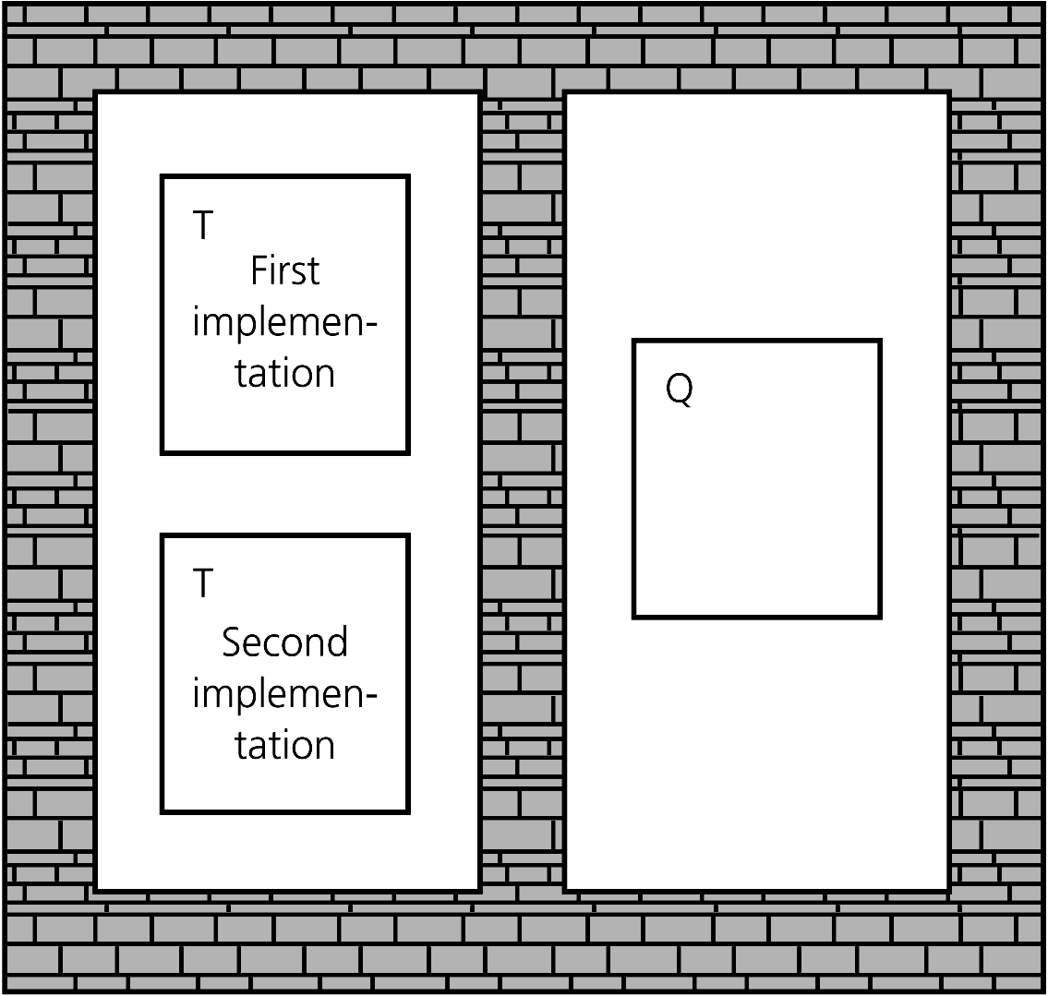
Abstract Data Types
Figure 3-1
Isolated tasks: the implementation of task T does not affect task Q

Slide 7
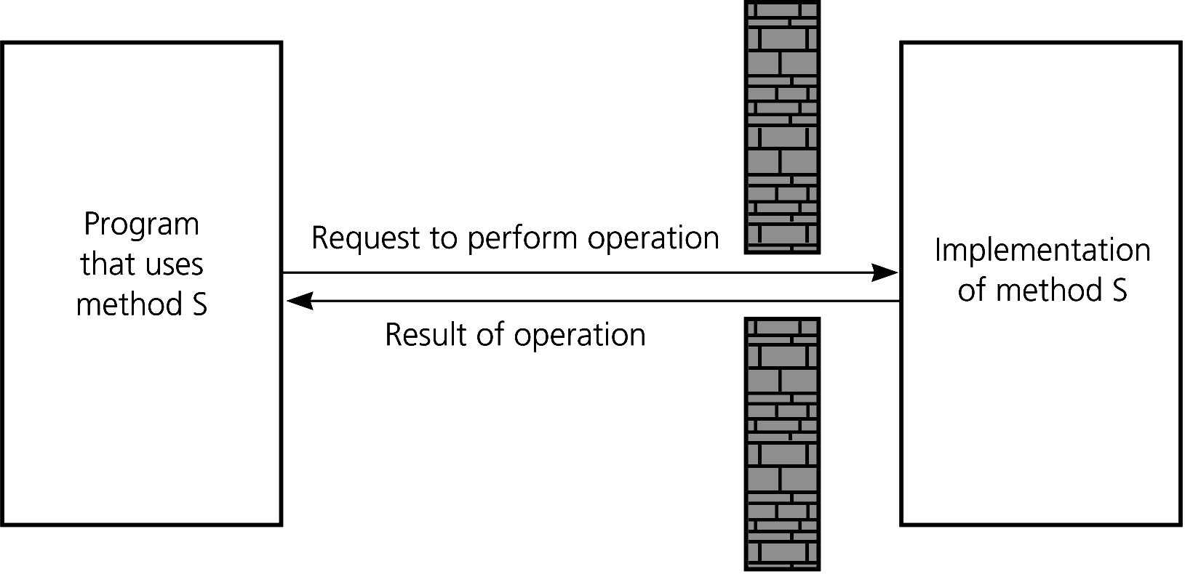
Abstract Data Types
The isolation of modules is not total
  A function’s specification, or contract, governs how it interacts with other modules
Figure 3-2 A slit in the wall

Slide 8
Abstract Data Types
Typical operations on data
  Add data to a data collection
  Remove data from a data collection
  Ask questions about the data in a data collection

Slide 9
Abstract Data Types
Data abstraction
  Asks you to think what you can do to a collection of data independently of how you do it
  Allows you to develop each data structure in relative isolation from the rest of the solution
  A natural extension of functional abstraction

Slide 10
Abstract Data Types
Abstract data type (ADT)
  An ADT is composed of
    A collection of data
    A set of operations on that data
  Specifications of an ADT indicate
    What the ADT operations do, not how to implement them
  Implementation of an ADT
    Includes choosing a particular data structure

Slide 11
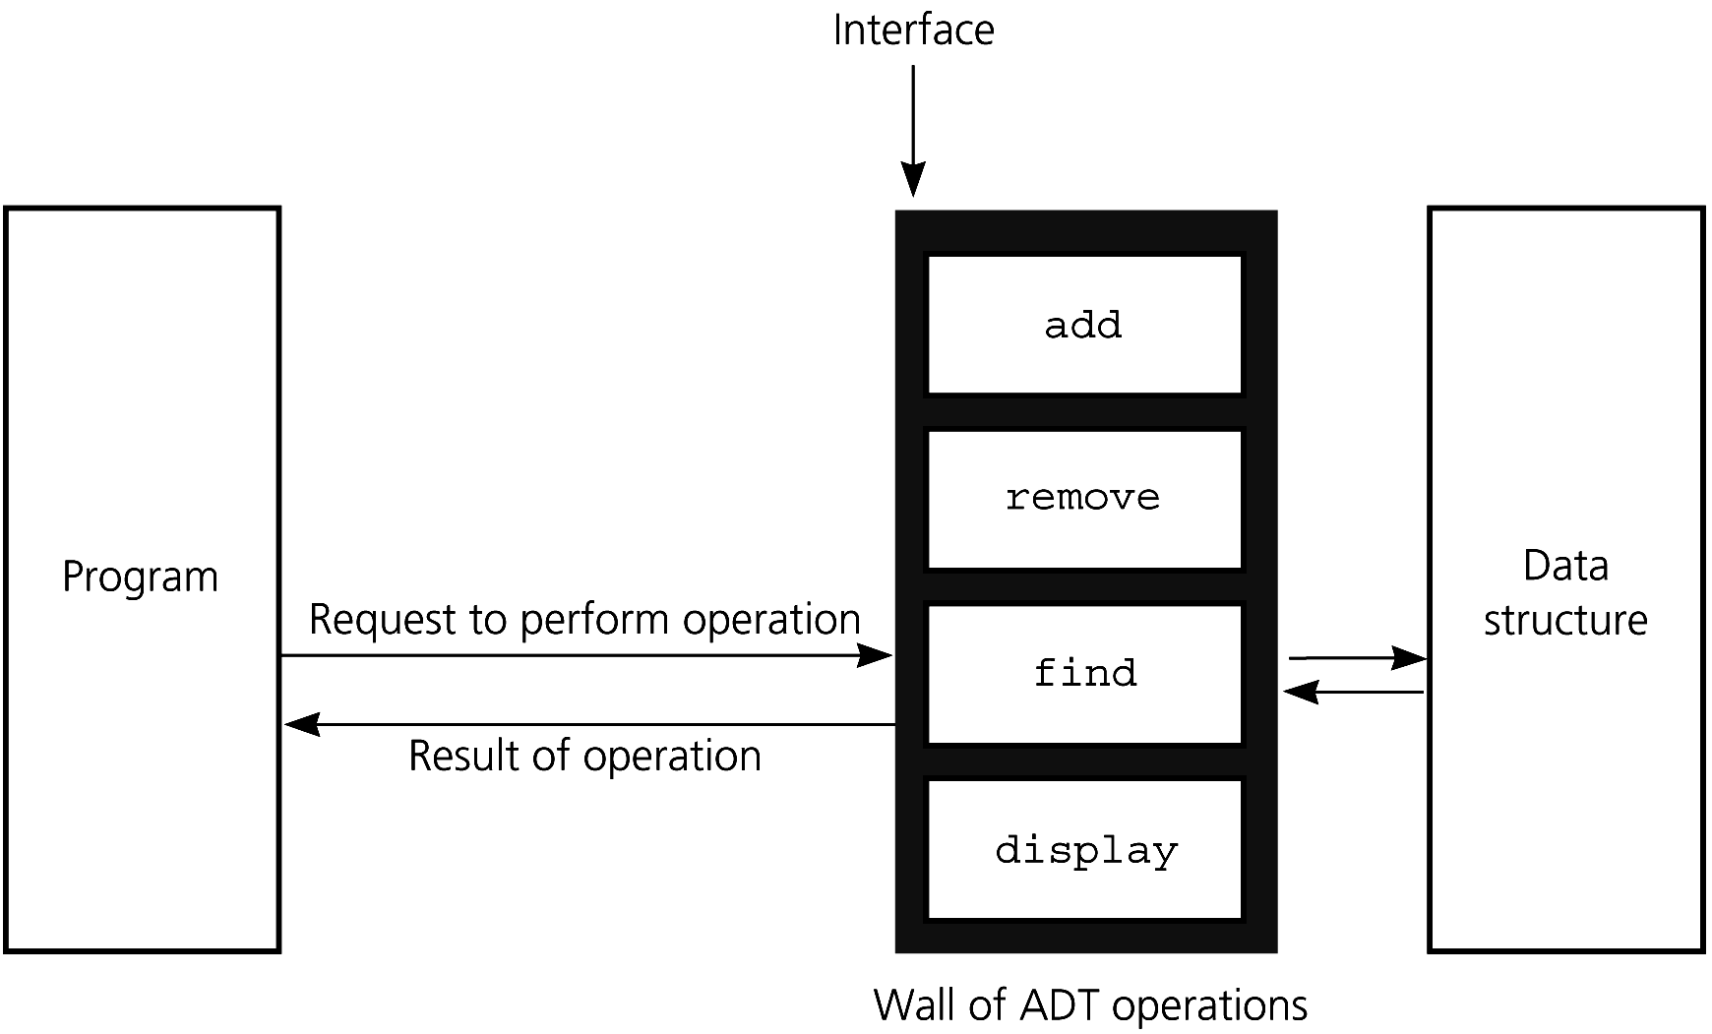
Abstract Data Types
Figure 3-4
A wall of ADT operations isolates a data structure from the program that uses it

Slide 12
Specifying ADTs: The ADT List
Except for the first and last items in a list, each item has a unique predecessor and a unique successor
Head (or front) does not have a predecessor
Tail (or end) does not have a successor

Slide 13
The ADT List
Items are referenced by their position within the list
Specifications of the ADT operations
  Define an operation contract for the ADT list
  Do not specify how to store the list or how to perform the operations
ADT operations can be used in an application without the knowledge of how the operations will be implemented

Slide 14
The ADT List
ADT List Operations
  Create an empty list
  Destroy a list
  Determine whether a list is empty
  Determine the number of items in a list
  Insert an item at a given position in the list
  Delete the item at a given position in the list
  Look at (retrieve ) the item at a given position in the list

Slide 15
The ADT List
Operation Contract for the ADT List
  createList()
  destroyList()
  isEmpty():boolean {query}
  getLength():integer {query}
  insert(in index:integer, in newItem:ListItemType, out success:boolean)
  remove(in index:integer, out success:boolean)
  retrieve(in index:integer, out dataItem:ListItemType, out success:boolean) {query}

Slide 16
The ADT List
Pseudocode to create the list
milk, eggs, butter
  aList.createList()
  aList.insert(1, milk, success)
  aList.insert(2, eggs, success)
  aList.insert(3, butter, success)

Slide 17
The ADT List
milk, eggs, butter
Insert bread after milk
aList.insert(2, bread, success)
milk, bread, eggs, butter
Insert juice at end of list
aList.insert(5, juice, success)
milk, bread, eggs, butter, juice

Slide 18
The ADT List
milk, bread, eggs, butter, juice
Remove eggs
aList.remove(3, success)
milk, bread, butter, juice
Insert apples at beginning of list
aList.insert(1, apples, success)
apples, milk, bread, butter, juice

Slide 19
The ADT List
apples, milk, bread, butter, juice
Pseudocode function that displays a list
displayList(in aList:List)
for (position = 1 to aList.getLength())
{ aList.retrieve(position, dataItem, success)
Display dataItem
} // end for

Slide 20
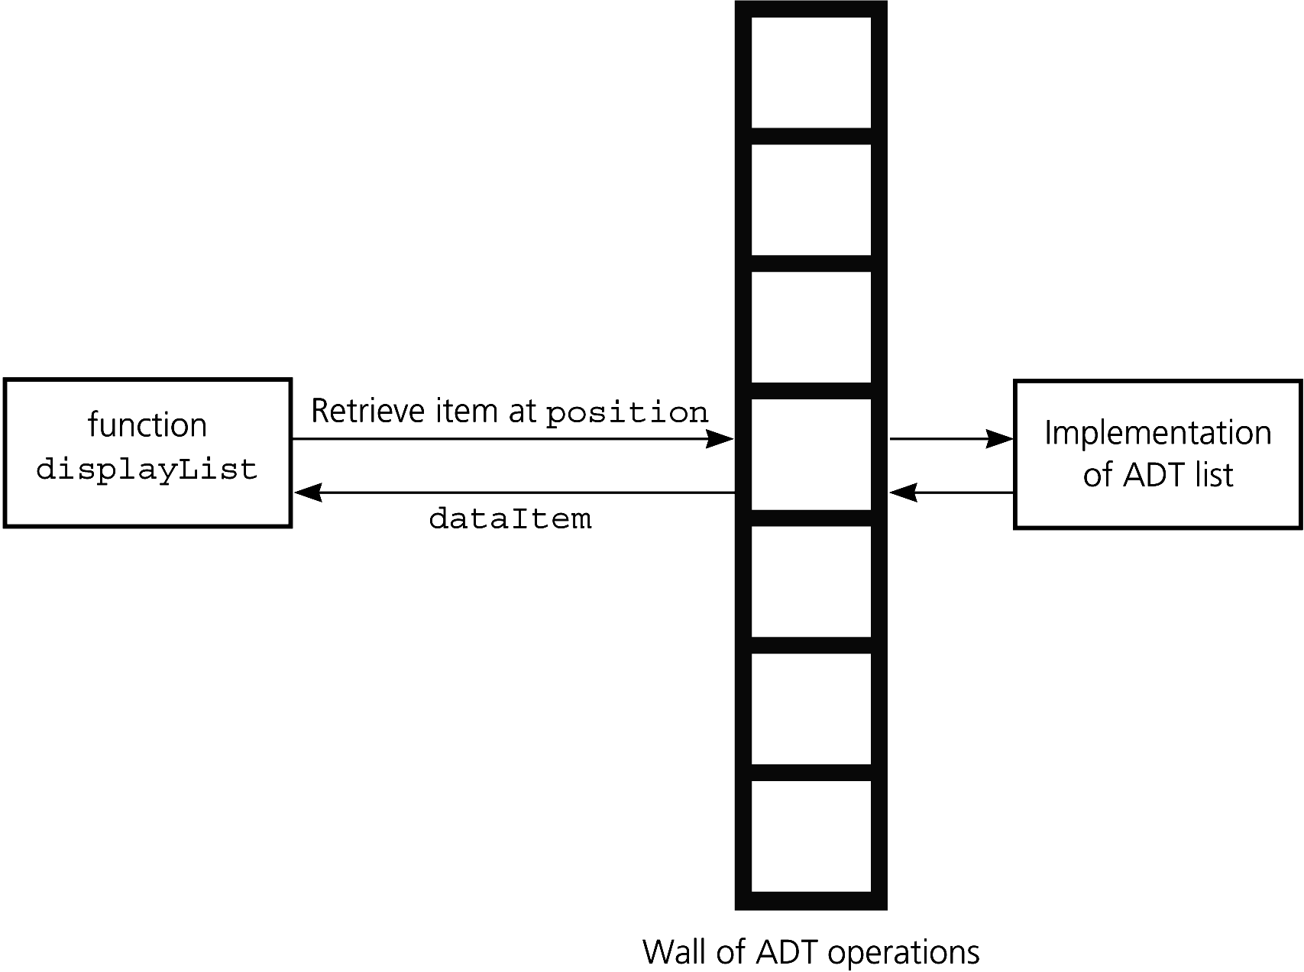
The ADT List
Figure 3-7
The wall between displayList and the implementation of the ADT list

Slide 21
The ADT Sorted List
The ADT sorted list
  Maintains items in sorted order
  Inserts and deletes items by their values, not their positions

Slide 22
The ADT Sorted List
Operation Contract for the ADT Sorted List
  sortedIsEmpty():boolean{query}
  sortedGetLength():integer{query}
  sortedInsert(in newItem:ListItemType, out success:boolean)
  sortedRemove(in index:integer, out success :boolean)
  sortedRetrieve(in index:integer,
  out dataItem:ListItemType,
  out success :boolean){query}
  locatePosition(in anItem:ListItemType,
  out isPresent:boolean):integer{query}

Slide 23
Designing an ADT
The design of an ADT should evolve naturally during the problem-solving process
Questions to ask when designing an ADT
  What data does a problem require?
  What operations does a problem require?

Slide 24
Designing an ADT
For complex abstract data types, the behavior of the operations must be specified using axioms
  Axiom: A mathematical rule
  Example : (aList.createList()).size() = 0

Slide 25
Implementing ADTs
Choosing the data structure to represent the ADT’s data is a part of implementation
  Choice of a data structure depends on
    Details of the ADT’s operations
    Context in which the operations will be used

Slide 26
Implementing ADTs
Implementation details should be hidden behind a wall of ADT operations
  A program (client) should only be able to access the data structure by using the ADT operations

Slide 27
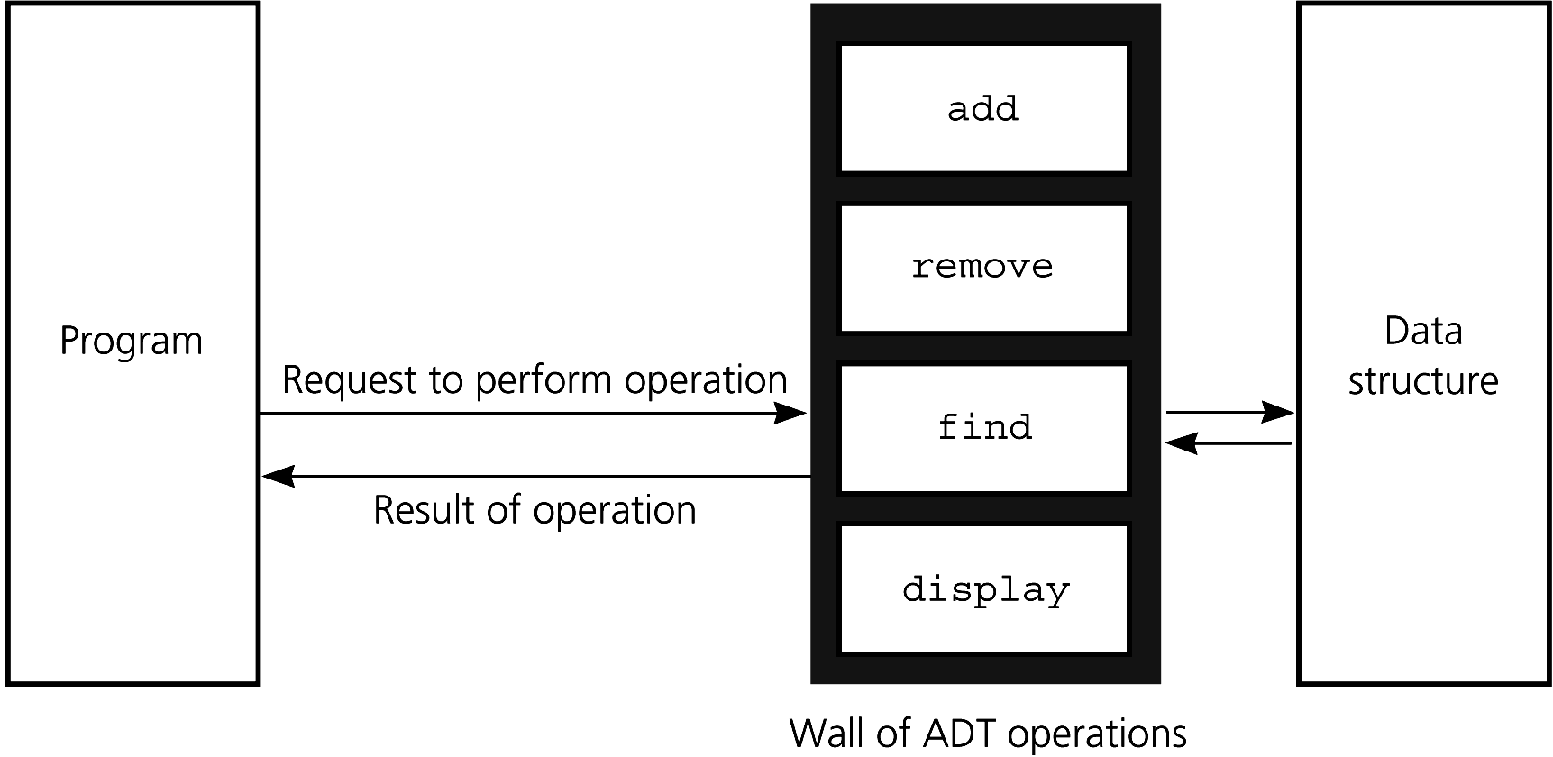
Implementing ADTs
Figure 3-8
ADT operations provide access to a data structure

Slide 28
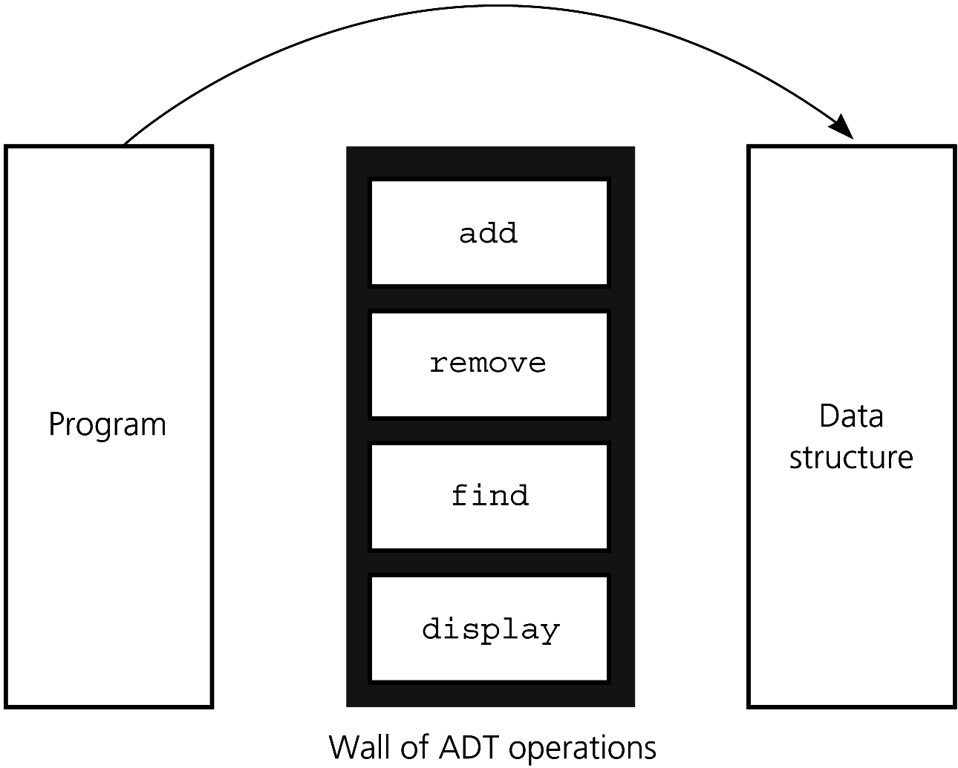
Implementing ADTs
Figure 3-9 Violating the wall of ADT operations

Slide 29
C++ Classes
Encapsulation combines an ADT’s data with its operations to form an object
  An object is an instance of a class
  A class defines a new data type
  A class contains data members and methods (member functions)
  By default, all members in a class are private
    But you can specify them as public
  Encapsulation hides implementation details

Slide 30
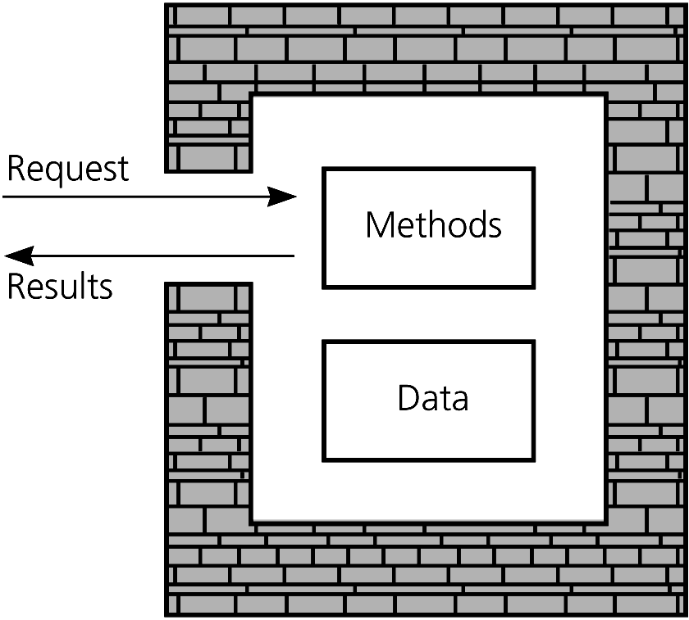
C++ Classes
Figure 3-10
An object’s data and methods are encapsulated

Slide 31
C++ Classes
Each class definition is placed in a header file
  Classname.h
The implementation of a class’s methods are placed in an implementation file
  Classname.cpp

Slide 32
C++ Classes: The header file
/** @file Sphere.h */
const double PI = 3.14159;
class Sphere
{
public:
Sphere(); // Default constructor
Sphere(double initialRadius); // Constructor
void setRadius(double newRadius);
double getRadius() const; // can’t change data members
double getDiameter() const;
double getCircumference() const;
double getArea() const;
double getVolume() const;
void displayStatistics() const;
private:
double theRadius; // data members should be private
}; // end Sphere

Slide 33
C++ Classes: Constructors
Constructors
  Create and initialize new instances of a class
    Invoked when you declare an instance of the class
  Have the same name as the class
  Have no return type, not even void
A class can have several constructors
  A default constructor has no arguments
  The compiler will generate a default constructor if you do not define any constructors

Slide 34
C++ Classes: Constructors
The implementation of a method qualifies its name with the scope resolution operator ::
The implementation of a constructor
  Sets data members to initial values
    Can use an initializer
Sphere::Sphere() : theRadius(1.0)
{
} // end default constructor
  Cannot use return to return a value

Slide 35
C++ Classes: Destructors
Destructor
  Destroys an instance of an object when the object’s lifetime ends
Each class has one destructor
  For many classes, you can omit the destructor
  The compiler will generate a destructor if you do not define one
    For now, we will use the compiler’s destructor

Slide 36
C++ Classes: The implementation file
/** @file Sphere.cpp */
#include <iostream>
#include "Sphere.h" // header file
using namespace std;
Sphere::Sphere() : theRadius(1.0)
{
} // end default constructor
Sphere::Sphere(double initialRadius)
{
if (initialRadius > 0)
theRadius = initialRadius;
else
theRadius = 1.0;
} // end constructor

Slide 37
C++ Classes: The implementation file
void Sphere::setRadius(double newRadius)
{
if (newRadius > 0)
theRadius = newRadius;
else
theRadius = 1.0;
} // end setRadius
The constructor could call setRadius

Slide 38
C++ Classes: The implementation file
double Sphere::getRadius() const
{
return theRadius;
} // end getRadius
. . .
double Sphere::getArea() const
{
return 4.0 * PI * theRadius * theRadius;
} // end getArea
. . .

Slide 39
C++ Classes: Using the class Sphere
#include <iostream>
#include "Sphere.h" // header file
using namespace std;
int main() // the client
{
Sphere unitSphere;
Sphere mySphere(5.1);
cout << mySphere.getDiameter() << endl;
. . .
} // end main

Slide 40
Inheritance in C++
A derived class or subclass inherits any of the publicly defined methods or data members of a base class or superclass
  #include “Sphere.h”
  enum Color {RED, BLUE, GREEN, YELLOW};
  class ColoredSphere: public Sphere
  {
  public:
  …
  Color getColor() const;
  …
  private:
  Color c;
  } // end ColoredSphere

Slide 41
Inheritance in C++
An instance of a derived class is considered to also be an instance of the base class
  Can be used anywhere an instance of the base class can be used
An instance of a derived class can invoke public methods of the base class

Slide 42
C++ Namespaces
A mechanism for logically grouping declarations and definitions into a common declarative region
namespace myNamespace
{
  // Declarations . . .
  } //end myNamespace

Slide 43
C++ Namespaces
The contents of the namespace can be accessed by code inside or outside the namespace
  Use the scope resolution operator (::) to access elements from outside the namespace
  Alternatively, the using declaration allows the names of the elements to be used directly

Slide 44
C++ Namespaces
Creating a namespace
  namespace smallNamespace
  {
  int count = 0;
  void abc();
  } // end smallNamespace
Using a namespace
  using namespace smallNamespace;
  count +=1;
  abc();

Slide 45
C++ Namespaces
Items declared in the C++ Standard Library are declared in the std namespace
You include files for several functions declared in the std namespace
  To include input and output functions from the C++ library, write
    #include <iostream>
    using namespace std;

Slide 46
An Array-Based ADT List
Both an array and a list identify their items by number
  Using an array to represent a list is a natural choice
  Store a list’s items in an array items
Distinguish between the list’s length and the array’s size
  Keep track of the list’s length

Slide 47
An Array-Based ADT List
Header file
/** @file ListA.h */
const int MAX_LIST = maximum-size-of-list;
typedef desired-type-of-list-item ListItemType;
class List
{
public:
. . .
private:
ListItemType items[MAX_LIST];
int size;
} // end List

Slide 48
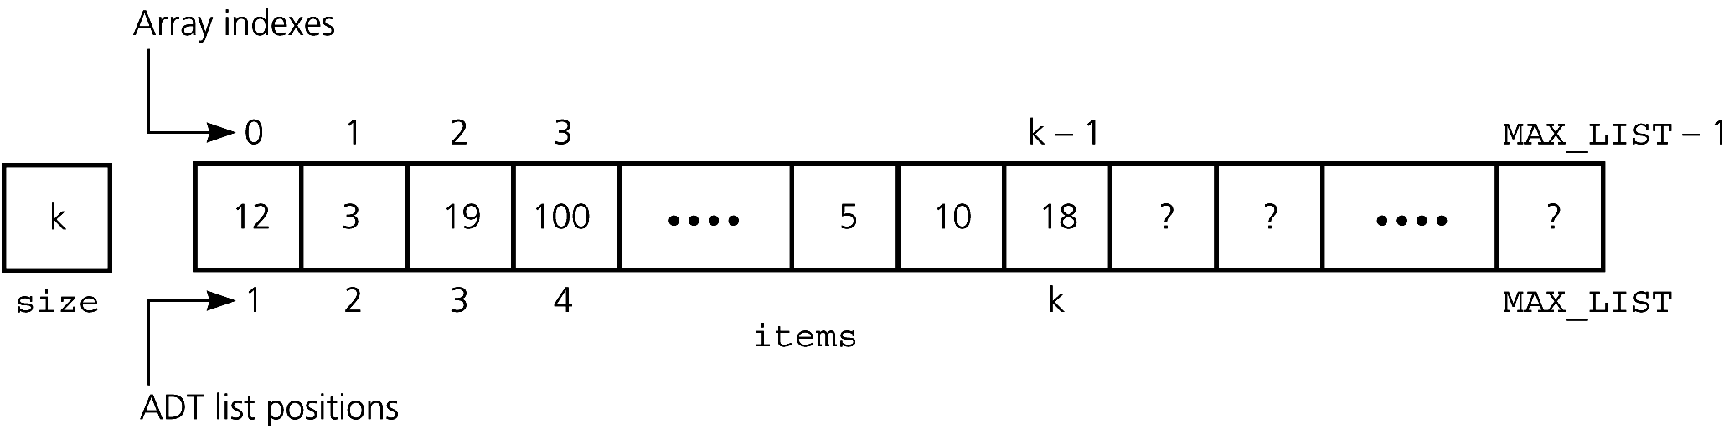
An Array-Based ADT List
A list’s k^{th} item is stored in items[k-1]
Figure 3-11 An array-based implementation of the ADT list

Slide 49
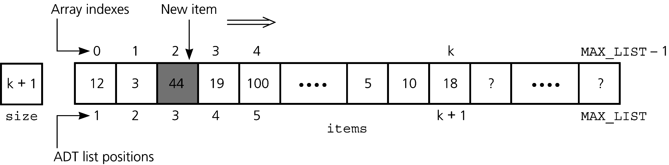
An Array-Based ADT List
To insert an item, make room in the array
Figure 3-12 Shifting items for insertion at position 3

Slide 50
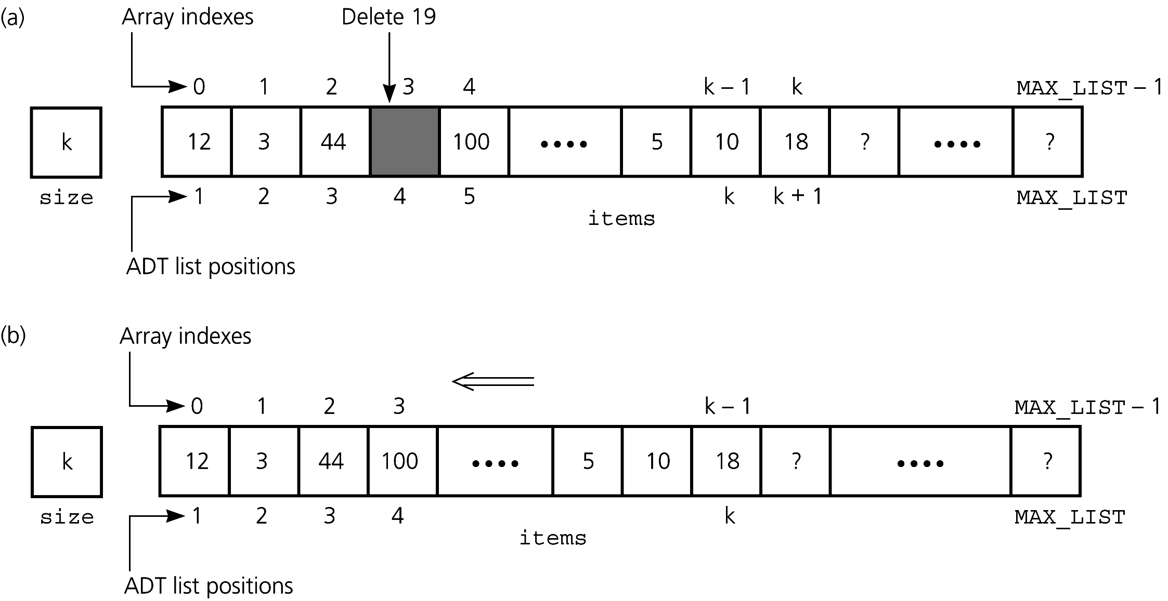
An Array-Based ADT List
To delete an item, remove gap in array
Figure 3-13 (a) Deletion causes a gap; (b) fill gap by shifting

Slide 51
C++ Exceptions
Exception
  A mechanism for handling an error during execution
  A function can indicate that an error has occurred by throwing an exception
  The code that deals with the exception is said to handle it
    Uses a try block and catch blocks

Slide 52
C++ Exceptions
try block
  Place a statement that might throw an exception within a try block
  try
  {
  statement(s);
  }

Slide 53
C++ Exceptions
catch block
  Deals with an exception
  catch (ExceptionClass identifier)
  {
  statement(s);
  }
Write a catch block for each type of exception handled

Slide 54
C++ Exceptions
When a statement in a try block causes an exception
  Rest of try block is ignored
    Destructors of objects local to the block are called
  Control passes to catch block corresponding to the exception
  After a catch block executes, control passes to statement after last catch block associated with the try block

Slide 55
C++ Exceptions
Throwing exceptions
  A throw statement throws an exception
    throw ExceptionClass(stringArgument);
  Methods that throw an exception have a throw clause
  void myMethod(int x) throw(MyException)
  {
  if (. . .)
  throw MyException(“MyException: …”);
  . . .
  } // end myMethod
You can use an exception class in the C++ Standard Library or define your own

Slide 56
An ADT List Implementation Using Exceptions
We define two exception classes
#include <stdexcept>
#include <string>
using namespace std;
class ListIndexOutOfRangeException :
public out_of_range
{
public:
ListIndexOutOfRangeException(const string &
message = “”)
  : out_of_range(message.c_str())
  {}
}; // end ListException

Slide 57
An ADT List Implementation Using Exceptions
#include <stdexcept>
#include <string>
using namespace std;
class ListException : public logic_error
{
public:
ListException(const string & message = “”)
  : logic_error(message.c_str())
  {}
}; // end ListException

Slide 58
An ADT List Implementation Using Exceptions
/** @file ListAexcept.h */
#include “ListException.h”
#include “ListIndexOutOfRangeException.h”
. . .
class List
{
public:
. . .
void insert(int index,
const ListItemType& newItem)
throw(ListIndexOutOfRangeException,
ListException);
. . .
} // end List

Slide 59
An ADT List Implementation Using Exceptions
/** @file ListAexcept.cpp */
void List::insert(int index,
const ListItemType& newItem)
throw(ListIndexOutOfRangeException,
ListException);
{
if (size > MAX_LIST)
throw ListException(“ListException: ” +
“List full on insert”);
. . .
} // end insert

Slide 60
Summary
Data abstraction controls the interaction between a program and its data structures
Abstract data type (ADT): a set of data-management operations together with the data values upon which they operate
Axioms specify the behavior of ADT operations in a formal mathematical study of an ADT
Define an ADT fully before making any decisions about an implementation

Slide 61
Summary
Hide an ADT’s implementation by defining the ADT as a C++ class
An object encapsulates both data and operations
A class contains one destructor and at least one constructor
The compiler generates
  A default constructor if no constructor is provided
  A destructor if none is provided

Slide 62
Summary
Members of a class are private by default
  Data members are typically private
  Public methods can be provided to access them
Define and implement a class within header and implementation files
Namespace: a mechanism to group classes, functions, variables, types, and constants
You can throw an exception if you detect an error during program execution. You handle, or deal with, an exception by using try and catch blocks

