Slide 1
Chapter 4:
Linked Lists
Data Abstraction & Problem Solving with
C++
Fifth Edition
by Frank M. Carrano

Slide 2
Preliminaries
Options for implementing an ADT List
  Array has a fixed size
    Data must be shifted during insertions and deletions
  Linked list is able to grow in size as needed
    Does not require the shifting of items during insertions and deletions

Slide 3
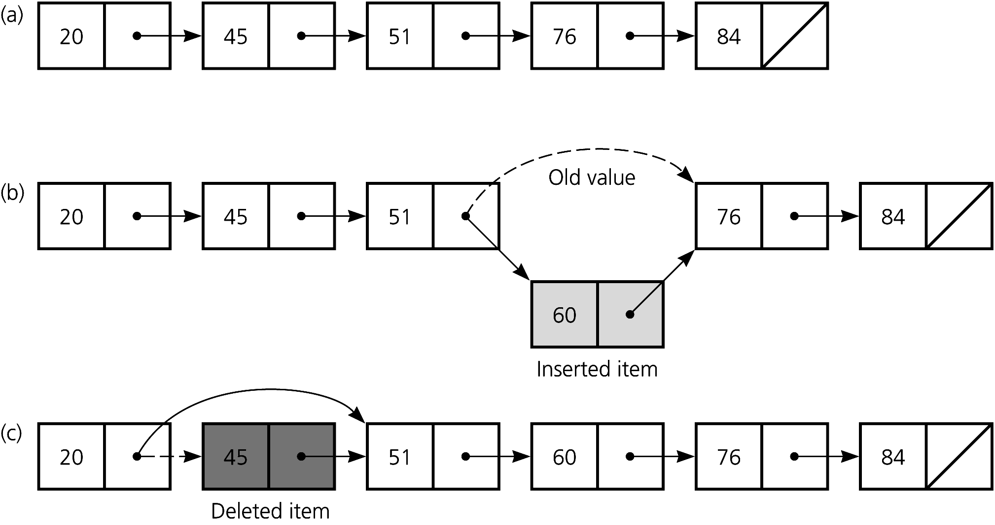
Preliminaries
Figure 4-1 (a) A linked list of integers; (b) insertion; (c) deletion

Slide 4
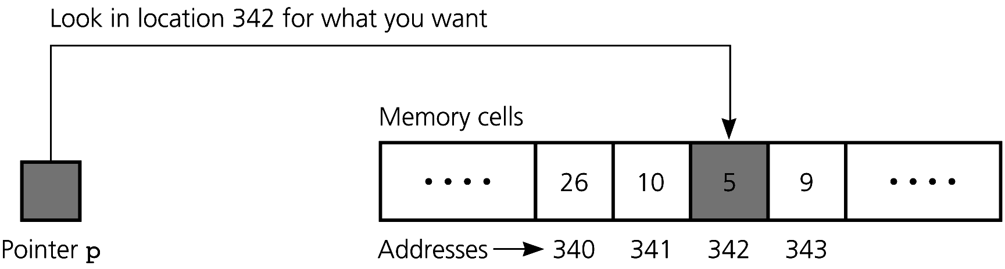
Pointers
A pointer contains the location, or address in memory, of a memory cell
  Declaration of an integer pointer variable p
    int *p;
    Initially undefined, but not NULL
    Static allocation
Figure 4-2 A pointer to an integer

Slide 5
Pointers
The expression *p represents the memory cell to which p points
To place the address of a variable into a pointer variable, you can use
  The address-of operator &
  p = &x;
  The new operator
  p = new int;
    Dynamic allocation of a memory cell that can contain an integer
    If the operator new cannot allocate memory, it throws the exception std::bad_alloc (in the <new> header)

Slide 6
Pointers
The delete operator returns dynamically allocated memory to the system for reuse, and leaves the variable’s contents undefined
  delete p;
  A pointer to a deallocated memory (*p) cell is possible and dangerous
  p = NULL; // safeguard

Slide 7
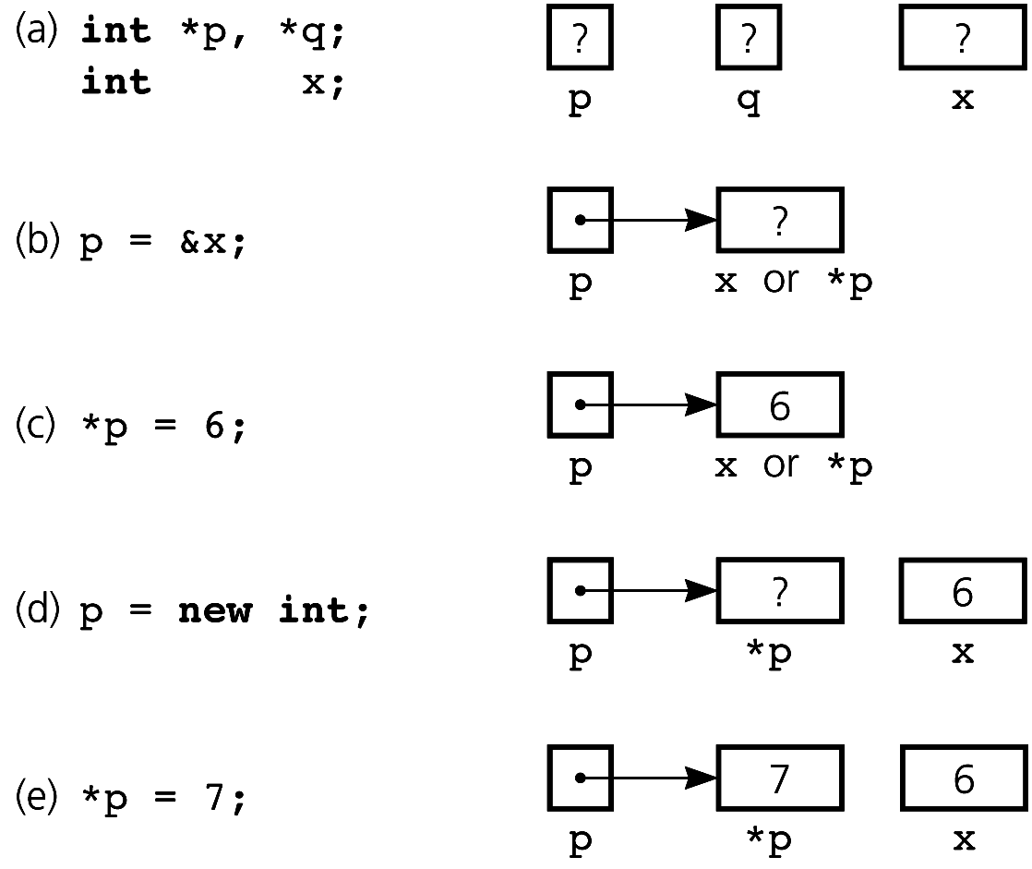
Pointers
Figure 4-3 (a) Declaring pointer variables; (b) pointing to statically allocated memory; (c) assigning a value;
(d) allocating memory dynamically; (e) assigning a value

Slide 8
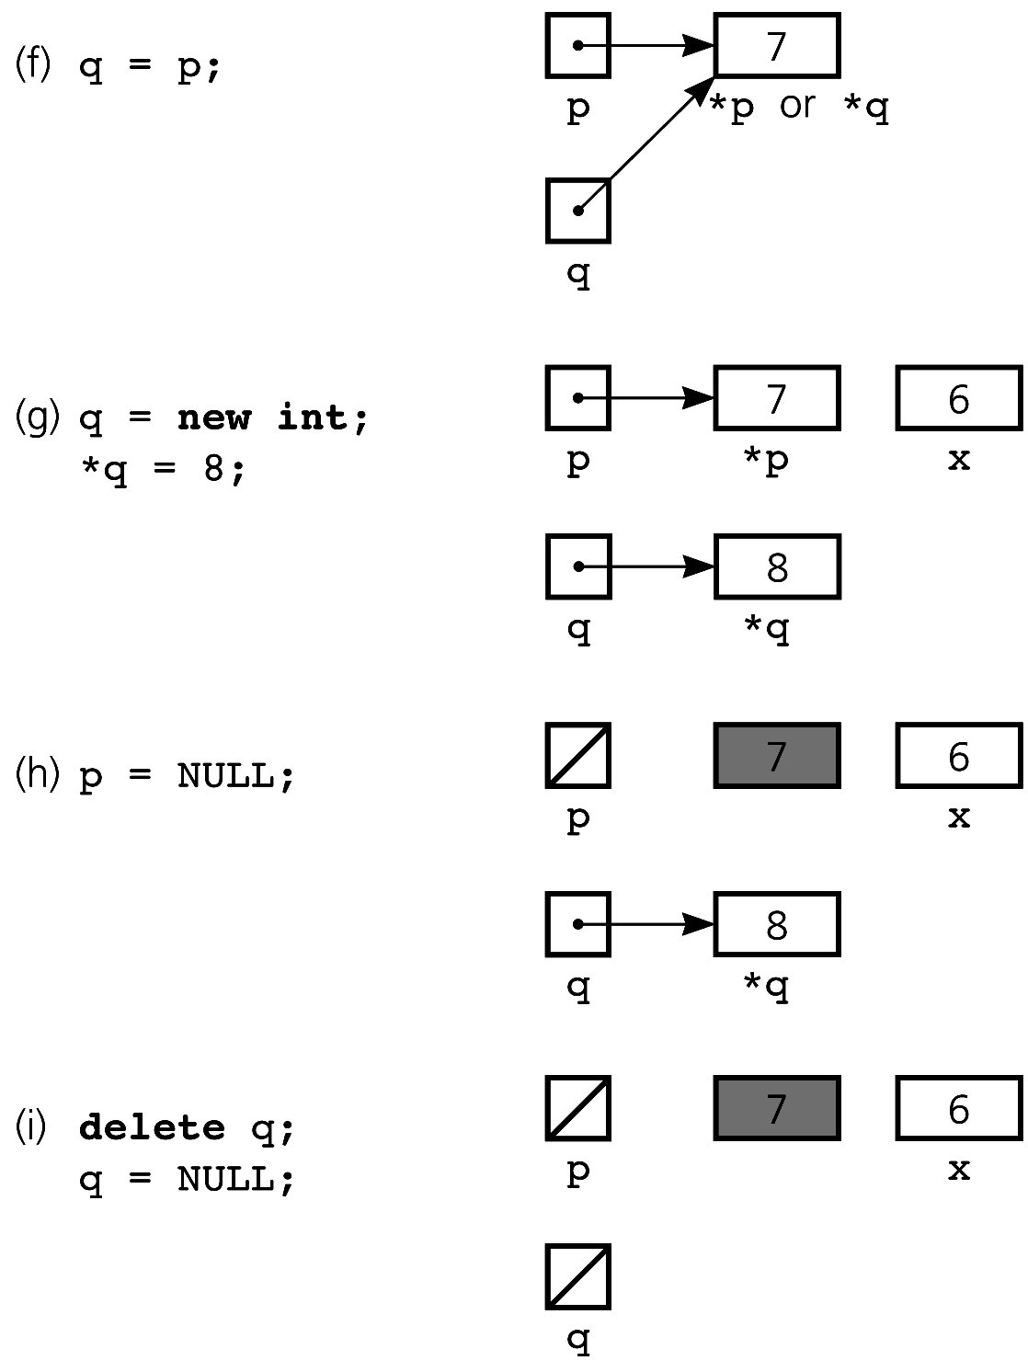
Pointers
Figure 4-3 continued
(f) copying a pointer;
(g) allocating memory dynamically and assigning a value;
(h) assigning NULL to a pointer variable;
(i) deallocating memory

Slide 9
Dynamic Allocation of Arrays
You can use the new operator to allocate an array dynamically
int arraySize = 50;
double *anArray = new double[arraySize ];
An array name is a pointer to the array’s first element
The size of a dynamically allocated array can be increased
  double *oldArray = anArray;
  anArray = new double[2*arraySize];

Slide 10
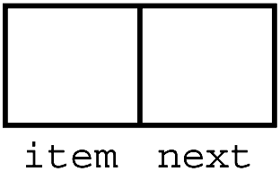
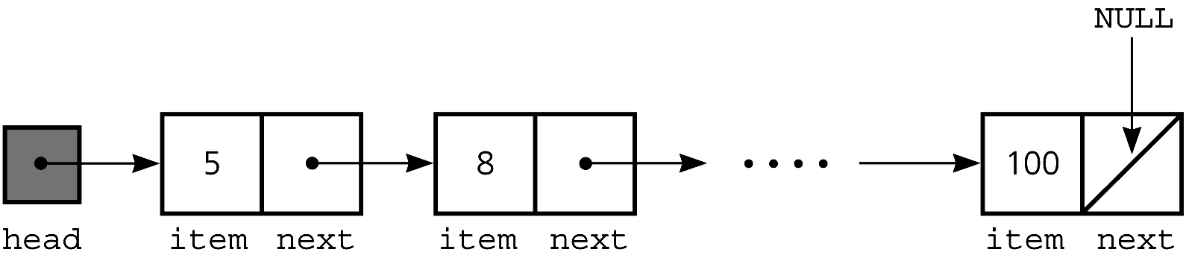
Pointer-Based Linked Lists
A node in a linked list is usually a struct
  struct Node
  { int item
  Node *next;
  }; // end Node
The head pointer points to the first node in a linked list
Figure 4-6 A node
Figure 4-7 A head pointer to a list

Slide 11
Pointer-Based Linked Lists
If head is NULL, the linked list is empty
A node is dynamically allocated
  Node *p; // pointer to node
  p = new Node; // allocate node

Slide 12
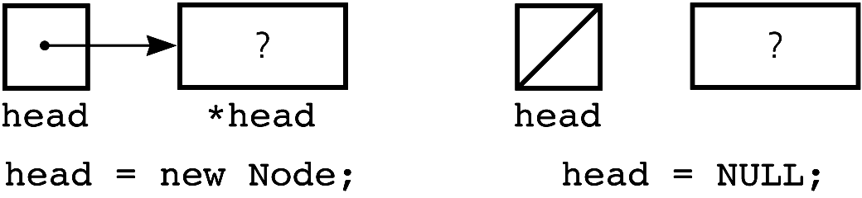
Pointer-Based Linked Lists
Executing the statement
head = new Node
before
head = NULL
will result in a lost cell
Figure 4-8 A lost cell

Slide 13
Displaying the Contents of a Linked List
Reference a node member with the -> operator
  p->item
A traverse operation visits each node in the linked list
  A pointer variable cur keeps track of the current node
  for (Node *cur = head; cur != NULL;
  cur = cur->next)
    cout << cur->item << endl;

Slide 14
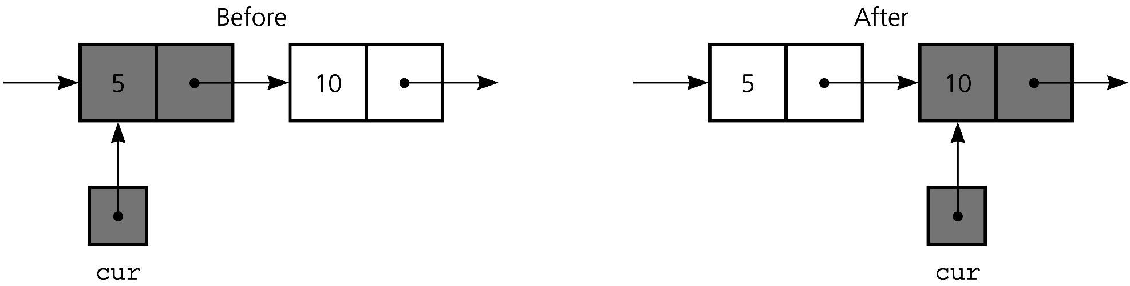
Displaying the Contents of a Linked List
Figure 4-9
The effect of the assignment cur = cur->next

Slide 15
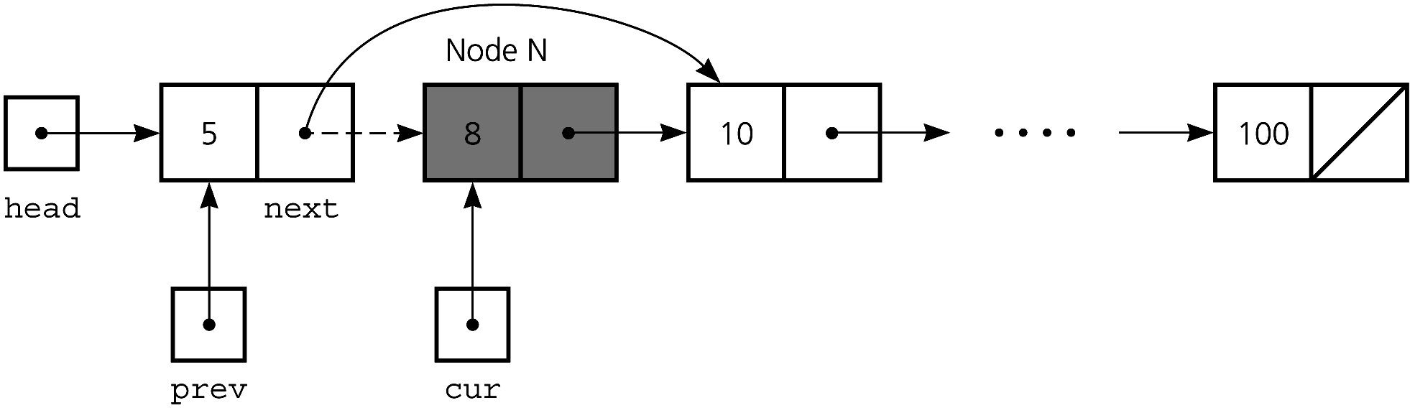
Deleting a Specified Node from a Linked List
Deleting an interior node
  prev->next = cur->next;
Figure 4-10 Deleting a node from a linked list

Slide 16
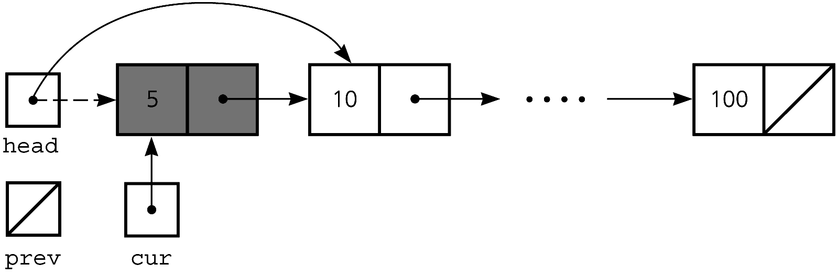
Deleting a Specified Node from a Linked List
Deleting the first node
  head = head->next;
Figure 4-11 Deleting the first node

Slide 17
Deleting a Specified Node from a Linked List
Return deleted node to system
    cur->next = NULL;
    delete cur;
    cur = NULL;

Slide 18
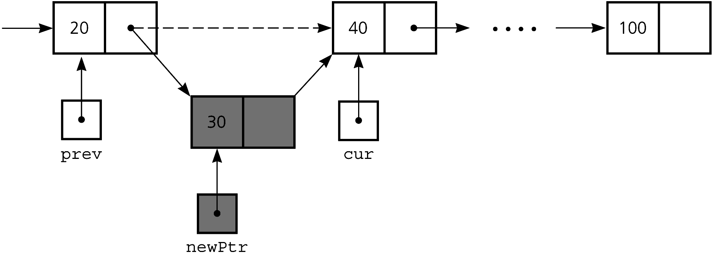
Inserting a Node into a Specified Position of a Linked List
To insert a node between two nodes
    newPtr->next = cur;
    prev->next = newPtr;
Figure 4-12
Inserting a new node into a linked list

Slide 19
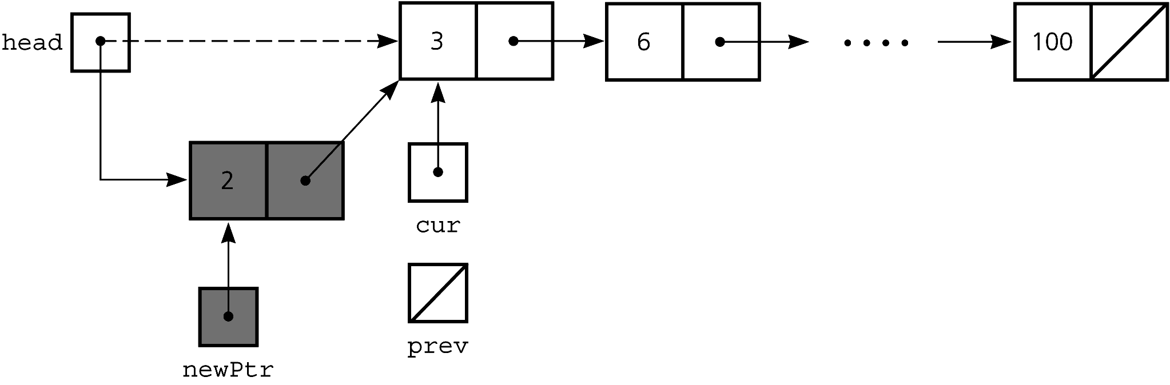
Inserting a Node into a Specified Position of a Linked List
To insert a node at the beginning of a linked list
    newPtr->next = head;
    head = newPtr;
Figure 4-13
Inserting at the beginning of a linked list

Slide 20
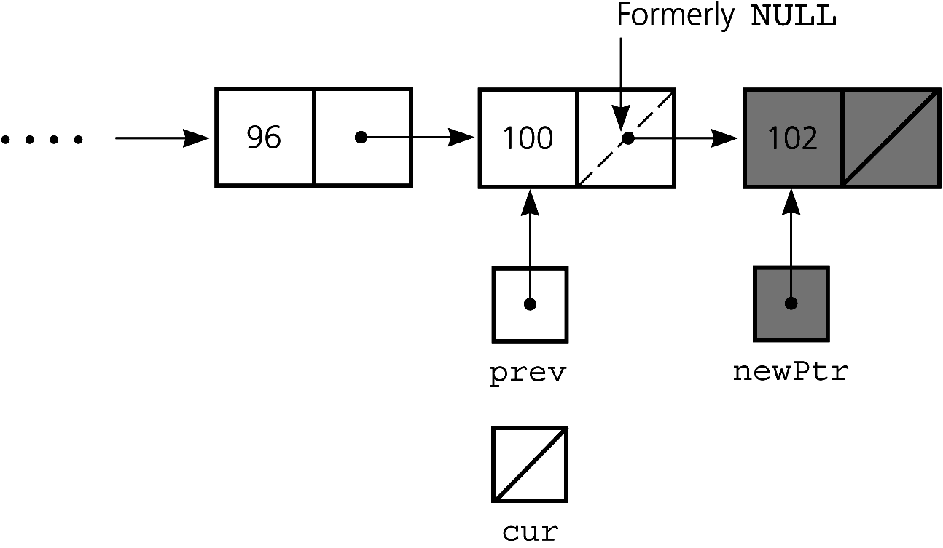
Inserting a Node into a Specified Position of a Linked List
Inserting at the end of a linked list is not a special case if cur is NULL
  newPtr->next = cur;
  prev->next = newPtr;
Figure 4-14
Inserting at the end of a linked list

Slide 21
Inserting a Node into a Specified Position of a Linked List
Finding the point of insertion or deletion for a sorted linked list of objects
Node *prev, *cur;
for (prev = NULL, cur = head;
  (cur != NULL) && (newValue > cur->item);
  prev = cur, cur = cur->next);

Slide 22
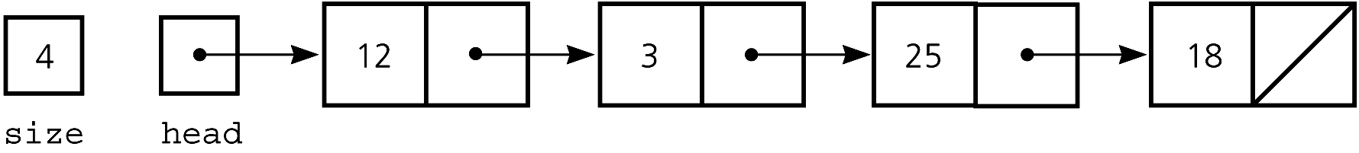
A Pointer-Based Implementation of the ADT List
Figure 4-17 A pointer-based implementation of a linked list

Slide 23
A Pointer-Based Implementation of the ADT List
Public methods
  isEmpty
  getLength
  insert
  remove
  retrieve
Private method
  find
Private data members
  head
  size
Local variables to methods
  cur
  prev

Slide 24
Constructors and Destructors
Default constructor initializes size and head
A destructor is required for dynamically allocated memory
List::~List()
{
while (!isEmpty())
remove(1);
} // end destructor

Slide 25
Constructors and Destructors
Copy constructor creates a deep copy
  Copies size, head, and the linked list
  The copy of head points to the copied linked list
In contrast, a shallow copy
  Copies size and head
  The copy of head points to the original linked list
If you omit a copy constructor, the compiler generates one
  But it is only sufficient for implementations that use statically allocated arrays

Slide 26
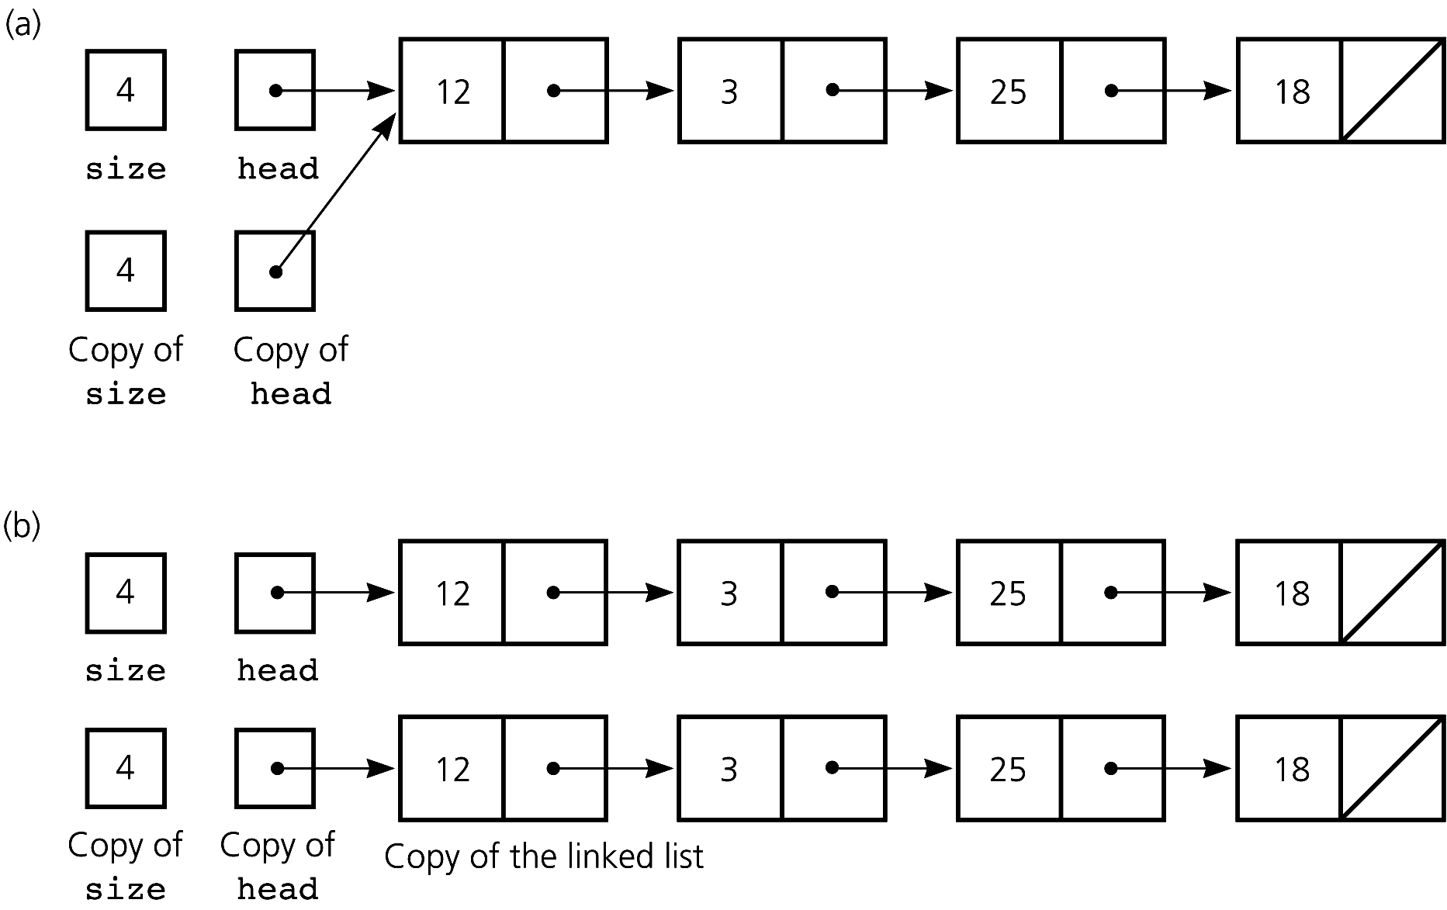
Shallow Copy vs. Deep Copy
Figure 4-18 Copies of the linked list in Figure 4-17; (a) a shallow copy; (b) a deep copy

Slide 27
Comparing Array-Based and Pointer-Based Implementations
Size
  Increasing the size of a resizable array can waste storage and time
  Linked list grows and shrinks as necessary
Storage requirements
  Array-based implementation requires less memory than a pointer-based one for each item in the ADT

Slide 28
Comparing Array-Based and Pointer-Based Implementations
Retrieval
  The time to access the i^{th} item
    Array-based: Constant (independent of i)
    Pointer-based: Depends on i
Insertion and deletion
  Array-based: Requires shifting of data
  Pointer-based: Requires a traversal

Slide 29
Saving and Restoring a Linked List by Using a File
Use an external file to preserve the list between runs of a program
Write only data to a file, not pointers
Recreate the list from the file by placing each item at the end of the linked list
  Use a tail pointer to facilitate adding nodes to the end of the linked list
  Treat the first insertion as a special case by setting the tail to head

Slide 30
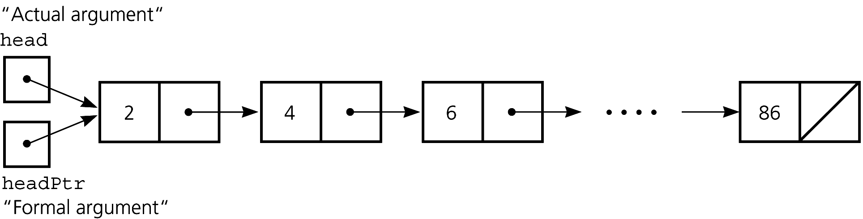
Passing a Linked List to a Method
A method with access to a linked list’s head pointer has access to the entire list
Pass the head pointer to a method as a reference argument
  Enables method to change value of the head pointer itself (value argument would not)
Figure 4-22 A head pointer as a value argument

Slide 31
Processing Linked Lists Recursively
Recursive strategy to display a list
  Write the first item in the list
  Write the rest of the list (a smaller problem)
Recursive strategies to display a list backward
  First strategy
    Write the last item in the list
    Write the list minus its last item backward

Slide 32
Processing Linked Lists Recursively
  Second strategy
    Write the list minus its first item backward
    Write the first item in the list
Recursive view of a sorted linked list
  The linked list to which head points is a sorted list if
    head is NULL or
    head->next is NULL or
    head->item < head->next->item, and
    head->next points to a sorted linked list

Slide 33
Objects as Linked List Data
Data in a node of a linked list can be an instance of a class
  typedef ClassName ItemType;
  struct Node
  { ItemType item;
  Node *next;
  }; //end struct
  Node *head;

Slide 34
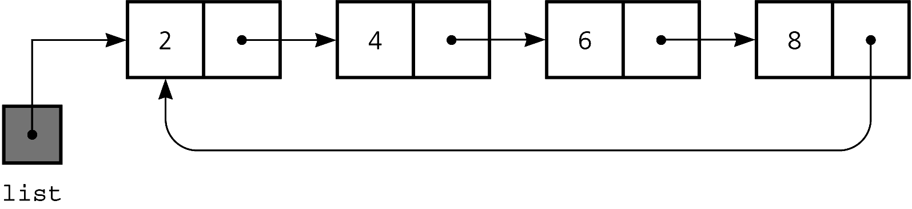
Variations: Circular Linked Lists
Last node points to the first node
Every node has a successor
No node in a circular linked list contains NULL
Figure 4-25 A circular linked list

Slide 35
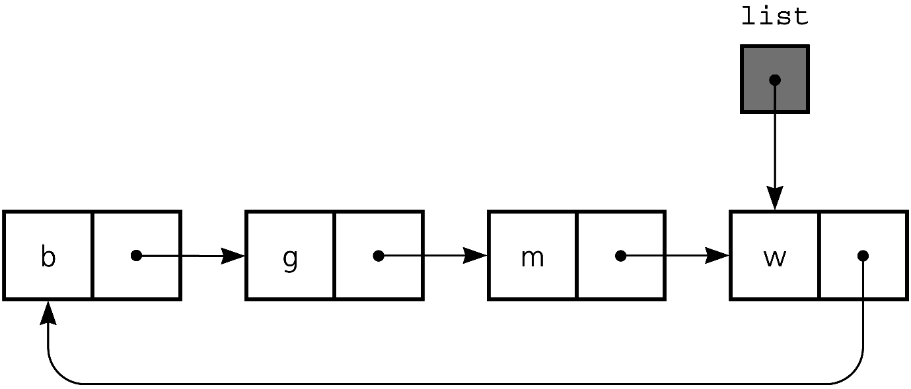
Variations: Circular Linked Lists
Access to last node requires a traversal
Make external pointer point to last node instead of first node
  Can access both first and last nodes without a traversal
Figure 4-26 A circular linked list with an external pointer to the last node

Slide 36
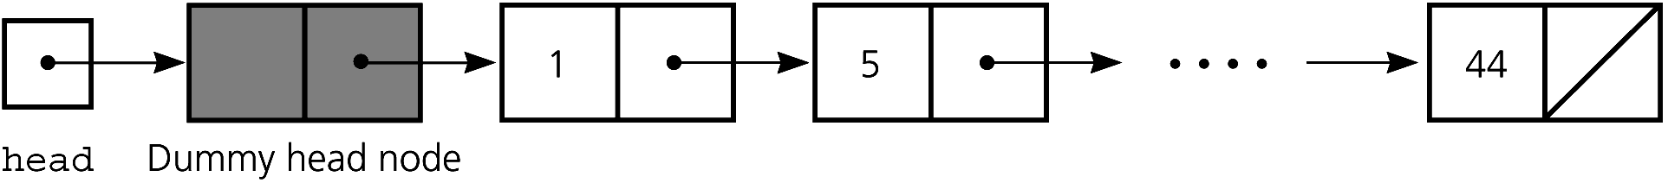
Variations: Dummy Head Nodes
Dummy head node
  Always present, even when the linked list is empty
  Insertion and deletion algorithms initialize prev to point to the dummy head node, rather than to NULL
    Eliminates special case
Figure 4-27 A dummy head node

Slide 37
Variations: Doubly Linked Lists
Each node points to both its predecessor and its successor
  precede pointer and next pointer
  Insertions/deletions more involved than for a singly linked list
  Often has a dummy head node
  Often circular to eliminate special cases

Slide 38
Variations: Doubly Linked Lists
Circular doubly linked list with dummy head node
  precede pointer of the dummy head node points to the last node
  next pointer of the last node points to the dummy head node
  No special cases for insertions and deletions

Slide 39
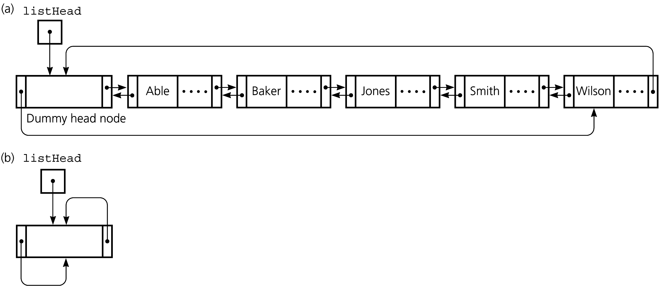
Variations: Doubly Linked Lists
Figure 4-29 (a) A circular doubly linked list with a dummy head node
(b) An empty list with a dummy head node

Slide 40
Variations: Doubly Linked Lists
To delete the node to which cur points
  (cur->precede)->next = cur->next;
  (cur->next)->precede = cur->precede;
To insert a new node pointed to by newPtr before the node pointed to by cur
  newPtr->next = cur;
  newPtr->precede = cur->precede;
  cur->precede = newPtr;
  newPtr->precede->next = newPtr;

Slide 41
Application: Maintaining an Inventory
Operations on the inventory
  List the inventory in alphabetical order by title (L command)
  Find the inventory item associated with title (I, M, D, O, and S commands)
  Replace the inventory item associated with a title (M, D, R, and S commands)
  Insert new inventory items (A and D commands)

Slide 42
The C++ Standard Template Library
The STL contains class templates for some common ADTs, including the list class
The STL provides support for predefined ADTs through three basic items
  Containers
    Objects that hold other objects
  Algorithms
    That act on containers
  Iterators
    Provide a way to cycle through the contents of a container

Slide 43
Summary
The C++ new and delete operators enable memory to be dynamically allocated and recycled
Each pointer in a linked list is a pointer to the next node in the list
Algorithms for insertions and deletions in a linked list involve traversing the list and performing pointer changes
  Use the operator new to allocate a new node and the operator delete to deallocate a node

Slide 44
Summary
Special cases
  Inserting a node at the beginning of a linked list
  Deleting the first node of a linked list
Array-based lists use an implicit ordering scheme; pointer-based lists use an explicit ordering scheme
  Pointer-based requires memory to represent pointers
Arrays enable direct access of an element;
Linked lists require a traversal

Slide 45
Summary
Inserting an item into a linked list does not shift data, an important advantage over array-based implementations
A class that allocates memory dynamically needs an explicit copy constructor and destructor
If you omit a copy constructor or destructor, the compiler generates one
  But such methods are only sufficient for implementations that use statically allocated arrays

Slide 46
Summary
You can increase the size of a linked list one node at a time more efficiently that you can increase the size of an array by one location
  Increasing the size of an array involves copying
A binary search of a linked list is impractical, because you cannot quickly locate its middle item
You can save the data in a linked list in a file, and later restore the list

Slide 47
Summary
Recursion can be used to perform operations on a linked list
  Eliminates special cases and trailing pointer
Recursive insertion into a sorted linked list considers smaller and smaller sorted lists until the actual insertion occurs at the beginning of one of them

Slide 48
Summary
In a circular linked list, the last node points to the first node
  The external pointer points to the last node
A dummy head node eliminates the special cases for insertion into and deletion from the beginning of a linked list

Slide 49
Summary
In a doubly linked list, each node points to both its successor and predecessor
  Enables traversal in two directions
  Insertions/deletions are more involved than with a singly linked list
    Both a dummy head node and a circular organization eliminate special cases

Slide 50
Summary
A class template enables you to defer choosing some data-types within a class until you use it
The Standard Template Library (STL) contains class templates for some common ADTs
A container is an object that holds other objects
An iterator cycles through the contents of a container

