Slide 1
Chapter 8:
Class Relationships
Data Abstraction & Problem Solving with
C++
Fifth Edition
by Frank M. Carrano

Slide 2
Inheritance Revisited
Inheritance
  A relationship among classes
  Allows a class to derive the behavior and structure of an existing class

Slide 3
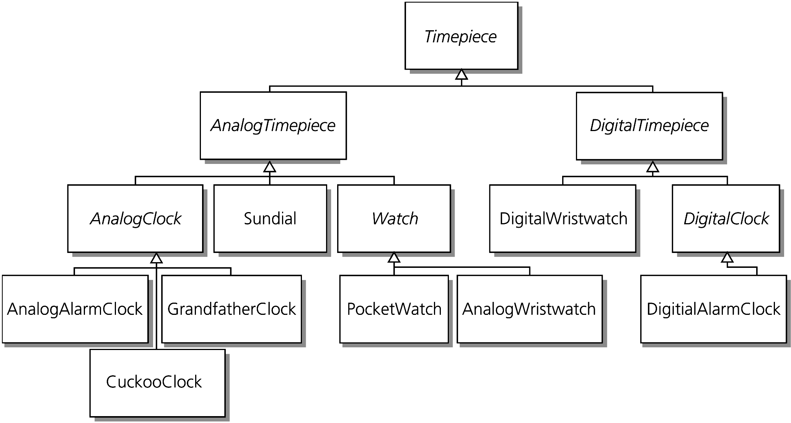
Inheritance Revisited
Figure 8-1 Inheritance: Relationships among timepieces

Slide 4
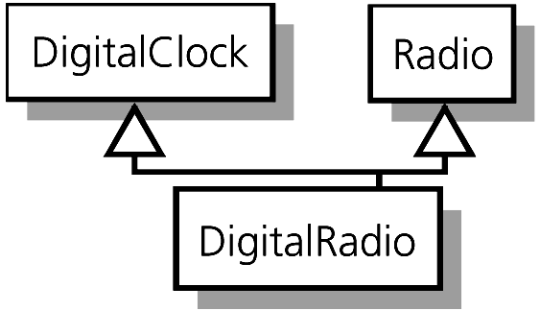
Inheritance Revisited
Multiple inheritance
  A derived class can have more than one base class
  We will not study this kind of inheritance
Figure 8-2 Multiple inheritance

Slide 5
Inheritance Revisited
Superclass or base class
  A class from which another class is derived
Subclass, derived class, or descendant class
  A class that inherits all members of another class
  Can add new members to those it inherits
  Can redefine an inherited method of its base class, if the two methods have the same parameter declarations

Slide 6
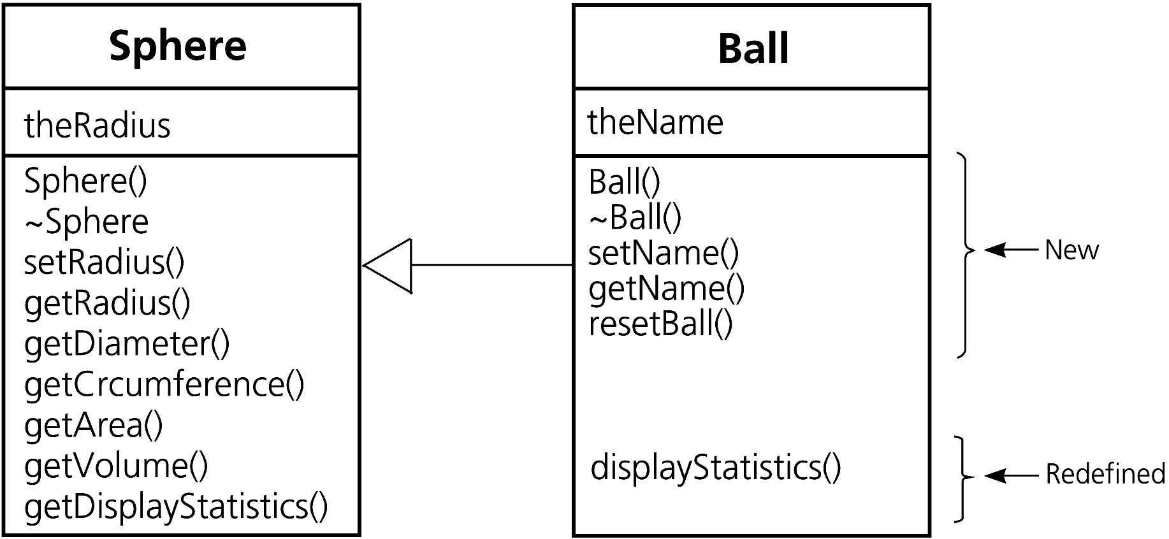
Inheritance Revisited
Benefits of inheritance
  It enables the reuse of existing classes
  It reduces the effort necessary to add features to an existing object
Figure 8-3 The derived class Ball inherits members of the base class Sphere and redefines and adds methods

Slide 7
Inheritance Revisited
The base class’s public methods can be called by
  An instance of the base class
  An instance of the derived class
  The derived class’s methods
A derived class inherits all of the base class’s members (except constructors and destructor)
  An instance of a derived class has all the behaviors of its base class (can call the base class’s public methods)
  A derived class cannot access the base class’s private data and methods directly by name

Slide 8
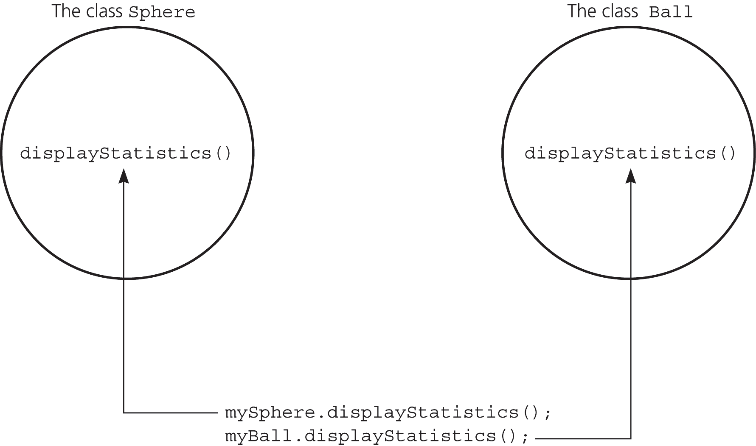
Inheritance Revisited
Figure 8-4 Early, or static, binding: The compiler determines which version of a method to invoke

Slide 9
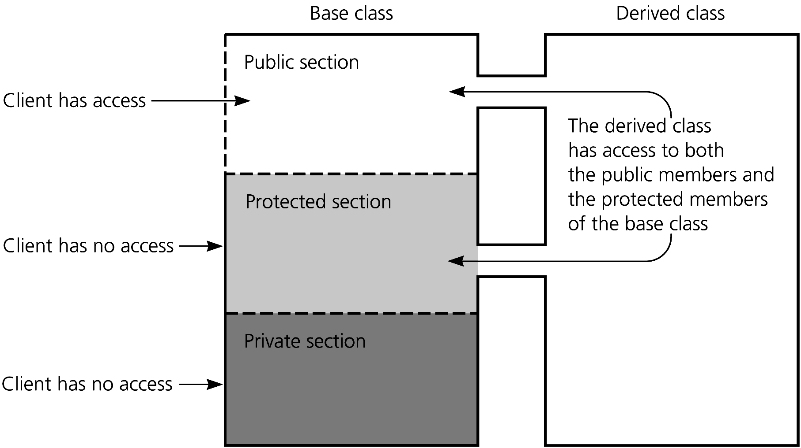
Inheritance Revisited
In general, a class’s data members should be private
Figure 8-5 Access to public, private, and protected sections of a class by a client and a derived class

Slide 10
Membership Categories of a Class
Public data and methods can be used by anyone
Private data and methods can be used only by methods and friends of the class
Protected data and methods can be used only by methods and friends of both the class and any derived class

Slide 11
Kinds of Inheritance
Public inheritance
  Public and protected members of the base class remain, respectively, public and protected members of the derived class
Protected inheritance
  Public and protected members of the base class are protected members of the derived class

Slide 12
Kinds of Inheritance
Private inheritance
  Public and protected members of the base class are private members of the derived class
In all cases, the private section of a base class cannot be accessed by a derived class

Slide 13
Is-a Relationships
Public inheritance should imply an is-a relationship
  Use inheritance only when an is-a relationship exists
Object type compatibility
  You can use an instance of a derived class anywhere you can use an instance of the base class, but not the other way around

Slide 14
Is-a Relationsips
If the class Ball is derived from the class Sphere
  A ball is a sphere
  Given the following function declaration:
    void displayDiameter(Sphere thing);
  The following statements are valid:
    Ball myBall(5.0, “Volleyball”);
    displayDiameter(myBall);

Slide 15
Has-a Relationships
If the relationship between two classes is not is-a, do not use public inheritance
Has-a relationship
  Also called containment
  A class has an object as a data member
  Cannot be implemented using inheritance

Slide 16
Has-a Relationships
Example: A has-a relationship between a pen and a ball
    class Pen
    {
    …
    private:
    Ball point;
    };

Slide 17
As-a Relationships
Uses private inheritance
  Example: Implement a stack as a list
  class Stack: private List
    Stack can manipulate the items on the stack by using List’s methods
    The underlying list is hidden from the clients and descendants of the stack

Slide 18
As-a Relationships
Private inheritance is useful when
  A class needs access to the protected members of another class, or
  If methods in a class need to be redefined

Slide 19
Virtual Methods and Late Binding
Late, or dynamic, binding
  The appropriate version of a polymorphic method is decided at execution time
  A polymorphic method
    Has multiple meanings
    Overrides a method of the superclass
  The outcome of an operation depends upon the objects on which it acts

Slide 20
Virtual Methods and Late Binding
A virtual method in a base class can be overridden in a derived class
  The overriding method is virtual
  The methods must have the same declarations
A derived class does not need to override an existing implementation of an inherited virtual method

Slide 21
Virtual Methods and Late Binding
Generally, a class’s methods should be virtual, unless you do not want any derived class to override them
Constructors cannot be virtual
Destructors can and should be virtual
A virtual method’s return type cannot be overridden

Slide 22
Virtual Methods and Late Binding
Every class that defines a virtual method
  Is extensible: can add capabilities to a derived class without access to the ancestor’s source code
  Has a virtual method table, or VMT
    Contains pointers to the versions of the virtual methods that are appropriate for the calling object
    Is invisible to the programmer
    Enables late binding

Slide 23
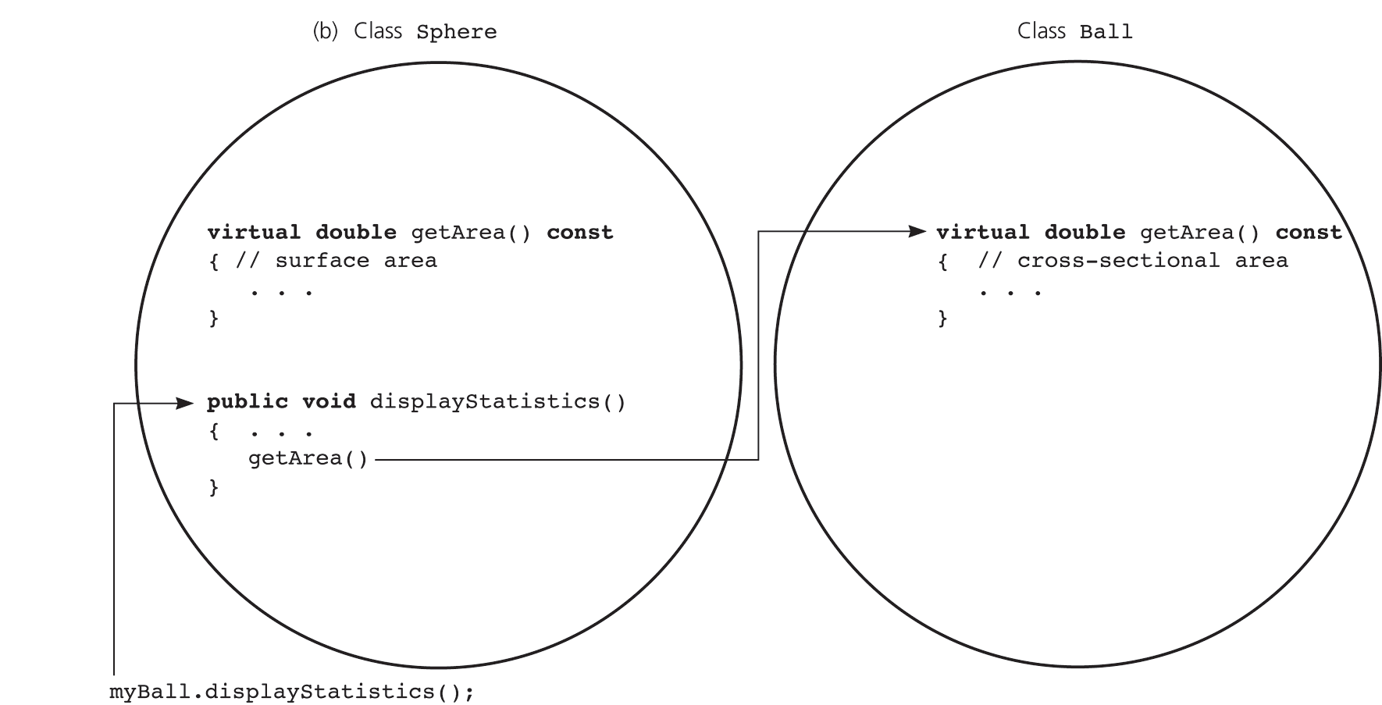
Virtual Methods and Late Binding
Figure 8-9 getArea is virtual: (b) myBall.displayStatistics() calls Ball::getArea

Slide 24
Abstract Base Classes
A pure virtual method has an undefined body
An abstract base class
  Contains at least one pure virtual method
  Used only as a base class for other classes
    Defines a minimum interface for derived classes
  Has no instances

Slide 25
Abstract Base Classes
An abstract base class
  Should generally omit implementations except for the destructor and methods providing access to private data members
    Virtual methods usually should be pure
  Must implement any virtual method that is not pure
    Provides a default implementation for derived classes

Slide 26
Abstract Base Classes
An abstract base class for Sphere
class EquidistantShape
{
public:
virtual void setRadius(double
newRadius) = 0;
virtual double getRadius()const = 0;
virtual void displayStatistics()
const = 0;
…};
  Forces a derived class to implement these methods
    Otherwise, the derived class would be abstract

Slide 27
Friends
Functions and classes can be friends of a class C
  Friend functions are not members of the class C
  Friend functions can access the private and protected members of the class C
  Methods of a friend class have access to the private and protected parts of the class C

Slide 28
Friends
Input and output functions are often defined as friend functions
  friend void readSphereData(Sphere &s)
Friendship is not inherited
  A friend of a base class is not automatically a friend of a derived class

Slide 29
Friends
A class List can be a friend of the class ListNode
  List can access ListNode’s private and protected members)
  class ListNode
  {
  private:
  … // define constructors and data
  // members item and *next
  friend class List;
  };

Slide 30
The ADTs List and Sorted List Revisited
Organize commonalities of list ADTs as an abstract base class
class BasicADT
{
public:
virtual ~BasicADT();
virtual bool isEmpty() const = 0;
virtual int getLength() const = 0;
};

Slide 31
The ADTs List and Sorted List Revisited
Use public inheritance to derive the class List from BasicADT
  class List : public BasicADT
Define protected methods in List that access its private data members so a derived class can also access them

Slide 32
Implementations of the ADT Sorted List That Use the ADT List
Recall the operation contract for the sorted list
  sortedIsEmpty():boolean {query}
  sortedGetLength():integer {query}
  sortedInsert(in newItem:ListItemType,
  out success:boolean)
  sortedRemove(in index:integer,
  out success :boolean)
  sortedRetrieve(in index:integer,
  out dataItem:ListItemType,
  out success :boolean) {query}
  locatePosition(in anItem:ListItemType,
  out isPresent:boolean):integer {query}

Slide 33
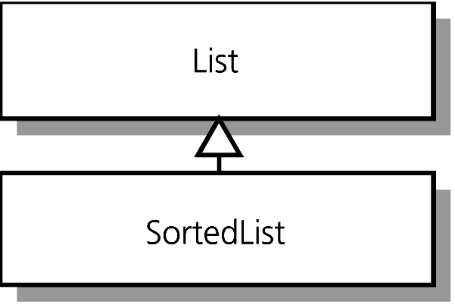
Implementations of the ADT Sorted List That Use the ADT List
A sorted list is a list
  class SortedList : public List
Figure 8-12 SortedList as a descendant of List

Slide 34
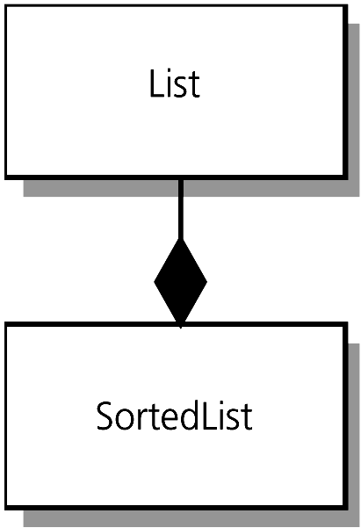
Implementations of the ADT Sorted List That Use the ADT List
A sorted list has a list as a member
  class SortedList …
  private:
  List aList; …
Figure 8-13 SortedList is composed of an instance of the class List

Slide 35
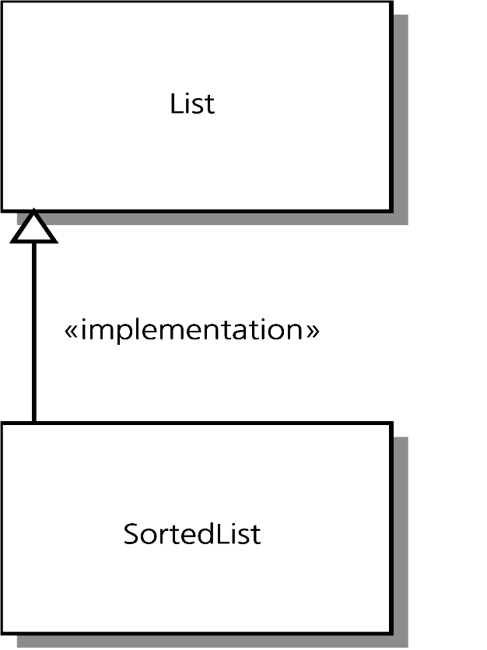
Implementations of the ADT Sorted List That Use the ADT List
A sorted list is implemented as a list
  class SortedList : private List
Figure 8-14 The SortedList class implemented in terms of the List class

Slide 36
Class Templates
A class template describes a class in terms of a data-type parameter
  Example: A header file for a list node
  #include <cstddef>
  template <typename T> class List;
  template <typename T>
  class ListNode
  {
  private:
  ListNode(): next(NULL) {} . . .
  T item;
  ListNode *next;
  friend class List <T>;
  };

Slide 37
Class Templates
The client specifies an actual data type when declaring an instance of the class template
  #include “ListT.h”
  int main()
  {
  List<double> floatList;
  List<char> charList;
  . . .

Slide 38
Class Templates
A class template’s implementation is not compiled separately from the client program
  The compiler must know the data type that the client is using
Any operation required of the actual data type should be clearly documented
Templates can have more than one data-type parameter

Slide 39
Overloaded Operators
An overloaded operator has more than one meaning
Overload common operators for classes to enable a particular operator to work correctly on instances of a class

Slide 40
Overloaded Operators
Example: a list
  Define the equality operator for a list
  virtual bool operator==
  (const List& rhs) const
  Overload the assignment operator to get a deep copy of a list
  virtual List& operator=
  (const List& rhs);

Slide 41
Overloading Operators
Guidelines for overloading operators
  You can overload any C++ operator except
  . .* :: ?: sizeof
  You cannot define new operators by overloading symbols that are not already operators in C++
  You cannot change the standard precedence of a C++ operator or the number of its operands

Slide 42
Overloading Operators
Guidelines continued
  At least one operand of an overloaded operator must be an instance of a class
  A typical class should overload the assignment, equality, and relational operators
    = == != < <= > >=
  You cannot change the number of arguments for an overloaded method

Slide 43
Iterators
An iterator is an object that traverses a collection of like objects
Common iterator operations
Operation | Description
* | Return the item that the iterator currently references
++ | Move the iterator to the next item in the list
-- | Move the iterator to the previous item in the list
== | Compare two iterators for equality
!= | Compare two iterators for inequality

Slide 44
Iterators
A header file for the class ListIterator
  // List and ListIterator are friend classes of ListNode
  #include “ListNode.h”
  class ListIterator
  {
  public:
  ListIterator(const List *aList, ListNode *nodePtr);
    const ListItemType & operator*();
    ListIterator operator++();
    bool operator==(const ListIterator& rhs) const;
    bool operator!=(const ListIterator& rhs) const;
    friend class List;
  private:
  const List *container //ADT associated with iterator
  ListNode *cur; //current location in collection
  };

Slide 45
Summary
Classes can have ancestor and descendant relationships
  A derived class inherits all members of the base class, but can access only its public and protected members
Use public inheritance only when an is-a relationship exists between classes
  An instance of a derived class can be used wherever an instance of its base class can be used
  Type compatible

Slide 46
Summary
A method in a derived class redefines a method in the base class if they have the same declarations
  If the base-class method is virtual, it is overridden by the method in the derived class
A virtual method is one that a derived class can override
A pure virtual method has an undefined body
A class with at least one pure virtual method is called an abstract base class

Slide 47
Summary
Early, or static, binding describes a situation whereby a compiler can determine at compilation time the correct method to invoke
Late, or dynamic, binding describes a situation whereby the system makes this determination at execution time
When a pointer to an object invokes a method, the pointer’s type determines the correct method (early binding); the type of object determines the correct method when the method is virtual (late binding)

Slide 48
Summary
Class templates enable you to parameterize the type of a class’s data
By overloading an existing C++ operator, you can provide it additional meaning when used with instances of the class
Iterators provide an alternative way to cycle through a collection of items

